Slide 1
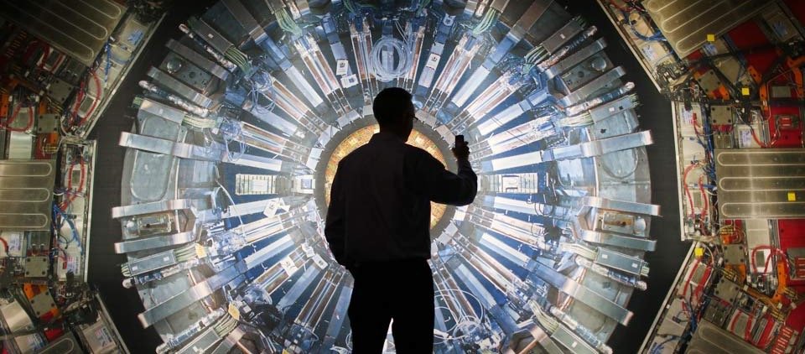

Nuclear Physics Research at BNL
Mickey Chiu

Slide 2
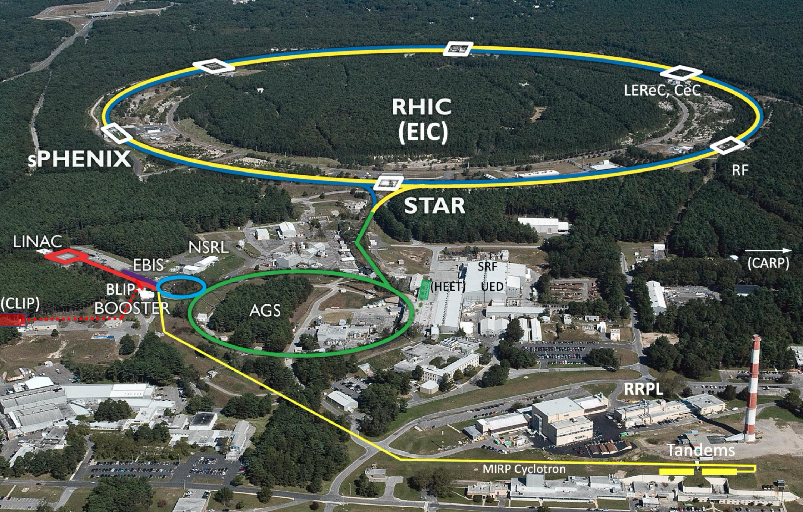
See talk by Prof. N. Abdelrahman

Slide 3
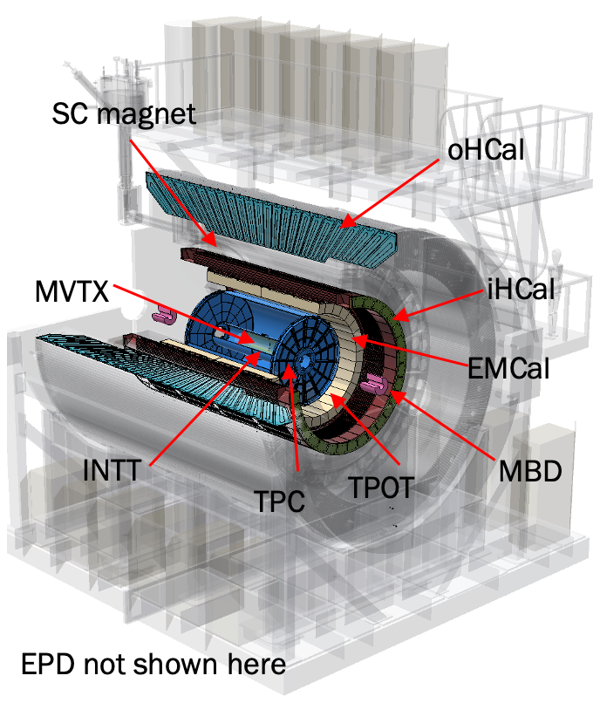
sPHENIX Detector
Began Data Taking in 2023!
1.4 T Solenoidal B Field
Calorimeters - full EM/Hadronic, γ, jets, triggers
Tracking/Micro-vertexing – MVTX, INTT, TPC, TPOT
Forward – Min. Bias Det., ZDC/SMD, Event Plane Det.
15 kHz trigger and streaming readout
|η| < 1.1 and full 2π azimuthal coverage

Slide 4
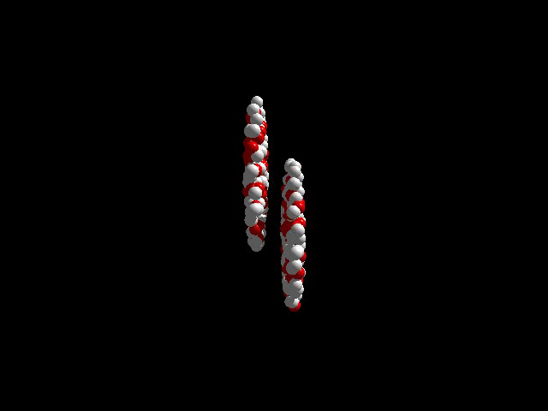

Slide 5
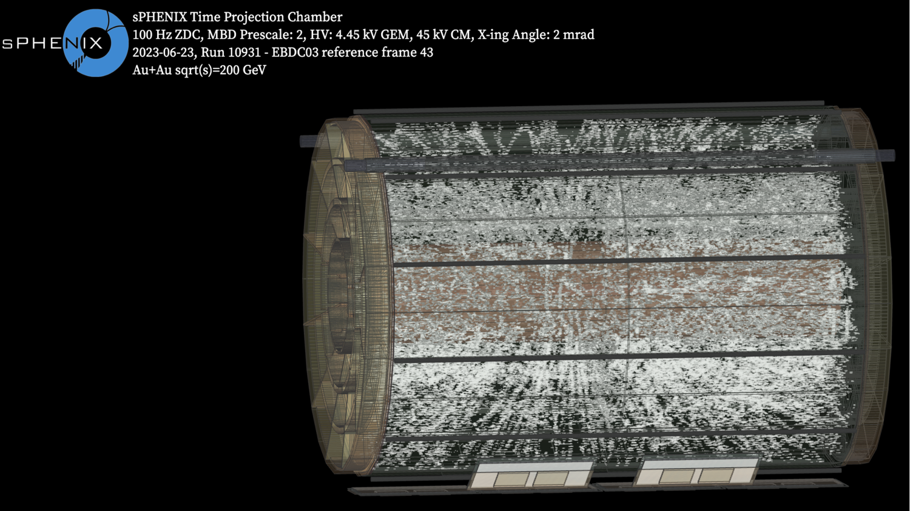

Slide 6
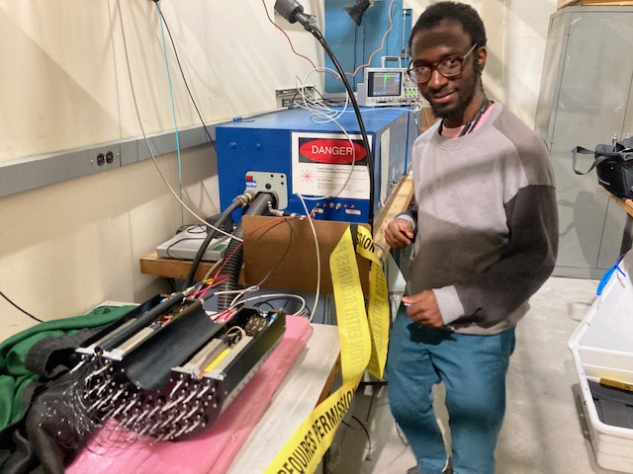
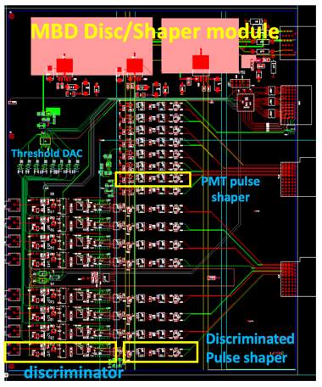
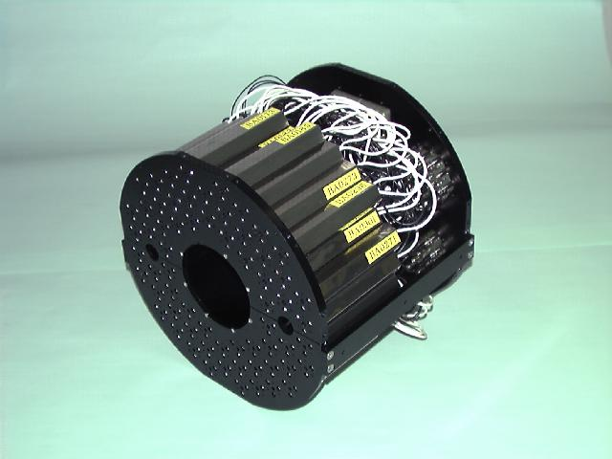
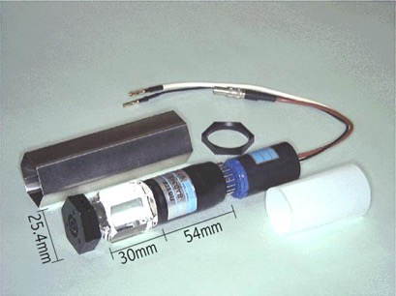
PHENIX BBC for sPHENIX MBD
Collaboration between BNL, Columbia Univ, FAMU, Howard, RIKEN
M. Damulira, TSU ‘23
Reuse of PHENIX BBC to provide high quality, cost effective solution
128 ch’s of 3 cm thick quartz radiator on mesh dynode PMTs
Provide MB trigger with high efficiency for heavy ion collisions (~90%), with selection on z-vertex (+/- 10 cm for Si Tracking)
Online z-vertex resolution of at least 2.5 cm, ie, 120 ps/ch
Uses New Custom Electronics Designed by Nevis Labs at Columbia University
Contributes to centrality, reaction plane, and start time

Slide 7
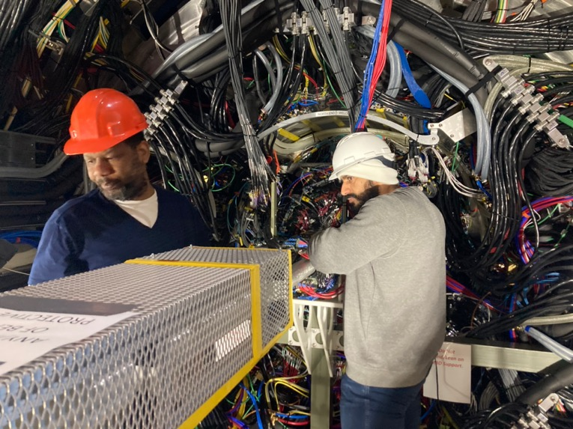
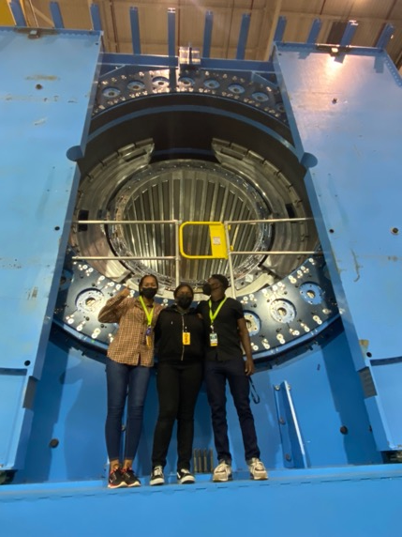
HBCU Collider Activity on sPHENIX
Alex Holt, Howard
Abdul al-Sayegh, FAMU
Howard NPT Fellows
Howard, FAMU (and soon Morgan St with the addition of S. Nelson) were the main contributors to the MBD along with BNL and RIKEN

Slide 8
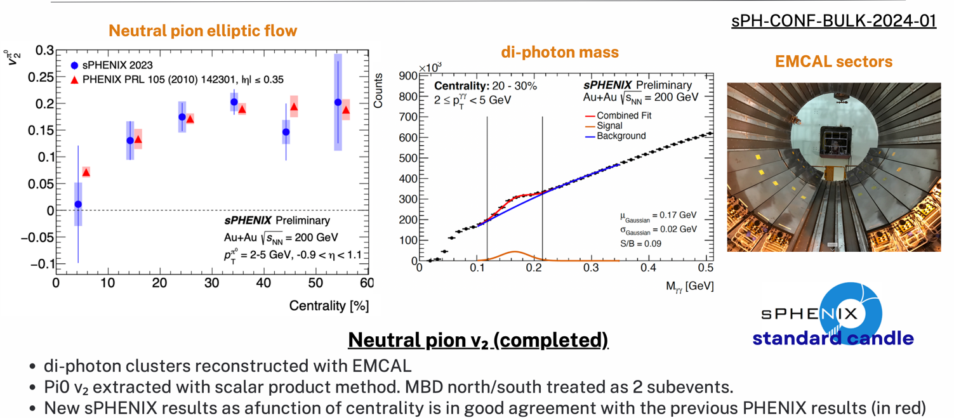
Flow Meaurements with MBD Eventplane

Slide 10
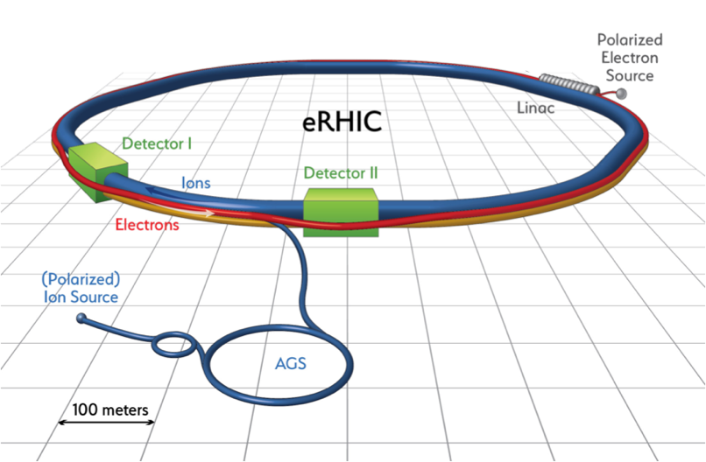
eRHIC: Electron Ion Collider At BNL
Use existing RHIC
Up to 275 GeV protons
Existing: tunnel, detector halls & hadron injector complex
Add 18 GeV electron accelerator in the same tunnel
Use either high intensity Electron Storage Ring or Energy Recovery Linac
Achieve high luminosity, high energy e-p/A collisions with full acceptance detector
Luminosity 100X previous electron-proton collider (HERA)

Slide 11
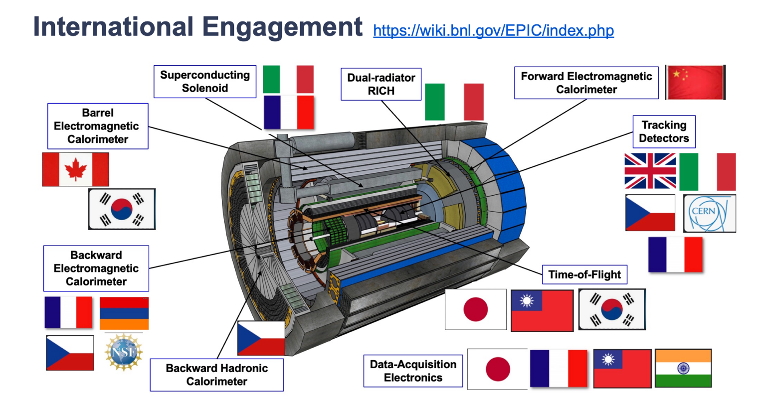

Slide 12
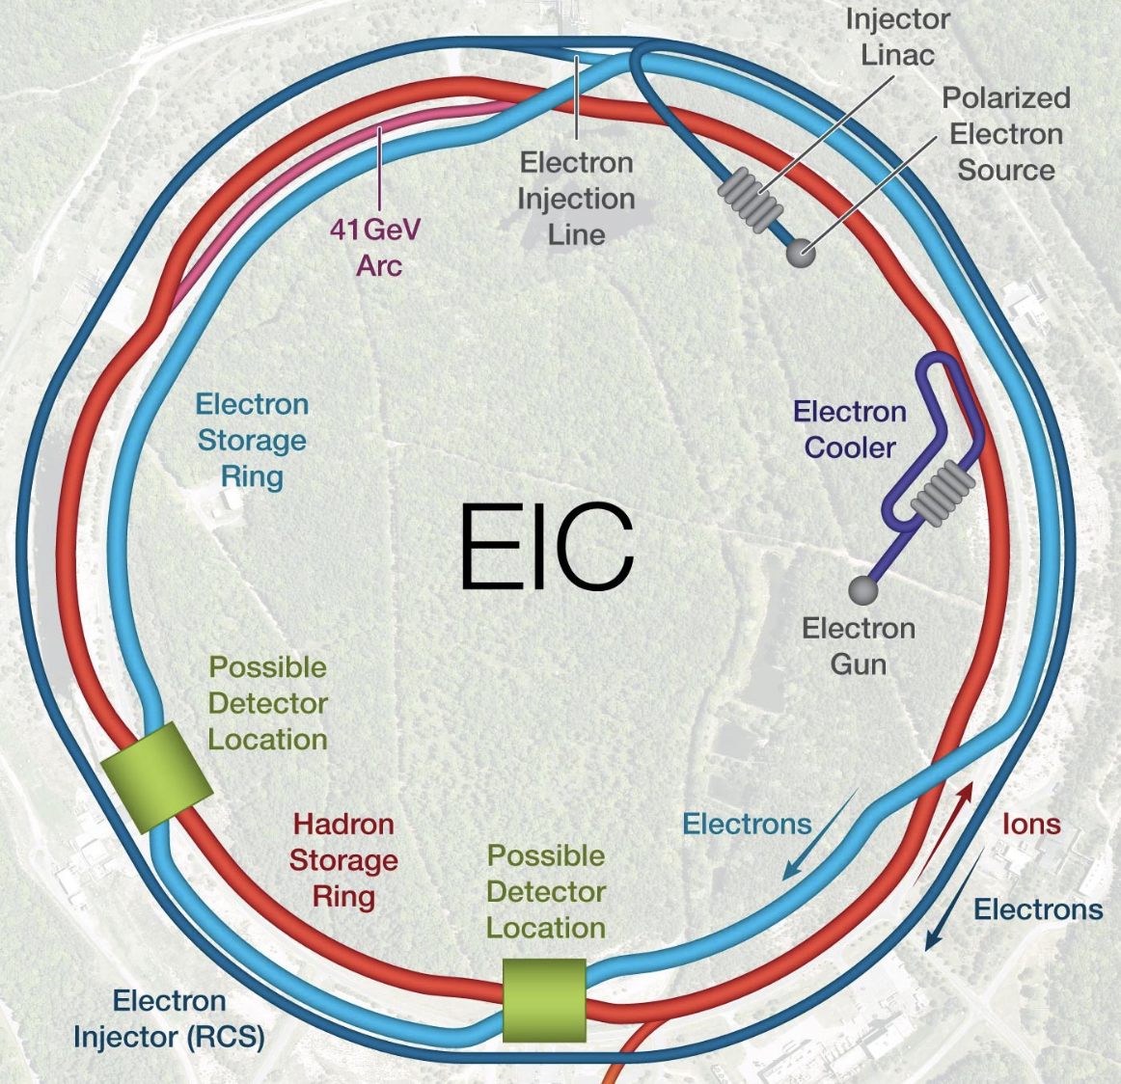
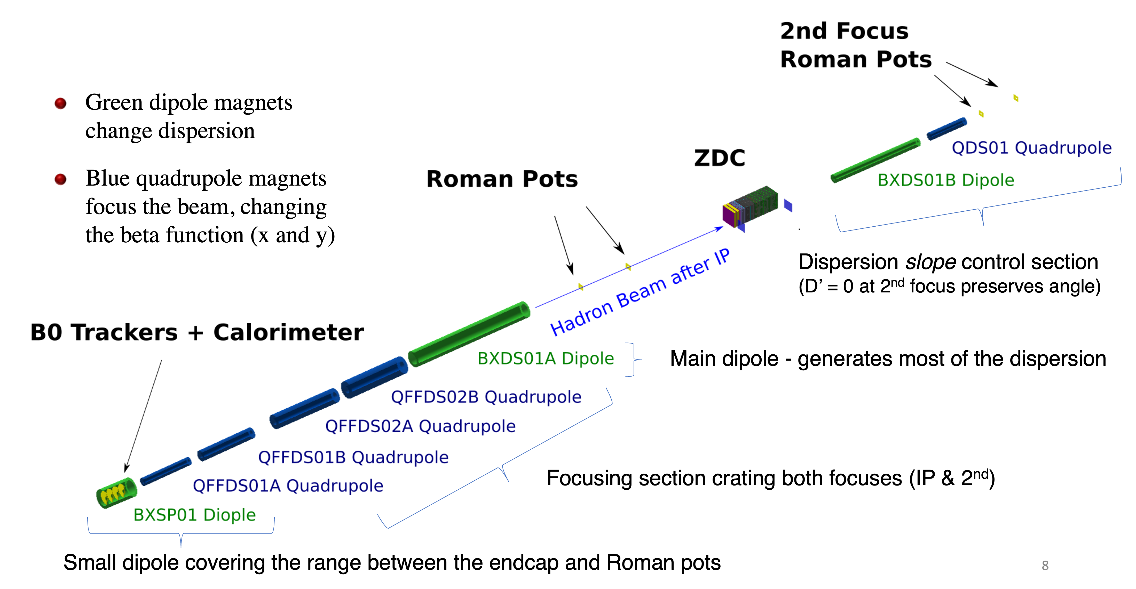
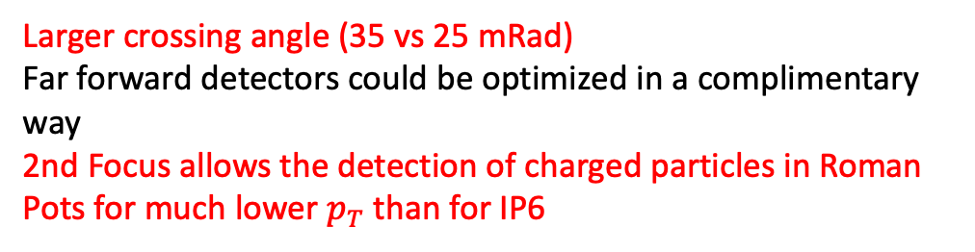
Possibility of 2nd Detector at EIC
Two interaction regions that can house detectors
IP6: Project detector ePIC
IP8: Detector 2
IP8
(ex-PHENIX)
IP6
ePIC (ex-STAR)
Larger crossing angle (35 vs 25 mRad)
Far forward detectors could be optimized in a complimentary way
2nd Focus allows the detection of charged particles in Roman Pots for much lower $p_{T}$ than for IP6
12

Slide 13
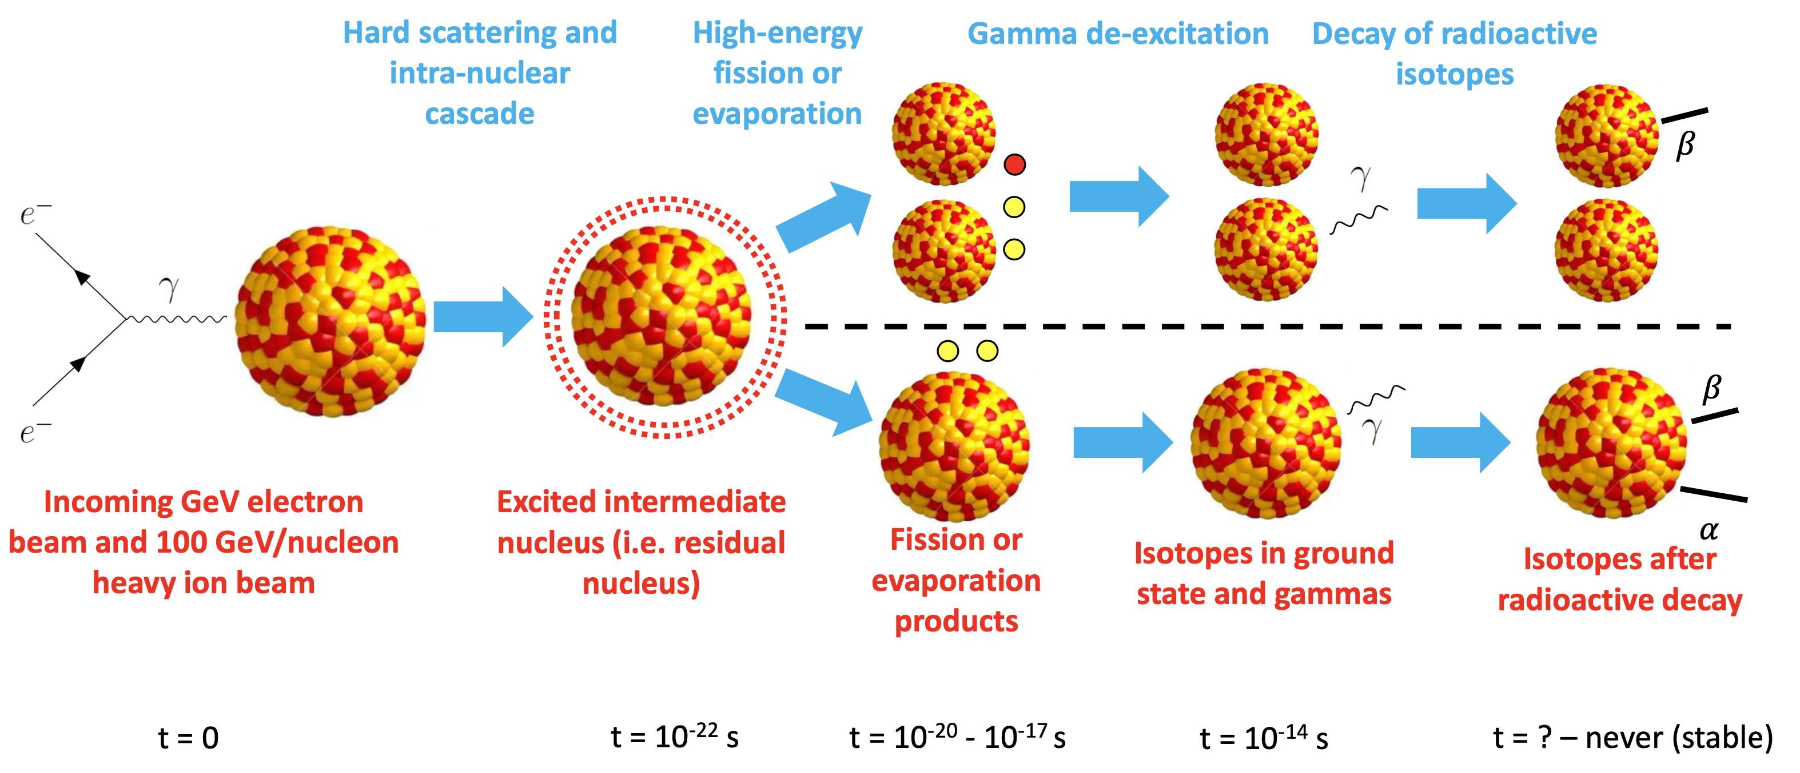
Proposed EIC Rare Isotopes Program

Slide 14
Proposed EIC Rare Isotopes Program
The ground-state isotopes will be at high energy (~100 GeV/nucleon).
The time dilation effect will allow for possible direct detection for lifetimes >1 ns.
Many of the de-excitation gammas will be Lorentz upshifted to energies much larger than background photons present in the detector area.
This will allow for clean detection/identification of these gamma rays, which can be used to study the level-structure of the isotopes.
See talk by Prof. M. Harvey at this workshop

Slide 15
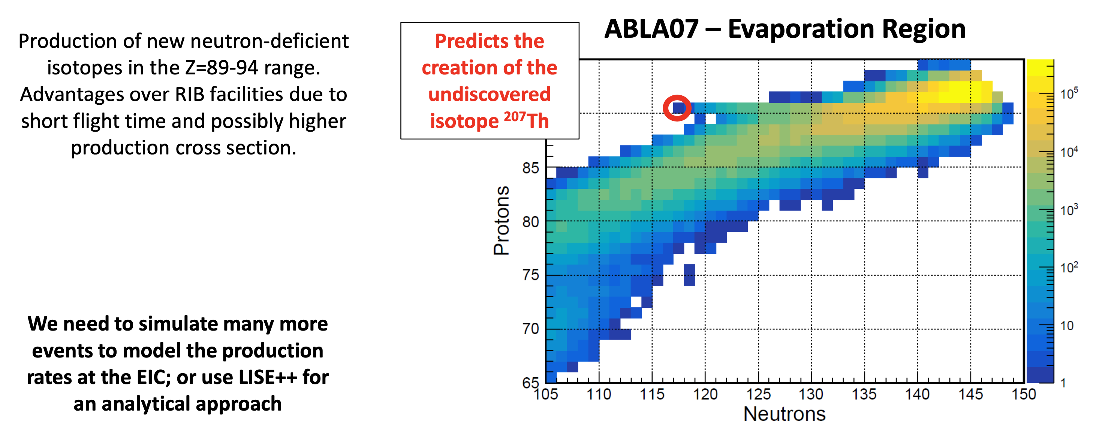
Need for More Studies of Rare Isotope Production

Slide 17
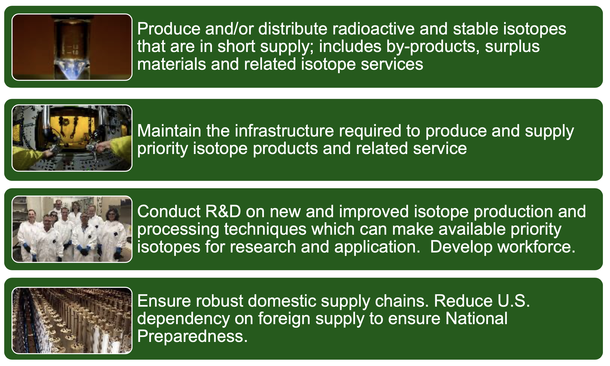
BNL: Part of the DOE Isotope Program

Slide 18
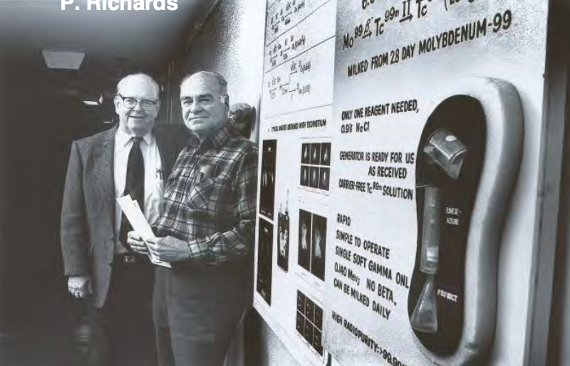
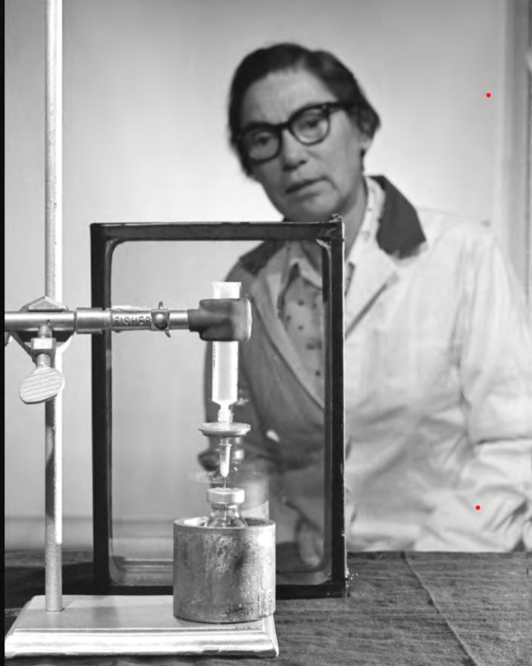
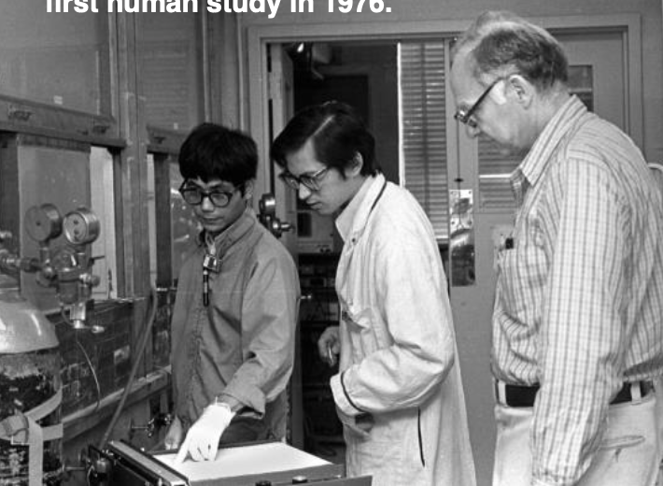
BNL - Birthplace of Nuclear Medicine
In the late 1950’s, BNL scientists Walter Tucker and Margaret Greene developed a generator system for producing Tc-99m and Powell Richards promoted its use for medical imaging. Tc-99m is now used in over 10 million patients/year in the US alone.
In the 1970's, scientists at BNL, U. Penn and NIH, combined chemistry, neuroscience and instrumentation to develop 18FDG (fluorodeoxyglucose), revolutionizing the study of the human brain.
In 1980, BNL scientists first reported high FDG uptake in tumors, leading to FDG/PET for managing the cancer patient.
Many radionuclide generator systems developed at BNL: 132Te/132I; 90Sr/90Y; 68Ge/68Ga; 52Fe/52mMn; 81Rb/81mKr; 82Sr/82Rb; 122Xe/122I
BNL pioneered the use of high energy proton beams for isotope production (BLIP)

Slide 19
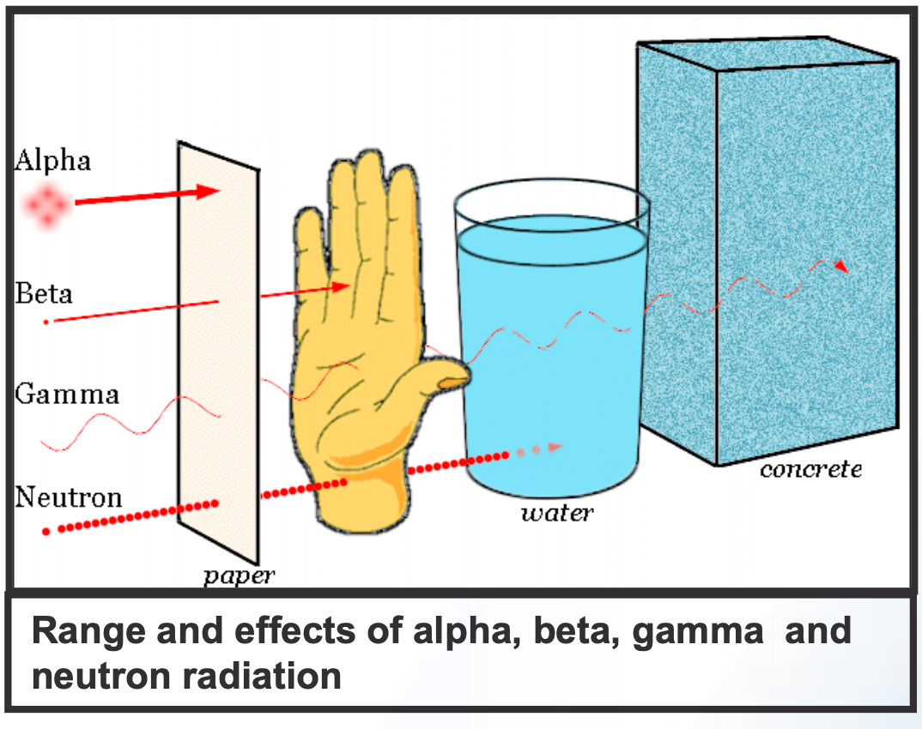
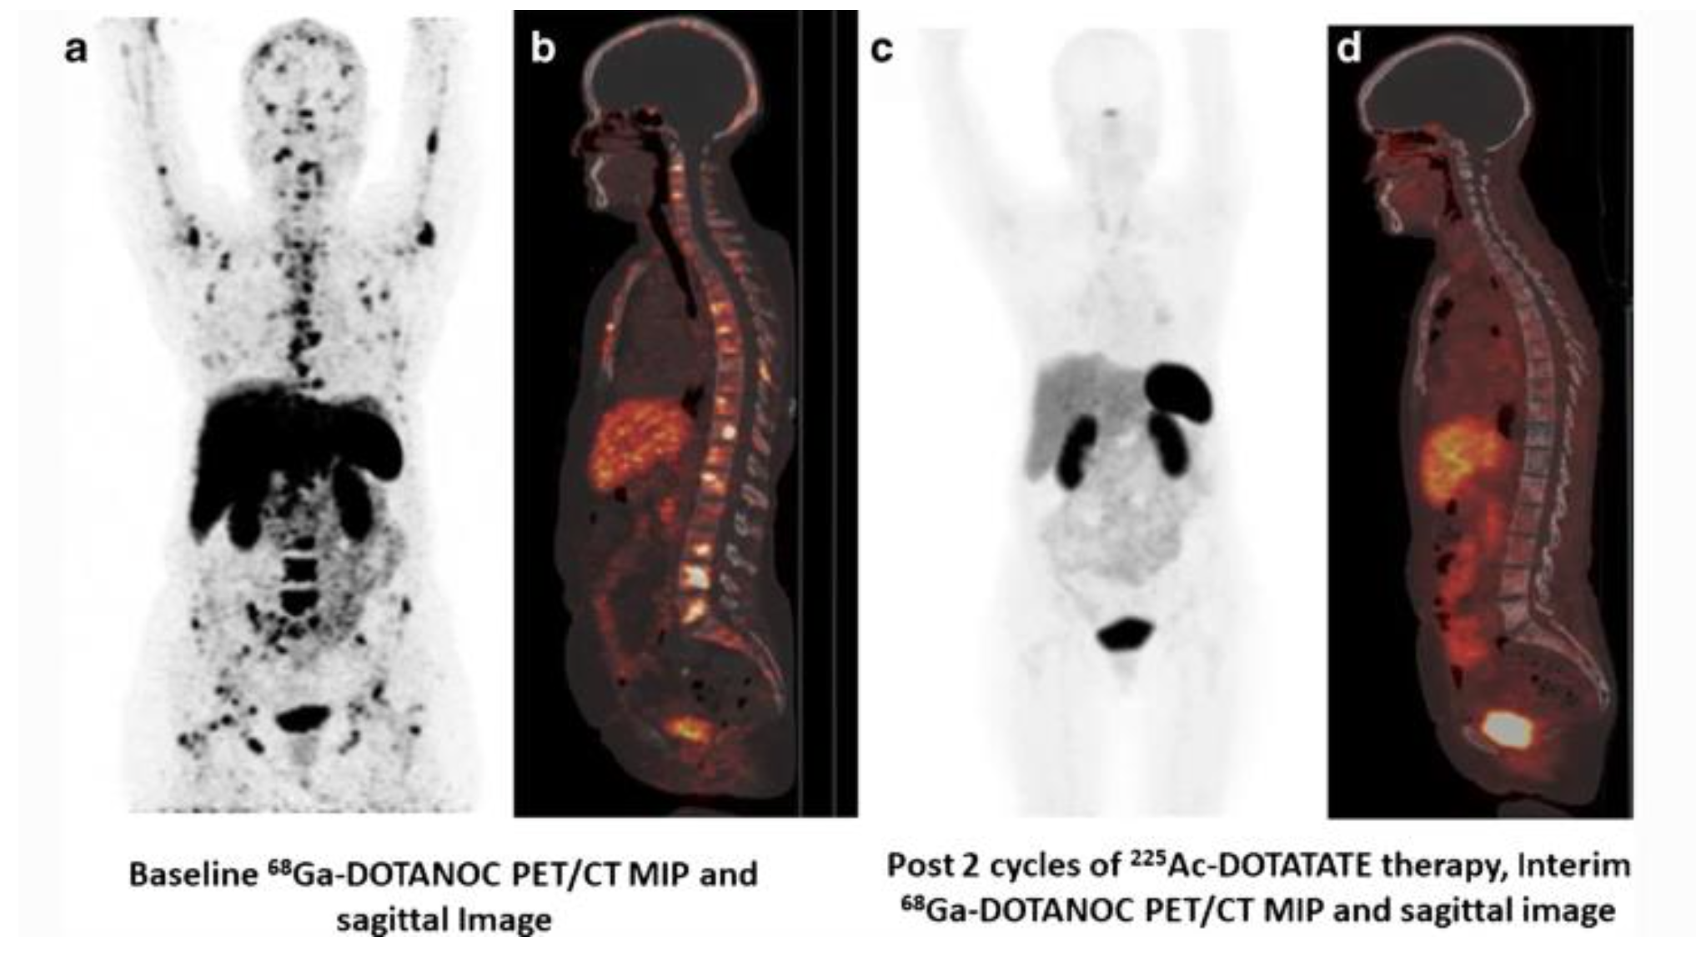
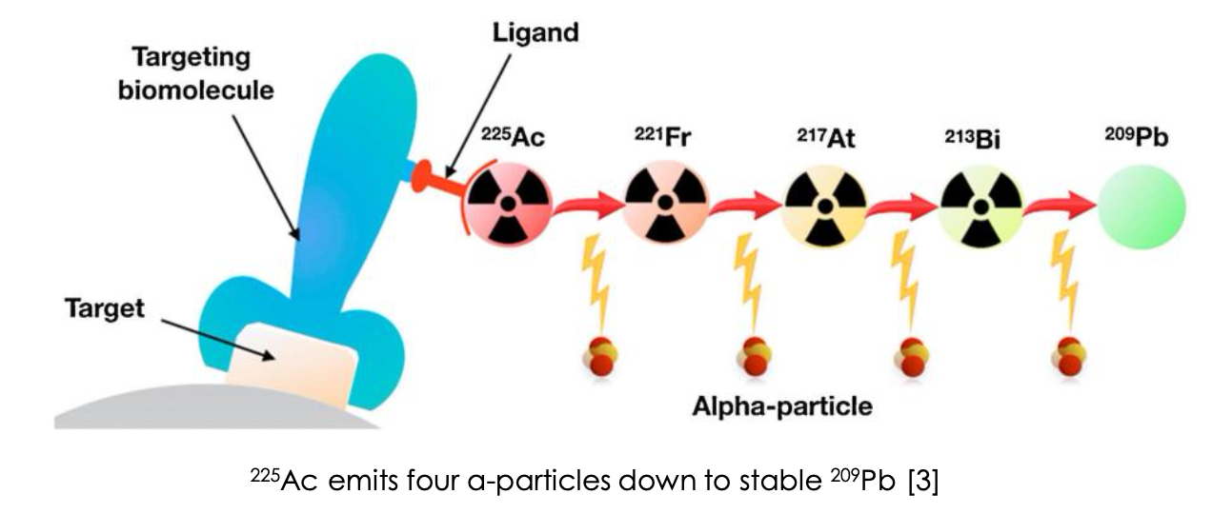
Targeted 𝛼-therapy For Cancer Treatment
Broadening horizons with 225Ac-DOTATATE targeted alpha therapy for gastroenteropancreatic neuroendocrine tumour patients stable or refractory to 177Lu-DOTATATE PRRT: first clinical experience on the efficacy and safety
Balla S., et.al Eur J Nucl Med Mol Imaging: 2020 47(4) 934-946 doi: 10.1007/s00259-019-04567-2

Slide 20
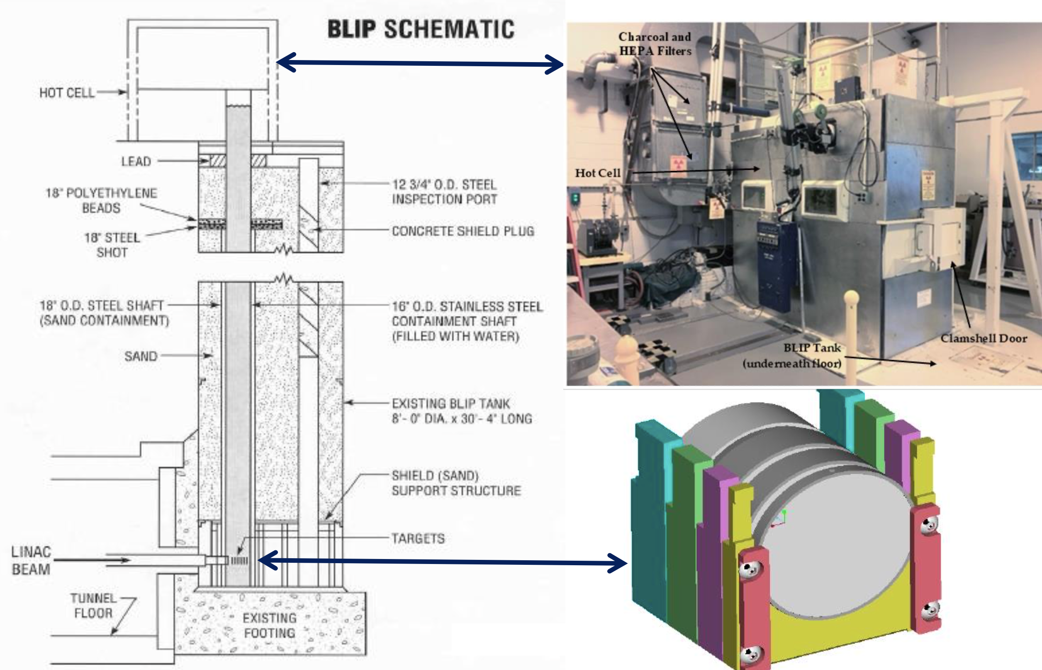
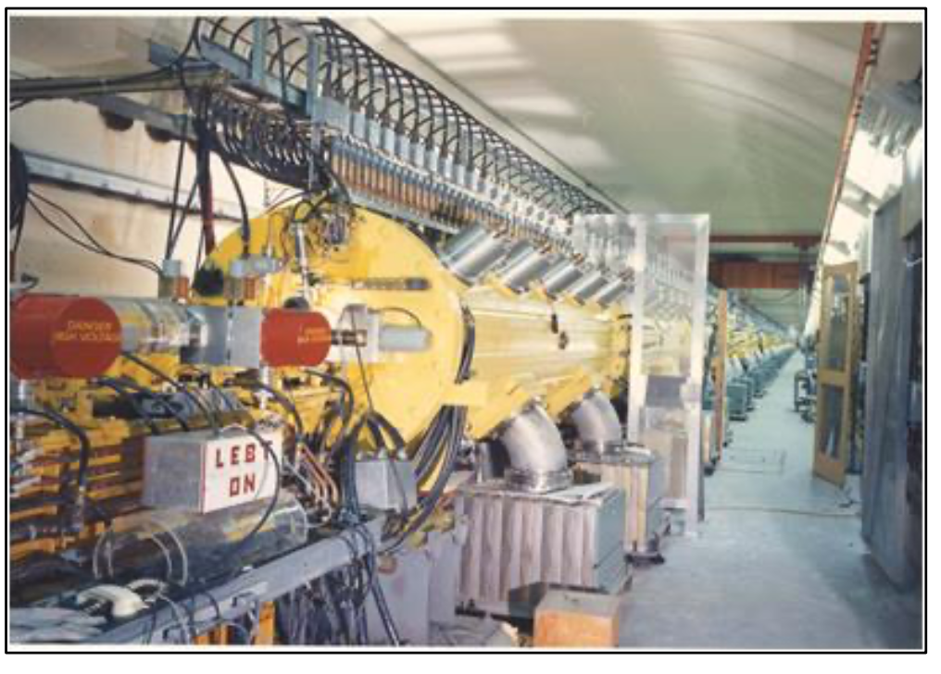
Brookhaven Linac Isotope Producer (BLIP)
BNL Linac at the Brookhaven Linac Isotope Producer (BLIP) 165 μA intensity to targets at incident energies ranging from 66-202 MeV

Slide 22
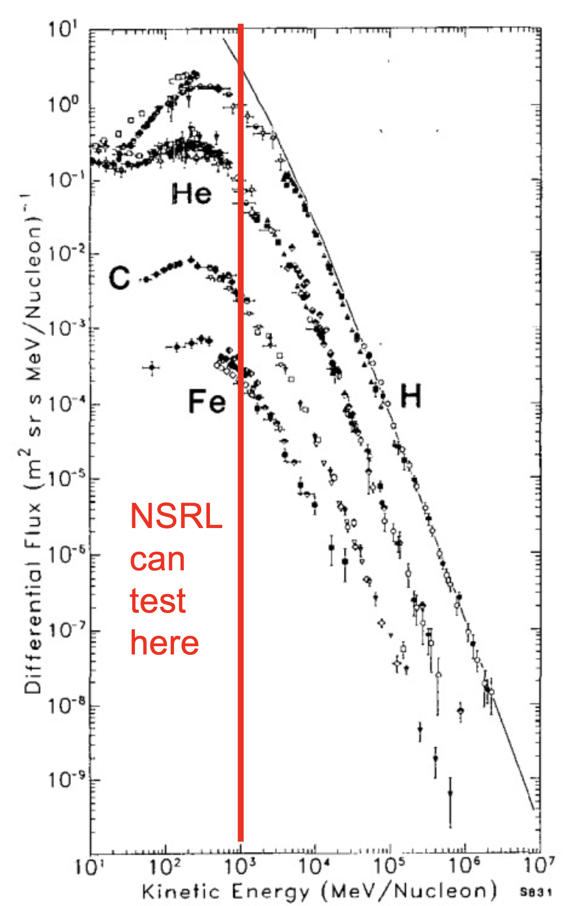
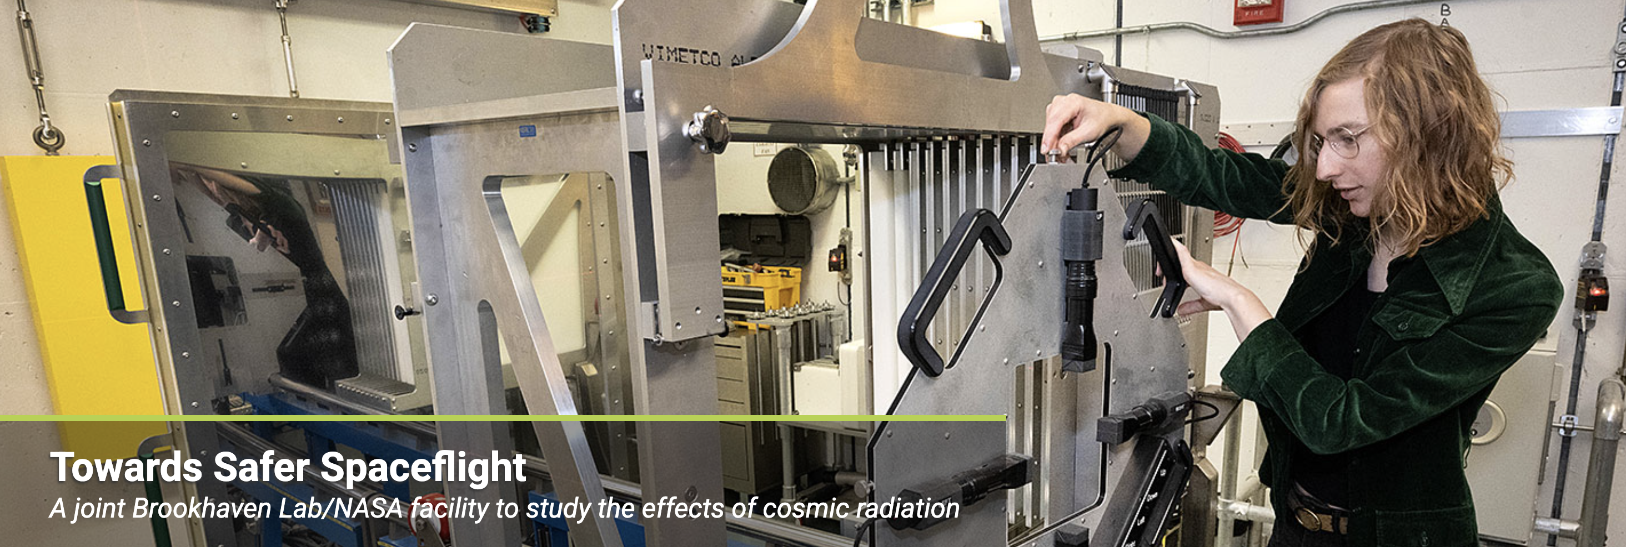
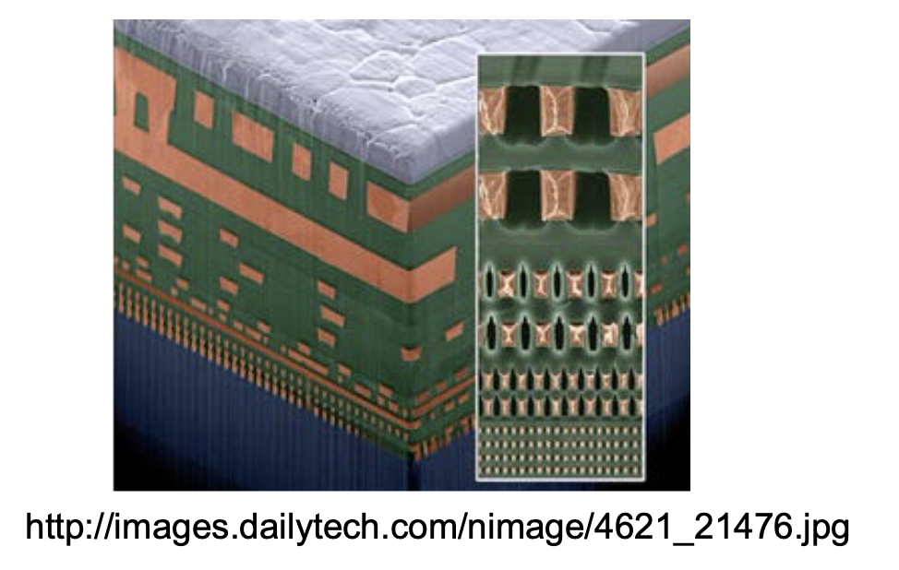
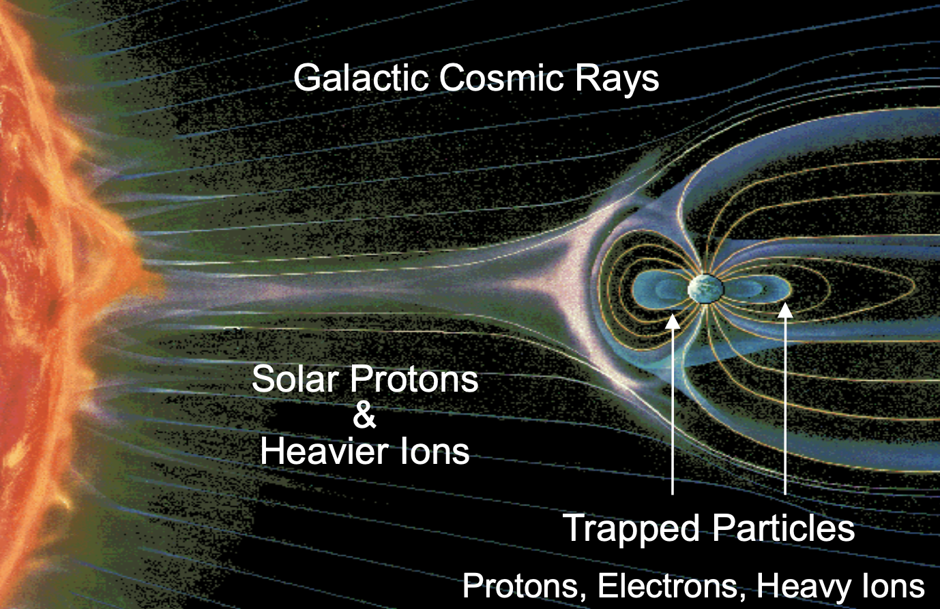
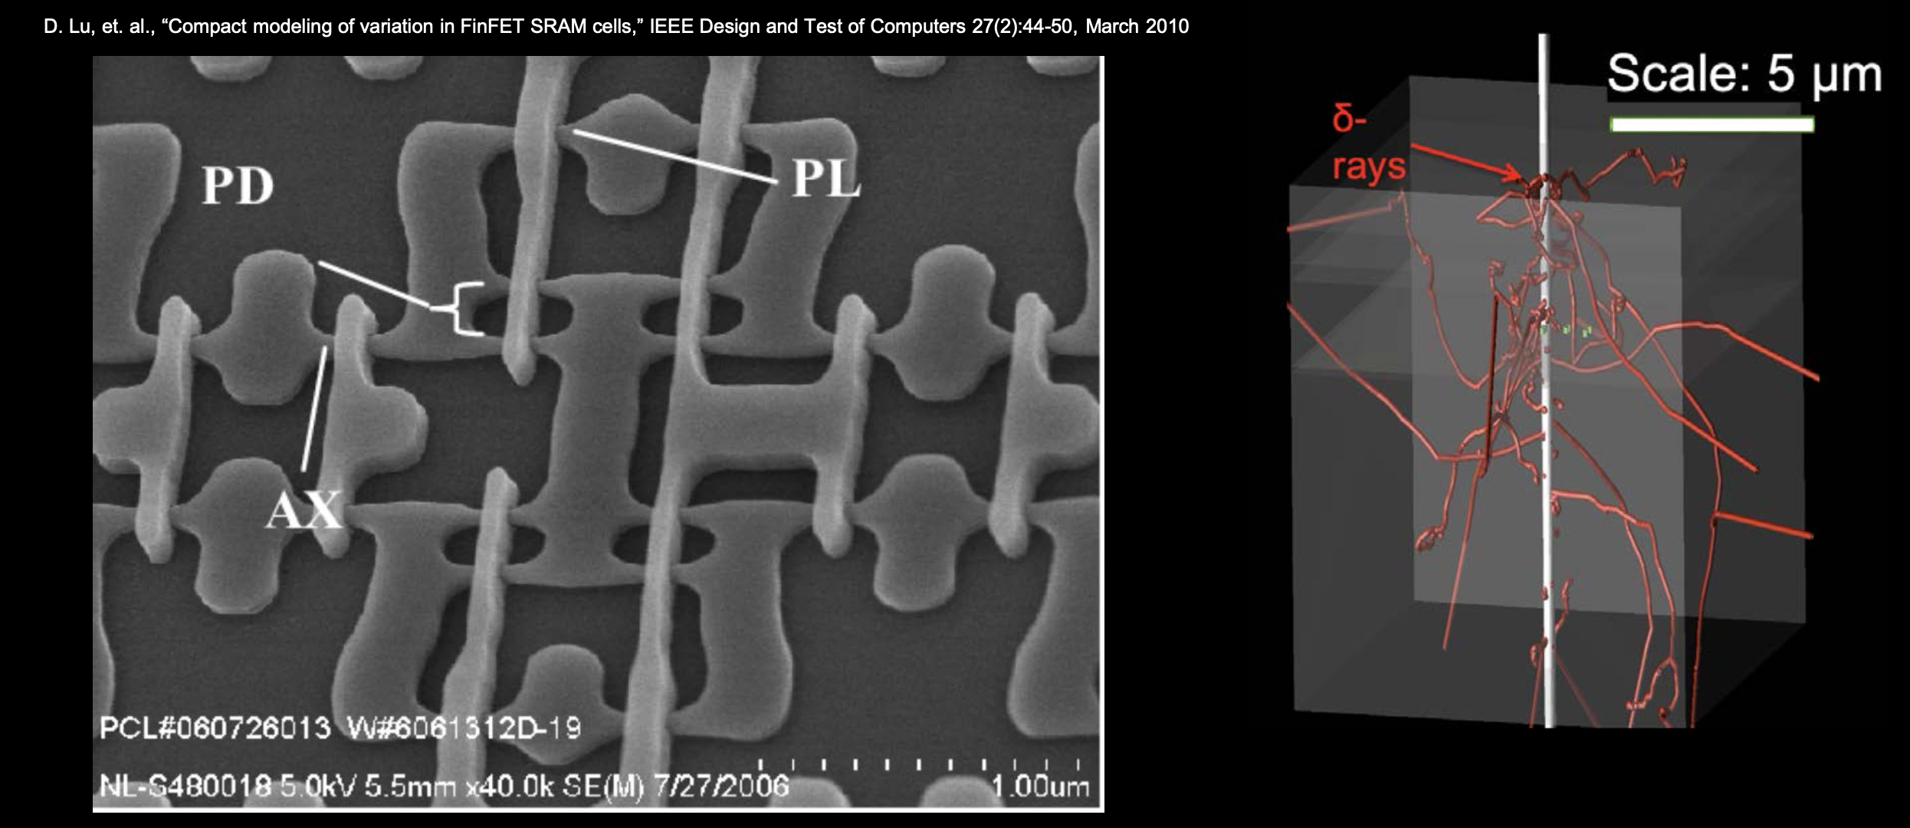
BNL-NASA National Space Radiation Lab
The cosmic ray kinetic energy spectrum has a broad peak that is nearly independent of ion species, from H to U.
The peak extends from ~300 to 1000 MeV/n, with a tail extending past that.
Has enormous implications for human safety in spaceflight!
Shielding studies, mitigation of biological effects from radiation
Also important implications for damage to electronics

Slide 23
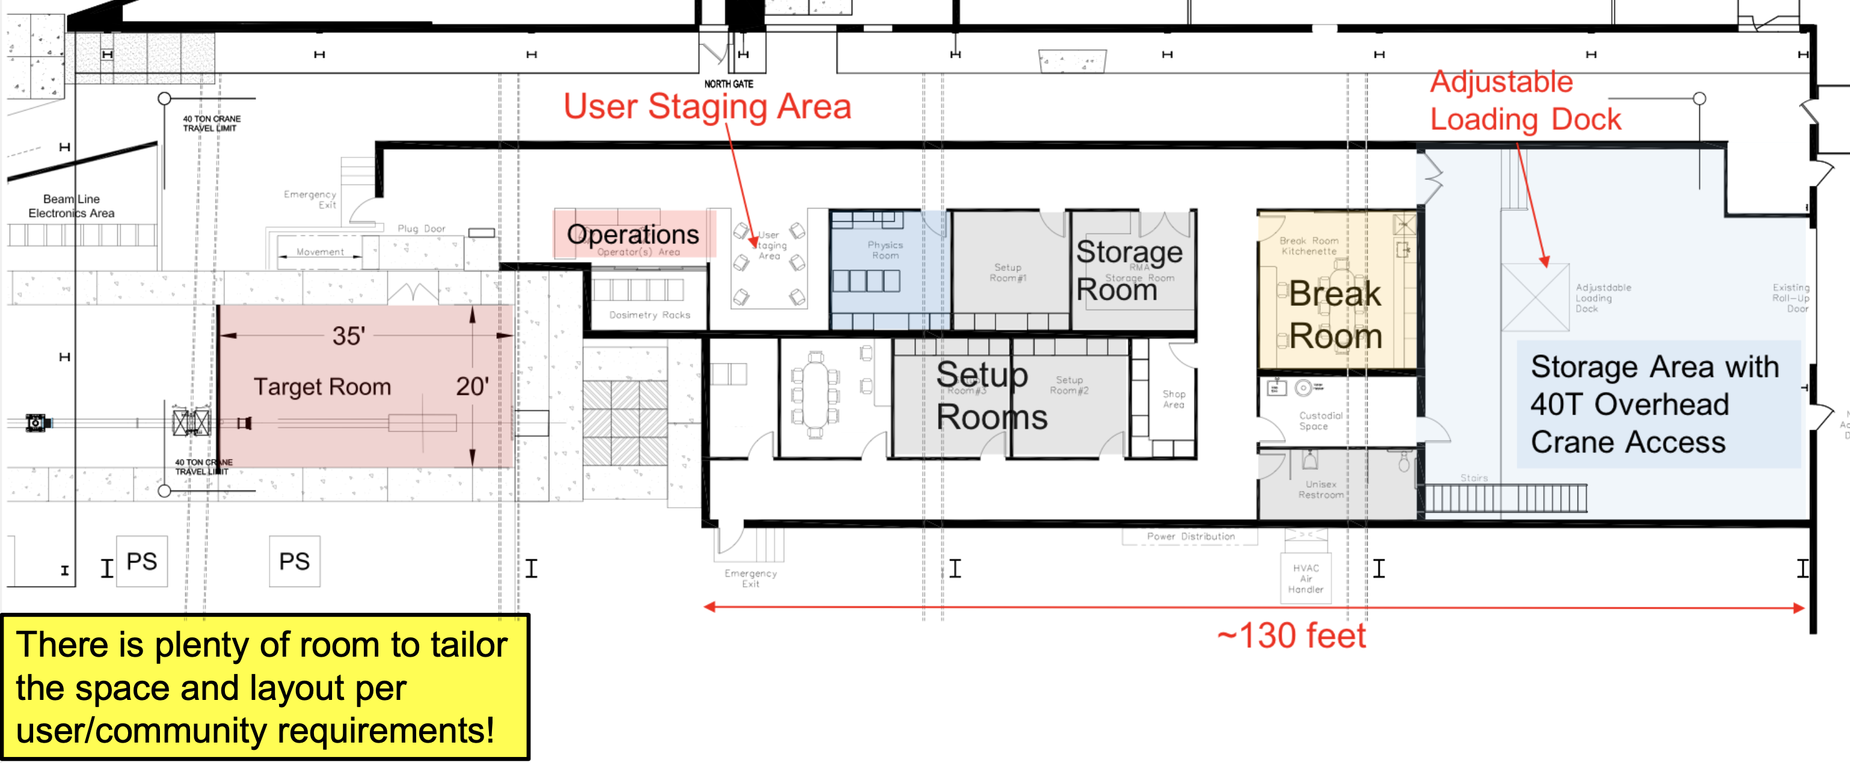
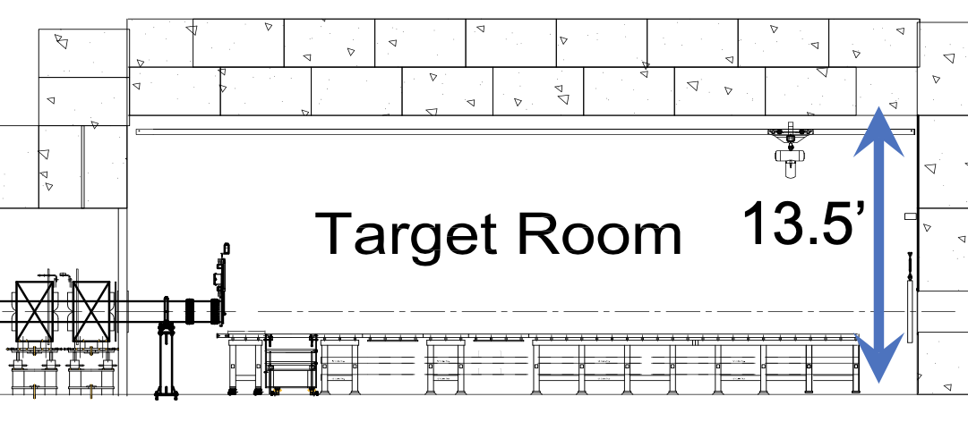
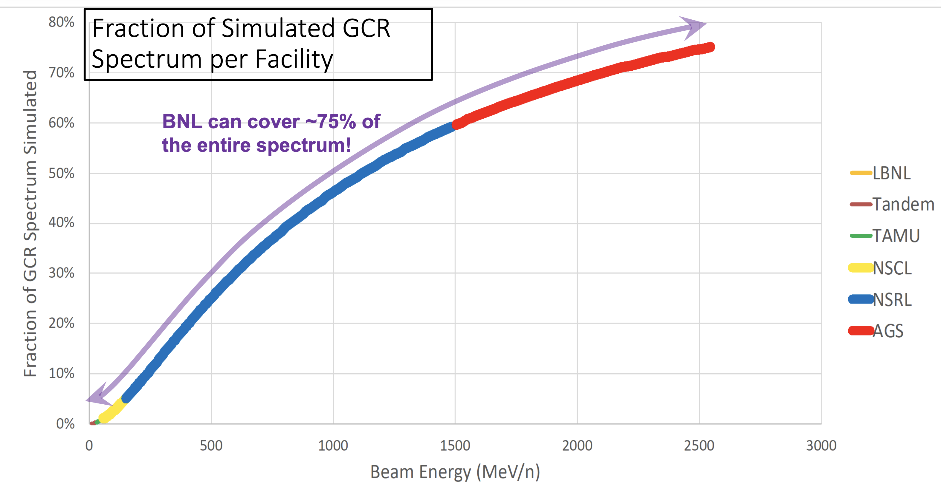
Proposed HEET Facility
High Energy Effects Test Facility Capabilities
Large range of beam energies (e.g., 40 - 2000 MeV/n Fe21+ ions)
Large number of available ion species (e.g., H to U [Z = 1 to 92] and more)
Fast energy change (minutes)
Fast switching of ions (minutes) [note: Simulation of GCR]
Support for both unclassified and classified experiments
3D Uniform Beams
Square uniform beam sizes from 1 cm2 to 400 cm², and larger
Small beams on the scale of 1 cm rms (and smaller are possible)
Beam spills from 0.1 - 5.0 seconds (longer and shorter are possible)
Fast beam cutoff with insignificant overshoot (e.g., 0.1%)
Same level of support and service as NSRL
ONLY FACILITY TO TEST HEP/NP DETECTORS WITH HADRONS

Slide 24
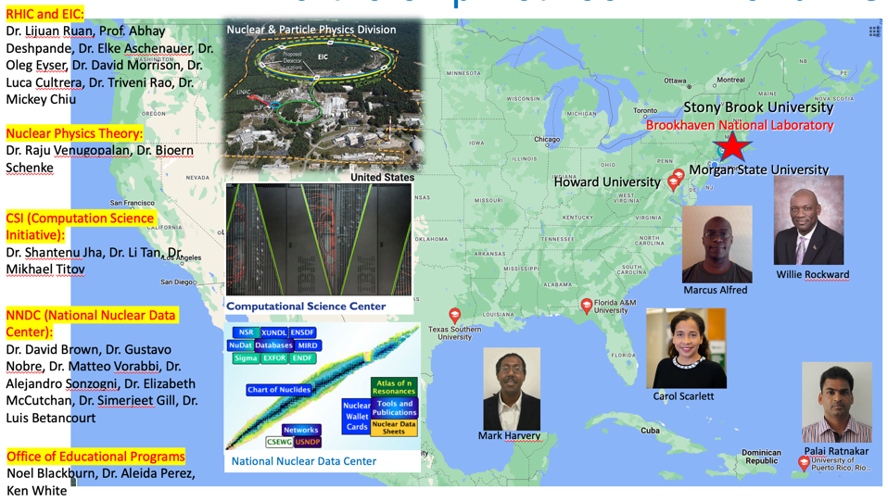

BNL-MSI PREP-NP Traineeship Program
Stacyann Nelson
2 year pilot program started in June ’21 with an initial cohort of 10 fellows, to access talent for NP research in under-represented populations
Funded by DOE ONP’s “Research Traineeships to Broaden and Diversify Nuclear Physics Program”
Student research fellows are paired with BNL scientist and MSI University Mentor for 1 to 2 years, full time during summer and 16 hrs/wk during the academic semesters. Stipend support of $6500 for summer, and $16/hr during semester*
Efficiently leverages existing NP infrastructure and resources (people and equipment) at BNL with talent pool at MSI’s and across the country
Fellows work on a cutting-edge NP research project and learn the tools and skills of a scientist while being supported by mentors
Program is like a SULI++ or ”mini grad student experience”, and builds their scientific abilities and confidence over time

Slide 25
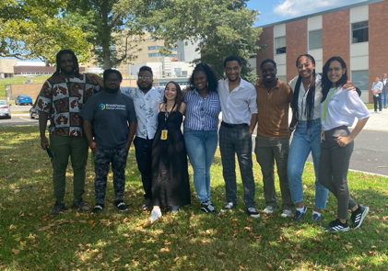
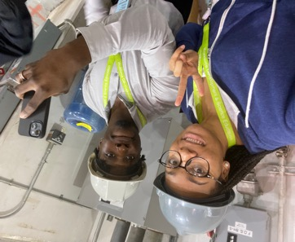
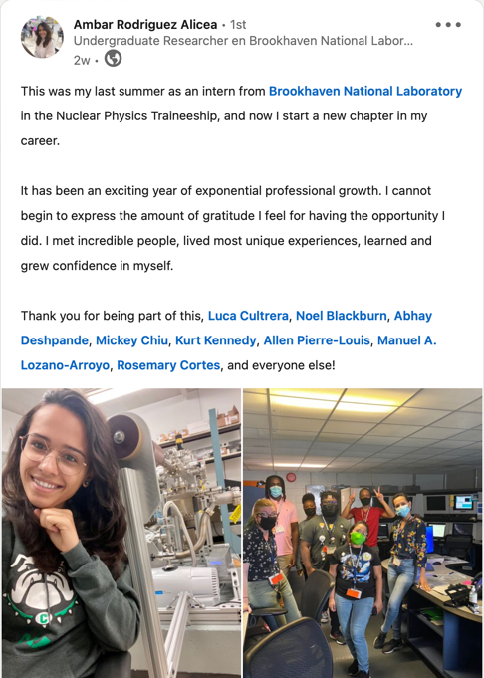
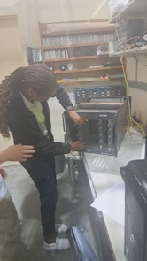
Program Results for the NPT Fellows
Since start of program, 13/15 fellows have gone on to graduate school
2 papers submitted for publication, at least 2 more expected
Graduate Program | Mentor
Morgan St MS Math | Nuclear Data
Michigan St PhD Biophysics | Nuclear Data
Vanderbilt Univ PhD Physics | sPHENIX UPC Feasibility
Vanderbilt Univ PhD Physics | nEXO photon readout
UMass Amherst PhD Physics | MOLLER backgrounds
Mass General Research Fellowship on Clinical Radiotherapy | Nuclear Data
Graduate Program | Topic
Stony Brook MS Physics | Rare isotope program, EIC
Duke Univ PhD Physics | Forward physics at EIC
Michigan St PhD Physics | Polarized e- production
Univ of Puerto Rico MS Physics | Mott polarimeter development
Illinois Inst PhD | Polarimeter Simulations
UC Davis APS Bridge | Nuclear Astrophysics
Fisk University APS Bridge | Lattice QCD, Charm in HIC

Slide 26
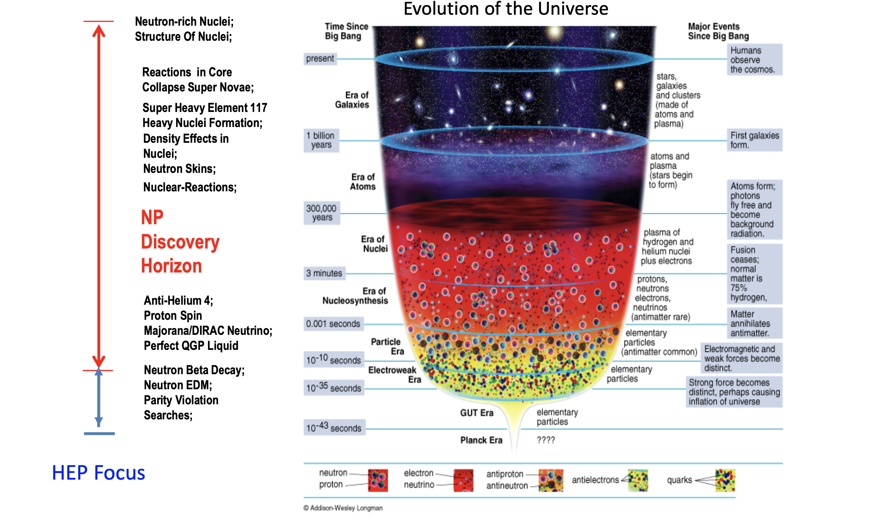
Summary
NNDC
Dr. E. Chimanski
BLIP
NSRL
EIC
RHIC Physics

