Slide 1
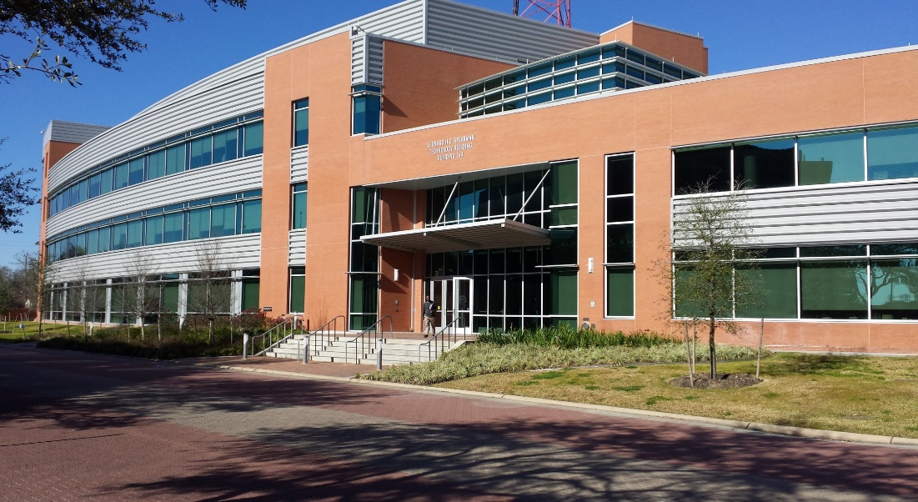

MASERs: From Star formation to Black holes
(back to the low-energy end of the spectrum)
Dr. Victor Migenes
Exploring the Frontiers of Nuclear, Particle & Astrophysics Workshop (TSU-BNL)
Apr/9-11/2025

Slide 2
MASER Emission Properties
High specific intensity
Narrow bandwidths
Polarization
Variability
High density (10⁶ – 10¹⁰ cm⁻³)
Close to energy source
High T_{B} (10⁹ – 10¹² K)

Slide 3
History
OH MASERs discovered by Weaver et al in 1965
Non-thermal nature and compactness by Davies et al and
Moran in 1968
H2O MASERs discovered by Cheung in 1969 (more powerful
& compact)
Associated with outflow stage in SFR
CH3OH & SiO discovered by Barret et al 1971 & Snyder 1974
Megamasers discovered in 1977
“Golden Era” from 1981 with instrument like the VLA,
MERLIN, VLBA (VLBI techniques)
New “Golden Era” from ~2010 with the E-VLA and NEW
instruments like ALMA and SKA

Slide 4
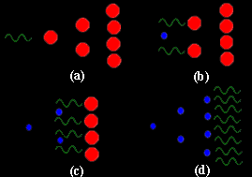
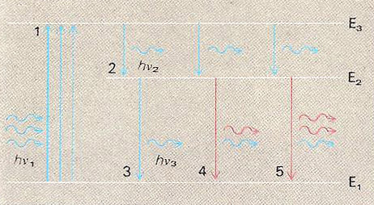
MASER Physics
Maser: Microwave Amplification by Stimulated Emission of Radiation
MASERs in the Interstellar Medium:
Dense regions: 10⁶ - 10¹¹ cm⁻³
Temperature: ~100K
Pumping scheme: star(s) or shock waves
Molecules: OH, H2O, SiO, CH3OH ...
Fundamental principles:
e- pumped to an excited state
Population inversion between 2 energy levels
Stimulated emission
Characteristics:
Very collimated emission
Non-Thermal emission

Slide 5
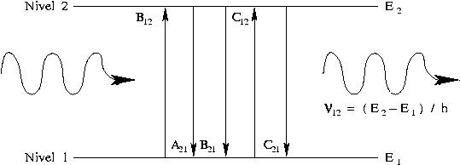
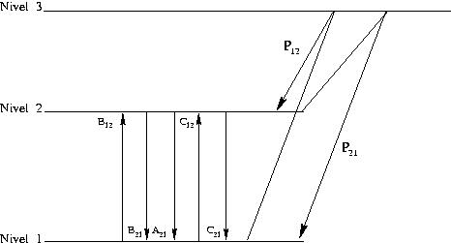
MASER Emission
Population inversion
MASER Pumping

Slide 6
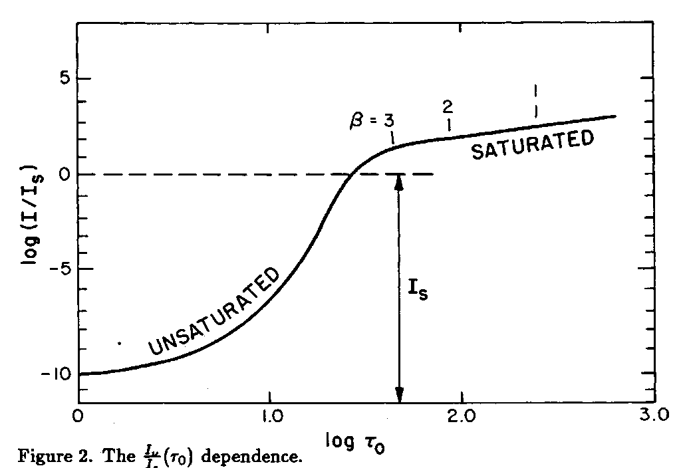
MASER Emission
MASER Amplification:
Non saturated MASER:
Saturated MASER:

Slide 7
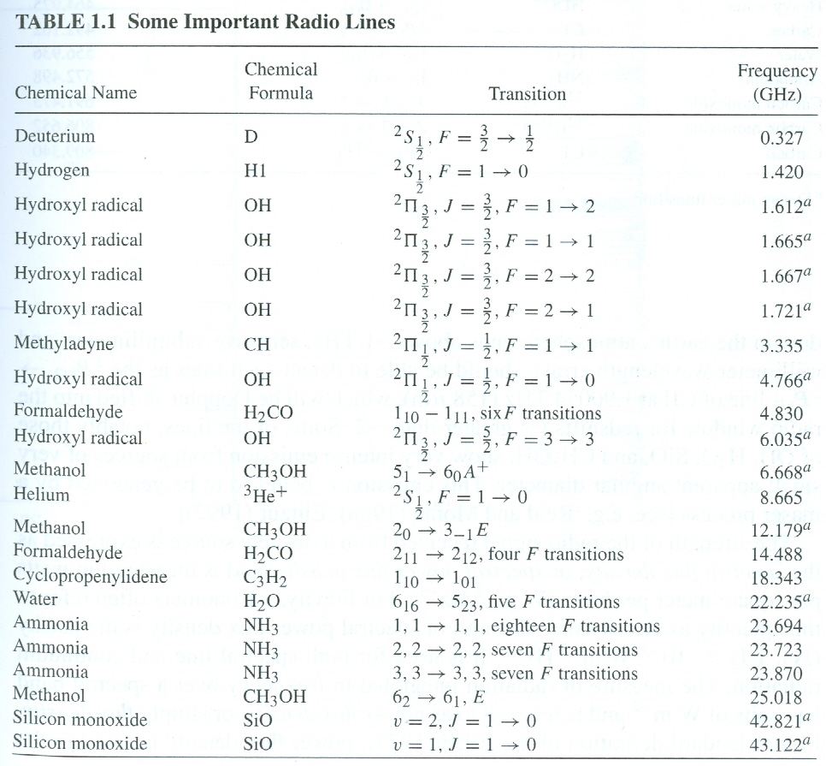
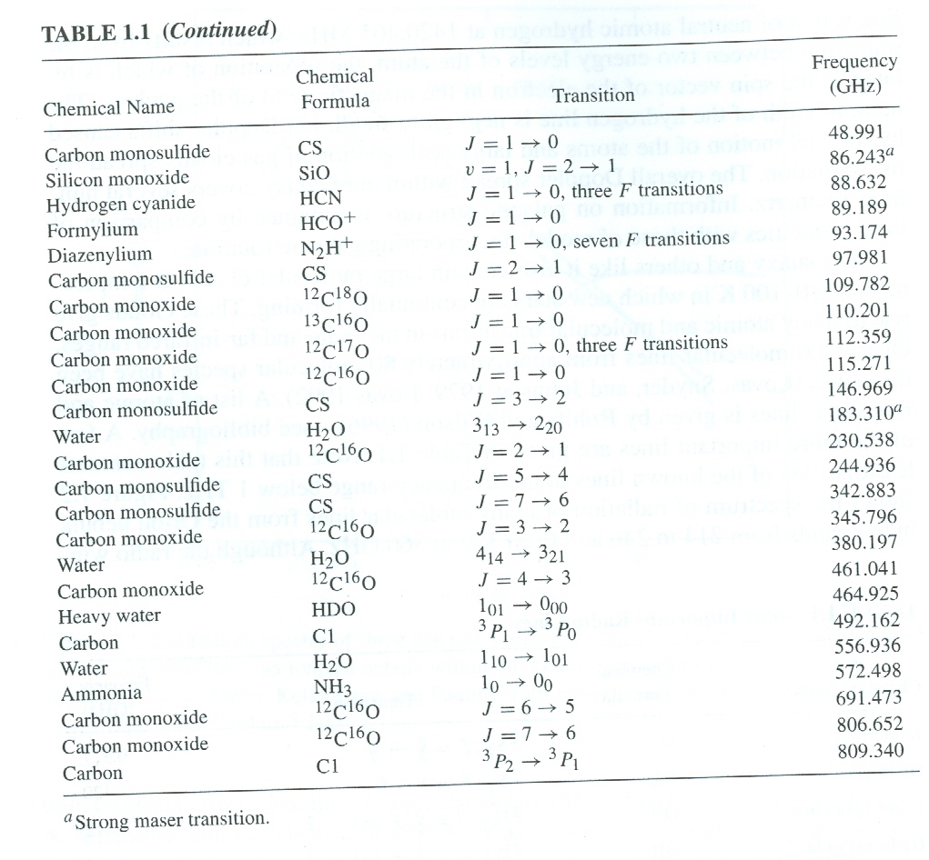
MASER Species
Most relevant species due to strength and abundance:
H2O, OH, SiO & CH3OH
*
*
*
*
*
*
*

Slide 8
MASER Scenarios
Star Forming Regions (SFR)
Late type stars (OH-IR stars)
Megamasers (AGNs & Starbursts)
Supernova Remnants (SNR)
Interstellar Medium (ISM)
Comets

Slide 9
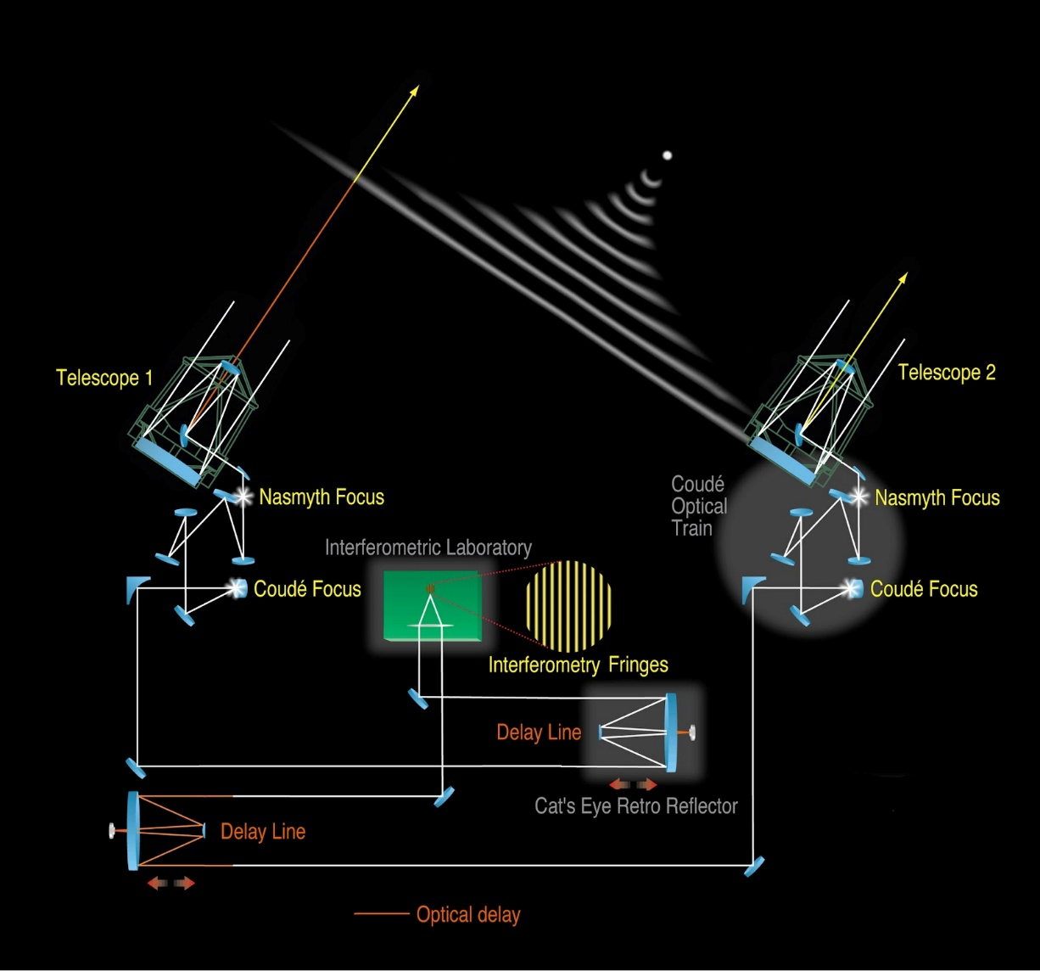
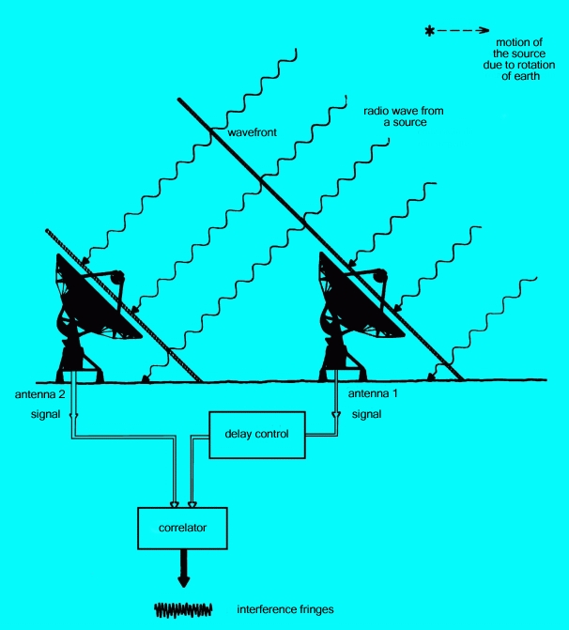
Interferometry
Resolution: θ α λ/D
Sensitivity: S α (D/2)²

Slide 10

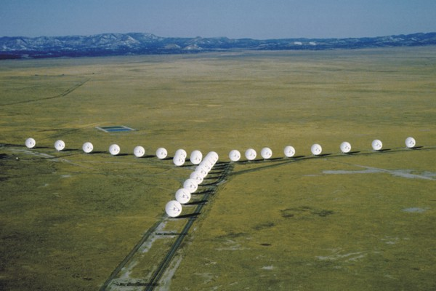
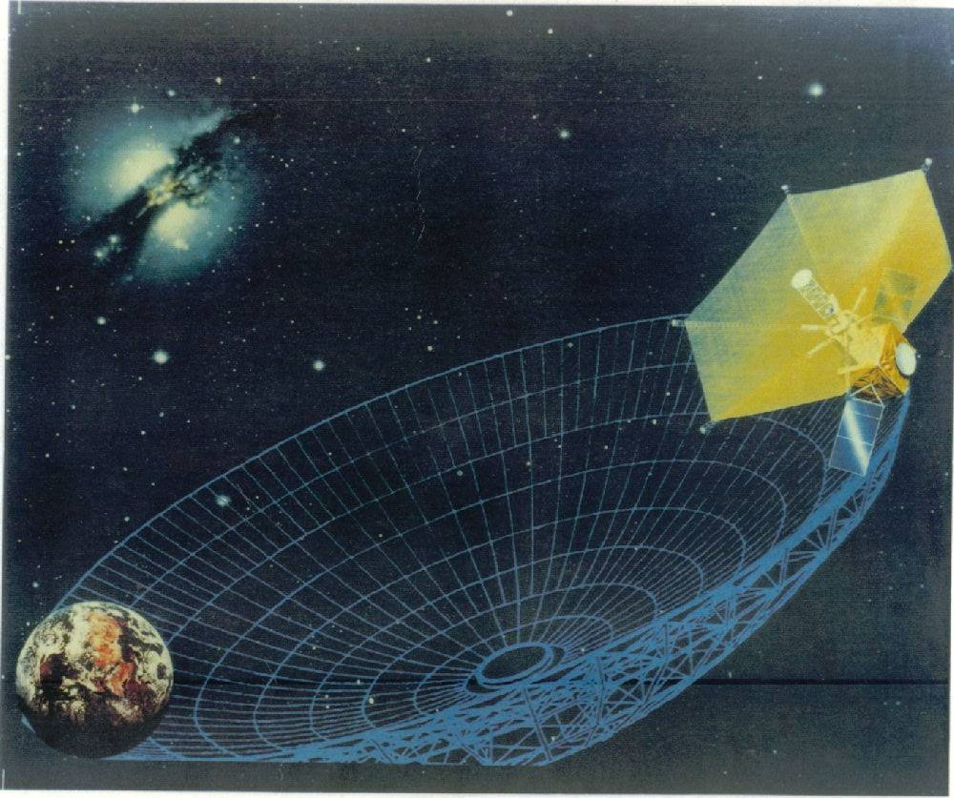
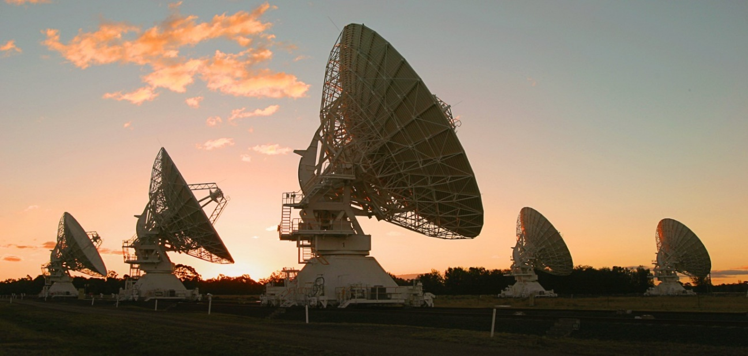
Radio Astronomy Instruments
VLBA
E-VLA
HALCA
ATCA

Slide 11
Why Study Stars?
Stars are crucial for the evolution of the Universe and for the creation of life, as we know it!
Stars create all elements heavier than H & He
An important side product of the process of star formation is planets
Stars in the Inter Stellar Medium work as recycling plants for the galaxy
The formation of Stars and their evolution determine how galaxies evolve, hence how the Universe evolves

Slide 12
Star formation and Stellar Evolution are low energy processes better studied in the I.R. and Radio portions of the EM spectrum.
In a nutshell, hydrostatic equilibrium breaks down and the star swells as it evolves to a dramatic death.
Star Formation and Late-type Stars

Slide 13
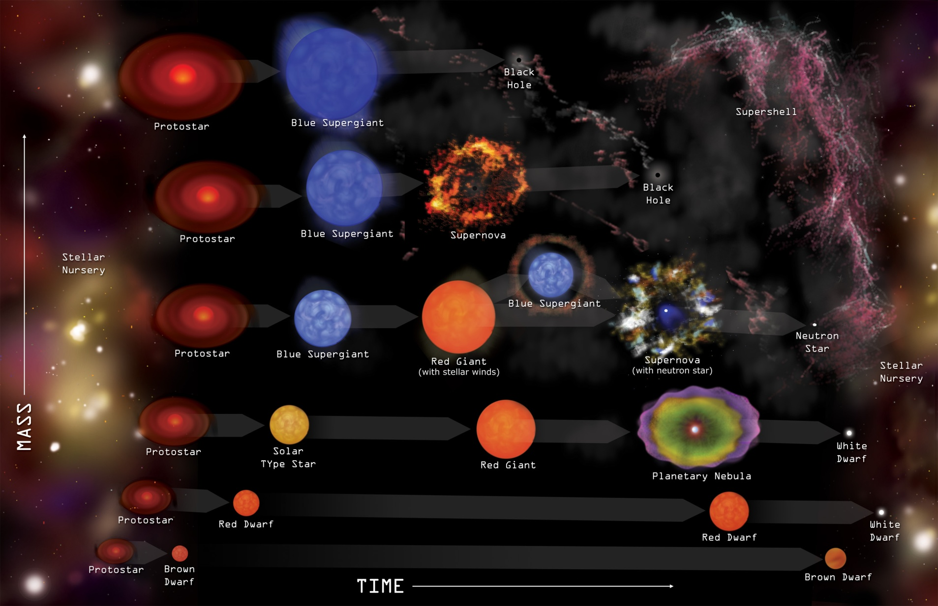
The Mass at Birth determines its Evolution and Death
Notes:
Stars form in clouds of gas and dust called nebulae in the interstellar medium. The interstellar medium is simply the “stuff in between the stars”. The way a star carries out and ends its existence all depends on the mass it begins with. Low-mass stars, such as our Sun, live long, relatively calm lives and end their lives in relatively peaceful ways as well, with the outer layers of their atmospheres expanding gently out into space to once again become part of the interstellar medium. More massive stars live more violent lives, going quickly through their fuel and not lasting as long. The way they end their lives is more violent as well—these stars end in explosions called supernovae. In a supernova, heavier elements are created through energetic interactions, and these, as well as the outer layers of the stars are ejected into space in what we call a supernova remnant that then also becomes part of the interstellar medium. The matter given to the interstellar medium by these star deaths will then eventually become new stars.

Slide 14
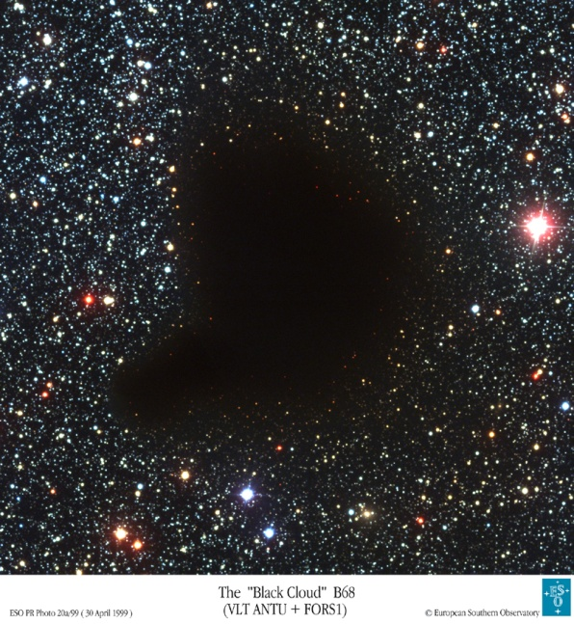
Star Forming Regions
Star Formation
Molecular Clouds
Low-mass stars (M ≤ 5M☼)
Dense cores in dark clouds
High-mass stars (M ≥ 8M☼)
Dense cores in giant molecular clouds
Mass : 10³ - 10⁶ M☉
Sizes: 2 - 100 pc
Density = 10³ - 10⁴ cm⁻³
Temperature: 10 – 100 K
Mainly gas and dust

Slide 15
Star Formation
Low-mass stars | High-mass stars
M ≤ 5 M☼ | M ≥ 8 M☼
Classification: Classes 0, I, II & III | No classification: Herbig Ae/Be - Late type: 5 < M < 8 M☼ - Early Type: M > 8 M☼
Formation: - disc-YSO-outflow system (Observational confirmation of theory) | Formation: - Disc-YSO-outflow systems? - Coagulation of molecular clouds? - Fusion of small stars?
Jets & bipolar outflows: - Very energetic phenomenon - Bipolar and highly collimated - Visible from X-Rays to Radio - Size: 0.1 – 5 pc - Mass: 0.01 – 10 M☼ | Jets & bipolar outflows: - Outflows: Very energetic phenomenon Bipolar and highly collimated Common in massive proto-stars - Jets: Not enough detected
Circum-stellar discs - Perpendicular to bipolar flow - Size: dozens to hundreds of AUs Mass: 0.01 – 1 M☼ - Temp.: ~100K at 1AU of central star | Circum-stellar discs: - Little observational evidence - Fast evolution: 10⁶ yrs -- 10 M☼ Reach MS still accreting mass actively

Slide 16
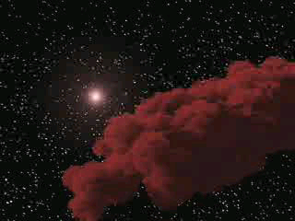
Giant Molecular Clouds

Slide 17
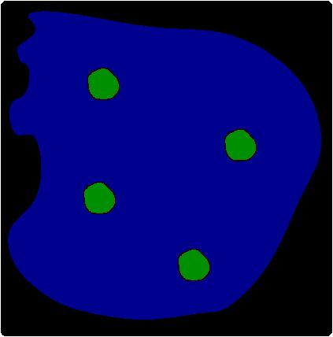
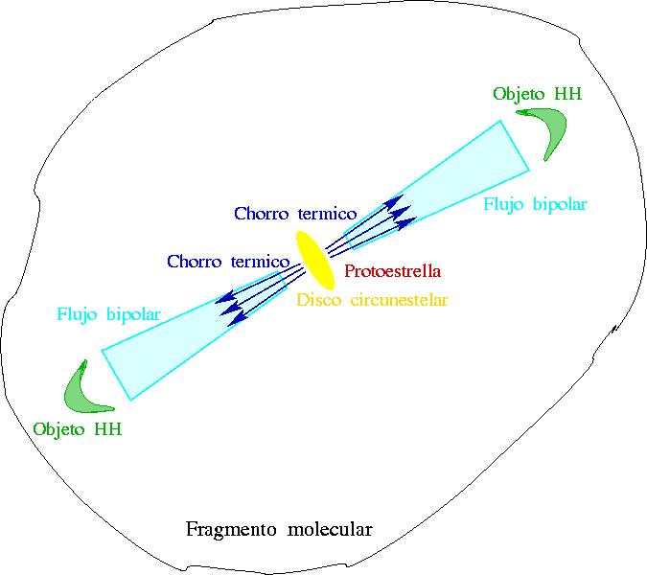
Star Formation Model
Molecular cloud
Dense cores

Slide 18
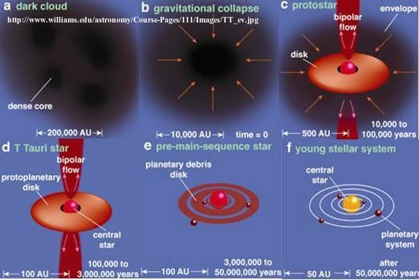
Star Formation Model
The Disk-YSO-Outflow Model

Slide 19
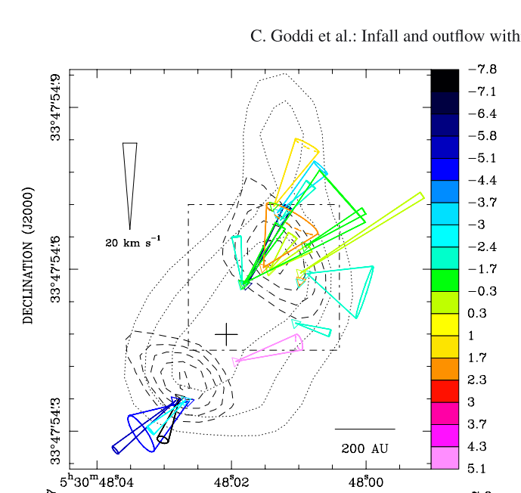
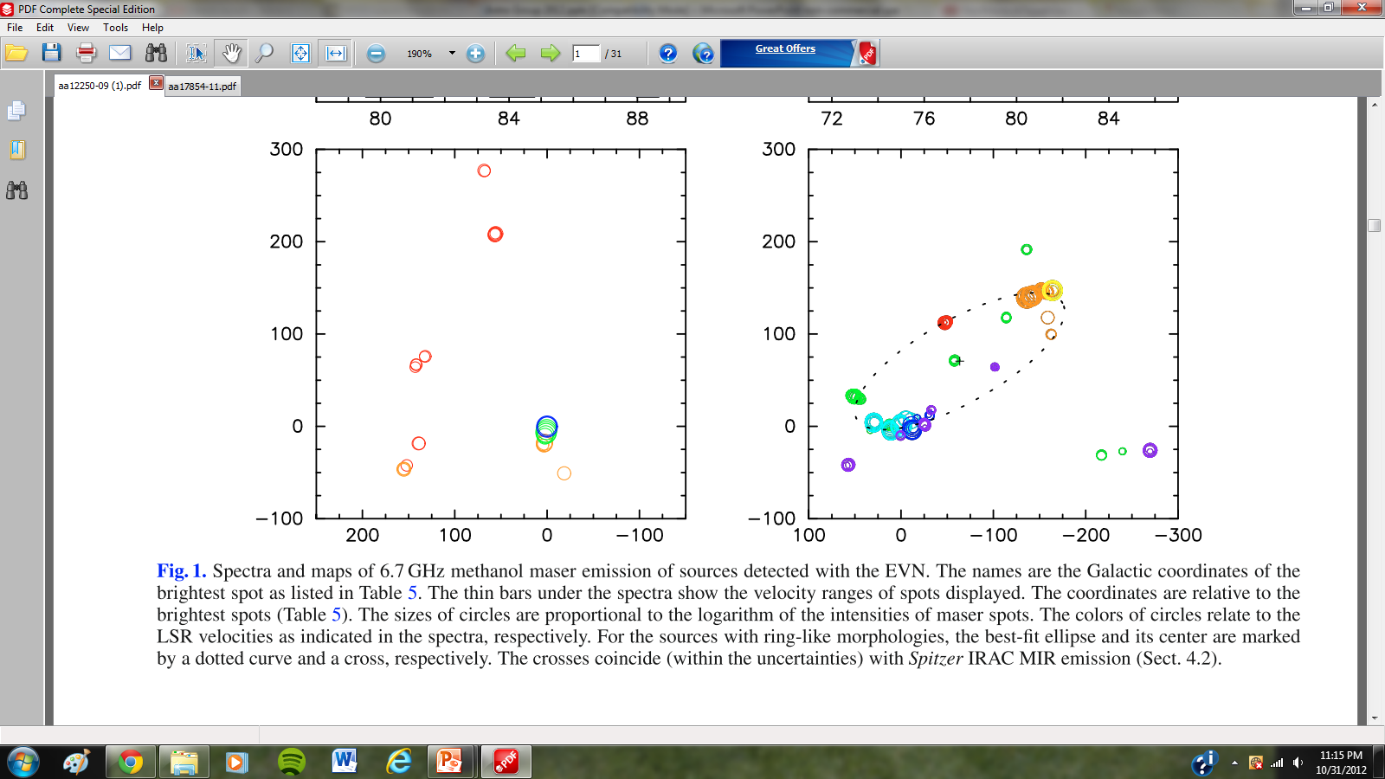
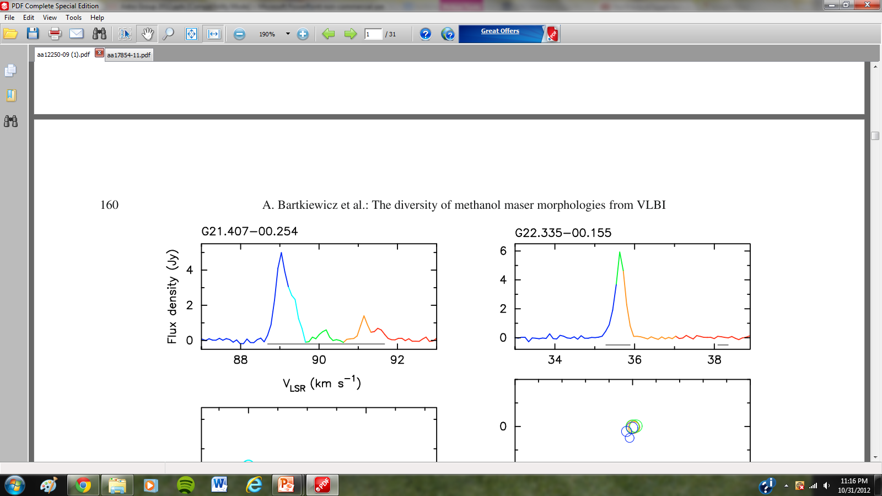
Masers
  H₂O at 22.2 GHz - Trace outflows
  CH₃OH at 6.7 GHz - Trace disks

Slide 20
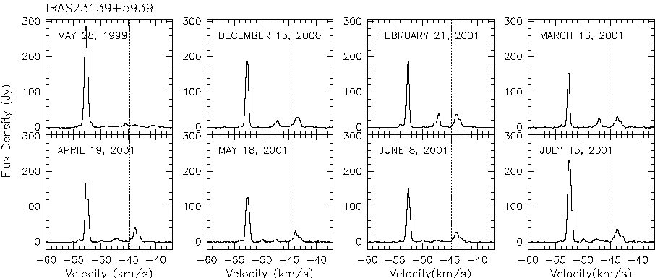
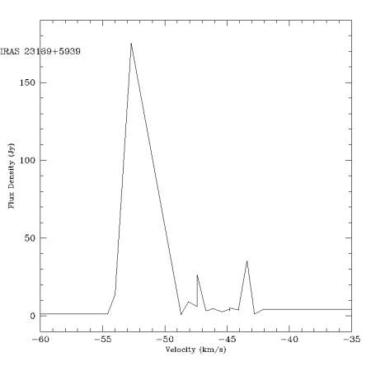
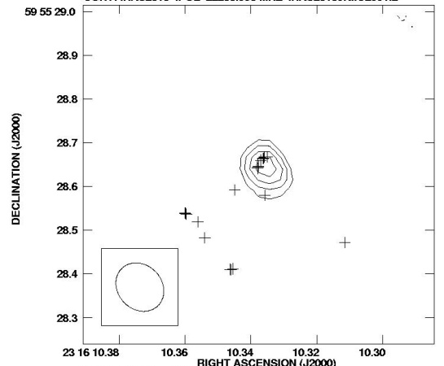
Water Vapor MASERs
Water MASER Observations
Single dish spectrum:
Interferometric: spectrum + spot distribution
IRAS 23139+5939
(Trinidad et al. 2003a)
IRAS 23139+5939
(Trinidad et al. 2005a)

Slide 21
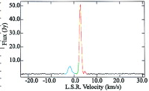
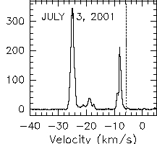
MASERs in SFR
Low-mass SFR
Weak MASER emission: dozens of Jy (hundred of Jy
in a few cases)
High-mass SFR
Very intense MASER emission: dozens to thousands of Jy (up to a million in flares)
IRAS 05413-0104
(Claussen et al. 1998)
AFGL 2591
(Trinidad et al. 2003a)

Slide 22
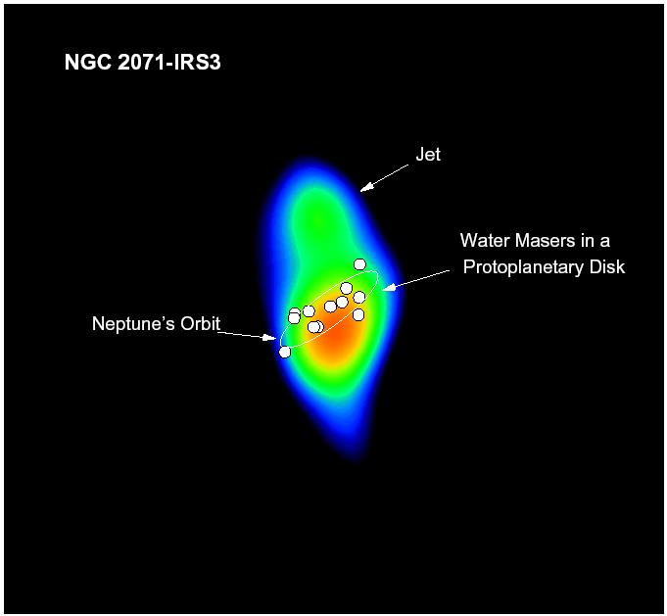
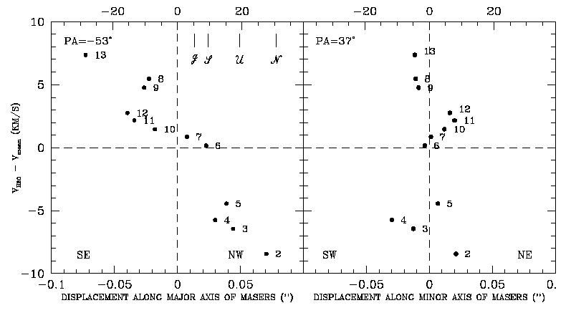
Circumstellar Disks
Circumstellar disks in NGC 2071 IRS3
(Torrelles et al. 1998)
Observations: VeryLargeArray (θ = 100x90 mas)
Water Vapor MASERs are associated with thermal jets.
Spatial-kinematical distribution of MASERs show they trace a rotating proto-planetary disk perpendicular to the jet.
Radius: 20 AU
Proto-star: 1 M☉
“disc-YSO-outflow” system

Slide 23
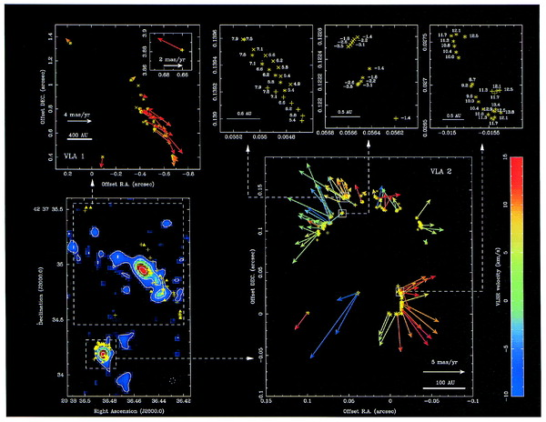
Shells, Rings and Disks
Shell expansion in: W75 N
(Torrelles et al. 2003)
Observations: 3-VLBA
(θ ~ 0.5 mas)
Proper motions: ~28 km s⁻¹
Shell pushed by stellar winds
Size: 160 AU
Variability and periodic events

Slide 24
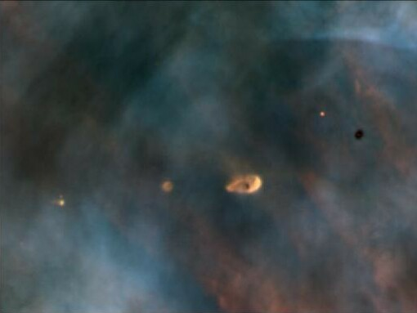
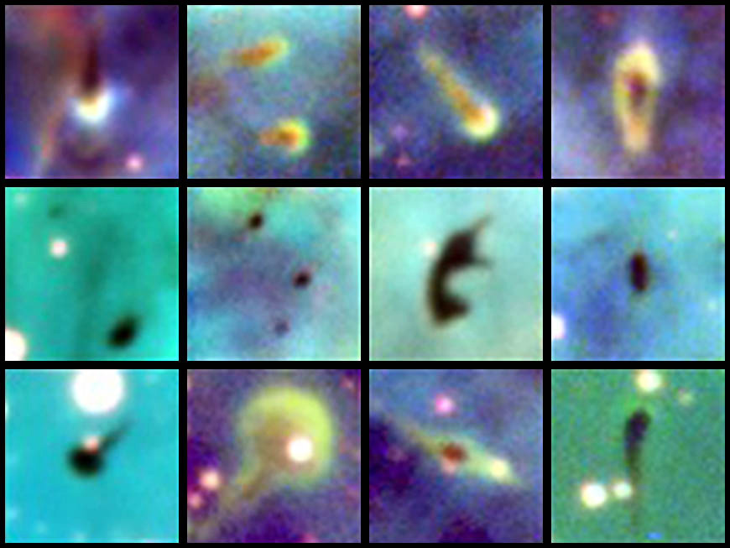
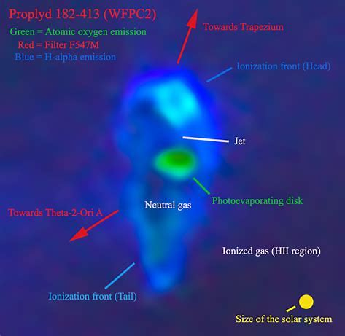
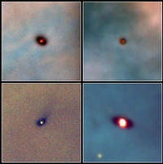
Proto-planetary disks & Proplyds
Proplyds in the Carina Nebula
Credit: University of Colorado/NOAO/AURA/NSF
Hubble Space Telescope Image of Orion Proplyds
Proplyds in the Orion Nebula
Credit: Hubble Space Telescope
Notes:
The dust cocoons that contain forming stars are called proplyds. Proplyds stands for protoplanetary disks. These disks around the newly-forming stars are disks of gas and dust that could eventually form planets around the stars. Some proplyds have been imaged in our Galaxy. These are some pictures of these star cocoons found in the Carina Nebula and in the Orion Nebula.

Slide 25
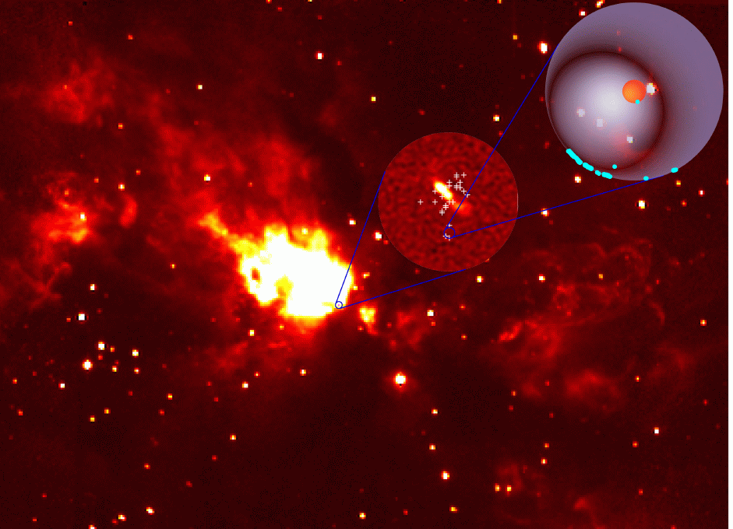
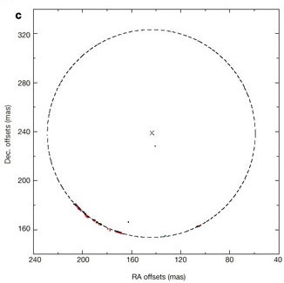
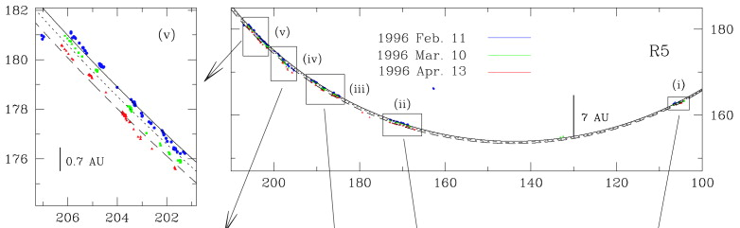
Other Structures
Bubbles: Cepheus HW2 R5
(Torrelles et al. 2001)
Observations: 3-VLBA
(θ  0.5 mas)
Proper Motions: 9 km s⁻¹
Radius: 62 AU
Periodic but unknown events
HII Region in expansion (Curiel, Trinidad, et al. 2002)

Slide 26
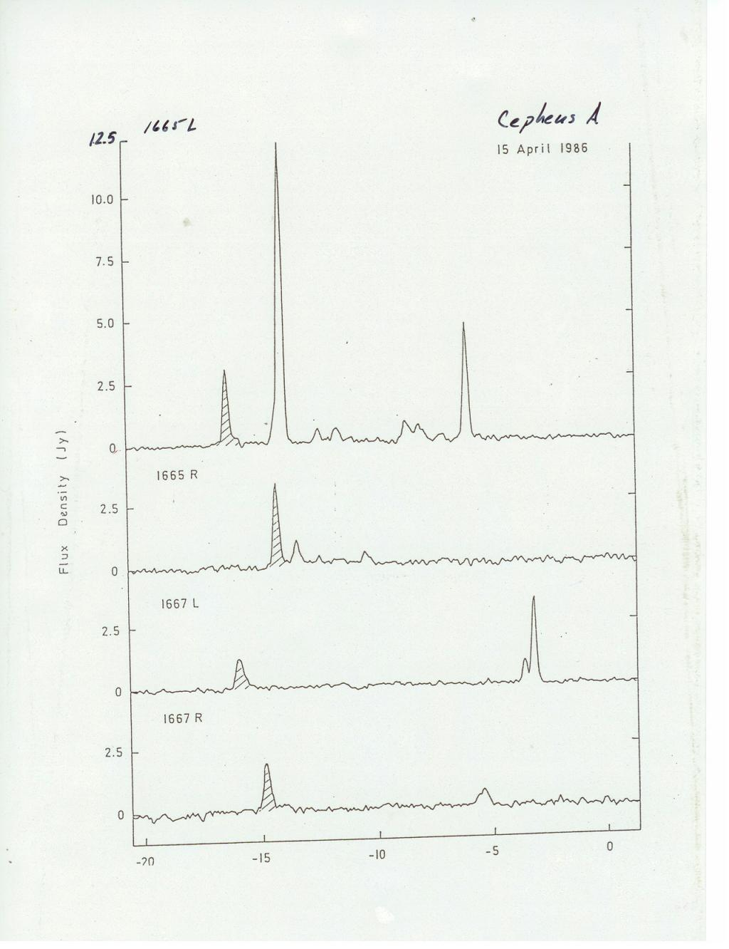
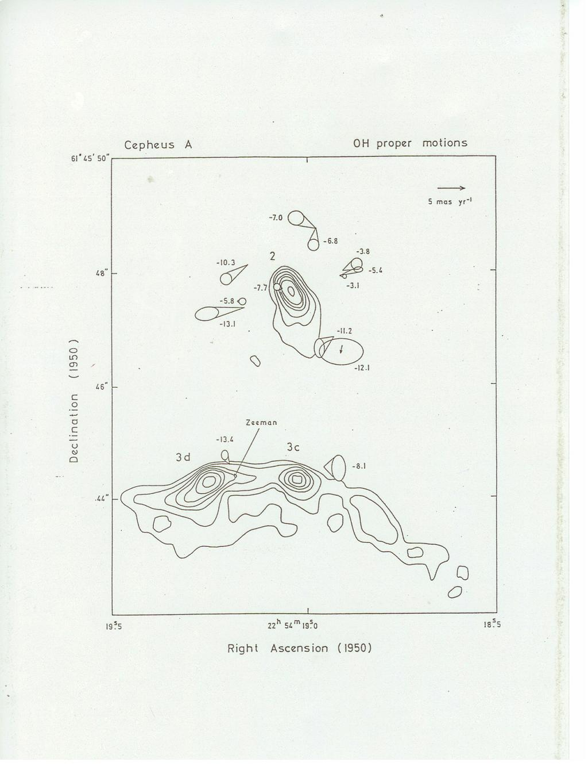
Other MASER species in SFR: OH MASERs
MASER emission towards Cepheus A. Spectrum, distribution and proper motion. Lower Energy (velocity) kinematics.

Slide 27
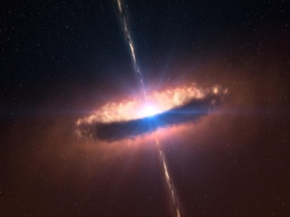
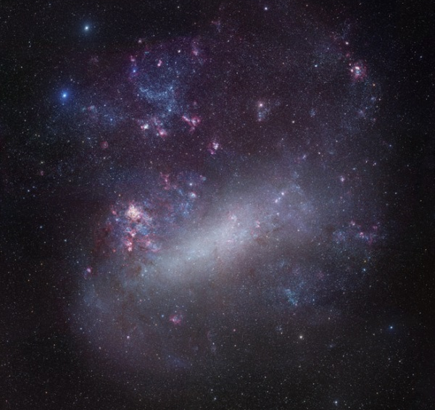
Summary
Found water masers associated massive YSOs
  Discovered a previously unknown YSO
  Potentially discovered the first low-mass YSO in the LMC with associated maser emission.
Discovered a continuum source associated with a massive YSO
  Will obtain more data to
  characterize the continuum source
Added three new masers in LMC
  20 in 14 to 23 in 15
  New maser region for use in
  statistical studies.

Slide 28
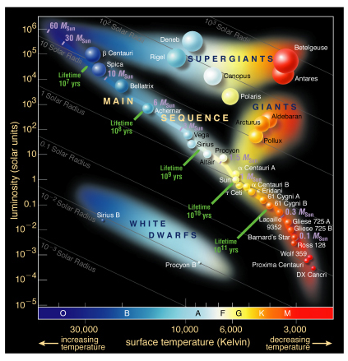
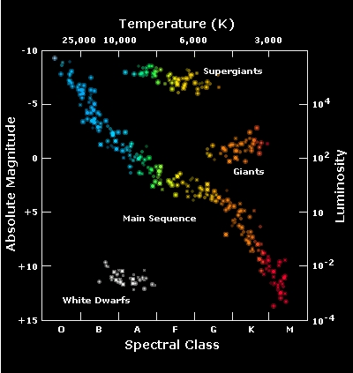
High-mass stars
Stars with M ≥ 8 M⊙
Visibly the hottest, largest and bluest stars
Their study is difficult:
- When in the formation stage they are embedded in dense and dusty clouds
- Very far away
- Short period of formation
- Short lifespan
Drivers of the Inter Stellar Medium (ISM) and
evolution of the galaxy

Slide 29
The Envelope of Late-type Stars
(Migenes, Imai, Marvel & Diamond)
stars with M < 8M evolved along AGB → Giants, SG
large (R* ~ 1-3AU), cool (T~2000-3000K) convective photospheres
long period variables (100 – 1000 days)
dust and gas accelerated to V~10-20 km/s
oxygen rich envelopes and intense radiation provide ideal conditions for maser excitation
replenishes the ISM with heavy atoms and molecules
masers are excellent probes of the mass loss mechanism

Slide 30
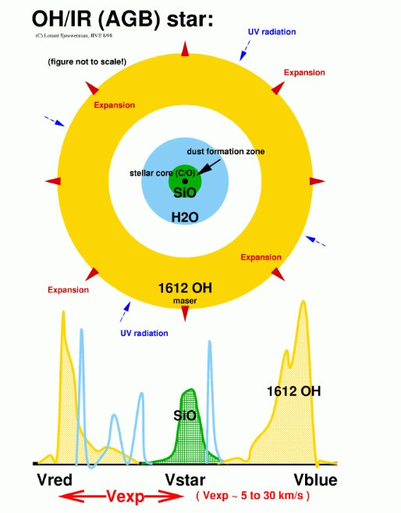
Theoretical ideal of star
rotational transitions of vibrationally excited SiO. Shell is 4-6 R* from star.
rotationally excited H₂O. Shell is closer to the SiO than OH shell.
hyperfine splitting of lambda doublet in the rotational ground state of OH. Shell is 8-10 R* from star.

Slide 31
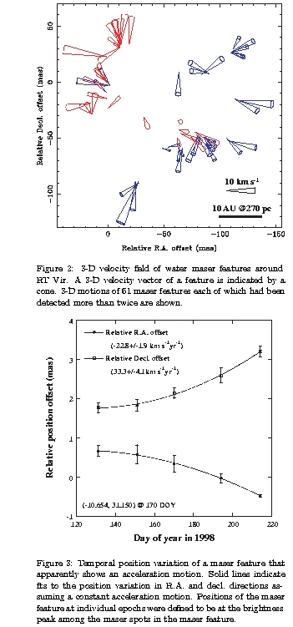
Circumstellar Envelopes (RT-Vir)
semi-regular variable (M=1.5 M, D=140-270 pc)
mass loss not spherically
symmetric (~10⁻⁶ M/yr) most probably due to un-isotropic mass ejection
the systematic shift of Vr~1 km/s of spots and the apparent motion of spots indicates an acceleration motion of about 36 km/s/yr which suggests propagation of shock waves (formed near stellar surface)
bipolar outflow being obscured by growing envelope

Slide 32
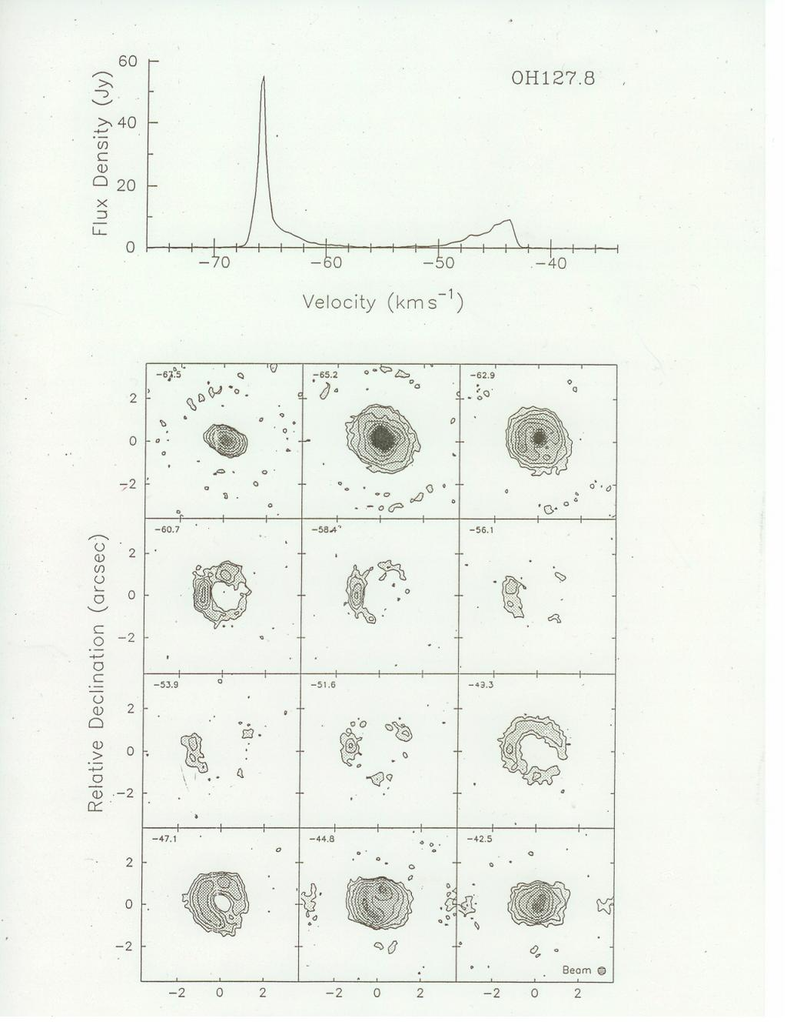
OH MASER Shell: OH127.8

Slide 33
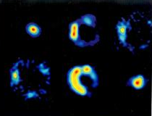
OH MASER Shells

Slide 34
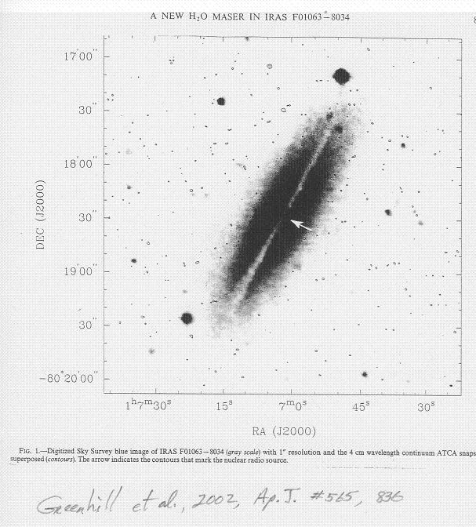
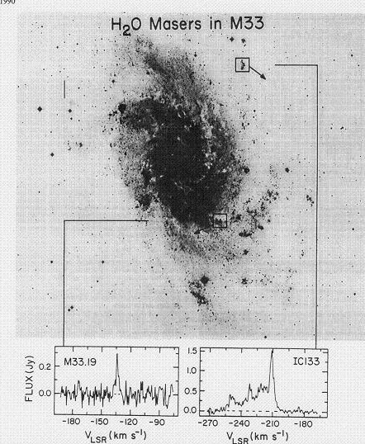
OH Megamasers

Slide 35
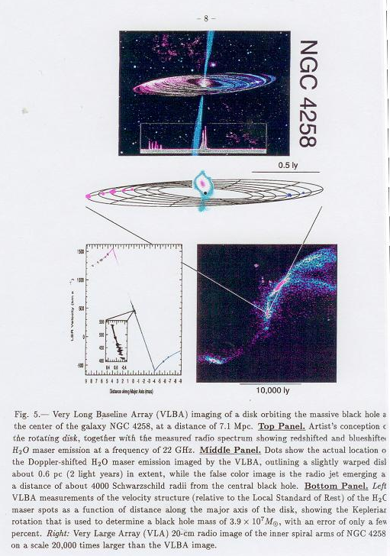

H₂O Megamasers (NGC4258)

Slide 36
The good, the bad and the ugly
of OHM & H2OM
OHM not as compact and intense as H2OM, so more difficult to detect
OHMs appear to be associated with H2CO maser activity and seem to be mutually exclusive with H2OM, which are associated with AGNs (no H2OM in SB)
OHM don’t seem to reveal the same internal structure of the host galaxy, like the cases of NGC 4258 and NGC 3079 for H2OM
VLBI imaging capable of resolving detailed structure and velocity patterns only good for a few sources…… sensitivity!
L-band receiver’s BW not broad enough to detect greater Z

Slide 37
End

Slide 38

MASERs can readily be found in certain stages of the Star formation and stellar evolution process.
Not present during the Planetary System formation.

Slide 39
Conclusions
Interferometric observations of masers are a powerful tool to study the gas surrounding YSOs at high spatial resolution.
Masers can be used as test particles to study the velocity field of the molecular gas surrounding YSOs.
It is found that groups of maser spots are associated with radio continuum sources.
Very Large Baseline Interferometry (VLBI) observations have permitted the study of proper motions of the maser spots in circumstellar disks and bipolar outflows on a scale of AUs.

Slide 40
OH MASERs and ISM Scattering
But, many OH MASERs do not seem to
suffer IS scattering
High resolution OH MASER observations
show a large proportion of unscattered
MASERs in the galactic plane
Why do Pulsar and MASER results don’t
agree?
Could there be a strong large scale
inhomogenity of scattering in the ISM?

Slide 41

Bipolar Outflows
Bipolar Outflows: IRAS 21391+5802
(Patel et al. 2000;
Observations: 3-VLBA
(θ = 0.8x0.4 mas)
Proper Motions ~40 km s⁻¹
Bipolar Outflow
Extension 500 AU
Circular Structure (shell)
low velocity
1 AU in radius
At small size-scales the outflow is
poorly collimated, but at large
size-scales is highly collimated

Slide 42

Low-mass Stars
Classification of Young Stellar Objects
André (1994):
Class 0. Earliest phase of the protostars (10⁴ years).
Consider the power spectrum: λFλ∝λ^{x} (2–100 μm)
Class I. x > 1.
Formation of a circumstellar disk and bipolar outflow (10⁵ years).
Class II. -3/4 < x < 0
Ejection of circumstellar material through a bipolar outflow (10⁶ years)
Class III. x < -3/4.
Star is closest to the Main Sequence (10⁷ years).

Slide 43

Circumstellar Disks
Cepheus A HW2 R4 disk
(Torrelles et al. 2001; Gallimore et al. 2003)
Observations: 3-VLBA (Very Large Baseline Array) MERLIN (Multi Element Radio Linked Interferometer Network)
(θ  0.8 - 8 mas)
Water vapor masers associated with a non detected (yet!) YSO.
Spatial-kinematical distribution of spots and proper motions indicate that masers are propagating outward with a shock wave (typo C) within a circumstellar rotating disk.
Radius: 16 - 28 AU
Protostar: 3 M☉
Speed of shock wave: ~13 km s⁻¹

Slide 44

OH MASERs in SFR
Distribution of MASER spots with respect to HII regions.

Slide 45
OH MASERs in SFR
Distribution of MASER spots with respect to HII regions.

Slide 46

Gruendl & Chu 2009
1172 YSO candidates
  IR colors and spectra
    Allen et al. 2004
      Color-Color
    Seale et al. 2009
      Spectral classification

Slide 47
End

Slide 48
Star Formation Regions

Slide 49
Late-type Stars

Slide 50


Relative position of the 1612 MHz OH masers in VX Sgr. The polarization vectors are tangential to the circumstellar envelope.

Slide 51

SiO MASERs in Late-type stars

Slide 52

3-epochs of VLBA observations of the H2O maser emission. Obs. show a clear expansion but not a symmetric and smooth outflow. This is the region between the SiO and OH maser shells.

Slide 53
General characteristics of the MASER emission in L-T Stars
OH: - expanding shell
- photo-dissociation of H2O maser emission
- I.R. radiation pumping
- variability systematic with stellar pulsations
- circular polarization vector tangential to shell
- hot spots (maybe amplified image of central star)
H2O: - spectrum with smaller velocity range
- strong time variability (perhaps related to stellar cycle)
- pumping by I.R. and collisional excitation
- acceleration of features
- discrete maser spots (narrow ≤ 1 km/s)
SiO: - spectrum centered on star velocity
- trace regions of mass loss
- correlation between variability and optical light curve
- linearly polarized and variable
- collisional pumping ??

Slide 54
Mega-masers

Slide 55

OH MASER Spectra (single-dish)

Slide 56

Radio Astronomy Instruments
VLBA
HALCA
E-VLA
GBT

Slide 57




Radio Astronomy in the XXI Century
HALCA
Atacama Large Millimeter Array
Square Kilometer Array

Slide 58



Slide 59

Astronomy in the XXI century

Slide 61


Water Vapor MASERs
The Water molecule (H2O)
Orthogonal transitions
Water: flat molecule (asymmetric rotor)
Three moments of inertia
Energy levels JK-K+
Transition: (447.30 – 446.56 cm⁻¹)
(1.35 cm).

Slide 62

Cinemática de los Máseres de Agua
Discos circunestelares
La mayoría son vistos de canto
Efecto de selección
Condiciones de la emisión máser
A lo largo de columnas grandes
Su velocidad a lo largo de la línea de
visión
Máseres intensos caen en el plano del
disco
Norris et al. (1998)

Slide 63

MASER Variability
Water vapor in SFR
MASER variability:
short (days to weeks)
Long (months to years)
Very limited studies (Persi et al. 1994;
Valdettaro et al. 2002; Trinidad et al. 2003a)
S233 IRAS 20126+4104
Types of Variability:
‣ Weakest lines disappear
‣ Strongest line disappear
‣ Line increases intensity by more
than factor
‣ Small changes in lines
Trinidad et al. (2003a)

Slide 64

MASERs in the ISM
The size of maser spots can be used to study the dispersion effect of the ISM. The right-hand side integral defines the Dispersion Measure, D or DM, usually
expressed in units of cm⁻³pc. The fit to t according to this equation provides a value for D, i.e. the electron density along the line of sight. <ne> ≈ 0.03 cm^{‑3}
dDM = D/(0.03cm^{‑3})
15 GHz continuum map of UC-HII Region in W3(OH)
Maser Size ≤ 1.5 mas. 1720 NHz MASERs 3X smaller than 1665 MHz so ISS effect ≤ 1.2 mas.

Slide 65





Discos Circunestelares
XIX Congreso Nacional de Astronomía
16-18 de Marzo de 2005
Depto. de Astronomía
Discos circunestelares
Curvas de rotación de un disco rotando
Cada anillo (diagrama superior) corresponde a una línea en el diagrama inferior.
La parte sombreada en el diagrama v-a indica la región donde se pueden encontrar los máseres.
Norris et al. (1998)
Espectro máser de OH de la fuente G309.92.
La distribución espacial y de velocidad de las manchas máser son consistentes con un anillo rotando visto de canto.
Universidad de Guanajuato

Slide 66
Otras Estructuras
XIX Congreso Nacional de Astronomía
16-18 de Marzo de 2005
Depto. de Astronomía
Cáscara en expansión: W75 N
(Torrelles et al. 2003)
Observaciones: 3-VLBA
(θ  0.5 mas)
Movimientos propios: 28 km s⁻¹
Cáscara impulsada por un viento
Tamaño 160 UA
Eventos periódicos
Universidad de Guanajuato

Slide 67
Conclusiones
XIX Congreso Nacional de Astronomía
16-18 de Marzo de 2005
Depto. de Astronomía
En otros casos, los máseres están distribuidos en una banda perpendicular al chorro de radiocontinuo, lo cual sugiere que están trazando discos circunestelares.
Observaciones con interferometría de base muy grade (VLBI) han permitido medir los movimientos propios de los máseres de agua en discos circunestelares y flujos bipolares a escalas de UA.
Se han descubierto nuevos fenómenos y han surgido preguntas a resolver.
Universidad de Guanajuato

Slide 68
Agua en el Medio Interestelar
XIX Congreso Nacional de Astronomía
16-18 de Marzo de 2005
Depto. de Astronomía
Formación de la molécula de Agua
O + H2 → OH + H
OH + H2 → H2O + H
Universidad de Guanajuato

Slide 69

Cinemática de los Máseres de Agua
XIX Congreso Nacional de Astronomía
16-18 de Marzo de 2005
Depto. de Astronomía
Discos circunestelares
La mayoría son vistos de canto
Efecto de selección
Condiciones de la emisión máser
A lo largo de columnas grandes
Su velocidad a lo largo de la línea de visión
Máseres intensos caen en el plano del disco
Modelo de un Disco
Disco en rotación o cáscara en expansión (contracción).
Movimiento del disco dominado por el campo gravitacional de una estrella central.
Velocidad:
Norris et al. (1998)
Cesaroni (1990)
Universidad de Guanajuato

Slide 70


Discos Circunestelares
XIX Congreso Nacional de Astronomía
16-18 de Marzo de 2005
Depto. de Astronomía
Discos circunestelares: S 255
(Cesaroni, 1990)
Observaciones: 32m-Medicina (θ  2´)
Modelo y observaciones máser con una sola antena.
Espectro de tres líneas (típico de discos máser)
Radio: ~700 UA
Protoestrella central: ~18 MA
Universidad de Guanajuato

Slide 71

Cinemática de los Máseres de Agua
XIX Congreso Nacional de Astronomía
16-18 de Marzo de 2005
Depto. de Astronomía
Microestructuras
(Torrelles et al. 2001
Observaciones: 3-VLBA
(θ  0.8 mas)
Movimientos propios : ~6 km s⁻¹
Filamentos
Tamaños: 2 a 18 UA
Rastros de superficie de choque aplanada
Mecanismo desconocido
Universidad de Guanajuato

Slide 72


Radiocontinuo y Máseres de Agua
XIX Congreso Nacional de Astronomía
16-18 de Marzo de 2005
Depto. de Astronomía
Mapa con calibración estándar
(usando el paquete AIPS)
Calibración cruzada
Observar simultáneamente continuo y línea
Corrige efectos de seeing atmosférico
Posiciones relativas entre máseres de 1mas
Mapa con calibración cruzada
(usando el máser mas intenso)
Detección del máser mas intenso en los datos de línea
Autocalibración de su señal: soluciones
Aplicar las soluciones a los datos de continuo
Universidad de Guanajuato

Slide 73





Radiocontinuo y Máseres de Agua

Slide 74


Estrellas de Baja Masa
XIX Congreso Nacional de Astronomía
16-18 de Marzo de 2005
Depto. de Astronomía
Formación de estrellas: Nubes moleculares
Shu, Adams & Lizano (1987):
a) Condensaciones de material rotando lentamente dentro de la nube molecular.
b) Formación de un disco de acreción alrededor del núcleo protoestelar.
c) Eyección de material circunestelar a través de un flujo bipolar.
d) Fin de la etapa de acreción, la protoestrella central y el disco son visibles.
Universidad de Guanajuato

Slide 75
Estrellas Masivas
XIX Congreso Nacional de Astronomía
16-18 de Marzo de 2005
Depto. de Astronomía
Formación: Núcleos densos de nubes moleculares
gigantes
Poco trabajo teórico y pocas evidencias observacionales.
Primera etapa: contracción y fragmentación de la nube molecular ➔ núcleos densos (Garay & Lizano, 1999)
Segunda etapa: Evolución del núcleo molecular ➔ incierta
Acreción: Similar a estrellas de baja masa: modelo de Shu (p.ej. Yorke, 2004)
Fusión: Dos estrella menos masivas (Bonnell et al. 1998; Stahler et al. 2000; Bonnell & Bate, 2002)
Combinación: Fusión + acreción (p.ej. Molinari et al. 2002)
Universidad de Guanajuato

Slide 76
Emisión Máser
Population Inversion
MASER Pumping
Universidad de Guanajuato

Slide 77
MASERs: A very special window to the Universe
Dr. Victor Migenes
Astronomy Department
University of Guanajuato
Morehead College
Department of Physics
Apr/10/2008

Slide 78

OH MASERs in SFR
The four OH maser transitions.
The Main line: 1665 and 1667 MHz, and the satellite lines: 1612 and 1720 MHz.

Slide 79

MASER
Historical Perspective
MASER Emission
Where can we find it
What can we learn
Conclusions
Charles Townes & Jim Gordon
NH3 Maser (1954)

Slide 80









Radio Astronomy BYU

