Slide 1
Simulating the Early Universe
David Garrison
University of Houston Clear Lake

Slide 2
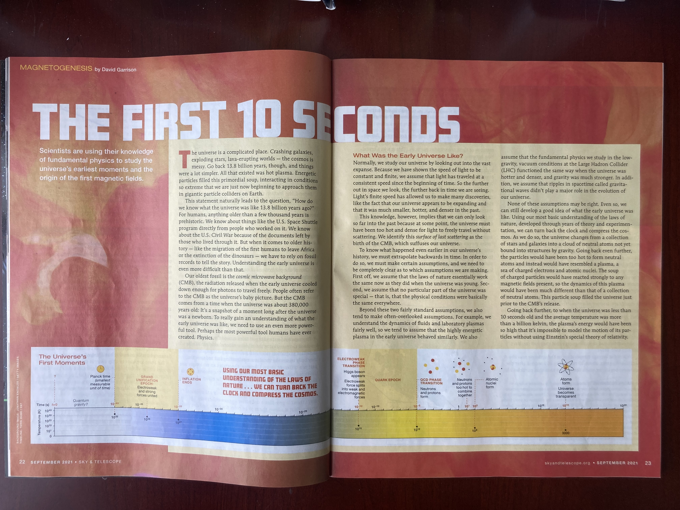
Sky & Telescope September 2021

Slide 3
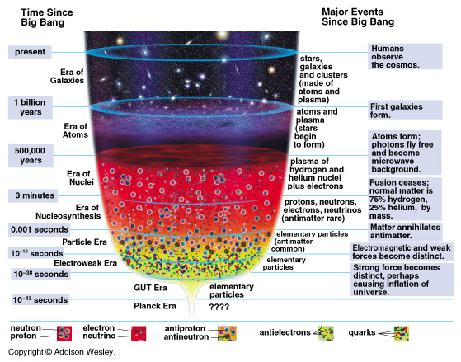
History of the Universe
We have some idea, but don’t know for sure how the universe is going to end yet.
The observable universe
We know what’s going on based on our knowledge of elementary particle physics
We still don’t know how physics works in this era yet.

Slide 4
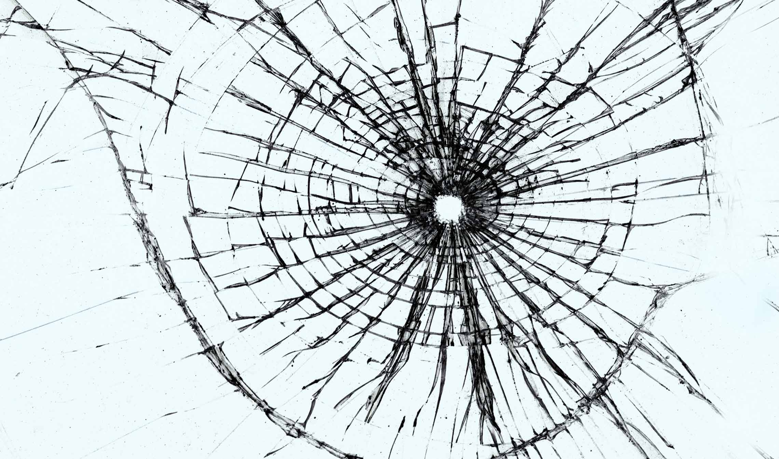
The Problem with Physics
We tend to do Physics by simplifying complex systems into separate non-interacting things
We end up ignoring nonlinear dynamics, relativistic effects, seemingly unrelated physics, etc…
Sometimes this doesn’t work because we end up ignoring things that we shouldn’t
Nonlinear dynamics and chaos theory has shown us that sometimes small things make a huge difference

Slide 5
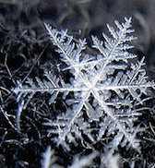
Emergence
The whole is greater than the sum of its parts
Complex systems can behave completely differently than the simple pieces it is composed of
This study combines as many physical effects as possible using a GRMHD code
Developed a virtual lab for testing theories of the Early Universe by running sims

Slide 6
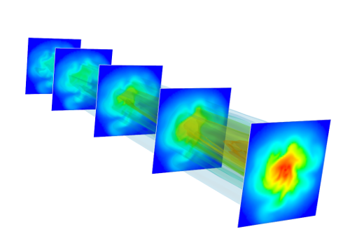
Primordial Plasma Turbulence
Simulate the early universe after the inflationary event when the universe was populated by a Turbulent Homogeneous Plasma Field, Dark Matter, Magnetic Fields and Gravitational Waves
At this stage “classical” physics, General Relativity and Relativistic Magneto-hydrodynamics, can describe the evolution of the universe at the “large” scale
We start with initial conditions at or before Electroweak Phase Transition and evolve these conditions numerically using the GRMHD equations
We then adjust these conditions using the QCD Phase Transition and continue the evolution

Slide 7
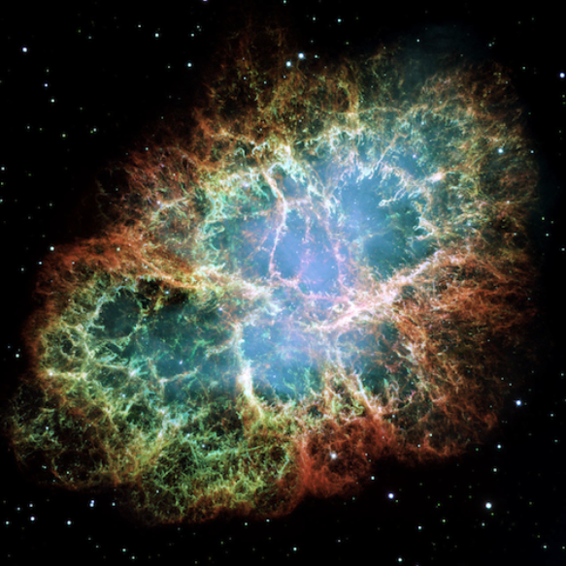
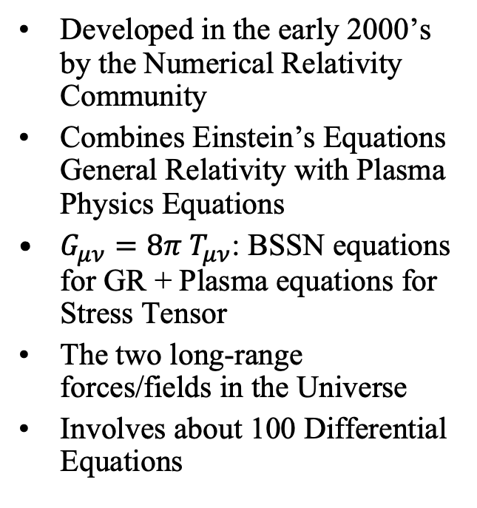
GRMHD
Developed in the early 2000’s by the Numerical Relativity Community
Combines Einstein’s Equations General Relativity with Plasma Physics Equations
$G_{μν}=8π{ T}_{μν}$: BSSN equations for GR + Plasma equations for Stress Tensor
The two long-range forces/fields in the Universe
Involves about 100 Differential Equations

Slide 8
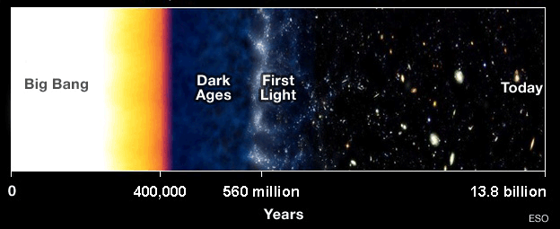
Experiment
Build a model of the Early Universe and let it run
Determine initial conditions: before the EW Phase Transition
Utilize a scale where General Relativity and Plasma Physics is relevant but QM isn’t
Analyze the results
Repeat focusing on areas of interest

Slide 9
Computational Conditions
Code developed in Cactus utilizing GRMHD equations and a modified version of BSSN
All runs utilized 128³ internal grid points on the UH Sabine Cluster
Adaptive time-step method and Spectral Differencing used
Simulation domain ~29 Gpc (or smaller), adjusted for scale factor
Initial scalar, vector and tensor perturbations f(k)

Slide 10
Initial Conditions
Energy = 246 GeV
Temperature = 2.85 x 10¹⁵ K
Thermal Degrees of Freedom = 106.75
Scale Factor = 9.58 x 10⁻¹⁶
Initial Time = 3.87 x 10⁻¹² s
Plasma Density = 6.7 x 10¹⁸ kg/m³
Specific Energy = 480,615
Dark Matter Density = 3.6 x 10¹⁹ kg/m³
Radiation Density = 2.96 x 10³¹ J/c² m³
Cosmological Constant = 9.94 x 10⁻³⁶ s⁻¹
Velocity Perturbations: EW = 3.6 x 10⁻³, QCD = 3.6 x 10⁻⁶
Scalar Perturbations: 𝛿_{m} = 𝛿_{T} = 𝛿_{d} = 7.0 x 10⁻¹²

Slide 11
Reference
Initial Conditions for GRMHD Simulations of Electroweak and QCD Phase Transitions in the Early Universe by Joshua Barerra, Aleisha Warren and David Garrison, Class. Quantum Grav. 40 215012, https://doi.org/10.1088/1361-6382/acfd00 (2023).

Slide 12
How Primary Values Change over Time

Slide 13
How Perturbations Change vs Scale Factor

Slide 14
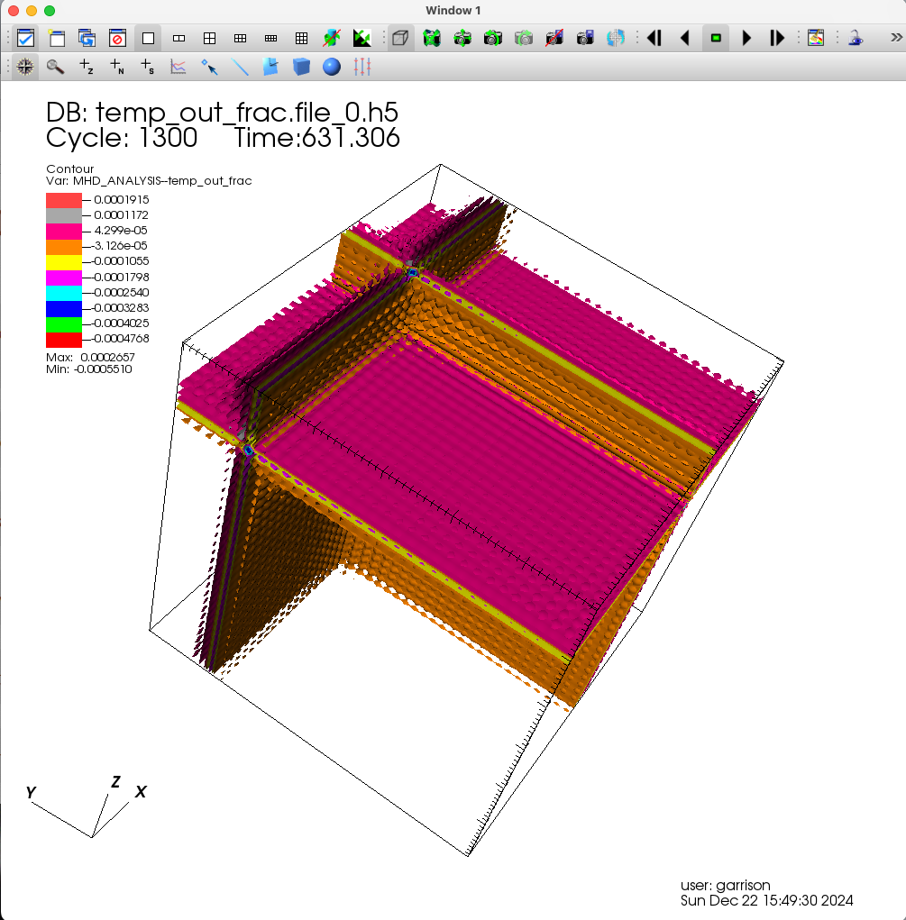
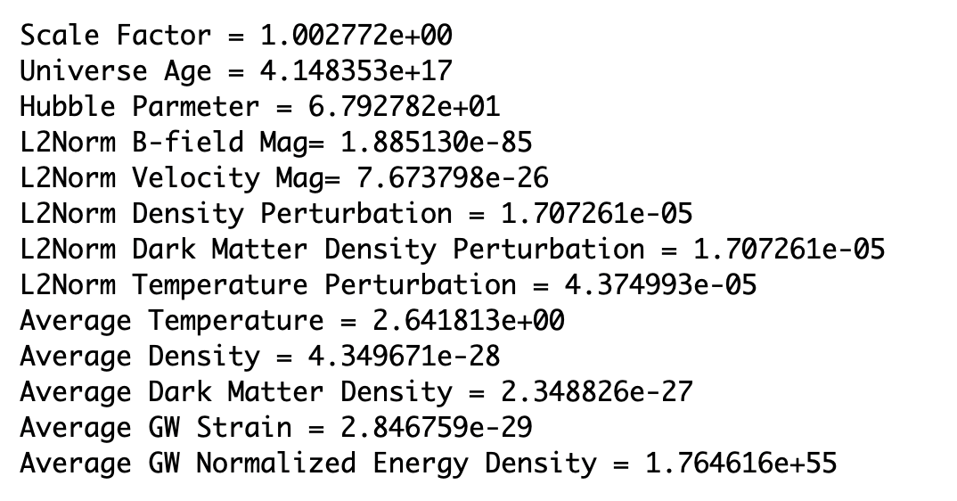
Final Values – Density Pert

Slide 15
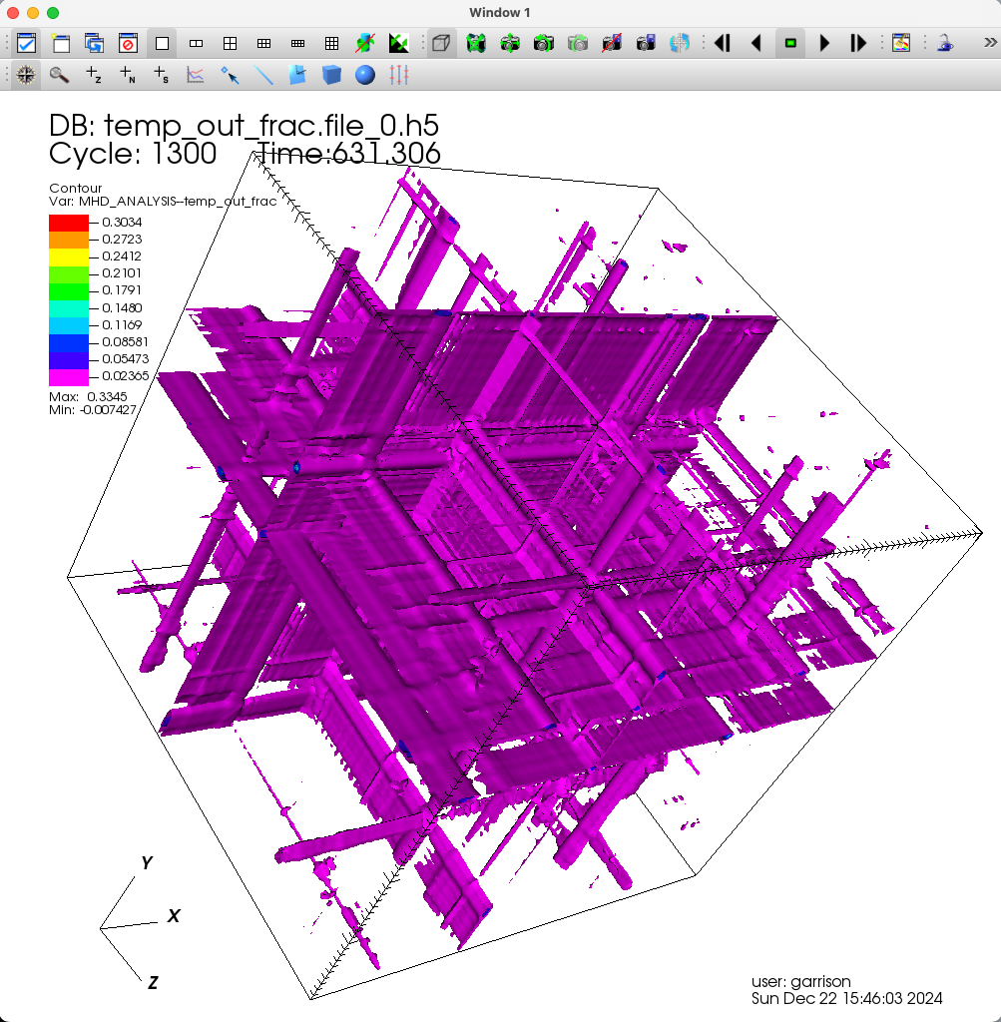
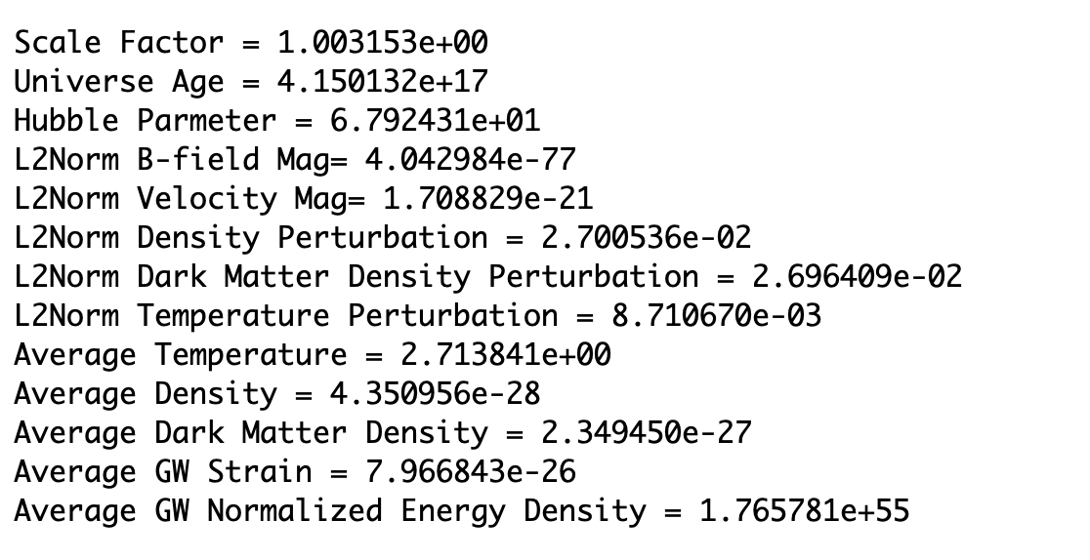
Final Values – Phase Transition

Slide 16
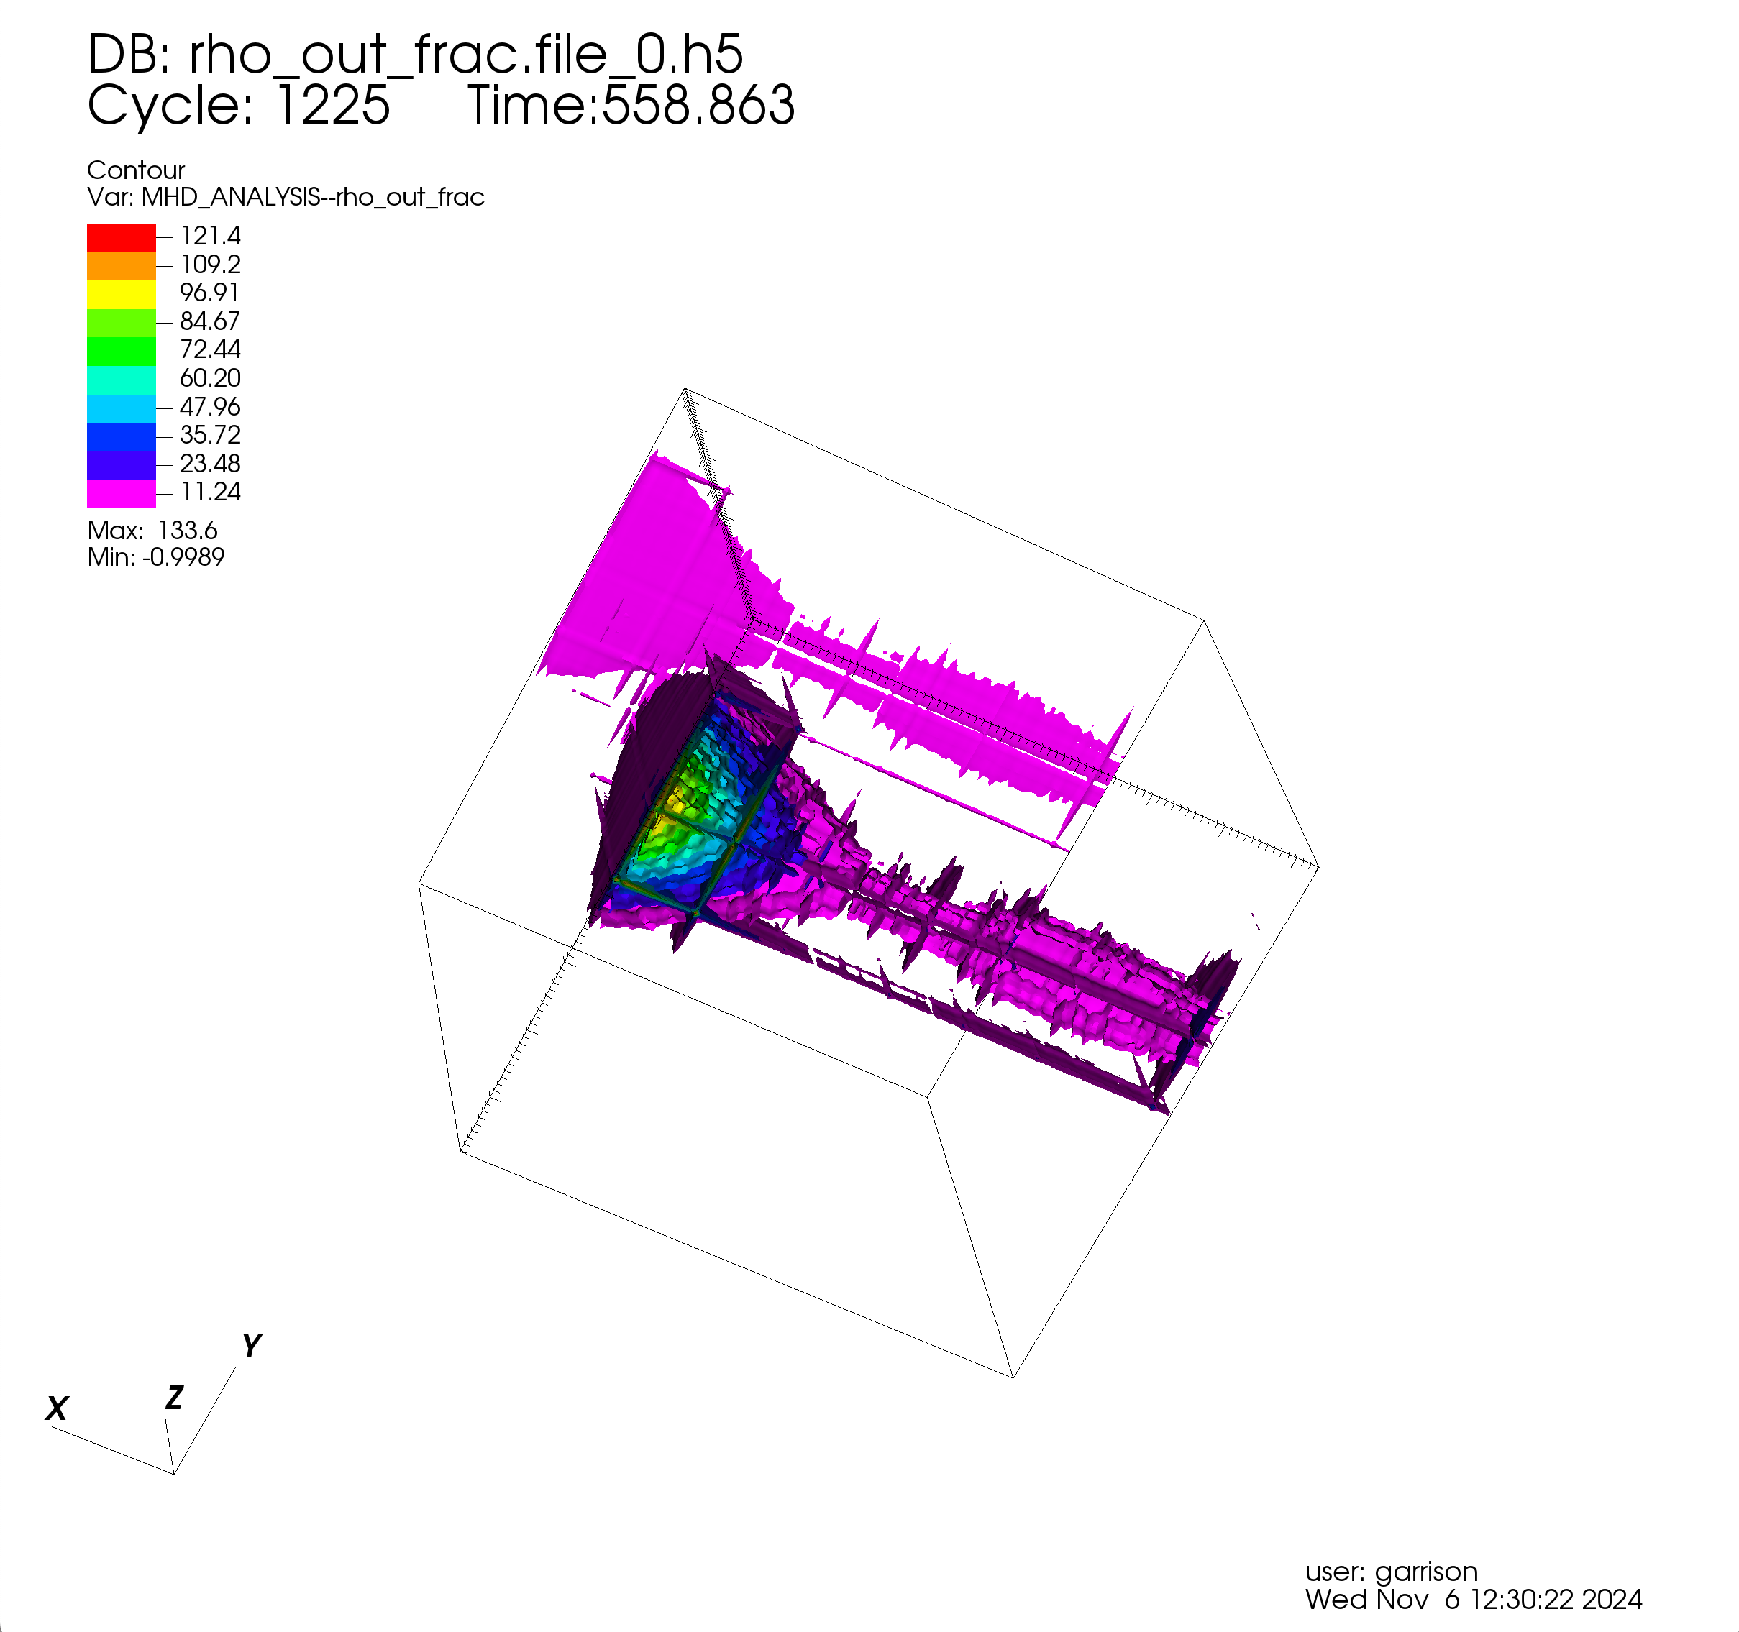
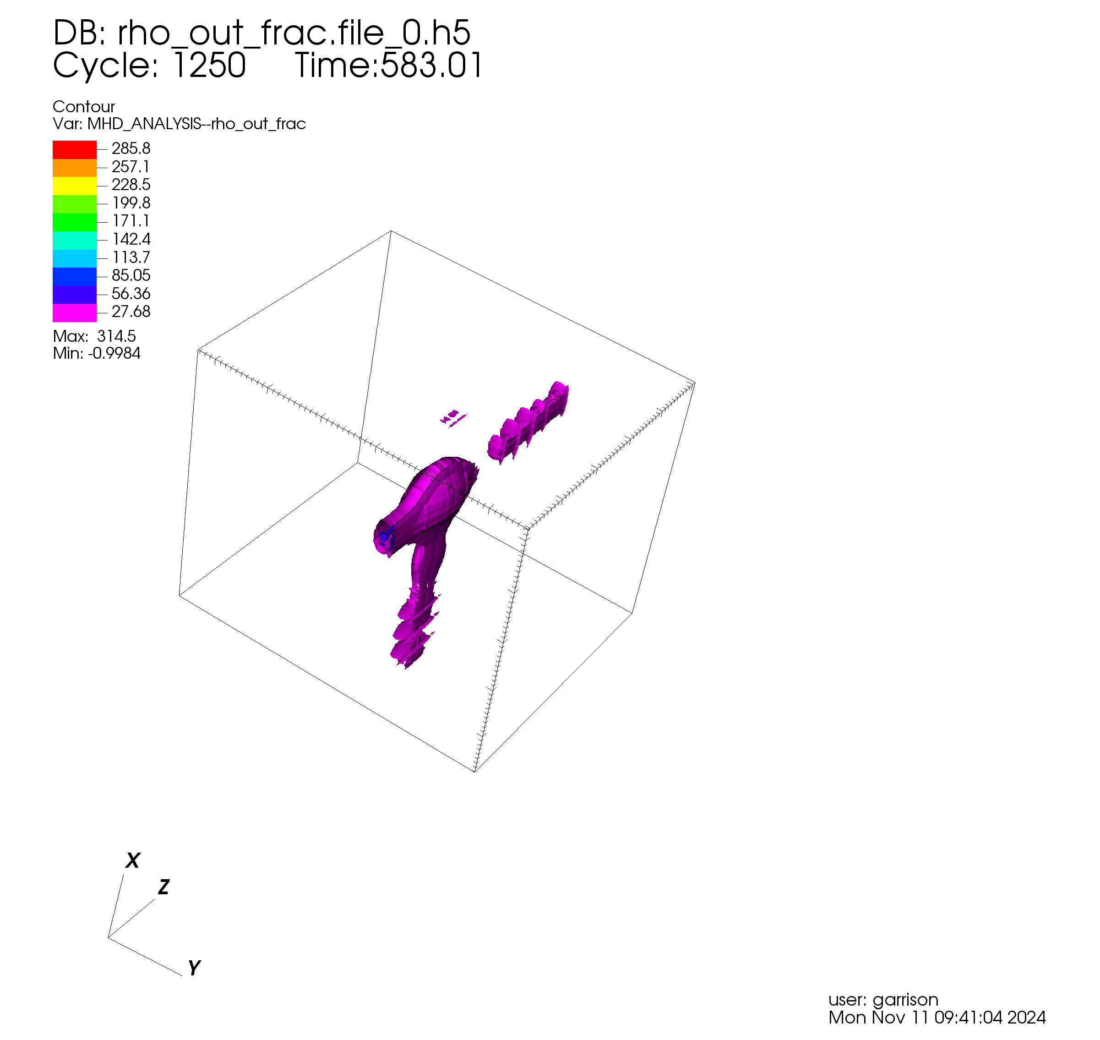
Re - Scale

Slide 17
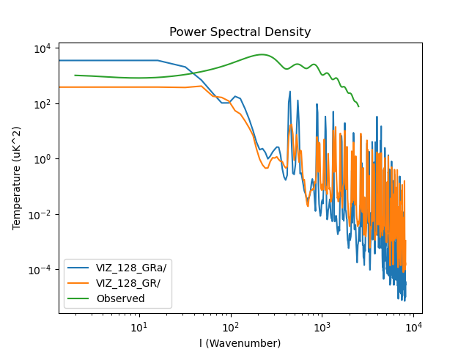
Diffusion Dampening

Slide 18
What we have learned…
The EW and QCD Phase Transitions could not have been 1st order w/o disrupting universal evolution
Maintaining a Flat Universe requires the critical and total mass/energy density to be the same (less than our computer’s round-off error)
Structure formation could have resulted from a combination of Phase Transitions and Inflation or possibly just from Phase Transitions

Slide 19
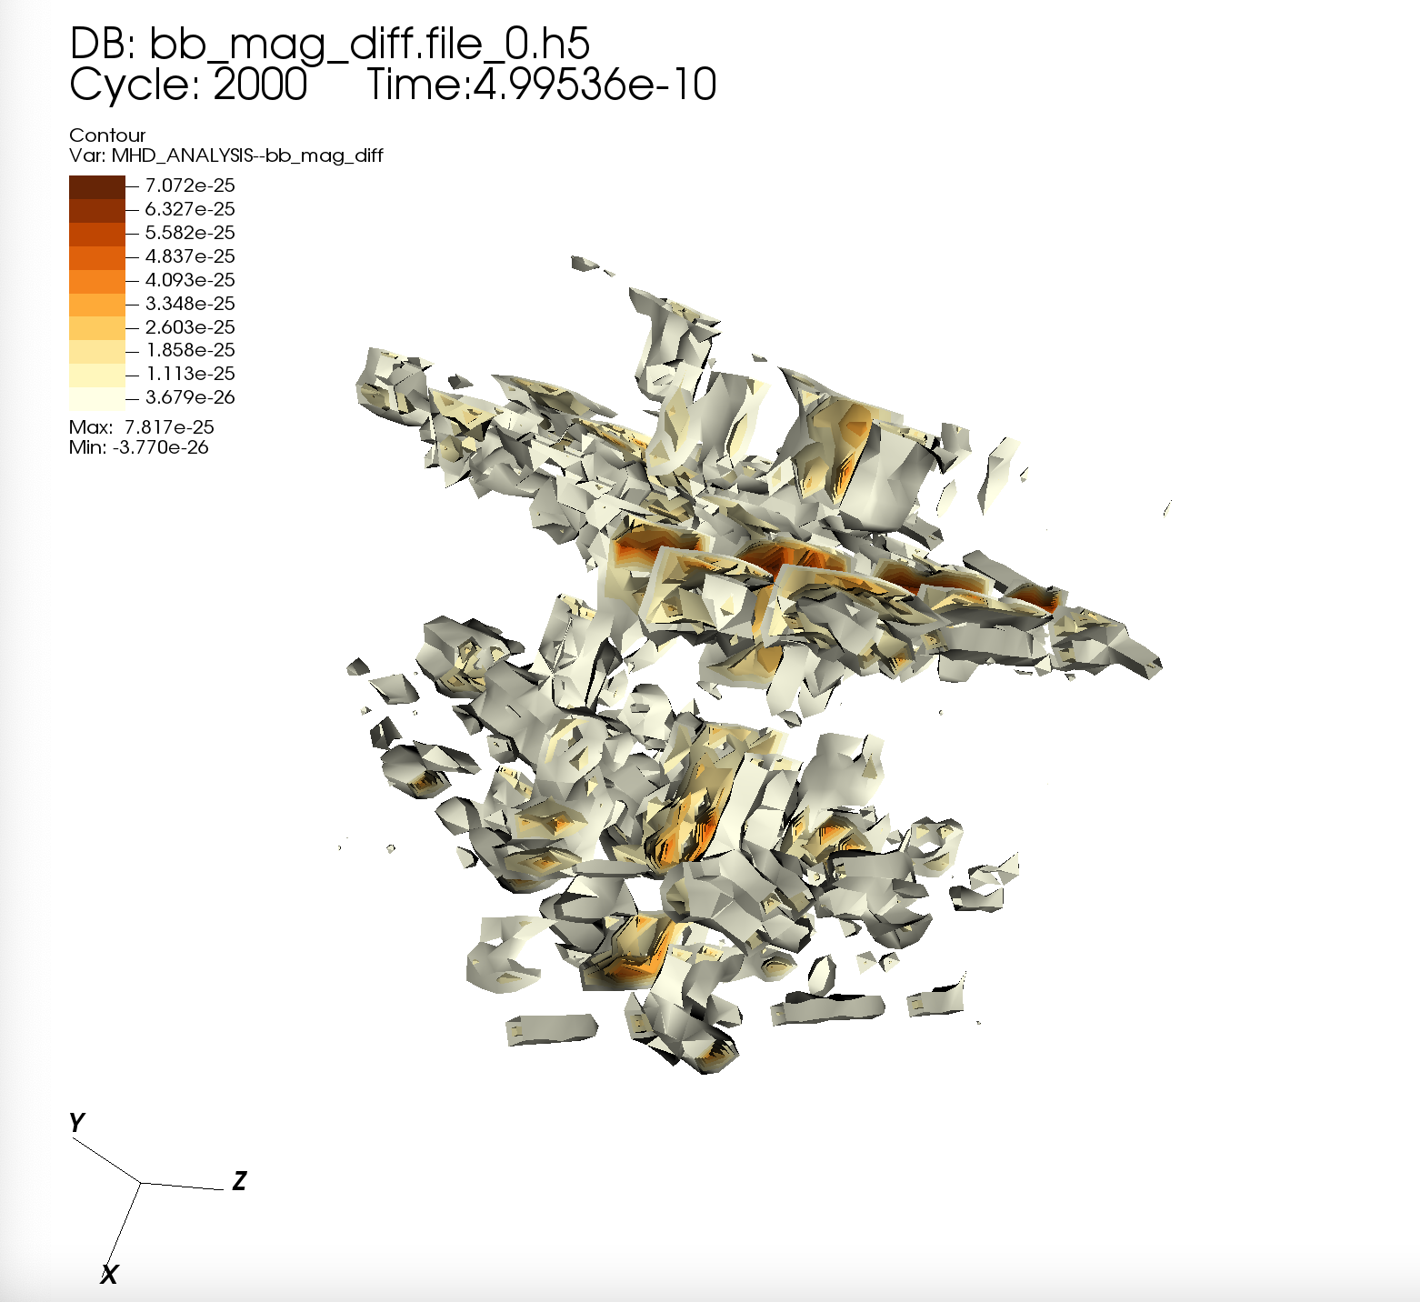
Questions???

Slide 20
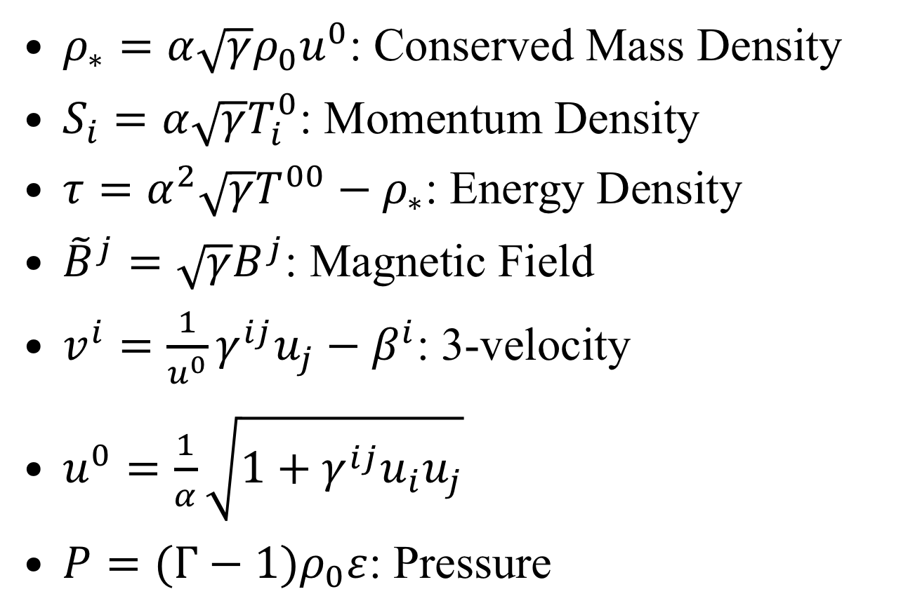
GRMHD Variables

Slide 21
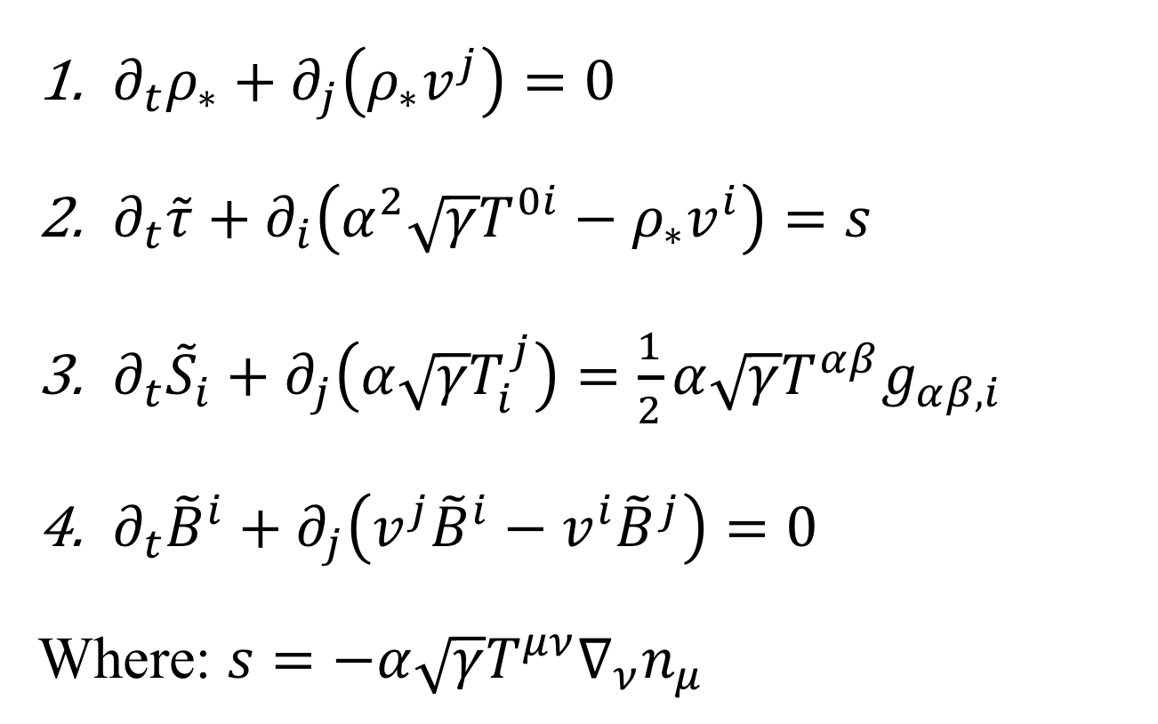
GRMHD Equations

