Slide 1
pfRICH Laser System PED Update Trace Pro Simulations: Diffuser Profile
Bob Azmoun (BNL), Dan Cacace, Bill Li (MSU)

Slide 2
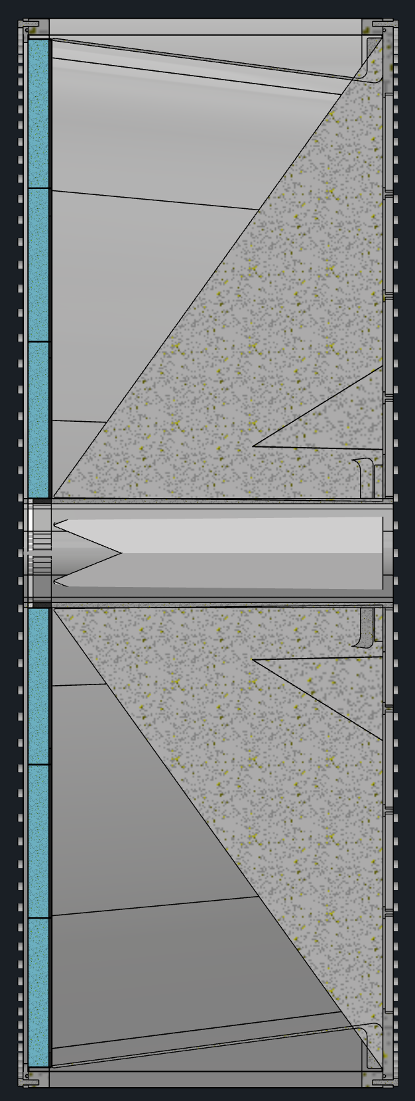
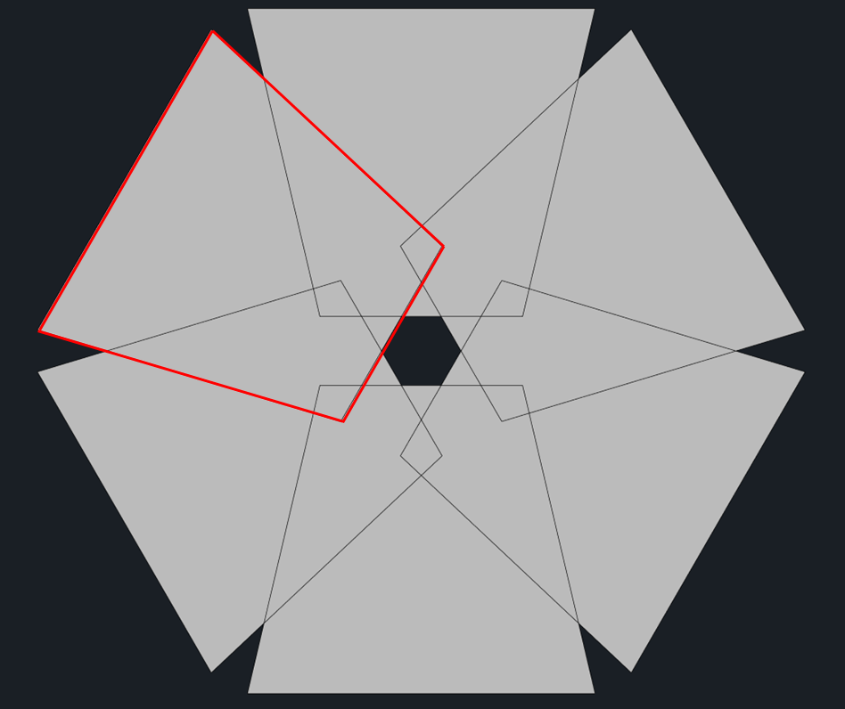
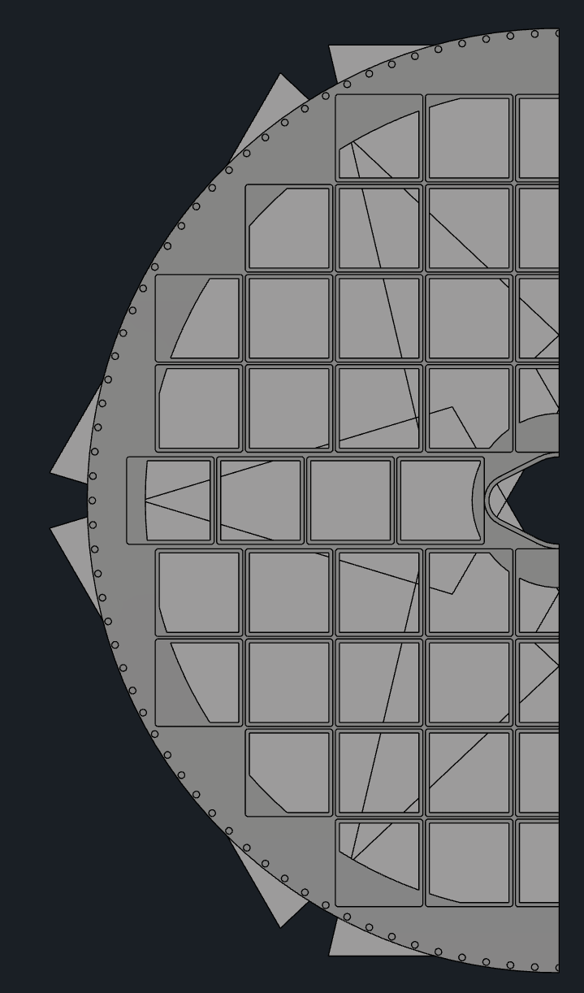
RECAP: Method of Light Delivery
Outer mirror
Array of 6 fibers may be used for direct illumination of HRPPDs + array 6 fibers may be used to reflect light off of the mirrors
Light profiles from 6 fibers for direct illumination
HRPPD coverage
Here 1 of 6 fibers directly illuminates a HRPPD from gap between inner mirror and aerogel
*Tilt angle of fiber is critical to minimize reflections from mirror; can also use baffle to better shape light profile
Inner mirror
The light path from a given fiber to a HRPPD pixel defines the photon flight length
A radially divergent profile is a good match for the annular shape of the HRPPD sense plane
Aerogel
HRPPD
Light profile from a single fiber on the HRPPD sense plane
*Overlapping profiles can be separated in time using different length fibers
pfRICH Vessel
6 fibers for direct HRPPD illumination + 6 fibers for the mirror illumination should suffice to illuminate all HRPPD pixels

Slide 3

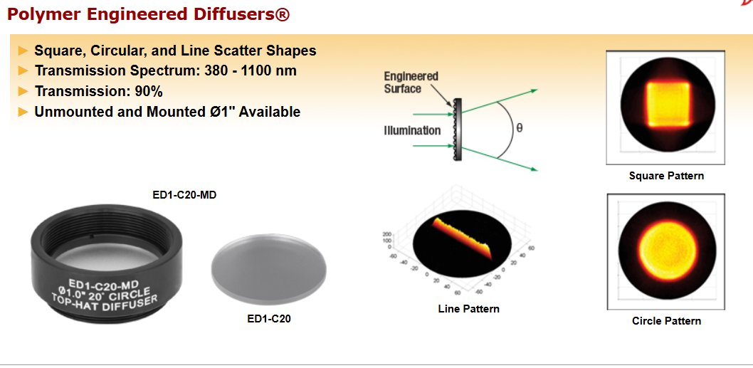
Compare simulated profile to actual profile

Slide 4
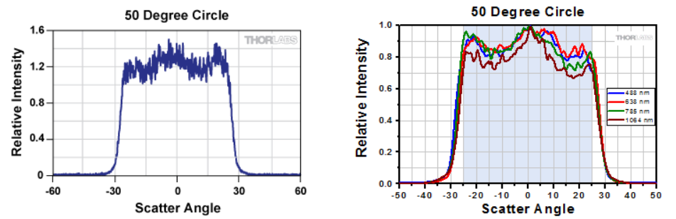
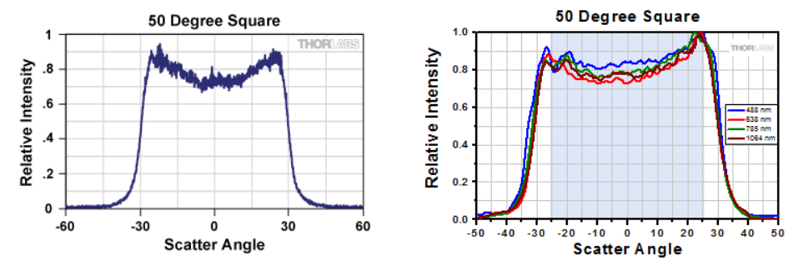
Thorlabs: Square vs circular profile/footprint
Actual angular spread:
47ºx45º

Slide 5
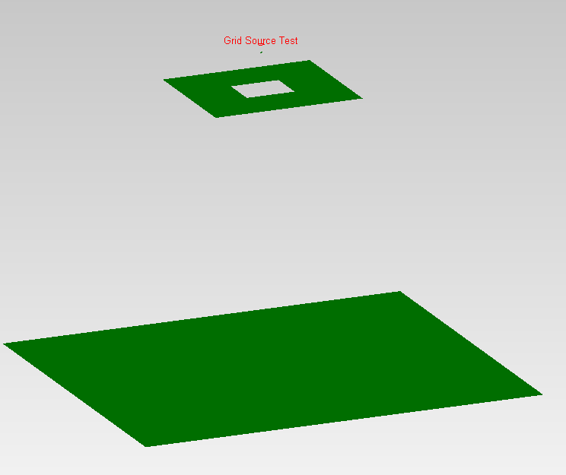
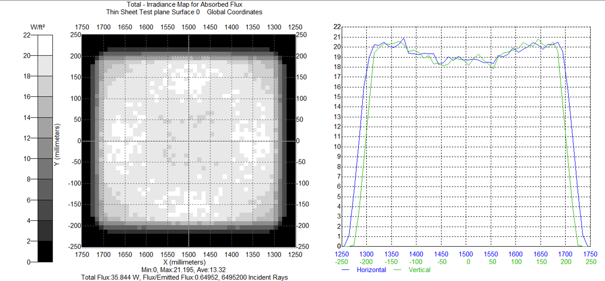
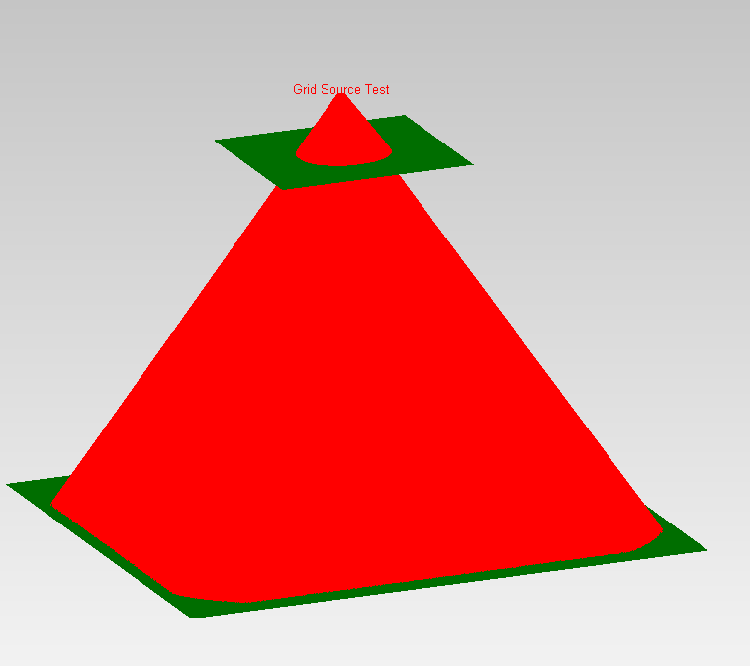
Ray Trace Sim: Light Profile of un-tilted fiber tip
47x45 deg (full angle),
Flat top distr. pattern
I engineer a square shaped flat top profile through the use of a series of apertures
A square shaped aperture is among the apertures used to shape the circular profile available in TracePro

Slide 6
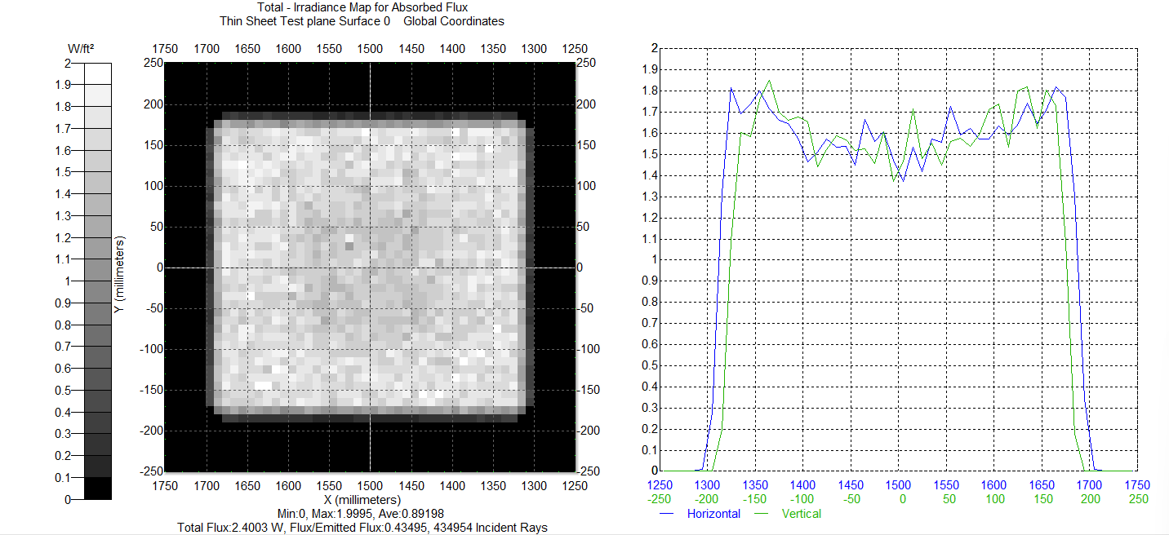
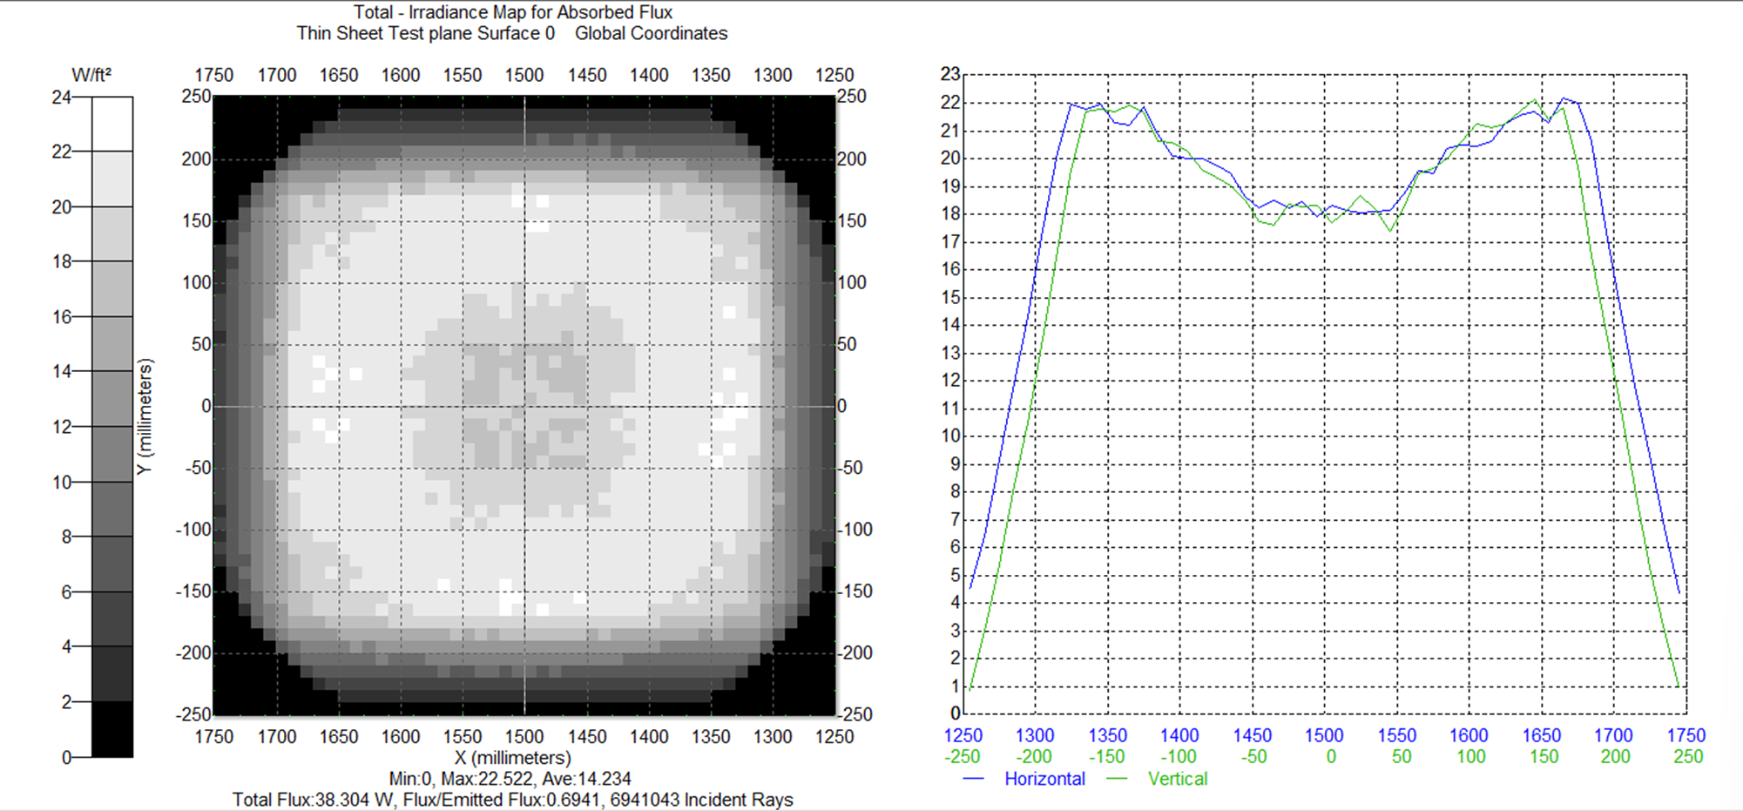
Iterate geometry of beam shaping optics

Slide 7


Found optimum profile by simply comparing X and Y profiles from the manufacturer

Slide 8
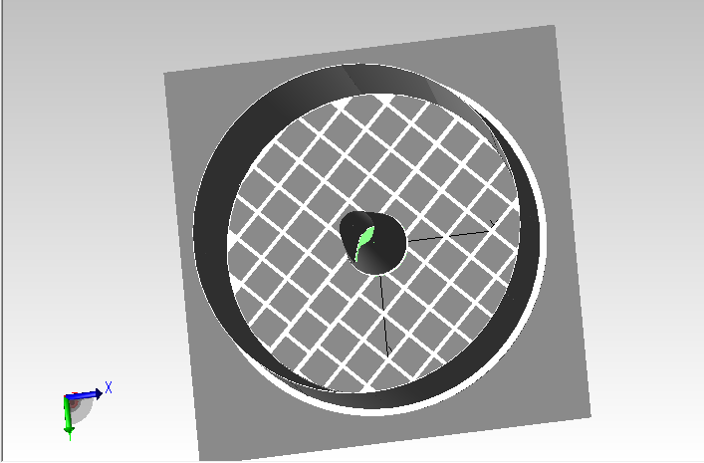
Import pfRICH model into TracePro

Slide 9
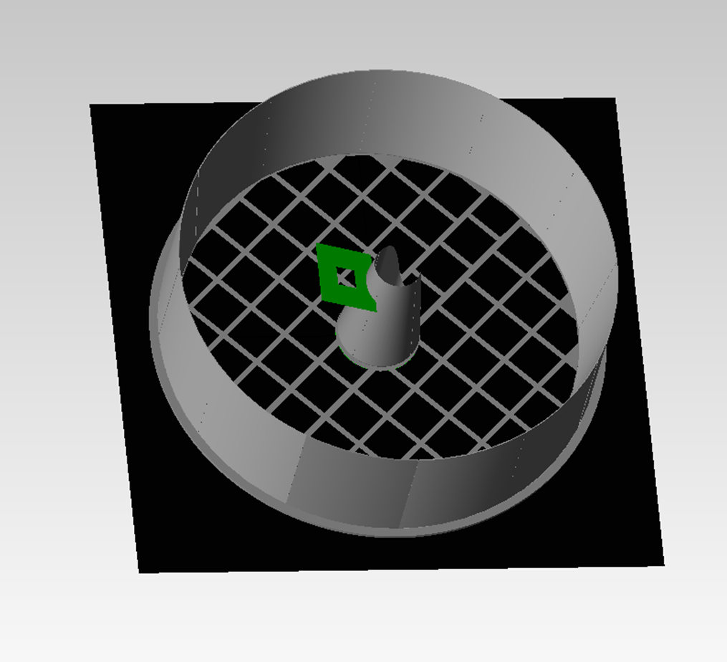
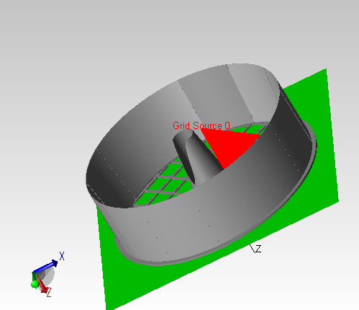
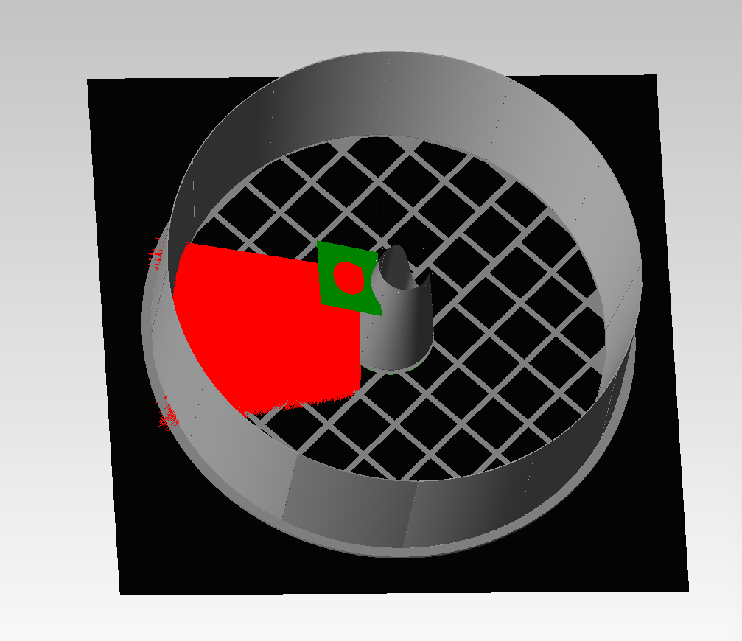
Single Fiber Light Source (Fiber tip Tilted at 24.2deg)
Series of 2 apertures used to engineer intensity profile
Fiber cone output, tilted at 24.2deg
Square shaped intensity profile on sense plane from a single fiber source

Slide 10
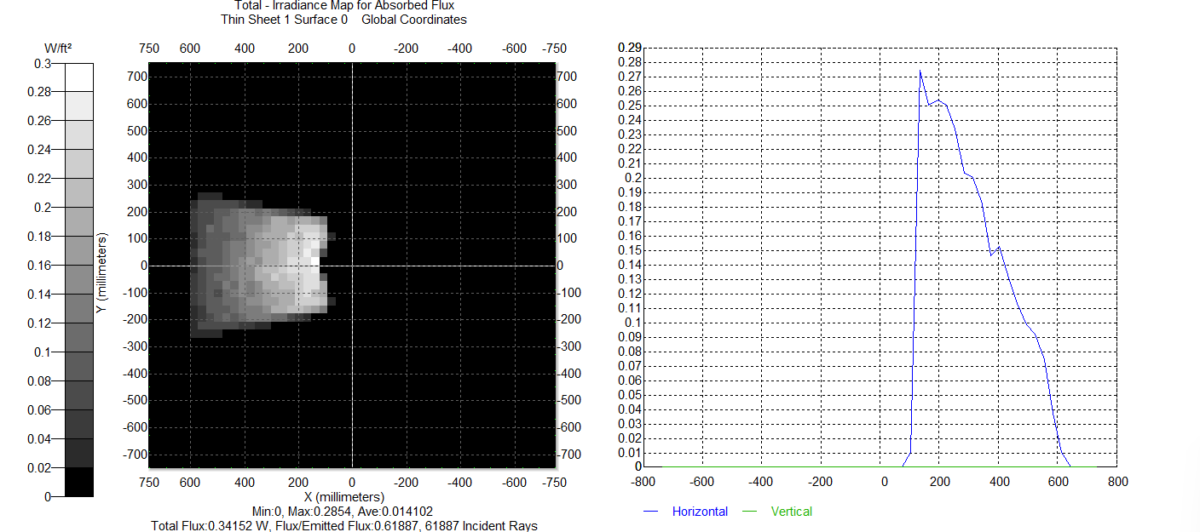
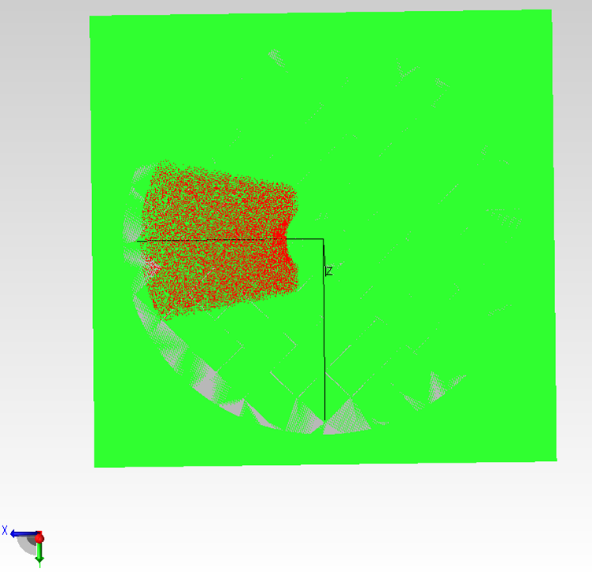
Profile from single light source tilted at 24.2deg
The lateral and angular positioning of the light source is not yet optimized – this was a first attempt
The goal is to use an array of 6 fibers to deliver photons to the HRPPD pixels without reflections and a 2nd set of 6 fibers to deliver photons after a single reflection (not studied here)
Already we can see quite a bit of reflections from the inner mirror

Slide 11
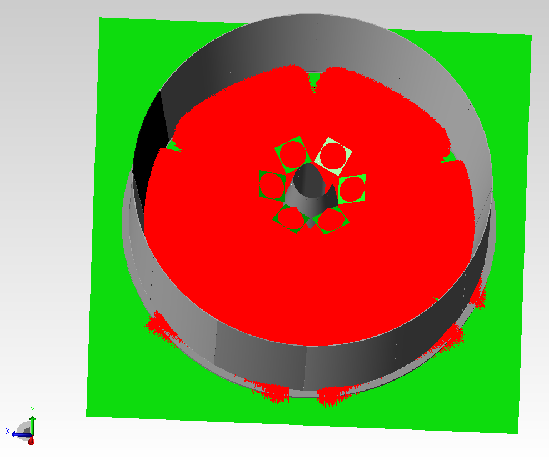
Array of 6 Tilted Fiber Sources: Mirrors are made to be Reflective in this model
The fiber tip is tilted at 24.2 deg in an attempt to efficiently fill active area, but there is room for optimization
The main constraint is the 47º x 45º divergence angle of the diffusers (this is the max angle available); virtually all geometric parameters may be tweaked

Slide 12
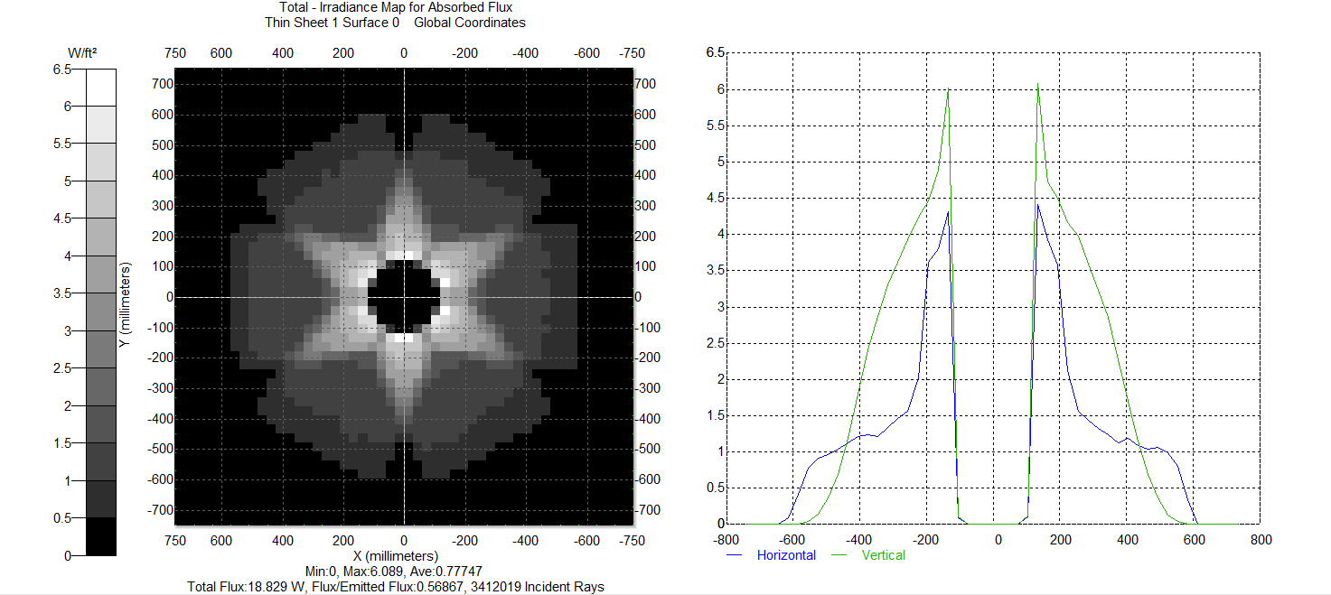
Profile from array of 6 fiber/diffuser sources
1st impression: Using an array of 6 fiber sources with a 47x45deg opening angle and flat top distr., with the fiber tips tilted at 24.2deg. does a reasonable job of filling active area, ie diffusers with such an opening angle will work
The profile on the right is not very uniform, but may be optimized, as mentioned
In any case, this is our justification for proceeding with the MOQ purchase of the Thorlabs custom 5mm x 5mm diffusers for ~$4K

Slide 13
Next Steps for the Simulation studies
Need to upgrade TracePro package to include scripting language so a range of source geometries may be studied and then optimized (up until now all geometry parameters are entered manually)
A student from MSU is willing to take on this job
We will also study the 2nd set of fibers which will be tilted toward the outer mirror to deliver reflected photons to the sense plane

Slide 14
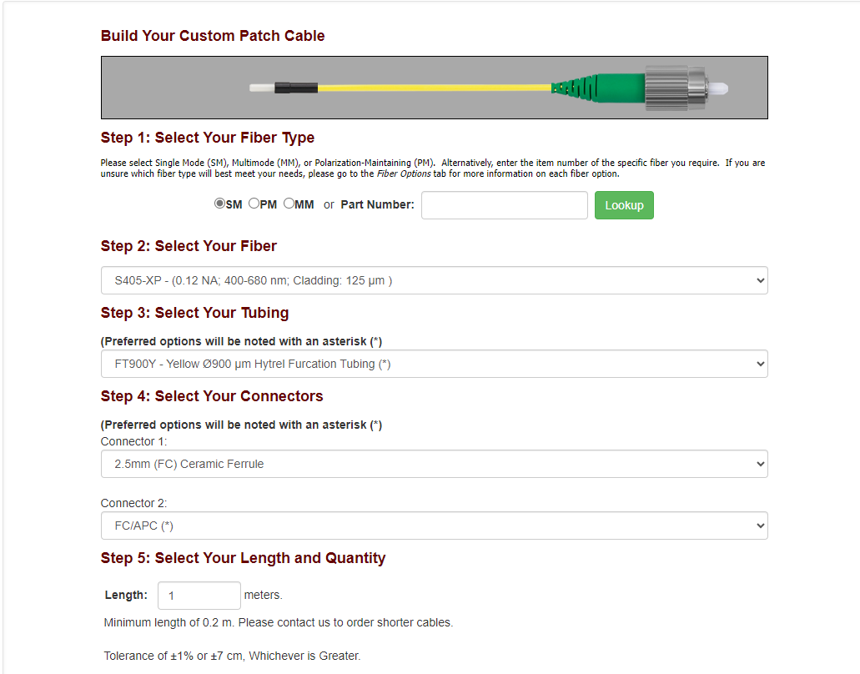
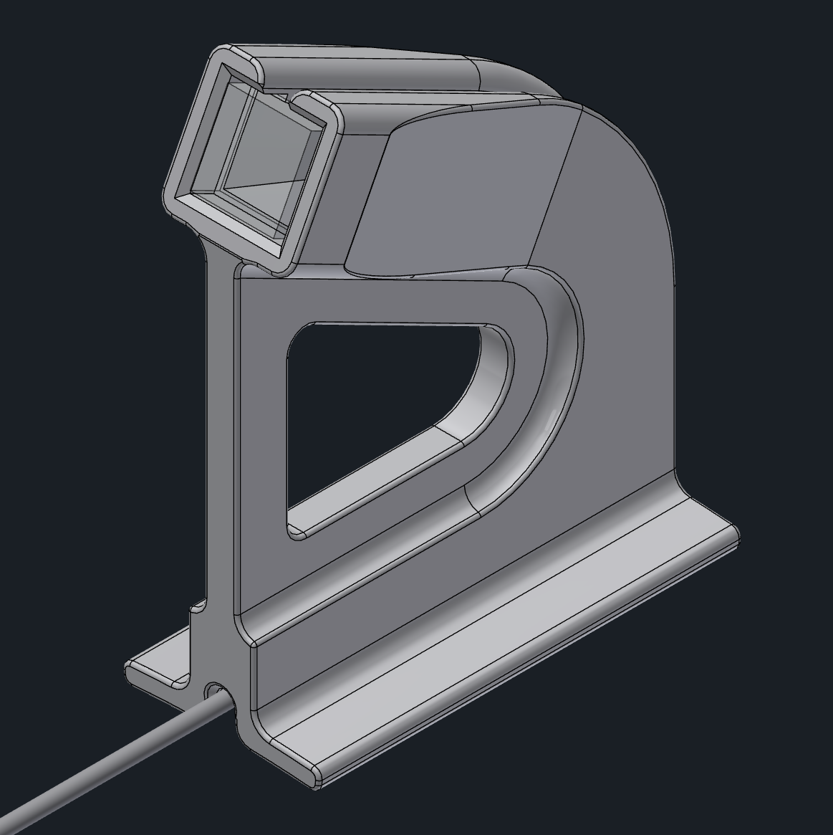
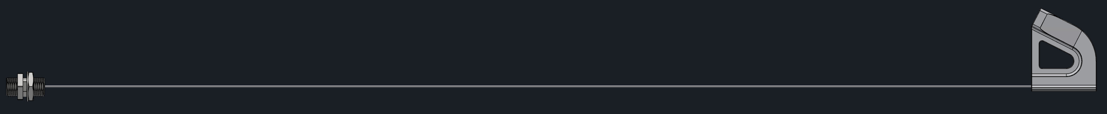
Some updates on the engineering of critical parts
Fiber termination
Fiber holder
Fiber routing

