Slide 1
Astrolinx
Bi-Weekly Update

Slide 2
Changes Overview
Most lines through flex region
Added power regulators for 1V8D, 1V8A, 1V2, 0V7
Moved solder bridges (for routing to chip pads)
Moved upstream connector to bottom of board

Slide 3
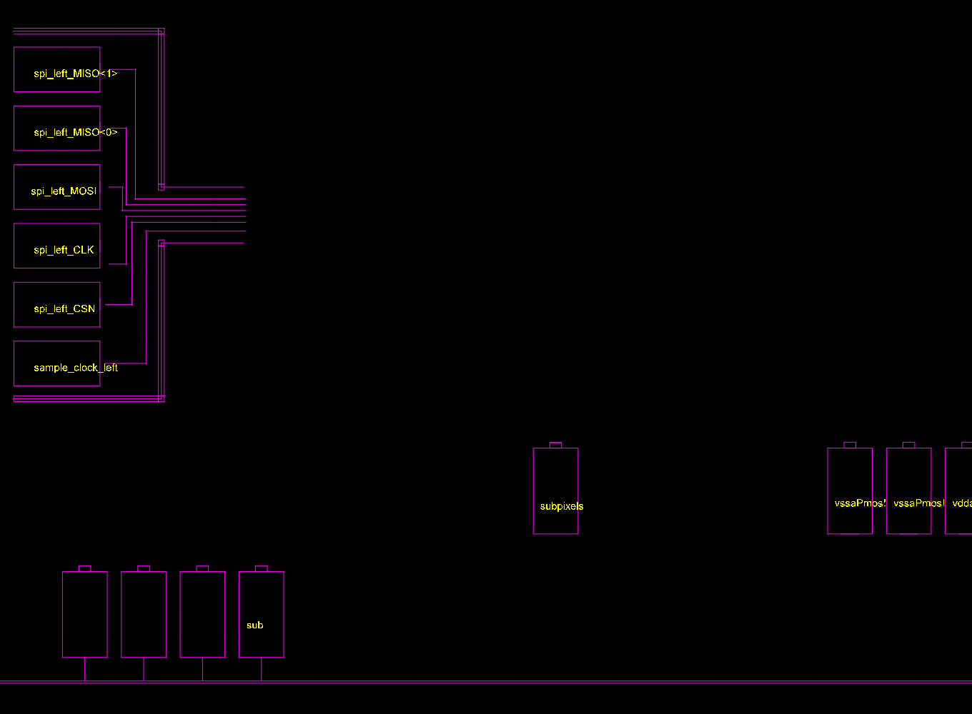
Breakout Update
Added ‘sub’ pad (assuming the ‘sub!’ that should be the HV net)
Orange box

Slide 4
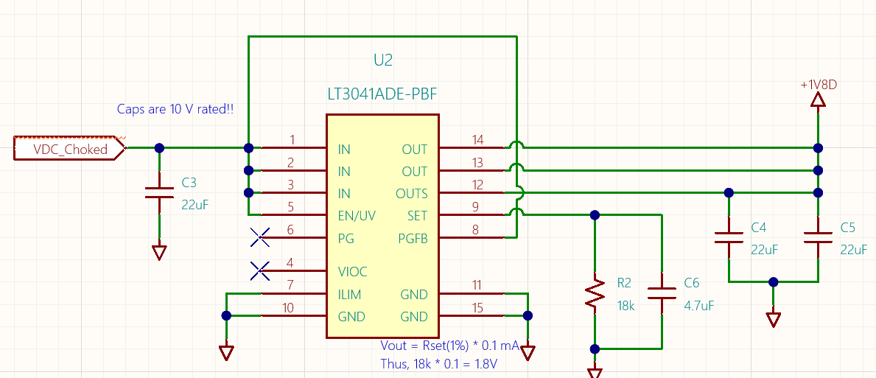
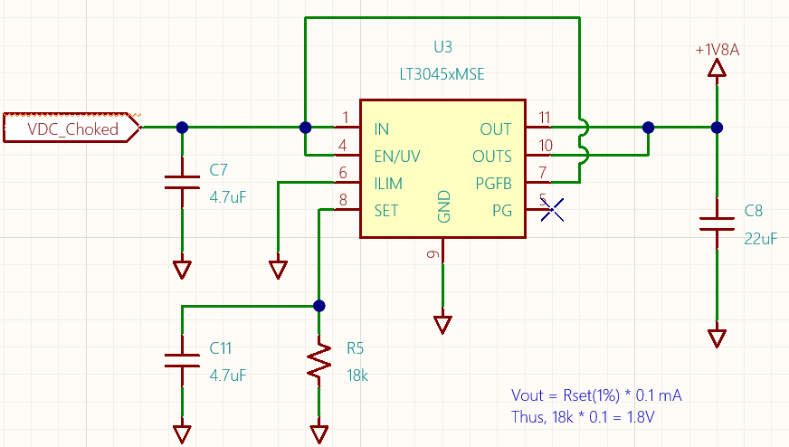
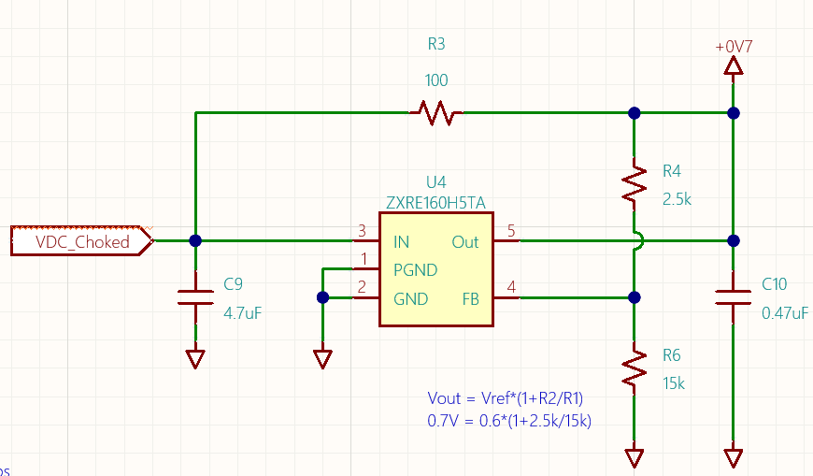
Power Circuits
Copied 0V7, 1V8A, 1V8D circuits from 9 chip board
Replicated 0V7 with resistor difference to make 1V2
These are the circuits from the test board
Our circuits next slide
VDC_choked discussed in following slide

Slide 5
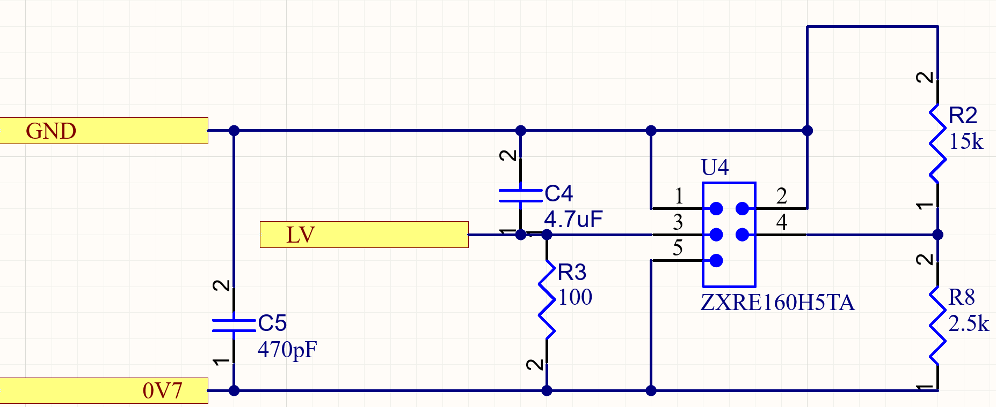
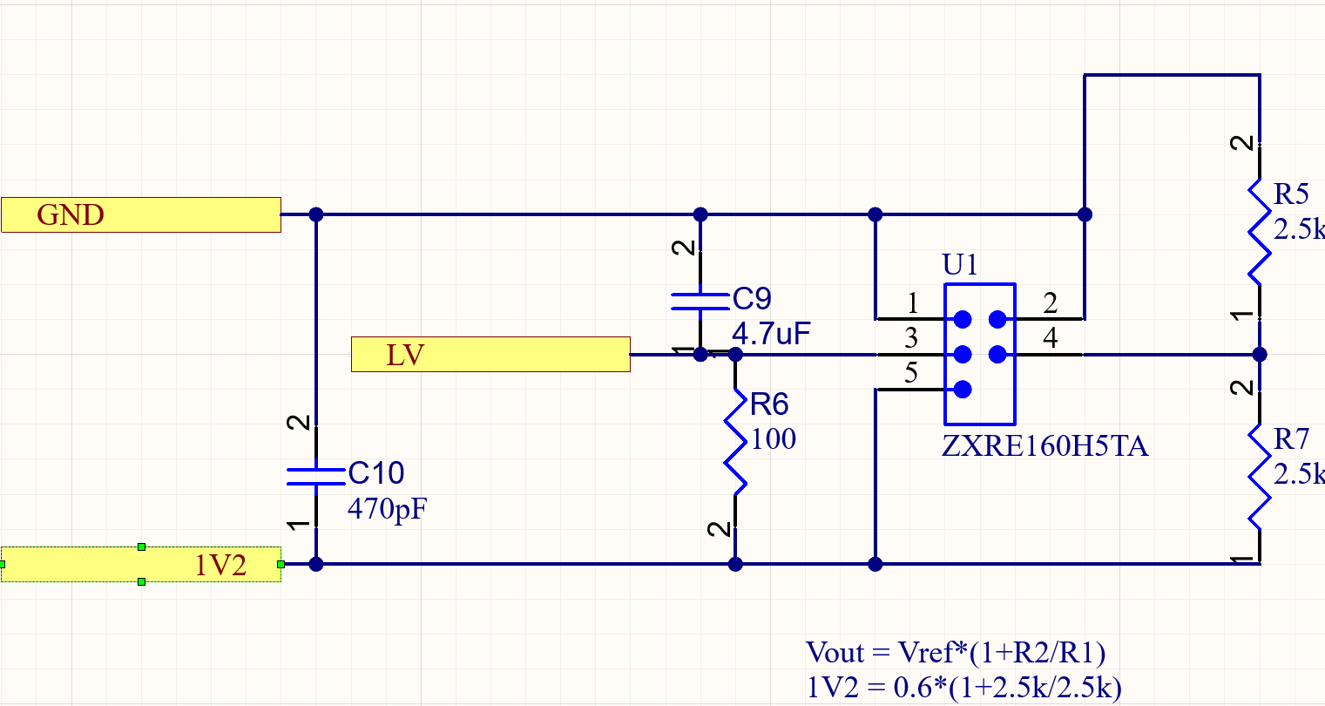
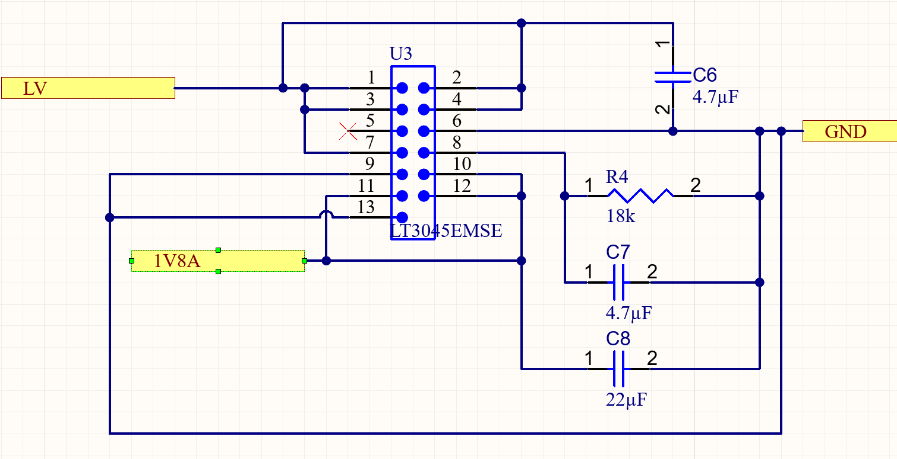
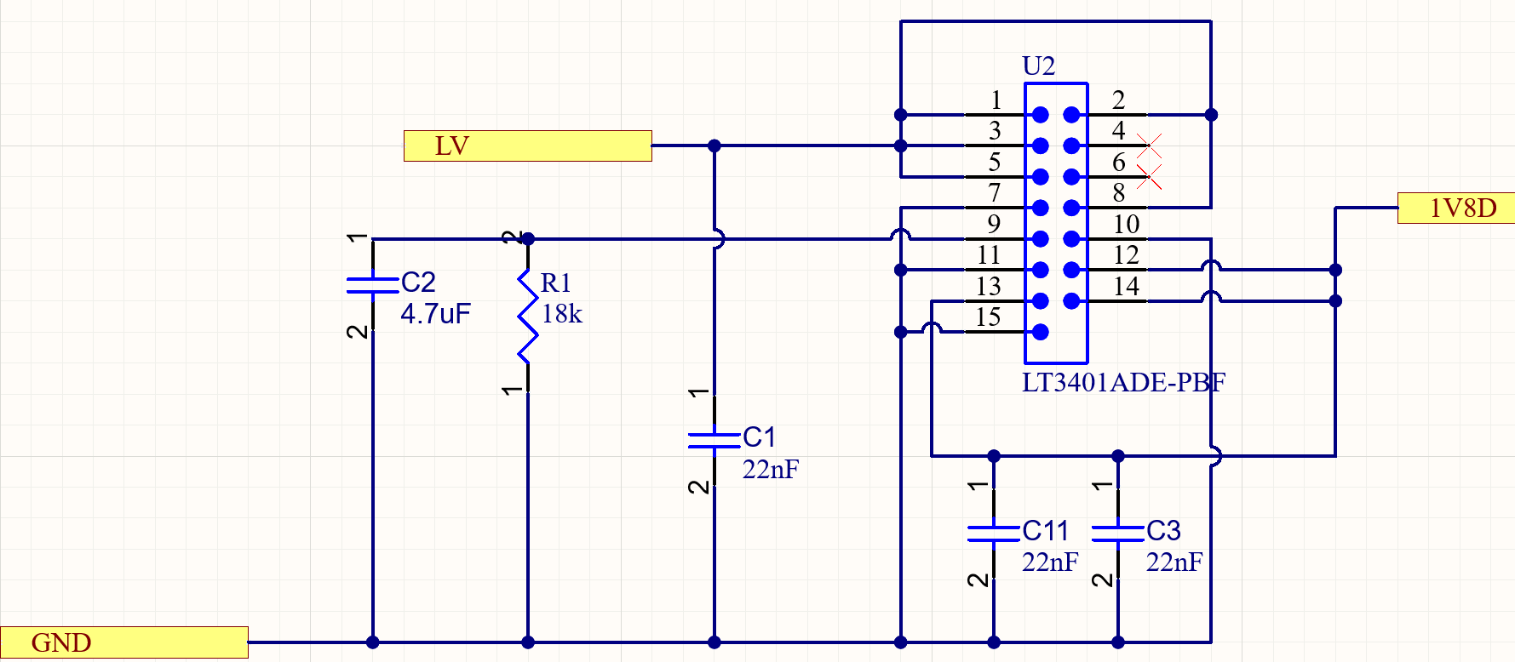
Power Circuits
VDC_choked (from the test board) will be called LV on Astrolinx

Slide 6
Power Circuits
LV needs to be >3V at the farthest board to allow for correct regulation
From the power table (right), the total W of a single PCB is 1.78 W. A full tray of 12 boards needs 21.36 W. Current is then 21.36/LV (in this case say 6V) is 3.56A. Our current design has drop of ~43mV. Therefore, a full tray has 516mV drop and would sufficiently maintain voltage to the last regulator
Where as 6V would theoretically get the job done, a higher voltage means less drop across each board and better security of voltage regulation. Could you supply 9V?

Slide 7
INT and CS Solder Bridges (Updated)
INTS are on right, unlabeled as of now

Slide 8
Board Updates – Chip Wirebonds
Image below is updated footprint. Includes ‘sub’ pad on far left for HV net.

Slide 9
Power Circuits
Image is all four circuits set on the top layer. Polygons are used for power dissipation. As of now, the voltages are unconnected, but represented in the tracks labeled
Only 1V8A regulator 3d model is shown
1V2
0V7
1V8A
1V8D

Slide 10
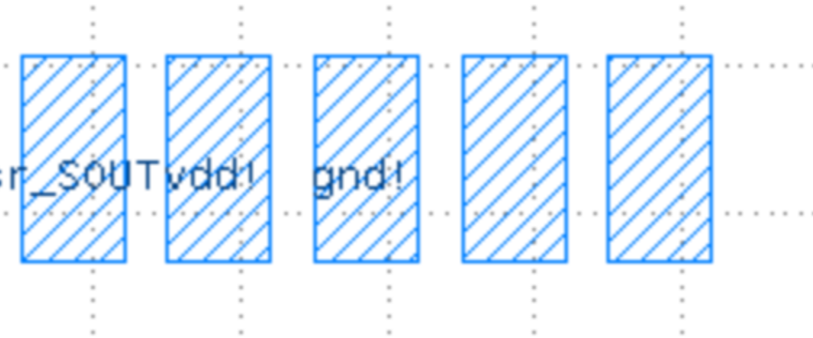
Questions
What pad does gets the 0V7 net?
Is ‘VDD’ pad VDDD? What net is that?

