Slide 1
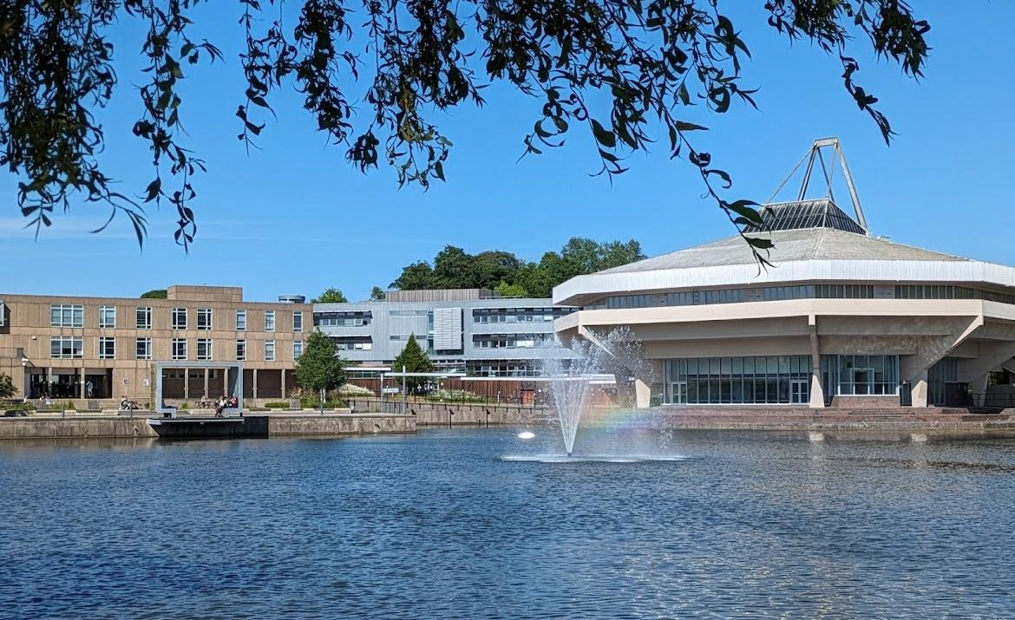
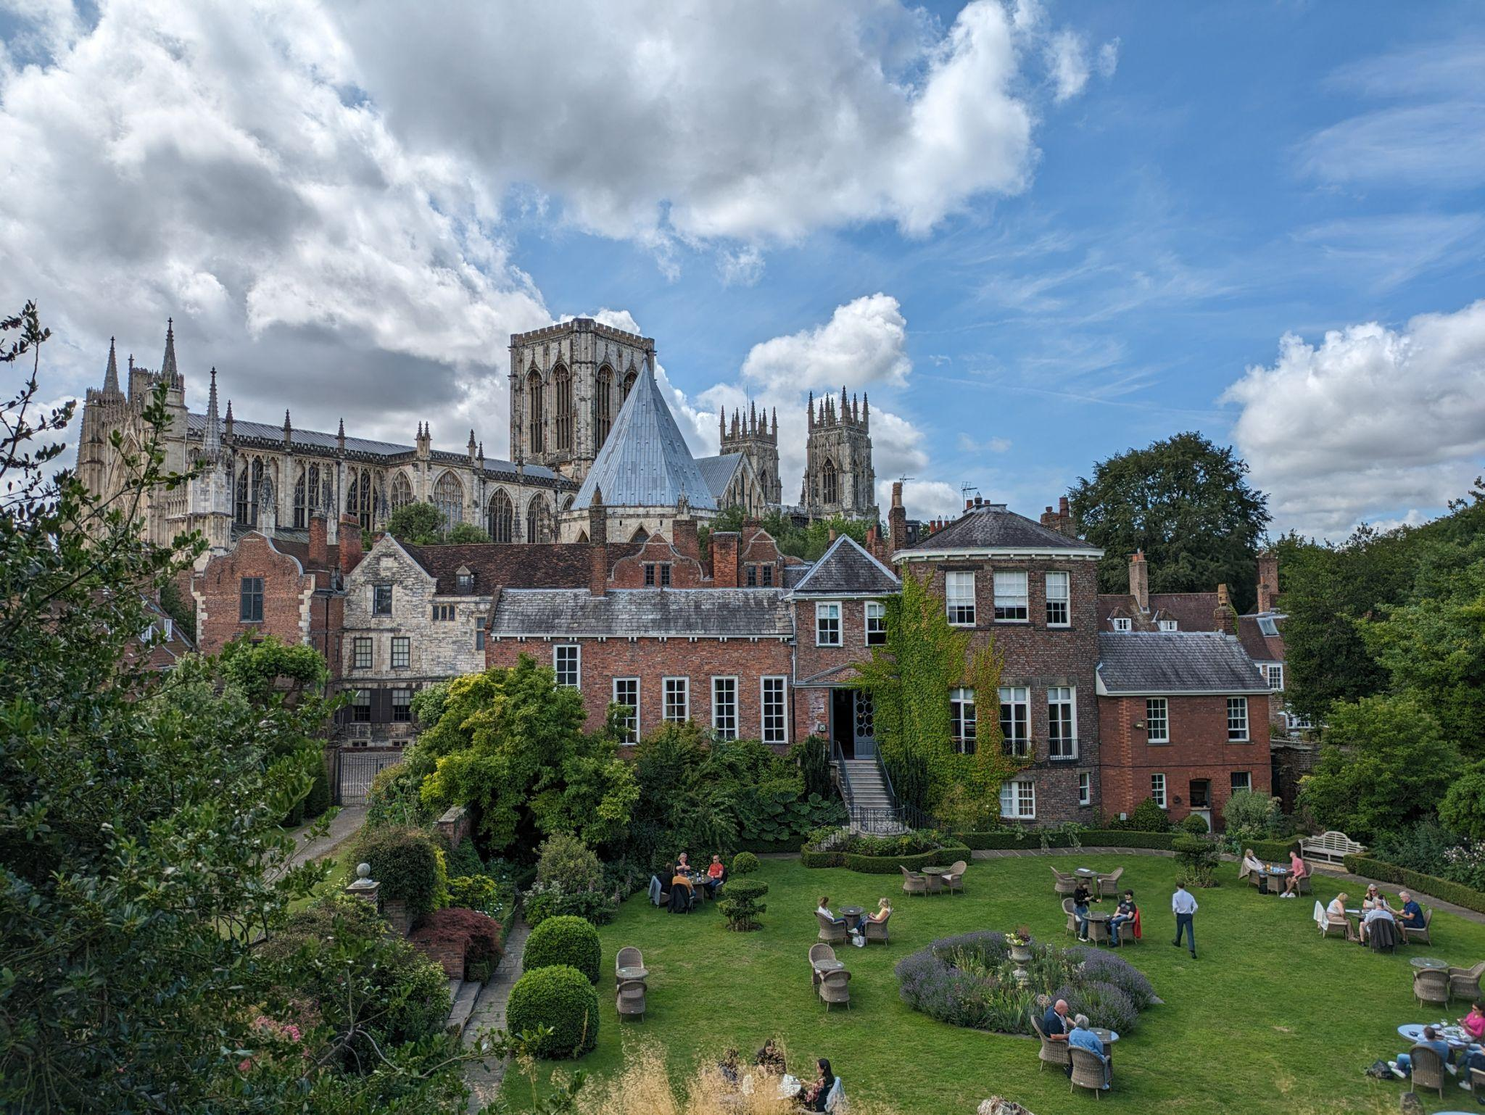

IR Design - Input from Lumi Group
Discussion/Comments on Request
Stephen JD Kay, Nicholas Zachariou, University of York
17/02/25

Slide 2
IR Design - Input From Lumi Group
Elke requested input from Luminosity group for some changes to the IR and the Lumi-Window
The requested input is outlined on the next few slides, with comments/discussion points

Slide 3
IR Design - Input From Lumi Group - Request 1
“All the requirements the lumi-window needs to fulfill, an example material thickness, and material uniformity…”
  Requirements are largely in terms of precision to which we know these things
  At Zeus, photon conversion in exit window contributed ~0.7% to overall systematic uncertainty (of ~1.8%)
    0.1% uncertainty from thickness
    0.3% from chemical composition
    0.6% from cross section
  Many of these are mitigated/improved upon by
    Sweeper magnet
    5σ obstruction free aperture
  But would expect comparable uncertainties from ePIC exit window

Slide 4
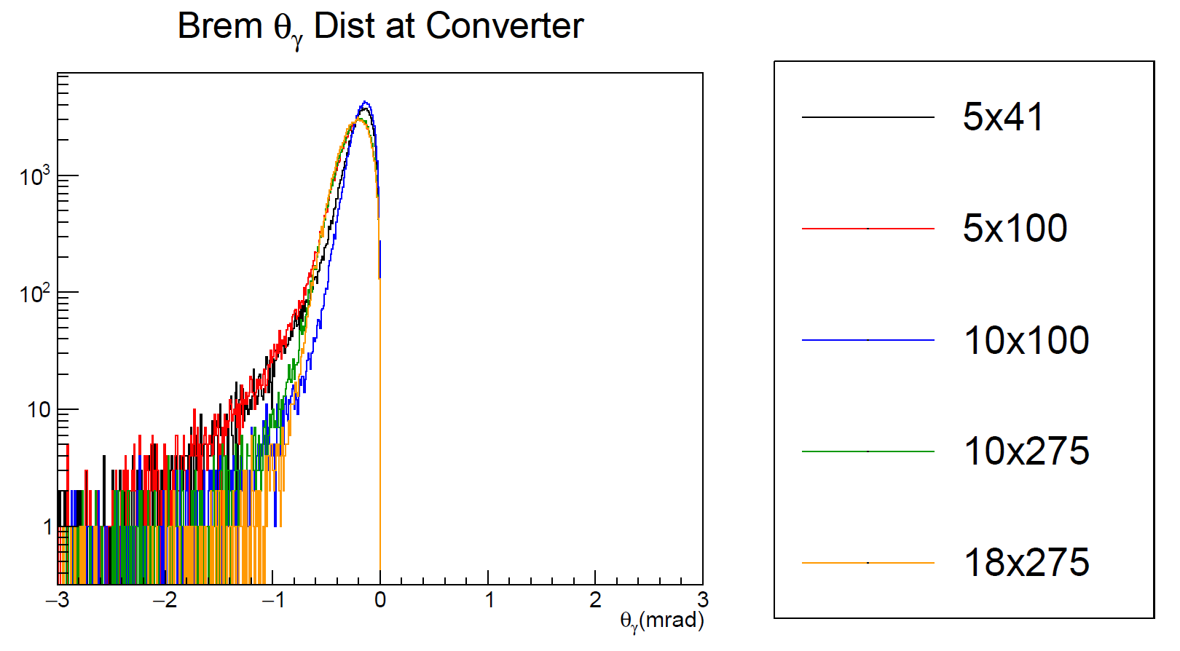
IR Design - Input From Lumi Group - Request 2
“We need for all energies 5, 10 and 18 GeV the distribution from the bethe-heitler photons with all bem effects included and we need this as a output from the MC generator, so we have all the info”
  This is straightforward, have run previously
  Will process large #events in range 0.1-Max GeV through generator/AB ASAP - produce updated versions of plots like those shown previously
    Will provide as HEPMC
    ROOT also possible
  Will re-run
    5x41
    10x100
    10x130
    10x275
    18x275
Notes:
Andrii Natochi - Wanted angular dist at window. Sync rad heating at window is enormous - 100 W per mm2! Wanted to know area over which window needs to be uniform and how uniform it needs to be in that region. Alex said 10x130 should actually work in AB - equivalent to 10x100, so could just force that. Script needs to know ion and electron energies too for BH spectrum generation.
..

Slide 5
IR Design - Input From Lumi Group - Request 3
“What you use as the most recent design of the lumi-window”
  Can provide latest geometry file from simulation (DD4HEP) used in lumi simulations
  Would note that for MC studies of the pair spec, the window doesn’t really factor in currently
    Generated photons from distribution are propagated to conversion foil and converted
    Saves simulation time (only want to look at detection of pairs)
  Can run directly with bremsstrahlung photon distribution as a test

Slide 6
IR Design - Input From Lumi Group - Request 4
“@Jarda a link to your generator and a description how to run it with the correct settings for the beam effects.”
  Jarda can send on

Slide 7
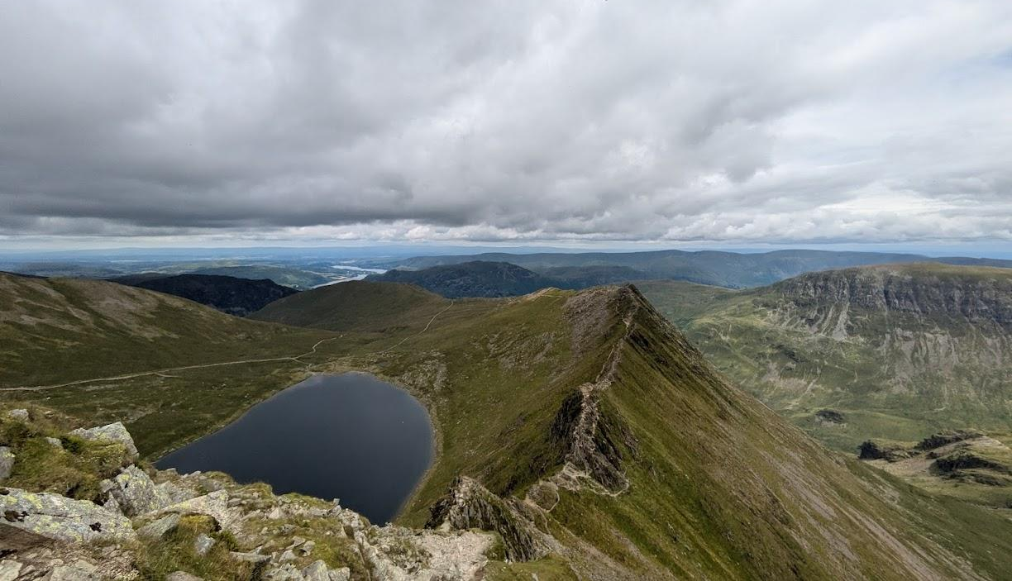
Thanks!
Any questions?

