Slide 1


Echelon-0 (DAQ) Overview and Timeline
Jeff Landgraf

Slide 2
Outline
Brief Overview of DAQ
DAQ / Echelon-0 Setup
Timeline

Slide 3
ePIC DAQ uses streaming architecture
DAQ
Definition of streaming is “No L0 trigger”
All data is zero suppressed by the front-end electronics
No system wide deadtime in normal operation
Collaboration should have the full ability to make data selection cuts on the widest possible criteria
Flexible event selection, data selection and background characterization
But subject to an overall throughput budget of ~100Gb/sec
ePIC Streaming will include
Capabilities for hardware and firmware based Filtering
Capability for flow control
Zero suppression & aggregation within data packets
Greater sensitivity to noise
Greater sensitivity to backgrounds
Computing
Definition of streaming is “Process data as it arrives”
Fast Analysis (~3 weeks not months or years) using automation of calibration and reconstruction.
Requires some overlap between DAQ/computing
Automation of calibrations
Mapping calibration dependencies
Mapping application of calibrations
Mapping evolution of calibrations
QA and monitoring can make use of full offline structure
Consistent schemes and language for data/metadata
Event selection / tagging / and accounting

Slide 4
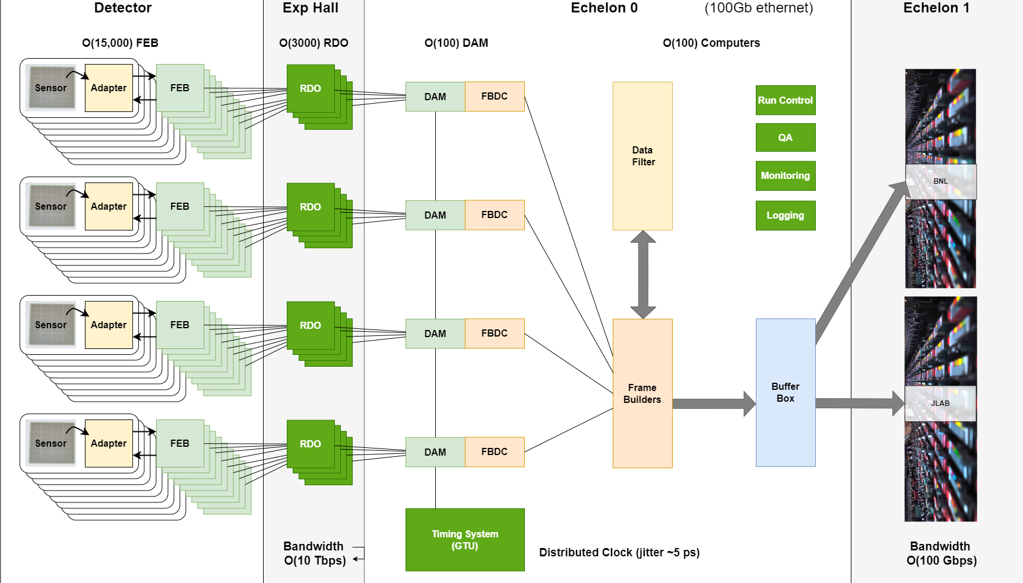
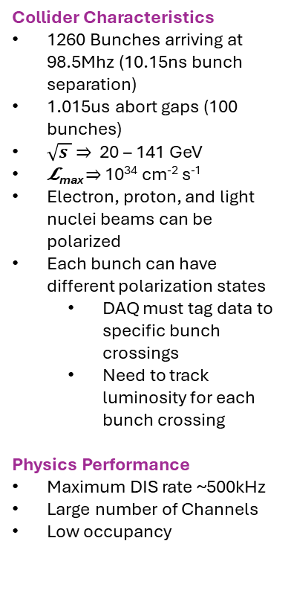
EIC Streaming DAQ/Computing Architecture
Collider Characteristics
1260 Bunches arriving at 98.5Mhz (10.15ns bunch separation)
1.015us abort gaps (100 bunches)
$\sqrt{s }$ ⇒ 20 – 141 GeV
𝓛_{max} ⇒ 10³⁴ cm⁻² s⁻¹
Electron, proton, and light nuclei beams can be polarized
Each bunch can have different polarization states
DAQ must tag data to specific bunch crossings
Need to track luminosity for each bunch crossing
Physics Performance
Maximum DIS rate ~500kHz
Large number of Channels
Low occupancy

Slide 5
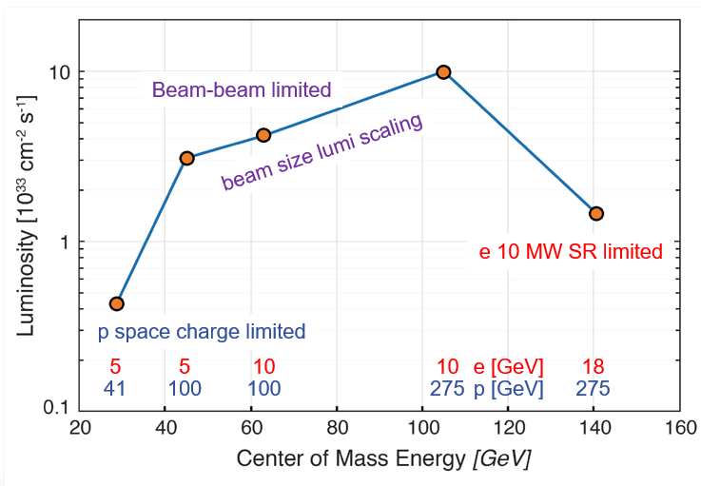
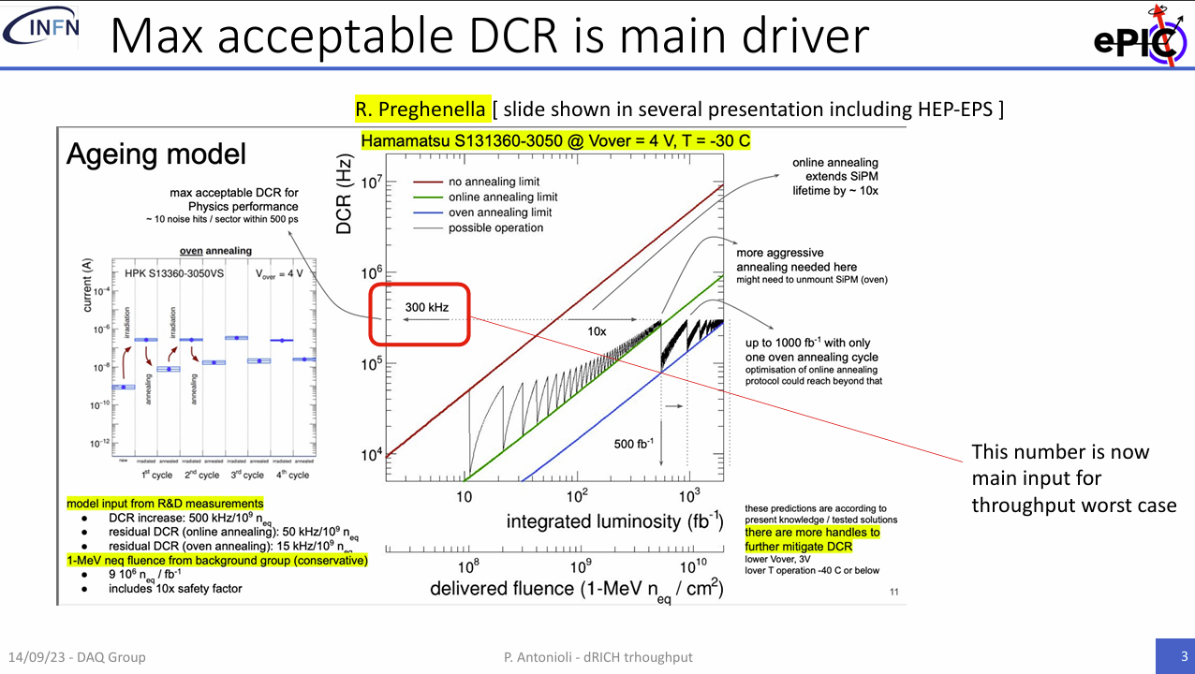
Summary Data Flow
Worst case Data Flow
“Worse Case Data Flow”
𝓛_{max} ⇒ 10³⁴ cm⁻² s⁻¹
10 x 275 GeV DIS
DIS rate ~500kHz
After 9 x 10⁹ (1-MeV n_{eq} / cm²) delivered fluence
300kHz DCR in dRICH
200x rate with no damage
At Worse Case
Need a factor of 20 reduction
PCI/Eth
Eth
Detector
FEB
Copper
RDO
Fiber
DAM
Readout Computer
Aggregate | 2.0 Tb/sec
Noise | 1.6 Tb /sec
Signal from Physics + Background | 400 Gb / sec
Aggregate | 109 Gb/sec
Collision Signal | 62 Gb/sec
Synchrotron Rad | Under design
Electron Beam | 4.5 Gb/sec
Hadron Beam | 1.0 Gb/sec
Noise | 41 Gb/sec
Aggregate | 2.0 Tb/sec
Per RDO (Avg) | 0.7 Gb/sec

Slide 6
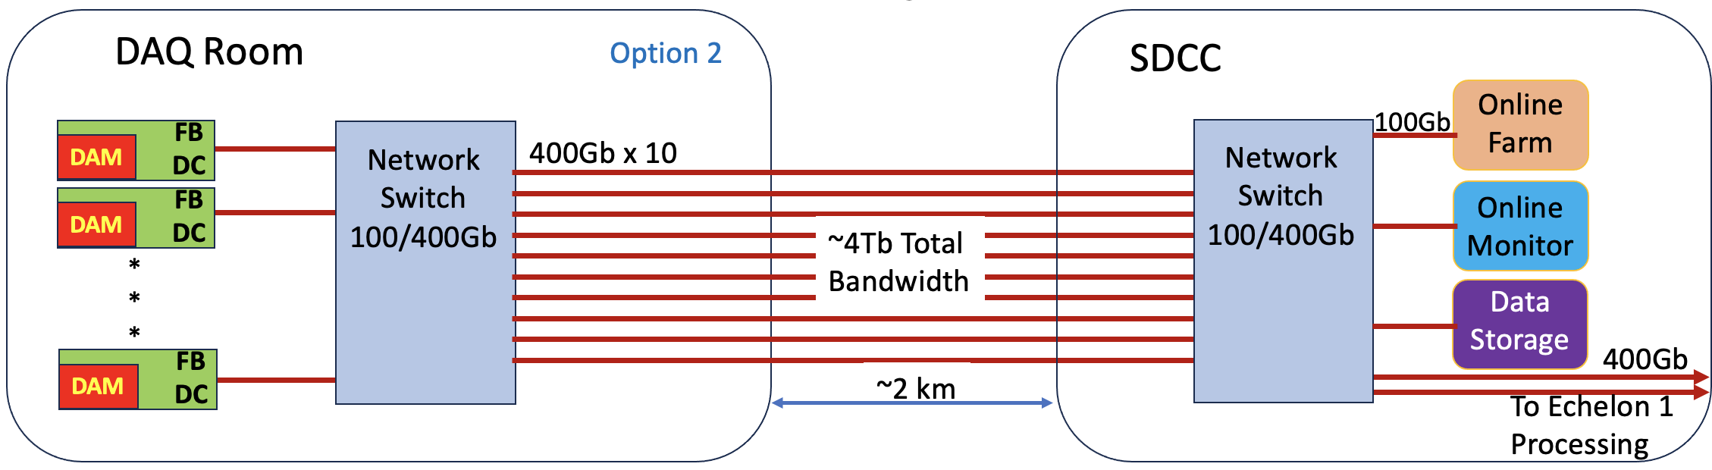
DAQ / Echelon-0
DAQ
O(100 Servers)
Echelon-0
O(100 servers)
Network Structure:
epic.public
epic.controlroom
O(1 link)
daq.local
sdcc.local
O(100 links)
O(30 link)
slowcontrols.local
O(10 links)
jlab.local
(esnet)

Slide 7
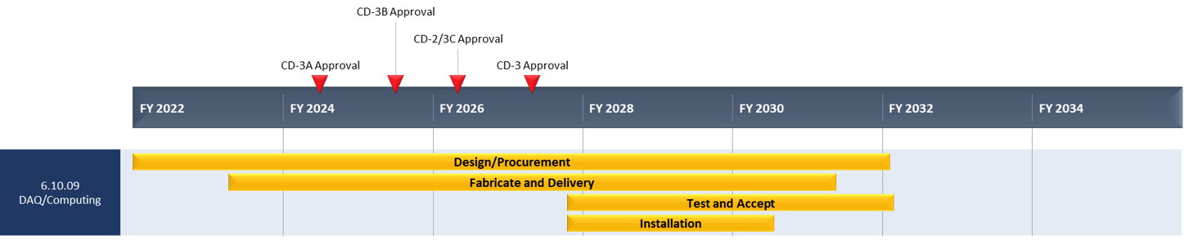
Streaming DAQ Milestones
Detector Install: FY29Q2 - FY31Q2
Cosmics: FY31Q3
Early CD-4: FY32Q4
DAQ Releases:
PicoDAQ FY26Q1
Readout test setups
MicroDAQ: FY26Q4
Readout detector data in test stand using engineering articles
MiniDAQ: FY28Q1
Readout detector data using full hardware and timing chain
Full DAQ-v1: FY29Q2
Full functionality DAQ ready for full system integration & testing
Production DAQ: FY31Q3
Ready for cosmics
PDR1
PicoDAQ
MiniDAQ
Production
DAQ
PDR2
MicroDAQ
Full DAQ-V1
PDR3

Slide 8
Streaming DAQ Milestones
Common Definition for all DAQ Releases
Tagged GIT release for all software and firmware so that a collaborator can retrieve and compile
Written manual to describe use
Definition of supported hardware
Detector Install: FY29Q2 - FY31Q2
Cosmics: FY31Q3
Early CD-4: FY32Q4
DAQ Releases:
PicoDAQ FY26Q1
Readout test setups
MicroDAQ: FY26Q4
Readout detector data in test stand using engineering articles
MiniDAQ: FY28Q1
Readout detector data using full hardware and timing chain
Full DAQ-v1: FY29Q2
Full functionality DAQ ready for full system integration & testing
Production DAQ: FY31Q3
Ready for cosmics
Echelon 1/2/3 – SRO
Should support DAQ releases
Should be supported by DAQ releases
PDR1
PicoDAQ
MiniDAQ
Production
DAQ
PDR2
MicroDAQ
Full DAQ-V1
PDR3

Slide 9
Streaming DAQ Milestones
“PicoDAQ” - Readout Test Setups
Communicate, program, access features: “Hello data”
Supporting:
FLX-155
DAM substitutes (2-port VD100, 48 port VMK180)
RDO articles (TBD)
GTU article
Detector Install: FY29Q2 - FY31Q2
Cosmics: FY31Q3
Early CD-4: FY32Q4
DAQ Releases:
PicoDAQ FY26Q1
Readout test setups
MicroDAQ: FY26Q4
Readout detector data in test stand using engineering articles
MiniDAQ: FY28Q1
Readout detector data using full hardware and timing chain
Full DAQ-v1: FY29Q2
Full functionality DAQ ready for full system integration & testing
Production DAQ: FY31Q3
Ready for cosmics
No direct connection to DAQ at this stage
Can have independent prototyping on same time scale
PDR1
PicoDAQ
MiniDAQ
Production
DAQ
PDR2
MicroDAQ
Full DAQ-V1
PDR3

Slide 10
Streaming DAQ Milestones
Detector Install: FY29Q2 - FY31Q2
Cosmics: FY31Q3
Early CD-4: FY32Q4
DAQ Releases:
PicoDAQ FY26Q1
Readout test setups
MicroDAQ: FY26Q4
Readout detector data in test stand using engineering articles
MiniDAQ: FY28Q1
Readout detector data using full hardware and timing chain
Full DAQ-v1: FY29Q2
Full functionality DAQ ready for full system integration & testing
Production DAQ: FY31Q3
Ready for cosmics
“MicroDAQ” – Readout detector data in test stand w engineering articles
Stand alone FEB -> RDO -> DAM implementation using DAQ protocol
Single RDO, DAM
Emulation of GTU in DAM
Echelon 0 still not developed at this point, so no interface to Echelon 1!
Will be creating “real” detector data
PDR1
PicoDAQ
MiniDAQ
Production
DAQ
PDR2
MicroDAQ
Full DAQ-V1
PDR3

Slide 11
Streaming DAQ Milestones
Detector Install: FY29Q2 - FY31Q2
Cosmics: FY31Q3
Early CD-4: FY32Q4
DAQ Releases:
PicoDAQ FY26Q1
Readout test setups
MicroDAQ: FY26Q4
Readout detector data in test stand using engineering articles
MiniDAQ: FY28Q1
Readout detector data using full hardware and timing chain
Full DAQ-v1: FY29Q2
Full functionality DAQ ready for full system integration & testing
Production DAQ: FY31Q3
Ready for cosmics
First stage where integrated tests can start
DAQ will still be stressing electronics
Development of QA/Calibrations should be in full swing
Echelon 0 should exist with final network structure. Do not need high-rates
“MiniDAQ” – Readout detector data using full hardware and timing chain
As above, with GTU echelon 0
Still single stream
PDR1
PicoDAQ
MiniDAQ
Production
DAQ
PDR2
MicroDAQ
Full DAQ-V1
PDR3

Slide 12
Streaming DAQ Milestones
Detector Install: FY29Q2 - FY31Q2
Cosmics: FY31Q3
Early CD-4: FY32Q4
DAQ Releases:
PicoDAQ FY26Q1
Readout test setups
MicroDAQ: FY26Q4
Readout detector data in test stand using engineering articles
MiniDAQ: FY28Q1
Readout detector data using full hardware and timing chain
Full DAQ-v1: FY29Q2
Full functionality DAQ ready for full system integration & testing
Production DAQ: FY31Q3
Ready for cosmics
“FullDAQ-v1 – Full functionality DAQ ready for system integration
Includes run control, capability for merging streams from separate DAM boards, and interface to echelon 1
All components should exist. This is when detectors are installed and integration testing begins. The streaming readout is still being debugged, but is a tool for the collaboration at this point
Echelon 0 computer purchases to ramp up with data needs
PDR1
PicoDAQ
MiniDAQ
Production
DAQ
PDR2
MicroDAQ
Full DAQ-V1
PDR3

Slide 13
Backup…

Slide 14
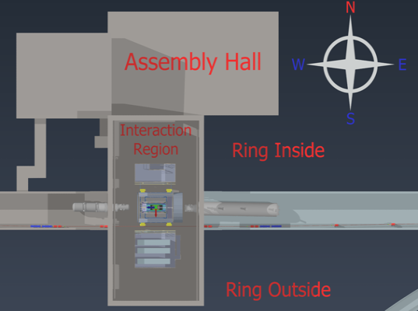
IP-6
Control
Room
DAQ
Room
Control Room overhaul should include total replacement of old consoles and replacement with sufficient workspaces to support the 24+ detector subsystems and their associated control systems
.
DAQ room upgrades (cooling and power) will be dependent on how much of the online computing is housed there.
Updates to available cable tray routing and availability of Riggers are needed to support pulling some 6000+ fibers to three different areas of the Interaction region (south platform and tunnels).

Slide 15
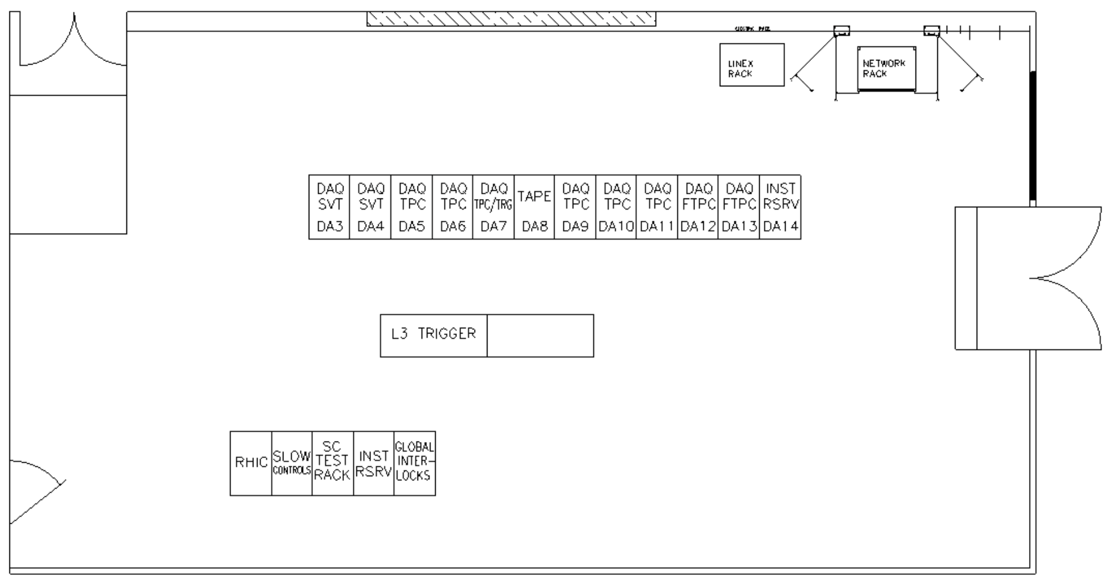
Scale of Echelon 0 (DAQ) Computing
Current Project estimates provide for roughly a total of 20 racks/cabinets
200+ total CPU nodes
~6000 fibers from the IR (~150m run)
100-110 DAM Servers (all must reside in the DAQ Room)
Expected total power requirements are between 300-350kW.
Current power infrastructure at IP-6 for the DAQ Room is sufficient (two 330kW taps avaiable):
Some additional power distribution will be needed
Existing cooling infrastructure needs to be updated.
Overall cooling efficiency will need to be improved if everything will be housed locally (DAQ Room).
Default option would be splitting Echelon 0 resources between IP-6 and the BNL Data Center (SDCC).
Control
Room
DAQ
Room
From Control Room
26 ft
DAQ Room
48 ft
To Assembly Hall

Slide 16
Data Transfer to Echelon 1
Principles
Equal transfer to both echelon 1 facilities (Both receive copies of data)
The desired transfer time to the echelon 1 is O(seconds) for fast feedback
Buffering for up to several days is available in Echelon 0
Details not yet fully defined
Data transfer mechanisms are under discussion
Orchestration is under discussion
Are reconstructions done twice or are they split between echelon 1 facilities?
How is QA organized
Some QA needed in echelon 0
Physics based QA expected at echelon 1
SDCC
IP-6
BNL ePIC
Echelon 1
ePIC DAQ
Echelon 0
DAQ
ROOM
400Gbps
4Tbps
400Gbps
ESNET
To JLAB ePIC
Echelon 1

Slide 17

Network Infrastructure
ePIC DAQ and computing will require network connectivity at BNL between resources in IP-6, SDCC as well as development labs that is bandwidth guaranteed and minimizes routing.
Early DAQ & Electronics development will be in labs (Physics, early 2026-).
Initial computing needs for development would best be placed in a central location (SDCC, initially 1-2 racks, by Q2 FY27).
As construction and installation ramps up at IP-6 additional Echelon 0 computing resources can be placed in both sites (5-6 racks at SDCC, Q2 FY29).
For production running it is important to all network infrastructure in place (Q1 FY32) and have equal and transparent network access from SDCC to both Echelon 1 sites (BNL and JLAB)
To JLAB ePIC (Echelon 1)
SDCC
ESNET
400Gbps
BNL ePIC
Echelon 1
ePIC
DAQ
DAQ
ROOM
IP-6
400Gbps
4Tbps
100Gbps
Lab
Lab
Lab
Physics

Slide 18

ePIC Readout Chain (role in data reduction)
Global Timing Unit (GTU)
- Interfaces to Collider
Run Control & DAM
- Config & Control
- Clock & Timing
(BNL)
On Detector
SMT BGA
(JLAB)
Name
Design
Sensor
Detector Specific
Adapter
Detector Specific
Front End Board
(FEB)
Detector Specific
Readout Board
(RDO)
Few Variants
Data Aggregation Module (DAM)
Common
Echelon 0
Computing
Common
Echelon 1
Computing
Common
COTS
Type
Custom Electronics
Custom Electronics
Custom Electronics
FPGA
Large FPGA / SoC
COTS
Role
Aggregation
High Level Filter
Data Reduction Processing
High Level Filter
Data Reduction Processing

