Slide 1
News from the SP Office
J. Lajoie, S. Dalla Torre
April 4, 2025

Slide 2
New Institution Petitions
Texas Southern University
Presented by Nissem Abdelrahman
Johannes Gutenberg University Mainz
Presented by Tyler Kutz
Mount Allison University
Presented by David Hornidge
University of Hawaii at Manoa
Presented by Jennifer Ott

Slide 3
What’s in a Name?
Especially in discussions outside the collaboration, there has been some confusion as to what “Analysis Coordination” is:
The name doesn’t fully convey what the coordination office does.
Historically, “Physics Coordination” was objected to when the initial management plan was proposed.
We propose to rename the “Analysis Coordination” office to “Physics Analysis Coordination”
This name is much clearer and more descriptive
Discussed in Coordinators meeting, well received
Discussed in AC meeting April 1st, well received

Slide 4
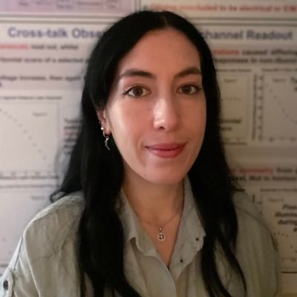
New Physics Analysis Coordinator
Rosi Reed has taken on substantial responsibilities as sPHENIX Run Coordinator for this year
Rosi will step back to Deputy Physics Analysis Coordinator
This helps maintain continuity within Physics Analysis Coordination
The Spokesperson’s Office nominates Rachel Montgomery as a new Physics Analysis Co-Coordinator:
Lecturer in Nuclear and Hadron Physics at University of Glasgow
Former ePIC Diffractive and Exclusive Physics WG Convener
Will ramp up by the end of the current academic semester

Slide 5
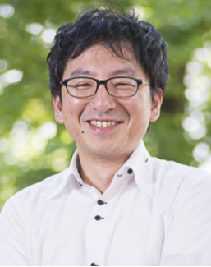
New Streaming Computing Model WG Convener
Jin Huang has been elected as sPHENIX co-spokesperson, along with Megan Connors
Jin held convener positions in both the Electronics, Readout & DAQ CC WG and the Streaming Computing Model WG. This helped provide communication and continuity between these two important groups.
After discussions with the remaining Electronics, Readout & DAQ CC WG conveners, an additional convener here is not necessary
Jeff Landgraf is a co-convener in both WG’s
The Spokesperson’s Office nominates Taku Gunji as a new Streaming Computing Model WG convener
Associate Professor at the University of Tokyo, CNS
SPADI Alliance member

Slide 6
Coming Soon
Interest from two institutions to host Jan. 2026 Collaboration Mtg.
More on this coming soon
ePIC/EIC R&D Days April 16-17:
https://indico.bnl.gov/event/27200/
Early Science Workshop April 24-25th:
https://indico.cfnssbu.physics.sunysb.edu/event/410/
Next General Meeting Friday, April 18th @ 10:30AM ET

Slide 8
2025 -2026
PDR2: Polarimetry
Sept./Oct 2025
PDR: DAQ - Slow Controls
Nov./Dec. 2025
ePIC Early Physics Workshop April 24-25, 2025
DOE IPR: SP Status 29-30th July, 2025
PDR2: Backwards HCal
~Sept. 2025
ePIC pre-TDR
V2.1
PDR3: Barrel EMCal
~August 2025
5th EIC RRB Meeting
June 5-6th 2025
ePIC Software and Computing Review ~Oct 2025
ePIC Software and Computing Review Check-in ~May 2025
DOE IPR and ICR, 13-16th Jan., 2026
PDR2: Cerenkov PID
April 1-2, 2025
PDR3: IR Integ. & Aux. Det
Nov./Dec. 2025
PDR3: Elec./DAQ
August 2025 (late)
PDR: Magnet/Cryo Infrastructure
Sept./Oct. 2025
2025
2026
Frascati
Jan 20-24,2025
Collider Subproject and Status Director's Review 21-23 Oct., 2025
CD-2/3 Review ~ mid 2026
EICUG/ePIC Collab. Mtg. July 14-18
FDR: Backward & Forward EM Calorimetry, Barrel & Forward HCAL
May 2025
PDR: Integ. + Installation (outside GST)
Nov/Dec 2025
PDR2: Si Tracking Detectors
Fall 2025
10th Detector Advisory Committee June 11-13th 2025
PDR2: MPGD Detectors
Summer 2025
Detector R&D Day (ePIC/Project) 16-17th April 2025
PDR2: AC-LGAD Detectors
Fall 2025
PDR: Integ. + Installation (inside GST)
Nov/Dec 2025
6th EIC RRB Meeting Nov. 4-5th 2025

Slide 9
ePIC Resources
Public Website - https://www.bnl.gov/eic/epic.php
Mailing Lists – https://lists.bnl.gov/mailman/listinfo
Indico Agenda - https://indico.bnl.gov/category/402/
ePIC Software and Computing: https://indico.bnl.gov/category/435/
Wiki - https://wiki.bnl.gov/EPIC
ePIC Software Training:
Landing Page: https://eic.github.io/documentation/landingpage.html
Tutorials: https://eic.github.io/documentation/tutorials.html
Mattermost: https://chat.epic-eic.org
ePIC Zenodo Community: https://zenodo.org/communities/epic

Slide 10
EICUG Membership
The EICUG is a vital organization to promote the interests of the EIC community!
Without the EICUG we would never have gotten far enough to form ePIC!
Please register your institution!
Check with your EICUG IB representative to get registered as a member
https://www.eicug.org/content/join.html

