Slide 1
Review of pfRICH & hpDIRC Readout
Fernando Barbosa (JLab)
6 March 2025

Slide 2
Some relevant parameters for the high-precision timing sub-detectors in ePIC:
Sub-Detector | ~# Ch | Sensor | ~Cin (pF) | ASIC (ch) Default | Package | Timing Precision (ps) | Design Group
bTOF | 2.4 M | AC-LGAD Strip | <10 | FCFD (128) (<15 pF) | Wire-Bonding | ~30 | FNAL
fTOF | 3.7 M | AC-LGAD Pixel | <5 | EICROC (32x32) (<5 pF) | Wafer Bump + WB | ~30 | OMEGA/IN2P3/IJCLab
pfRICH | 70 k | HRPPD | 5 – 7* | FCFD | BGA?
hpDIRC | 74 k | MCP-PMT | <5* | FCFD | BGA?
* PCB trace routing capacitance not included.
pfRICH – HRPPD/MCP-PMT – HRPPD is default; MCP-PMT is backup.
hpDIRC – MCP-PMT/HRPPD – MCP-PMT is default; HRPPD is backup.
ASIC – FCFD/EICROCx – FCFD is default; EICROCx is variant and backup.
Package – packaging of die is recommended for PCB assembly, likely a BGA package.

Slide 3
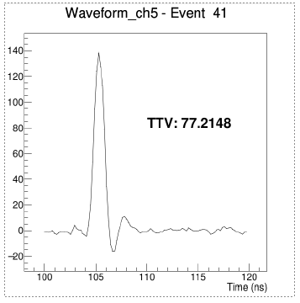
HRPPD
HRPPD HTCC Ceramic
120 mm x 120 mm
1024 channels
Trace & pad capacitance is 5-7 pF
Gain in excess of 10⁷
Signals: Tr < 500 ps; Tw ~ 2 ns
Interface PCB
ASICs on PCB or plug-ins (TBD)
Trace routing adds capacitance – minimize length
Transmission lines: terminate to ASIC Zin (150 – 200 Ohm), BW ~ 500 MHz - 1 GHz
Favors multiple ASIC packages, lower channel density per package use
3D simulations started for HTCC and Interface PCB (Ray Dawson, Jlab)

Slide 4
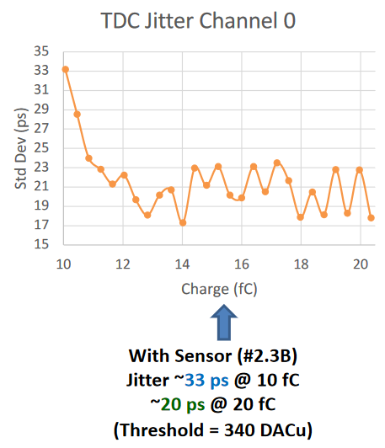
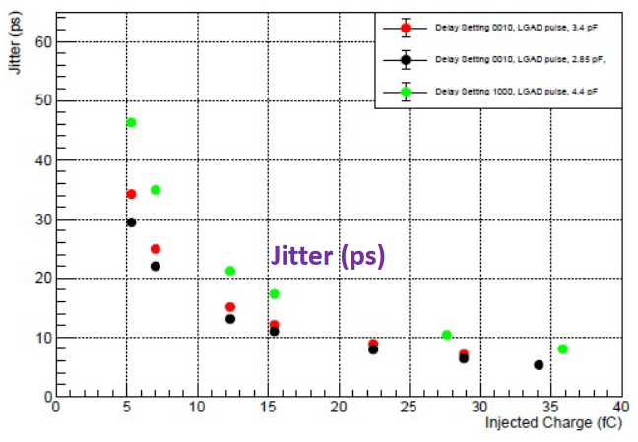
Other considerations
EICROC
Leading edge timing:
σ_{time} = σ_{noise}/(dS/dt)_{threshold} ~ T_{risetime}/(S/N)
Higher slew rate, higher detector gain
But …
Decreased longevity
After-pulsing
Higher cross-talk, ringing
Dynamic range concern
Lower noise
Narrower preamp BW
Improved interconnects
Need to balance these variables empirically.
Reference – 4th LAPPD(/HRPPD) Workshop – 8 May 2024 -https://indico.cfnssbu.physics.sunysb.edu/event/265/contributions/929/attachments/255/405/Vavra_BNL_workshop_2024.pdf
FCFD

Slide 5
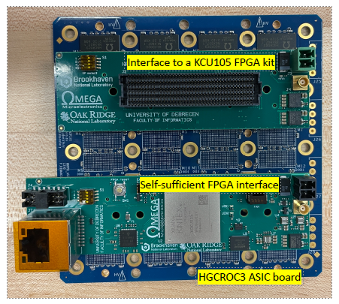
Next Steps
FCFDv1.1
available in 2025
frontend only
to be tested with HRPPD prototype at Jlab
Wire-bonded to a plug-in test PCB, to be designed (Jlab)
EICROCx
Readout setup with HGCROC3 developed (OMEGA, Debrecen, BNL, ORNL)
HGCROC3 frontend is different from EICROC, though, but should provide valuable feedback.
Plans to test EICROC0 (frontend only) if evaluation board becomes available.
FCFD is default ASIC readout for pfRICH and hpDIRC.
pfRICH and hpDIRC benefit from current ASIC developments for TOFs.
However, we will continue assessing alternative solutions.

