Slide 1



SLDO Update
04/03/2025
Notes:
The abstract pattern can be removed or repositioned if required. Be careful to ‘Send to Back’ so that it does not obscure any important information.

Slide 2
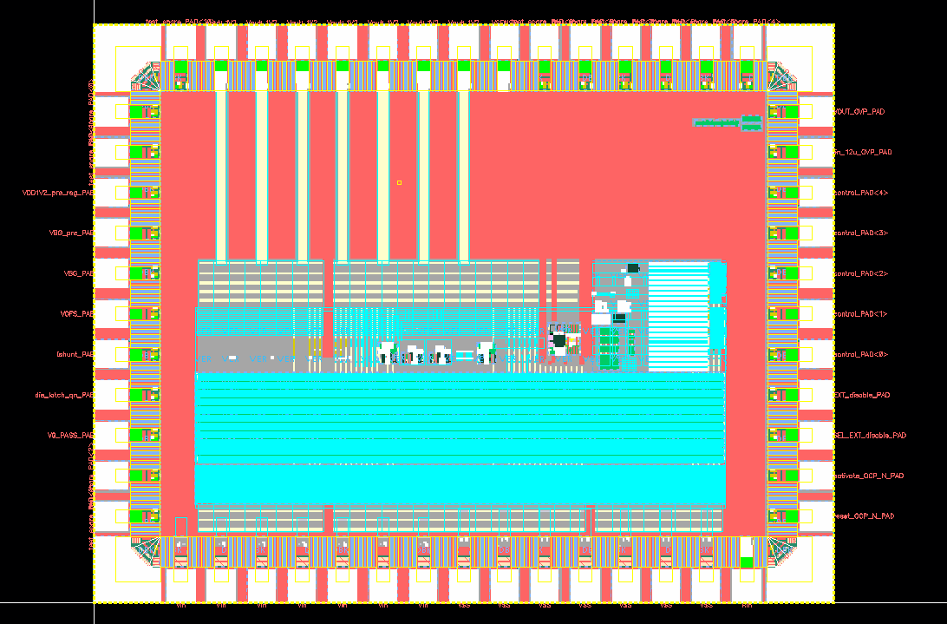
SLDO Submission
Prototype submitted
No Design Sharing Agreement
Independent submission
UK Infrastructure Fund
Submission via Europractice
Single SLDO, many test pads
Expect out-of-fab September

Slide 3
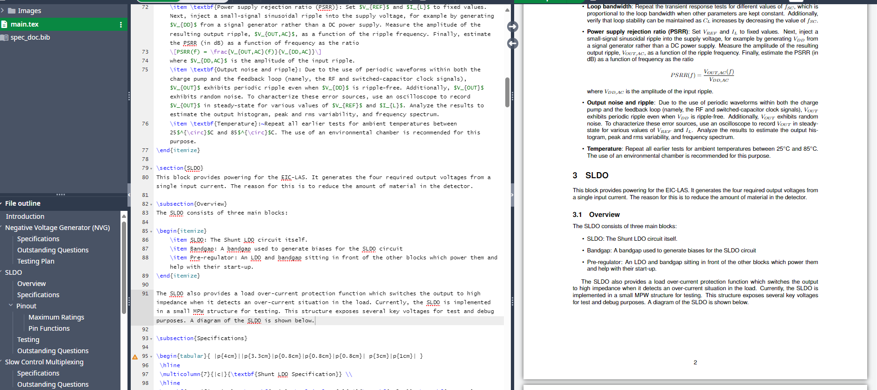
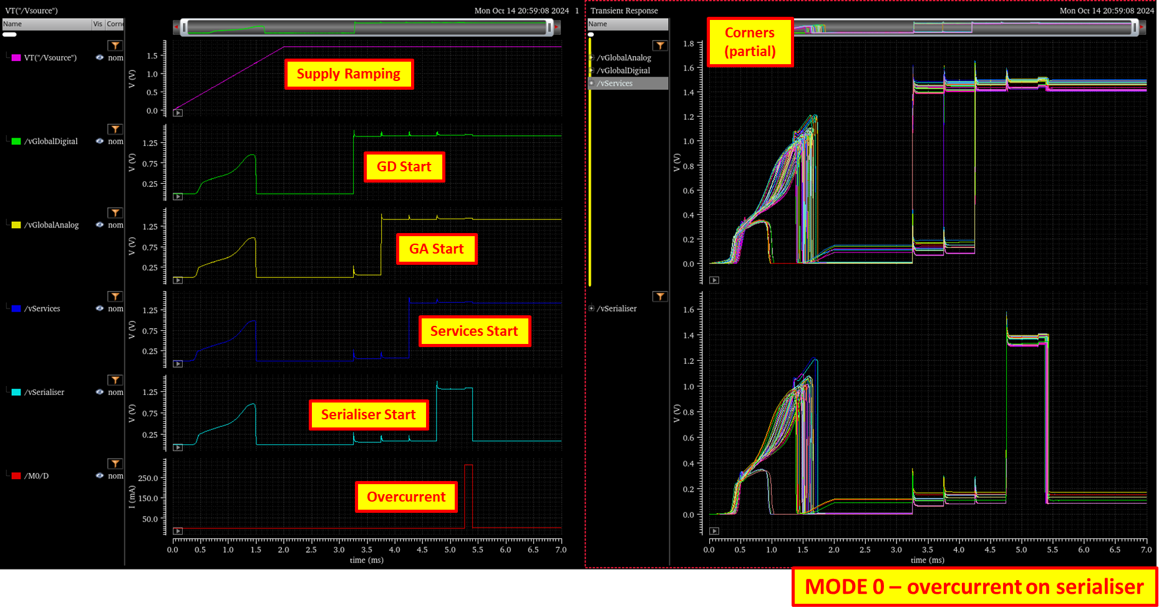
SLDO Submission
Next steps
Properly document and record FDR
Complete some additional simulations
Complete documentation in overleaf
Support WP2 testing
Birmingham and Daresbury submitted SoI for testing to WP2
Provide details for AncBrain design

Slide 4


Notes:
The abstract pattern can be removed or repositioned if required. Be careful to ‘Send to Back’ so that it does not obscure any important information.

Slide 5





Science and Technology Facilities Council
@STFC_matters
Science and Technology Facilities Council
Notes:
The abstract pattern can be removed or repositioned if required. Be careful to ‘Send to Back’ so that it does not obscure any important information.

