Slide 1

AncASIC – Ancillary ASIC for power, bias and slow-control management in serially powered OB layers and disks
AncASICXT011_P1 (NBVG) fabrication in XFAB XT011 process
Common design efforts of RAL, BNL and LBL within WP1

Slide 2
Design Team
BNL:
Dominik Gorni, Syed Hassan, Arif Iqbal, Joao de Melo, Soumyajit Mandal, Prafull Purohit, Sergio Rescia, Nicholas St. John, Grzegorz W. Deptuch
RAL:
Iain Sedgwick, Roy Wastie, Jaya John John
LBL:
Amanda Krieger

Slide 3
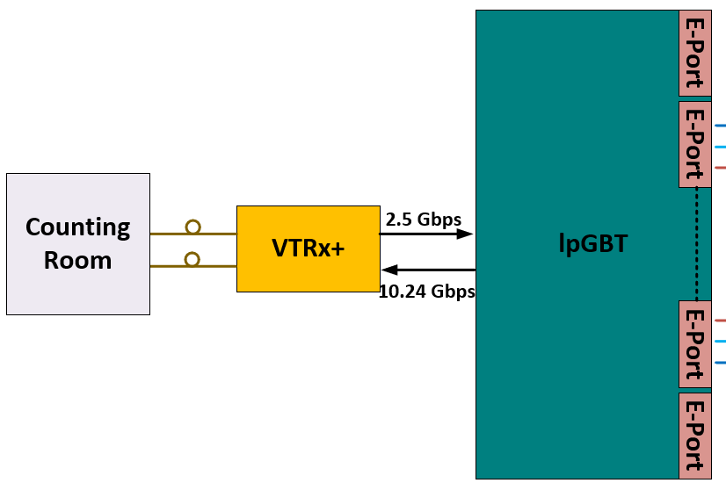
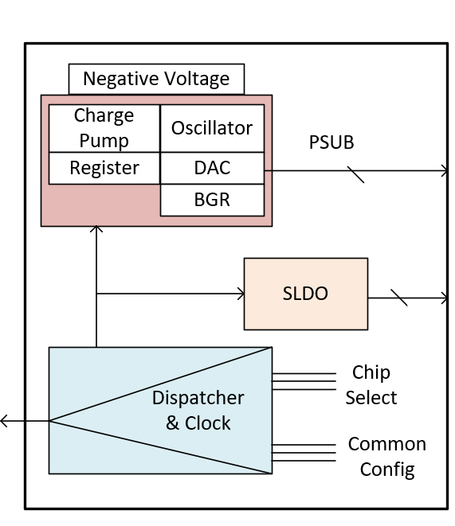
Functionality
MOSAIX / EIC-LAS interface
AncASIC
MOSAIX (all diff. CLPS):
Clock - input
Reset - input
Sync - input
2× slow control – input/output
Services management
Core management
1× reserved
– +HS Data (all differential):
8× high-speed channels
(4 top, 4 bottom)
slow control downlink
40, 160 or 320 Mbps ?
5-10 Mbps
MOSAIX interface needs to be formalized

Slide 4
Fabrication Process XFAB XT011 Platform
Automotive quality compliant with extended temperature range -40°C …. 175°C
(Bipolar, CMOS, and DMOS)-on-SOI 110nm technology 1.5V/5V with Cu Back End of Line (metal stack) and HV devices up to 85V
TOX for 1.5V transistors: 3.5 nm / 3.5 nm and good value resistors: rnw 1.17 kΩ/sq
Floating capacitors mosvcti/mosvc: 9.8 fF/um² – 10.8 fF/um²
Digital 244 kGE/mm² (kilo gate equivalent/mm²)
3,740 nm
4.5 mΩ/*
400 nm
62 mΩ/*
400 nm
62 mΩ/*
400 nm
62 mΩ/*
400 nm
62 mΩ/*
Suitable for high current application in voltage regulation
400 nm
62 mΩ/*
400 nm
62 mΩ/*

Slide 5
Selection of Process Features
process modules selected:
ALUCAP, COPTHK, DTI, LVT, METAL1, METAL2, METAL3, METAL4, METAL5, MOS5, MOSLP, PSUB Æ only 31-mask layer set
(it is the ‘1157’ option settings)
rejected DEPL, NHVA, PHVA, DIODEA, NVM, OTPF – HV layers.
number of thin metals: 5 metal layers, (no point to impose restriction to default 3 metal layers)
XFAB provides pricing (and delivery time) based on modules selected for both options:
  MPW Æ $22.5k per 10 mm^2 (minimal chip size with 45 die delivered)
  engineering/production run Æ $177.2k per with minimum 3 wafers delivered
  2-MLM mask-set option used
Wafer thickness (725 µm +/- 15 µm) delivered unlapped; thinning can be ordered 250 µm.
XFAB Foundry Facility in France in Corbeil – Essonnes
Less frequent and longer delivery than other mainstream foundries
Purchase Order dispatched by BNL for AncASICXT011_P1 (first 10 mm² prototype)

Slide 6
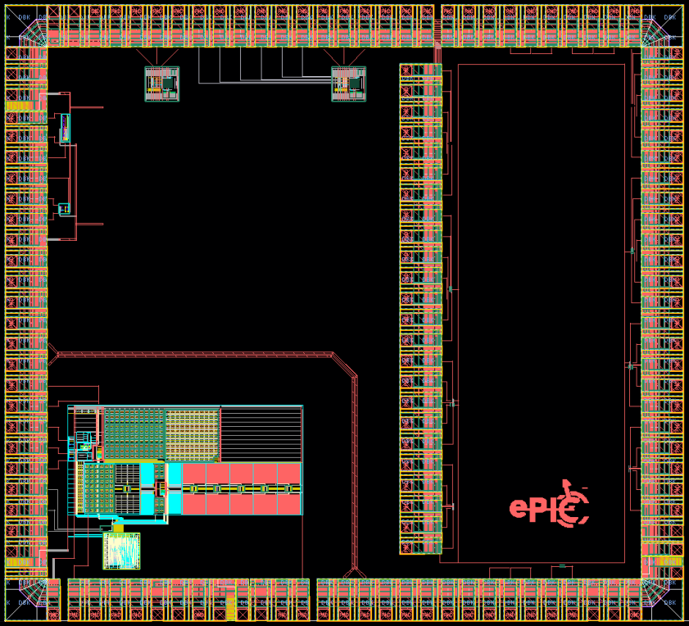
AncASICXT011_P1 - Design
3.2 mm
includes:
  NVBG first prototype (w/o DAC.ADC for setting.monitoring)
  SLDO preregulator stages
  TX/RX stages for DC-coupling demo
  transistor test structures for irradiations
  Number of pads = 109 + 24
  Pad pitch = 100 μm
  NVBG regulation from negative sub-1V to negative 5V
CML transceiver
SLDO pre-regulator from LBL
SLDO pre-regulator from LBL
Test devices
Test devices
2.9 mm
Presentation by Praful Purohit @ ePIC collab. meeting
https://agenda.infn.it/event/43344/contributions/253230/
Negative Voltage Generator
Test devices

Slide 7
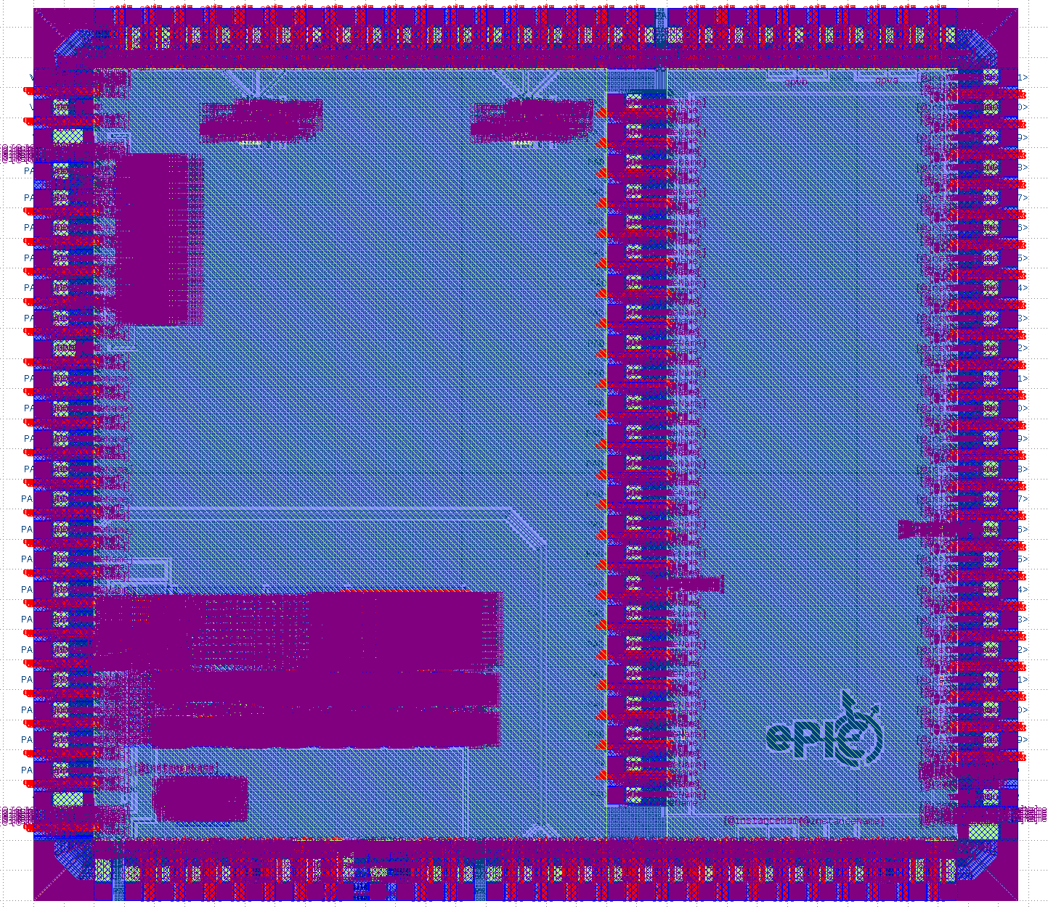
AncASICXT011_P1 - Fabrication
submission for fabrication
  tape in 03/03/2025, data release form underway
Next steps for AncASICXT011_P2 (miniAncASIC):
  complete NBVG (DAC to generate reference voltage for programmability, monitoring ADC based on ER2_BNL_VFM_ADC) and SLDO stages (integrating towards complete prototype)
  selection of size and aspect/form factor ratio
  use pads for final/complete AncASIC
  early implementation of Anc Brain
  development of software (digital-twin) and hardware (FPGA emulator) mockups
Testing
  documentation and test plans
  coordination with WP2
  mounting on FPC (wire, TAB or bump bonding)
Complete Chip with Metal Fill
3.2 mm
SLDO pre-regulator from LBL
SLDO pre-regulator from LBL
CML transceiver
Test devices
2.9 mm
Negative Voltage Generator
Test devices

Slide 8
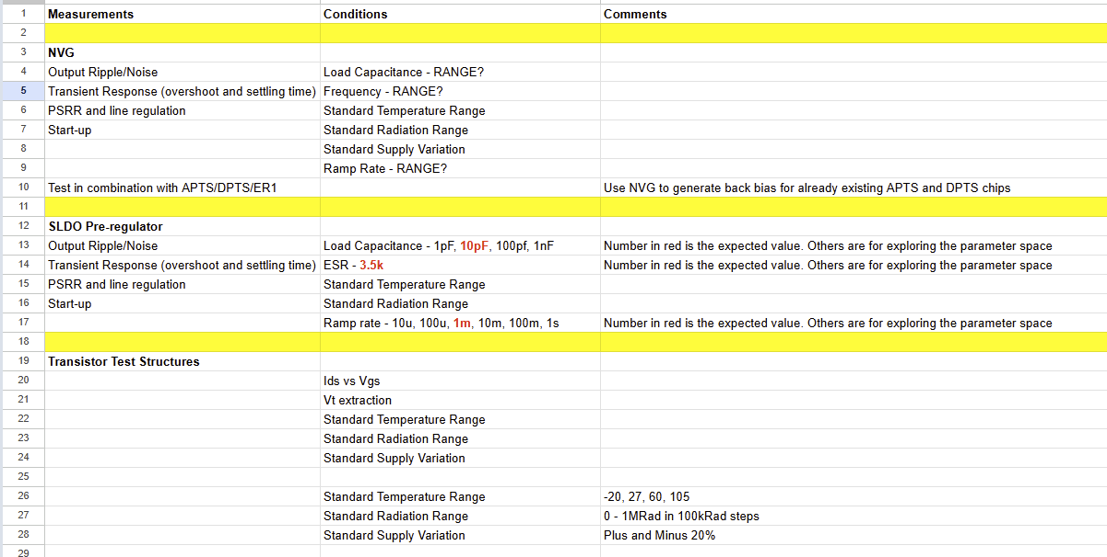
AncASICXT011_P1 – Testing Plan
Testing & Characterization Plan: Document Prepared

Slide 9
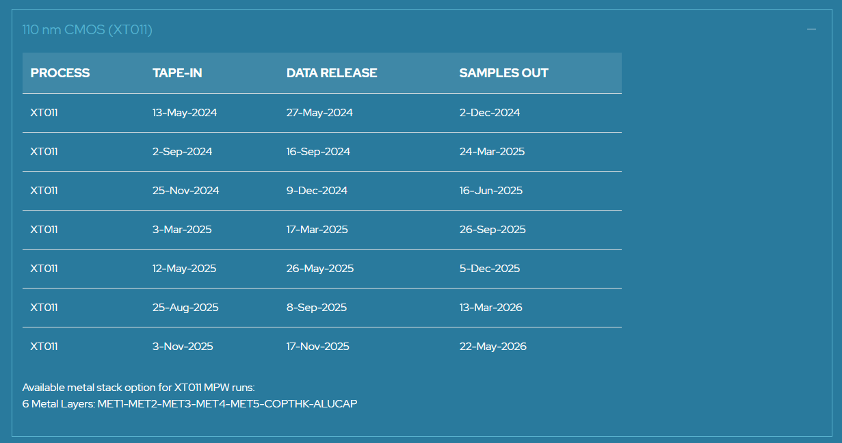
Plans and Schedule
initial plan: part of NBVG (open loop) + transistors test structures for irradiations
Å
È
closed loop of NBVG + SLDO preregulation + test structures + CML TX/RX + trline
Å
canceled with potential of delay
È
Å
closed loop of NBVG + complete SLDO + test structures + CML TX/RX + trline
Å
miniAncASIC w. NBVG DAC/ADC and w. early AncBrain
Å
complete AncASIC with AncBrain (MPW)
Q1 CY 2026: Engineering Run
If no sharing
agreement
RAL: separate SLDO submission
Undergoing refinement / precision

