Slide 1

EIC-AncBRAIN:
A Slow Control & Communication Management System of AncASIC
Date: 03/04/2025
Contribution: Arif Iqbal, Dominik Gorni, Grzegorz W. Deptuch

Slide 2
Outline
    Architecture of AncASIC
    Key Features of EIC-AncBrain
    Documentation for Design and Implementation
    EIC-AncBrain Block Diagram
    AncASIC System-Level Design and Implementation Flow
    Implementation Plan

Slide 3
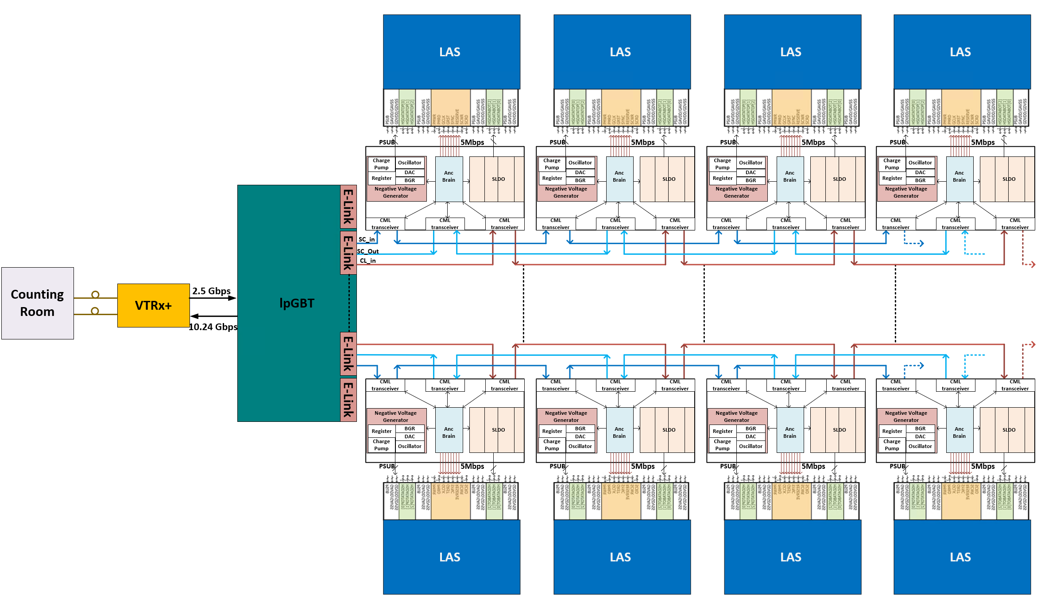
The Bottleneck
Challenge: Limited e-links on lpGBT to drive multiple EIC-LASs
Solution: AncBrain - a bridge
Notes:
Motivation: We cannot drive multiple LAS from one single LPGBT because we will be over saturating available ports of lpGBT
Number of elinks available on one lpGBT will not allow us to handle all these wires
To lower the number of tracks
Since sitting between multiple LASs it has provide local brain

Slide 4
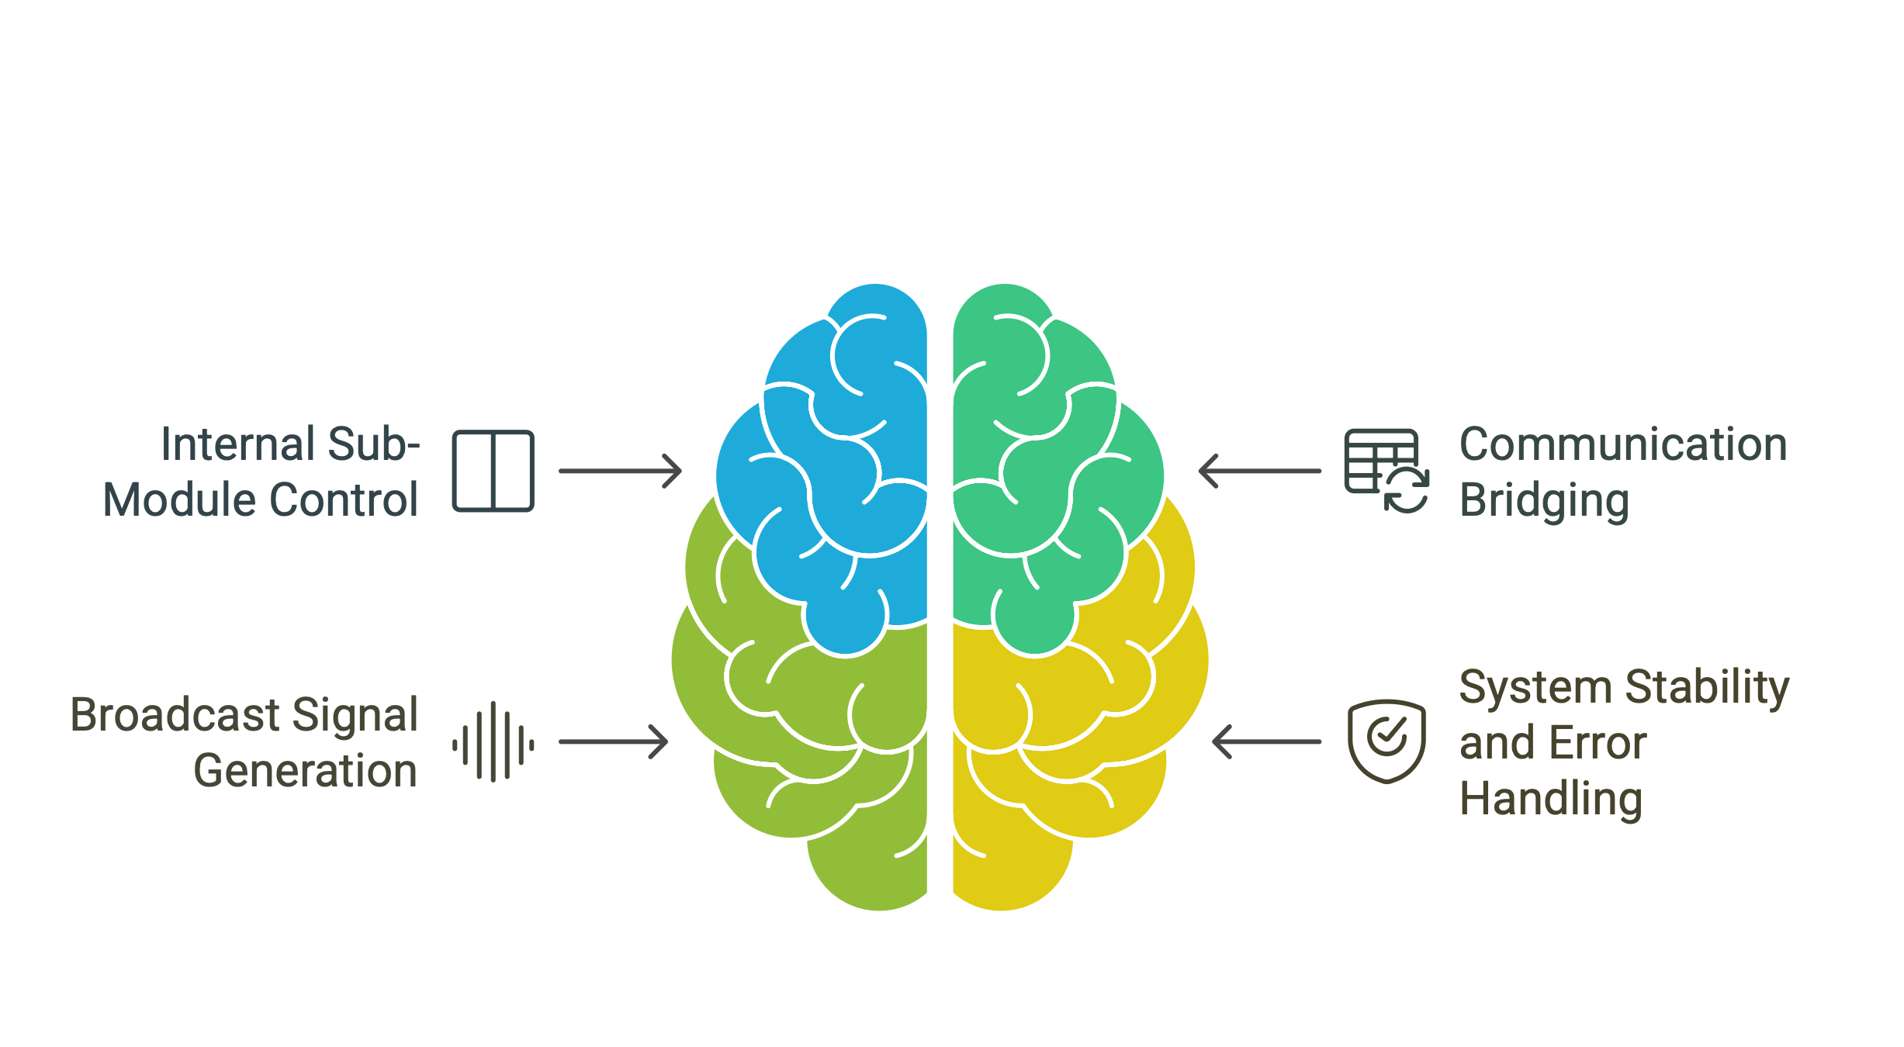
AncBrain: Key Functionalities
Core Operations Inside AncBrain

Slide 5
Communication Interface
Talking to the world:
    lpGBT Interface:
      Serial, Global Clock Synchronized
      SC_in, SC_out
      Protocol: Start/End Frame, Address, Data Type, Payload, CRC
    Las Interface:
      Dedicated serial, 5 Mbps
      Manchester encoding for reliability
      LAS Protocol (REQ01-1-1 to REQ01-4-1)
    GCLK Interface:
      Routing Global Clock (SCL) to LAS
Communication Bridge

Slide 6
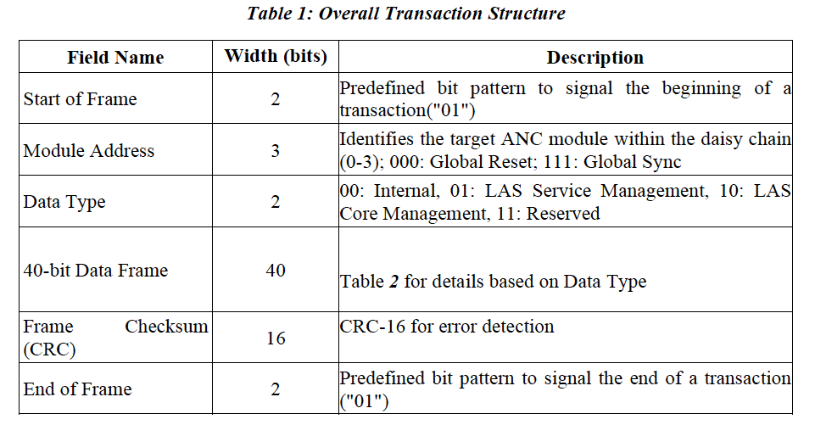
Interface Protocol Format
Transaction Breakdown
Communication Bridge

Slide 7
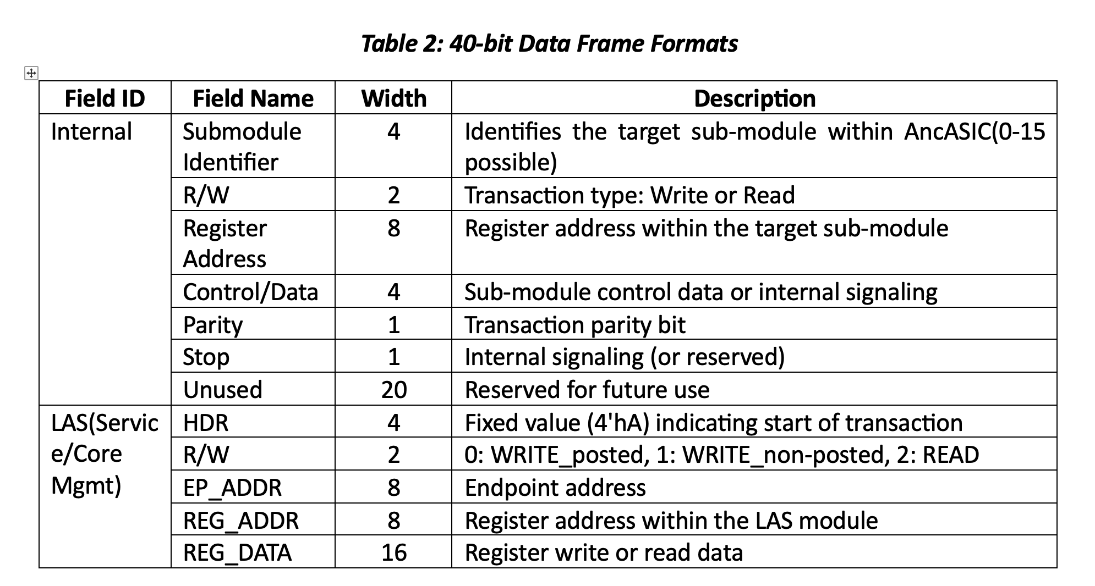
Interface Protocol Format
Payload Interpretation
Communication Bridge

Slide 8
Broadcast Signal Generation
Broadcast Signal Generation
Synchronization and Efficiency
    Dedicated Bit in "Module Address": Broadcast signal indicator.
    Digital Delay Line: Fine-grained timing adjustment.
    Broadcast Identification Patterns:
      000: Global Reset
      111: Global Sync
      001-100: Module Addresses
    Broadcast Detection: Address Comparator triggers broadcast_command signal.

Slide 9
Broadcast Signal Generation
Broadcast Signal Generation
Delay Line Configuration
    Configurable Digital Delay Line: Per-AncASIC delay adjustment.
    Synchronous Counters/Shift Registers: Implementation using SCL clock.
    lpGBT Configuration: Sets delay based on daisy-chain position.
    Compensation: Addresses propagation delays between modules.
    Dedicated Register: Stores delay value per AncASIC.

Slide 10
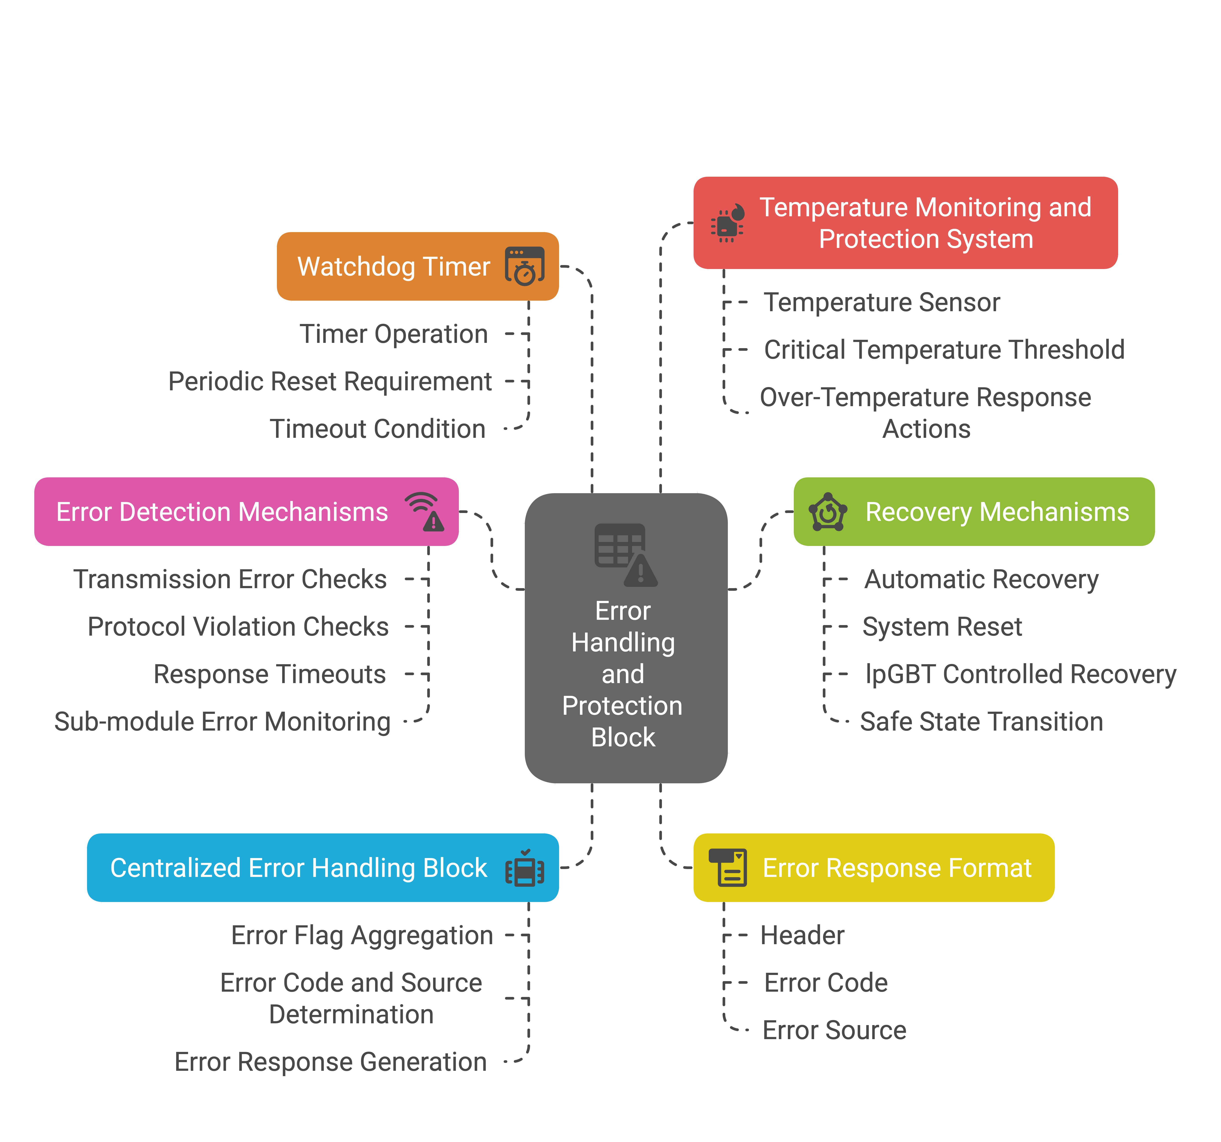
Error Handling & Protection
System Stability & Error Handling

Slide 11
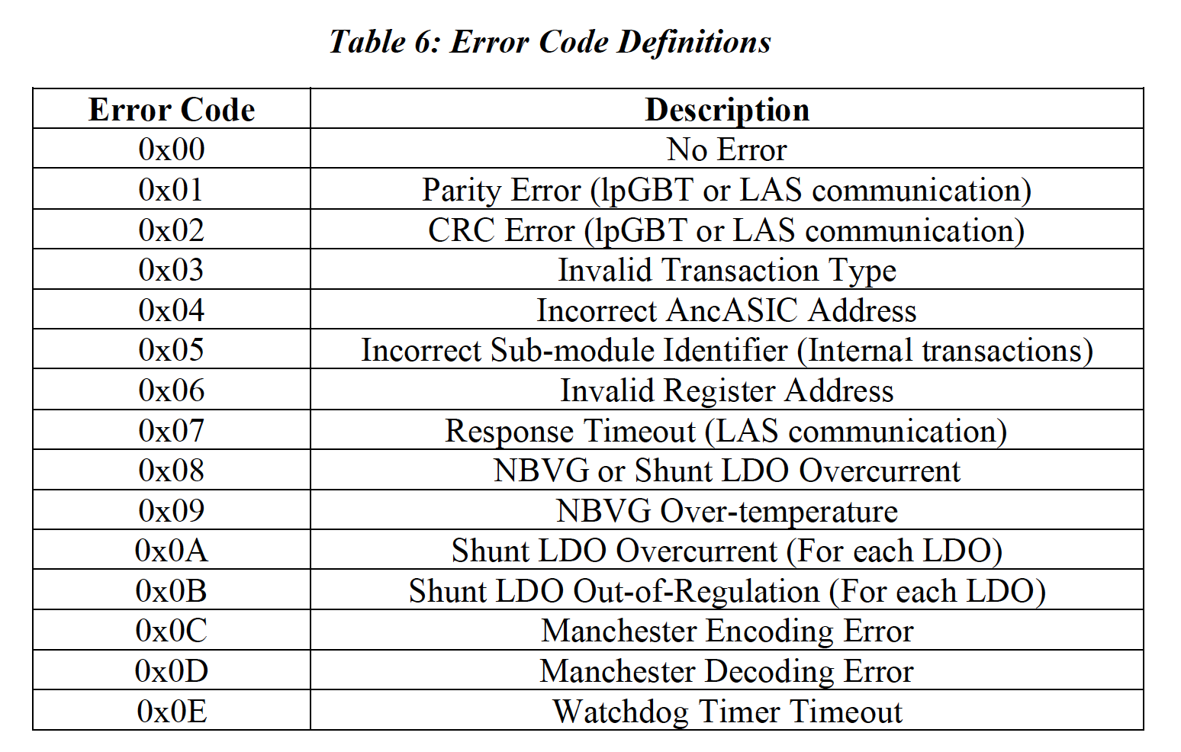
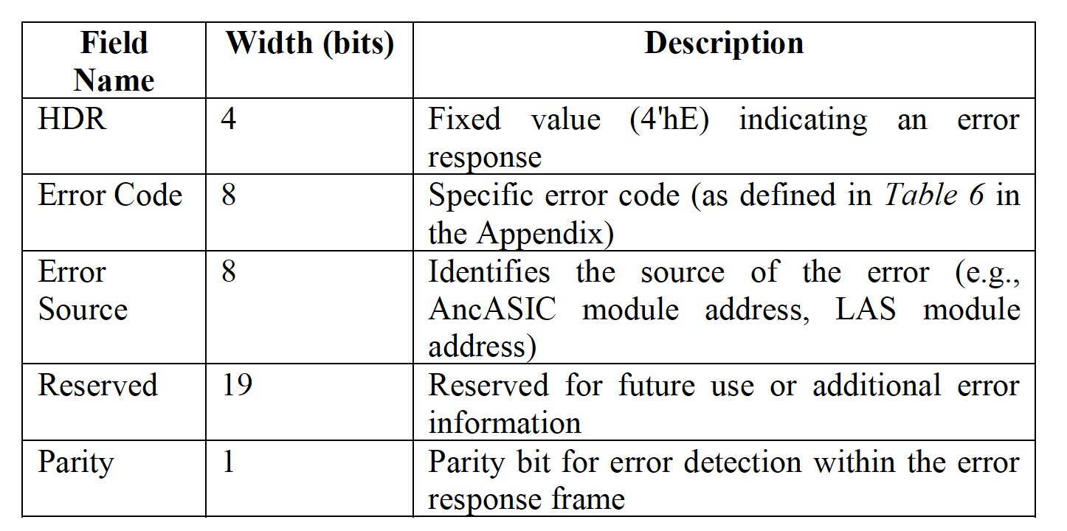
Error Response Format
System Stability & Error Handling

Slide 12
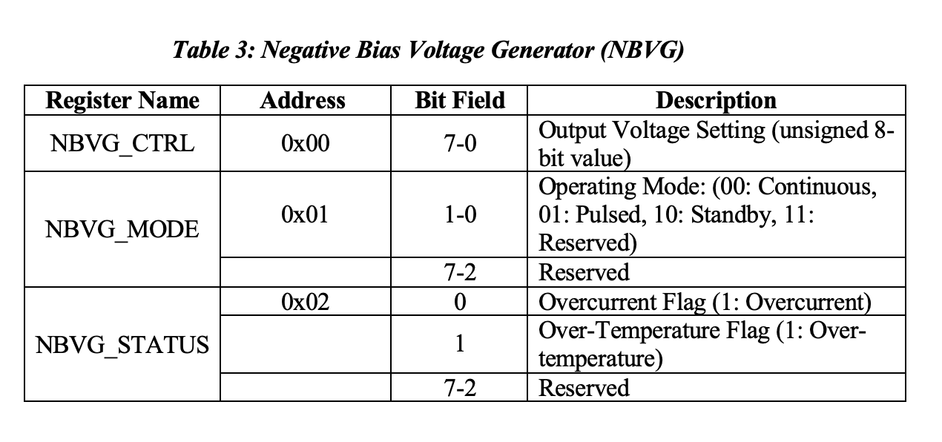
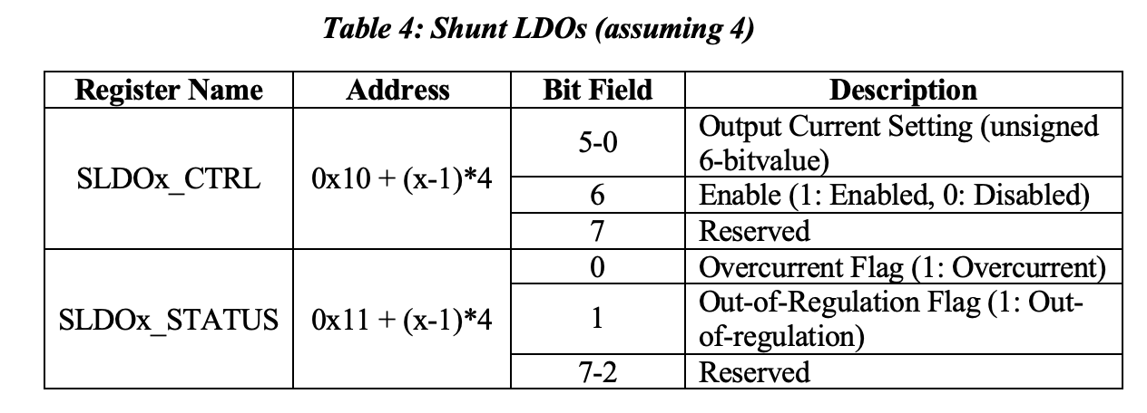
Sub-Module Control
Sub-Module Control
Managing NBVG & SLDO:
    Negative Bisa Voltage Generator (NBVG):
      Bias Voltage Generator
      Configurable Bias level
      Dedicated Registers
    Shunt LDO (SLDO):
      Stable and regulated output voltage
      Configurable Bits
      Dedicated Registers

Slide 13
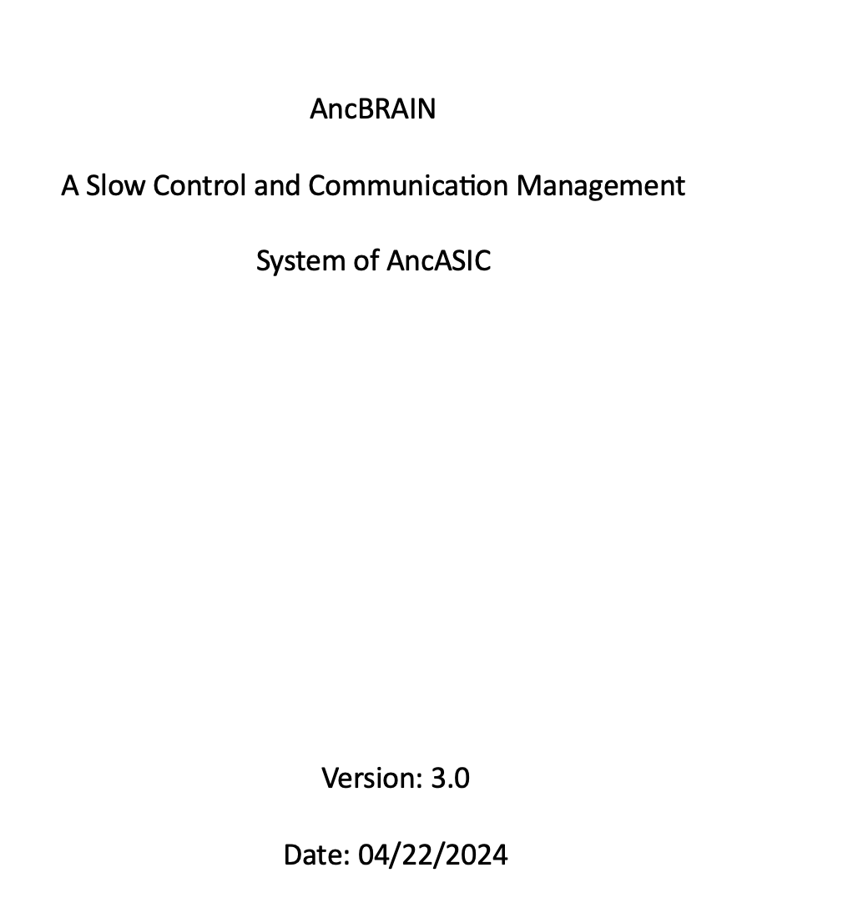
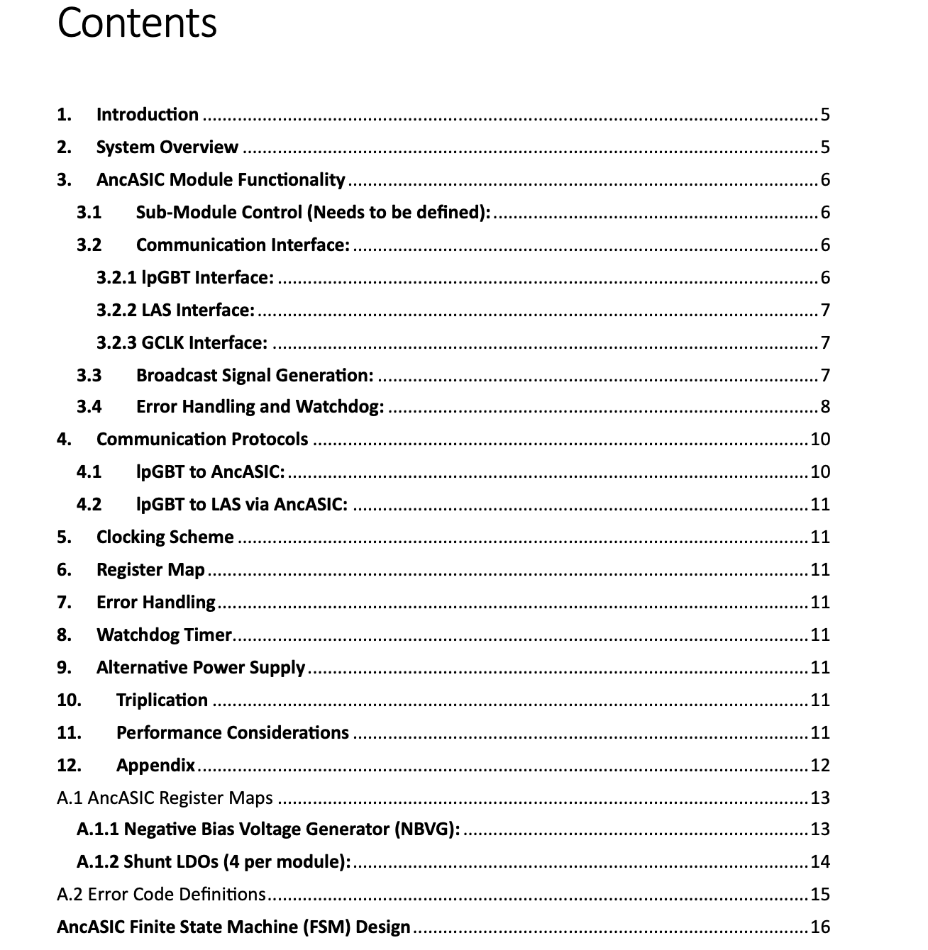
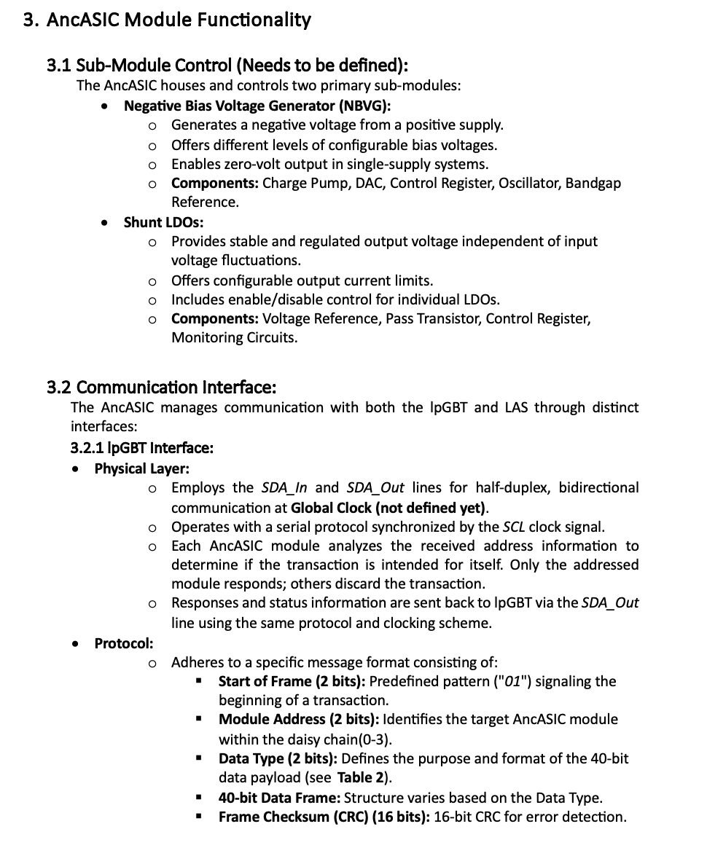
Documentation for Design and Implementation
The key functions are:
    System Overview
    Architecture
    Communication Protocols
    Internal Sub-module Control
    Error Handling and Watchdog
    Clocking Scheme
    Physical Implementation
    Verification and Validation

Slide 14
EIC-AncBrain Block Diagram

Slide 15



AncASIC System-Level Design and Implementation Flow
Icon | Status | Timeline
 | Done | -
 | Underway | March’25
 | To be done | Sep’25
Needs to be formalized
30
30
30
30
30
30
30
Notes:
Ready for RTL coding

Slide 16
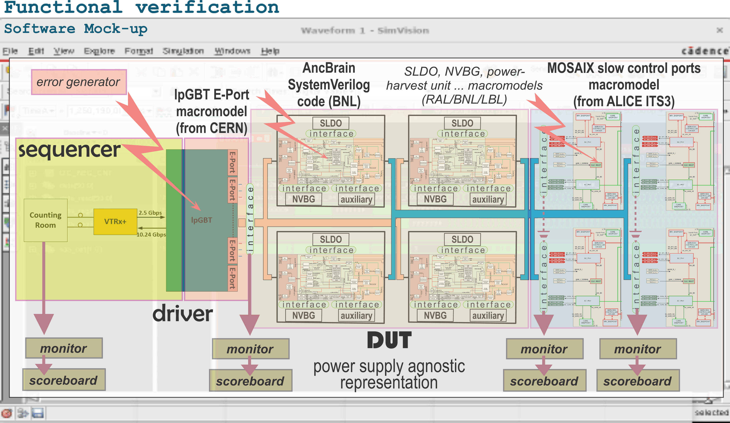
Design Verification – digital twin

Slide 17
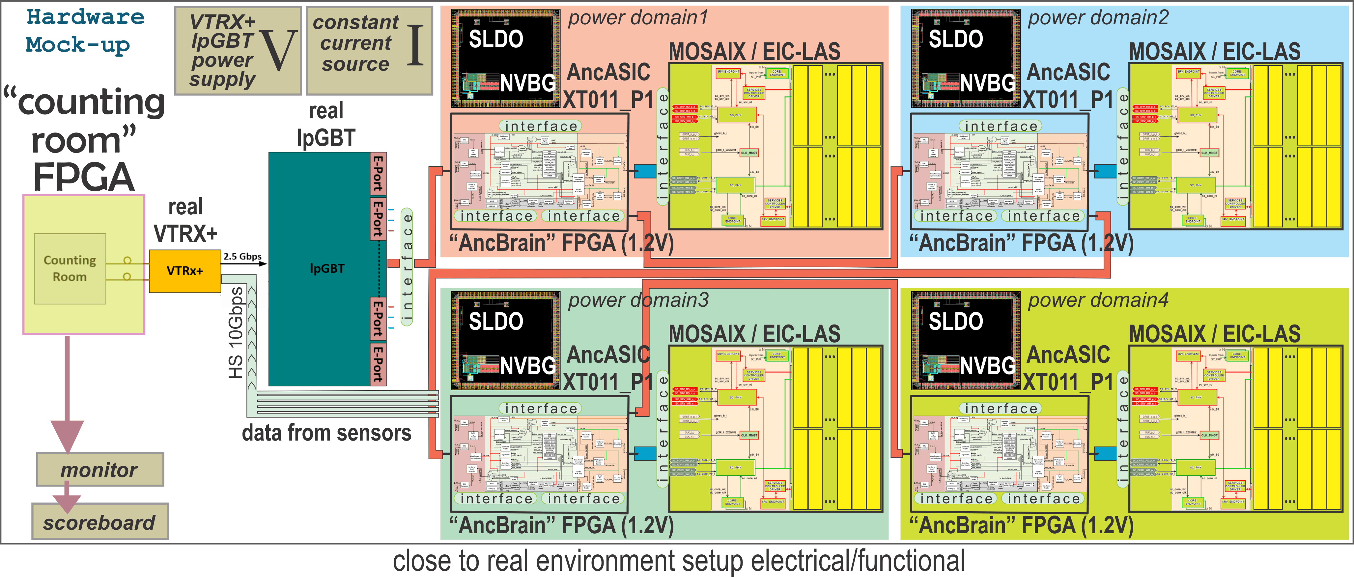
Design Verification – hardware emulation
Software Mockup (BNL) – needed for functional verification before implementation
  to verify code coverage, find exceptional situations, and reduce risks Æ single step implementation.
Hardware mockup (LBL)– needed to perform verification in experiment like environment
Both included in FY25 eRD113’s deliverables

Slide 18
Digital Verification: Digital Twin and Hardware Verification
In Summary:
These mockups are intermediate milestone towards ensuring the success of our digital work (that has some analog components still) hence full implementation.

Slide 19
Thank You

