Slide 1
ePIC Electronics and DAQ WG - 3/20/2025 – Echelon 0
News / Announcements
Schedule
Mar 27: GTU & Timing Synchronization Updates
Apr 1-2: Cherenkov PID project review
Apr 3: eRD109 Updates
Apr 10: RDO/DAM/GTU protocol ? Potential topics: Tasks needed for fall review / organization of
RDO/FEB development, Interface to Collider, Filtering logic, flow control, suggestions ?
Apr 17: Echelon 0 ? Potential topics: Frameworks, Data formats/readers, Frame building operation,
suggestions ?
Week of April 24 -- Combined meeting with SRO WG on monitoring & how its divided between SRO/DAQ
Pre-TDR text from DSCs/WGs: By June
- Need High Quality Plots
- Images --> tables
- Editing / updates in some sections
Agenda
Recent Activities of Interest
Digitization Effort in the Software and Computing (and calorimeter WG)
Unified ML initiatives starting up in Collider
TIC update
Revisit / Summarize last months run control state models discussion

Slide 2
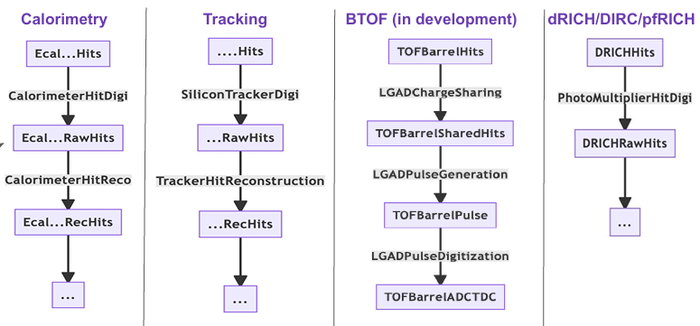
Digitization Effort in S&C
DAQ Files
Meeting yesterday: (me, Gerard, Norbert) https://indico.bnl.gov/event/27217/
Dmitry Kalinkin Described Sim Flow. The important point is that the intention is that DAQ data/readers Should be transparently able to insert into this chain at RawHits. The RawHits are logically equivalent to the data from the daq files (if in different format)
Also BIC (Minho Kim), LFHCAL (Derk Anderson), Tracking (Yann Bedfer), Low Q2 (Simon Gardner) updates on active digitization efforts
We should inspect the RawHits structures to ensure they match the expected electronics info
There may be follow-up meetings in conjunction with Electronics&DAQ
DAQ readers

Slide 3
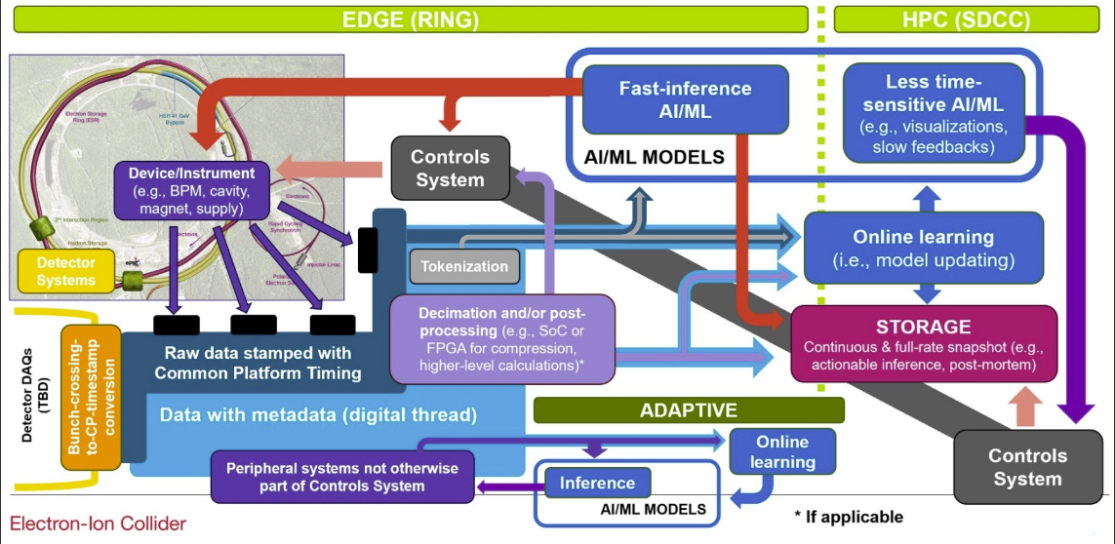
Unified ML Effort in EIC collider
Linh Nguyen organizing a global ML infrastructure for collider
She is soliciting use cases in order to generate requirements
Two useful ideas
Global Time Stamp associated to a global bunch number
“Digital Thread” – a global header for system events
My opinion is that full ePIC data is not that useful to a unified collider AI, but that we could have a DAQ component that distills useful DAQ/Slow Controls information
Use Cases:
Machine Protection – use Beam Position Monitors to sense instabilities and abort beam before the destroy ePIC detectors
After the fact debugging – determining causes of backgrounds seen in detectors, or of detector trips, or events.
Feedback for collider tuning
(Others?)

Slide 4
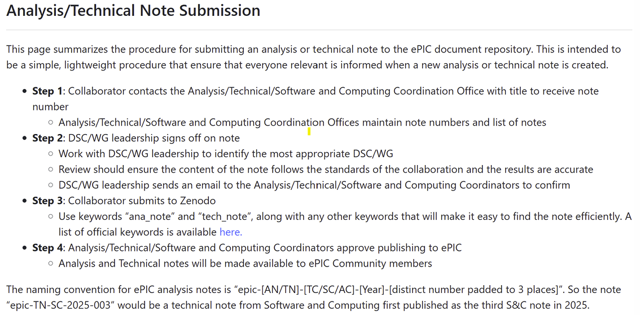
TIC Summary
Attending (Me, Fernado, Norbert, Tonko)
A scheme now exists for official ePIC technical notes
Oskar Hartbrich is coordinator for all CERN test beam requests
He requests needs for next 5 years
As they are far in the future, they should be short (single line) descriptions
Another test beam report (Carlos Camacho for EEEMCal)
Detailed discussion of Beam Pipe Constraints for detectors. (Firm 5mm clearance required for all detectors, 10mm for certain detectors). Outlined status of many detectors (Roland Wimmer)
No TIC Meeting next week!

Slide 5
Summary of Last Months Run Control State Discussion
A small number of states (and transitioning states) are maintained for each component at the DAM board level
Transitions are initiated from the run control software through the fast command path to the DAM.
Each DAM board interprets transition commands and orchestrates the detailed states of its components
Configuration and State Changes (at the component level) are independent of one another.
Slow Controls descriptions of detectors are also specified into states, and these states are known to the run control.
At the component level there is no run concept. There is only the current list of running components. This list is modified by configuration events
This allows the underlying fact of continuously operating systems, and systems coordinated in physics runs beginning and ending at specific times to co-exist
The labeling and organization of runs moves to the control logic, and doesn’t affect the core DAQ processes
This scheme does require splitting of configuration commands
Config – “Full” configuration (can be slow)
Restart – Reconfigures only data routing information (must be fast)
REBOOT,
Disconnection
Powerup
Unconnected
Error
Accept Connection
Ready
SET_ERROR
CONFIG
STOP_DONE
CONFIG
configuring
DONE_CONFIG
stopping
Configured
STOP
(usually from Server
Can be from client)
START
starting
DONE_START
DONE_RESTART
Running
PAUSE
restarting
pausing
RESTART
Paused
DONE_PAUSE
DONE_RECOVERY
(from client)
START_RECOVERY
(from client)
Auto-recovering

Slide 6
Example of Multiple Data Stream Operation
1 | 2 | 3 | 4 | 5 | 6 | 7 | 8 | 9 | 10 | 11 | 12 | 13 | 14 | 15 | 16 | 17 | 18 | 19 | 20 | 21 | 22 | 23 | 24 | 25 | 26 | 27 | 28
 |  |  | (Restart) |  |  | Restart |  |  |  |  |  |  | Restart |  |  |  | Restart |  |  |  |  | (Restart)
 |  |  |  | Config |  | Start |  |  |  |  |  |  | Stop |  | Config |  | Start |  |  |  |  | (Restart)
 |  |  |  |  |  |  |  |  |  |  |  |  |  |  | Config |  | Start |  |  |  |  | (Restart)
 |  |  |  |  |  |  |  |  |  |  |  |  |  |  | Config |  | Start |  |  |  |  | (Restart)
 |  | Config | Start |  |  |  |  |  |  |  |  |  |  |  |  |  |  |  |  |  |  | Stop
 |  |  |  | Config |  | Start |  |  |  |  |  |  | Stop |  | Config
 |  | Config | Start |  |  |  |  |  |  |  |  |  |  |  |  |  |  |  |  |  |  | Stop
Time
(Always On Detectors)
Detector 1
Detector 2
Detector 3
Detector to test stream
Global Run #1
Issue
Stop
Change
Detector
List
Issue
Start #2
Global Run #2
Shift Perspective
Issue
Start #1
Main RC Interface
Test RC Interface
(If used)

