Slide 1
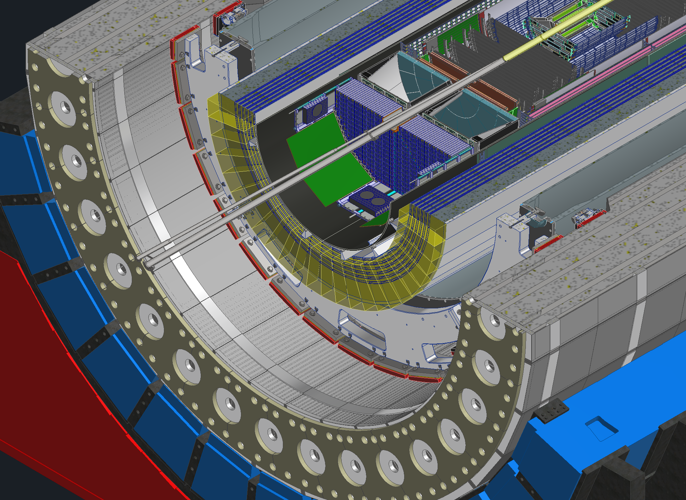
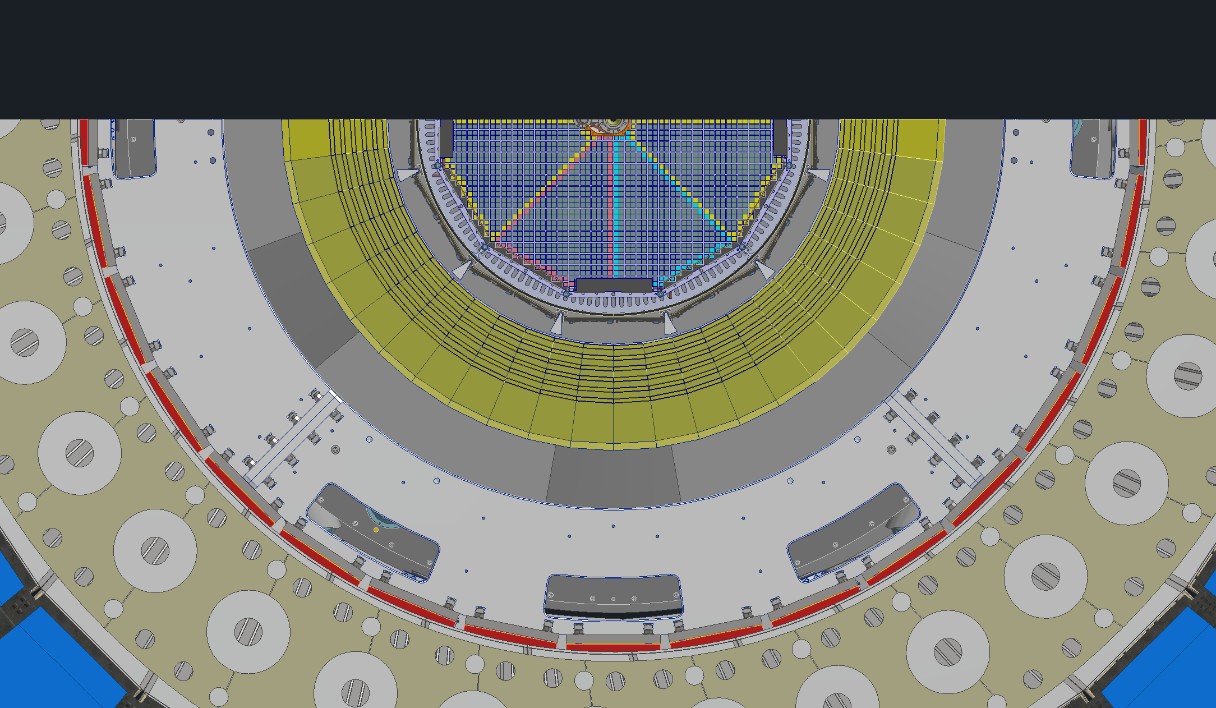
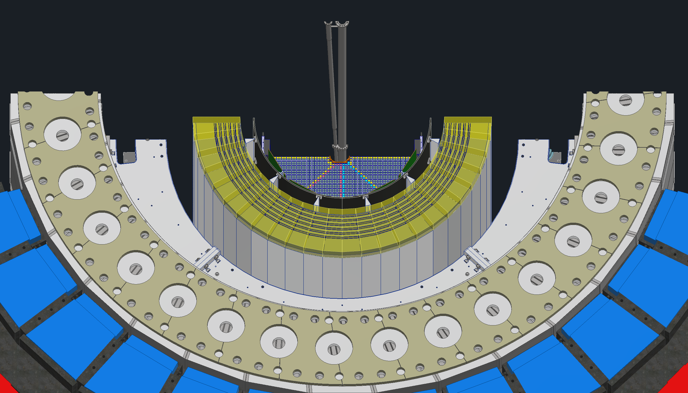
Backward end views

Slide 2
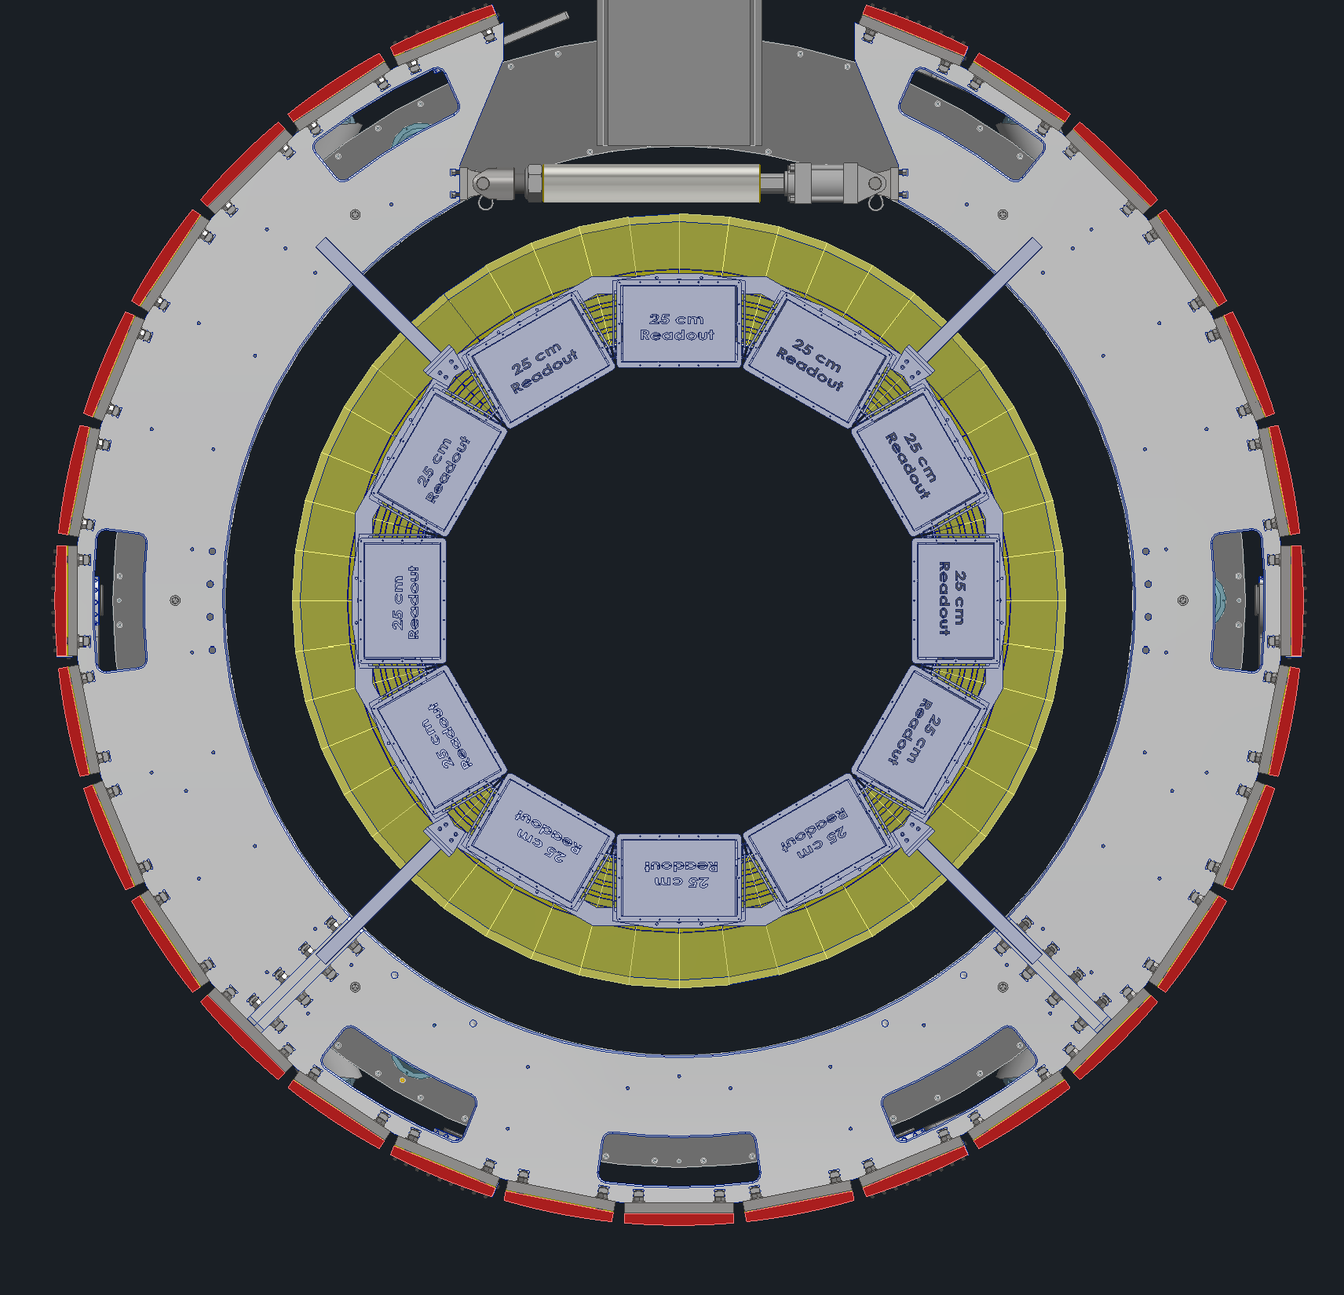
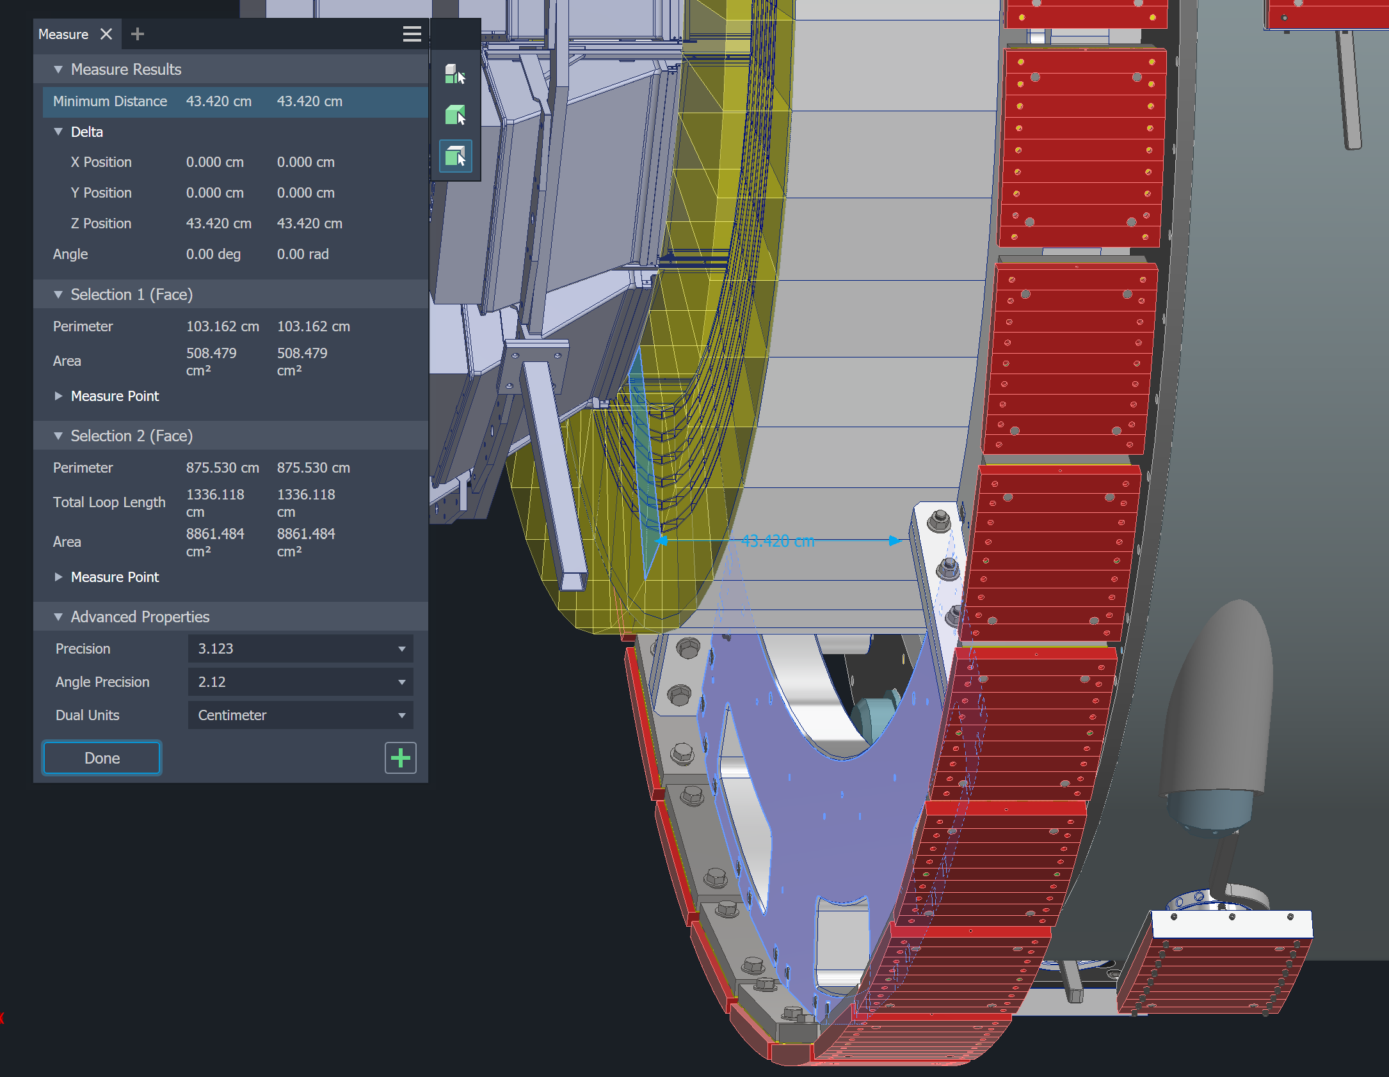
Orange is proposed support location. The EMCAL supports would sit on top of the inner support rings. The inner support rings sit at Z = -217.17 cm to -227.33 cm in the backward direction and Z = 194.310 cm to Z = 204.470 cm in the forward direction. In the backward direction the support will be simple and will support the EMCAL directly from the inner support rings.

Slide 3
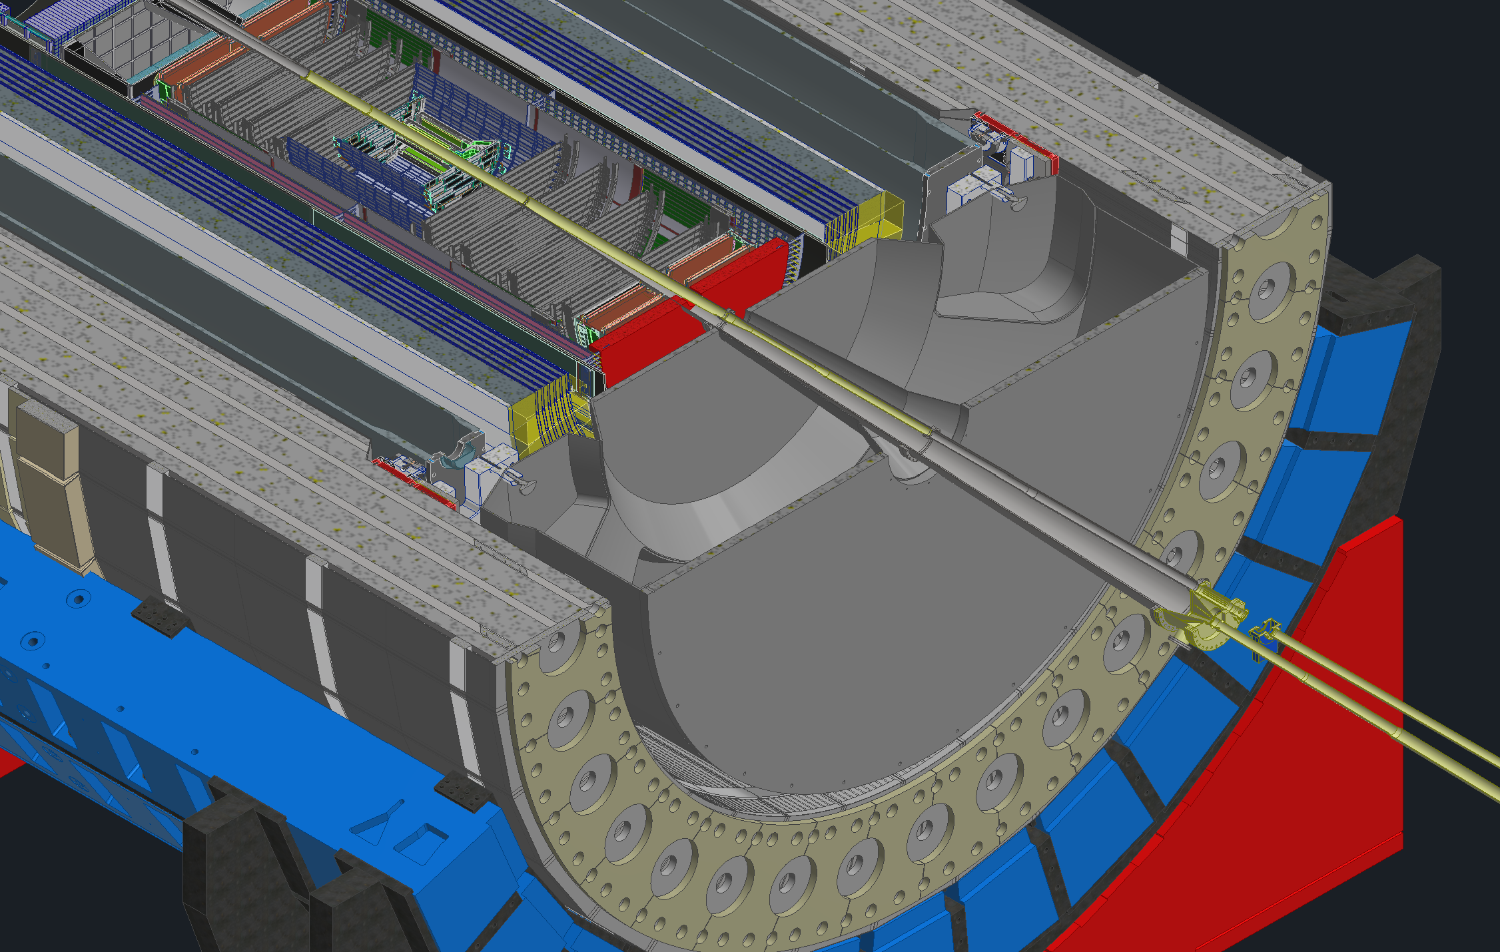
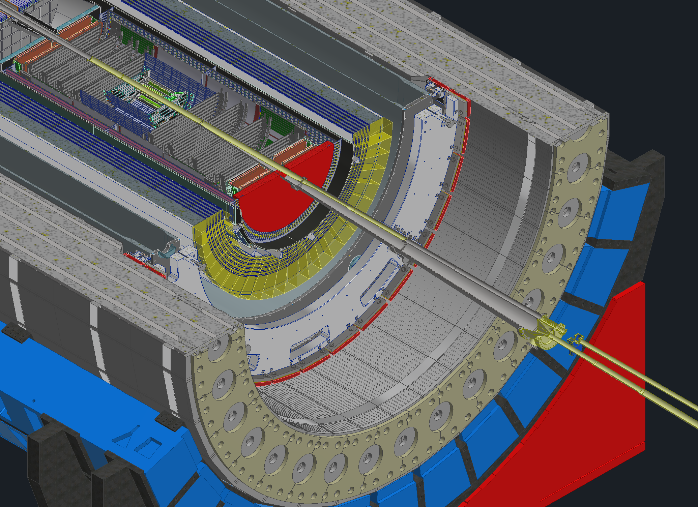
Forward end
dRICH missing view

Slide 4
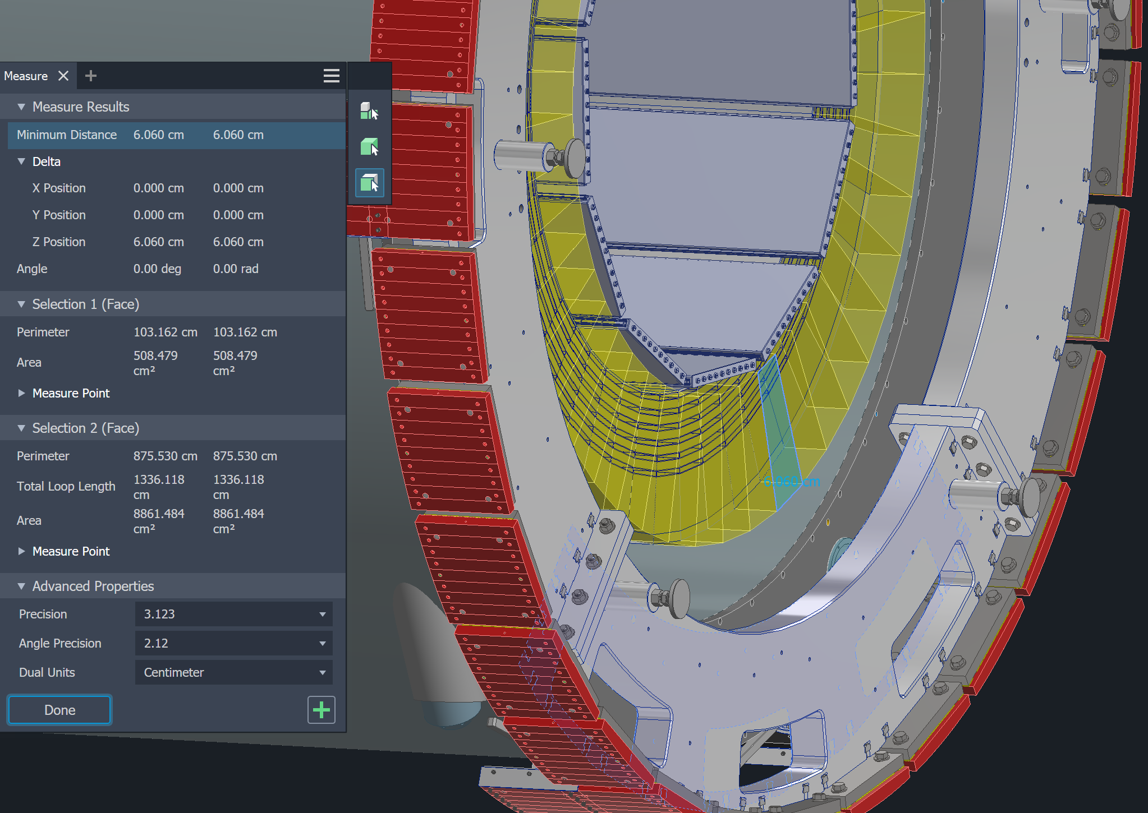
In the forward direction the support will be a little bit more complicated due to the support ring being past the EMCAL in Z. Moving the electronics outward radially may not be possible.

Slide 5
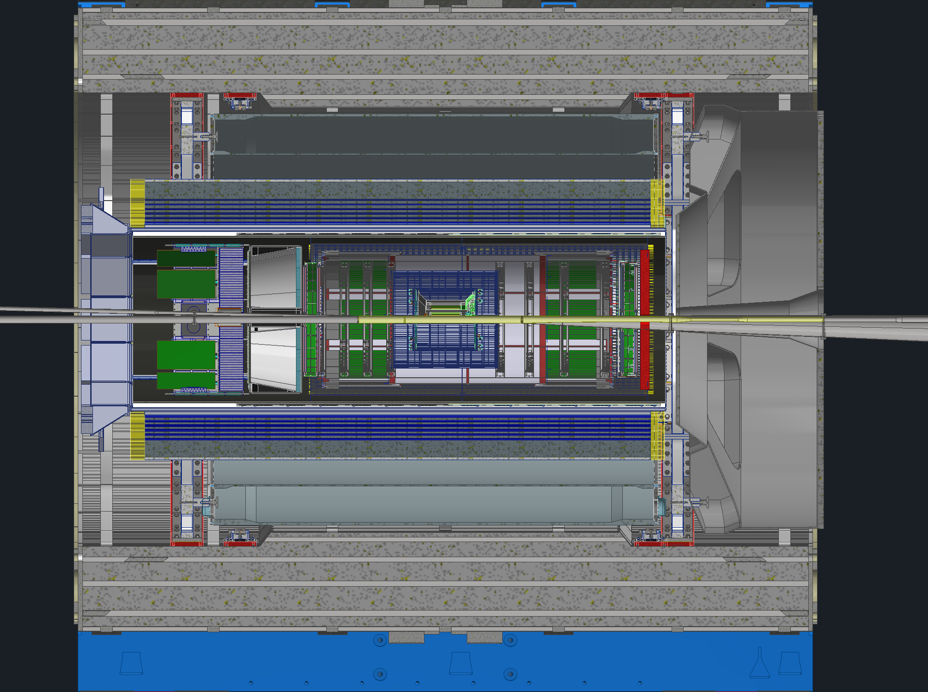
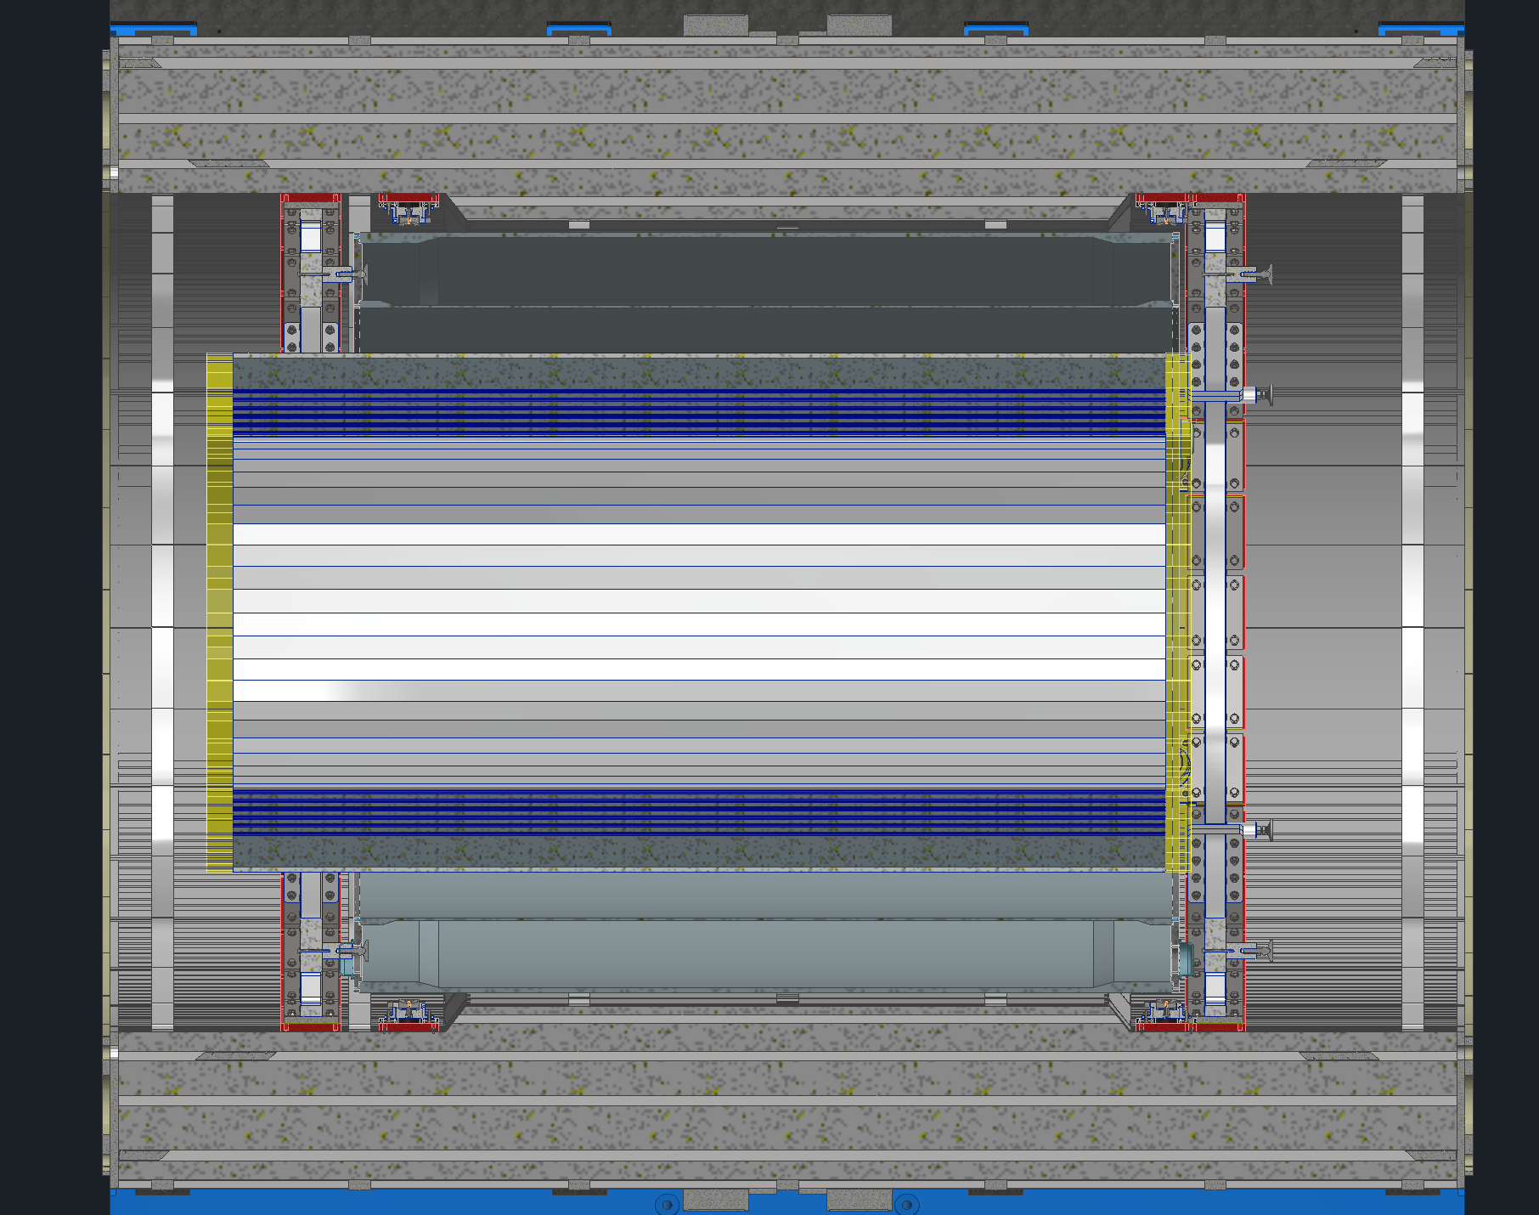
Inner support rings
Proposed support locations

