Slide 1
pfRICH Sensor Plane Structural FEA
Simon Snydersmith, Sushrut Karmarkar, Andreas Jung
23 February 2025

Slide 2
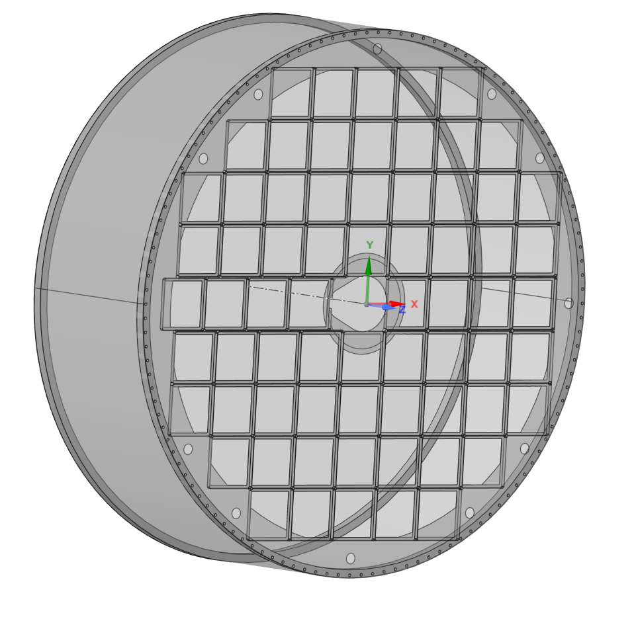
Geometry
Shells:
Sensor plane
Aerogel plate
Honeycomb sandwich vessel
Solid bodies:
End rings
Interstitial beams (T-beams) for pyramid update

Slide 3
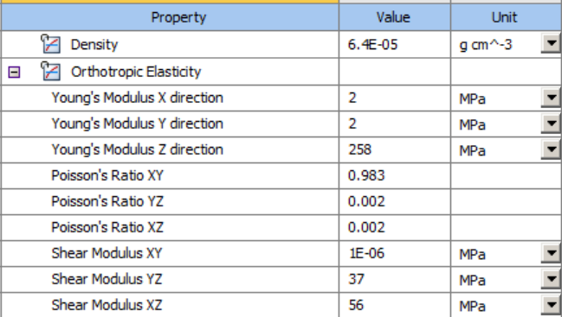
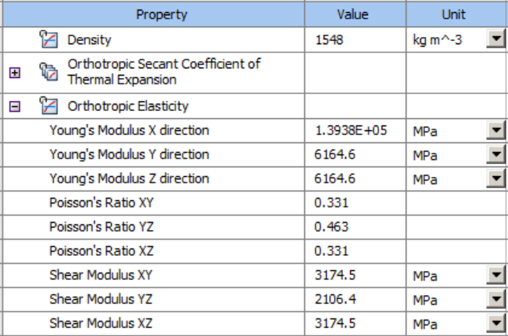
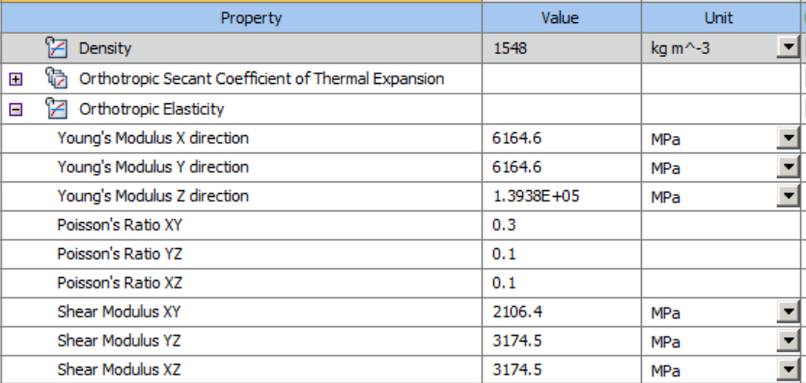
Material Properties
Aramid Honeycomb
AS4-epoxy composite

Slide 4
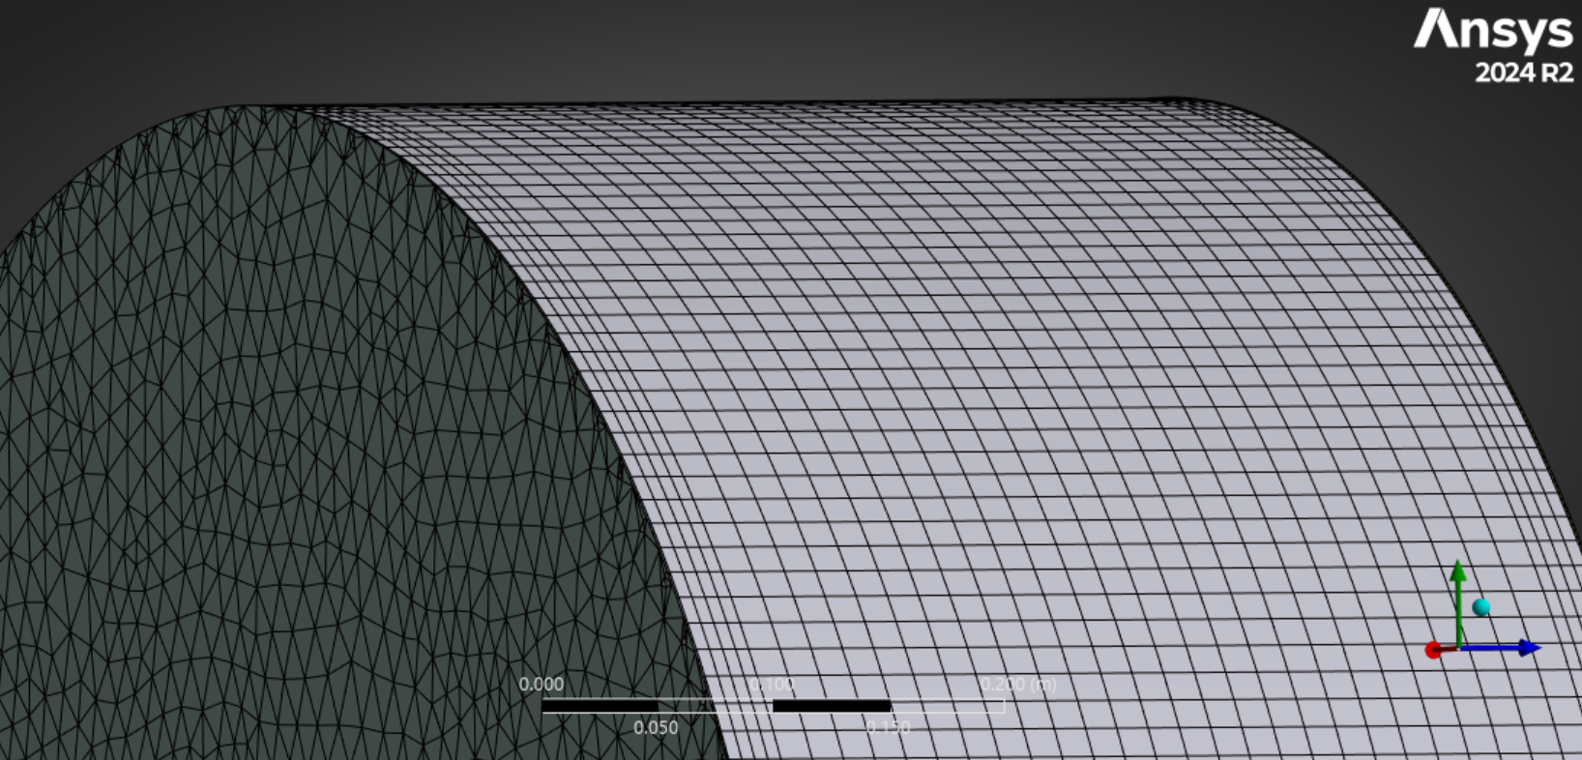
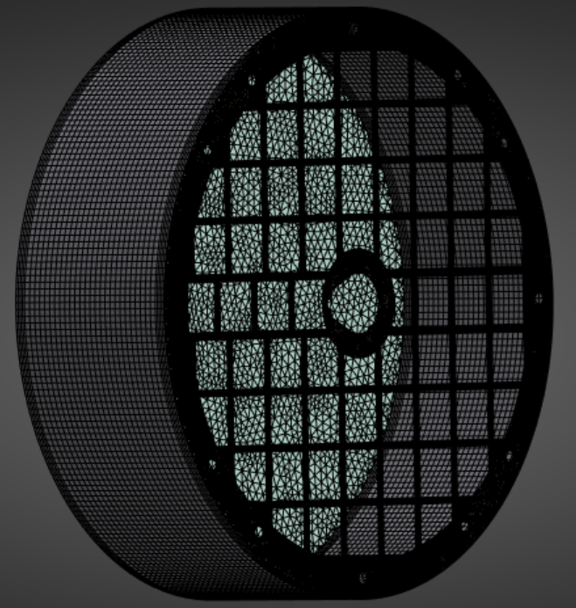
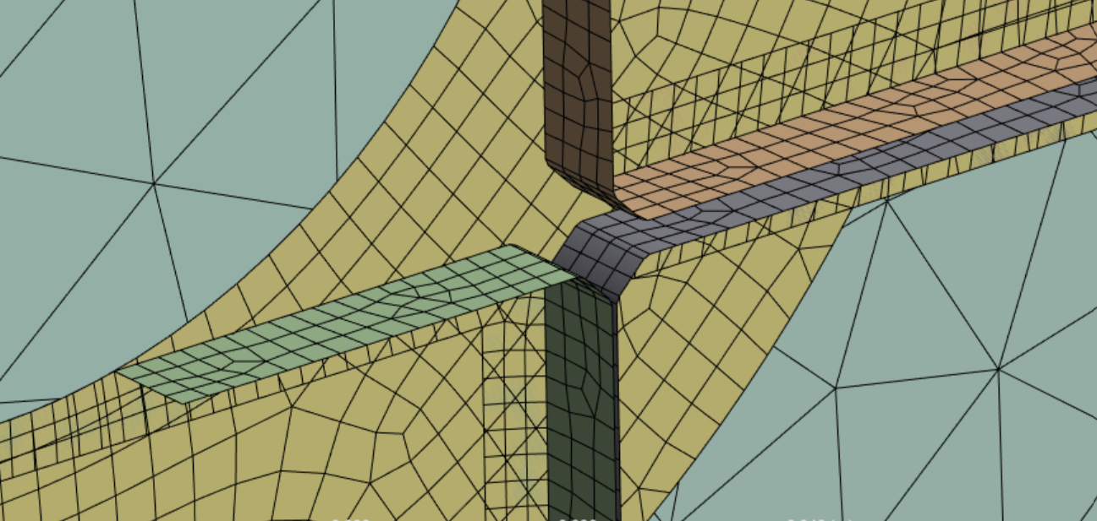
Shell Composite Meshing
Maximum element sizes (mm)
Sensor frames, 3
Backing plate, 4
Gel plate, 20
Vessel, 15
Vessel
Gel plate
Backing plate
Sensor frames

Slide 5
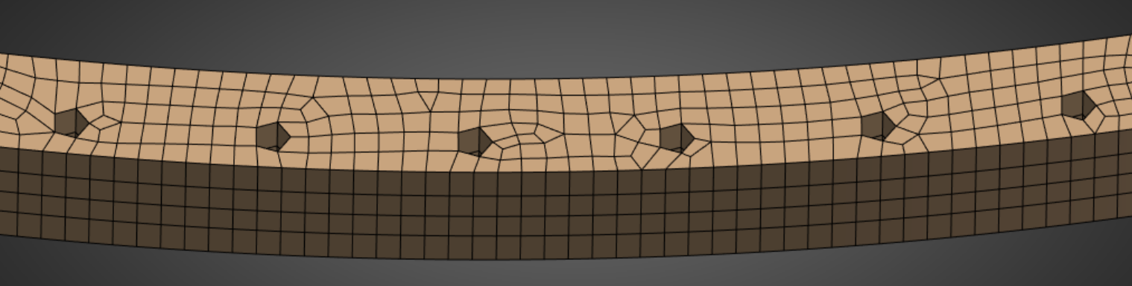
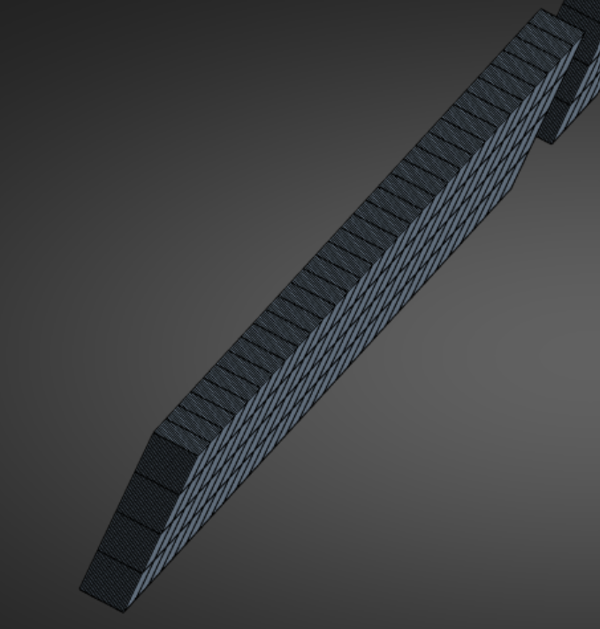
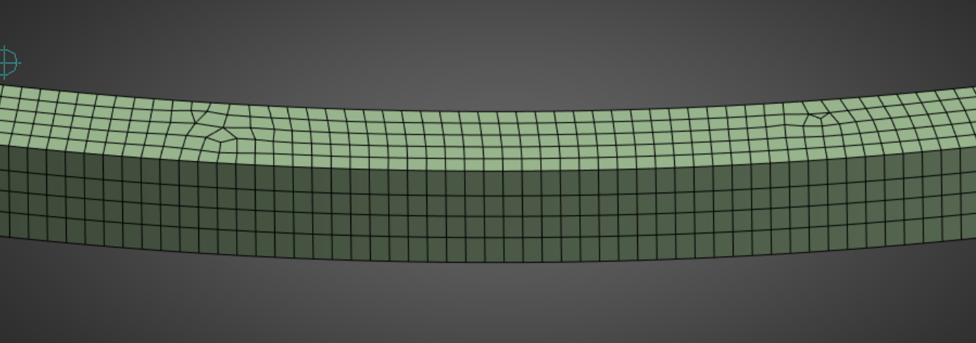
Solid Composite Meshing
Maximum element sizes (mm)
Interstitial beams, 2.5
End rings, 4
End ring top

Slide 6
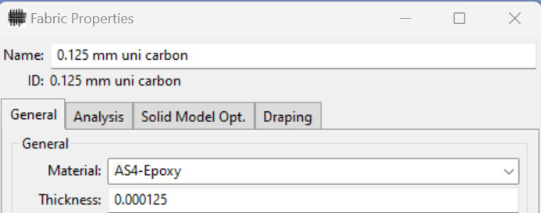
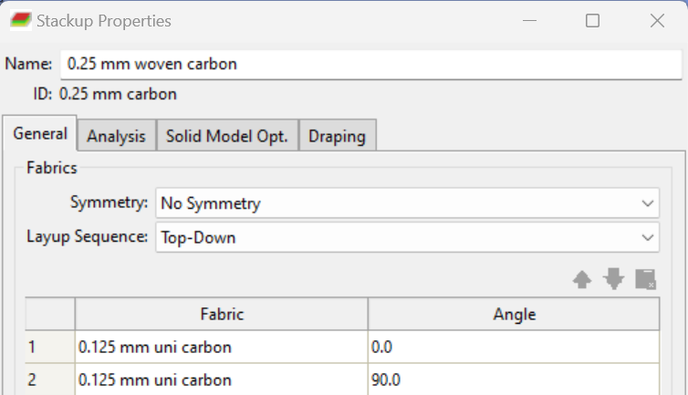
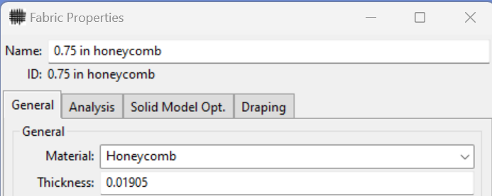
Shell Layup Fabrics

Slide 7
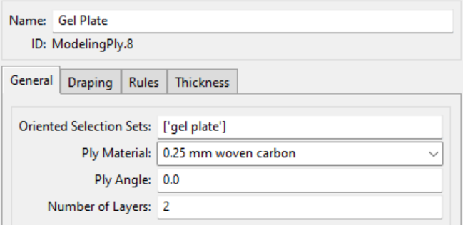
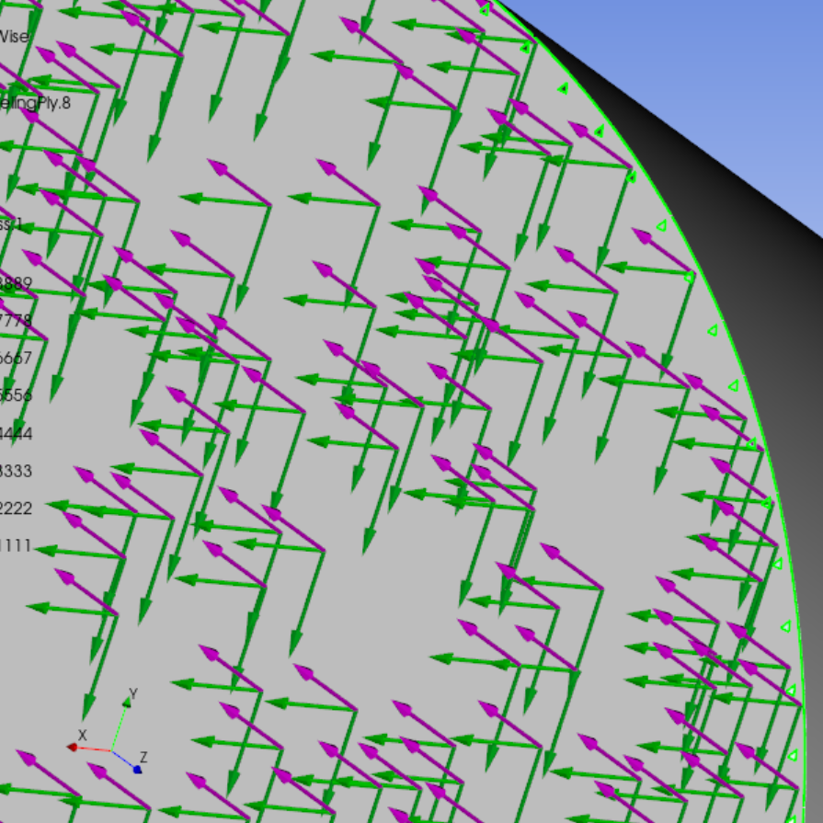
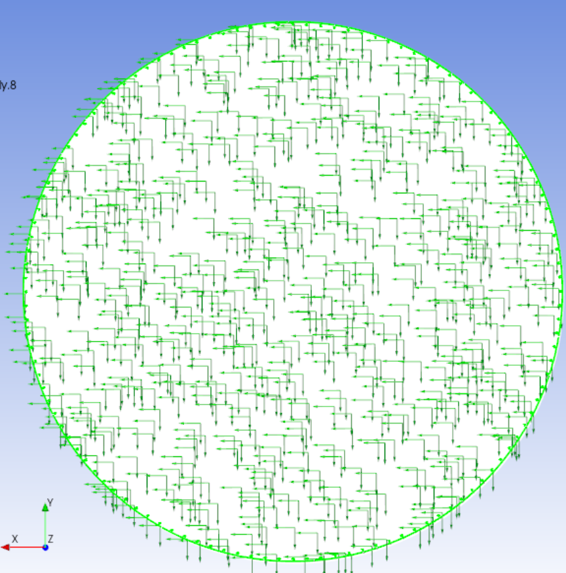
Aerogel Plate Layup
Fiber Direction (light green)
Transverse Direction (dark green)
Layup Orientation (magenta)

Slide 8
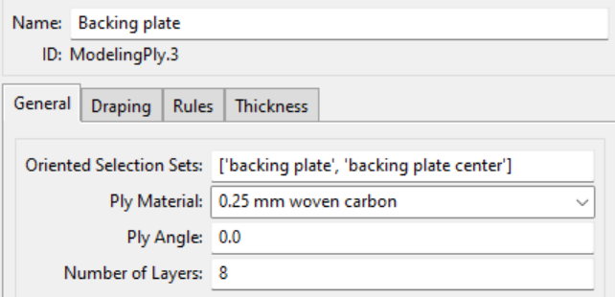
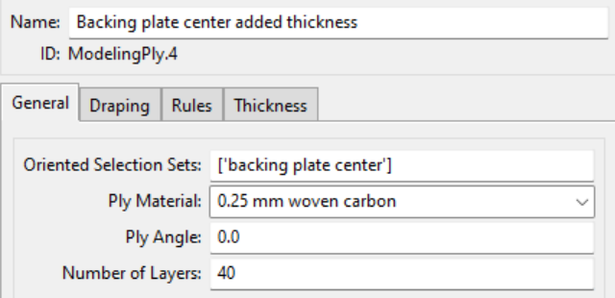
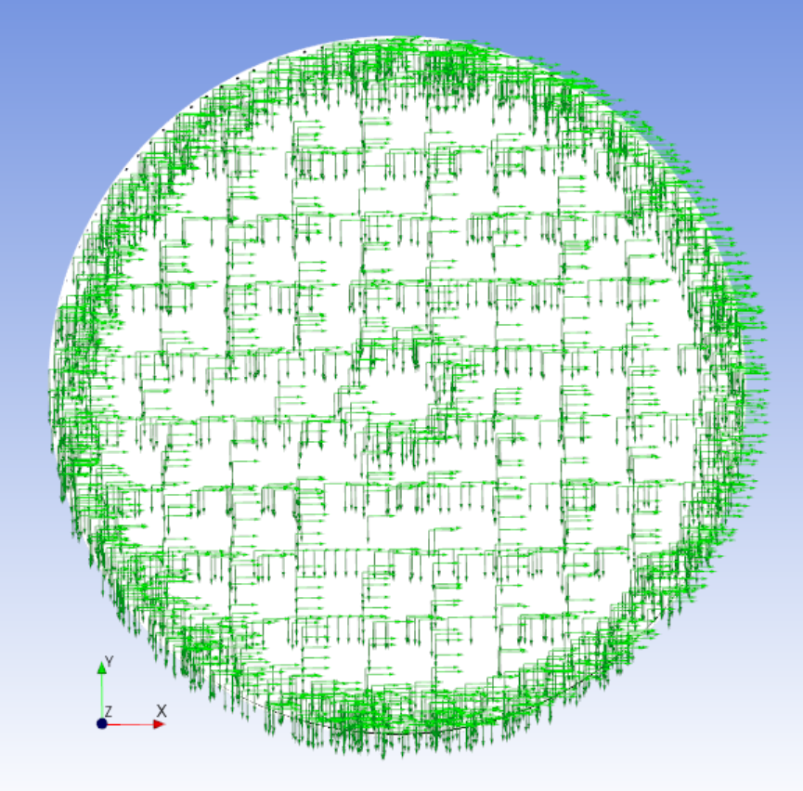
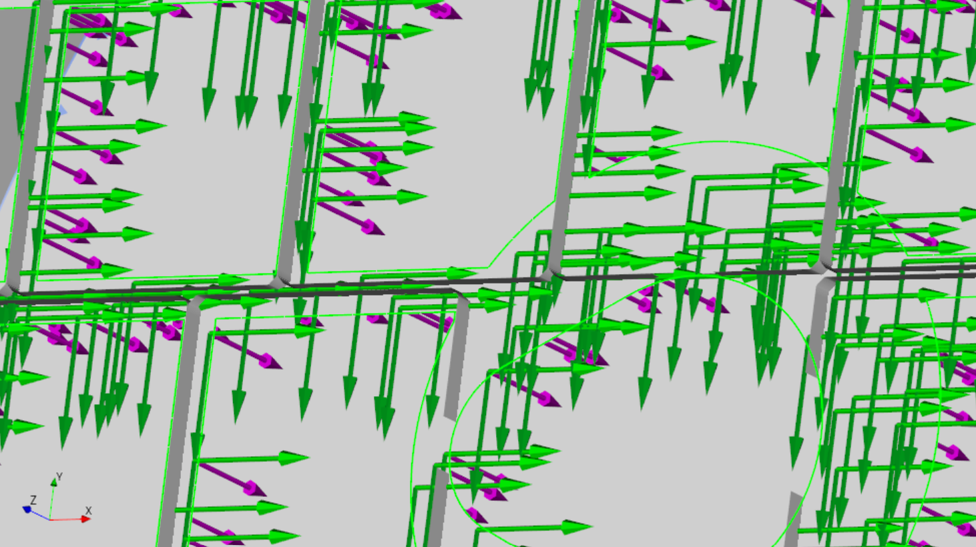
Backing Plate Layup

Slide 9
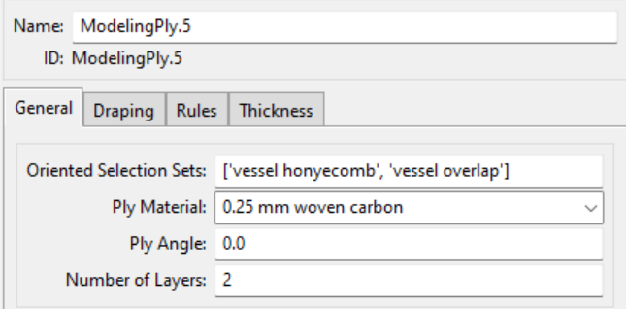
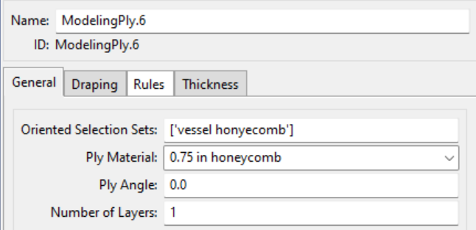
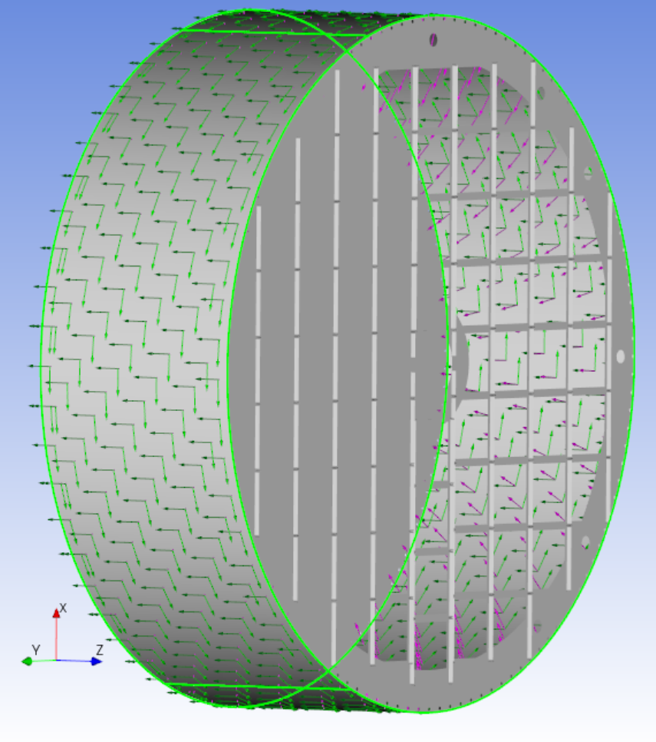
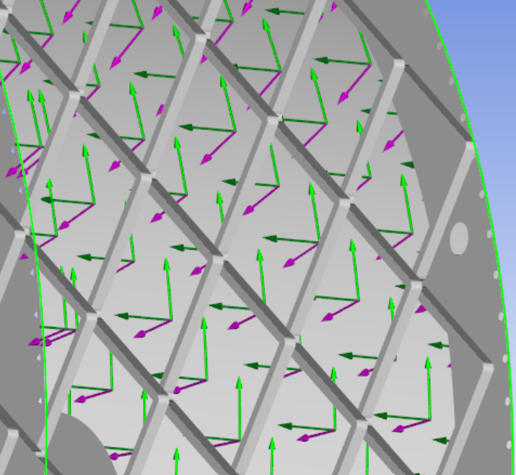
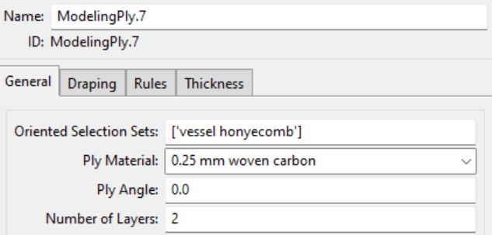
Vessel Layup

Slide 10
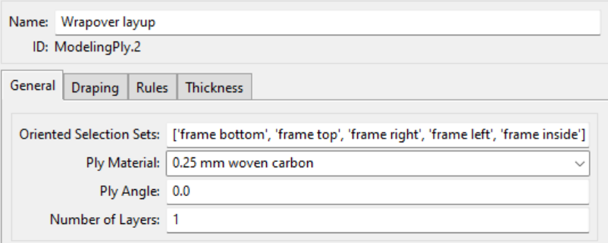
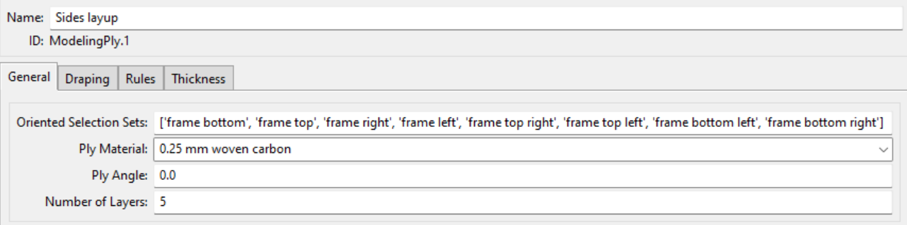
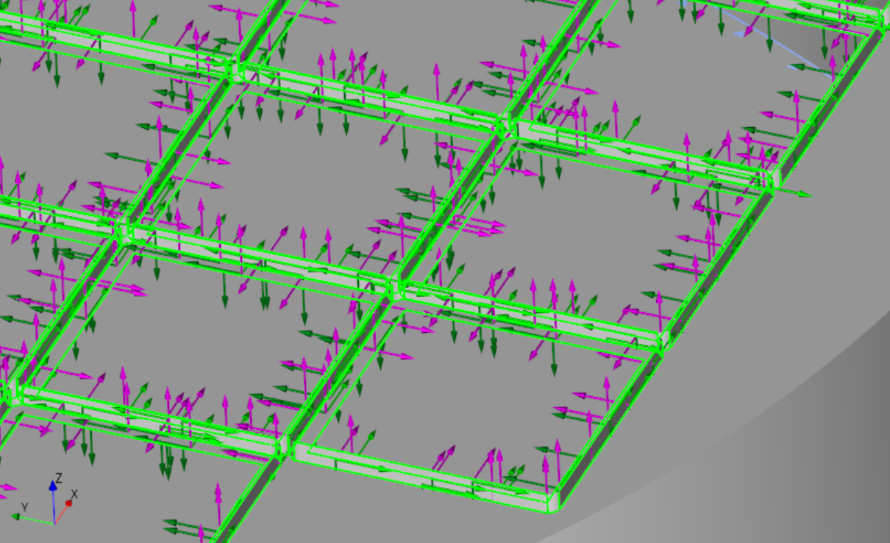
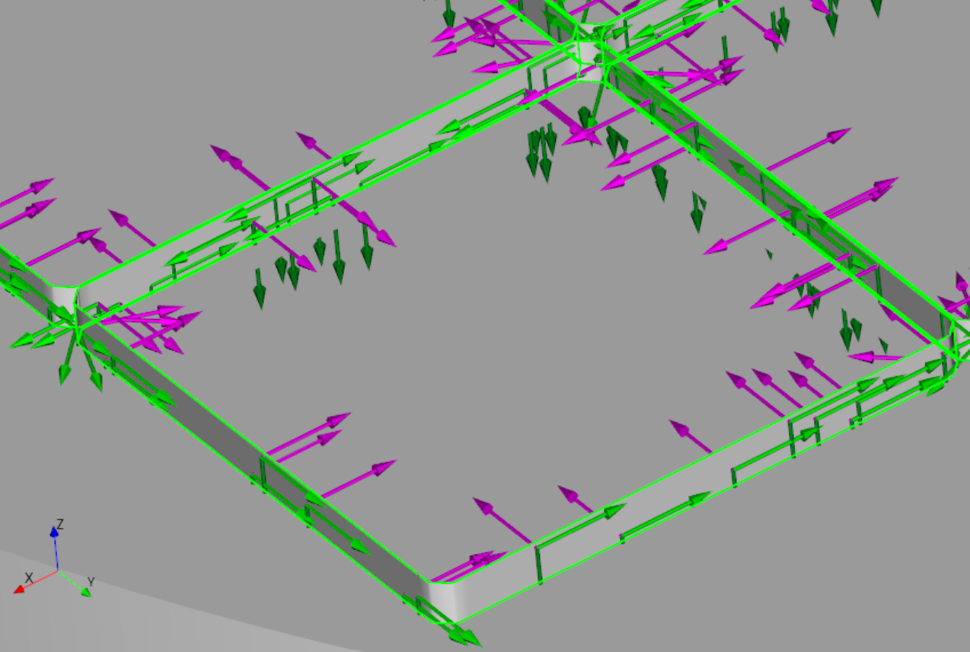
Sensor Frames Layup

Slide 11
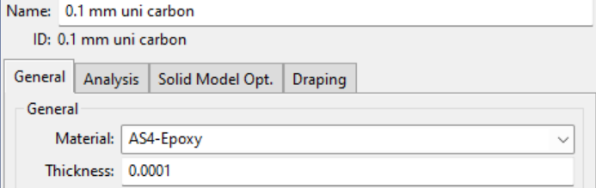
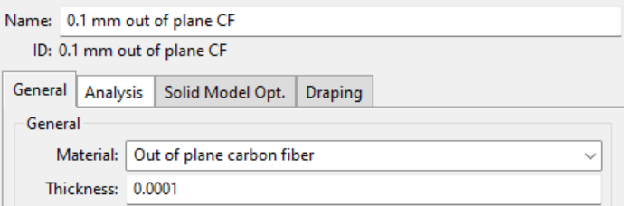
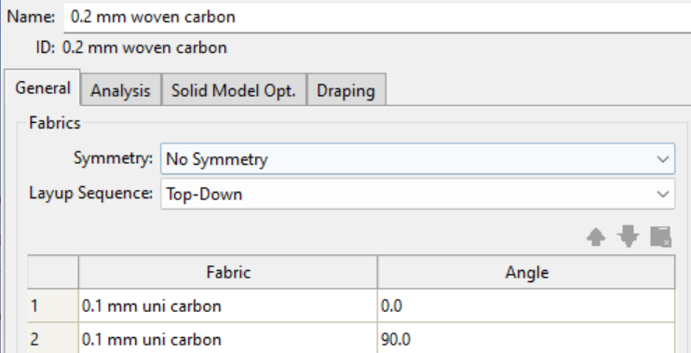
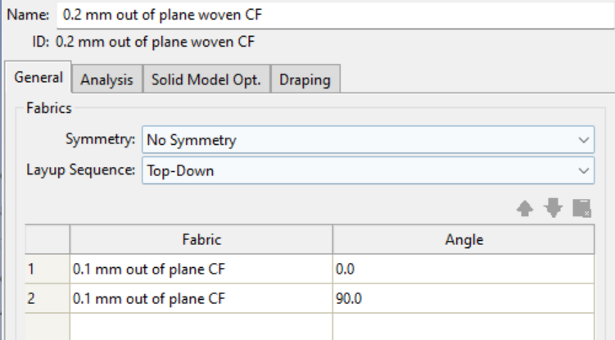
Solid Layup Fabrics

Slide 12
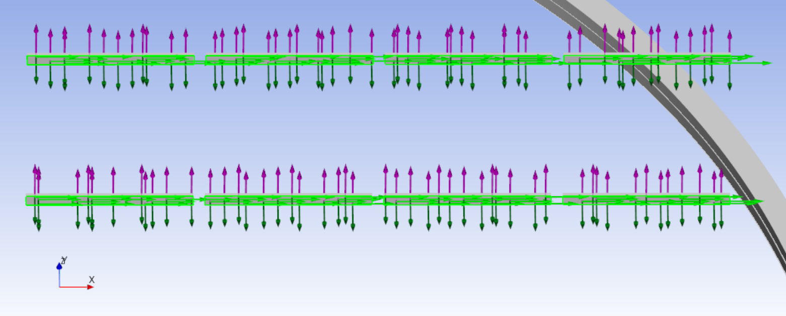
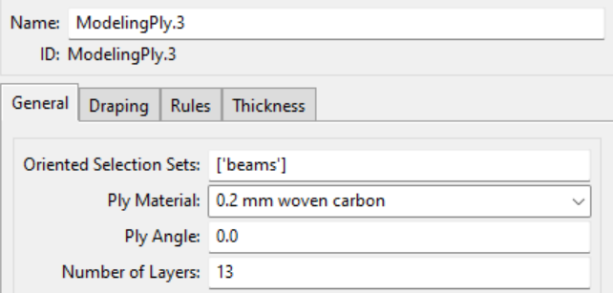
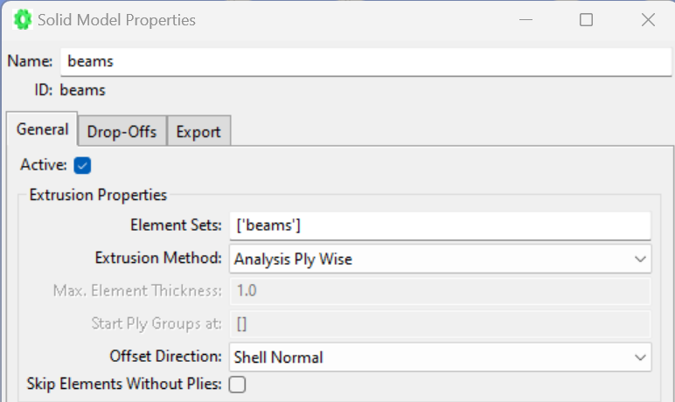
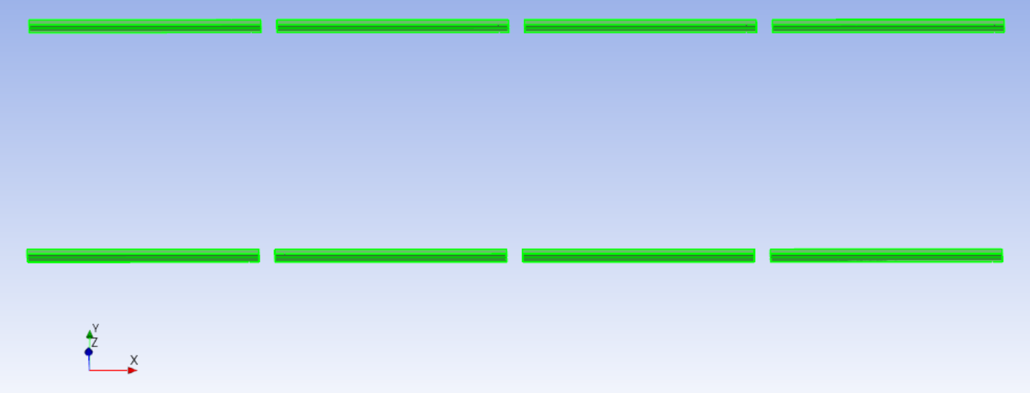
Interstitial Beams Layup

Slide 13
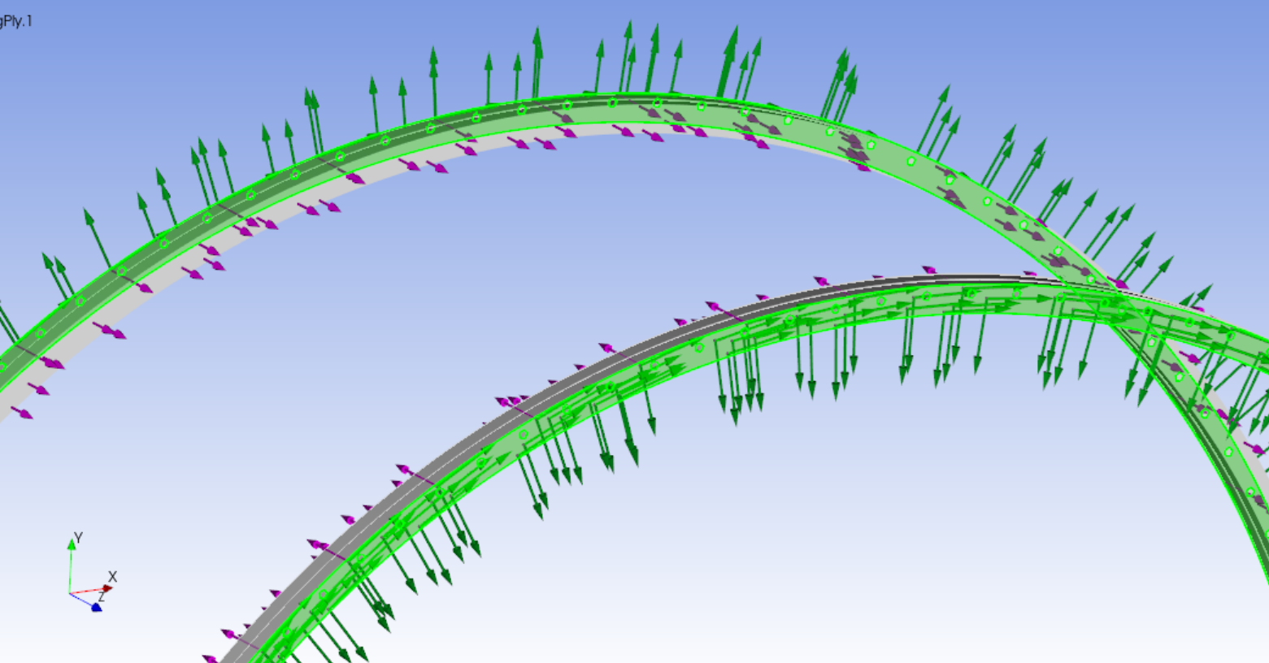
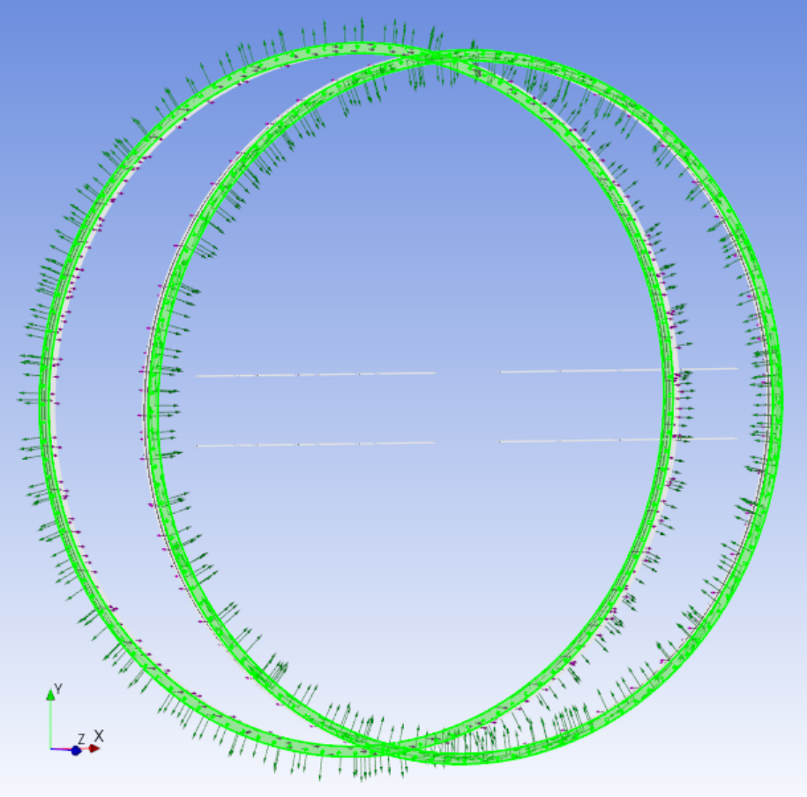
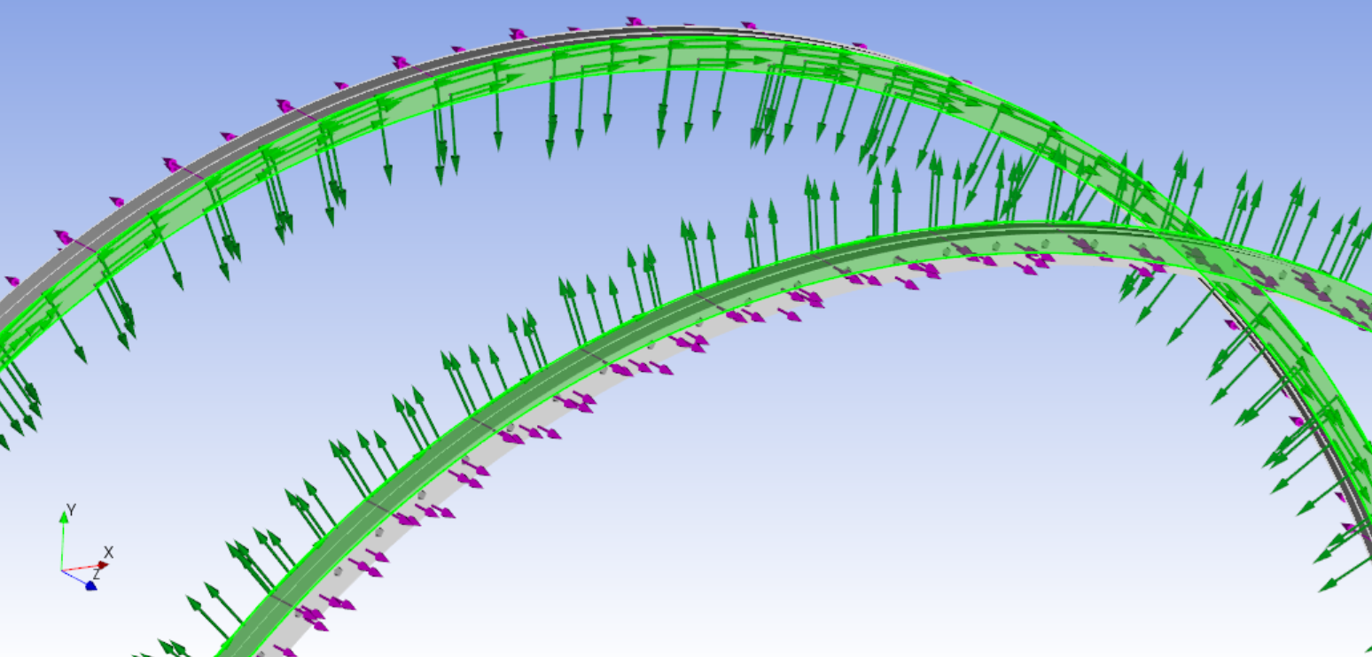
End Rings Layup

Slide 14
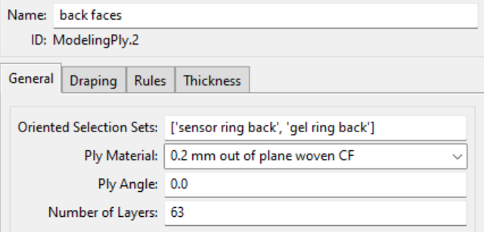
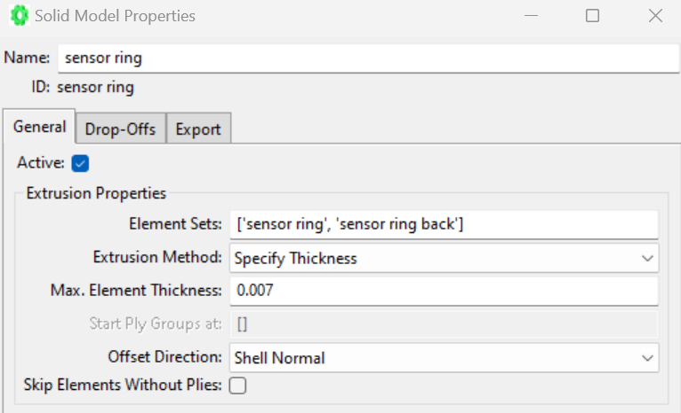
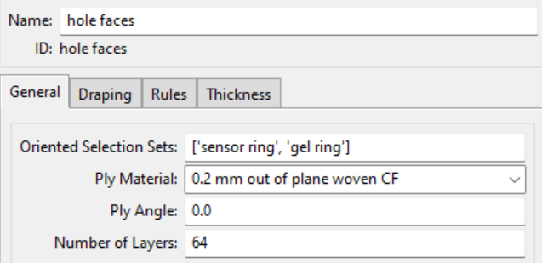
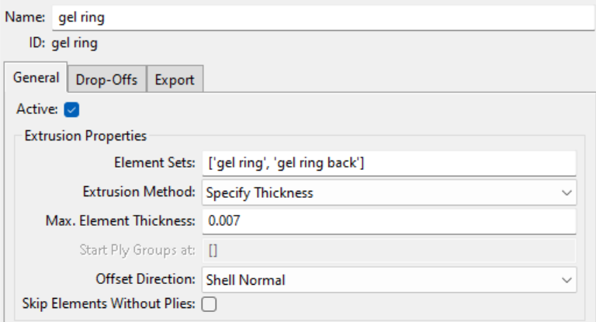
End Rings Layup

Slide 15
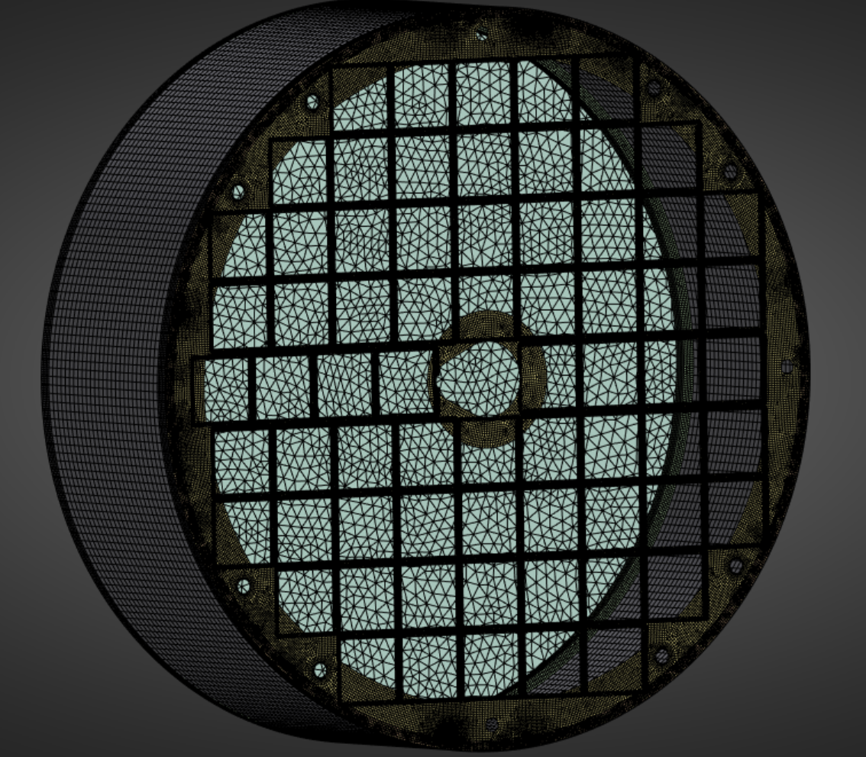
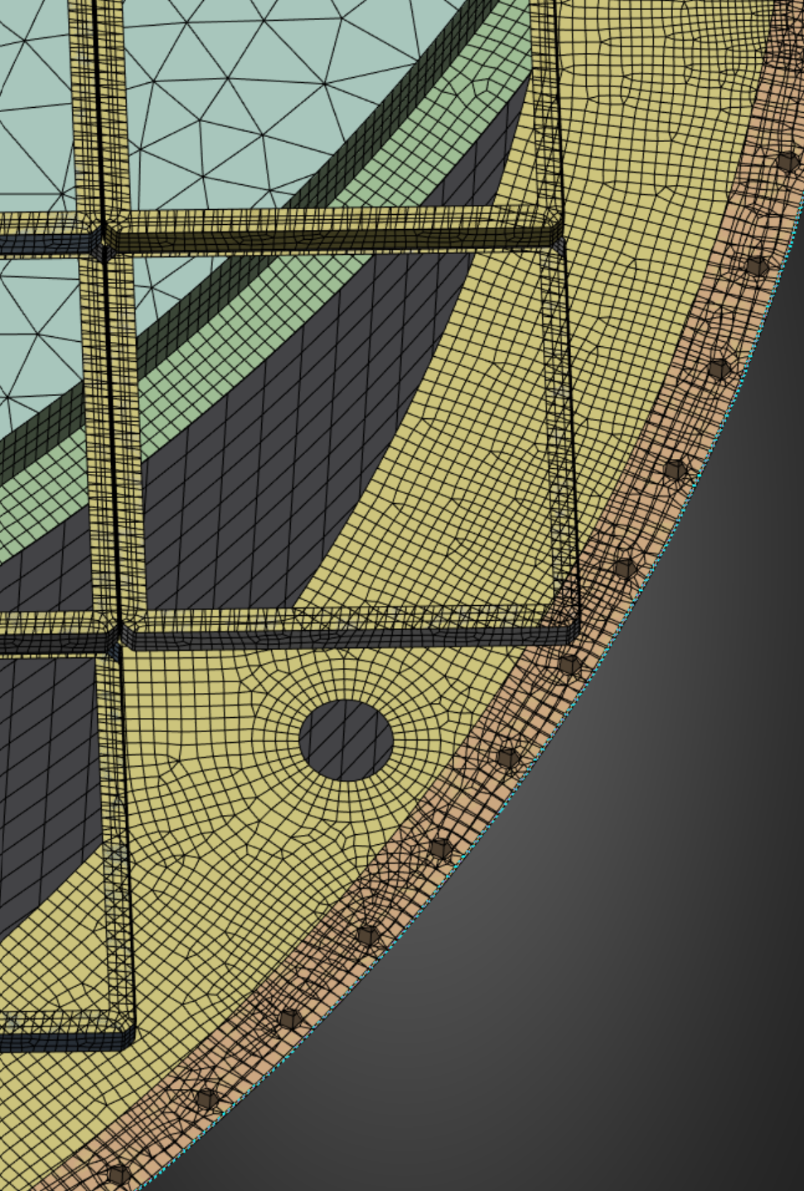
Combined Mesh

Slide 16
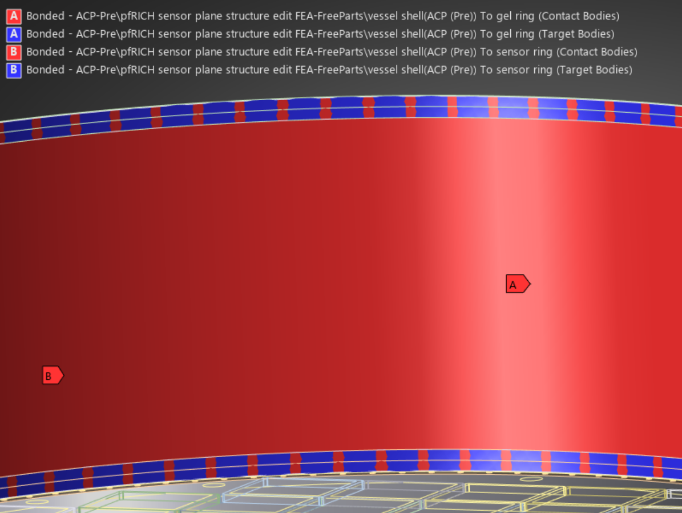
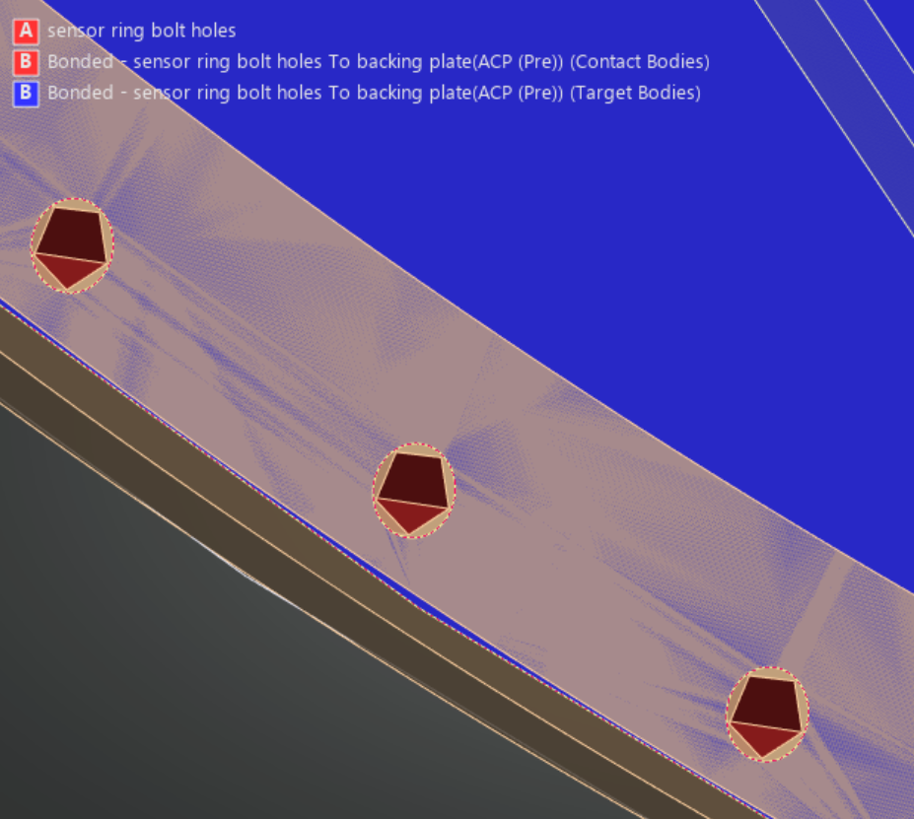
Connections
Contacting faces in shell model (sensor frames to backing plate) automatically bonded

Slide 17
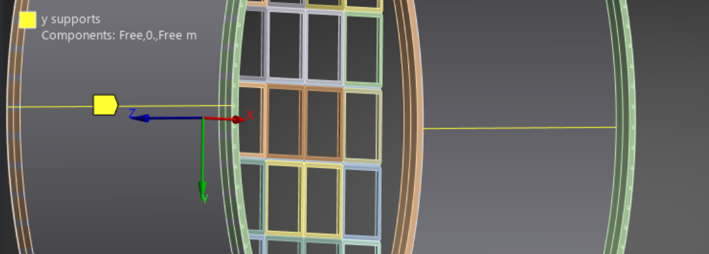
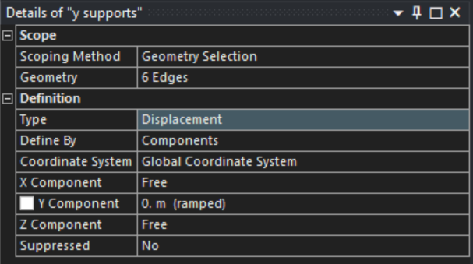


Constraints

Slide 18



Upright load case
1 kg per 68 sensors applied downward onto the bottom faces of sensor frames
Manually calculated gravity weight applied downward to all bodies

Slide 19



Total Deformation
Backing Plate Only, different scale

Slide 20



Von Mises Stress
Backing Plate Only, different scale

Slide 21


Laying Flat Loads and Constraints
All loads switched from –Y direction to –Z direction
Fixed support on backing plate

Slide 22



Total Deformation
Backing Plate Only, different scale

Slide 23



Von Mises Stress
Backing Plate Only, different scale

Slide 24

Machining progress on End Ring #4
Insert bonding done on Friday, 21st Feb, 2025
Continue with top final pass and outer and inner diameter.

Slide 25
Vacuum pressure nomenclature
The numbers correspond to the vacuum pressure as shown in this table
DP460 as well as PT2712
Sample ID | Pressures
1 & 2 | 20 in Hg
3 & 4 | 10 in Hg
5 & 6 | 0 (no vacuum)

Slide 26

Things to discuss when Alex E. is at Purdue this week

