Slide 1
Co-Bonding Discussion
Alex Eslinger (JLab)
3-5-25

Slide 2
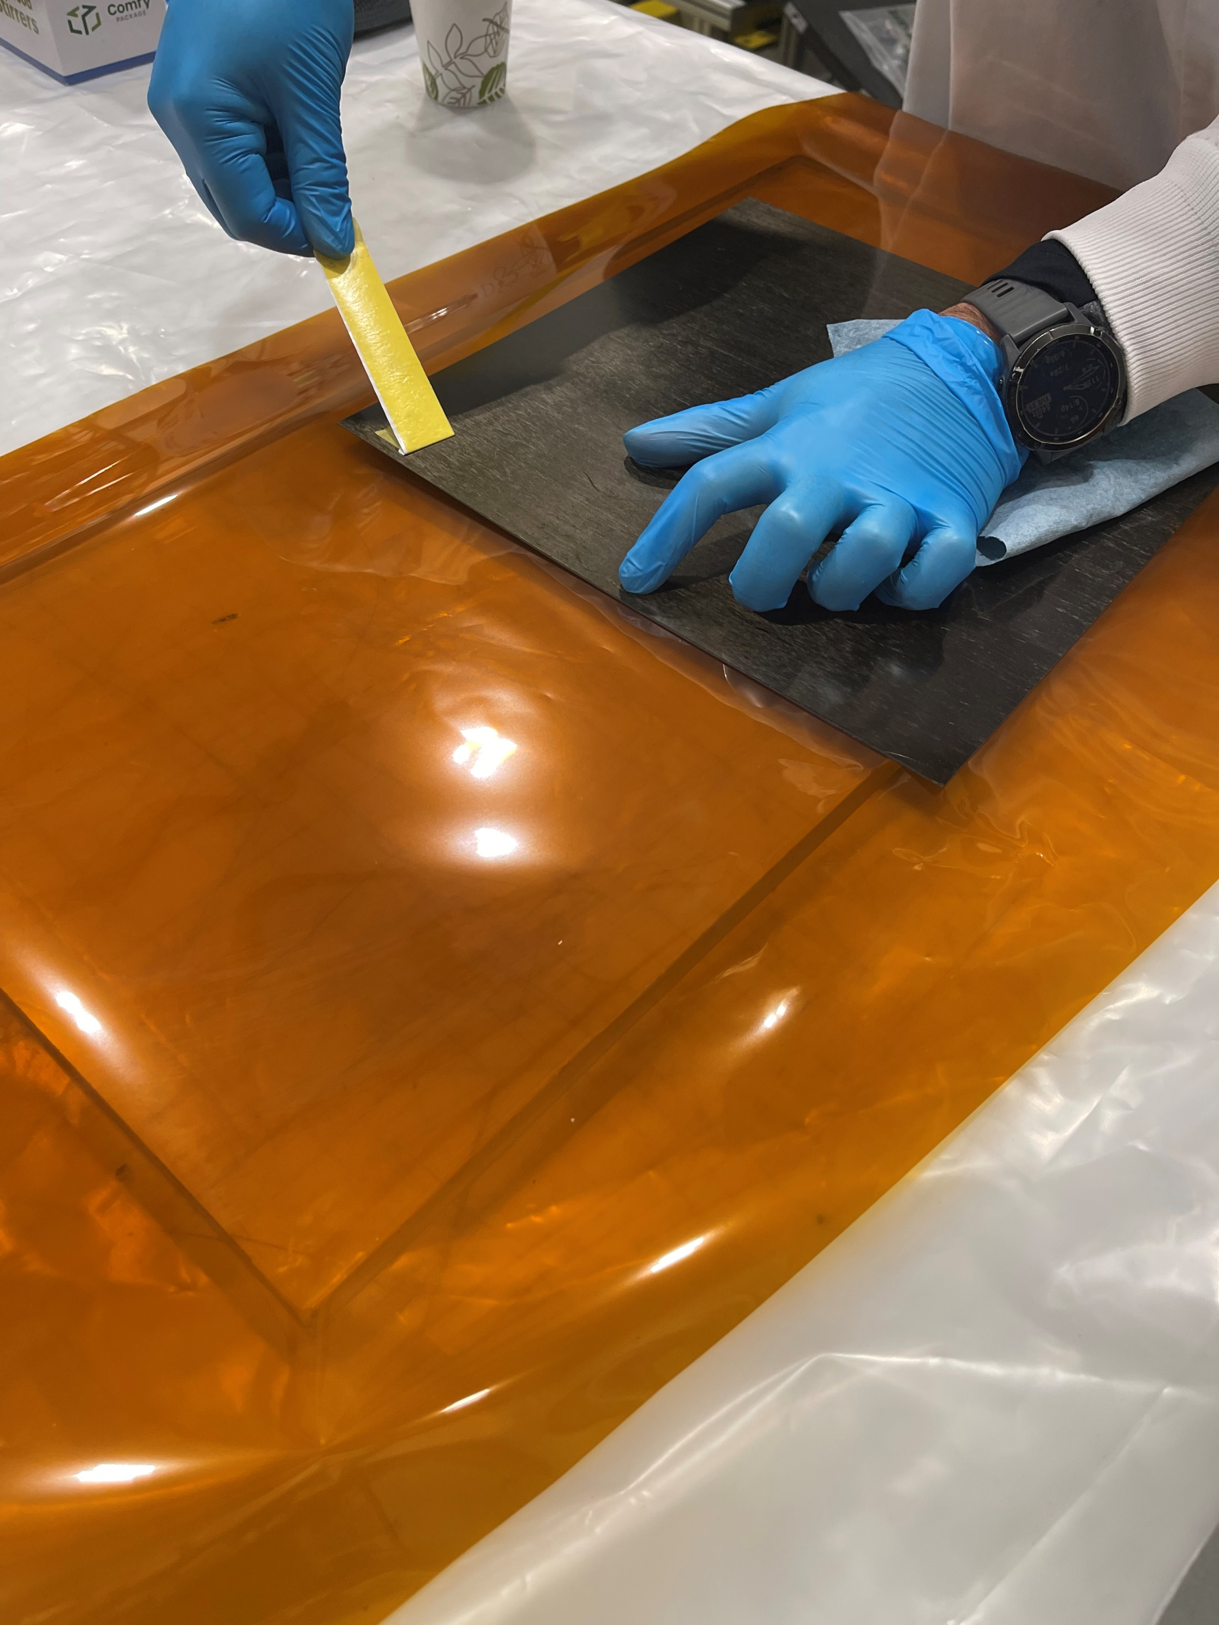
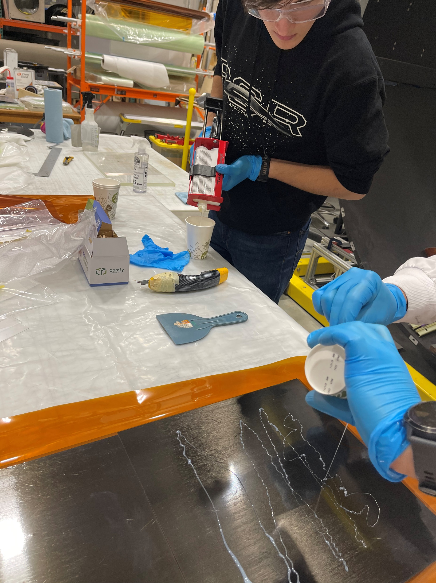
Preparation

Slide 3
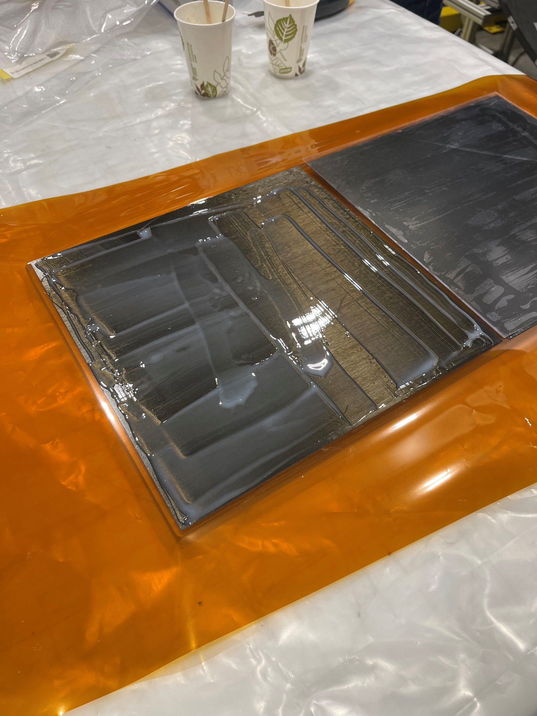
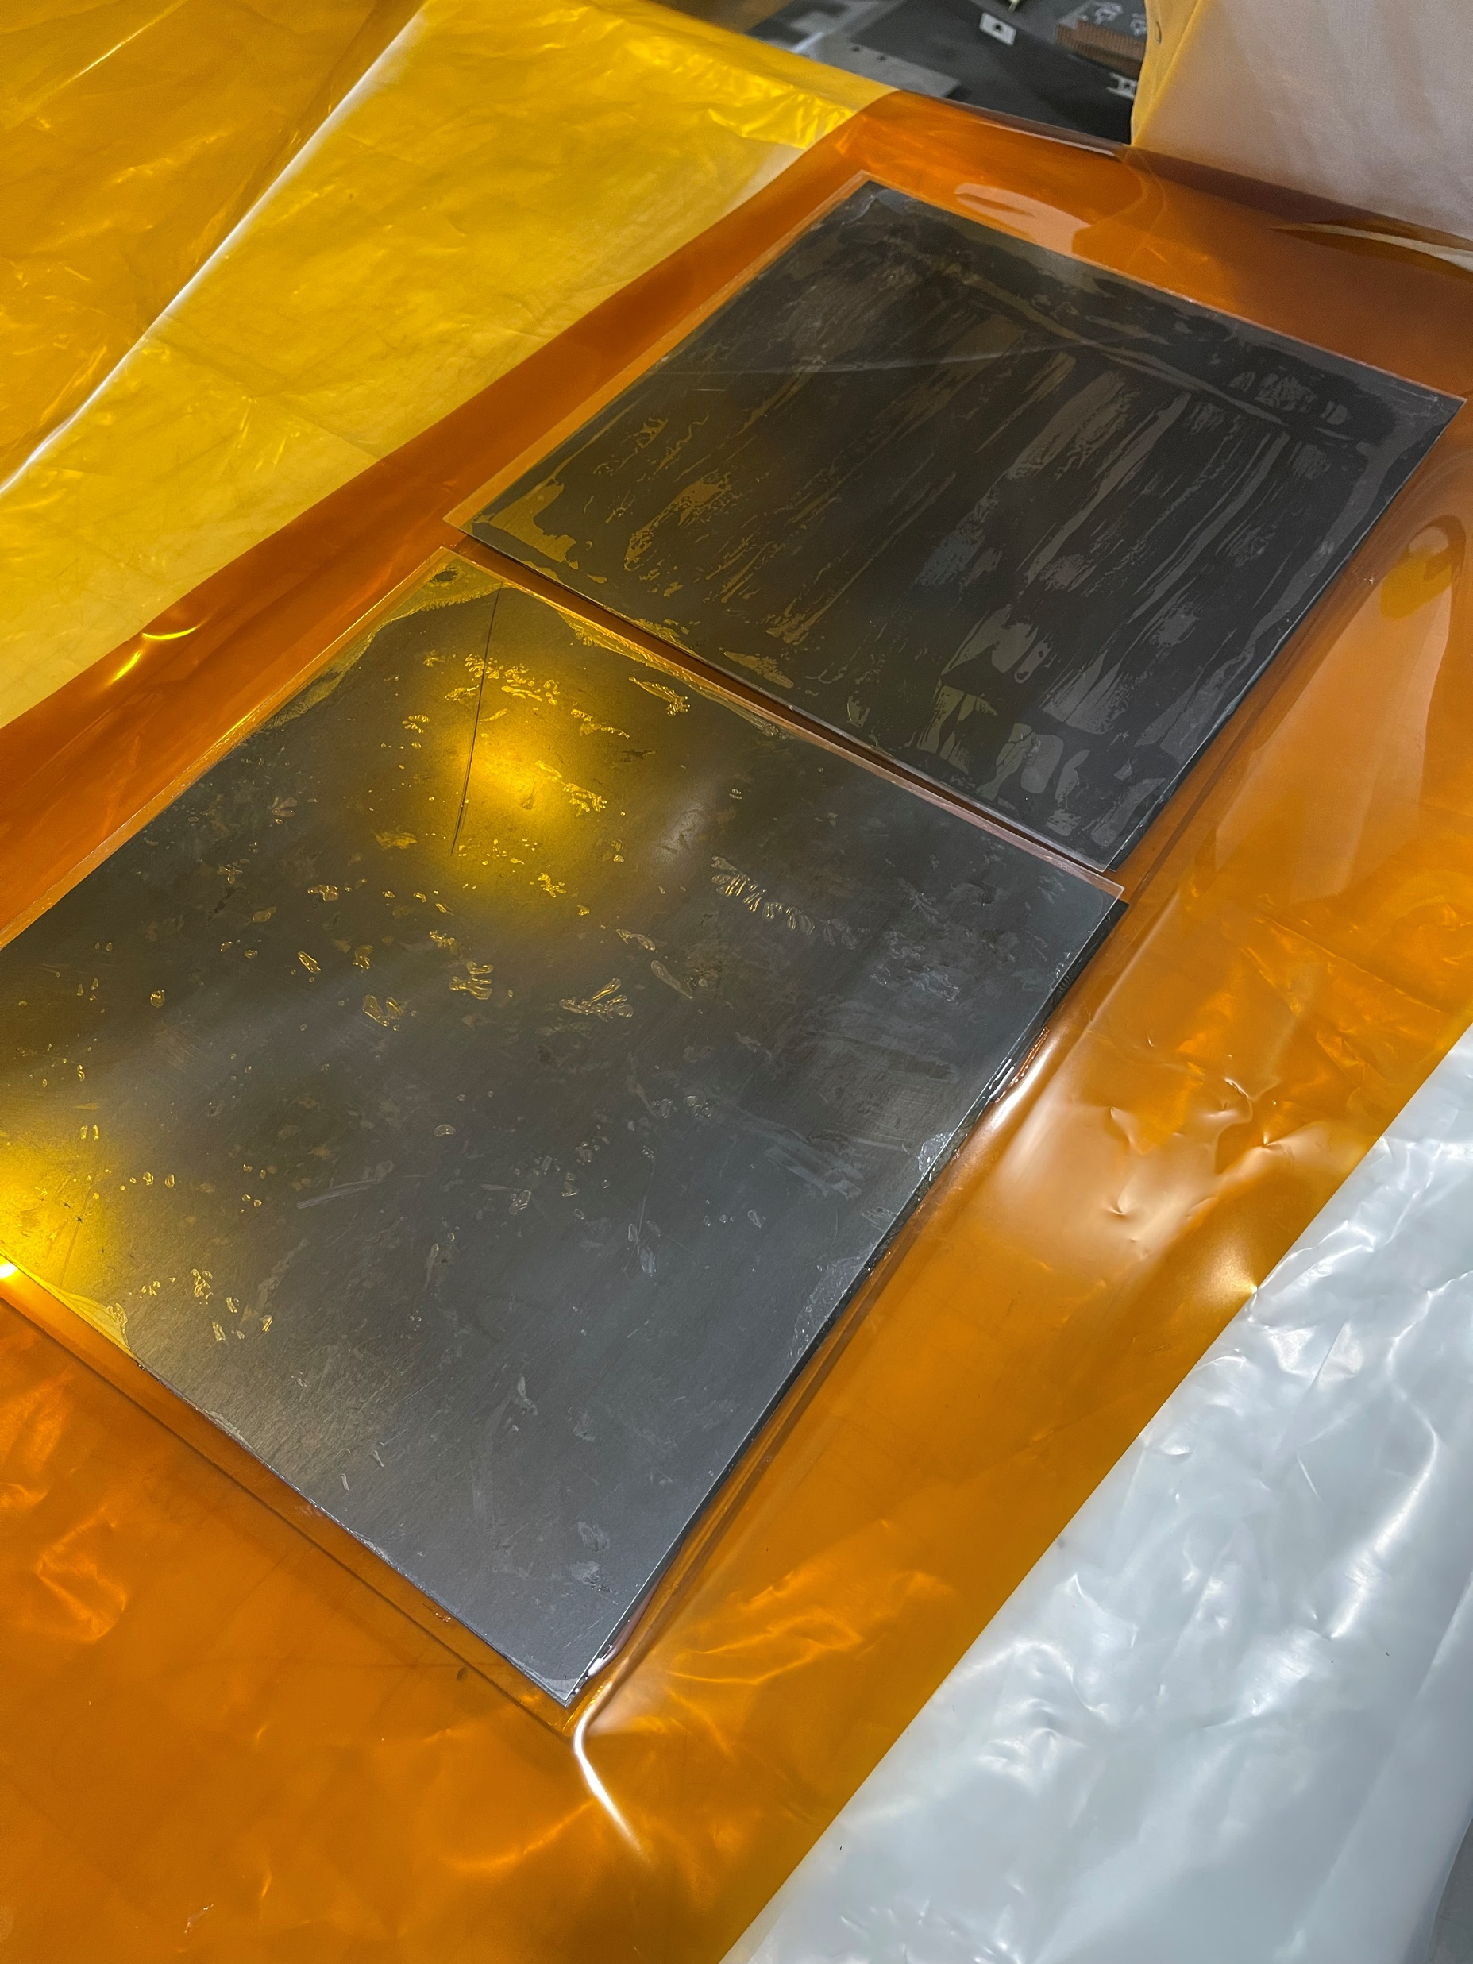
Preparation
DP460 (Thin)
DP460 (Thin)
DP460 (Thin)
DP460 (Thick)
DP460 (Thick)
DP460 (Thick)

Slide 4
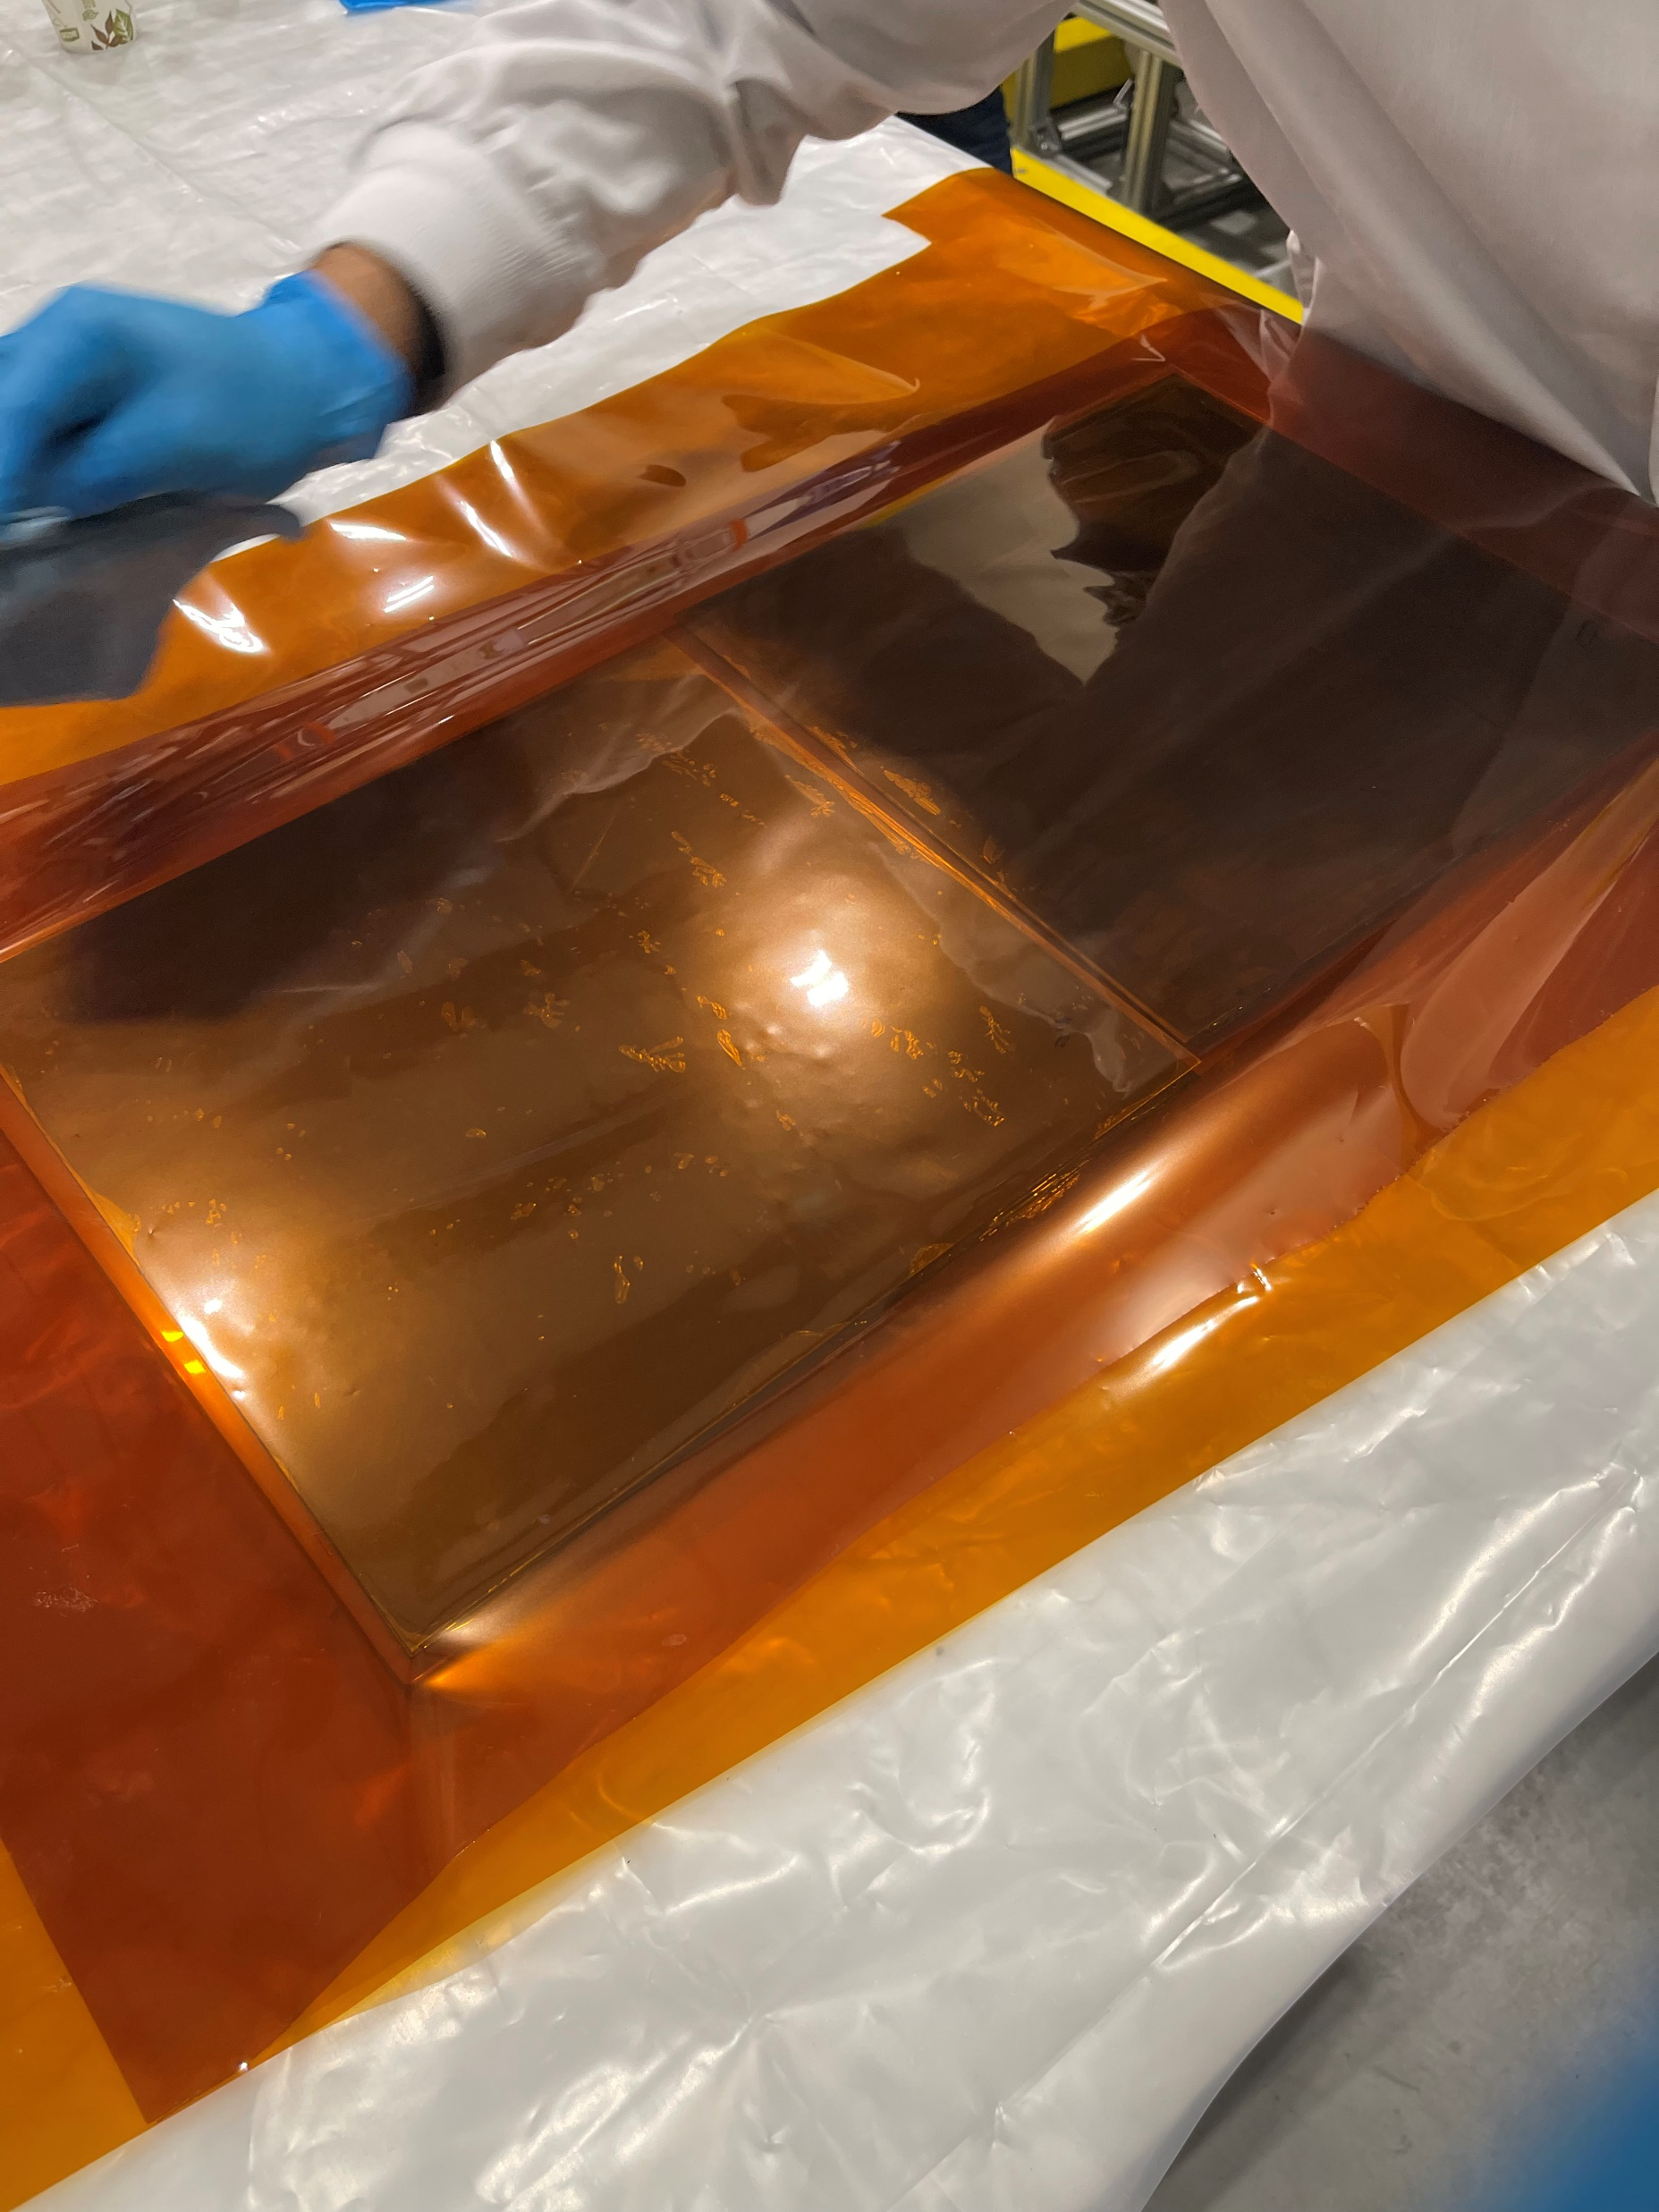
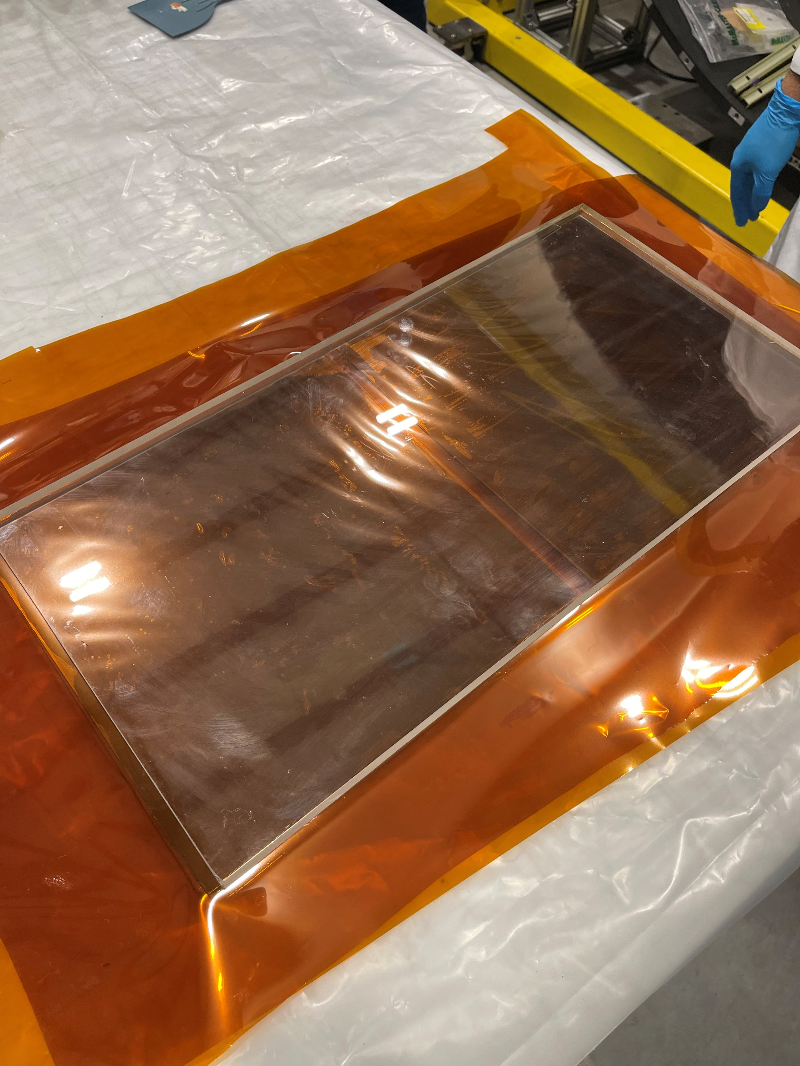
Preparation

Slide 5
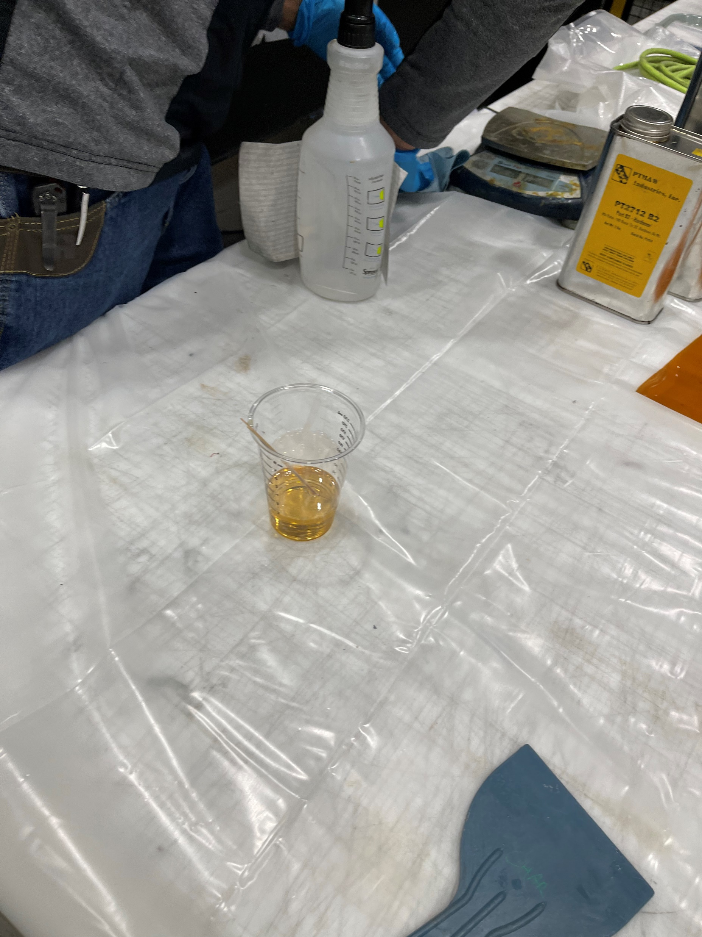
Preparation

Slide 6
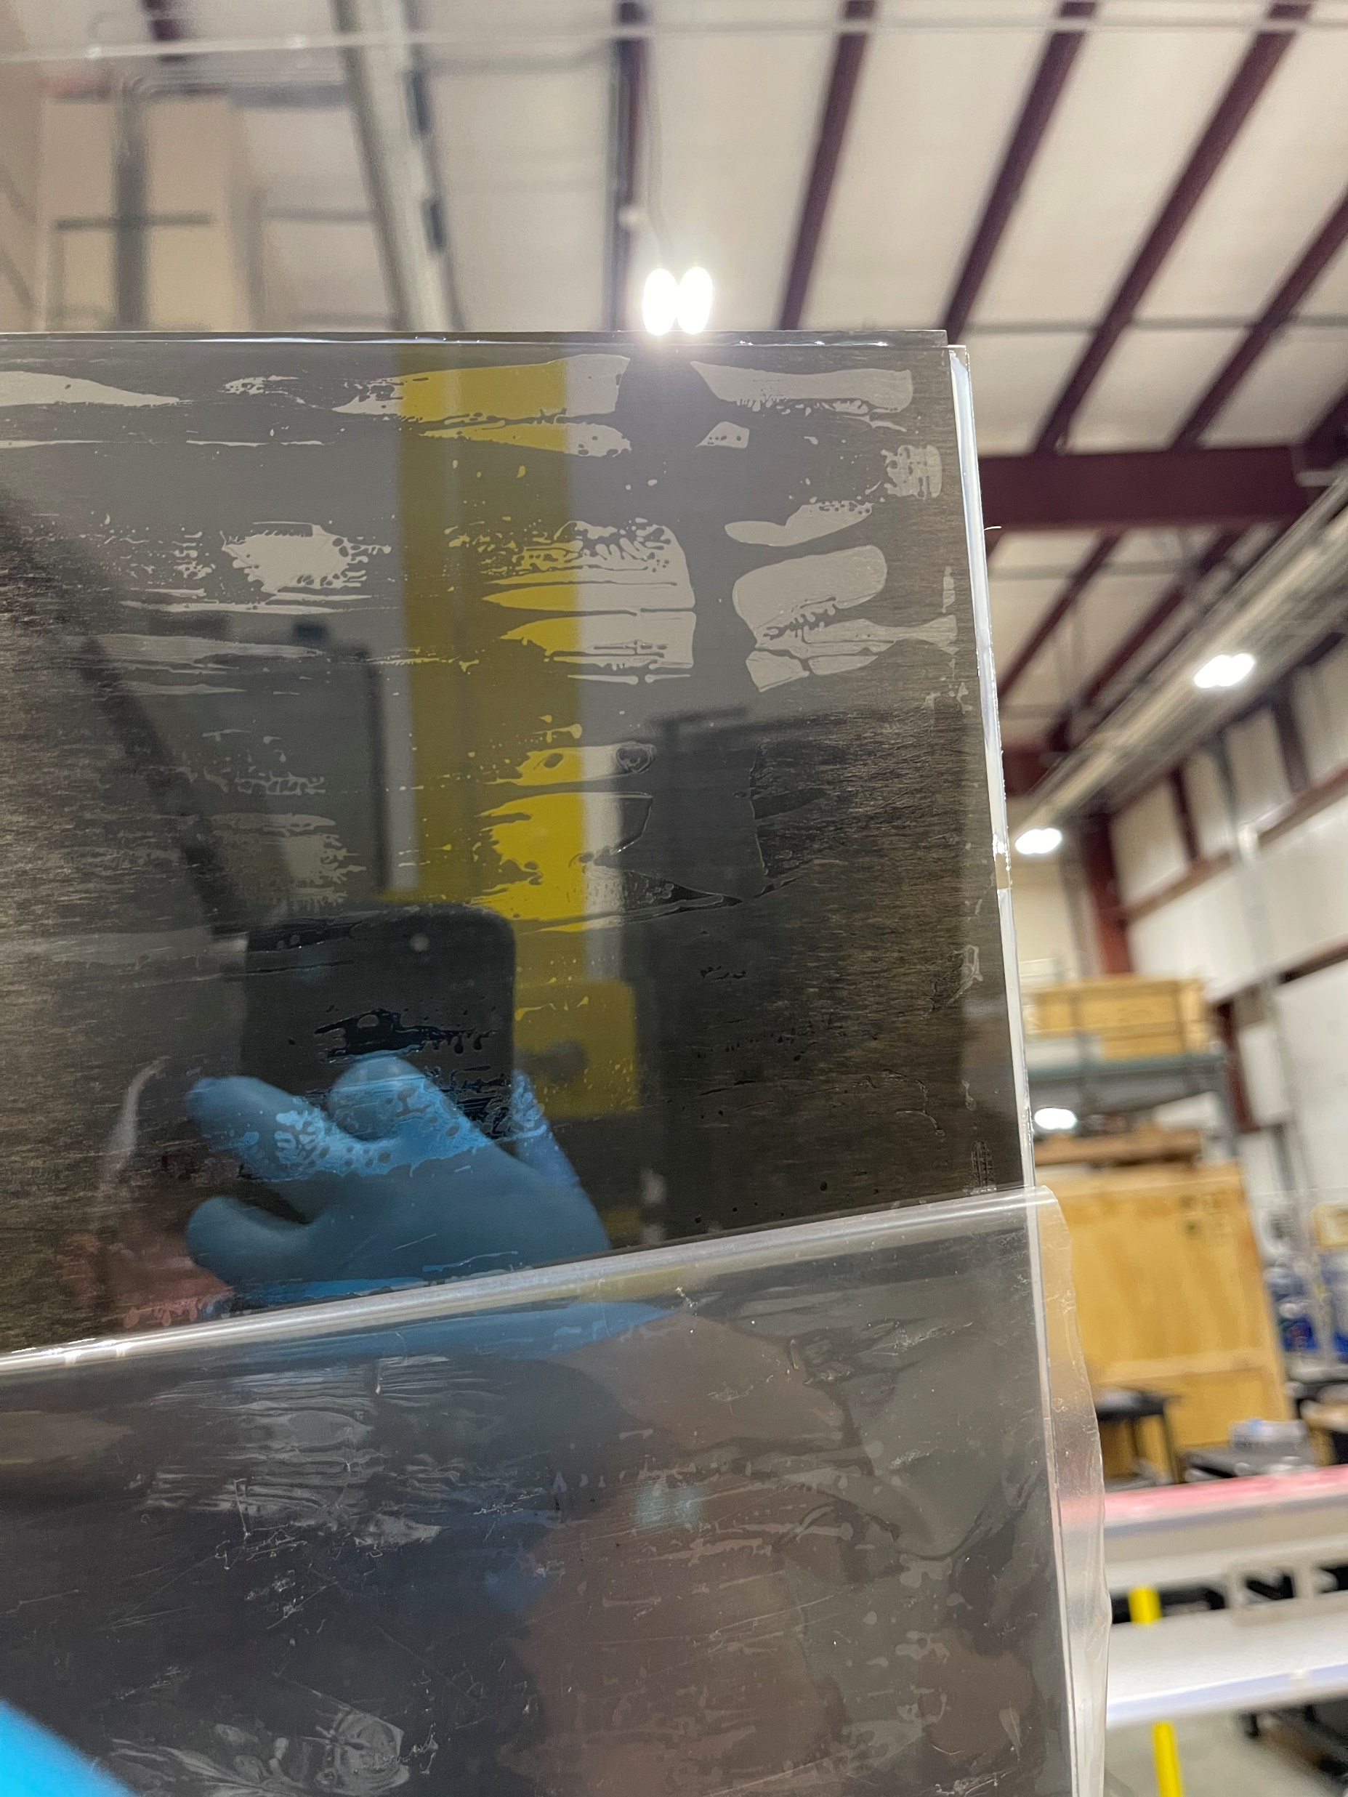
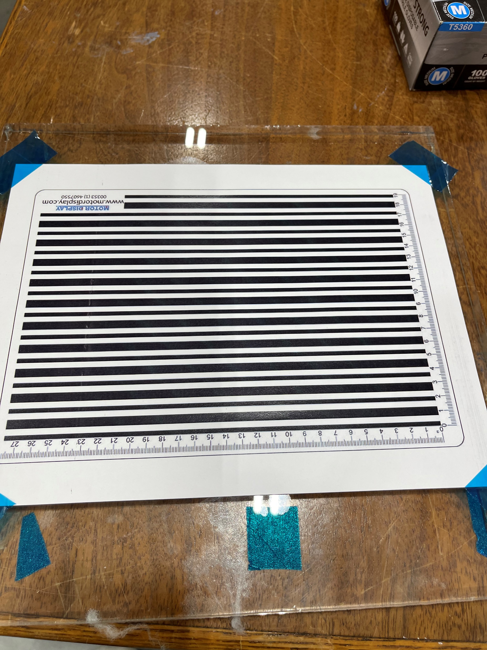
Results (Videos show much more detail)
Link to Line Printout

Slide 7
Videos Link:
https://nextcloud.wildc4t.com/s/QfwTGW86SfpHNCK
(Download whole folder, extension wasn’t working to play in browser)
Videos before (7) are preparation
Videos (7) and after are results

Slide 8
To-Do:
(Purdue) Create Curved Samples:
Use existing (non-ideal cone)
DP460 and PT2712 at “low” vacuum
Add threaded inserts to the 3D printed fixture
SBU will coat
(Purdue) Send SBU the ones Alex and Sushrut created (after serializing and trimming)
Please take a picture of the 12”x12” sheet and draw a grid onto it (PowerPoint) and serialize each square before cutting (example next slide, use a straight on picture)
SBU will coat and video with the stripes
(SBU) Check for thickest Lexan available? (200-300 micron?)
(Purdue) Additional Samples:
Small DP460 without any weight
Small PT 2712 with weight, but don’t peel protective film
Link to Line Printout

Slide 9
Example serializing DP460 (Thin), please use a straight-on photo!
4
3
2
1
A
B
C
D

