Slide 1
Polarization Status
Haixin Huang
RHIC Coordination Meeting
12/23/2025

Slide 2
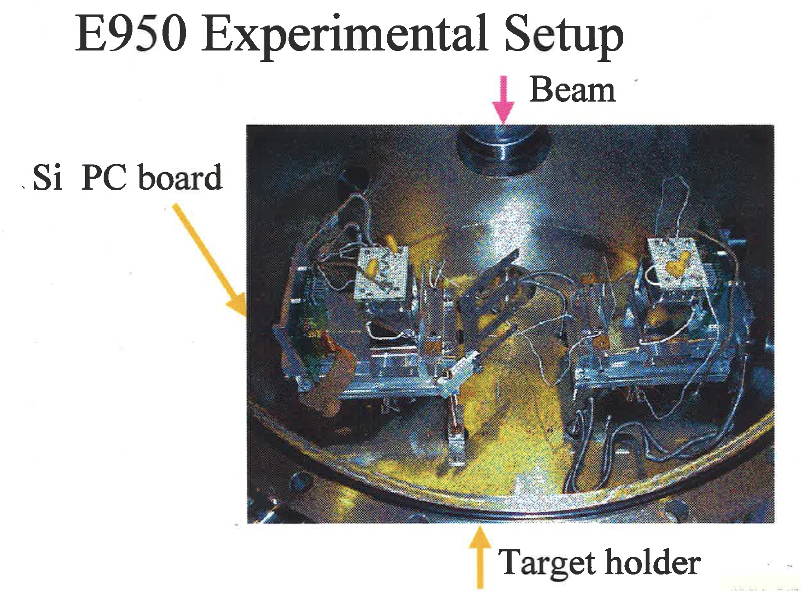
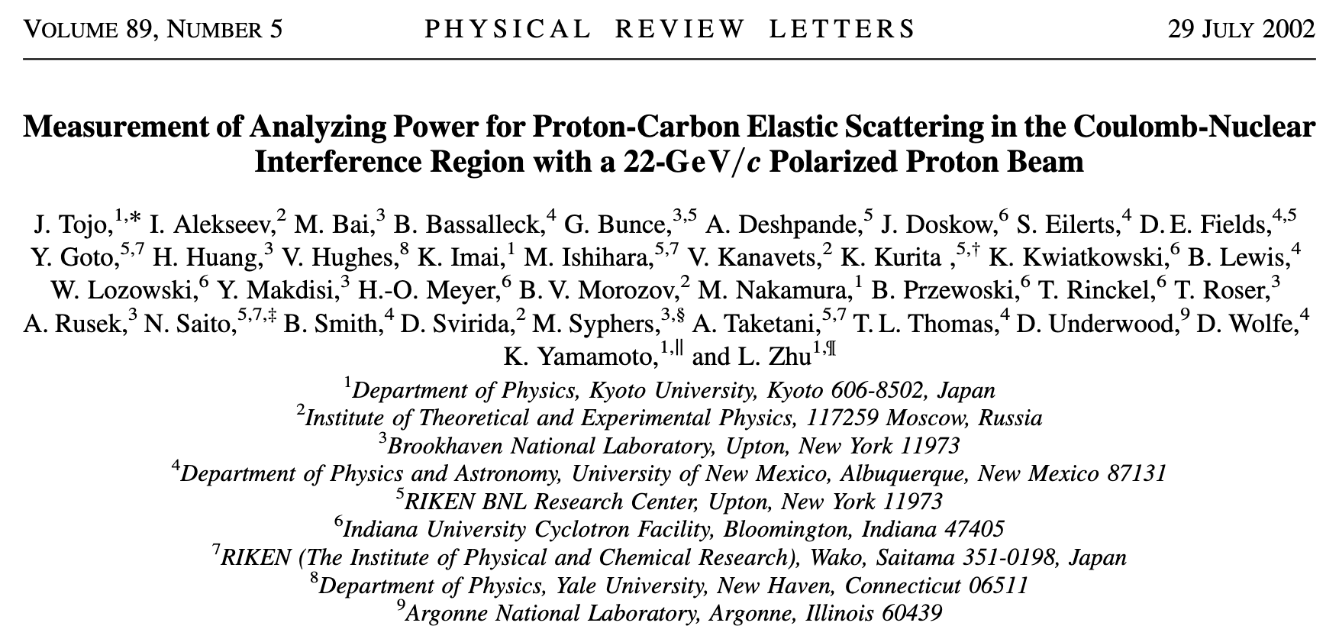
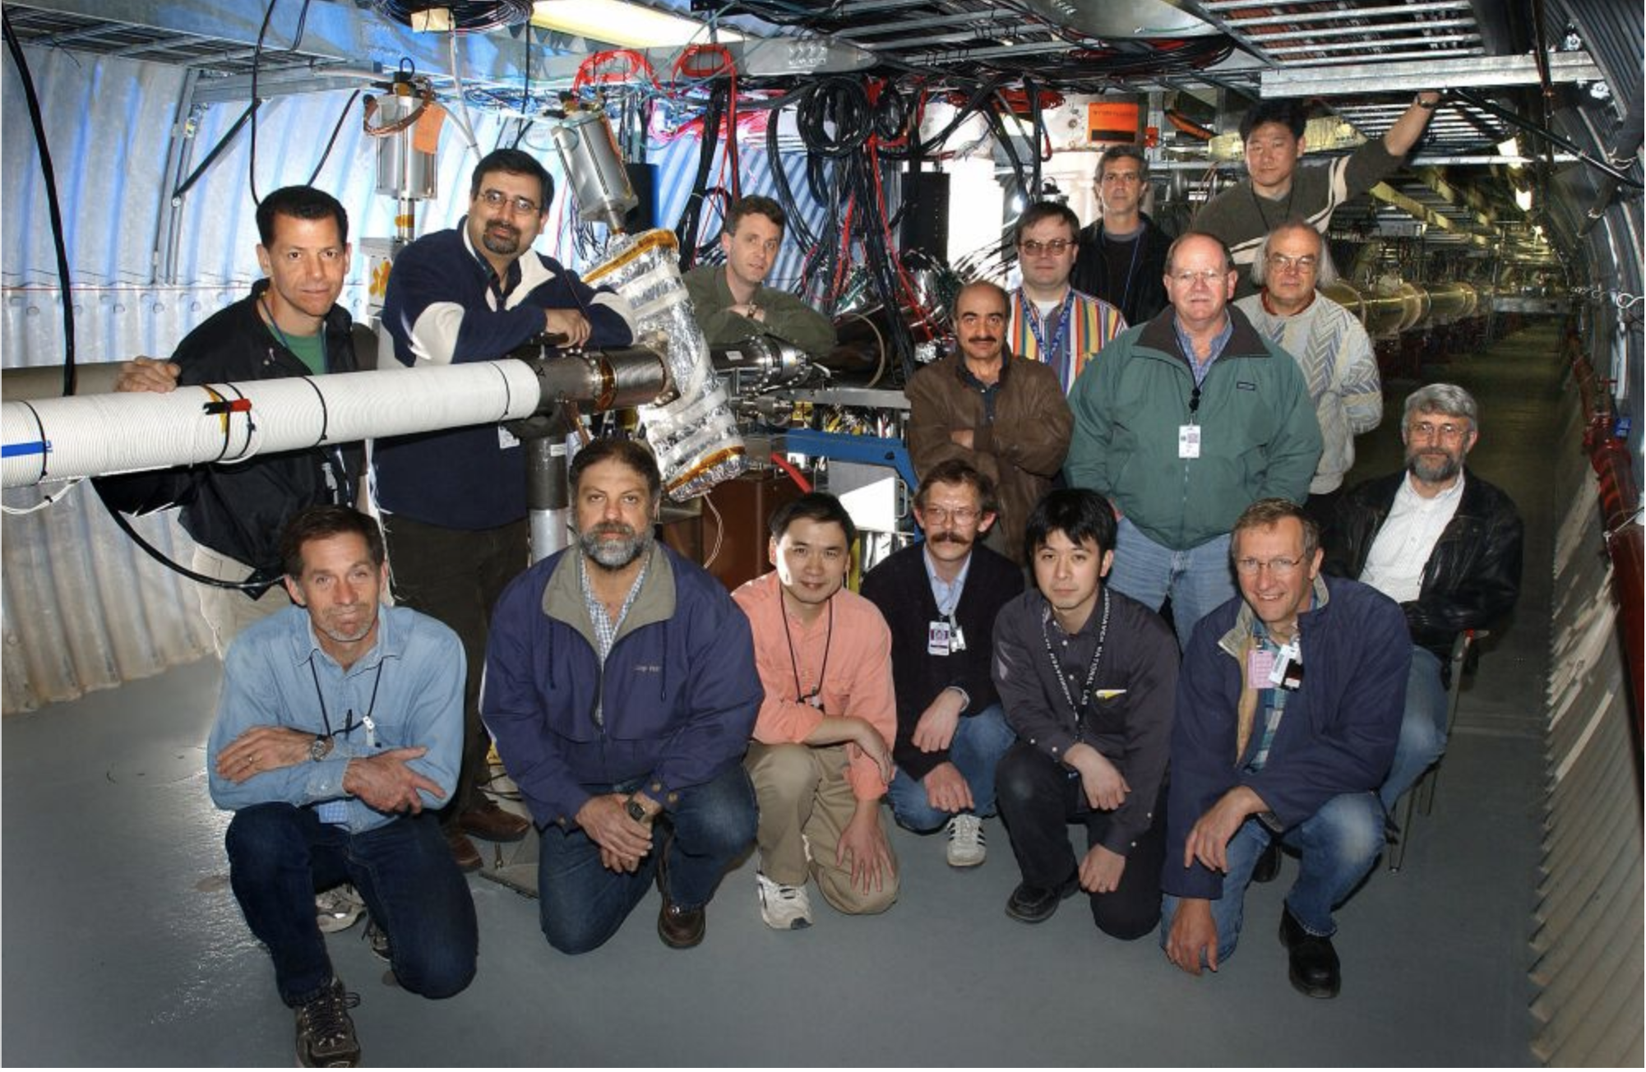
History of p-Carbon Polarimeter
The Proof of Principle Expt. was carried out in AGS in 1999. With its success, RHIC Polarimeter was developed by the RHIC polarimeter group and used till now.

Slide 3
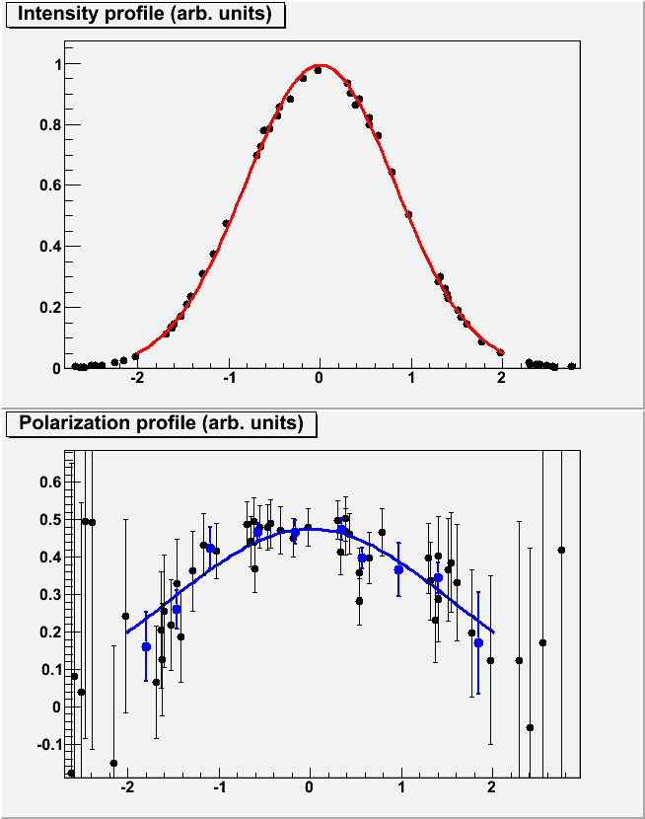
Pol. Profile and Average Polarization
Scan C target across the beam
In both X and Y directions
Carbon
Intensity
σ_{I}
Ideal case: flat pol. profile (σ_{P}=∞ ⇒ R=0)
Polarization
Run9:
√s=200 GeV: R~0.1 ⇒ 5% correction
√s=500 GeV: R~0.35 ⇒ 15% correction
σ_{P}
Target Position

Slide 4
Polarization Profile
If polarization changes across the beam, the average polarization seen by Polarimeters and Experiments (in beam collision) is different
H-Jet
pC
Collider
Experiments
~1 mm
6-7 mm
x=x₀
P_{1,2}(x,y) – polarization profile, I_{1,2}(x,y) – intensity profile, for beam #1 and #2

Slide 5
Fixed Target Polarization and Whole Beam Polarization

Slide 6
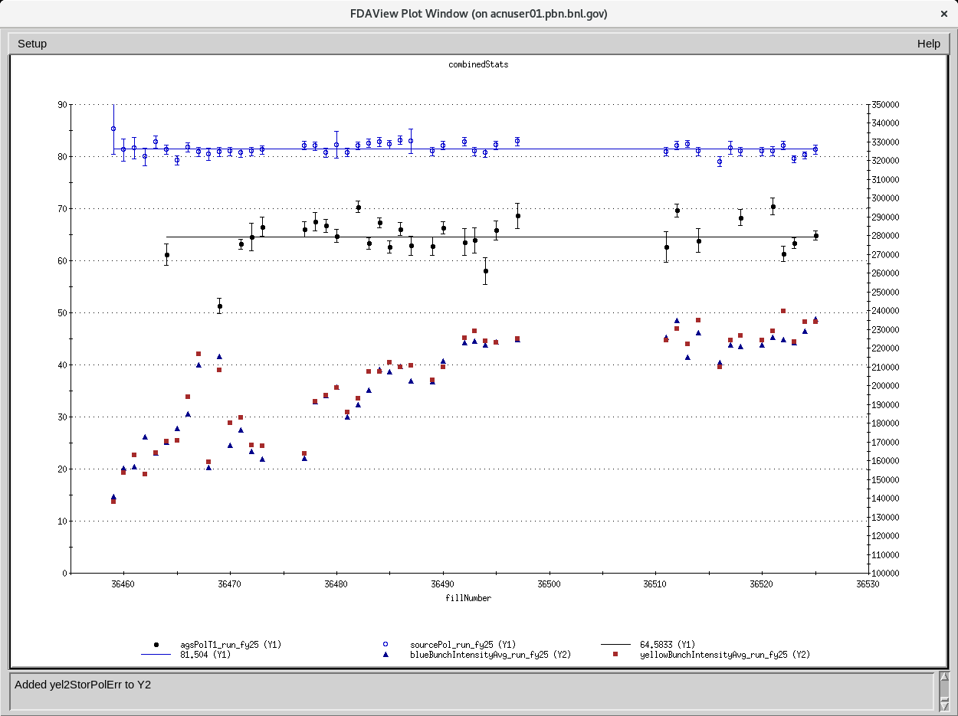
Source/AGS Polarization and RHIC Injection Intensity
Source polarization is around 81.5% while AGS flattop polarization is around 64.6%. In the well tuned scenario, AGS is expected to be around 70% with 2E11 intensity. Currently, we put 2.3E11 intensity into RHIC.

Slide 7
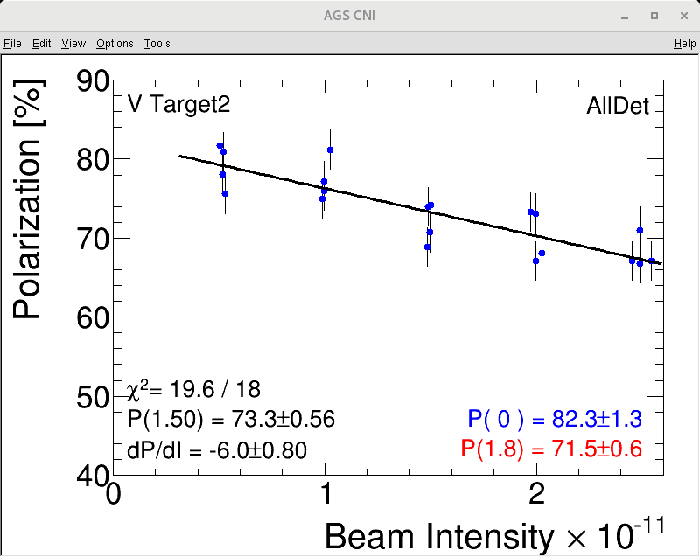
AGS Polarization vs. Intensity
At 2.5E11 intensity, this scan gives ~67%.

Slide 8
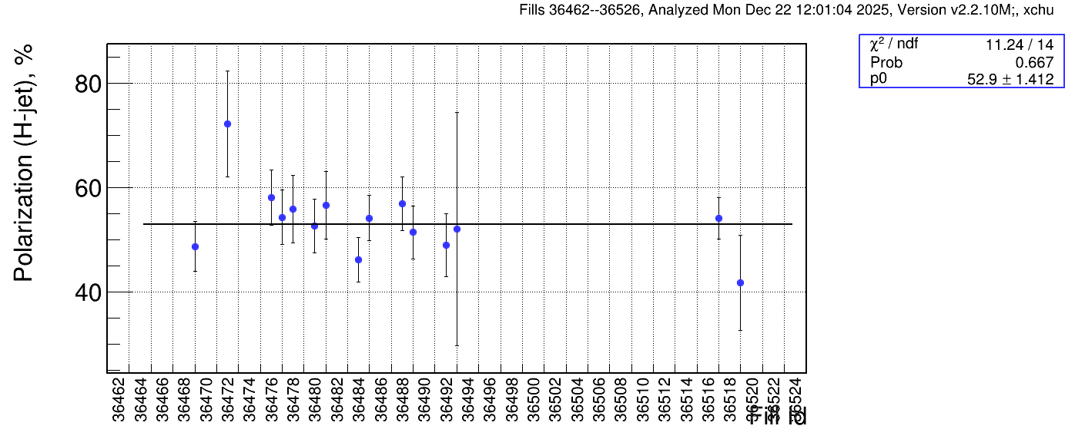
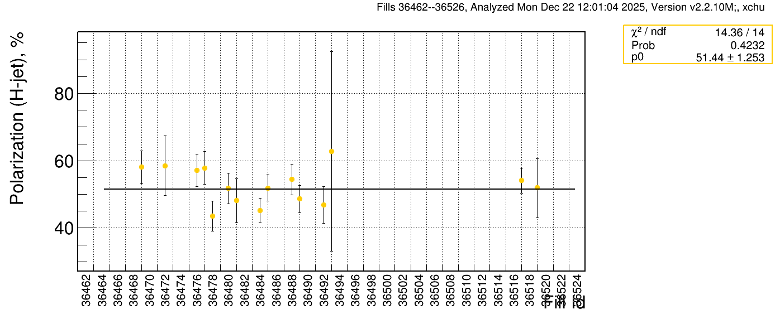
100GeV Polarization from Jet
Average polarization is 52.9+-1.4 in blue and 51.4+-1.3 in yellow. We expect yellow to be 1-2% higher due to spin transfer efficiency difference in AtR line.

Slide 9
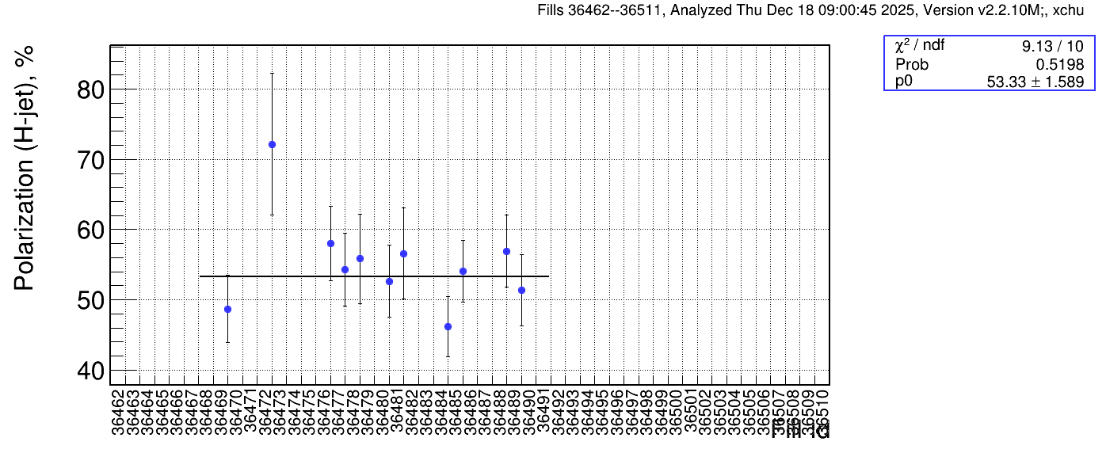
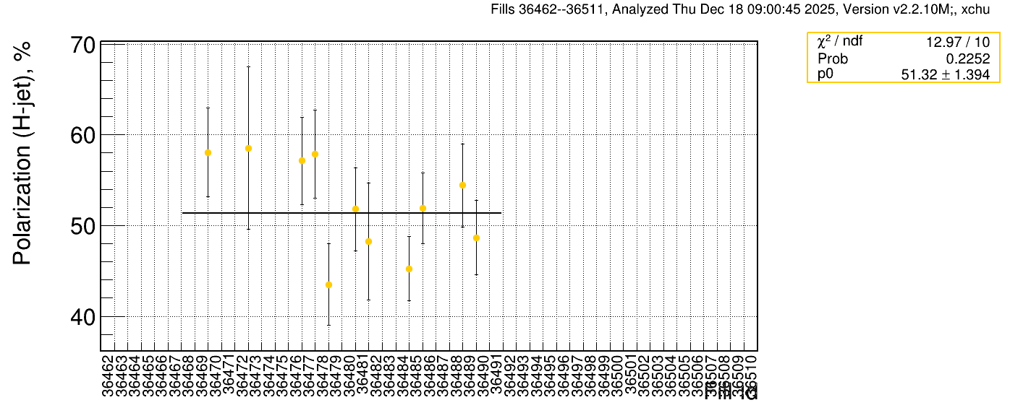
100GeV Polarization from Jet
Average polarization is 53.3+-1.6 in blue and 51.3+-1.4 in yellow. We expect yellow to be 1-2% higher due to spin transfer efficiency difference in AtR line. As comparison, these numbers are 52.7+-0.3 and 56.7+-0.4 in run24.

Slide 10
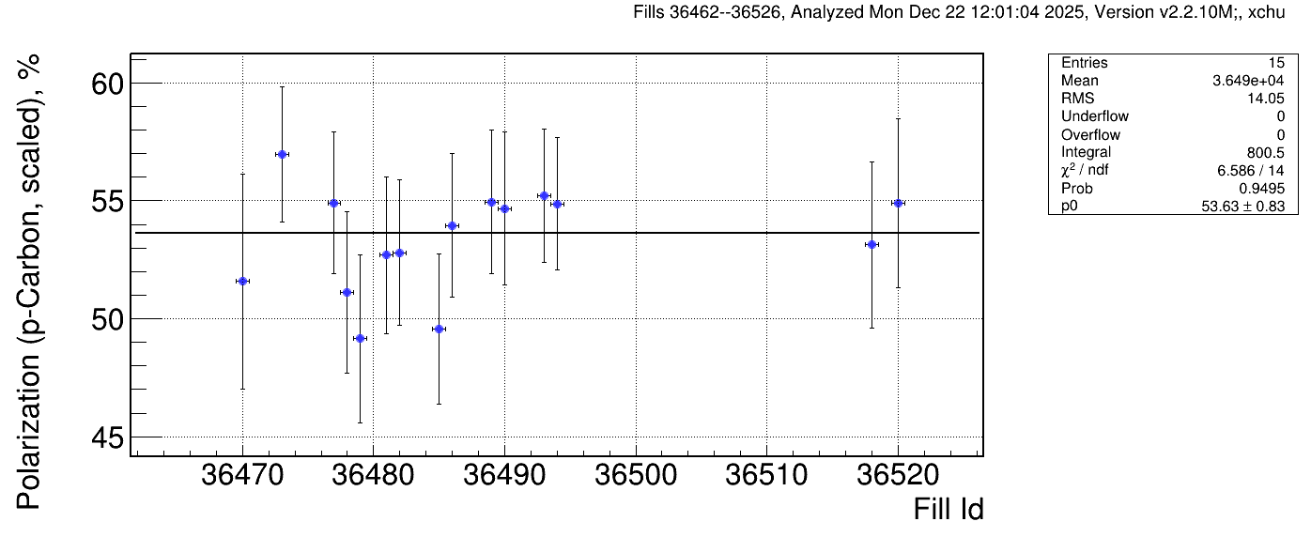
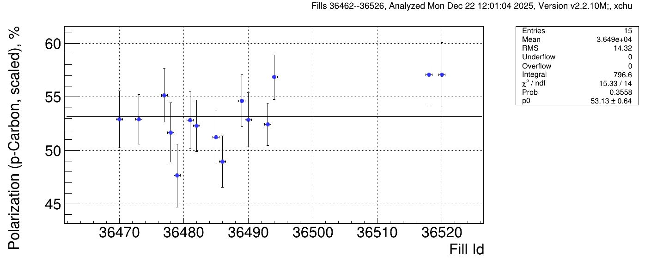
100GeV Blue Polarization from p-Carbon
Blue 1
The p-carbon values have been scaled based on H-jet numbers. The scaling factors are 1.093+-0.035 for blue 1 and 1.099+-0.033 for blue 2.
Blue 2

Slide 11
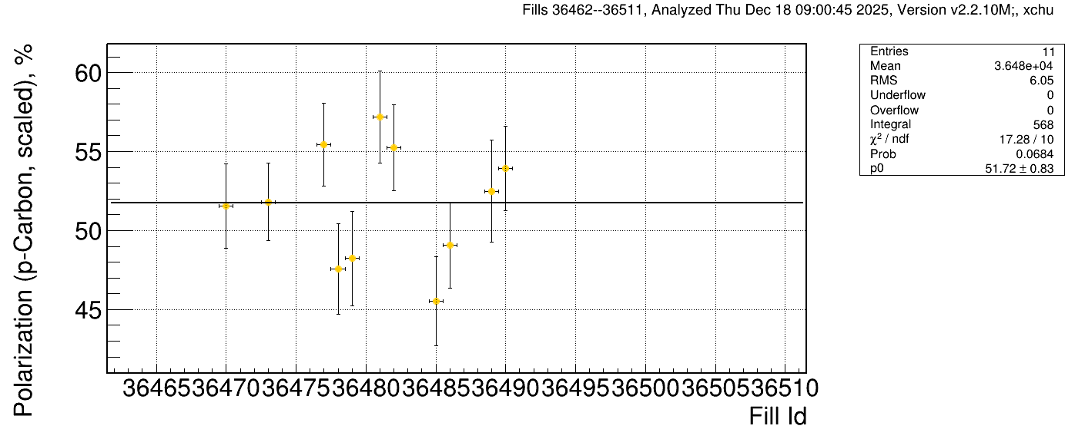
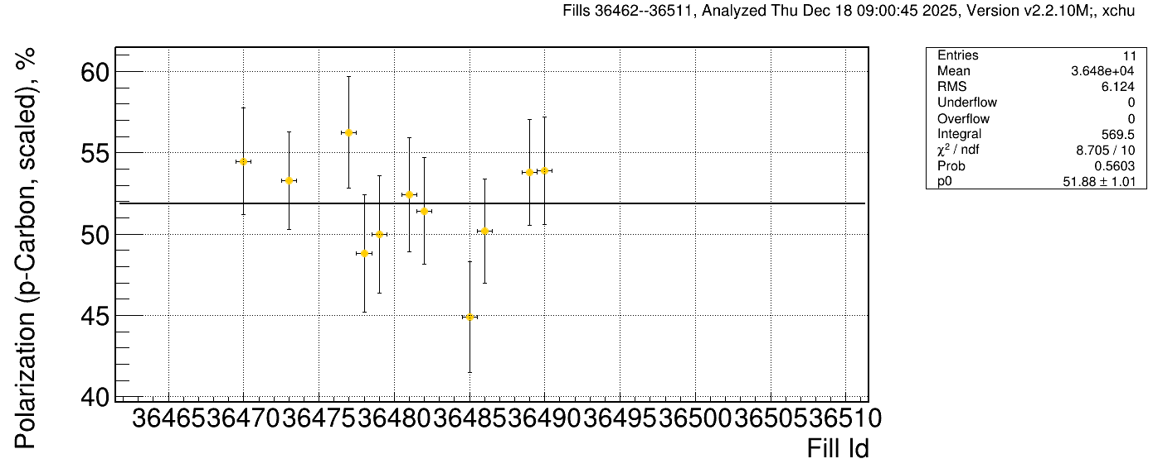
100GeV Yellow Polarization from p-Carbon
Yellow 1
The p-carbon values have been scaled based on H-jet numbers. The scaling factors are 1.11+-0.032 for Yellow1 and 1.12+-0.034 for Yellow2.
Yellow 2

Slide 12
Summary
Year Energy AGS/Source Pol. Blue Polarization Yellow Polarization Jet/Pcarbon Ratio. Intensity
255GeV 66.9/80.36 51.23+-0.33 52.25+-0.36 0.95-0.98 1.85
2015 100GeV 67.1/81.00 54.18+-0.27 57.02+-0.26 0.96-1.05 2.25
2017. 255GeV 68.3/83.70 55.45+-0.27 56.06+-0.26 0.97-1.04 1.97
2022. 254GeV 61.9/82.46 55.50+-0.26 53.30+-0.25 1.08-1.14 2.00
2024. 100GeV 63.7/78.79 52.65+-0.32 56.69+-0.35 1.10-1.13 2.10
2025. 100GeV 64.6/81.36 52.90+-1.41 51.44+-1.25 1.09-1.11 2.30
AGS measured the peak of the polarization (fixed target mode) and RHIC polarimeters measured the whole beam polarization. There is also a spin transmission efficiency in AtR line: 96% for blue ring and 99% for yellow ring. Yellow polarization is expected slightly higher than blue polarization.
The ratio between Jet and p-carbon is stable in past three runs. The difference from even earlier runs could be due to Si detector aging.
AGS polarization has room for improvement. RHIC Yellow polarization may also have some room for improvement.

Slide 13
Backup Slides

Slide 14
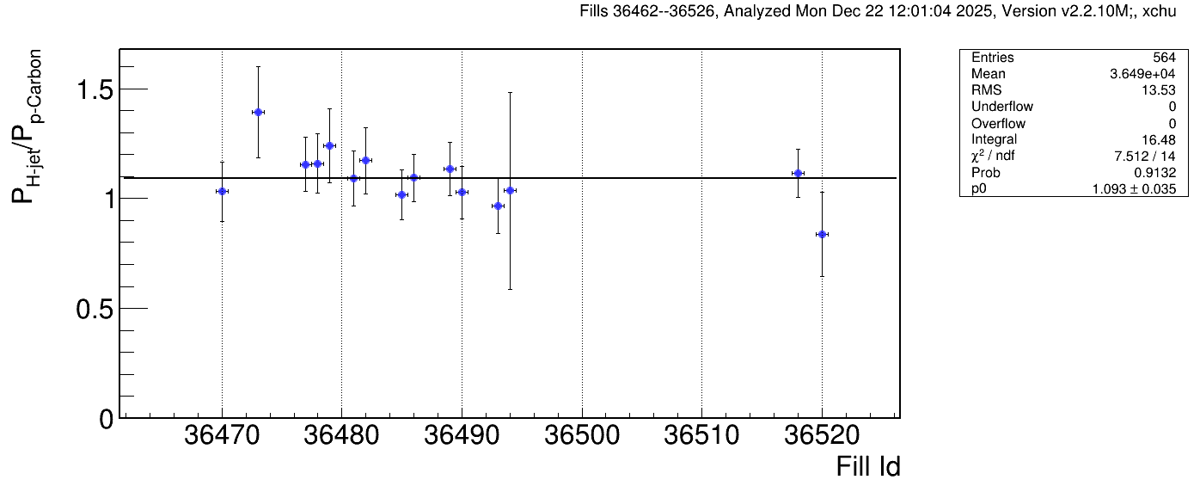
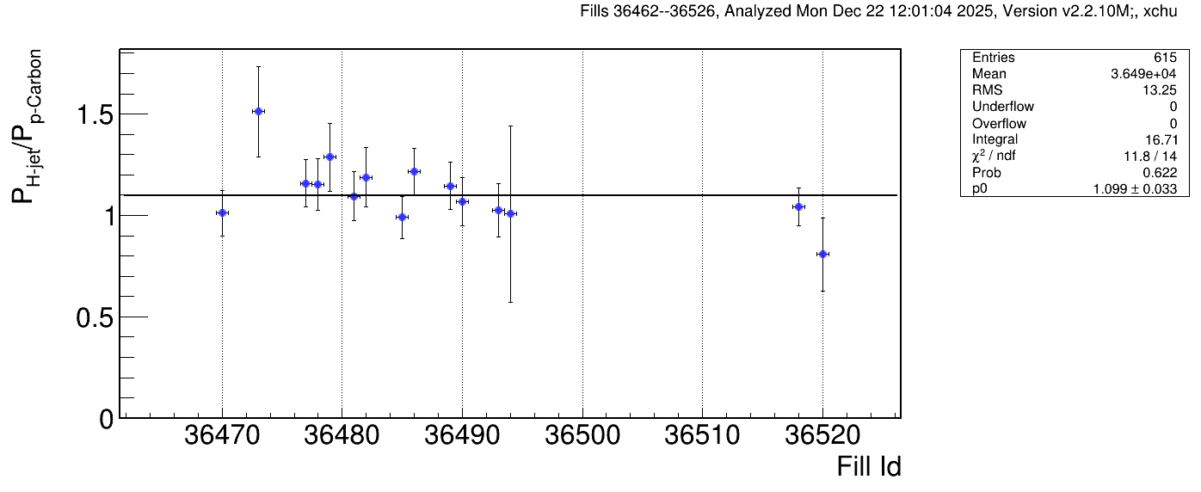
100GeV Jet /Blue p-carbon Ratios
(Curtsey to Oleg/Andrei)
Blue 1
Jet to Blue p-carbon offline polarization ratios are 1.093+-0.035 for blue 1 and 1.099+-0.033 for blue 2.
Blue 2

Slide 15
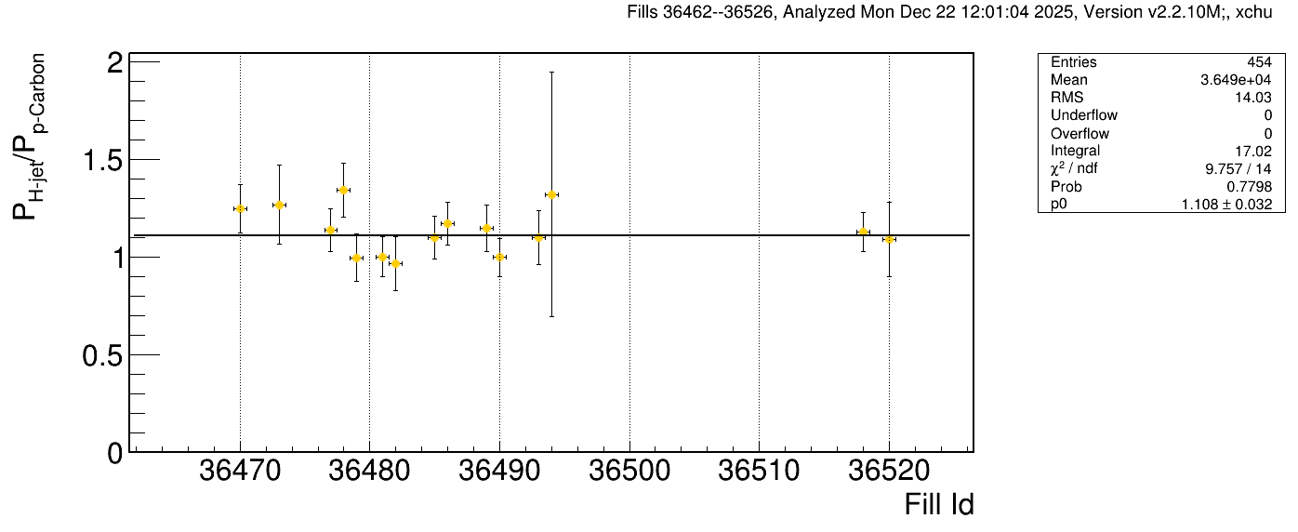
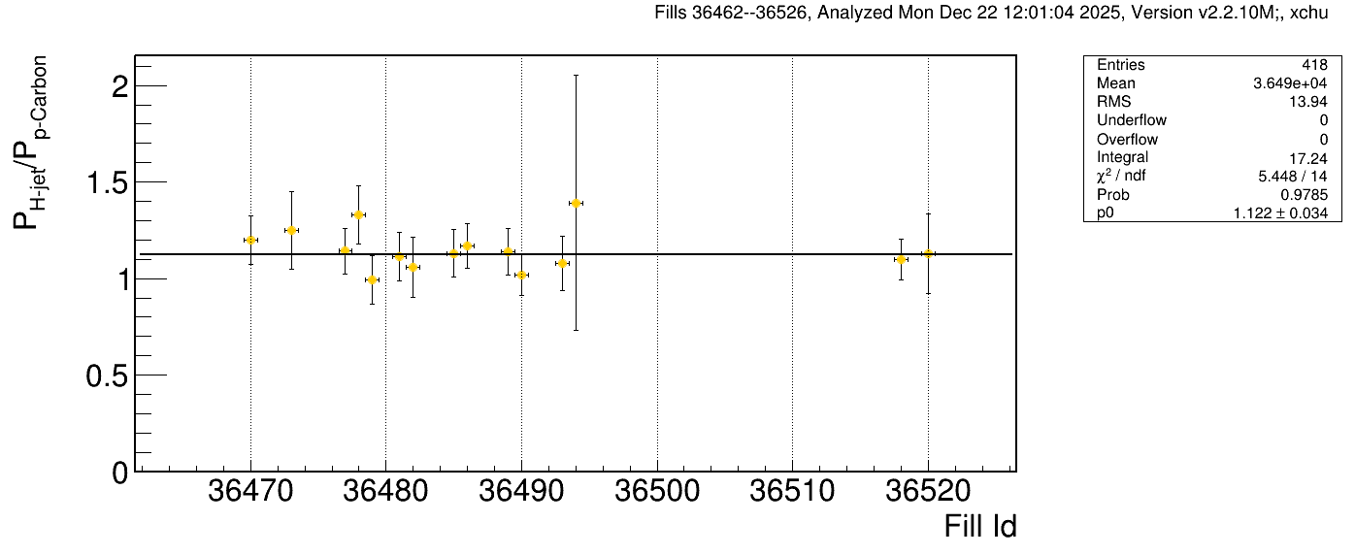
100GeV Jet /Yellow p-carbon Ratios
Yellow 1
Jet to Yellow p-carbon offline polarization ratios are 1.108+-0.032 for yellow 1 and 1.122+-0.034 for yellow 2.
Yellow 2

