Slide 1
Field Response Filter in WCT
Xuyang Ning, Wenqiang Gu
Discussion with Brett

Slide 2
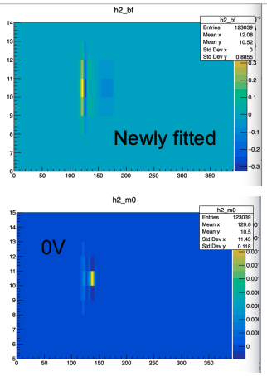
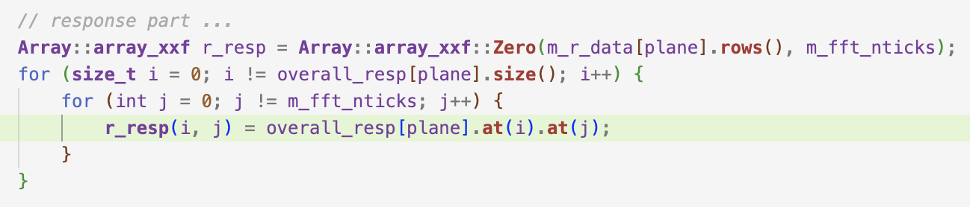
Motivation
Xuyang updated her fitted field response in PDHD APA1 (talk)
The newly fitted field response does not provide the best performance in determining ROIs
To further optimize, we proposed to add additional filter for the new field response
* filter( i, j ) // i: wire, j: tick

Slide 3
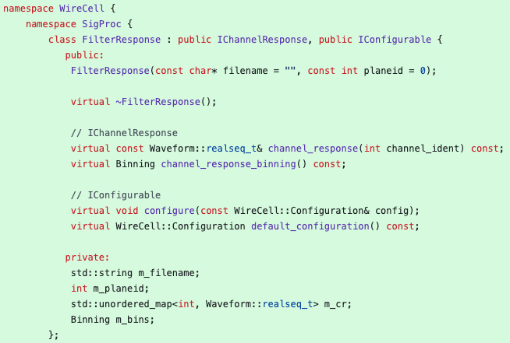
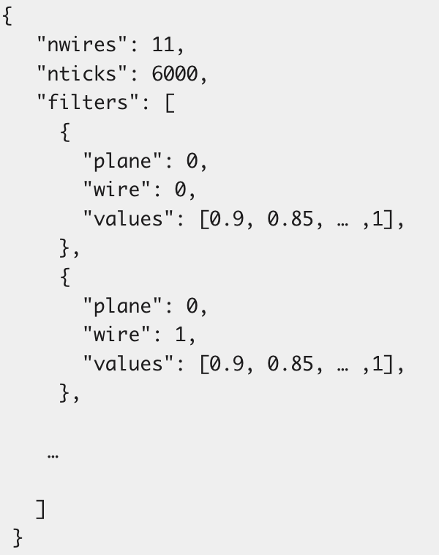
FilterResponse
wire-cell-toolkit feature/wgu_filt_resp

Slide 4
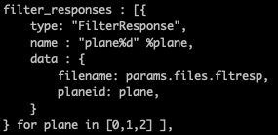

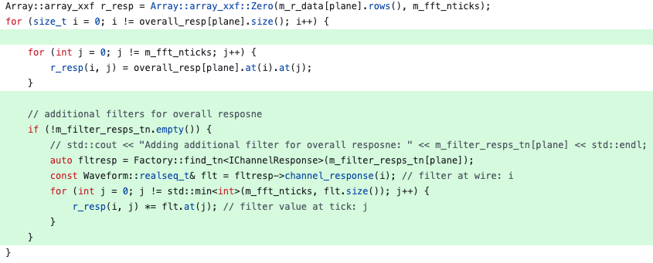
Integration in OmnibusSigProc
// tools.jsonnet
// sp.jsonnet
configurable array of “type:name”
// OmnibusSigProc.cxx

