Slide 1
pfRICH Info for GST Workshop
Alex Eslinger (JLAB)
Mechanical Design Engineer
March 24th, 2025

Slide 2
pfRICH: Summary
Overview of the Detector
Installation and Support
Considerations for GST Integration
A. Eslinger

Slide 3
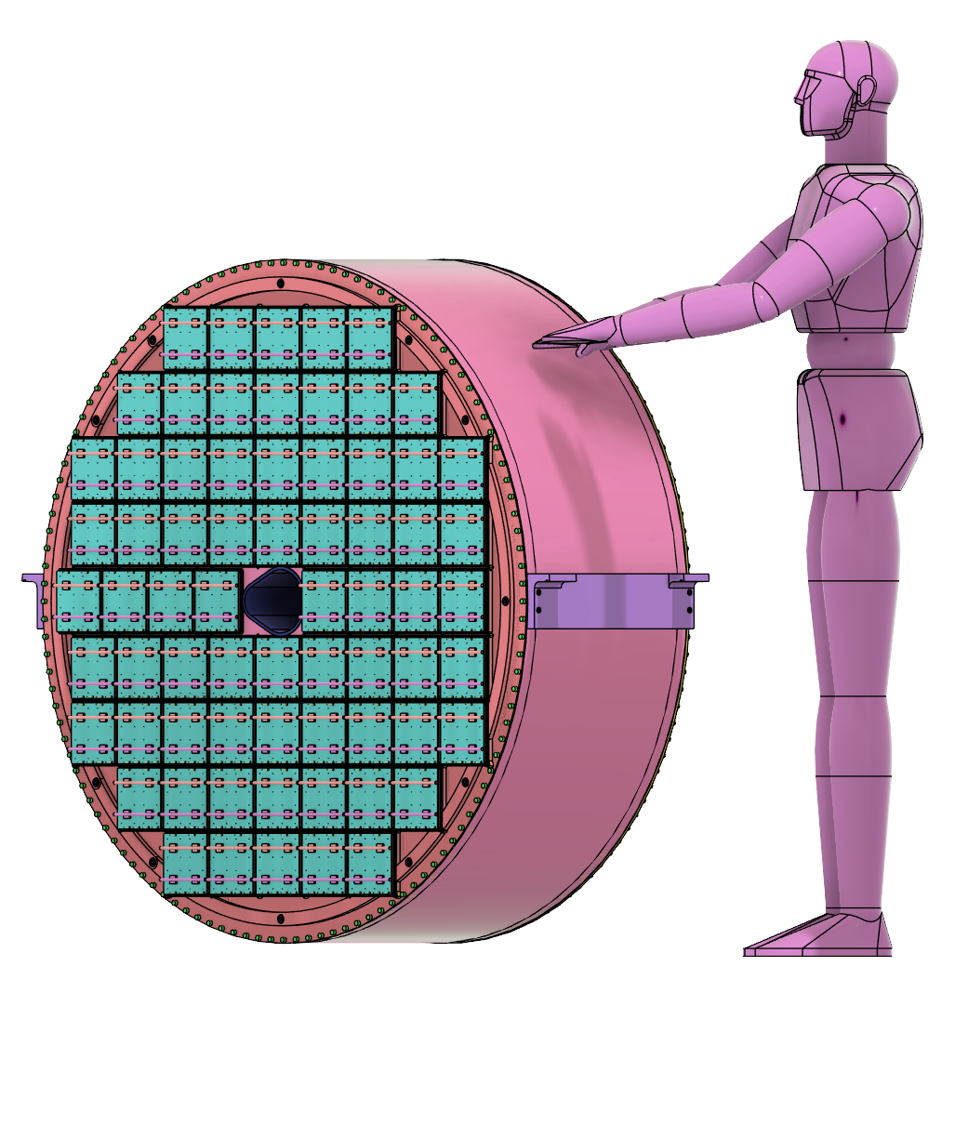
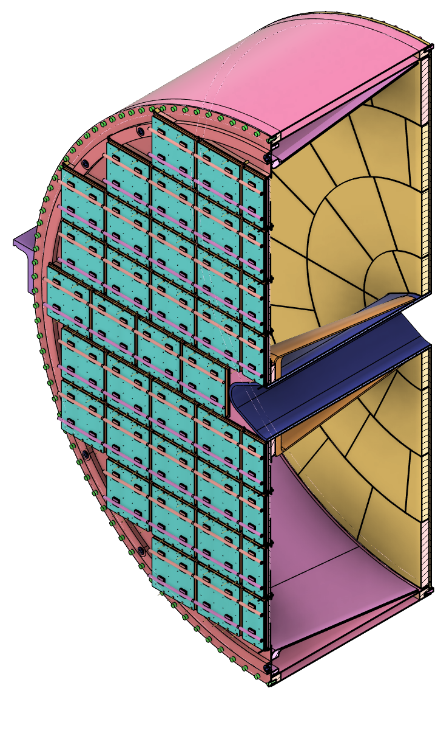
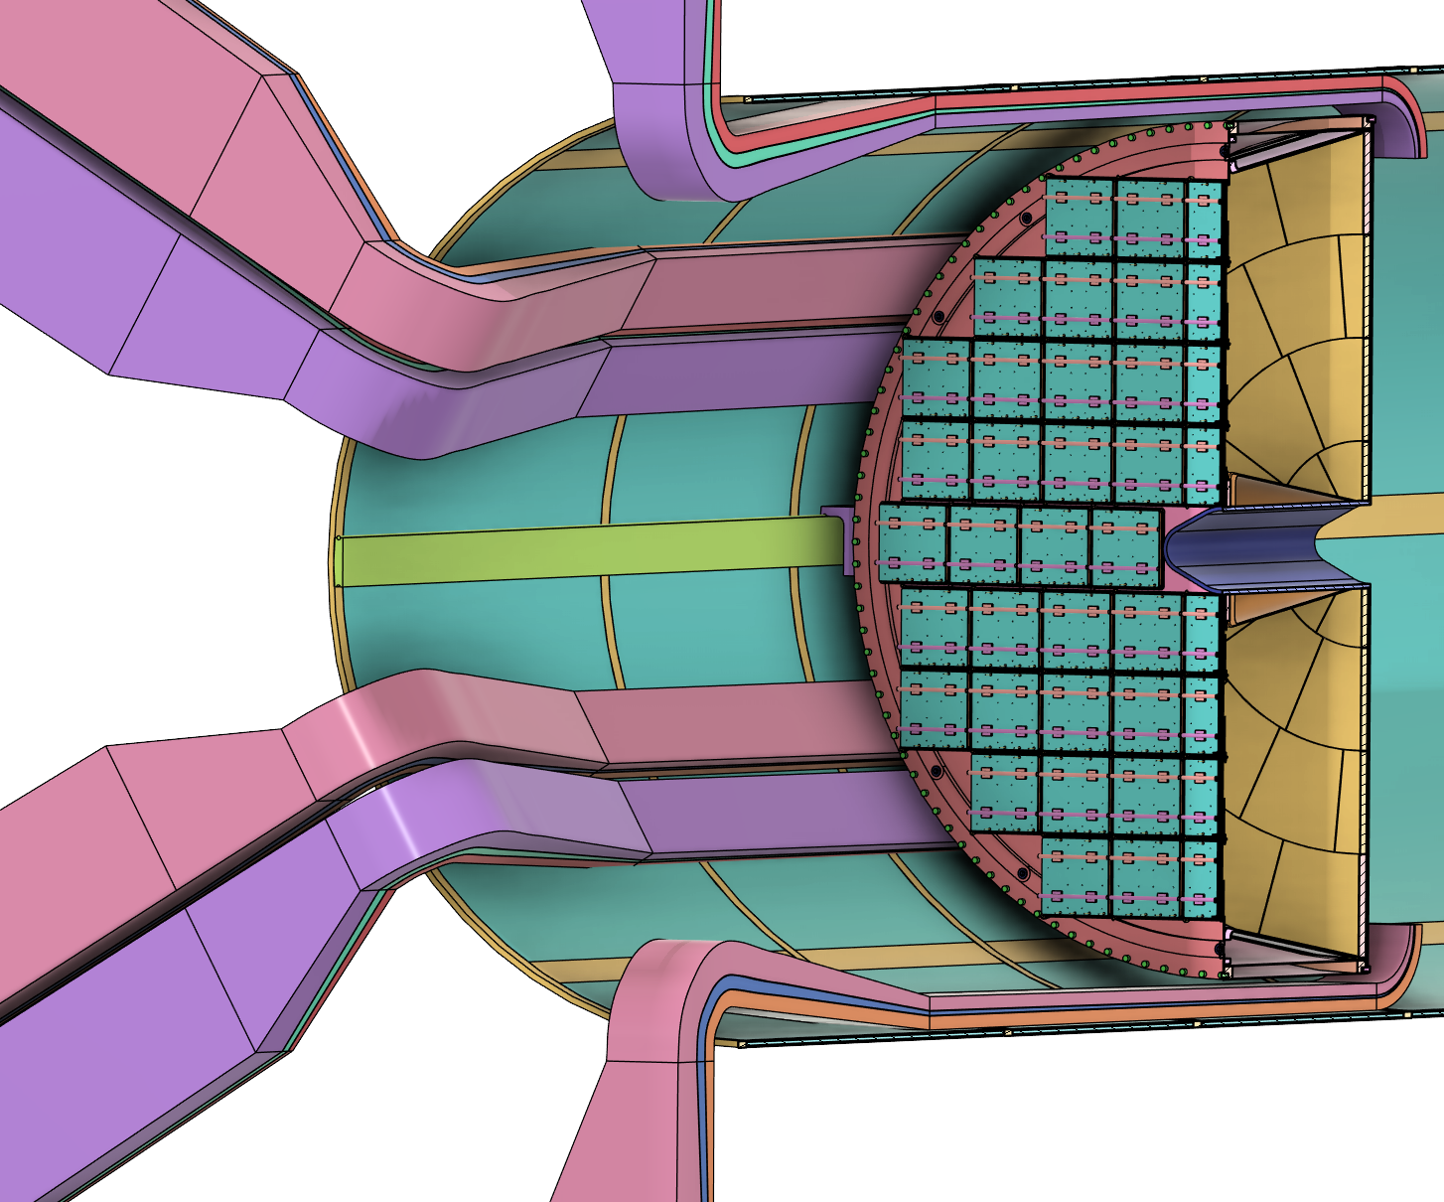
pfRICH: Overview
Vessel
Inner
Conical Mirrors
Size and scale:
Outer Diameter: 130cm
Weight: ~200kg
Major components:
Vessel
Sensor Plane with 68 HRPPDs
Aerogel Plane with radially-tiled aerogel
Inner Conical Mirrors
Outer Conical Mirrors
Gas Ports
To IP
Size and Scale
68 HRPPDs
Radially-Tiled
Aerogel
12 Outer
Conical Mirrors
Services Estimate from Inner Detectors
A. Eslinger

Slide 4
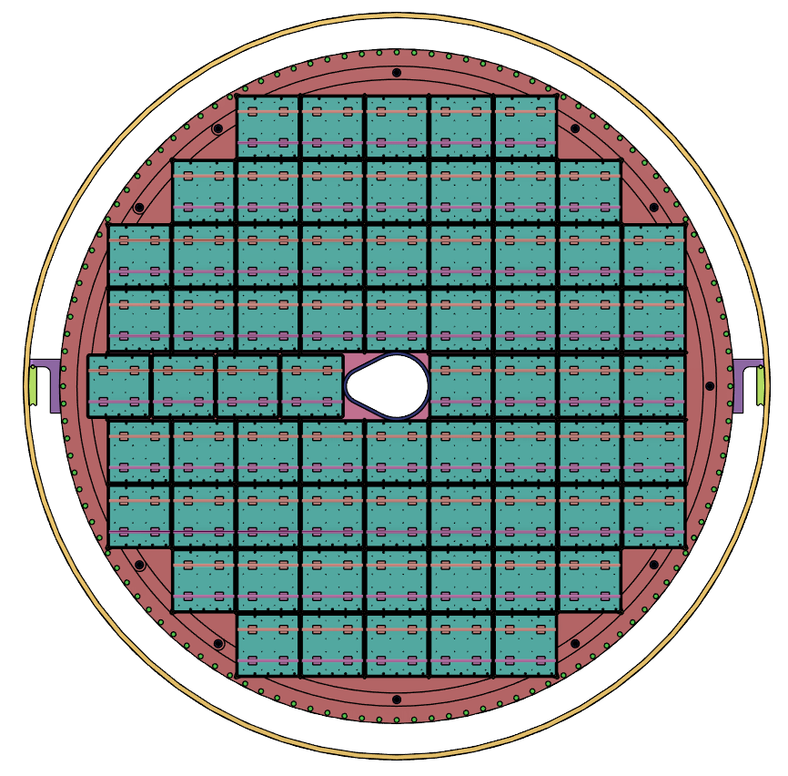
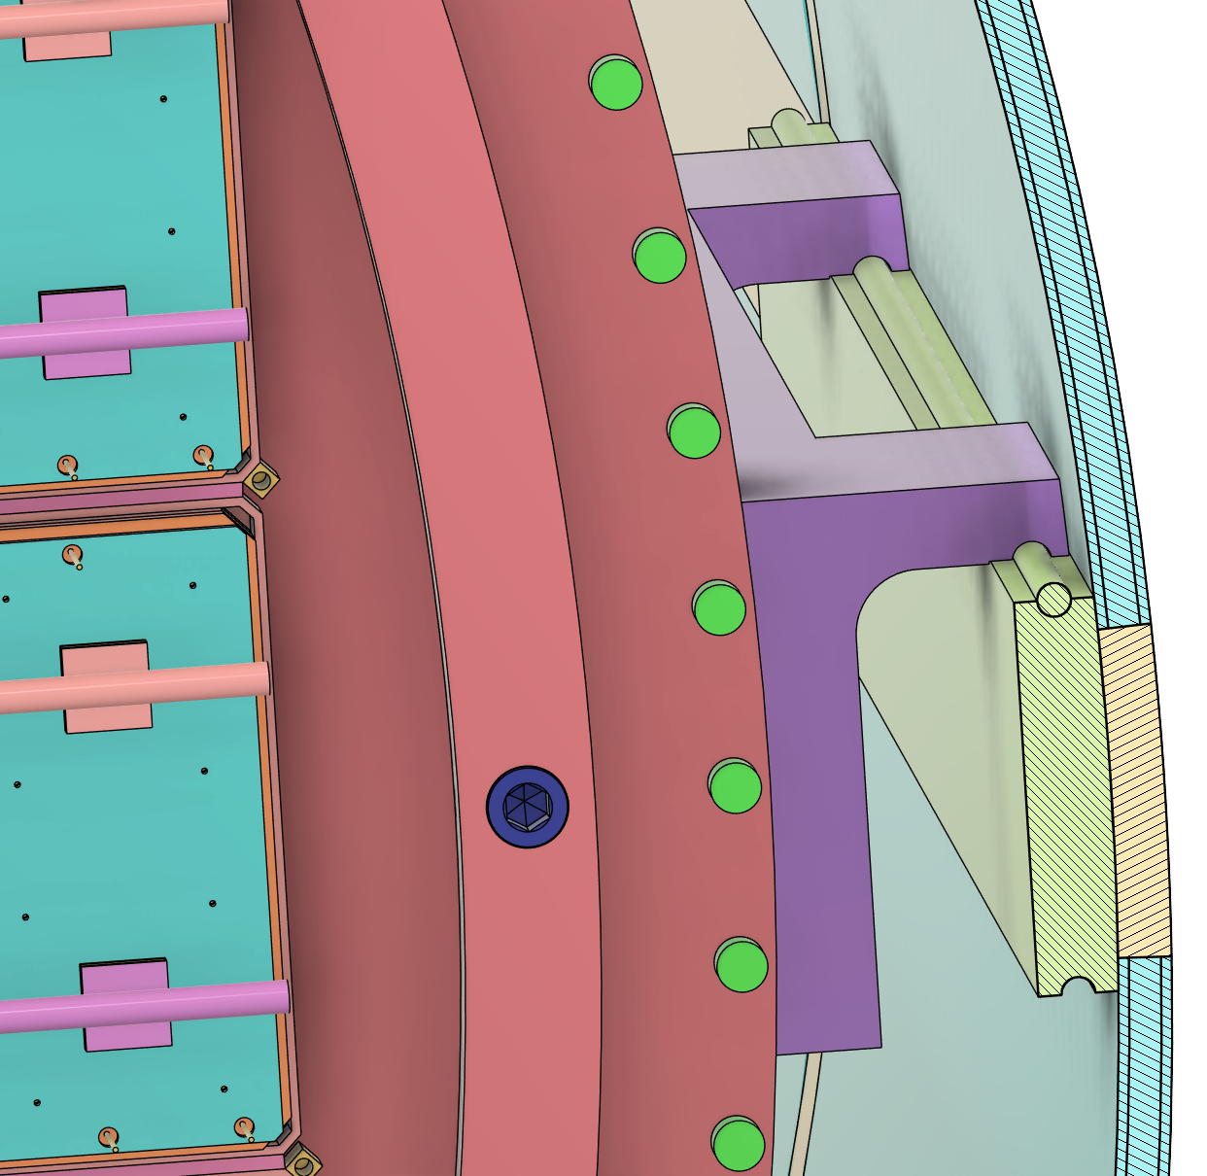
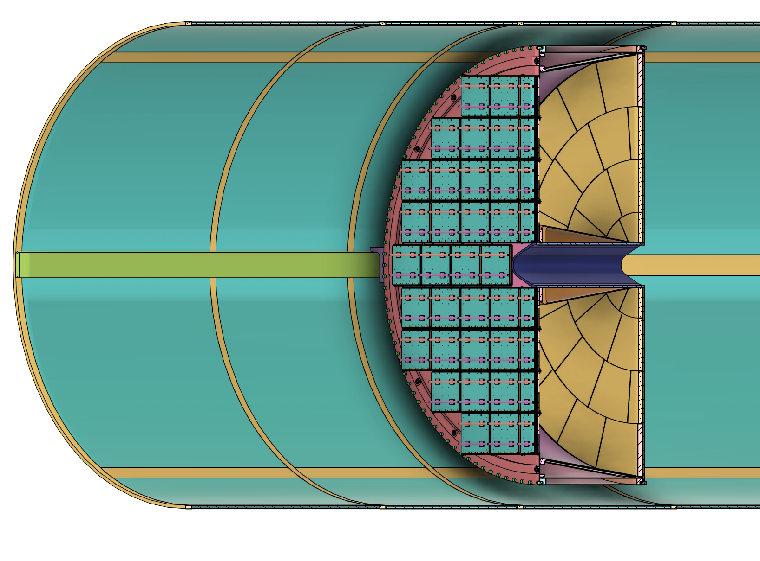
pfRICH: Installation and Support
Installation concept:
Installation cart is placed on an installation platform
Rails between installation cart and global support tube (GST) are aligned on the platform
pfRICH slides into the GST into its operating position
pfRICH in GST
A. Eslinger

Slide 5
pfRICH: Considerations for GST Integration
The current integration concept into the GST would have the services dressed to some existing trays that are self-supported by the pfRICH during installation. Once the pfRICH is installed, threaded holes would be need to be placed in order to secure these service trays to the GST
It’s not likely that many holes would be needed for these trays, probably two/a few per tray
The services have been estimated (roughly), but they aren’t defined enough to design these trays out just yet. The ASICs haven’t been well-defined until more recently
The pfRICH would like to “claim” the space for their services tray as soon as we have a better understanding
The rails shown on the previous slide are just a rough concept. They are based on the idea that the GST uses rails similar to the ones used in the CMS project.
Adjustments are being considered to ensure the pfRICH is located concentrically in the GST
The services that come out at 3 and 9 would need to be considered if a large rail (like the one from CMS) is going to be used.
The weight of the pfRICH is relatively low (and hasn’t been re-estimated in quite some time), but it’s biased to the sensor plane pretty significantly
A. Eslinger

Slide 6
Questions?

