Slide 1
Services
GST Workshop
Roland Wimmer

Slide 2
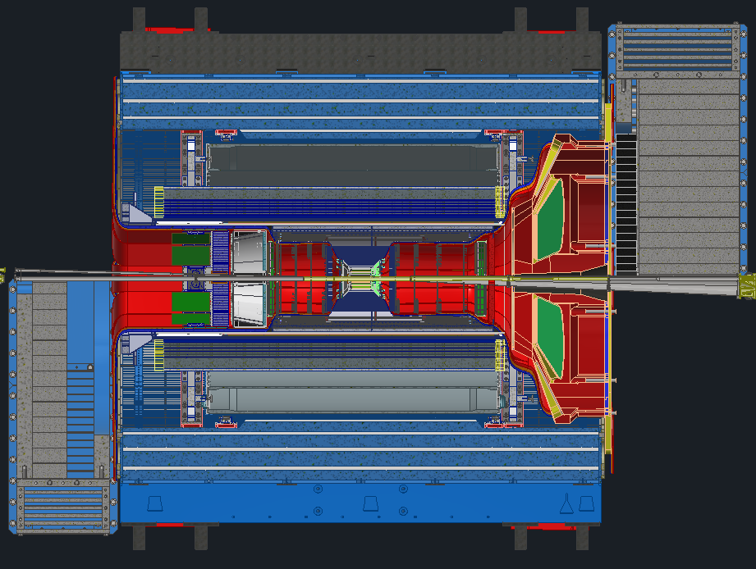
Services
Recently updated volumes model to include recent changes
Cooling estimates will likely be redone in the coming months now that we have more info from the subgroups
Still need to find locations for patch panels and the VTRX+ modules
Need to add insulation to some cooling estimates
Once the last groups finish adding their services I will go and update the spreadsheet

Slide 3
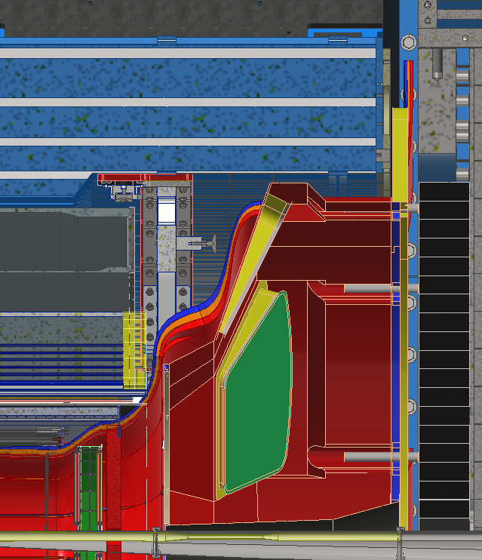
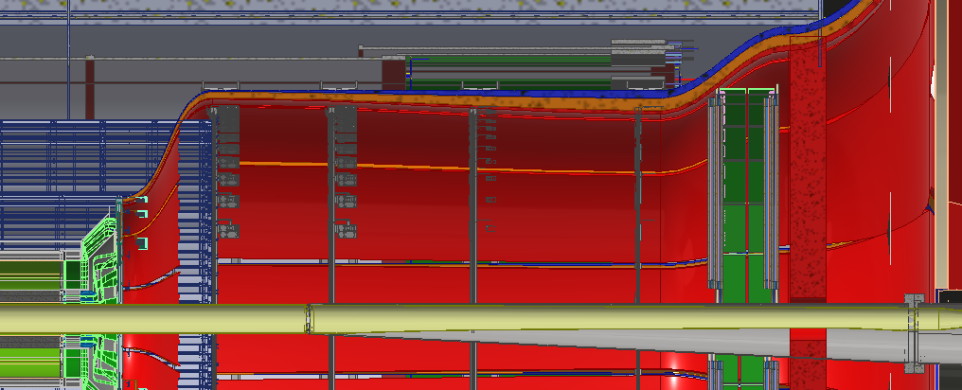
Forward Direction
Recently shifted the DIRC and oMPGD outward and shortened the DIRC
This will relieve stress on services going around the dRICH
Need to meet with dRICH group to discuss some interferences after their review
Depending on levels of adjustment, the region between the GST and dRICH may become an issue

Slide 4
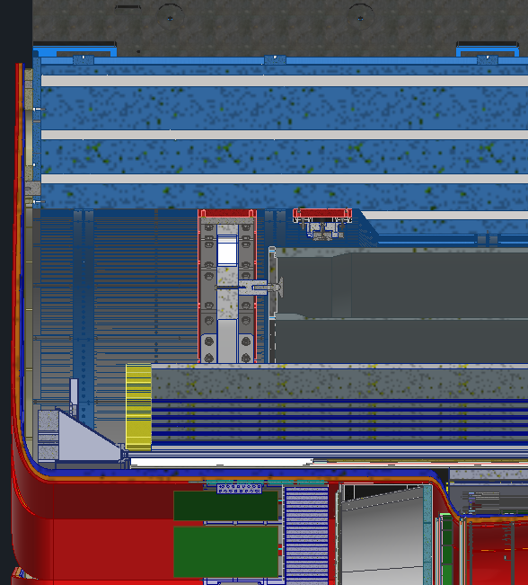
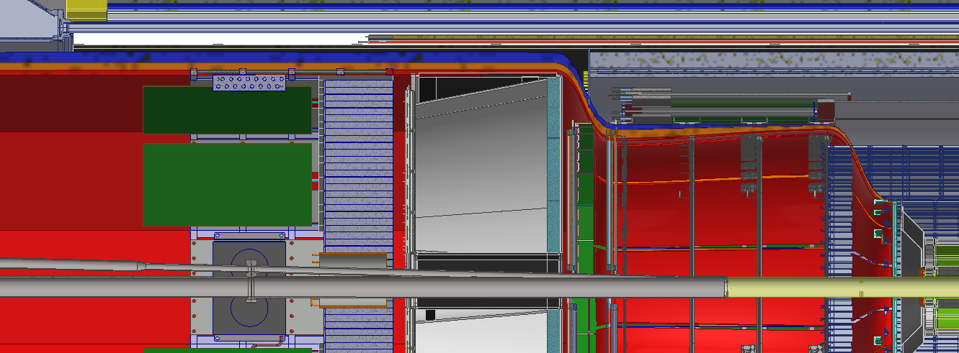
Backward direction
Space between GST and pfRICH is becoming an issue
  Were currently using 104% of the space after recent updates
Still need to determine best locations for patch panels / disconnects and for the VTRX+ modules

Slide 5
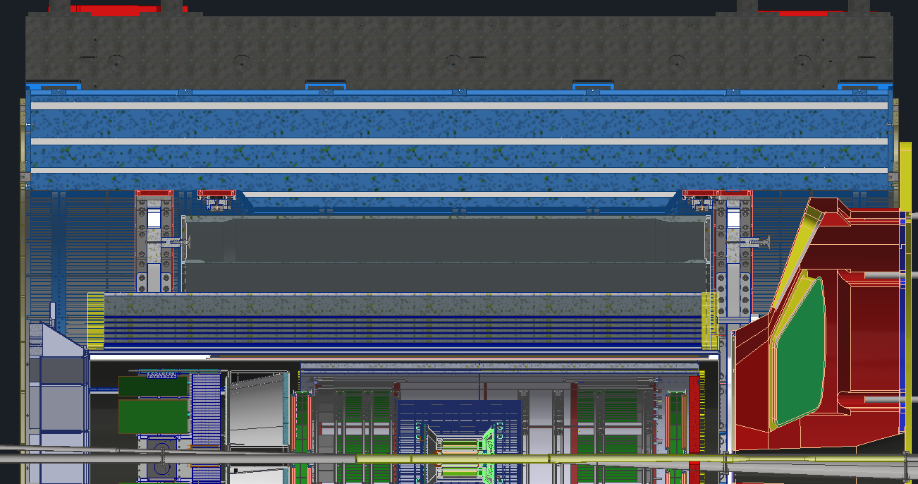
Spaces Required
Location | Total Area (cm²)
A | 148
B | 423
C | 1290
D | 1699
E | 2979
F | 3065
G | 3065
H | 3065
I | 3065
M | 148
N | 423
O | 1290
P | 1784
Q | 1883
R | 1965
S | 2158
T | 2314
T
I
G
H
S
E
P
F
N
B
C
R
Q
D
O
M
A

Slide 6
Question & Comments

