Slide 1
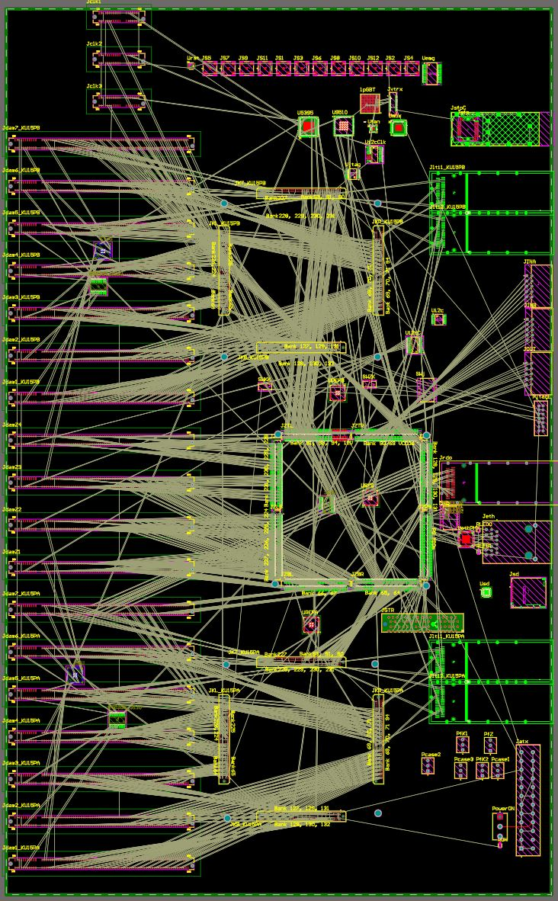
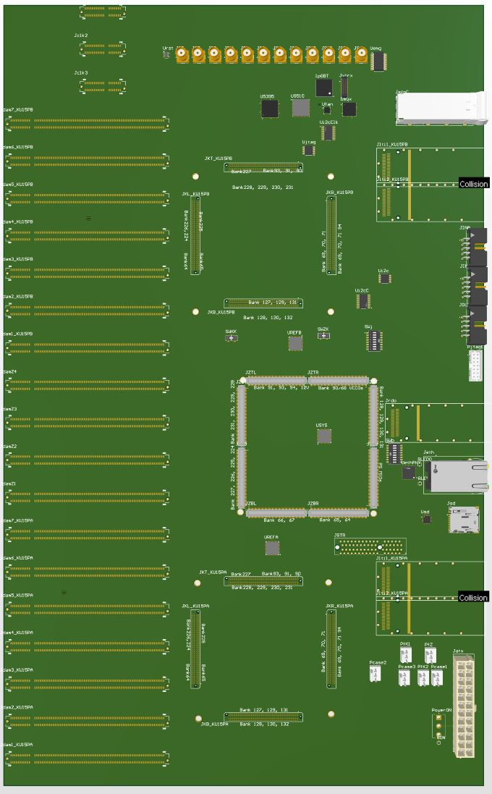
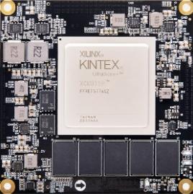
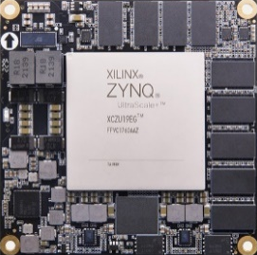
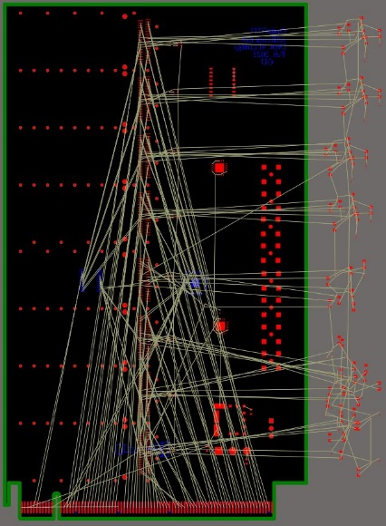
1. GTU design: PCBs
262 mm
This summer
Right now:
Schematics: 60%
PCB placement: 80%
PCB routing: 0%
425 mm

Slide 2
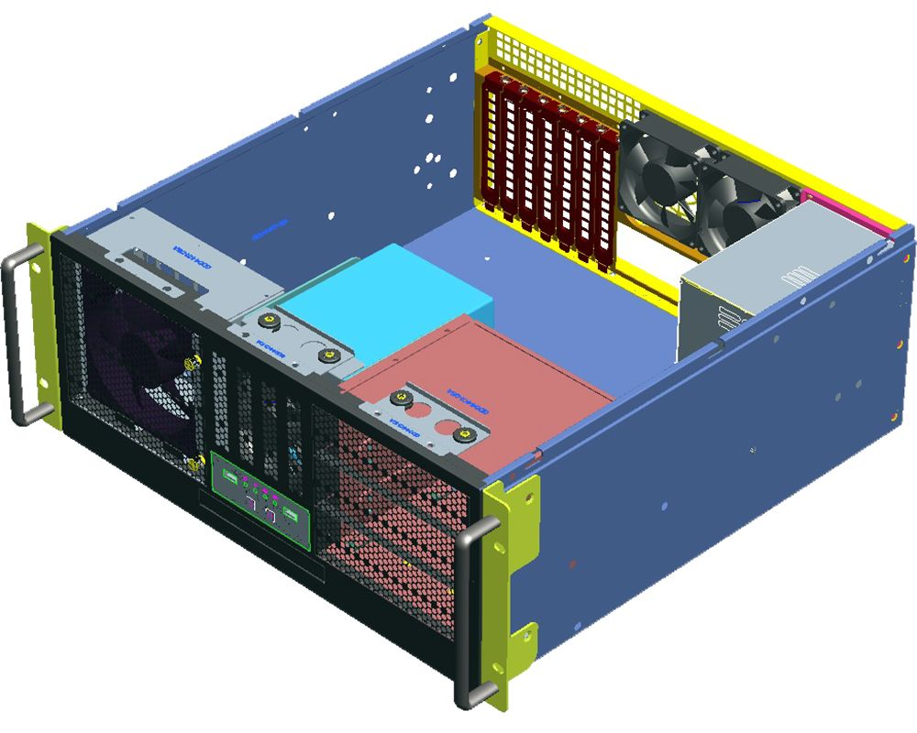
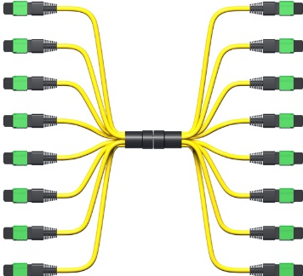
1. GTU design: in the rack
GTU
Up to 144
DAM

Slide 3
2. GTU-DAM interface: optic transceivers
MTP fibers (8 or 12 strands)
One per GTU-DAM
GTU
QSFP
19.7 MHz clock
DAM
Samtec
B04
PCB
TX1
TX2
TX3
TX4
RX4
RX3
RX2
RX1
RX1
RX2
RX3
RX4
TX4
TX3
TX2
TX1
PCB
Downlink, 7.88 gbps
Non-MGT
Future expansion
Uplink, 7.88 gbps
QSFP: AC-coupled on the electric signals

Slide 4
2. GTU-DAM interface: signal description
Synchronization
MGT package
Future Expansion

Slide 5
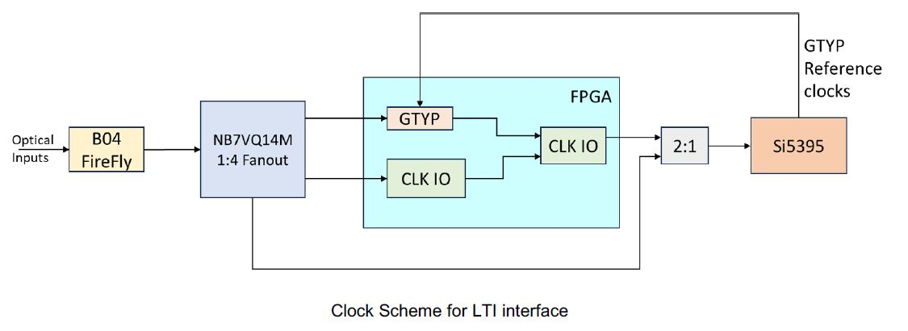
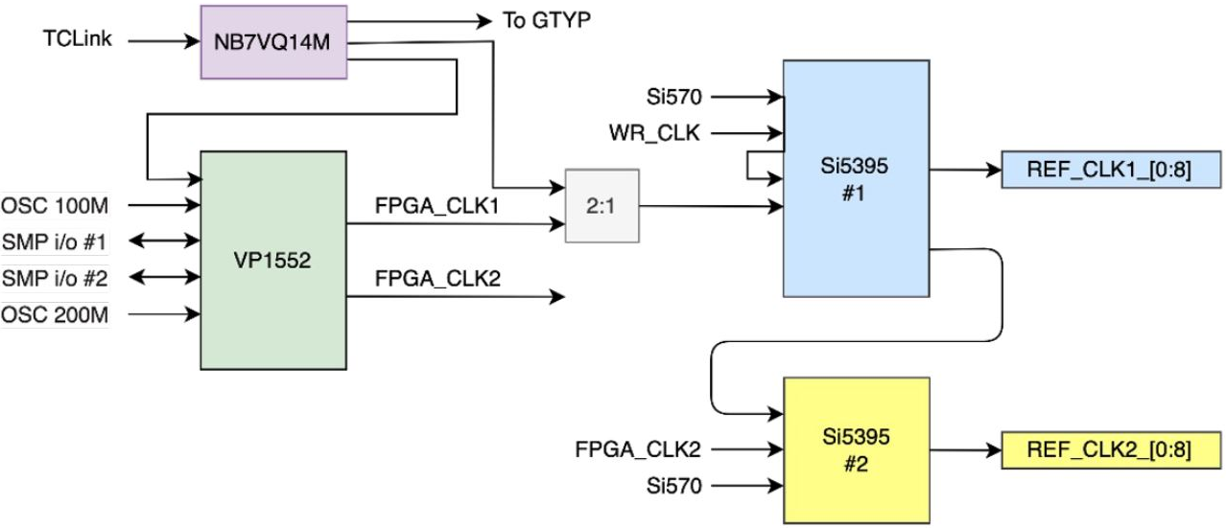
2. GTU-DAM interface: FLX155 clock interface
Dedicated Clock input,
up to three MGT lanes (Tx/Rx)
MTP multimode 850µm optical
* These two diagrams are from FLX155 presentations

Slide 6
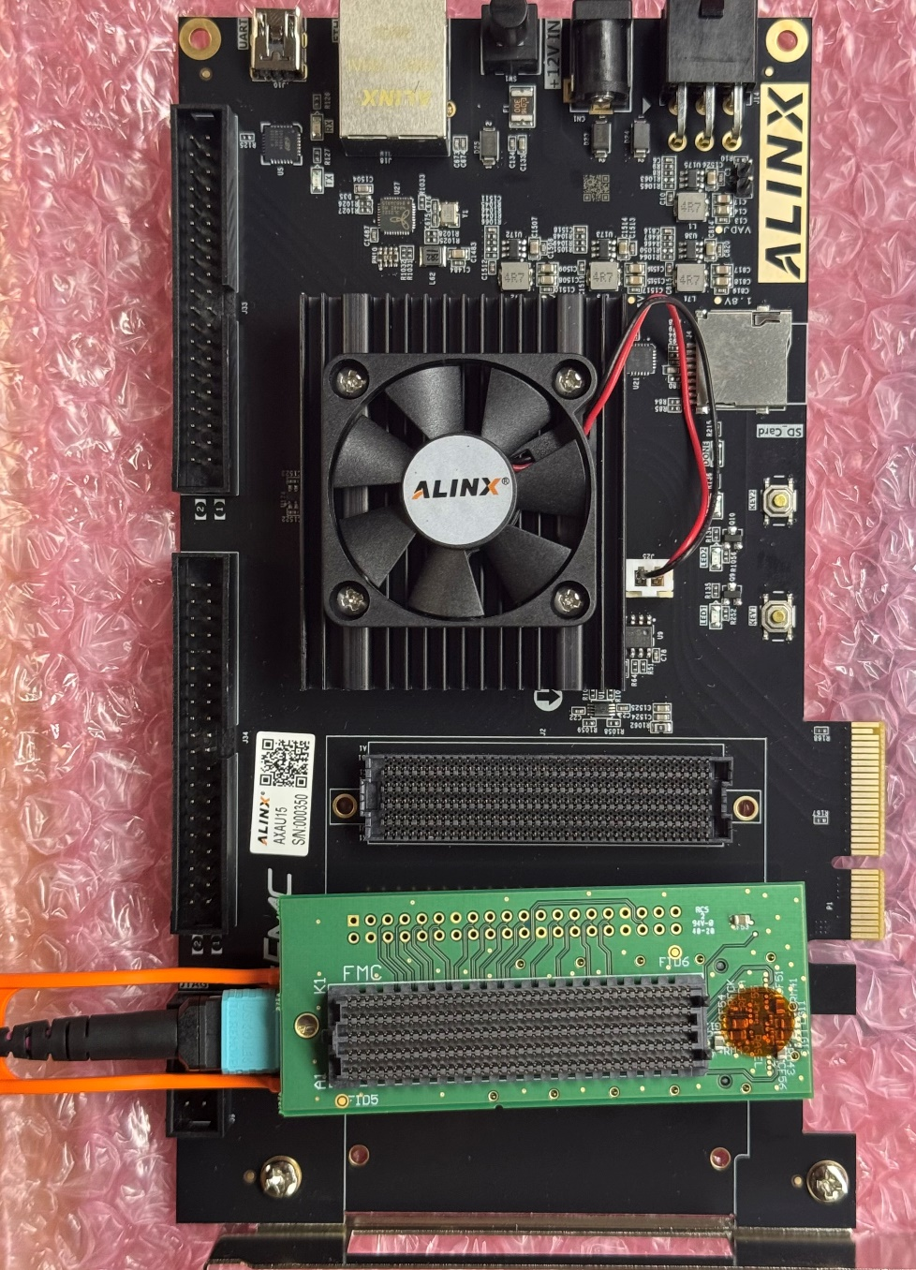
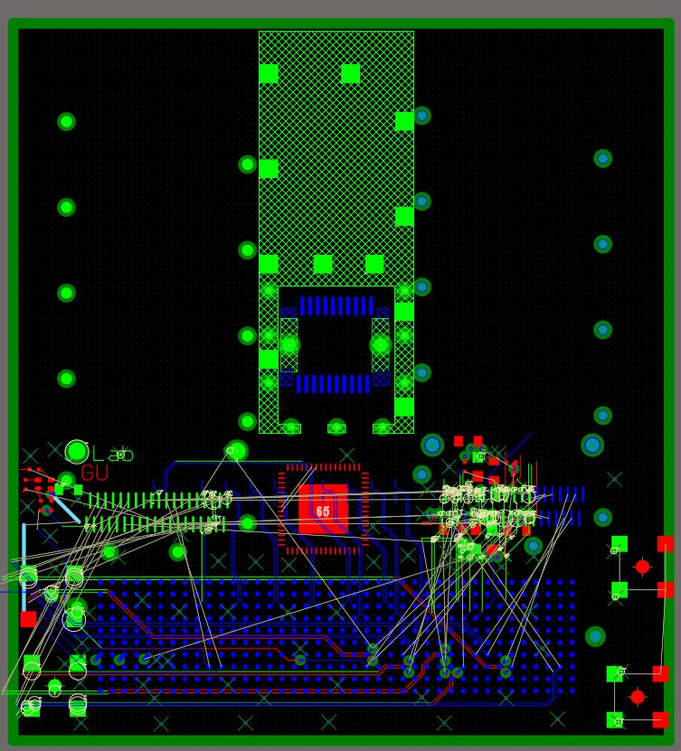
3. AXAU15 FMC adaptor design
QSFP_R
4xSFP
4xRDO
QSFP_G
GTU
(LTI)
Si5395
FMC to AXAU15

Slide 7
BACKUP SLIDES

Slide 8
3. The GTU Design
3.1 Clock distribution

Slide 9
3. The GTU Design
3.3 GTU fast control

