Slide 1
The 3 mile high view of our “GTU”
GL1 / core
Start/stop etc
DB interaction
Granule
vGTM
Granule
FEM
FEM
Clock
FEM
FEM
vGTM
Granule
FEM
FEM
FEM
FEM
vGTM
Granule
FEM
Busy
FEM
FEM
FEM
vGTM
FEM
Busy
FEM
FEM
V124
Busy
FEM
Busy
…
The GL1 transmits the RF clock to the vGTMs
The vGTMs (virtual Granule Timing Modules) transmit clock and other info to their front-ends
Think of them partially as a Gate & Delay generator from 30 years ago (each detector system needs different timing)
At each bunch crossing they distribute 96 bits
They are aware of the bunch rotation in the accelerator
And they facilitate the calibration running
All this is following a “KISS” - “keep it simple and stupid” – principle

Slide 2
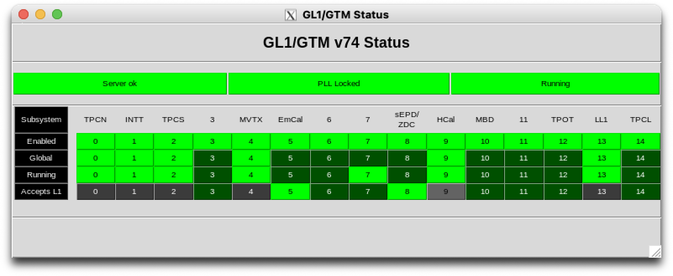
15 vGTMs
We have 15 vGTMs total (completely driven by how many transceivers are free), and use 11
Each vGTM’s output is a fiber bundle (a Minipod worth) with up to 12 fibers sending an identical signal
Each vGTM is assigned to a detector (TPC has 2 for N/S split, all others have 1)
yesterday during commissioning around 7pm – taking cosmics data with TPC, INTT, MVTX, HCAL:

Slide 3
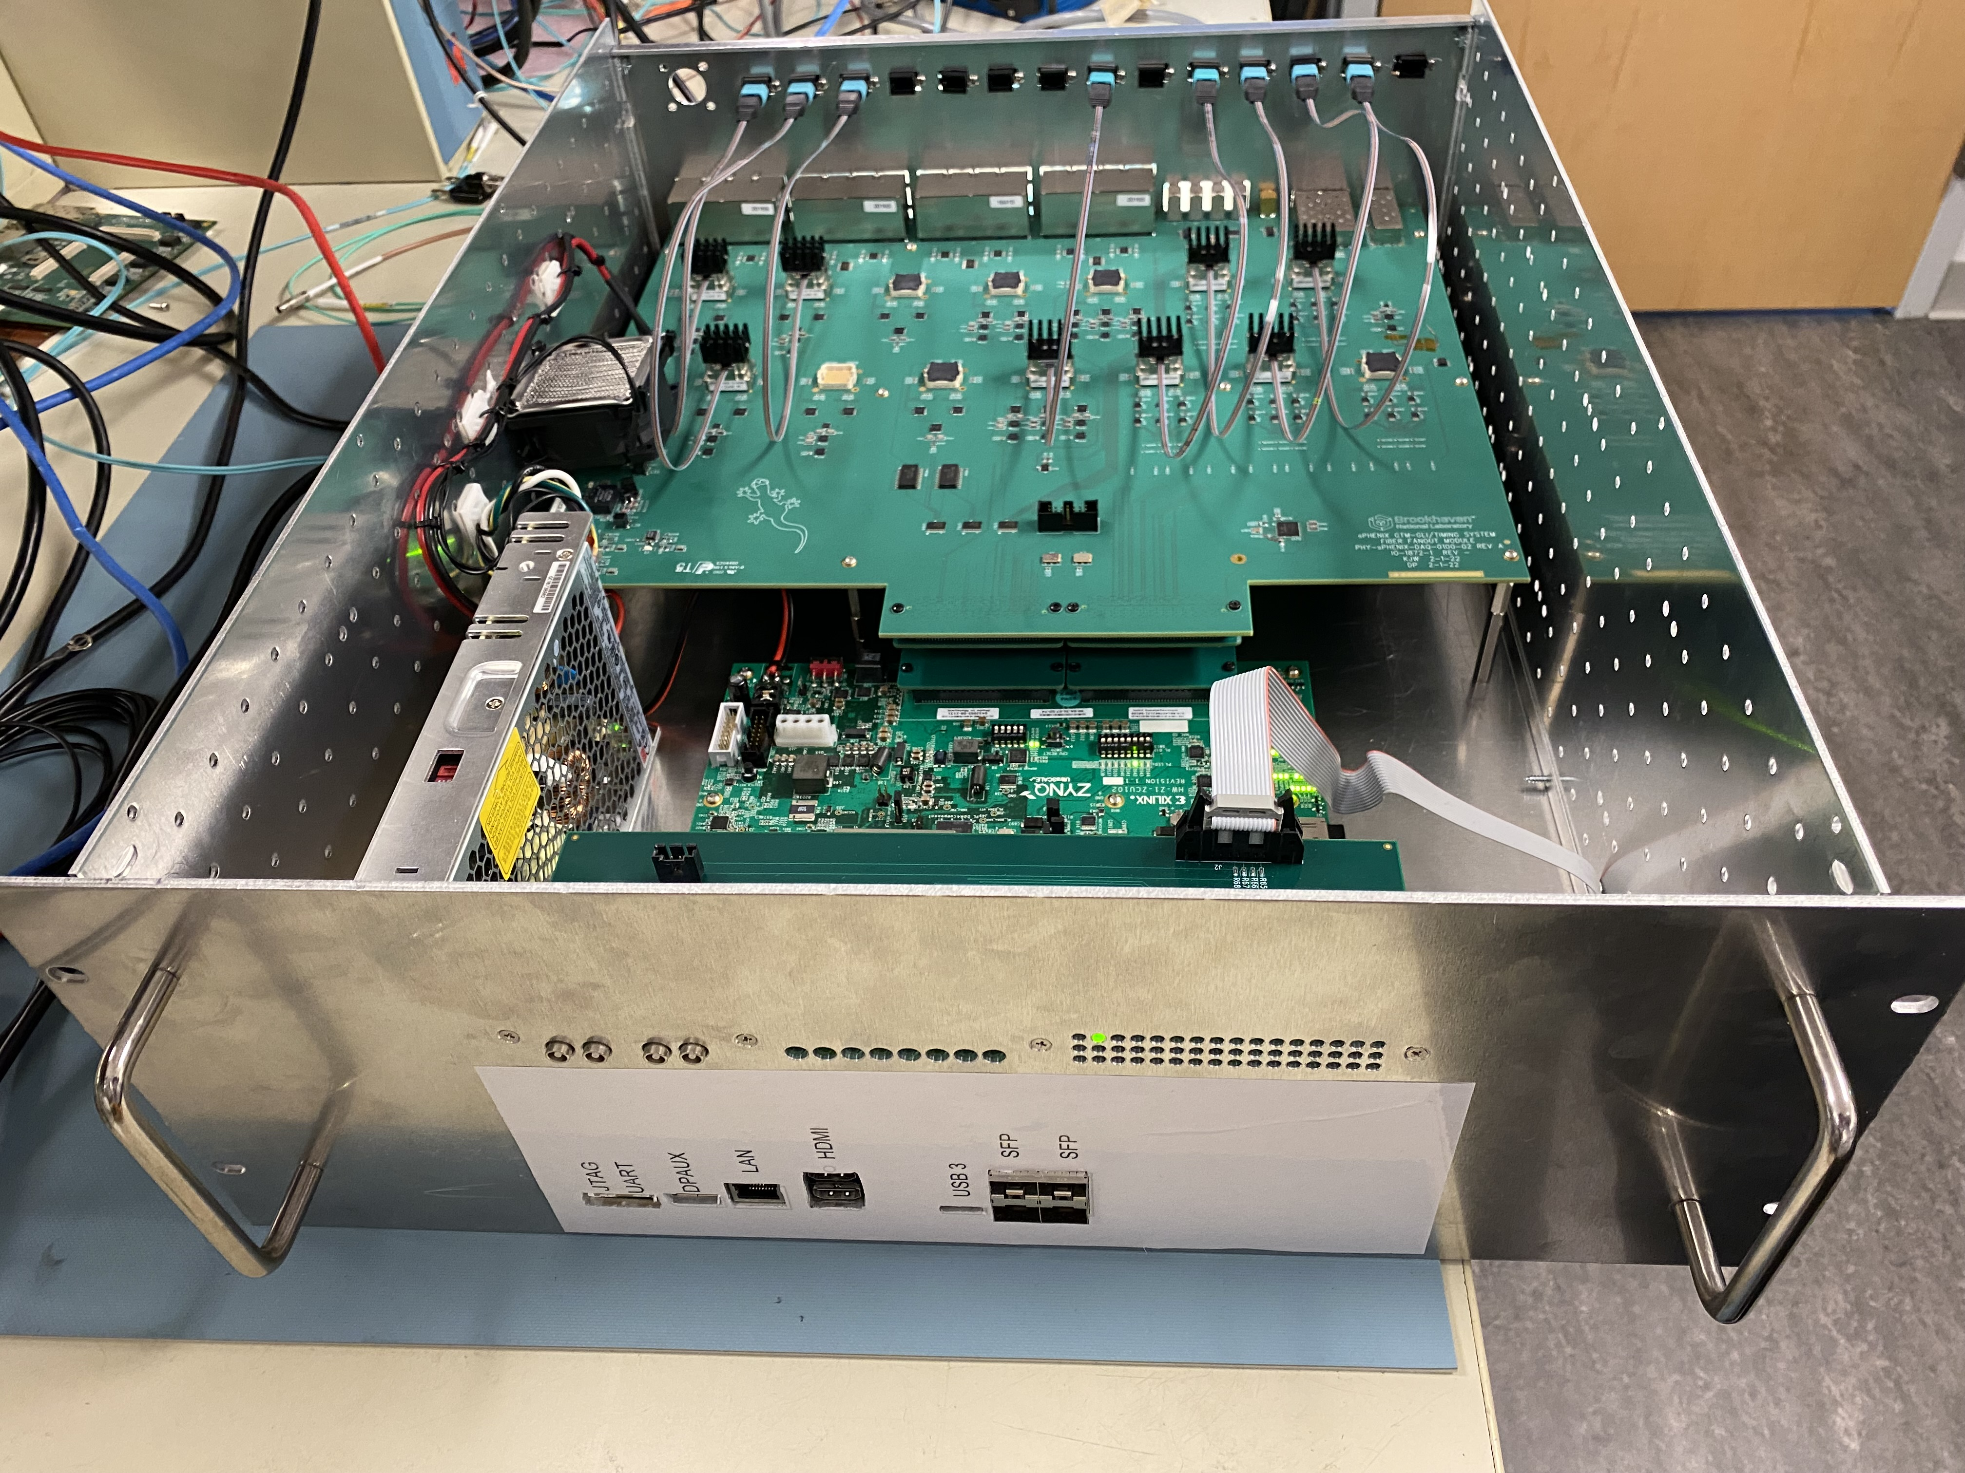
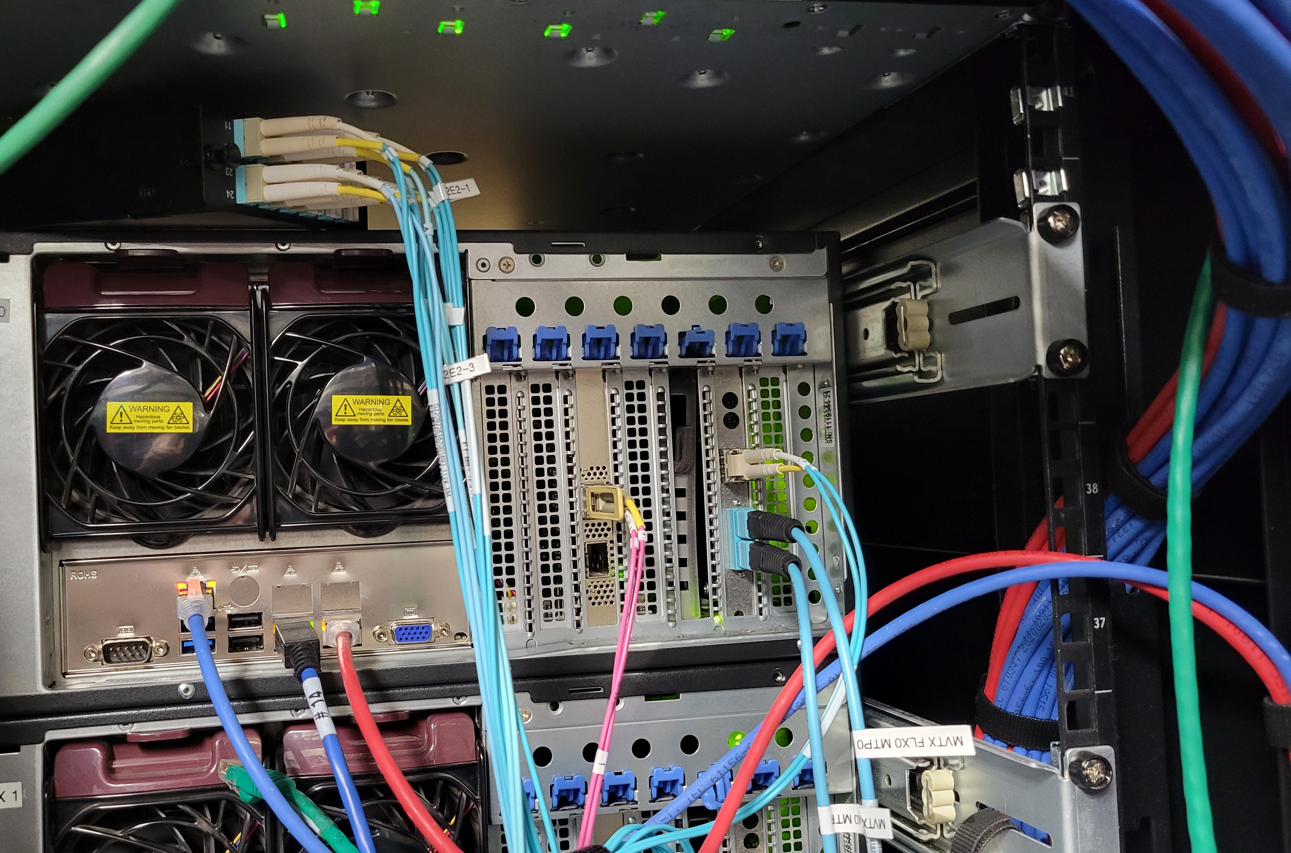
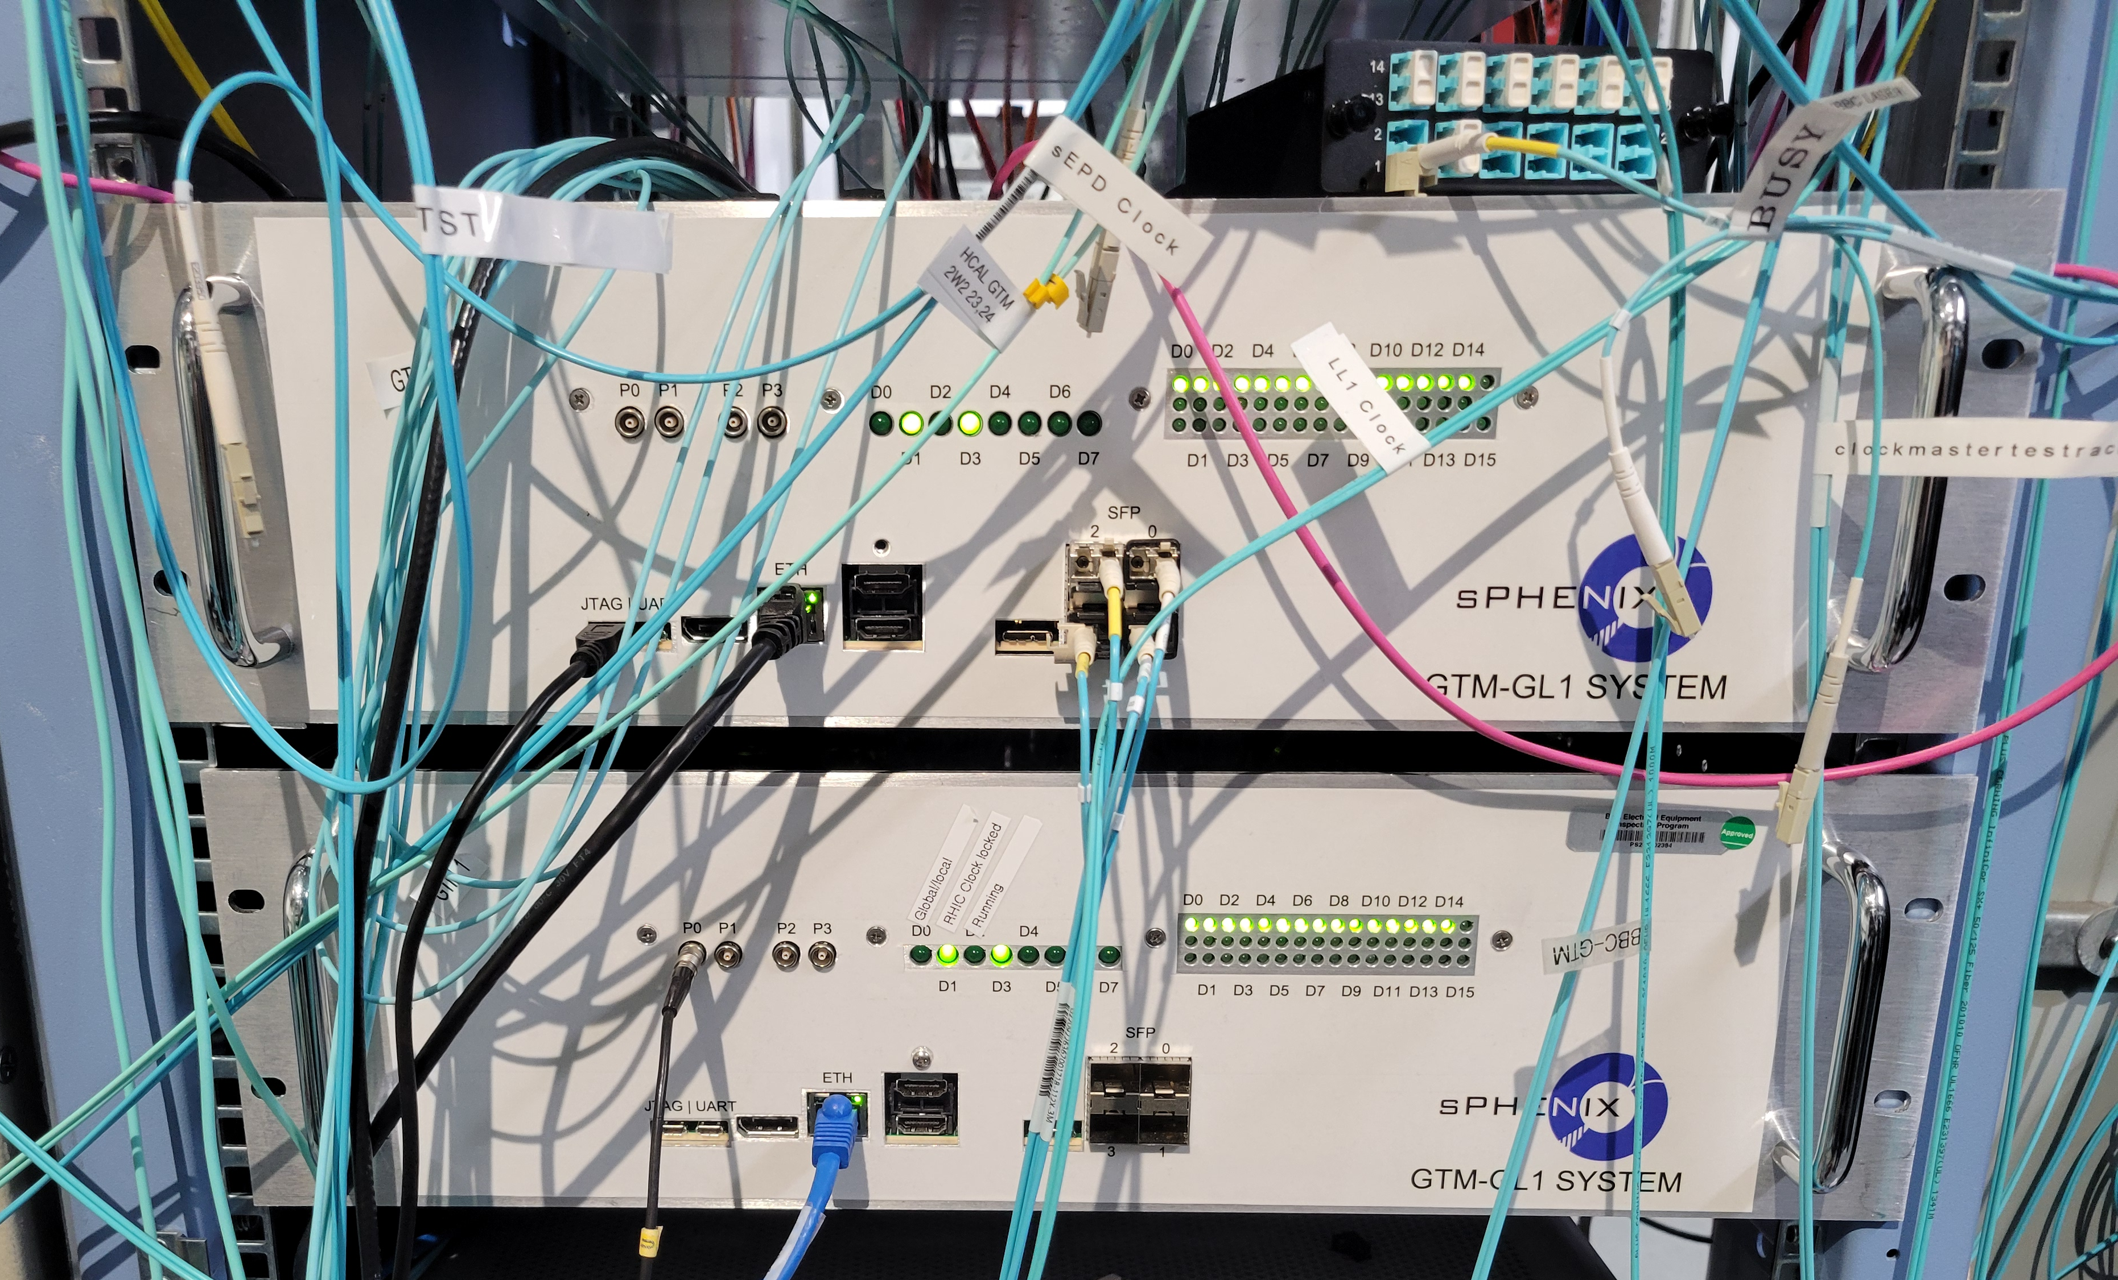
Units of 12 MTP Fibers…
Just to show you how the FELIX hardware interface looks…
Groups of 12 identical-signal fibers via MTP fibers to a rack, then ->LC breakout
MPT->12 LC converter
GTM->FELIX input
Detector fibers

Slide 4
Global or local
Mostly vGTMs run in “global” mode with beam
They start and stop together – this is how you run the experiment with beam
They can individually be brought into “local” mode primarily for debugging but also for LED/calibration running
Local - they start and stop individually. Say you debug the TPC, and someone else is debugging the EmCal… in this way it is as if you have completely independent timing systems.
In local mode, you can do your thing without having to coordinate with anyone else
We also use this local mode to take LED/calibration data for, say, HCal and EmCal concurrently and independently

Slide 5
Accelerator rotation / “modebits”
RHIC has 120 bunch “buckets” – one full rotation of about 12us
The vGTMs know (from the v124) when “bunch 0” is passing buy
Each vGTM has 32 “banks” with information for 120 individual bunch crossings each
We can store detector instructions (“modebits”) for any crossing and per vGTM
(so you can send different instructions to, say, the TPC and the EmCal)
That is the way to make a frond-end do things exactly when we need it to
They are detector-specific special instructions such as “reset all your internal counters”, “prime yourself for taking data”, “start”, etc
All modebits but a tiny handful are empty - “just the clock and nothing else”
Better explained with an example…

Slide 6
Modebits
Here is the (dirt simple) setup for our calorimeters using 5 such 120-slot banks
(remember each bank represents one RHIC turn, about 12us)
When we start, we issue a “run” modebit, more accurately “prime yourself”
Later we issue a “reset” modebit, clearing all internal counters - now we are ready to go
What you see here is a one-shot init section in banks 0..3, followed by sending ”nothing” indefinitely (until we say “stop”)
0 – we make 100 turns doing nothing
1 – in bucket 9 we issue “run”
2 – 100 turns / 1.2ms nothing
3 – bucket 9 sends “reset”
4 – 120,000 turns of nothing, followed by a jump to bank 4 again, going on forever
# modegrp repeat jump target values
0 100 0 0
1 0 0 0 9:RUN;
2 100 0 0
3 0 0 0 9:RESET;
4 120000 1 4

Slide 7
LED etc calibs
Now it’s easy to see how calibration events are triggered, and the readout is started.
We place the LED firing into the abort gap, where the detector is quiet
From there it’s a calibrated propagation latency until we need to trigger the ADC readout (here: 29 buckets)
… again until we say “stop”
0…3 you already know
4 – we wait 757 turns - ~10ms
5 – “PULSE” fires the LEDs in bucket 119 (last bucket in abort gap)
6 – 29 beam crossings after we start the readout (FA = “Forced Accept”)
… and we jump back to 4, so we get ~100Hz of LED events.
# modegrp repeat jump target values
0 100 0 0
1 0 0 0 9:RUN
2 100 0 0
3 0 0 0 0:RESET
# 757 is about 10ms
4 757 0 0
5 0 0 0 119:PULSE
6 0 1 4 28:FA

Slide 8
And you can see what this does
# modegrp repeat jump target values
0 100 0 0
1 0 0 0 9:RUN
2 100 0 0
3 0 0 0 0:RESET
# 757 is about 10ms
4 757 0 0
5 0 0 0
6 0 1 4 28:FA
# modegrp repeat jump target values
0 100 0 0
1 0 0 0 9:RUN
2 100 0 0
3 0 0 0 0:RESET
# 757 is about 10ms
4 757 0 0
5 0 0 0 119:PULSE
6 0 1 4 28:FA
This is the setup for a pedestal run, everything as before, just no LED firing

Slide 9
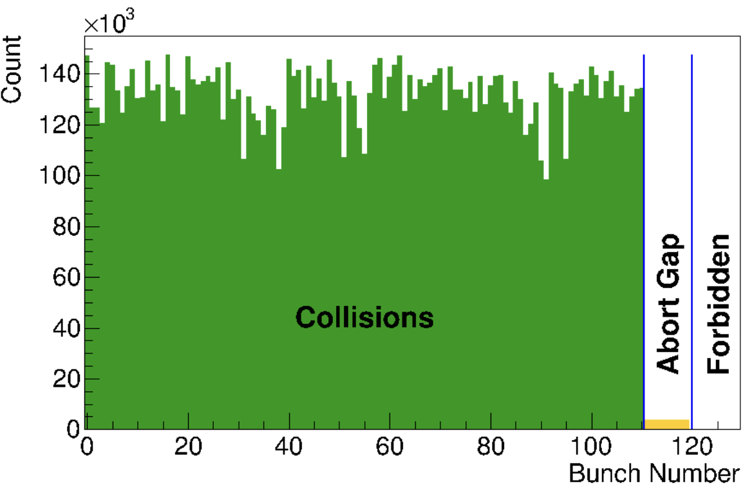
Summary
The GL1 core, and by extension the vGTMs know the “bunch number” that is currently flying by
They count bunches 0…119, 0…119, and so on
That allows us to place special actions such as the LEDs firing into the abort gap when the detector is quiet, and schedule the detector readout at the right moment after
We can do that on a per-detector basis (latency of the HCal LED->signal is different from the emcal)
Important b/c even though we take dedicated LED runs, we need to do this with beam in the machine.
We meticulously check (online monitoring plot here) that the abort gap is in the right place, meaning that the V124 told us the truth

