Slide 1
Summary on the ePIC/EIC Session
Derek Anderson & Cheuk-Ping Wong
05-23-2025

Slide 2
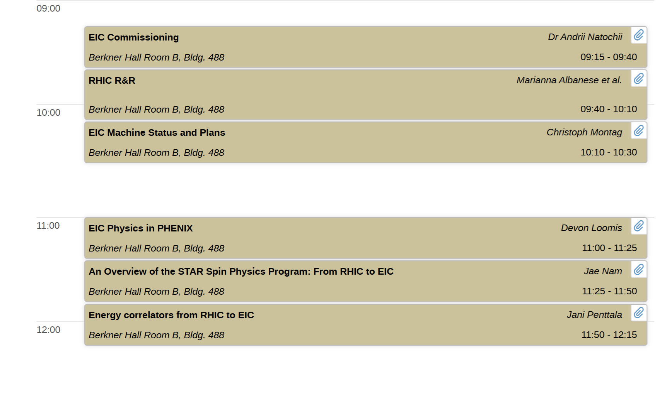
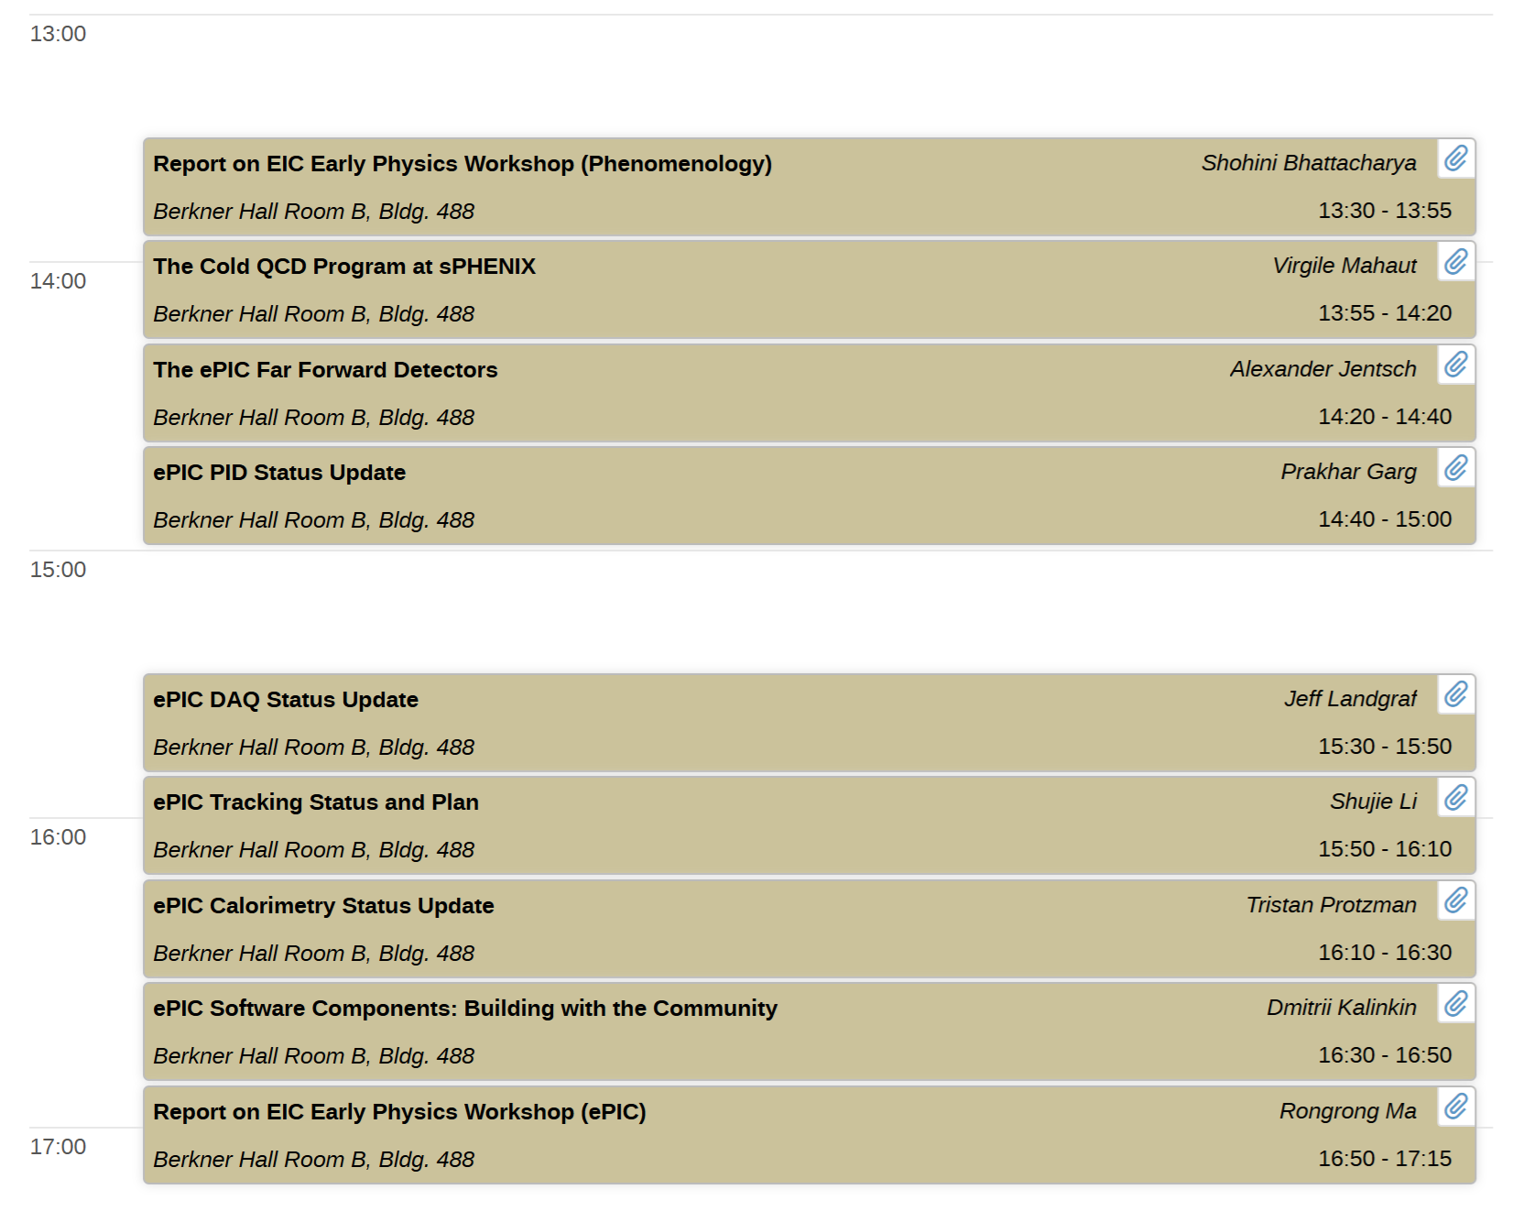
Introduction
https://indico.bnl.gov/event/27198/sessions/8057/#20250520
Theme of the session:
  How do we go from RHIC, to the EIC?
3 Categories:
  cQCD & ME prospects with RHIC
  Preparing for the EIC
  Commissioning/early science with the EIC

Slide 3
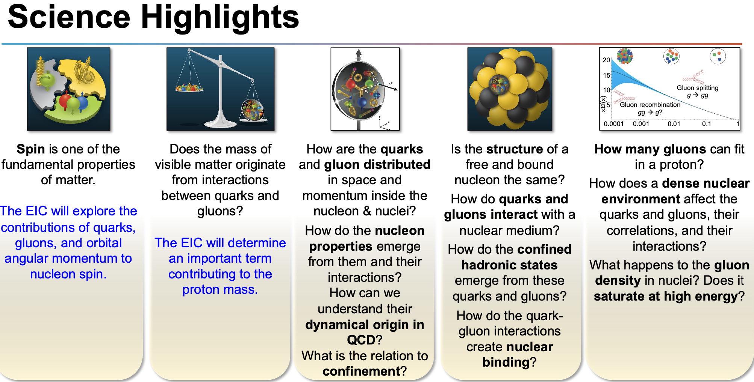
Andrii Natochii (BNL)

Slide 4
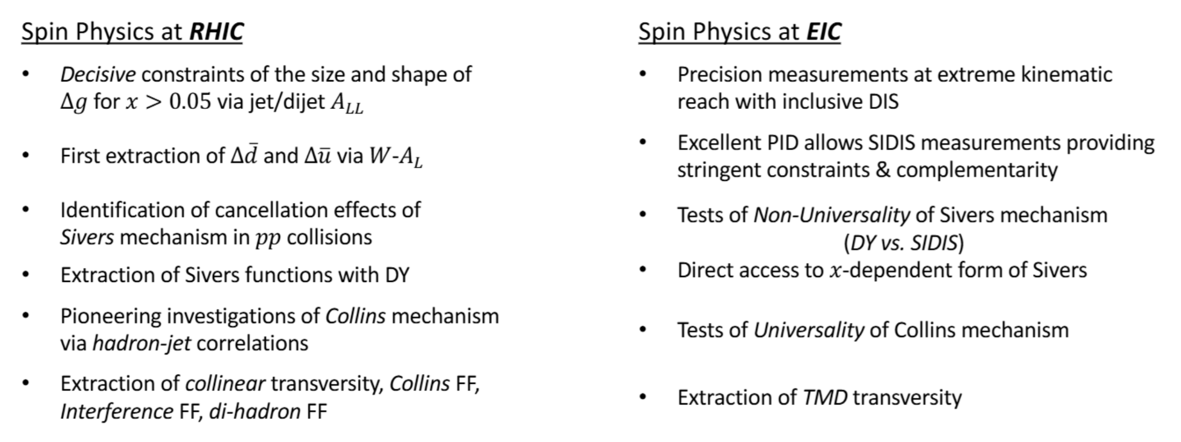
Spin at RHIC
Jae Nam (Temple)

Slide 5
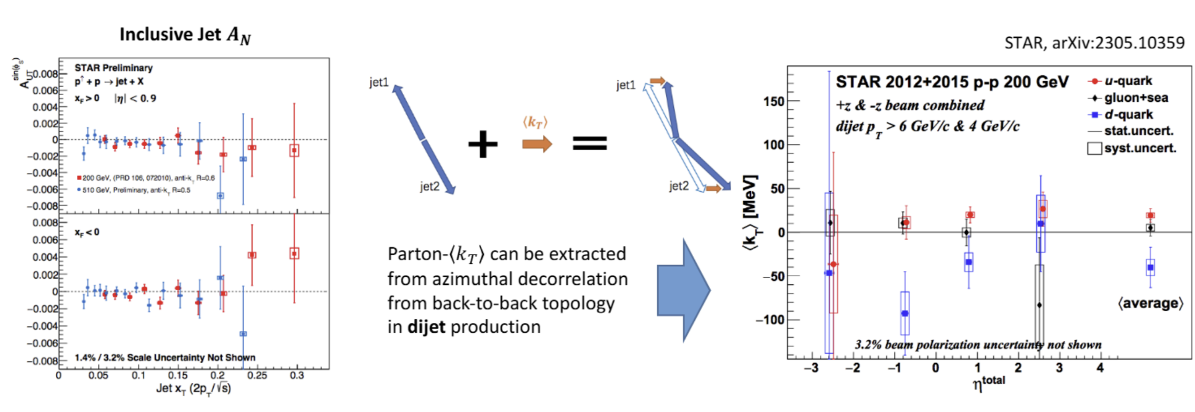
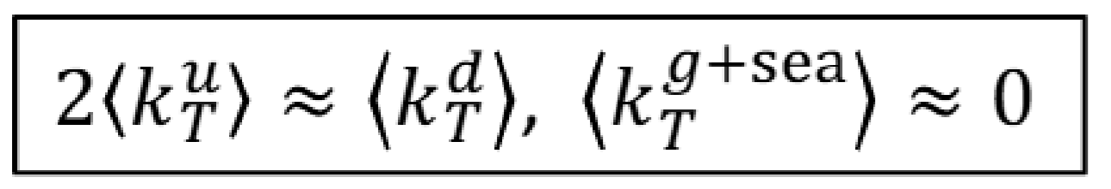
Spin at STAR
Jae Nam (Temple)
Recent STAR result on dijet Transverse Single Spin Asymmetry (TSSA)
  Dijets can probe Sivers effect in p+p
Inclusive dijet asymmetry is ~0
  But jet charge-separated asymmetry shows hint of nonzero asymmetry

Slide 6
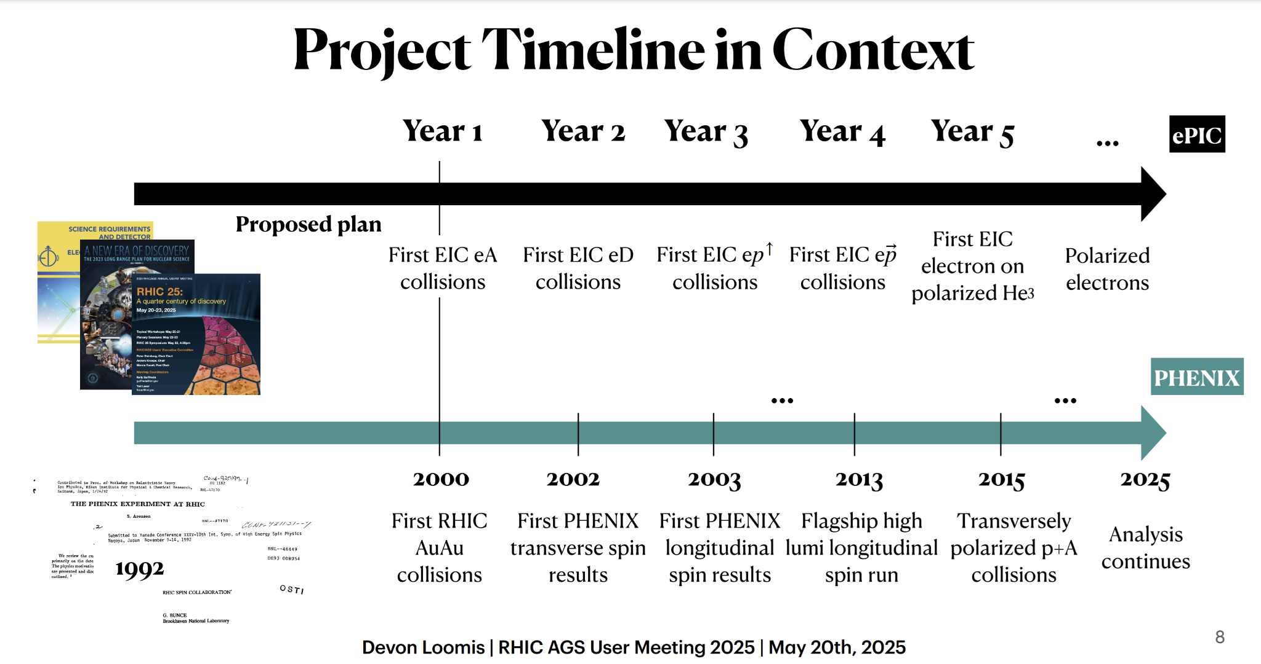
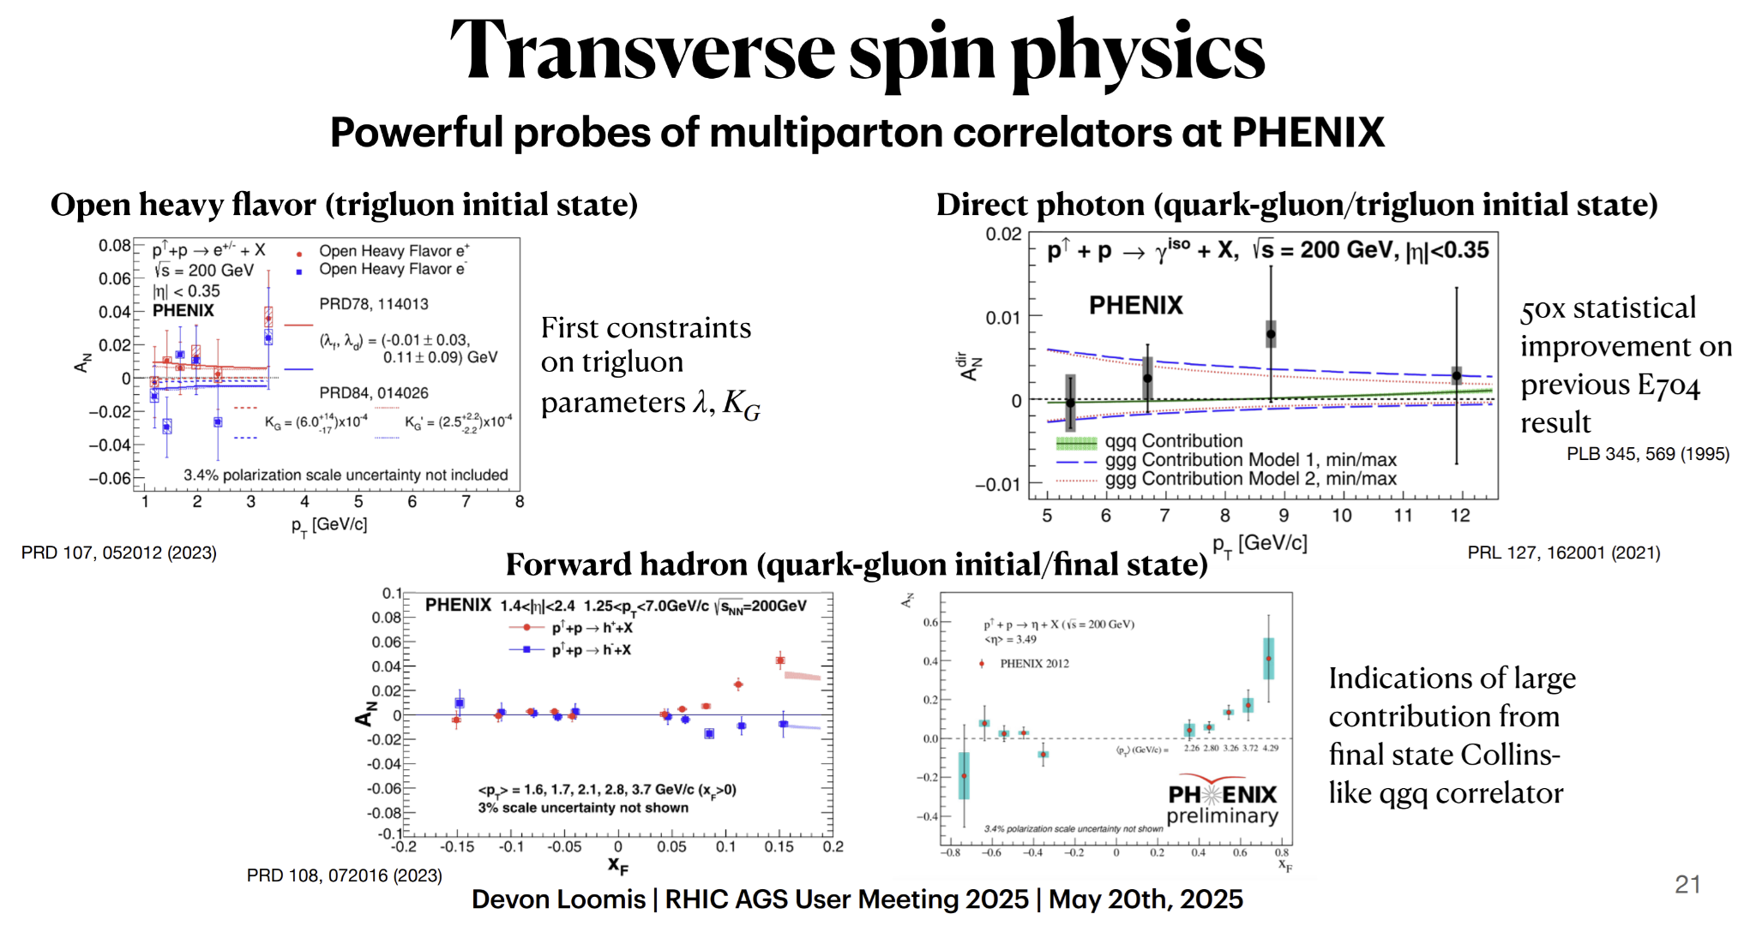
Spin at PHENIX
Devon Loomis (U.Mich.)
Put PHENIX spin & cQCD in context!
  Left: comparison of possible EIC early physics timeline to PHENIX timeline
Right: a compilation of 2021 - 2023 PHENIX TSSA measurements
  Sensitive to Twist-3 correlators
  Results demonstrate partonic correlations in nucleus and fragmentation

Slide 7
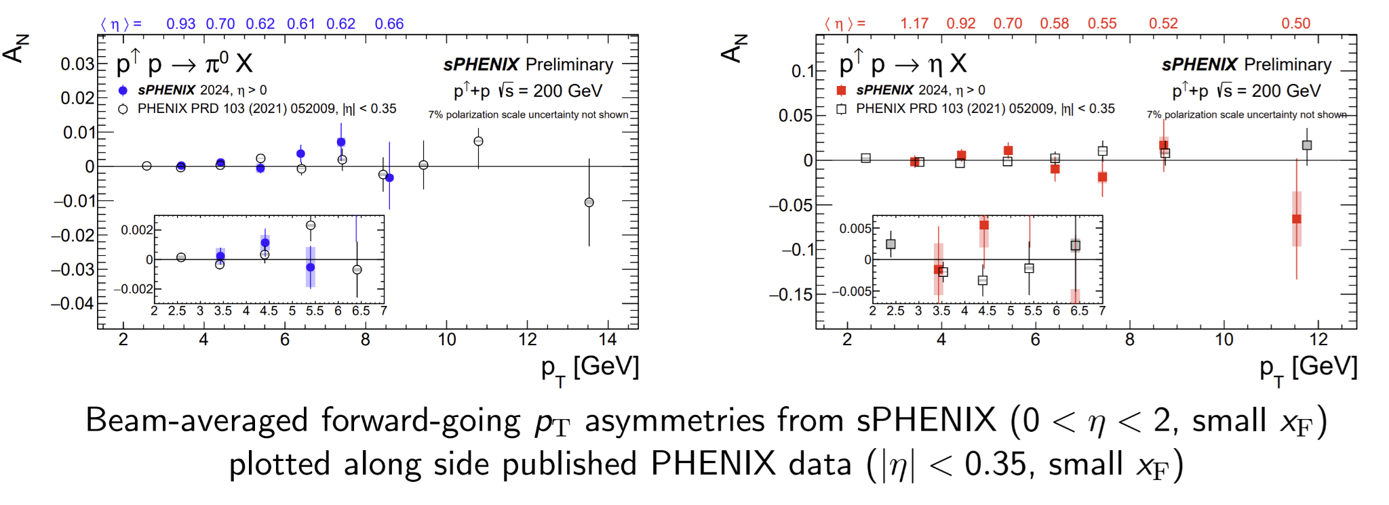
Spin at sPHENIX
Virgile Mahaut (CEA)
Above: TSSA for neutral mesons from sPHENIX Run 24 data
  One of the 1st sPHENIX preliminary results
Sensitive to TMD and twist-3 effects
  (Note: η calculated wrt polarized beam)

Slide 8
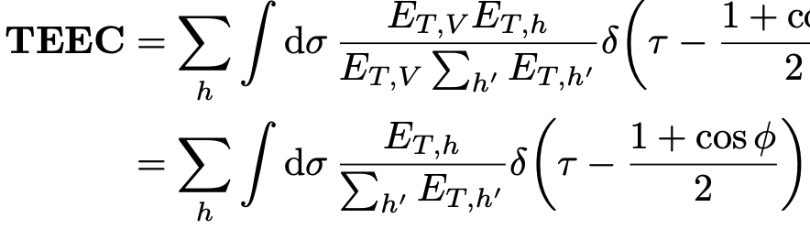
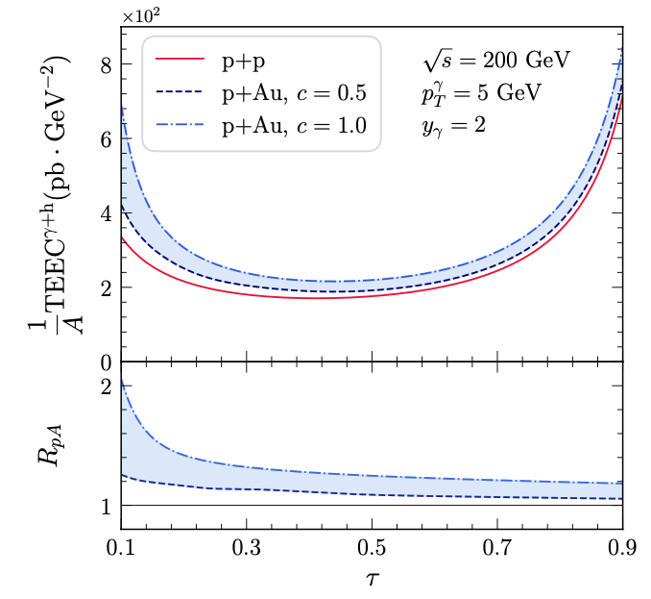
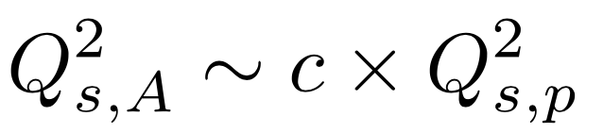
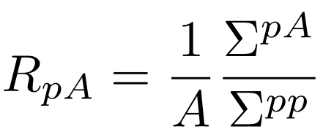
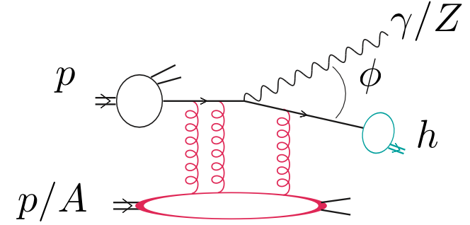
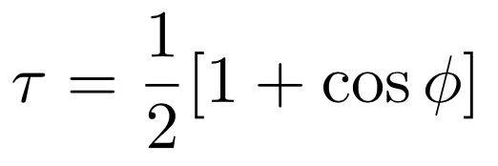
Transverse Energy-Energy Correlation at RHIC
Jani Penttala (UCLA)
Azimuthal angle correlation weighted by the transverse energy
→ Suitable for hadronic collider experiments
Vector-boson tagged TEEC at the back-to-back region
→ Nuclear effects
→ Gluon saturation
arXiv:2410.02747
Back-to-back
Collinear

Slide 9
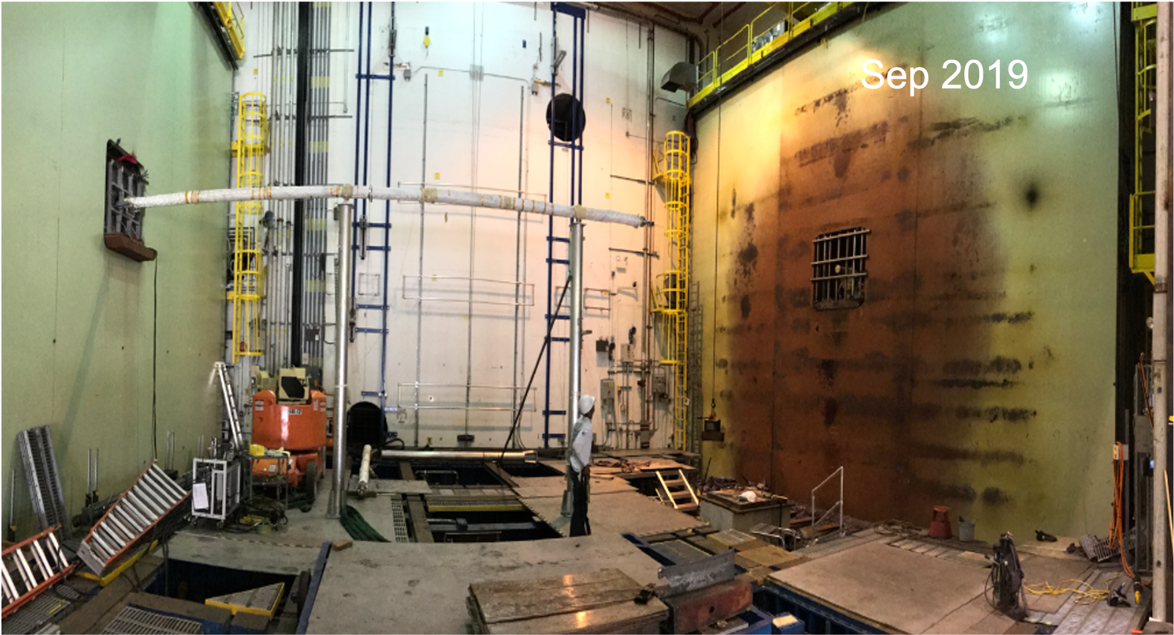
RHIC Removal and Repurpose
Marianna Albanese (BNL)
What’s included in the RHIC R&R Project
Scheduled to begin on early 2026
Accelerator Removals (6 ring section, 6 IR section, service building, Alcoves)
STAR Removals & Repurposing (prepare space to store the repurposed detectors)
sPHENIX Removals and Repurposing (Calorimeters, beam pipe, electronics, equipments)
1008 Muon Steel Removal
Muon steel Weight and Arrangement:
15 plates per side (north/south)
Each side: 5 rows, 3 columns
3 of the rows:
~8-inch thick solid steel
~80 tons each
2 of the rows:
~4-inch thick
~40 tons each
Necessary for the potential 2nd detector

Slide 10
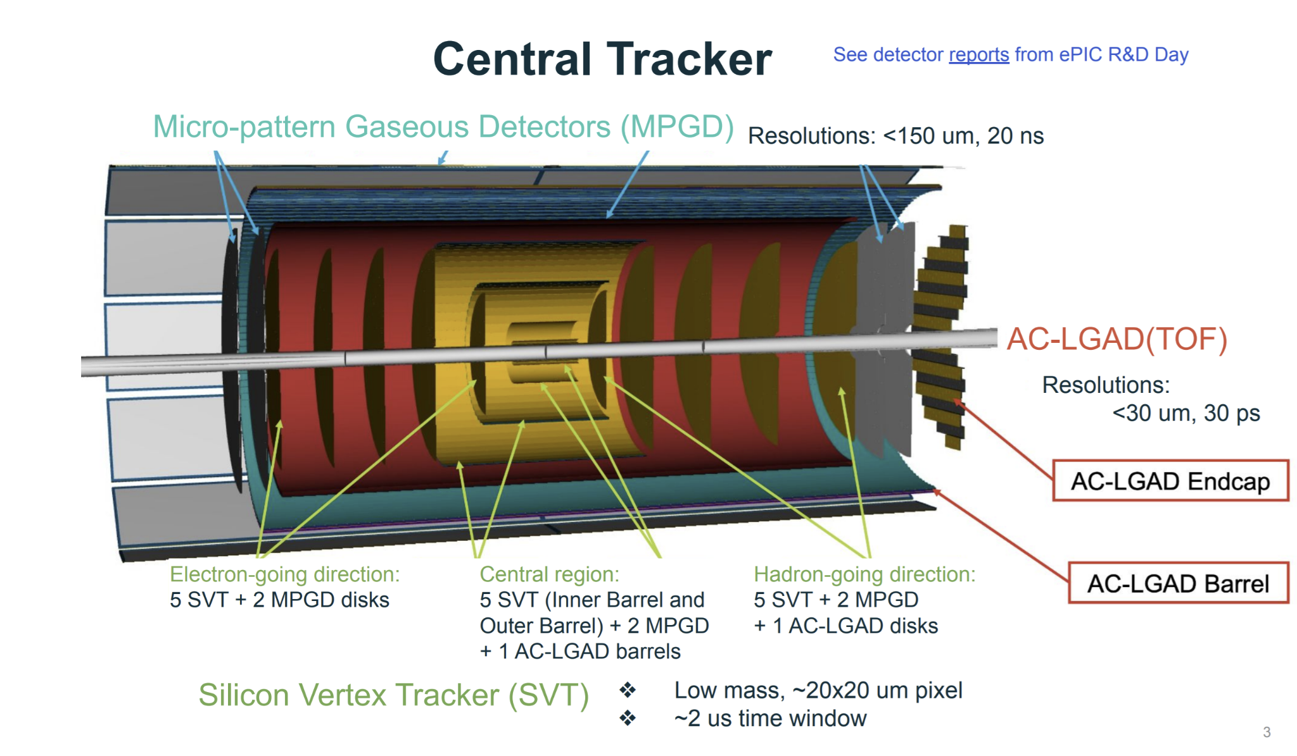
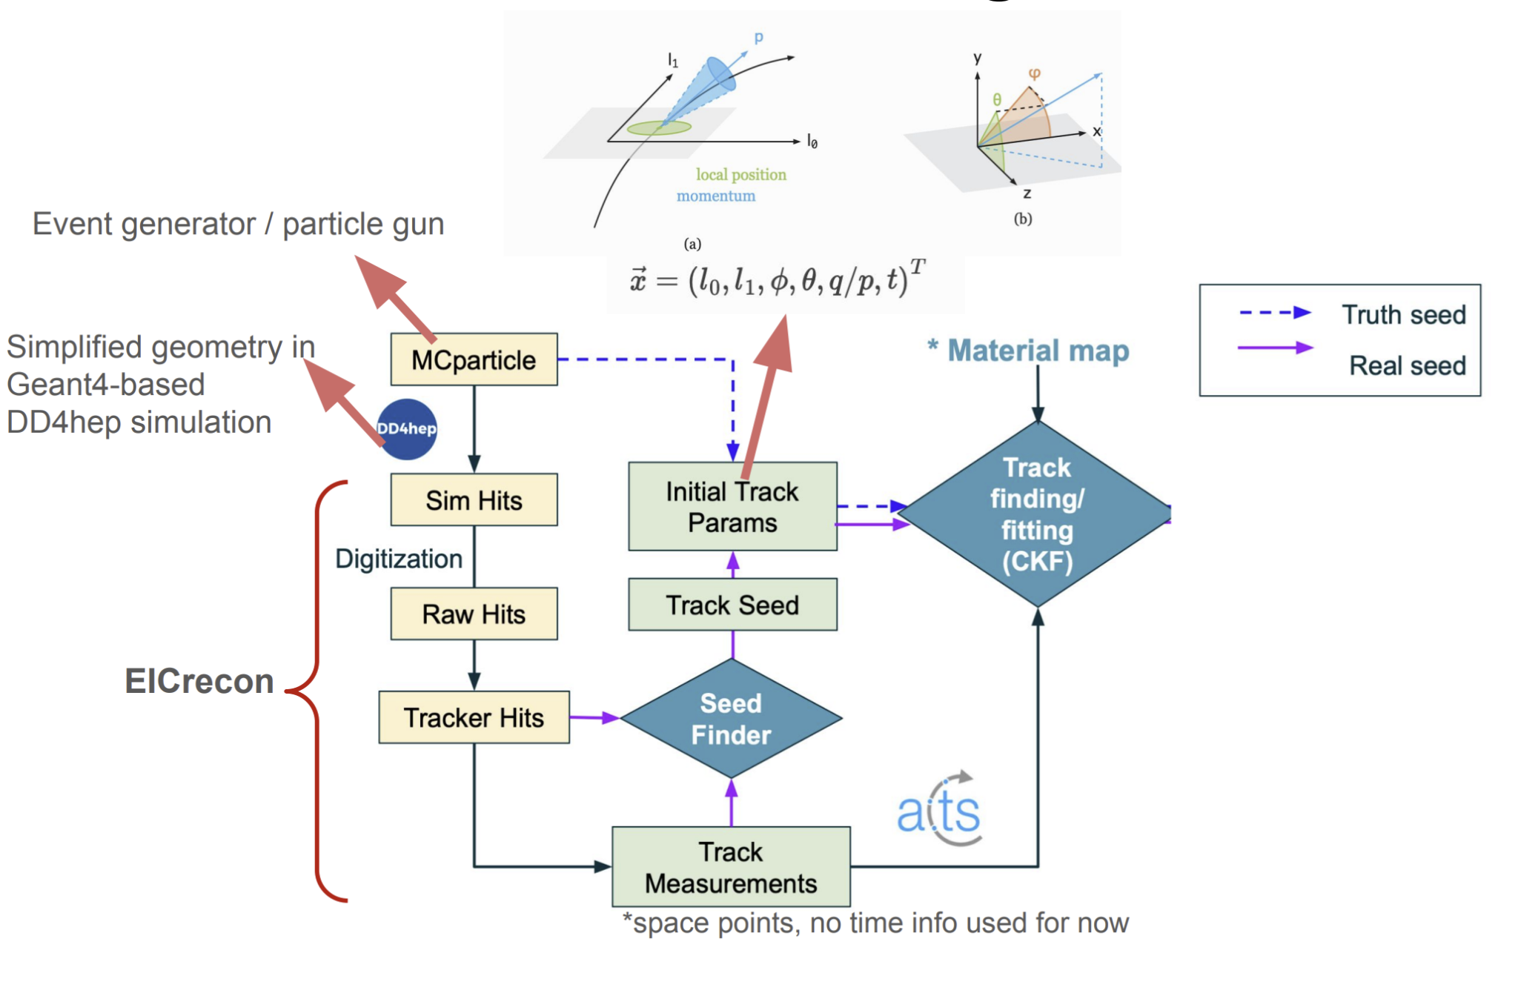
ePIC Tracking
Shujie Li (LBNL)
Precision tracker/vertexer w/ multiple components covering -4<η<4
  Aiming for p resolutions between
(px0.10%)⨁2.0%
(px0.05%)⨁0.5%
ACTS-based tracking well integrated into software
Pursuing several critical efforts for EIC TDR:
  Tracking in realistic environments
  Finalizing designs of certain components
  Assessing impact of noise, missing hits, etc.

Slide 11
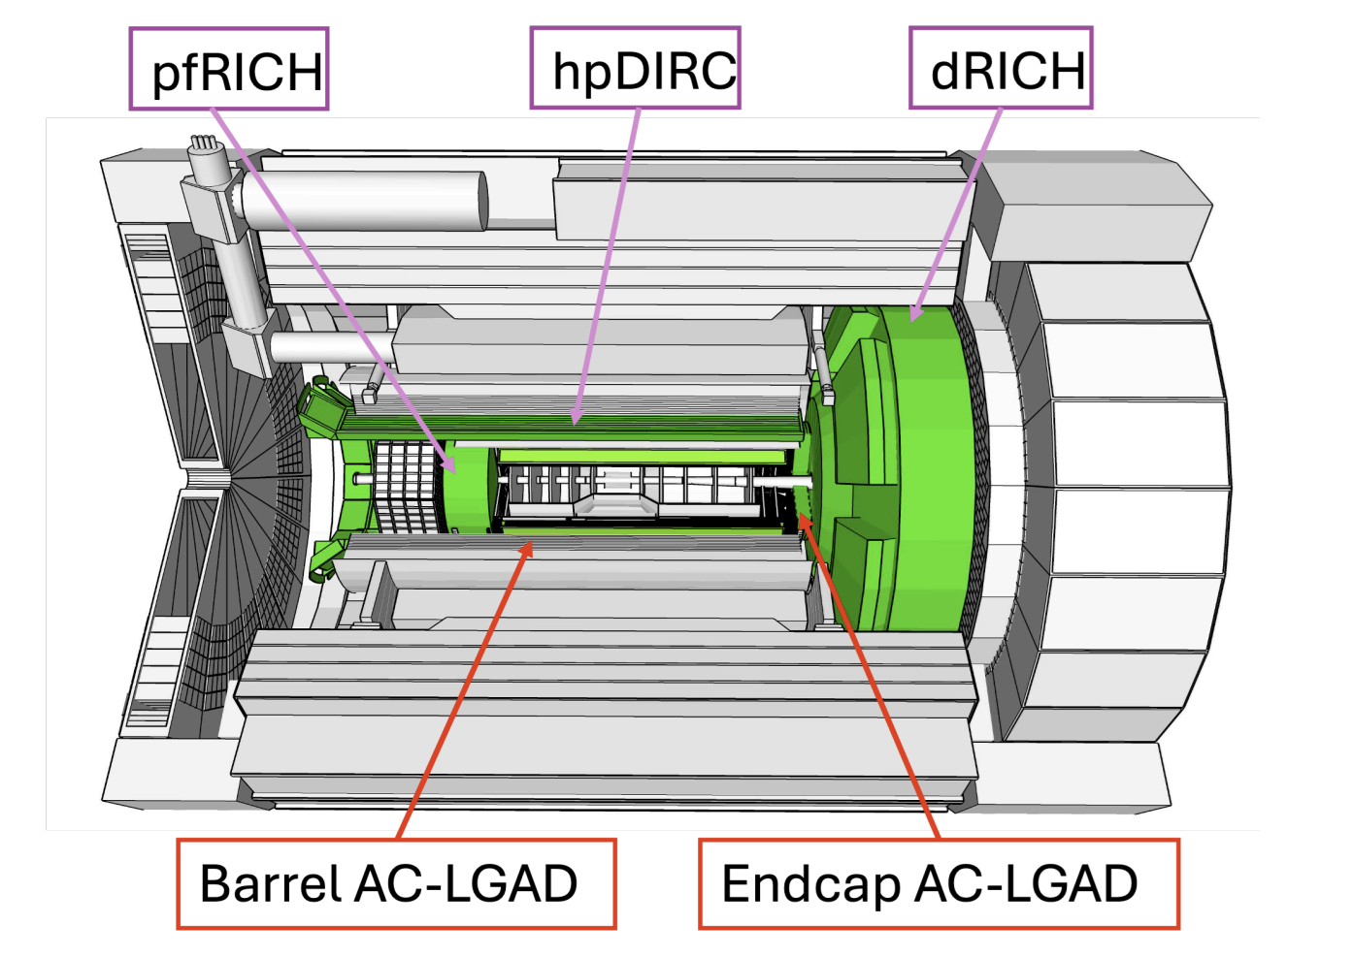
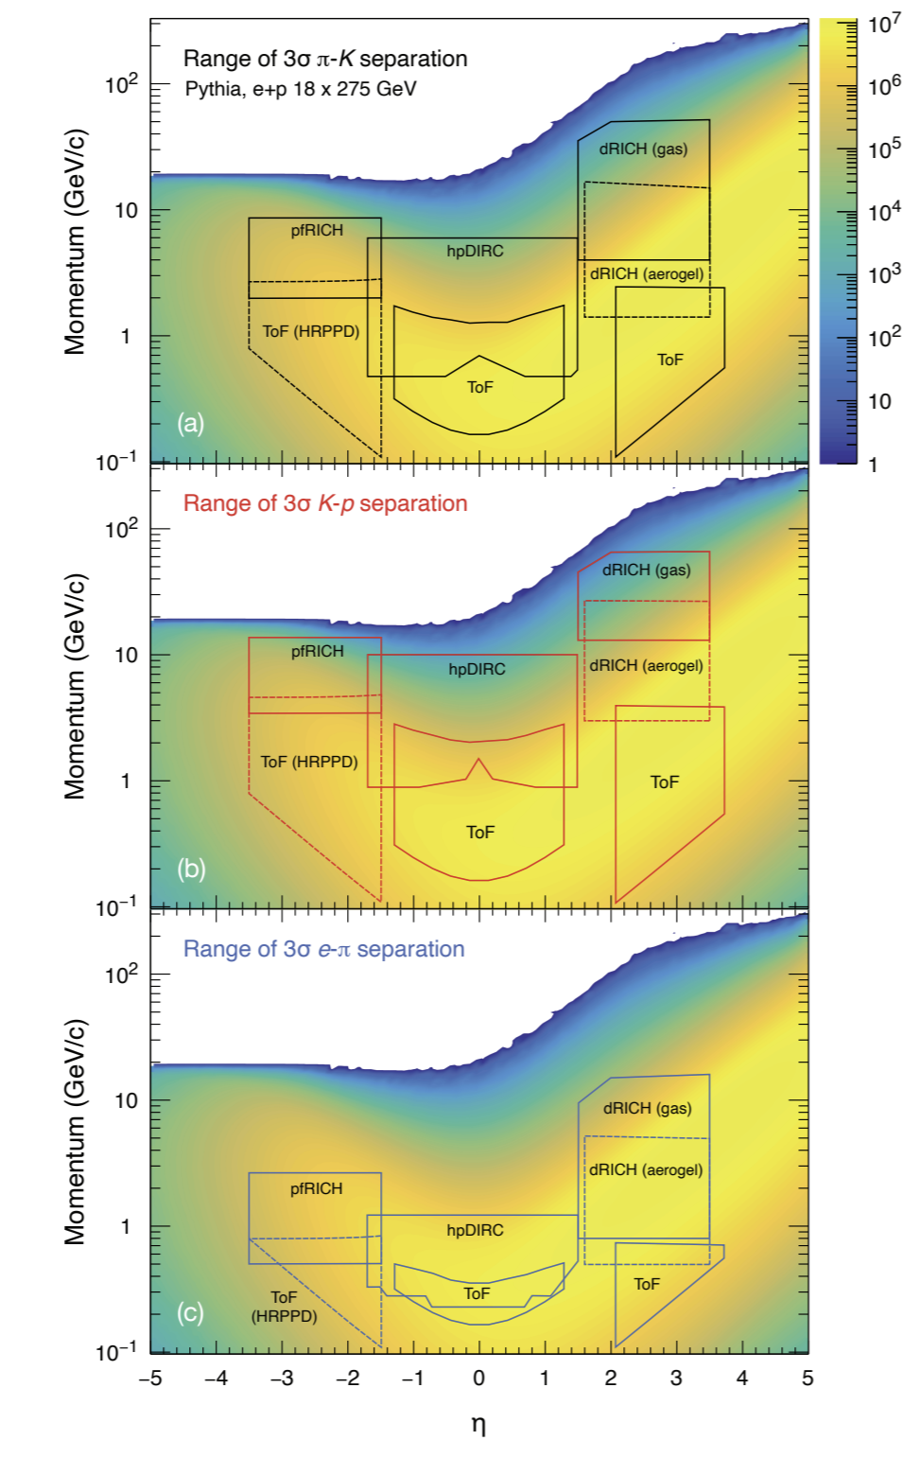
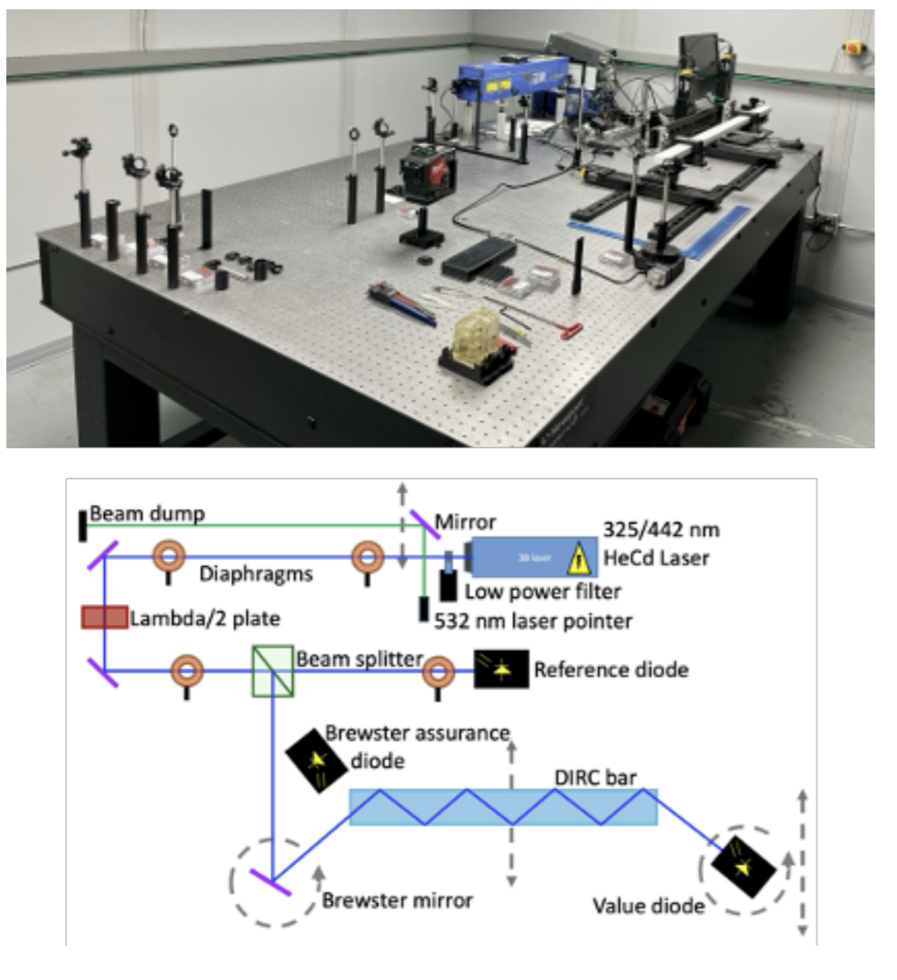
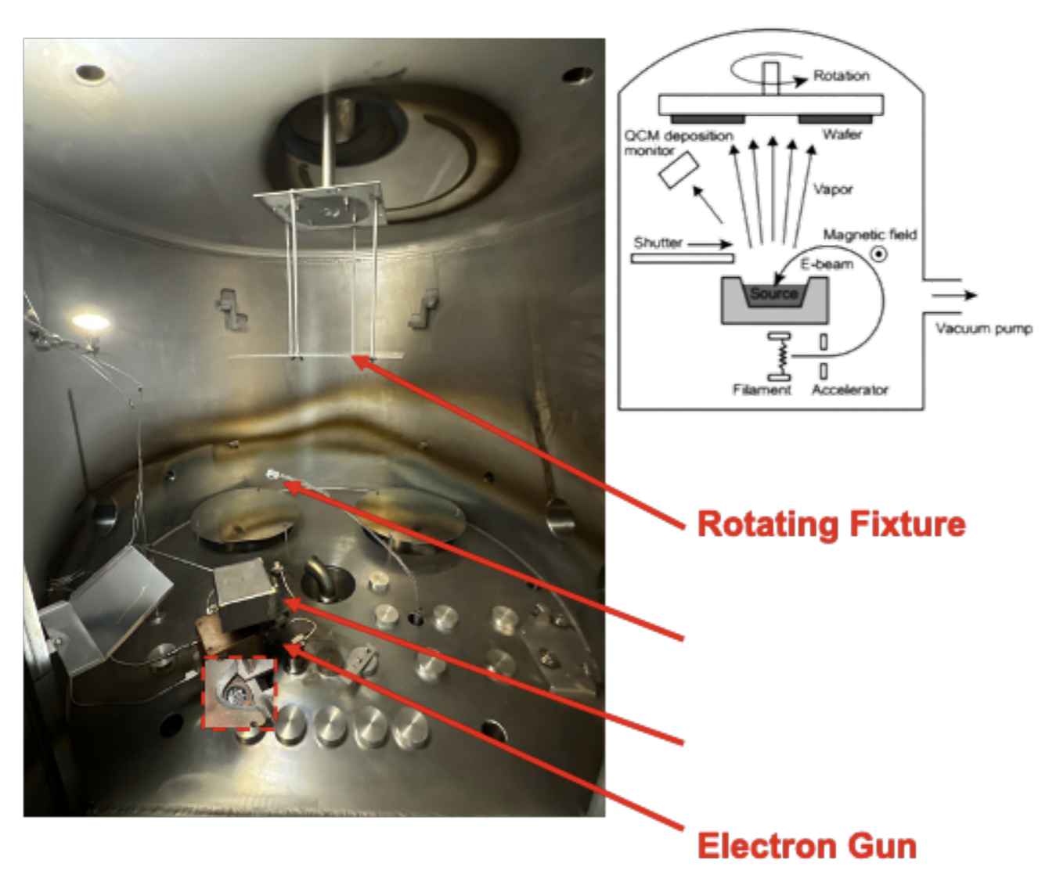
ePIC PID
Prakhar Garg (Yale)
Comprehensive PID crucial for separating e, π, K, p
  Utilizes both Cherenkov & AC-LGAD (ToF) technology
  Necessary for full η, p coverage
Many ongoing efforts:
  Evaluating pfRICH areogel at Temple, Chiba
  Fabricating of pfRICH mirrors at SBU
  Analyzing dRICH test beam data
  Testing BaBar DIRC bars at JLab
  Testing hpDIRC prototype via CRT at SBU
  Implementing/integrating reconstruction into software

Slide 12
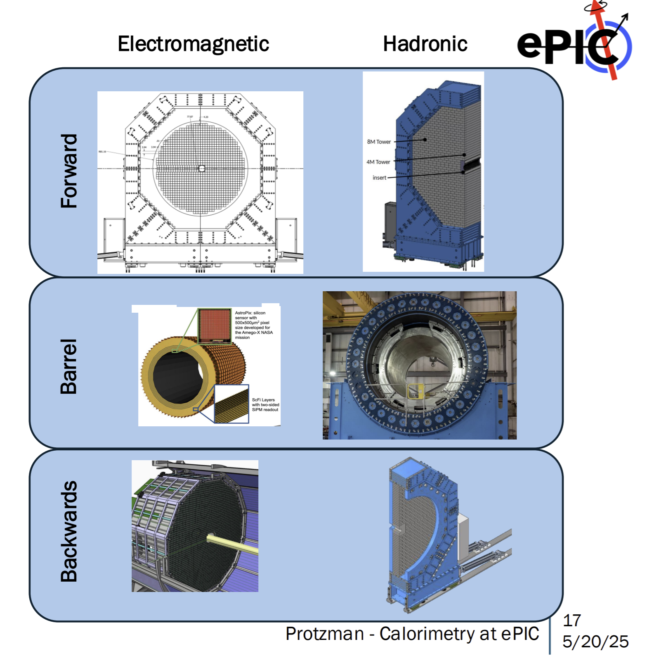
ePIC Calorimetry
Tristan Protzman (LU)
Calorimetry critical part of ePIC:
  Electron ID
  Particle flow
  Hadronic final state
  Jet reconstruction
  etc
Central detector has (almost) fully hermetic coverage of calorimeters over -4<η<4.5
  + coverage in FF/FB region
Several recent & ongoing tests
  EEEMCal: DESY-II test beam, Feb. 2025
  BIC: multiple test beams, 2023 & 2024
  LFHCAL: CERN test beams, 2023 & 2024
  FHCal insert/ZDC: parasitic test @ STAR hall, 2024

Slide 13
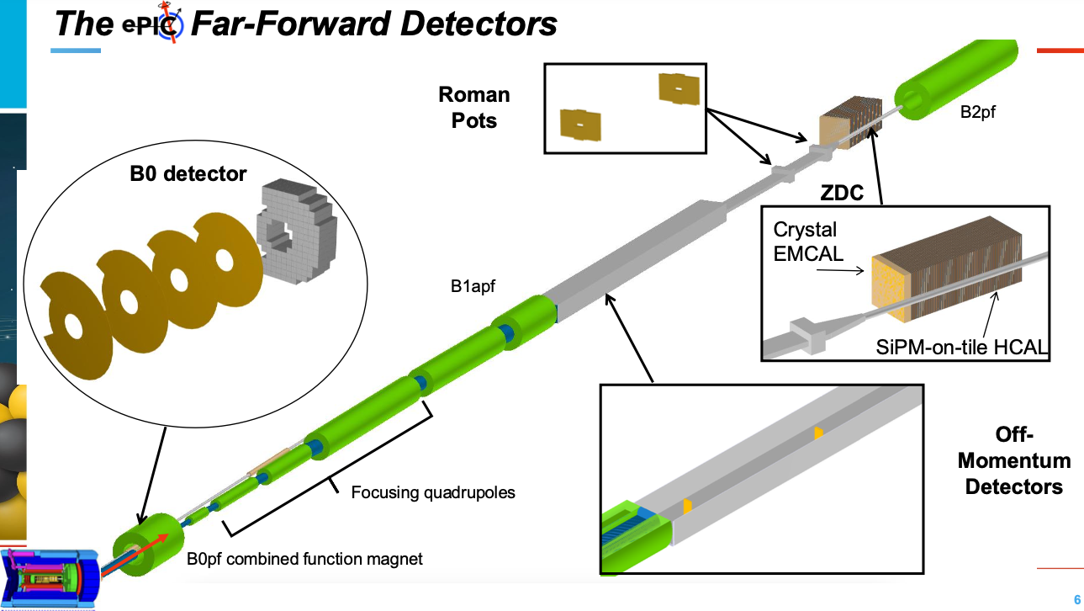
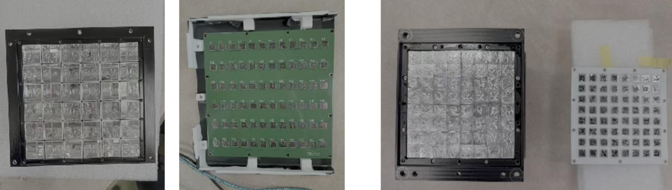
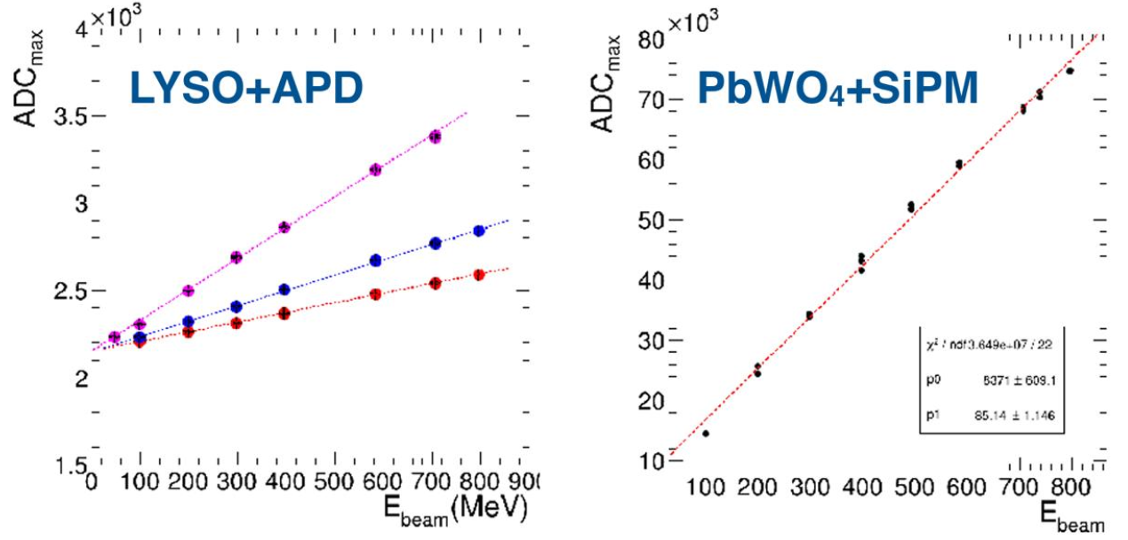
Far-Forward/Backward Detectors
Alex Jentsch (BNL)
Detector | Detection | technologies | Acceptance
B0 (track + ECal) | 𝛾 + charged particles | AC-LGAD, PbWO4 | 5.5<θ<20 mrad
Off-Momentum Detectors (OMD) | charged particles | AC-LGAD | 0<θ<5 mrad
ZDC (ECal + HCal) | 𝛾 + neutrons | LYSO/PbWO4, SiPM-on-tile
Roman Pots | charged particles + nuclear fragments | AC-LGAD
AC-LGAD testing
  Jitter measurements
  Wire bonding (done) and bump bonding
  (work in-progress) to EICROC0
Gen III prototype of the SiPM-on-Tile HCAL was tested at NSRL at BNL, and at JLab with different number of sampling layers
ZDC ECal prototypes (PbWO4+SiPM, LYSO+APD) were tested with 47-823 MeV e+ beam at RARiS@Tohoku U., Japan

Slide 14
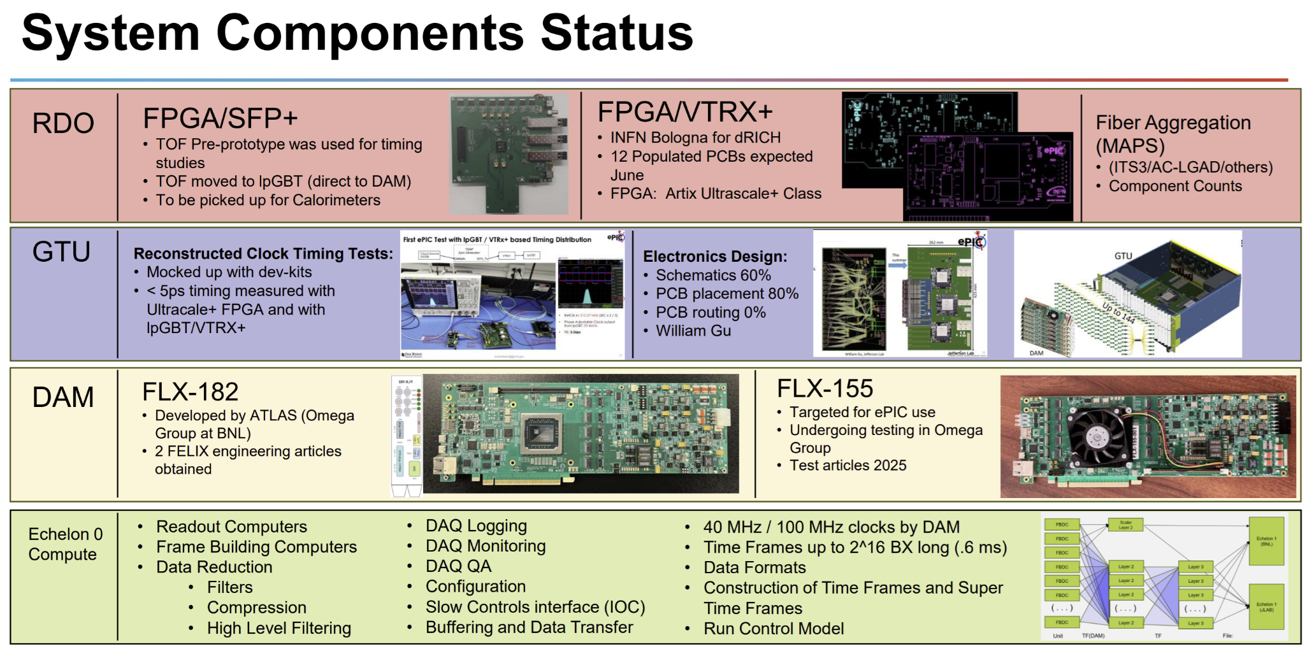
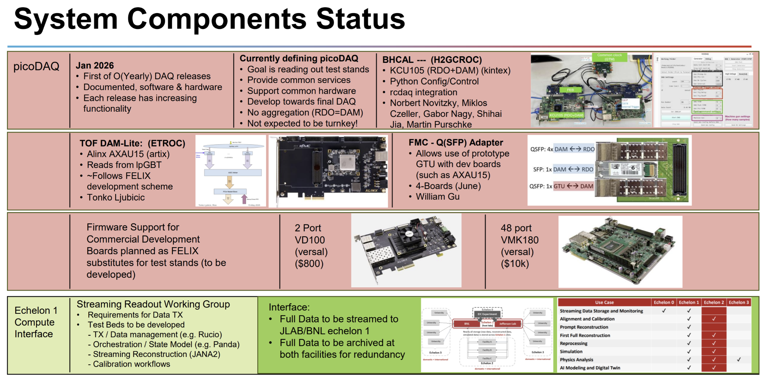
ePIC DAQ
Jeff Landgraf (BNL)
ePIC will be very challenging for DAQ
  30+ detectors, 5 readout technologies, streaming readout…
  Expect max data volume of of 2 TB/s digitized → 100 GB/s recorded
Many efforts ongoing for pre-prototypes of readout tech
  Some components (e.g. the VTRX+) already finalized!
Effort underway to define the picoDAQ (initial DAQ release for test beam use)

Slide 15
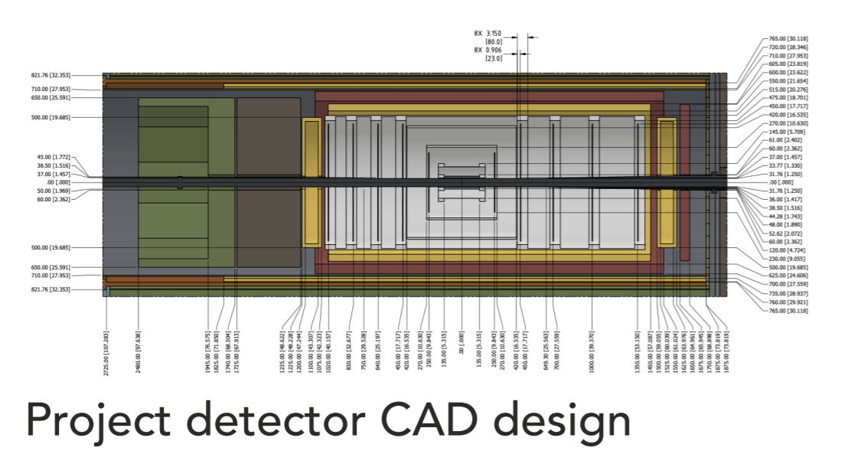
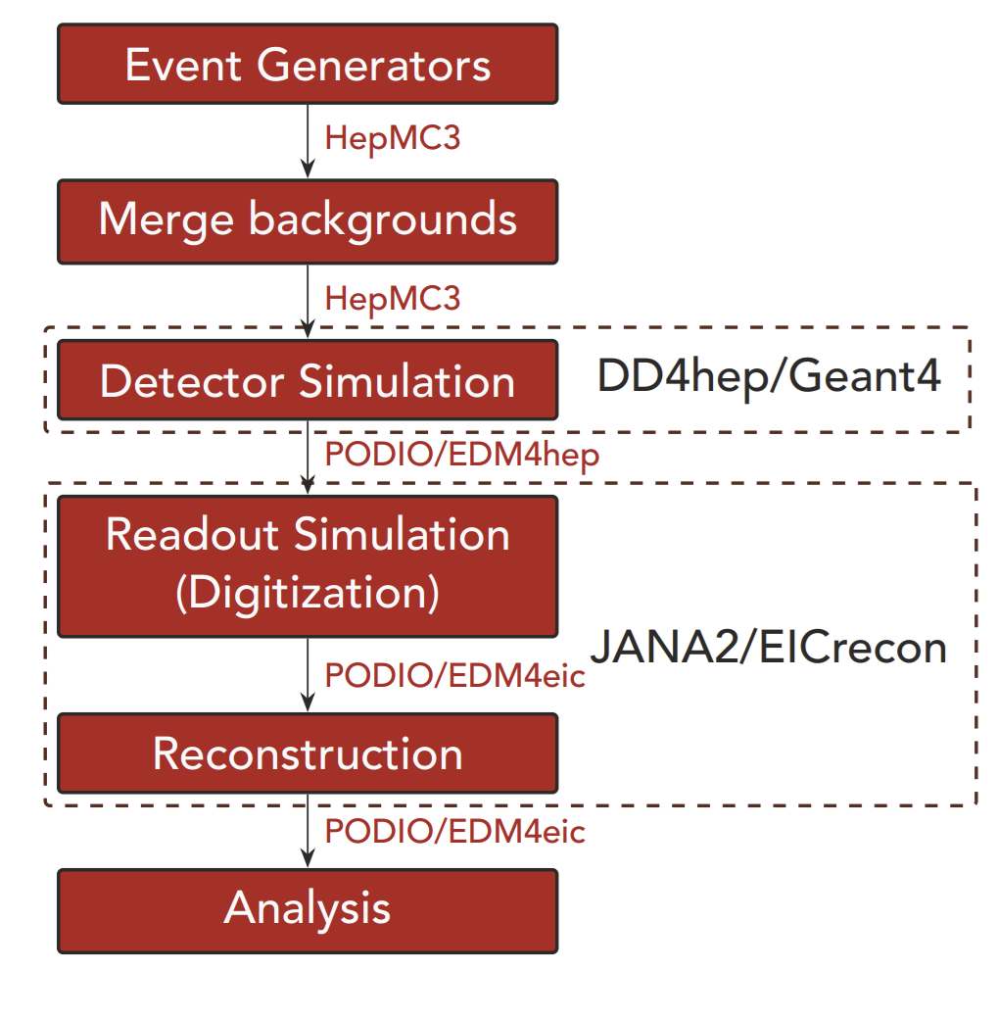
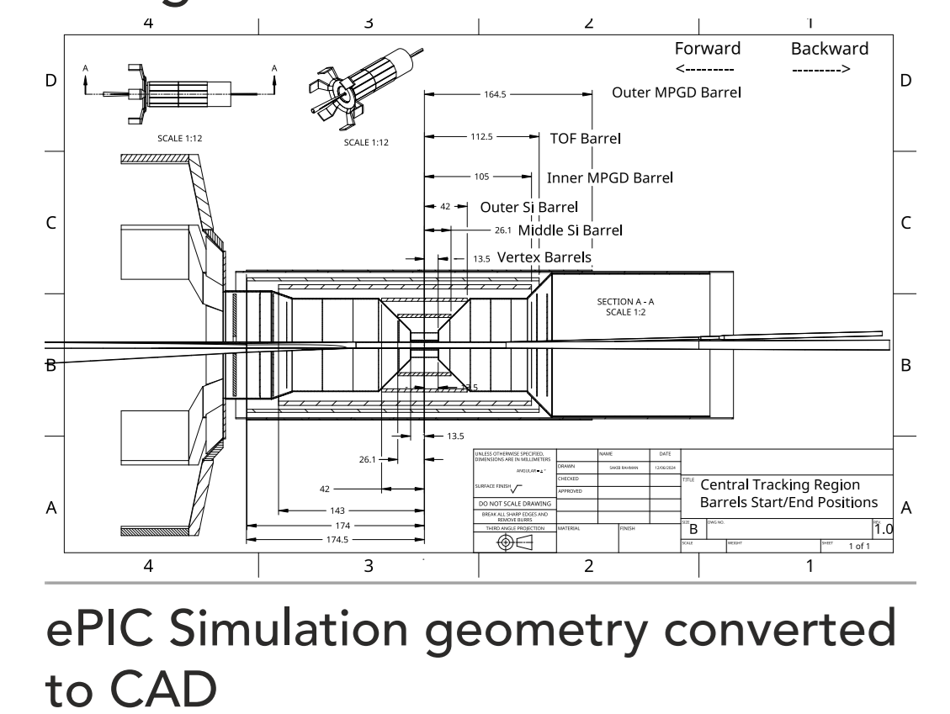
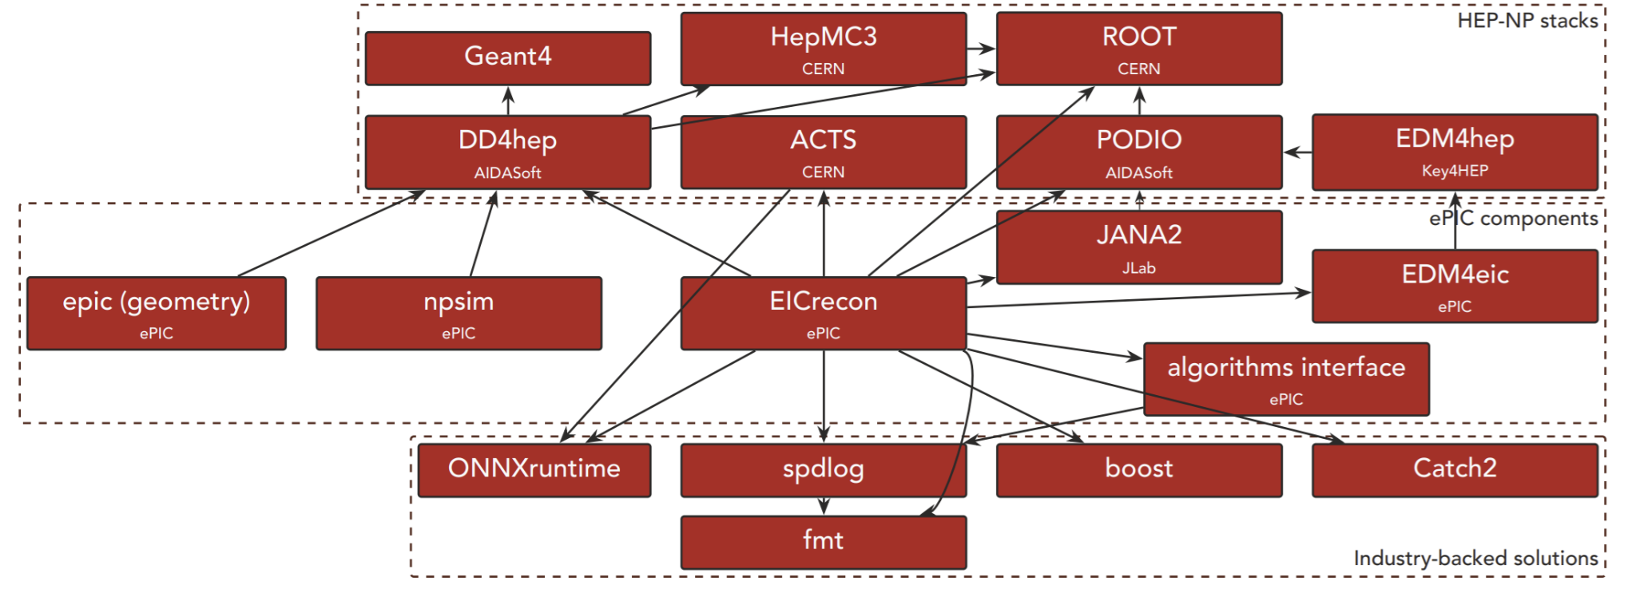
ePIC Computing
Dmitry Kalinkin (UK)
ePIC software/computing effort is ambitious and very active!
  Highly modular stack utilizing many common HENP & industry tools
  Monthly large-scale simulation campaigns
  Regular tutorials & ongoing work on documentation
Select ongoing efforts:
  EICrecon development
    PF+eID, AI/ML integration, ACTS tracking/vertexing, RICH
  Simulating streaming readout + reconstruction
  Simulating digitization + noise
  Validing simulated geometry

Slide 16
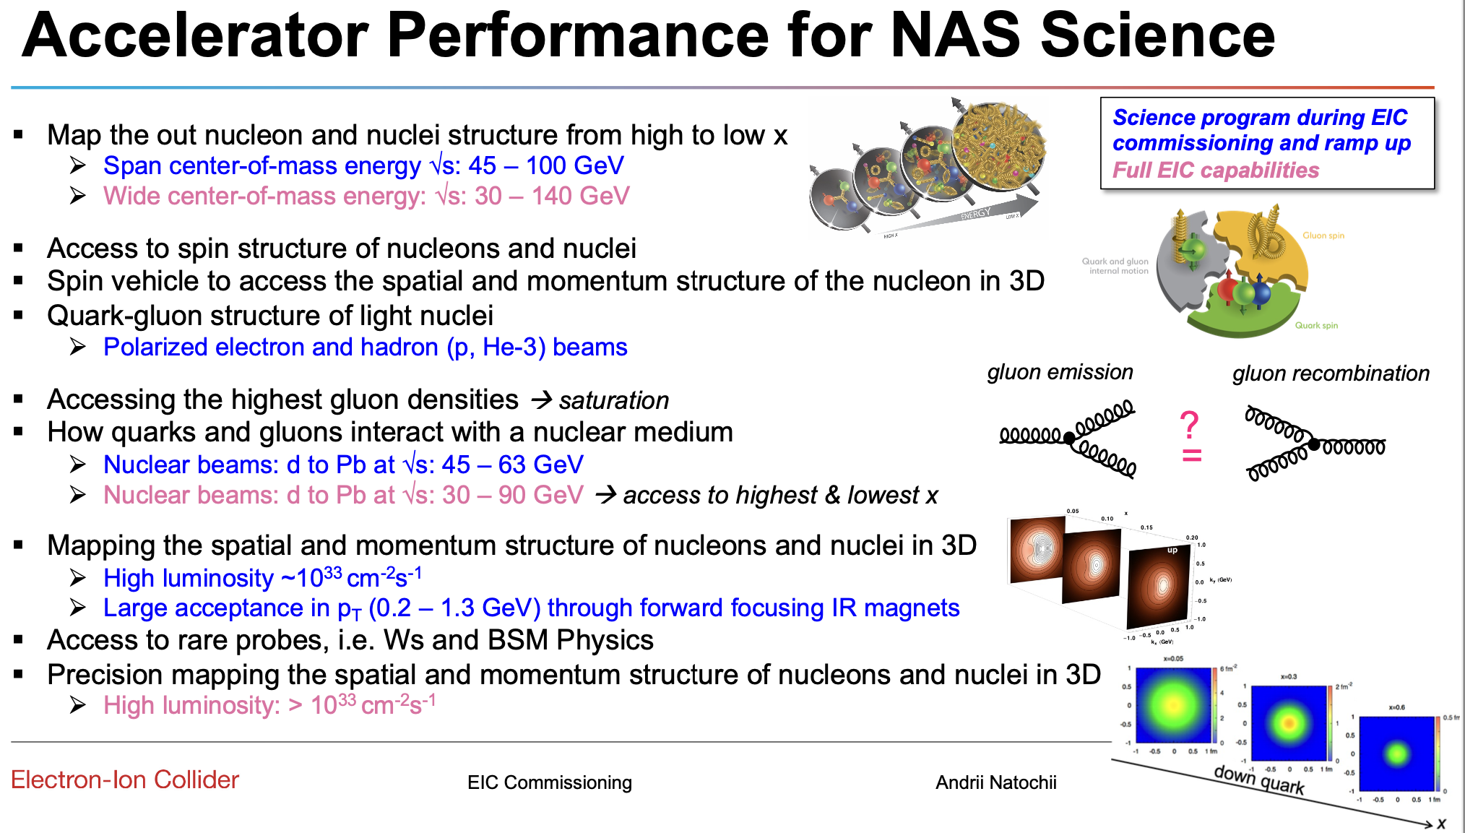
Andrii Natochii (BNL)

Slide 17
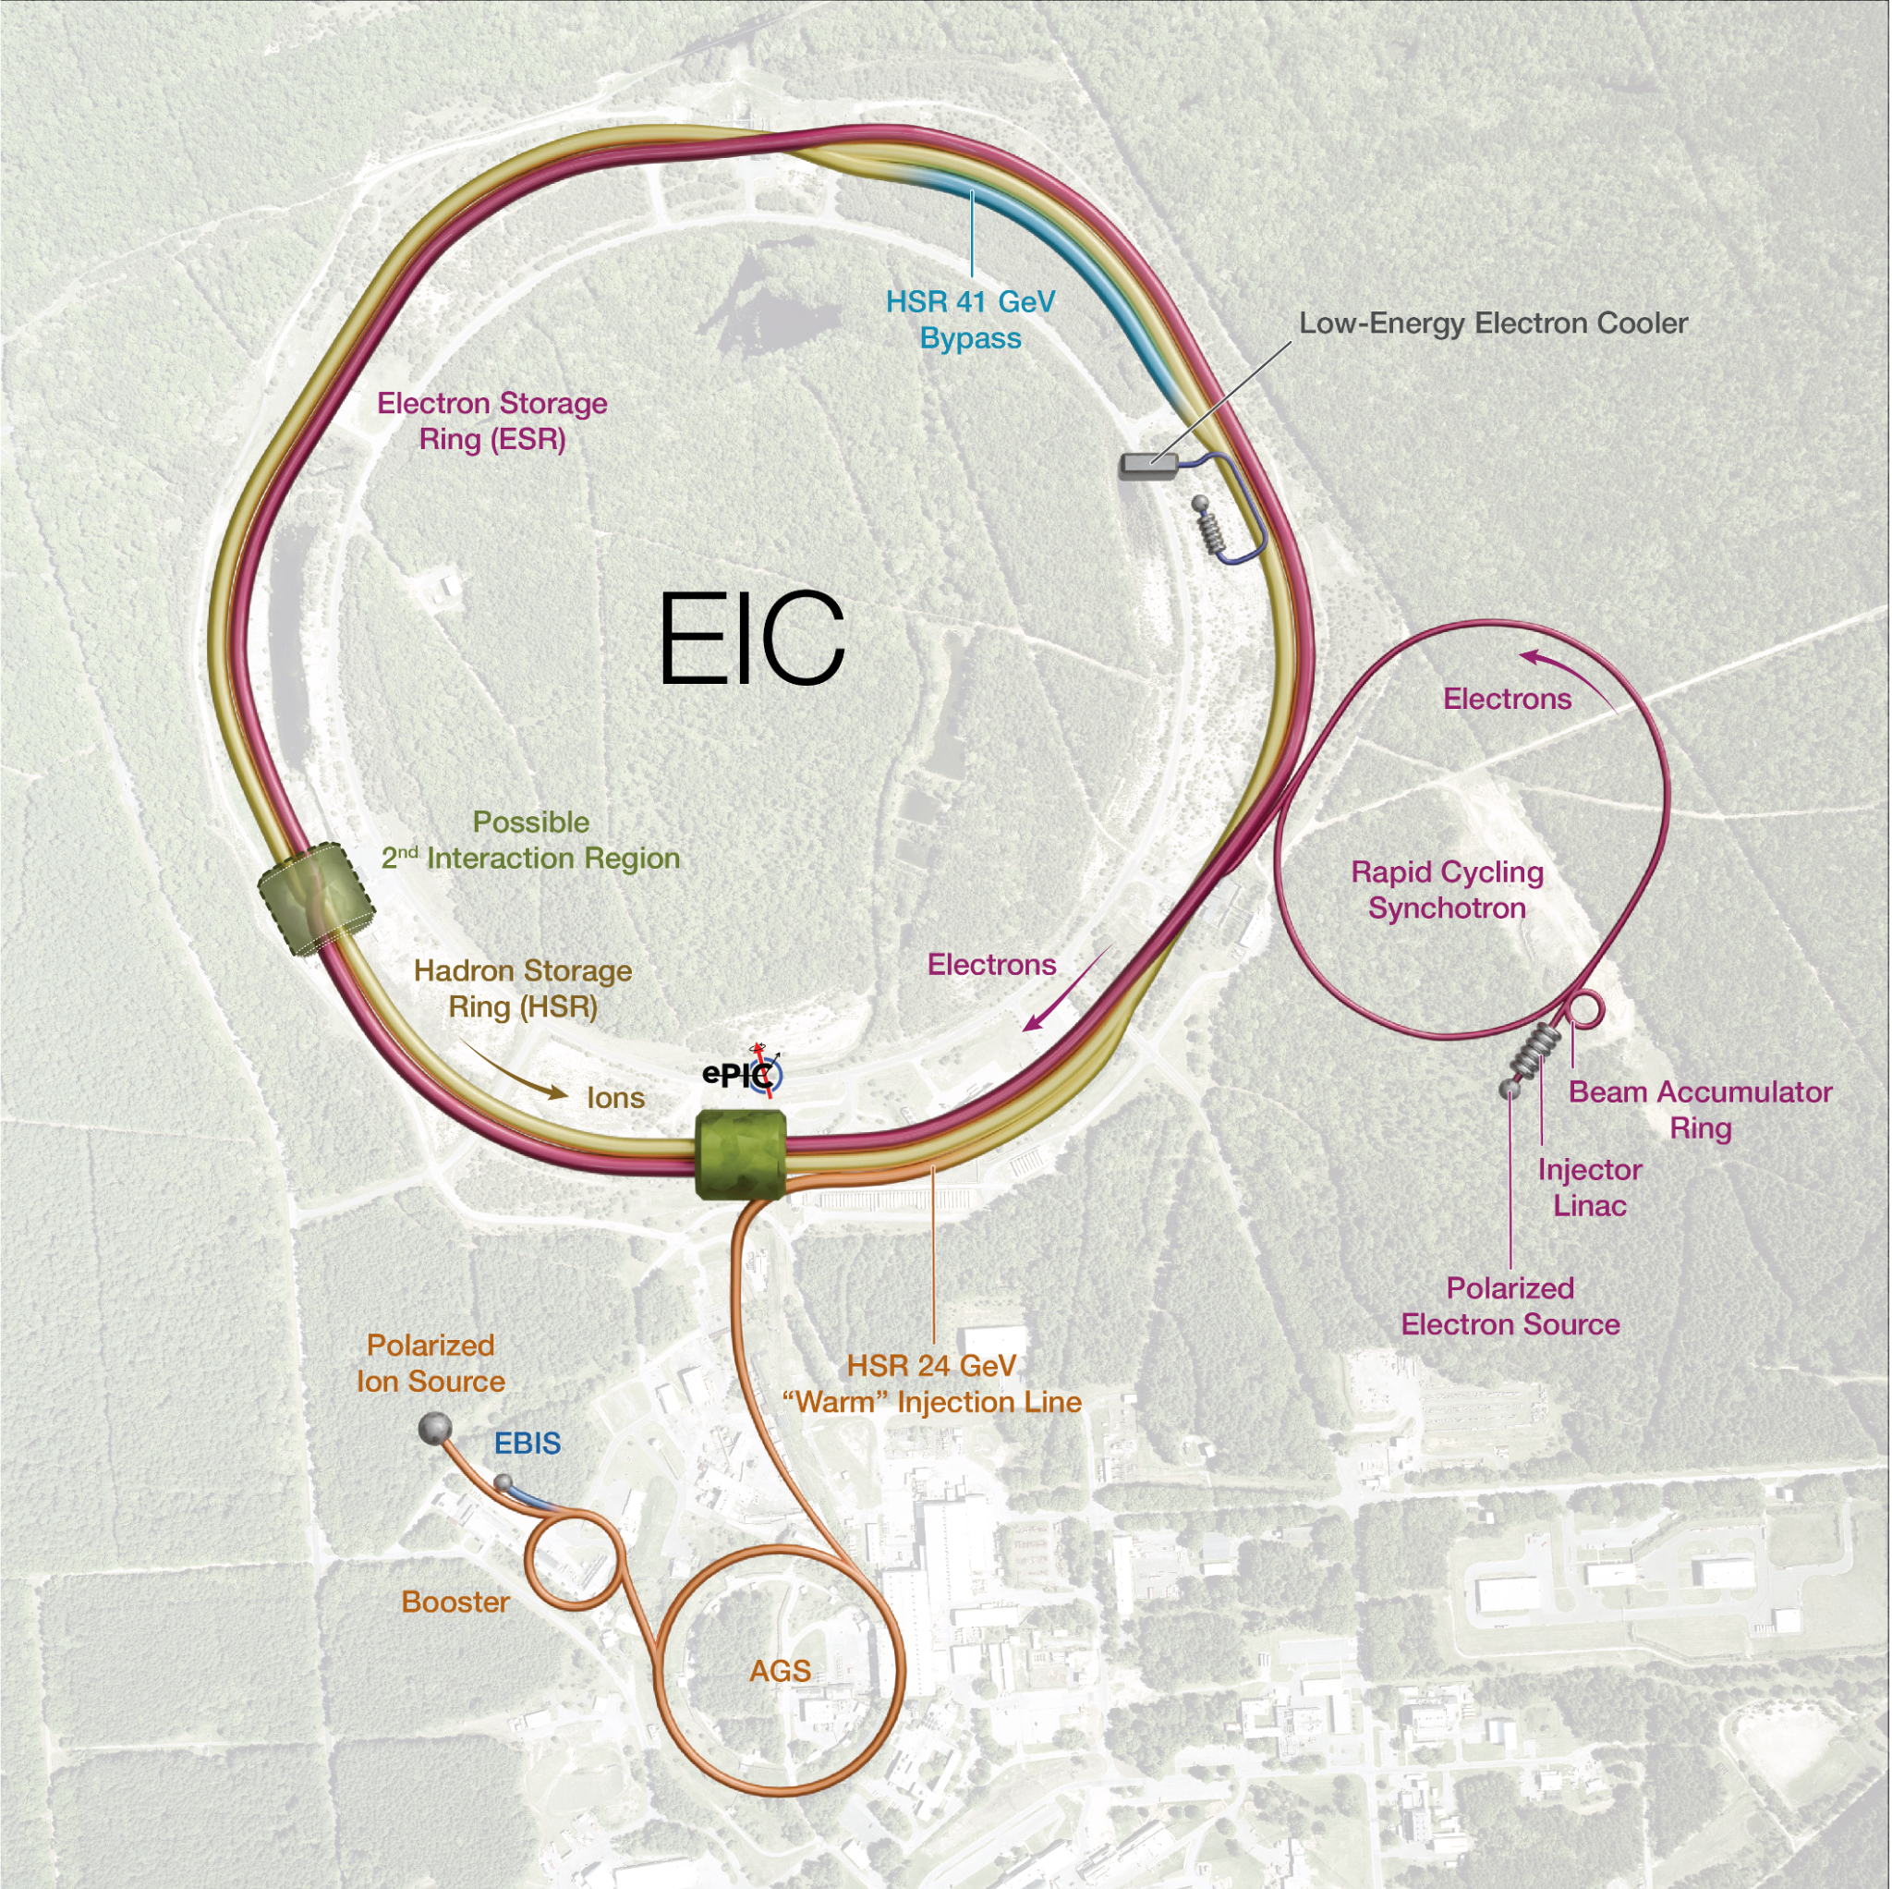
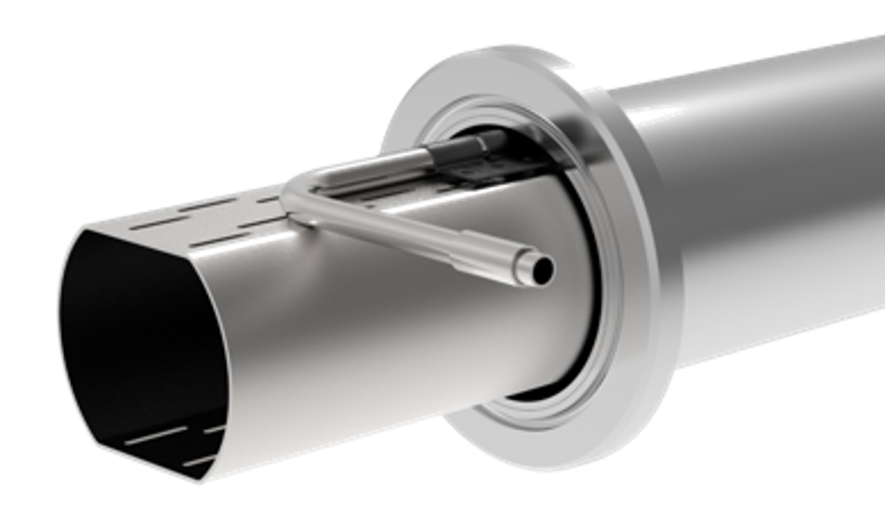
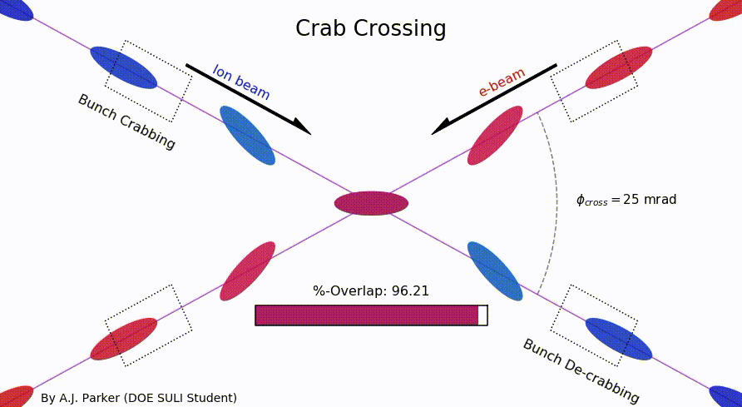
EIC – HSR
Christoph Montag (BNL)
Insert sleeves coated with copper and amorphous carbon into superconducting
magnet beam pipes
to reduce
electron cloud
Add new RF cavities
Add hadron cooling to create ‘flat’ bunches
Add crab cavities, new IR SC magnets
Add a collimation system

Slide 18

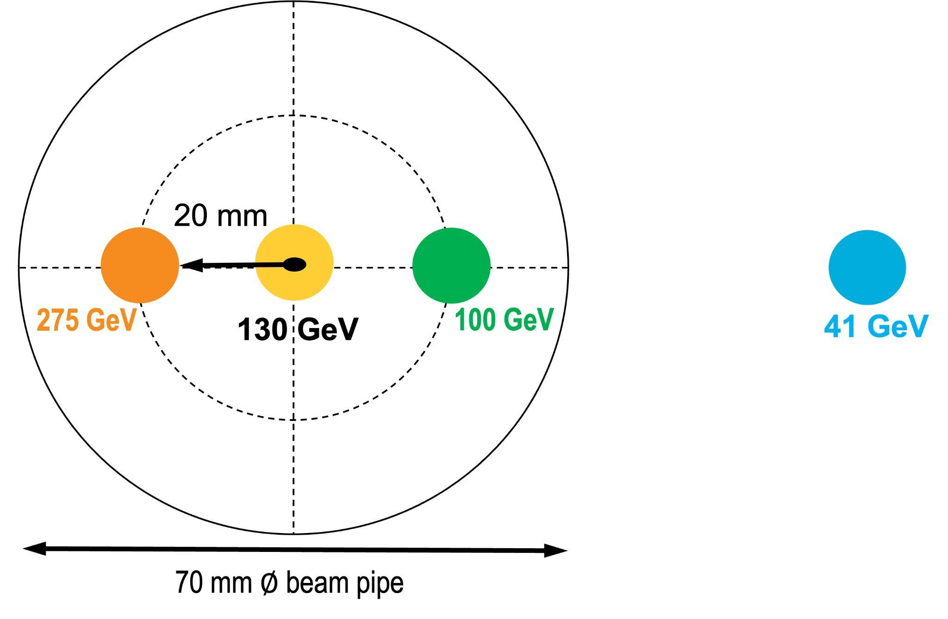
EIC – 41 GeV Bypass
Christoph Montag (BNL)
Since the electron revolution frequency is fixed, the hadron orbit must be adjusted with energy to keep the collisions in sync

Slide 19
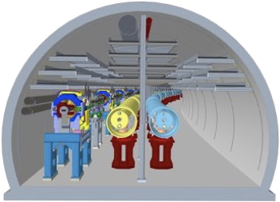
EIC – 41 GeV Bypass
Christoph Montag (BNL)
Since the electron revolution frequency is fixed, the hadron orbit must be adjusted with energy to keep the collisions in sync
100-275 GeV
41 GeV

Slide 20
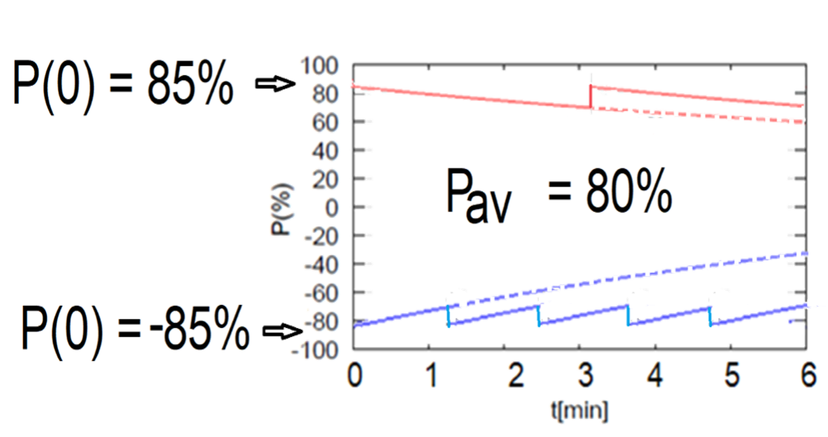
EIC – ESR
Christoph Montag (BNL)
6 focusing-defocusing (FODO) cell arcs
Emittance control
6 straight sections at each IR
Polarization in the ESR
  Initial polarization of 85%, decays toward 30% (conservative)
  Frequent injection → maintain polarization
  At 18 GeV, bunch is replaced every 2.2min

Slide 21
EIC – Electron Injection System
Christoph Montag (BNL)
Linac
  750 MeV @ 3 GHz copper RF
  28 x 1 nC single bunch injection @ 30 Hz
BAR: 28 nC/bunch accumulator ring
RCS
  1.4 km circumference
  cycling rate of 1Hz for 0.75 – 18 GeV beam
  fRF =591 MHz
  Spin transparent due to high periodicity, high vertical tune
ESR

Slide 22
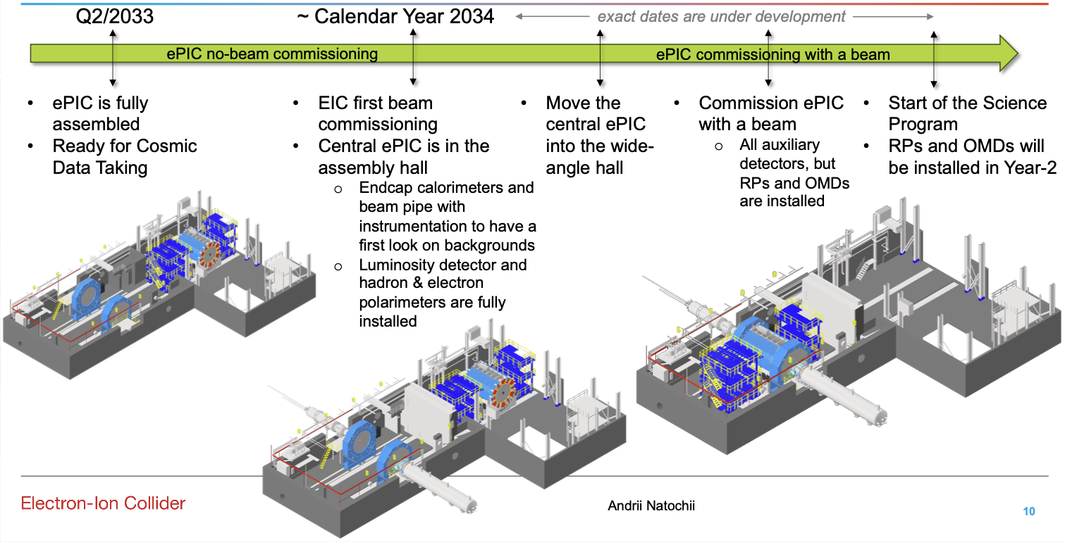
EIC-ePIC Commissioning
Andrii Natochii (BNL)

Slide 23
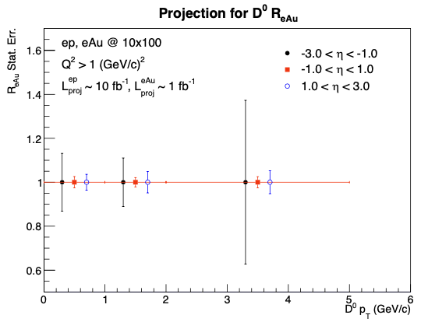
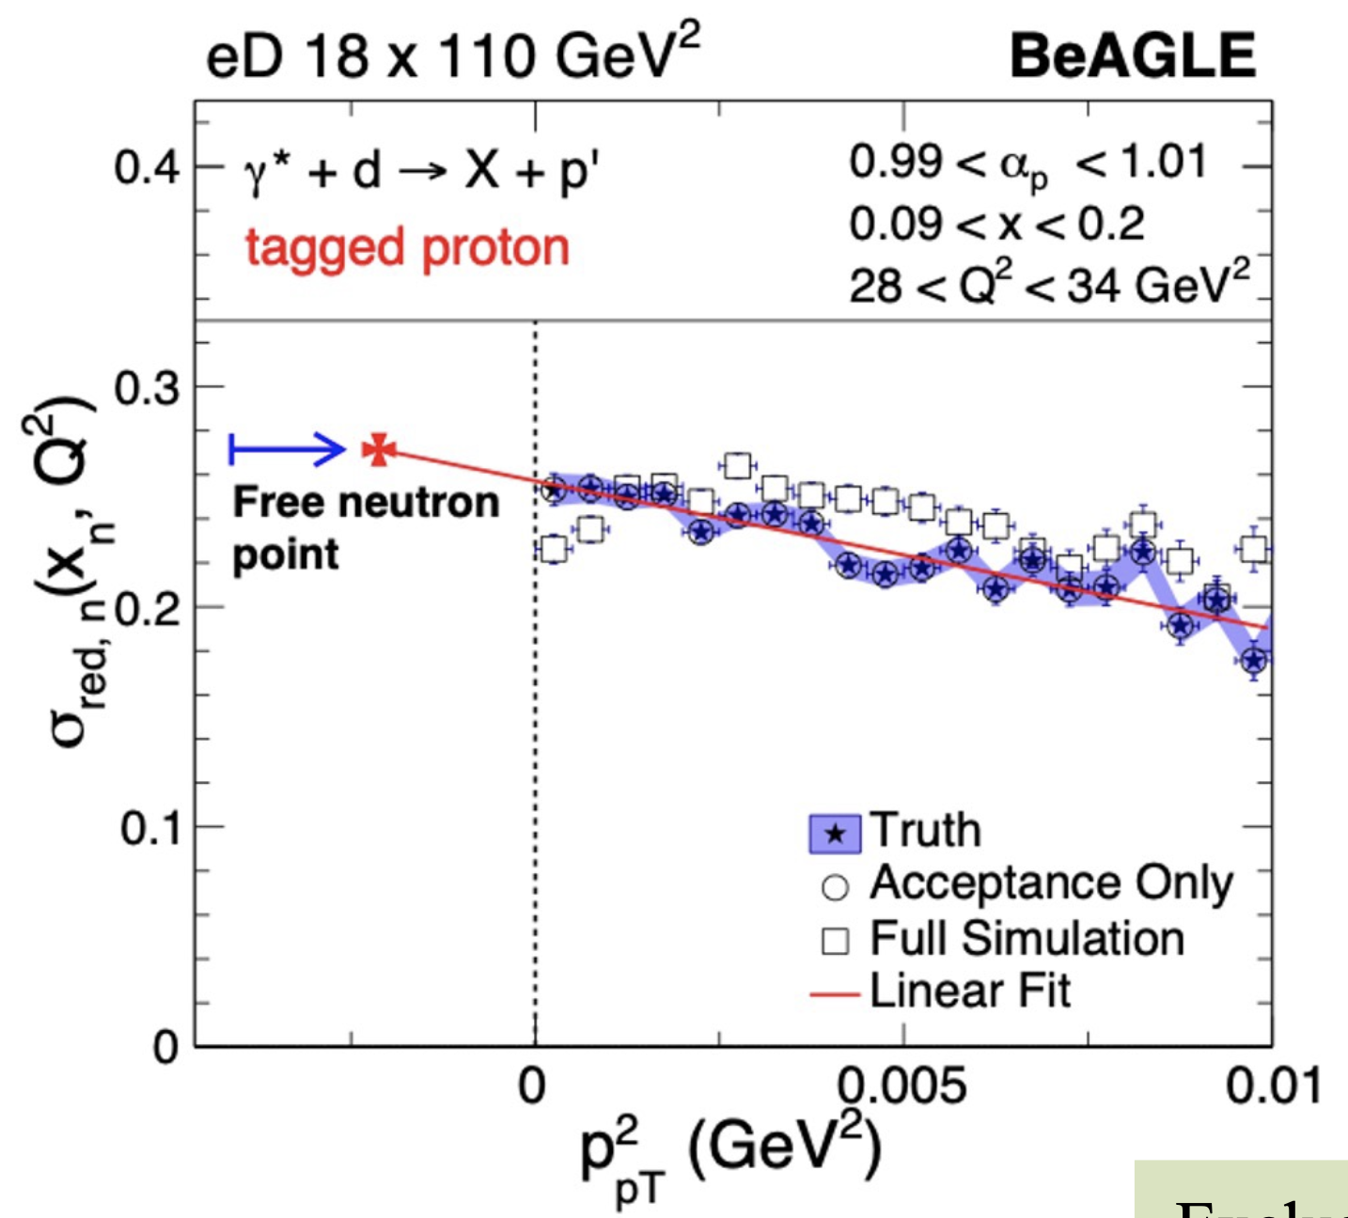
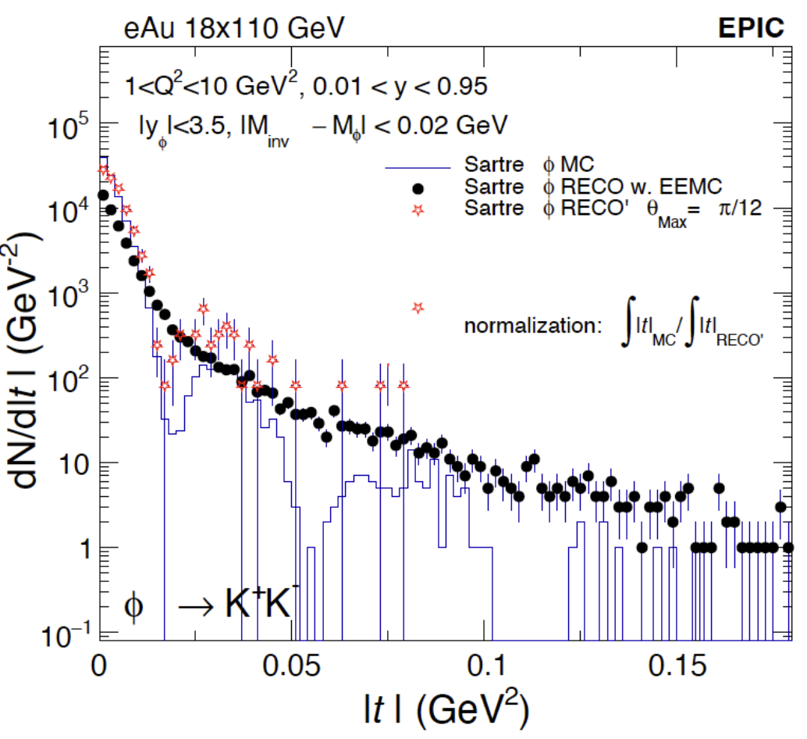
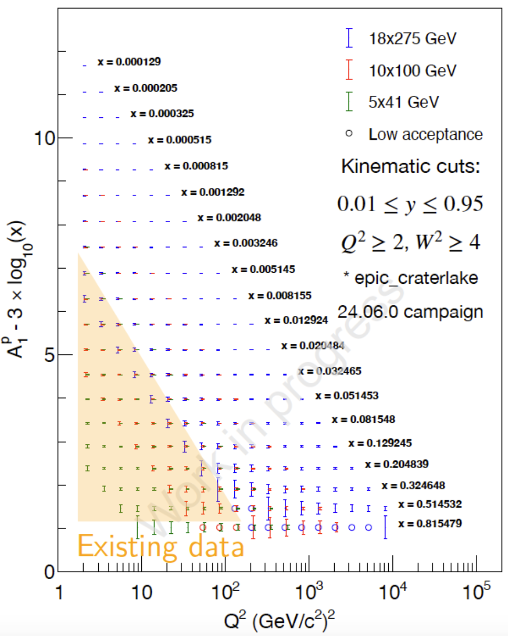
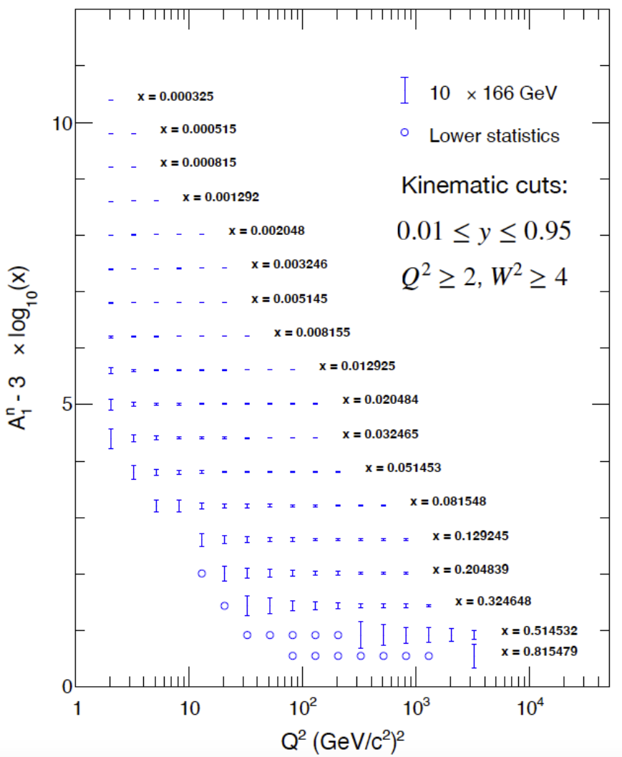
Proposed Run Plan & Early Science
RongRong Ma (BNL)
Year | Species | Energy (GeV) | Lumi/year (fb⁻¹) | e- Polarization | p/A Polarization | Measurements | Physics
1 | e+Ru/Cu | 10x115 | 0.9 | No | N/A | DIS cross section Excl. µµ production in elastic interactions | nPDF in unexplored low-x region Electric & magnetic form factors
2 | e+D | 10x130 | 11.4 | Long | No | Reduced cross section with proton tagging + pole extrapolation | Free neutron structure
 | e+p | 10x130 | 4.95-5.33 | Long | Trans | DIS cross section DEMP for meson form factors Constraints on proton PDF (yr 2/3/4) | PDF, structure function Hadron structure, hadron mass Baseline for saturation effect
3 | e+p | 10x130 | 4.95-5.33 | Long | Trans and/or Long
4 | e+p | 10x250 | 6.19-9.18 | Long | Trans and/or Long | Long. & trans. spin asymmetries | Proton spin structure at low x
 | e+Au | 10x100 | 0.84 | Long | N/A | Excl. coh. vector meson production Charged hadron production Modification of charm hadron production | Gluon spatial distribution Constrain nFF Nuclear effects, hadronization
5 | e+Au | 10x100 | 0.84 | Long | N/A
 | e+He³ | 10x166 | 8.65 | Long | Trans and/or Long | Neutron spin structure via double-spectator tagging | Quark orbital angular momentum
Reduced cross section
Excl. coh. ɸ
Proton spin structure
Neutron spin structure

Slide 24
Proposed Run Plan & Early Science
Shohini Bhattacharya (U. Conn.)
RongRong Ma (BNL)
Year | Species | Energy (GeV) | Lumi/year (fb⁻¹) | e- Polarization | p/A Polarization | Measurements | Physics
1 | e+Ru/Cu | 10x115 | 0.9 | No | N/A | DIS cross section Excl. µµ production in elastic interactions | nPDF in unexplored low-x region Electric & magnetic form factors
2 | e+D | 10x130 | 11.4 | Long | No | Reduced cross section with proton tagging + pole extrapolation | Free neutron structure
 | e+p | 10x130 | 4.95-5.33 | Long | Trans | DIS cross section DEMP for meson form factors Constraints on proton PDF (yr 2/3/4) | PDF, structure function Hadron structure, hadron mass Baseline for saturation effect
3 | e+p | 10x130 | 4.95-5.33 | Long | Trans and/or Long
4 | e+p | 10x250 | 6.19-9.18 | Long | Trans and/or Long | Long. & trans. spin asymmetries | Proton spin structure at low x
 | e+Au | 10x100 | 0.84 | Long | N/A | Excl. coh. vector meson production Charged hadron production Modification of charm hadron production | Gluon spatial distribution Constrain nFF Nuclear effects, hadronization
5 | e+Au | 10x100 | 0.84 | Long | N/A
 | e+He³ | 10x166 | 8.65 | Long | Trans and/or Long | Neutron spin structure via double-spectator tagging | Quark orbital angular momentum
What do the theorists say?
Constrain quark/gluon orbital angular momentum (single/double spin asymmetry using jet/dijet, SIDIS)
Proton mass (vector meson threshold production?)
TMD (DVCS/DVMP, Sivers function, x-dependence of A_{N}, transversity)
QCD at small-x/saturation (structure functions: geometric scaling, linear/non-linear evolution, dihadron correlations, diffractive measurements)
nPDF, nuclear gluons, hadronization (medium modifications, open charm production, parton energy loss)

