Slide 1
The Birth of RHIC and Its First Discoveries
presented at the
2025 RHIC/AGS Annual Users’ Meeting Brookhaven National Laboratory
May 22nd, 2025 W.A. Zajc Columbia University
Profound thanks to Wit Busza, Larry McLerran, Rob Pisarski and Ann Therrien
This work was supported by the United States Department of Energy Grant DOE-FG02-86ER-40281

Slide 2
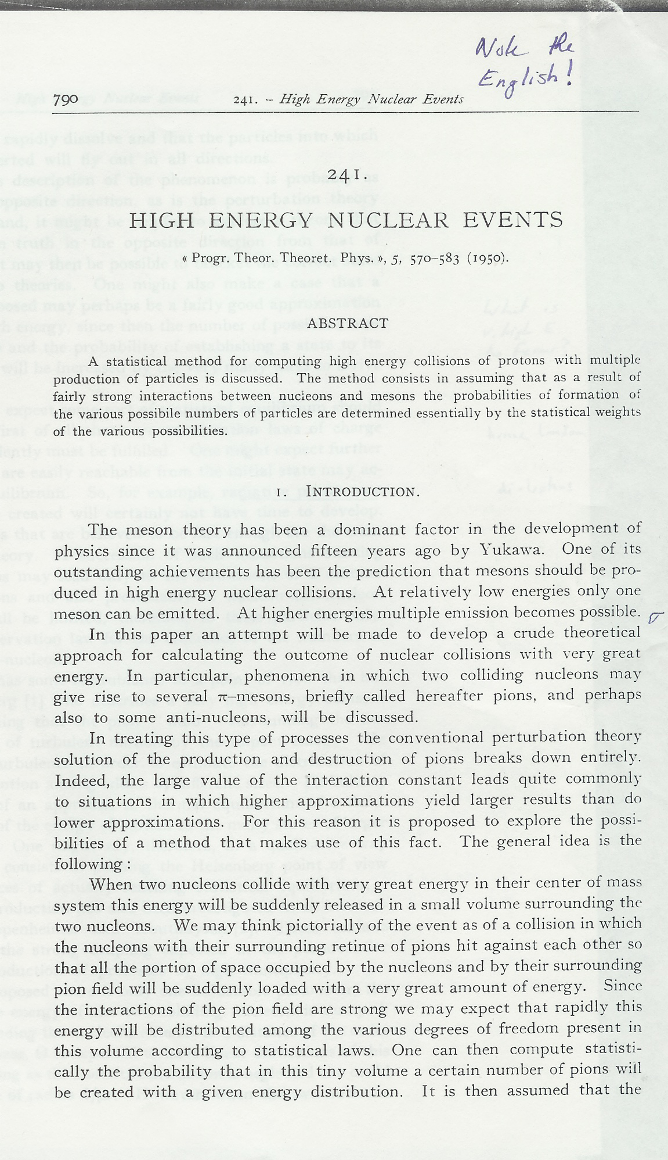
Fermi (1950)
Fermi
“High Energy Nuclear Events”, Prog. Theor. Phys. 5, 570 (1950)
Lays groundwork for statistical approach to particle production in strong interactions:
“Since the interactions of the pion field are strong, we may expect that rapidly this energy will be distributed among the various degrees of freedom present in this volume according to statistical laws.” (emphasis added)
“It is realized that this description of the phenomenon is probably as extreme, although in the opposite direction, as is the perturbation theory approach. On the other hand, it might be helpful to explore a theory that deviates from the unknown truth in the opposite direction from that of the conventional theory. It may then be possible to bracket the correct state of fact in between the two theories.”

Slide 3
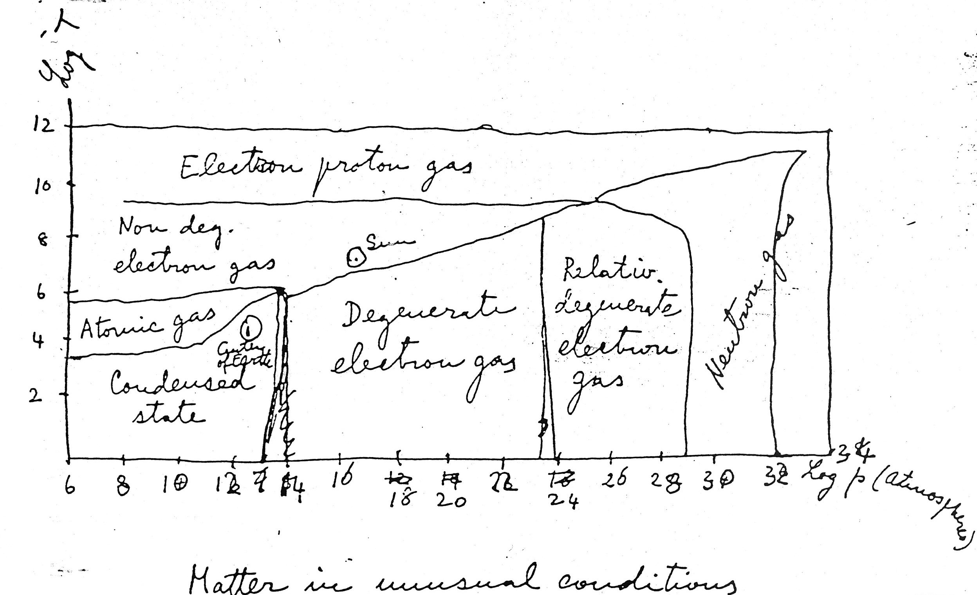
Fermi (1952) Notes on Thermodynamics and Statistics
Notes:
1 Pascal = 10 dynes
1 GeV/fm^3 = 1.6 10^{-19} J/eV x 10^9 eV/GeV x 1 GeV / (10^{-15} m)^3 = 1.6 x 10^{35} Pa = 1.6 x 10^{36} dynes/cm^2

Slide 4
Fermi (1952) Notes on Thermodynamics and Statistics
RHIC
Notes:
1 Pascal = 10 dynes
1 GeV/fm^3 = 1.6 10^{-19} J/eV x 10^9 eV/GeV x 1 GeV / (10^{-15} m)^3 = 1.6 x 10^{35} Pa = 1.6 x 10^{36} dynes/cm^2

Slide 5
Landau (1955) Was Inspired by Fermi . . .
Fermi
“High Energy Nuclear Events”, Prog. Theor. Phys. 5, 570 (1950)
Lays groundwork for statistical approach to particle production in strong interactions:
“Since the interactions of the pion field are strong, we may expect that rapidly this energy will be distributed among the various degrees of freedom present in this volume according to statistical laws.” (emphasis added)
“It is realized that this description of the phenomenon is probably as extreme, although in the opposite direction, as is the perturbation theory approach. On the other hand, it might be helpful to explore a theory that deviates from the unknown truth in the opposite direction from that of the conventional theory. It may then be possible to bracket the correct state of fact in between the two theories.”

Slide 6
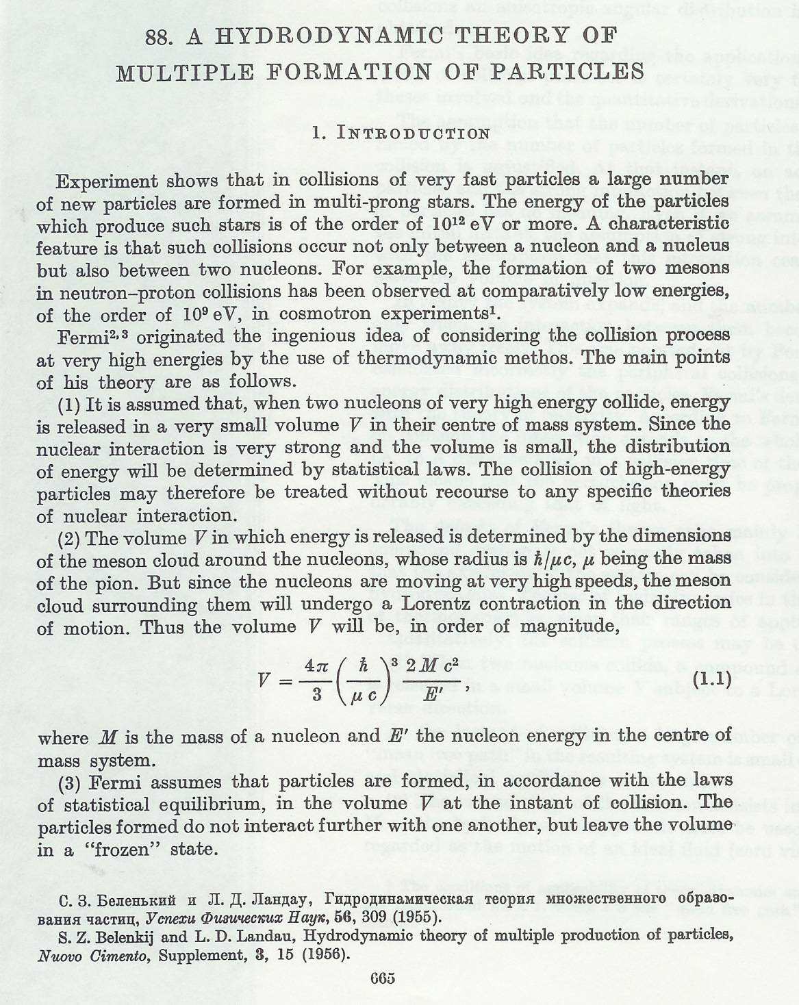
Landau (1955) Was Inspired by Fermi . . .

Slide 7
Landau (1955) Was Inspired by Fermi . . .
.. . . to make some rather harsh statements: “The defects of Fermi’s theory arise mainly because the expansion of the compound system is not correctly taken into account…(The) expansion of the system can be considered on the basis of relativistic hydrodynamics.” (emphasis added)

Slide 8
(One of) the Origins of the Study of Relativistic Nuclear Collisions
Seminal Event: The Bear Mountain Workshop,
Nov. 29 to Dec. 1, 1974
“This Workshop addressed itself to the intriguing question of the possible existence of a nuclear world quite different from the one we have learned to accept as familiar and stable.”
Prime Mover: T.D. Lee (together with Leon Lederman)

Slide 9
T.D. and the Origin of Relativistic Heavy Ion Collisions
Seminal Event: The Bear Mountain Workshop,
Nov. 29 to Dec. 1, 1974
“This Workshop addressed itself to the intriguing question of the possible existence of a nuclear world quite different from the one we have learned to accept as familiar and stable.”
Prime Mover: T.D. Lee (together with Leon Lederman)

Slide 10
T.D. and the Origin of Relativistic Heavy Ion Collisions
Prime Motivation: “Hitherto, we have concentrated on experiments which distribute a higher and higher amount of energy into a region with smaller and smaller dimensions. In order to study the question of the ‘vacuum’ . . . we must turn to a different direction: we should investigate some ‘bulk’ phenomena by distributing high energy or high nucleon density over a relatively large volume. The fact that such directions have never been explored should, by itself, serve as an incentive for doing such experiments.”
Seminal Event: The Bear Mountain Workshop,
Nov. 29 to Dec. 1, 1974
“This Workshop addressed itself to the intriguing question of the possible existence of a nuclear world quite different from the one we have learned to accept as familiar and stable.”
Prime Mover: T.D. Lee (together with Leon Lederman)

Slide 11
T.D. and the Origin of Relativistic Heavy Ion Collisions
Prime Motivation: “Hitherto, we have concentrated on experiments which distribute a higher and higher amount of energy into a region with smaller and smaller dimensions. In order to study the question of the ‘vacuum’ . . . we must turn to a different direction: we should investigate some ‘bulk’ phenomena by distributing high energy or high nucleon density over a relatively large volume. The fact that such directions have never been explored should, by itself, serve as an incentive for doing such experiments.”
Seminal Event: The Bear Mountain Workshop,
Nov. 29 to Dec. 1, 1974
“This Workshop addressed itself to the intriguing question of the possible existence of a nuclear world quite different from the one we have learned to accept as familiar and stable.”
But note: No mention of
Quarks
Gluons
QGP

Slide 12
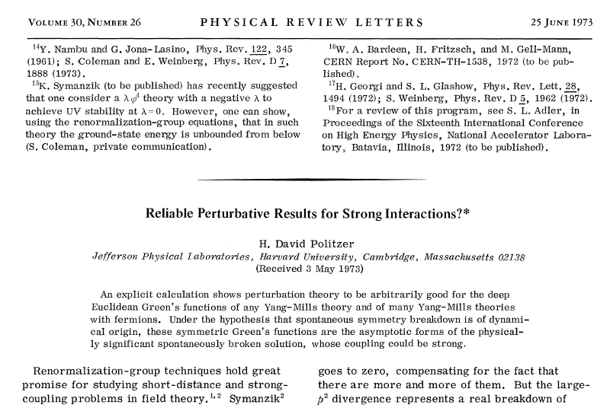
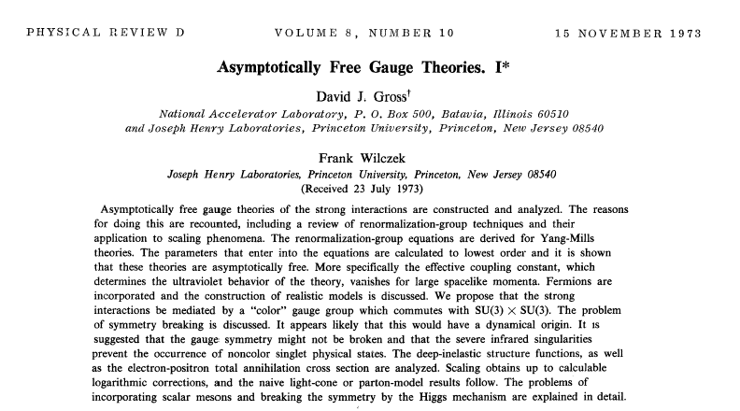
Parallel, Independent Developments 1973-1974
1973 = Birth of QCD
Politzer, Gross and Wilczek

Slide 13
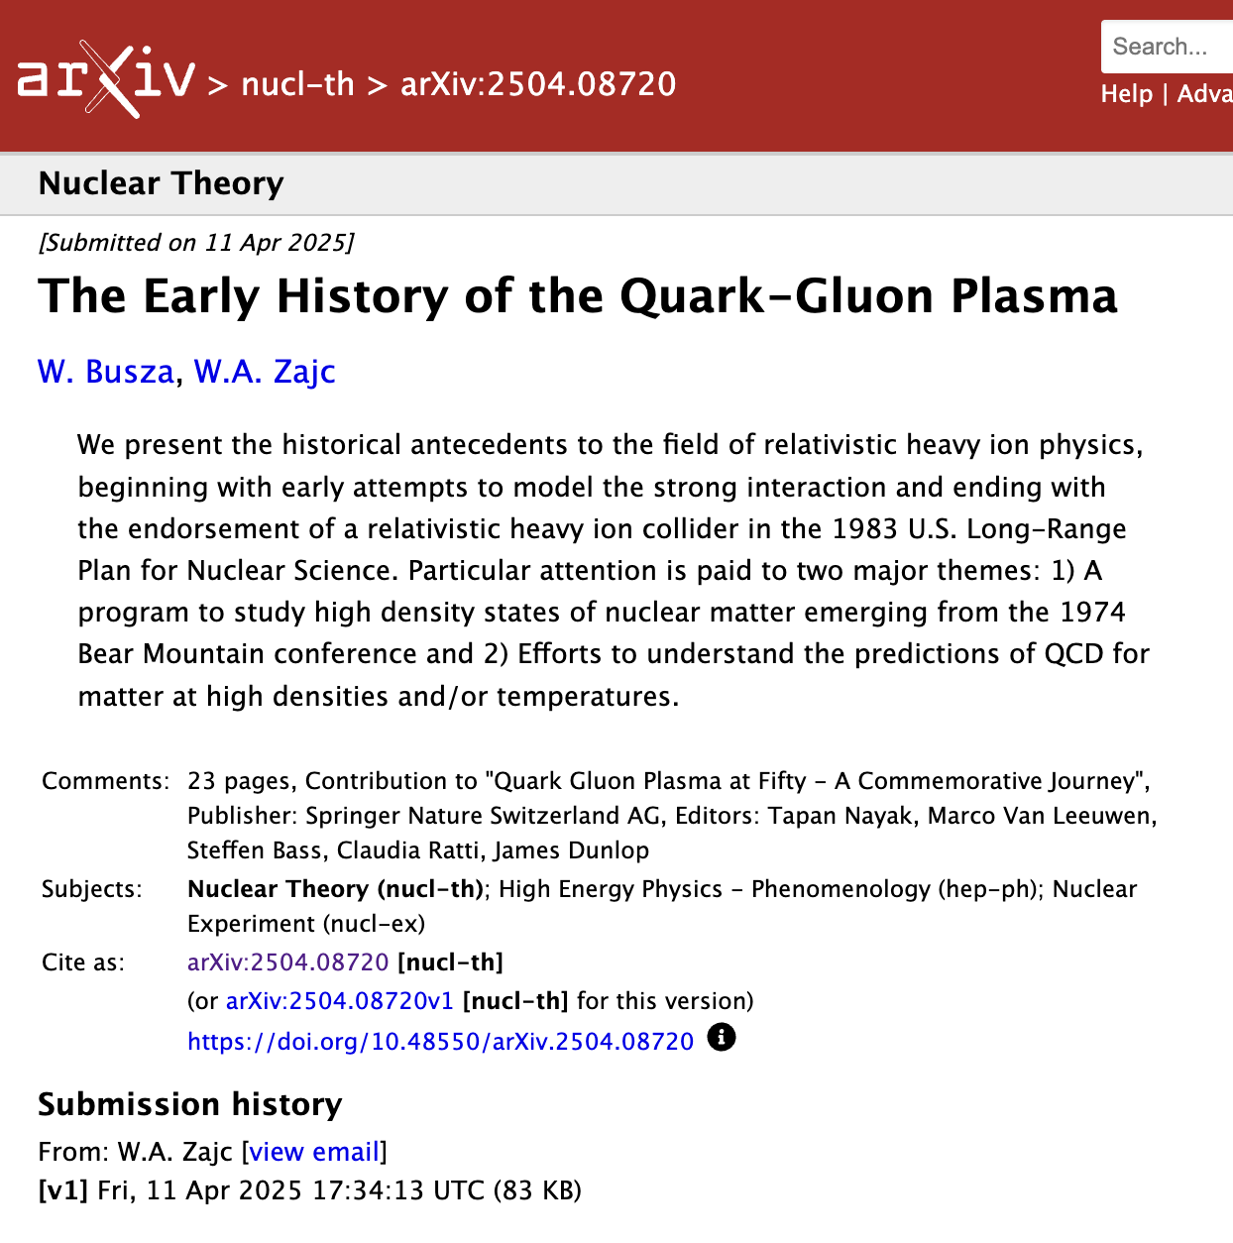
Parallel Paths that Nonetheless Converged
Focus of this review article:
1973 to 1983, convergence of
Bear Mountain “exciting the vacuum” program
Understanding bulk QCD effort
1983 as Fundamentum Anni
“a remarkable year, marked by confluence, convergence and consequence. More specifically, that year saw confluence in a particular theoretical approach to applying hydrodynamics, convergence of experimental and theoretical efforts in understanding the expected reaction dynamics, and far-reaching consequences of funding decisions made by the U.S. government.”

Slide 14
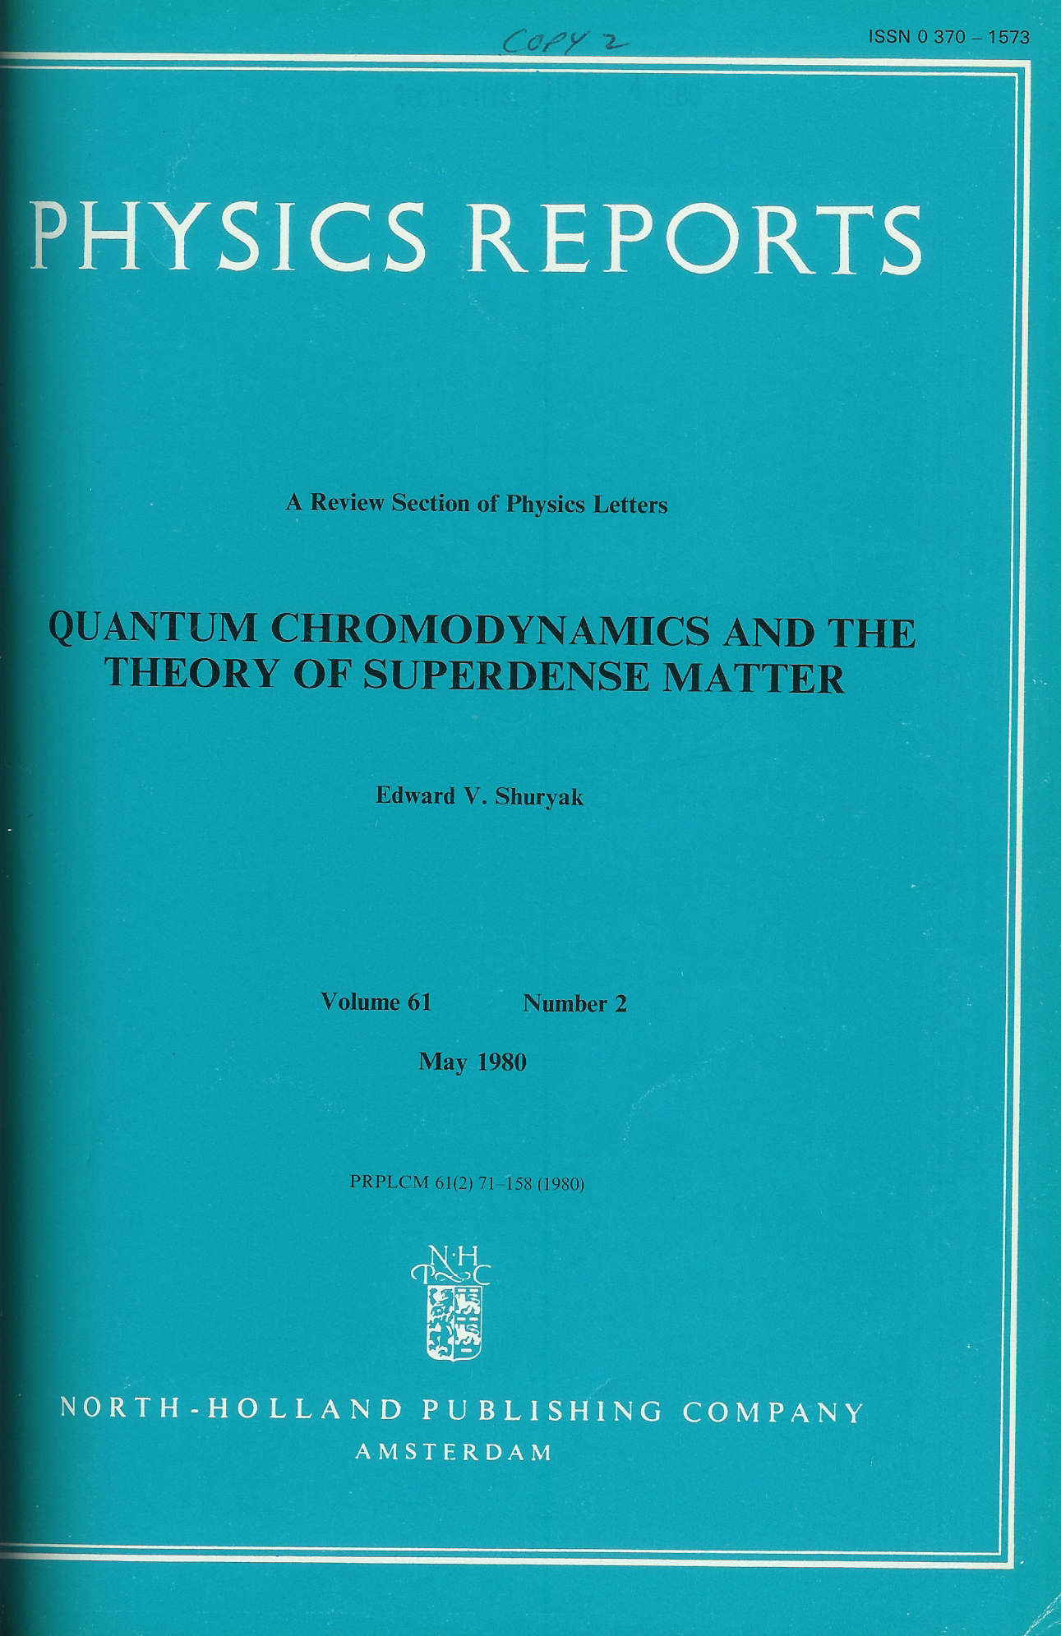
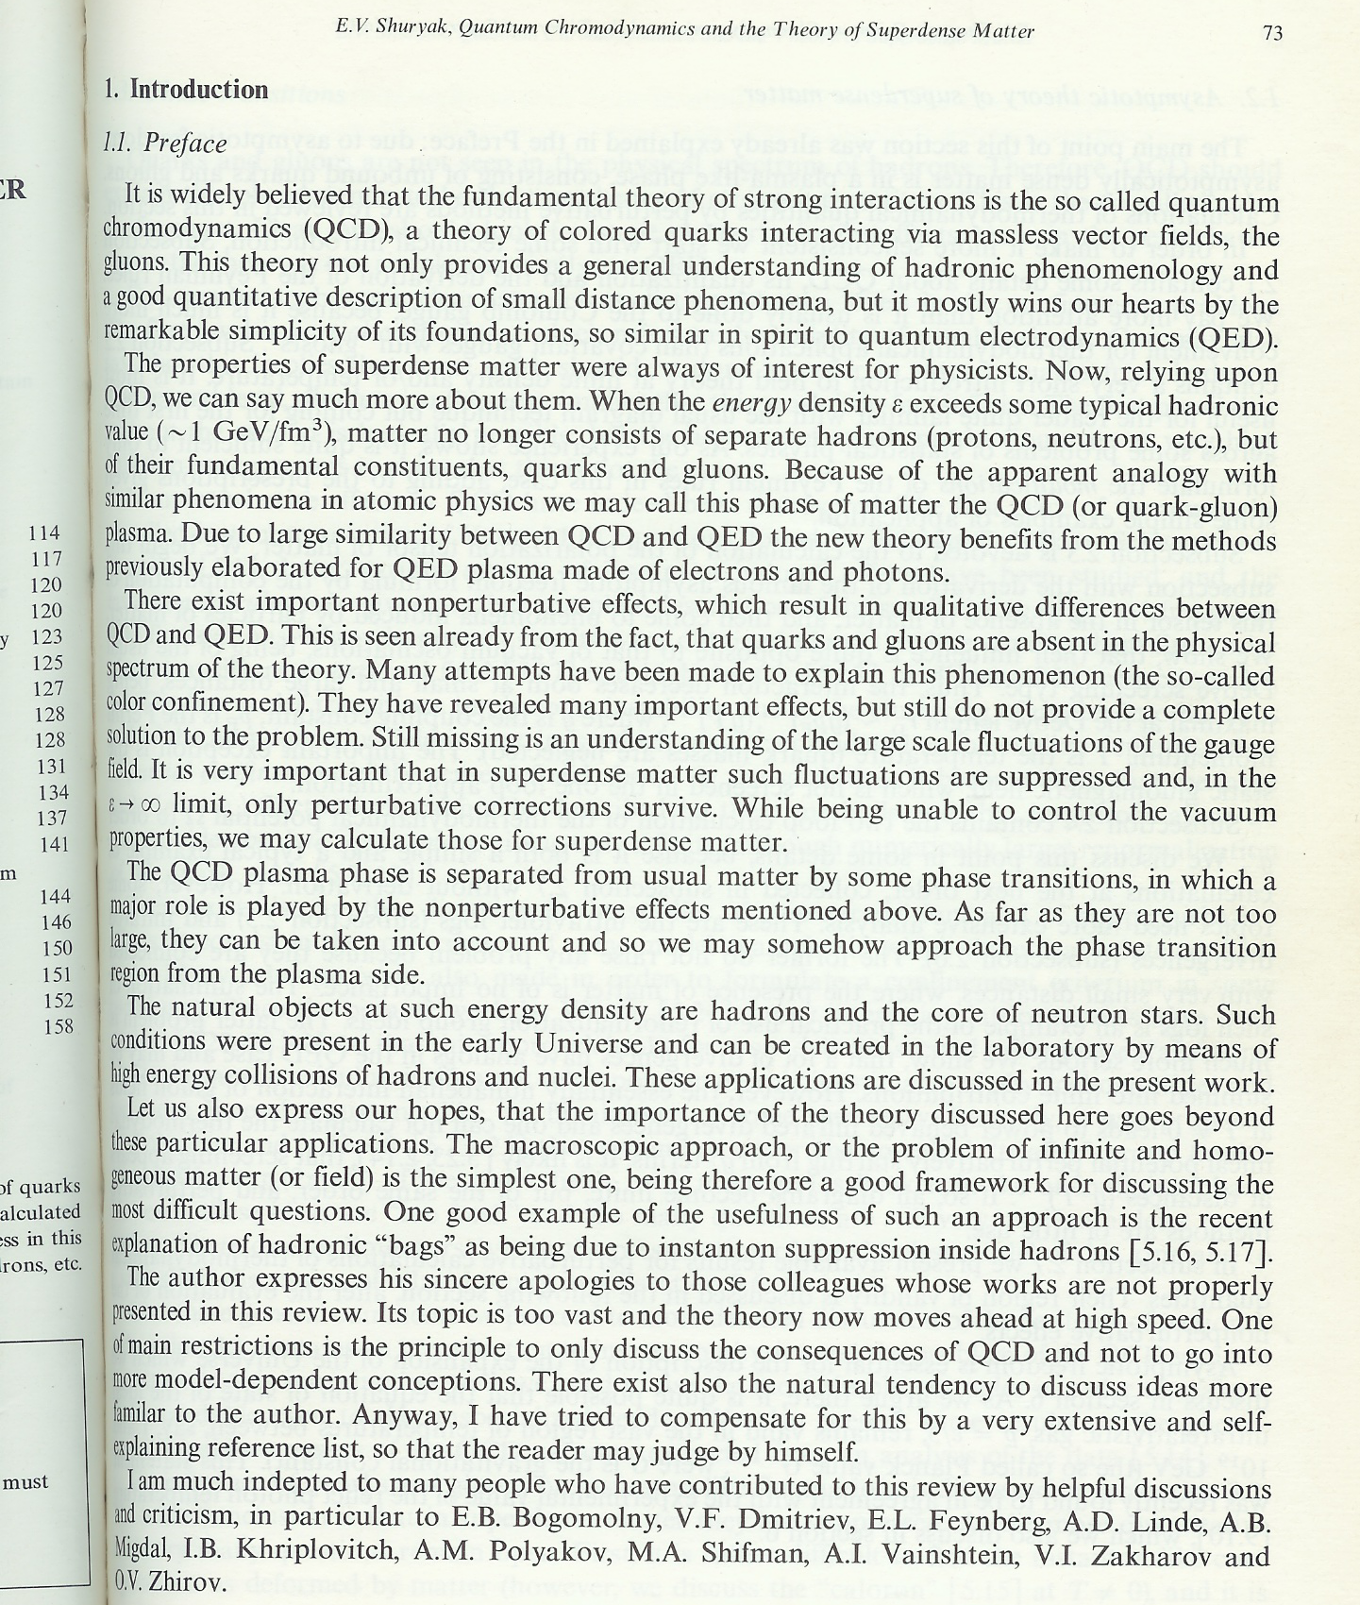
Shuryak 1980
Shuryak publishes first “review” of thermal QCD- and coins a phrase:
“Because of the apparent analogy with similar phenomena in atomic physics, we may call this phase of matter the QCD (or quark-gluon) plasma.” (QGP)

Slide 15
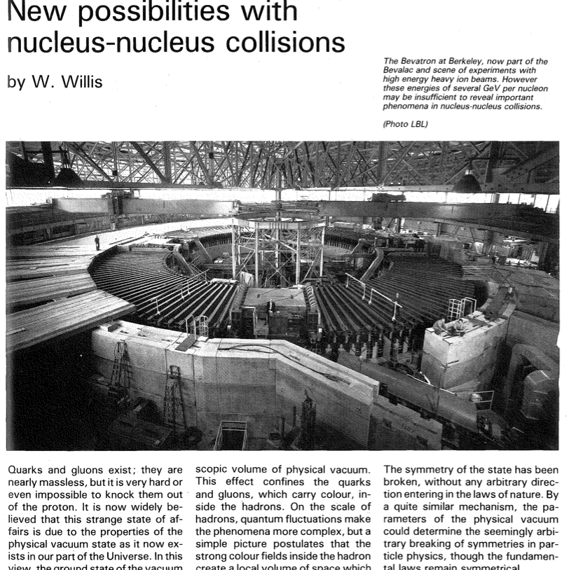
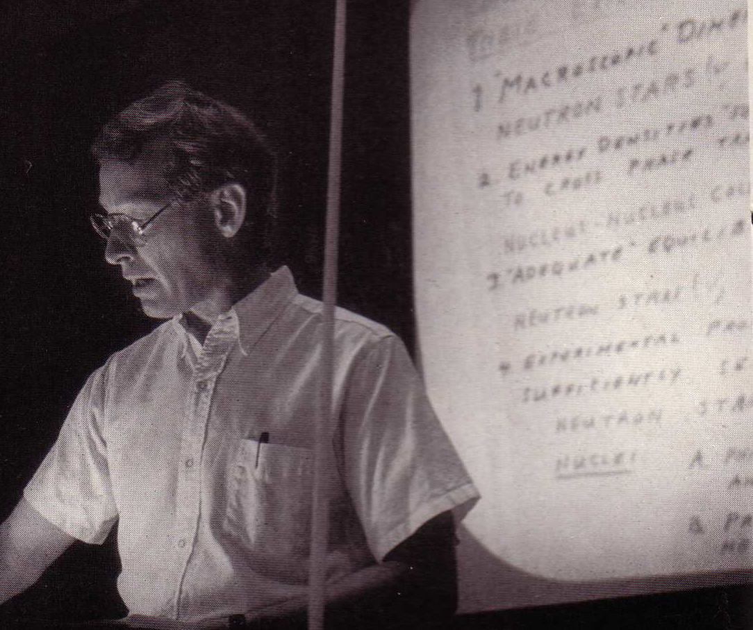
An Important Prophet
CERN Courier, January 1982, pp. 17-20

Slide 16
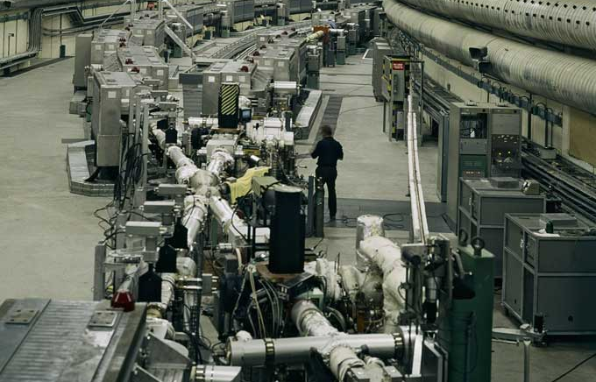
The CERN ISR
The world’s first light ion collider

Slide 17
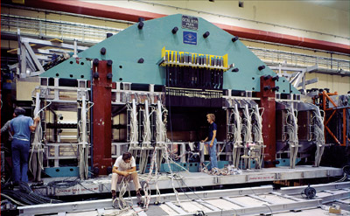
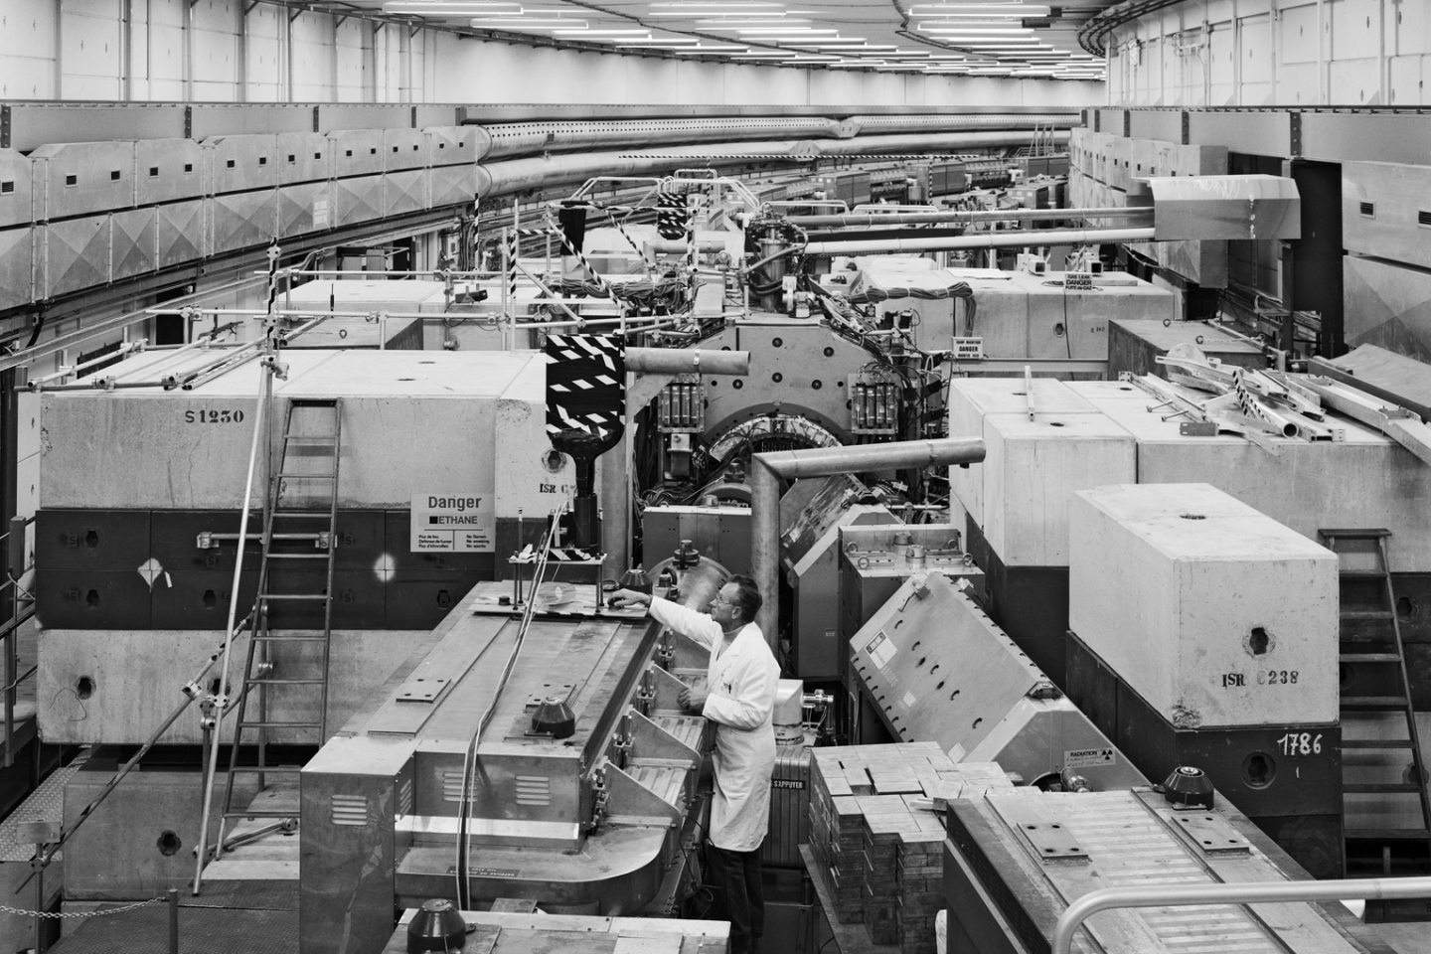
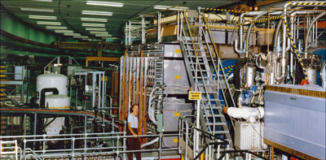
The CERN ISR
The world’s first light ion collider (and first hadron collider detectors)

Slide 18
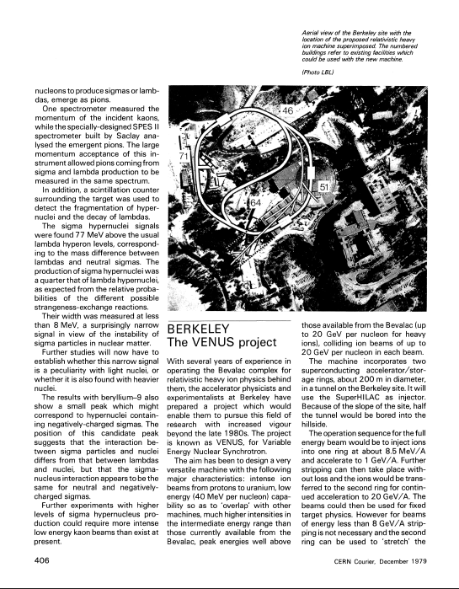
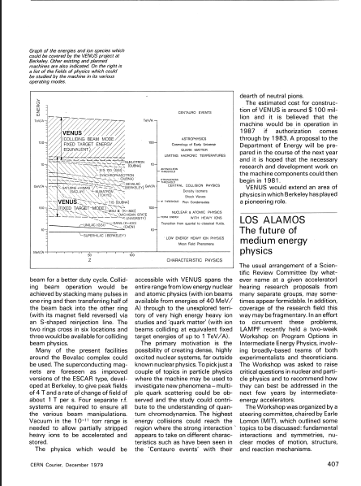
Circa 1979: VENUS ??
Notes:
December 1979 CERN Courier, p. 406-407
40+40

Slide 19
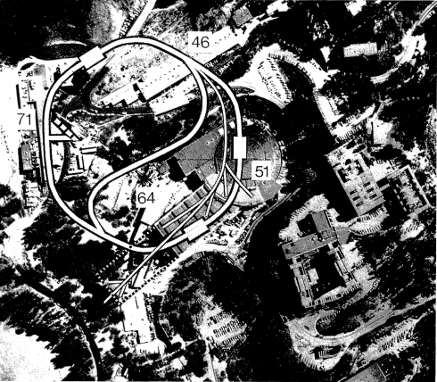
Circa 1979: VENUS ??
Notes:
December 1979 CERN Courier, p. 406-407
40+40

Slide 20
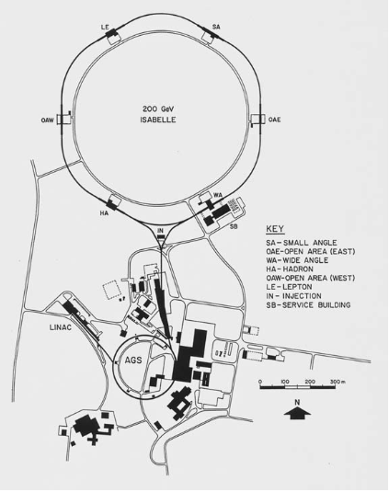
In the World of High Energy Physics . . .
1971: Fitch panel (AUI) endorses ISABELLE 200 GeV+200 GeV
1974: HEPAP approves ISABELLE at BNL
1978: Construction start
. . . Issues with superconducting magnet design(s)
1982: “Desertron” rumblings appear, ISABELLE → CBA (Colliding Beams Accelerator)
1983: HEPAP considers path forward . . .
References:
Quenched! The ISABELLE Saga, I, R. Crease, Physics in Perspective 7, 330-376 (2005)
Quenched! The ISABELLE Saga, II, R. Crease, Physics in Perspective 7, 404-452 (2005)

Slide 21
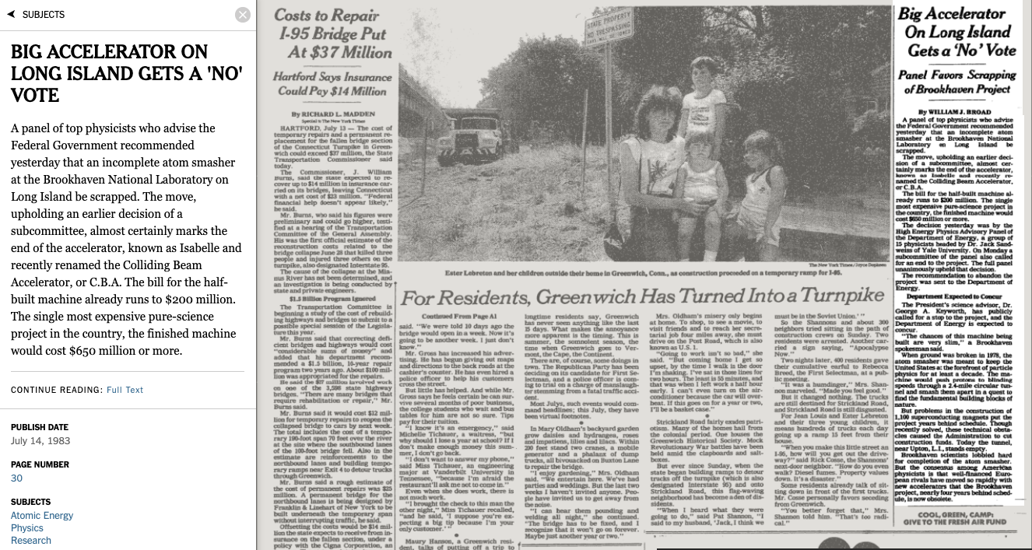
July 14, 1983
The effective termination of CBA

Slide 22
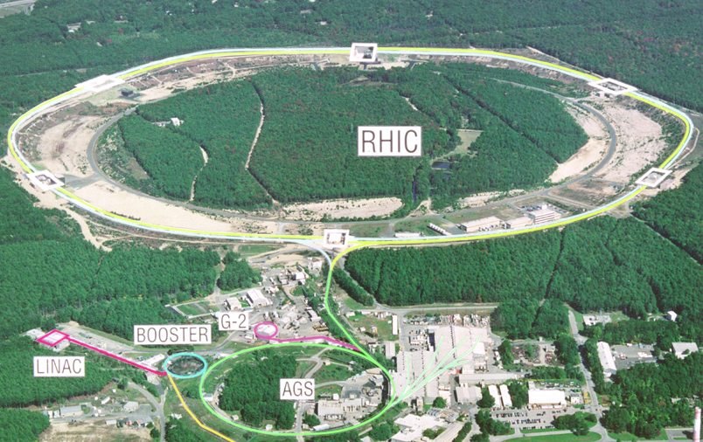
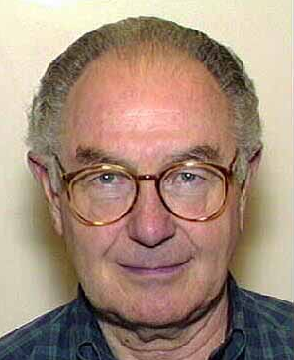
The Origin of RHIC (1983)
Required reading: Recombinant Science: The Birth of the Relativistic Heavy Ion Collider (RHIC), Robert P. Crease, Historical Studies in the Natural Sciences, Vol. 38, No. 4 (Fall 2008), pp. 535-568
Lee invited Sandweiss and Samios over to his visitor apartment. “I said, ‘Come to my place and we’ll pool our sorrows together.’ Lee pulled out a pot of curried chicken Jeannette had made for him: the three consumed it all, and put a large dent in a case of Beaujolais Nouveau as well. They did all the mourning that they were able, and then Lee promoted the idea of a heavy- ion collider, which he found Samios was greeting with increasing enthusiasm. “With Beaujolais,” Lee remarked later, “you can look into the future more easily.”

Slide 23
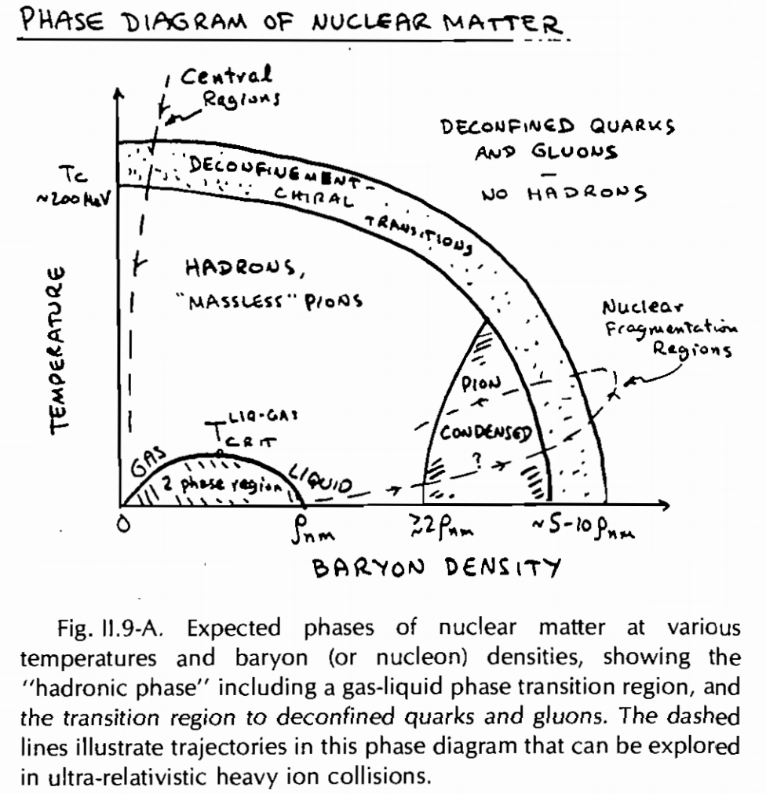
The Origin of RHIC (1983)
Required reading: Recombinant Science: The Birth of the Relativistic Heavy Ion Collider (RHIC), Robert P. Crease, Historical Studies in the Natural Sciences, Vol. 38, No. 4 (Fall 2008), pp. 535-568
Literally contemporaneous with these events at BNL: The Long Range Plan for Nuclear Physics meeting at Wells College (upstate NY).
Shuttle diplomacy ensued . . . (via Tom Ludlam)
Out of that meeting:
Why? “…a spectacular transition to a new phase of matter, a quark-gluon plasma, may occur… ”
It is the opinion of this Committee that the United States should proceed with the planning for the construction of this relativistic heavy ion collider facility expeditiously, and we see it as the highest priority new scientific opportunity within the purview of our science.

Slide 24
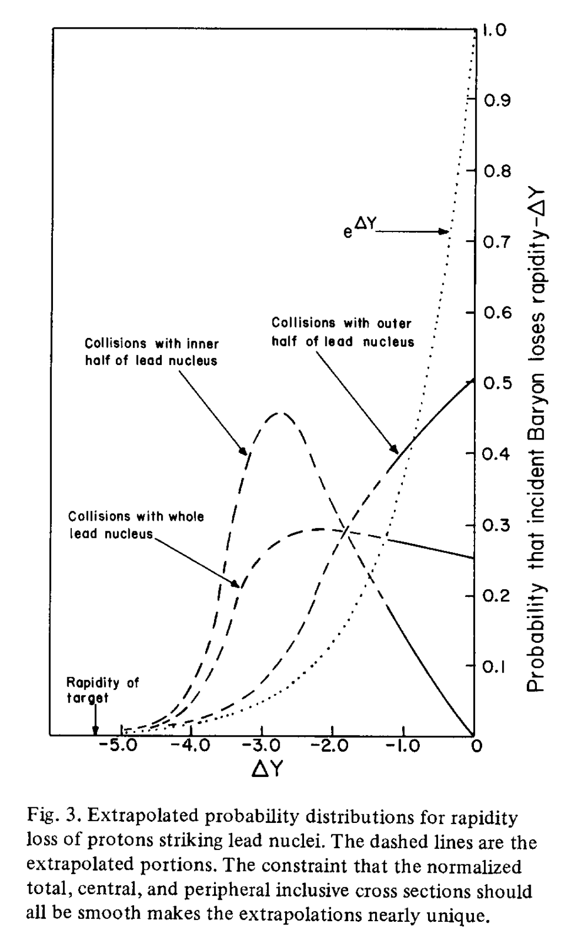
1983 As the Fundamentun Anni
The extraordinarily adept transition CBA → RHIC
The endorsement of a high-energy collider in the NP Long-Range Plan
Publication of Bjorken’s enormously influential “hydro” paper
Highly Relativistic Nucleus-Nucleus Collisions: The Central Rapidity Region, Phys. Rev. D27, 140 (1983)
Quark Matter 1983 held at Brookhaven
Explicitly noted in the Preface by Tom Ludlam and Harvey Wegner: “newly analyzed data from Fermilab on the crucial question of nuclear stopping power provided the basis for improved estimates of the required collision energies. ”
Nuclear Stopping Power, W. Busza and A.S. Goldhaber, Phys. Lett. B139, 235 (1983).

Slide 25
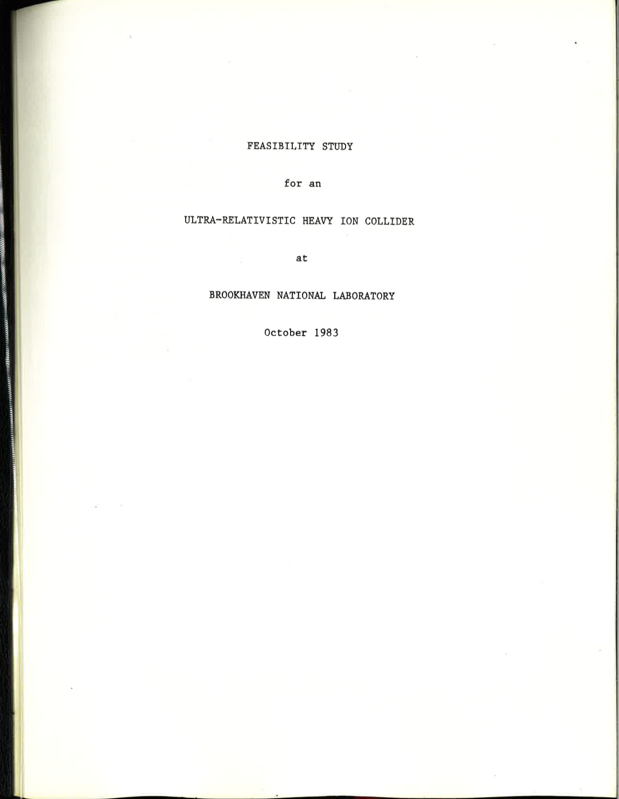
1983 As the Fundamentun Anni
The extraordinarily adept transition CBA → RHIC
The endorsement of a high-energy collider in the NP Long-Range Plan
Publication of Bjorken’s enormously influential “hydro” paper
Highly Relativistic Nucleus-Nucleus Collisions: The Central Rapidity Region, Phys. Rev. D27, 140 (1983)
Quark Matter 1983 held at Brookhaven
Explicitly noted in the Preface by Tom Ludlam and Harvey Wegner: “newly analyzed data from Fermilab on the crucial question of nuclear stopping power provided the basis for improved estimates of the required collision energies. ”
The physics interest in an Ultra-Relativistic Heavy Ion Collider has recently been recognized by the Nuclear Science Advisory Committee which recommended such a facility as its highest priority new program. . . The availability of the CBA tunnel for the ion collider represents an unprecedented opportunity to construct the new machine at minimal cost.

Slide 26
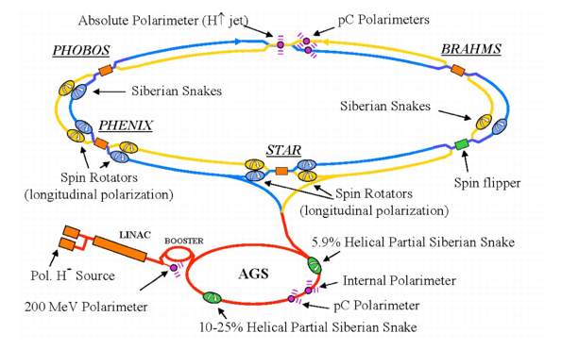
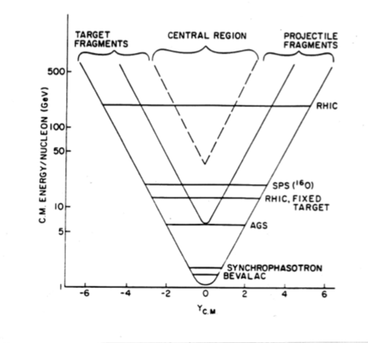
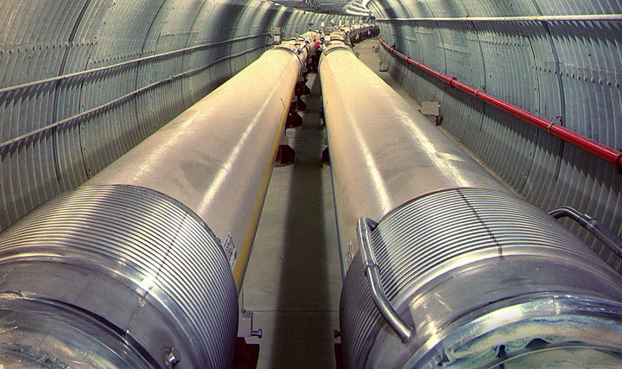
RHIC
The world’s first purpose-built heavy ion collider
VENUS
ISR
Notes:
VENUS: cosh(3.69) = 20
ISR: 31.5 GeV *(79/197) = 12.63 GeV, cosh(3.23) = 12.65

Slide 27
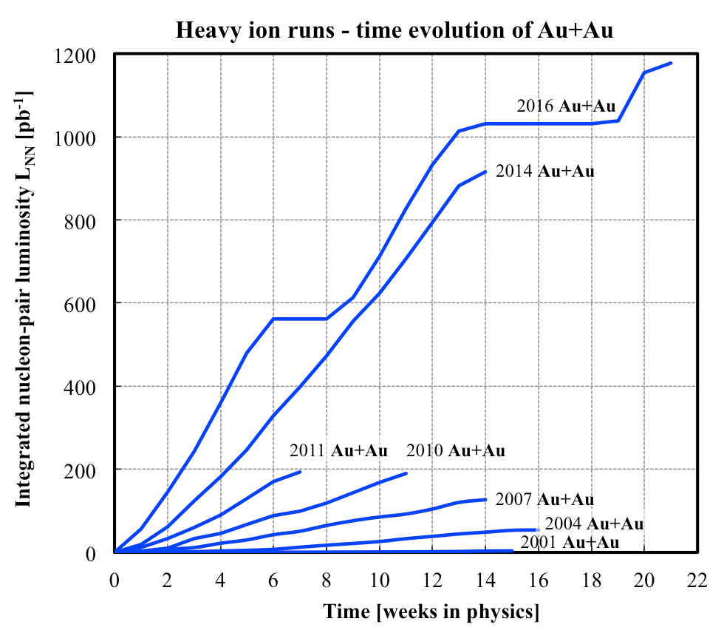
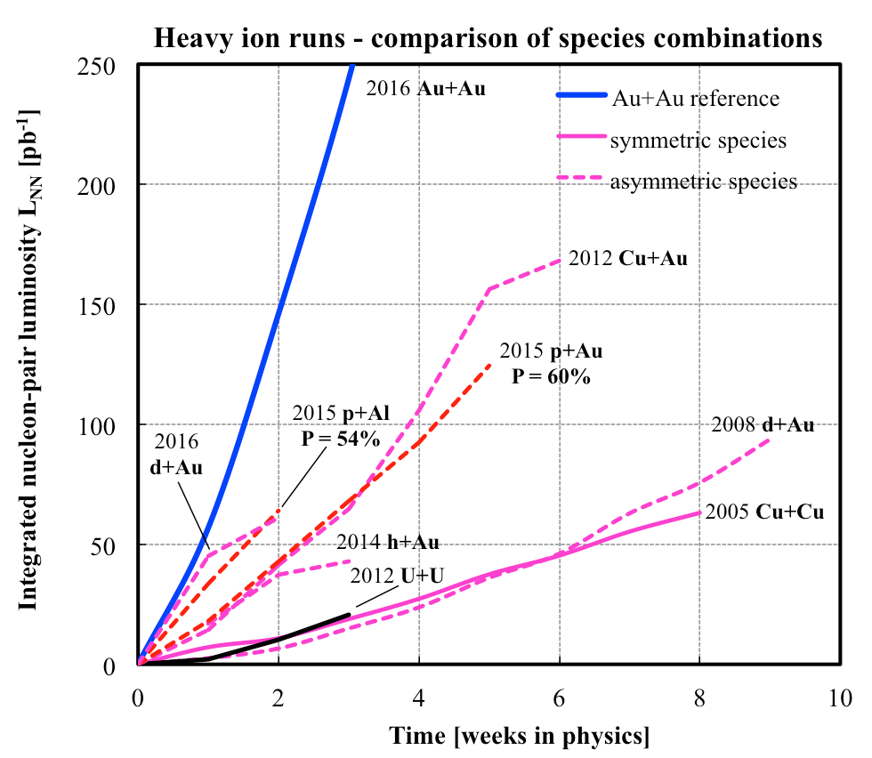
RHIC
The world’s first purpose-built heavy ion collider
Has demonstrated its enormous flexibility
Has enabled 25 years of fundamental discoveries
→ RHIC is the most versatile collider ever built !
Notes:
Run-1 = 20/mub Au+Au = 0.8 /pb p+p equivalent
http://www.rhichome.bnl.gov/RHIC/Runs/

Slide 28
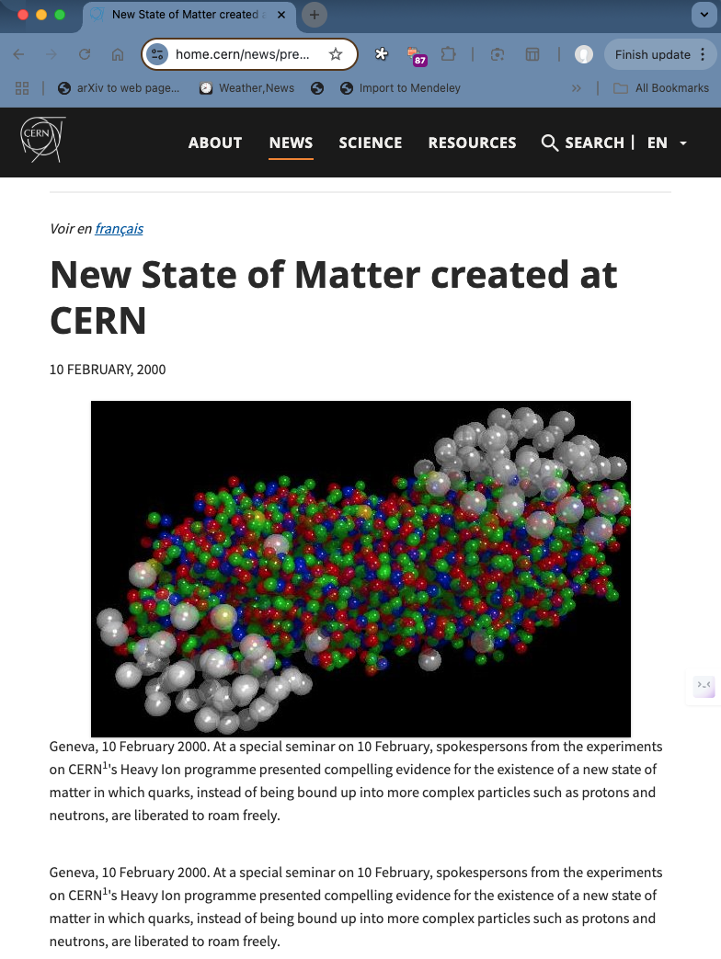
An Unfortunate Affair - 2000 CERN Press Release
”Good” news (from the RHIC perspective): It did not directly claim discovery of the quark-gluon plasma.
Bad news:
Was not linked to publication of peer-reviewed findings.
Nonetheless stated
“the experiments on CERN's Heavy Ion programme presented compelling evidence for the existence of a new state of matter in which quarks, instead of being bound up into more complex particles such as protons and neutrons, are liberated to roam freely.”

Slide 29
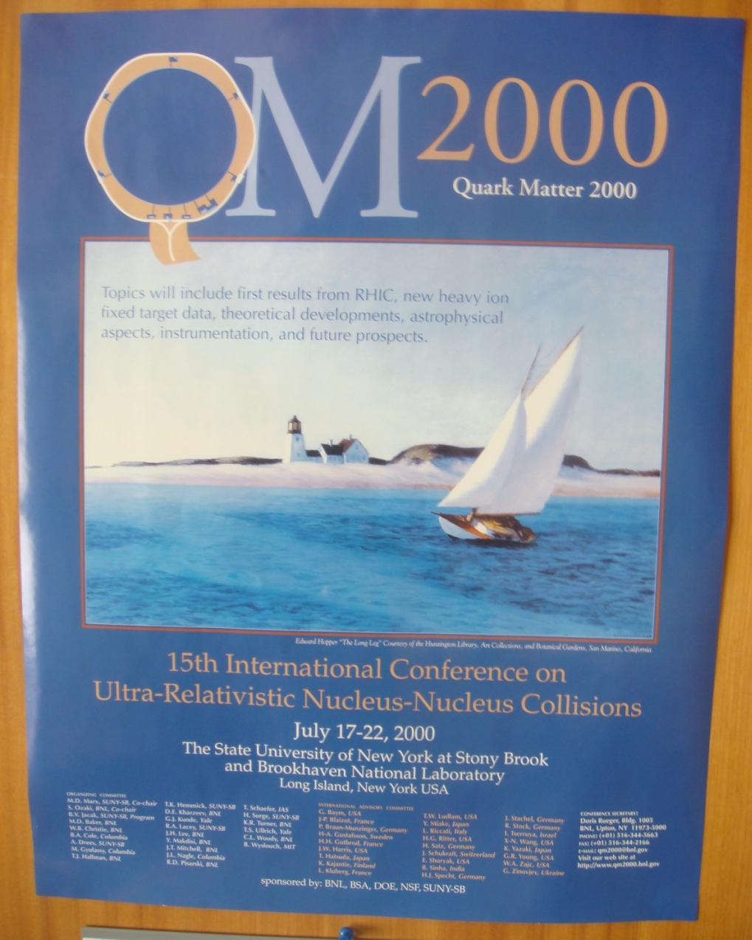
RHIC’s First Phase Transition

Slide 30

RHIC’s First Phase Transition
1

Slide 31
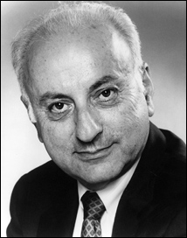
Not Described Here . . .
The long arduous process by which 7 proposals became 4 approved experiments.
Mel’s vision
2 large ($30M) experiments
“Facilities”
Permanent installations
2 small (~$5M) experiments
Flexible
Replaceable

Slide 32
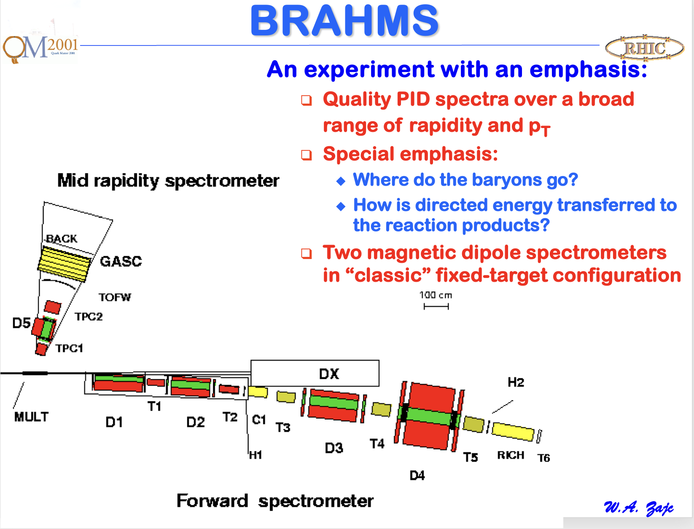
Quark Matter 2001

Slide 33
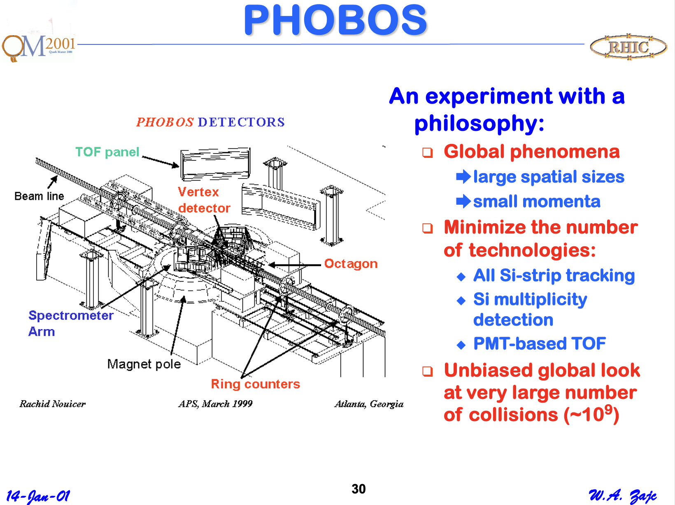
Quark Matter 2001

Slide 34
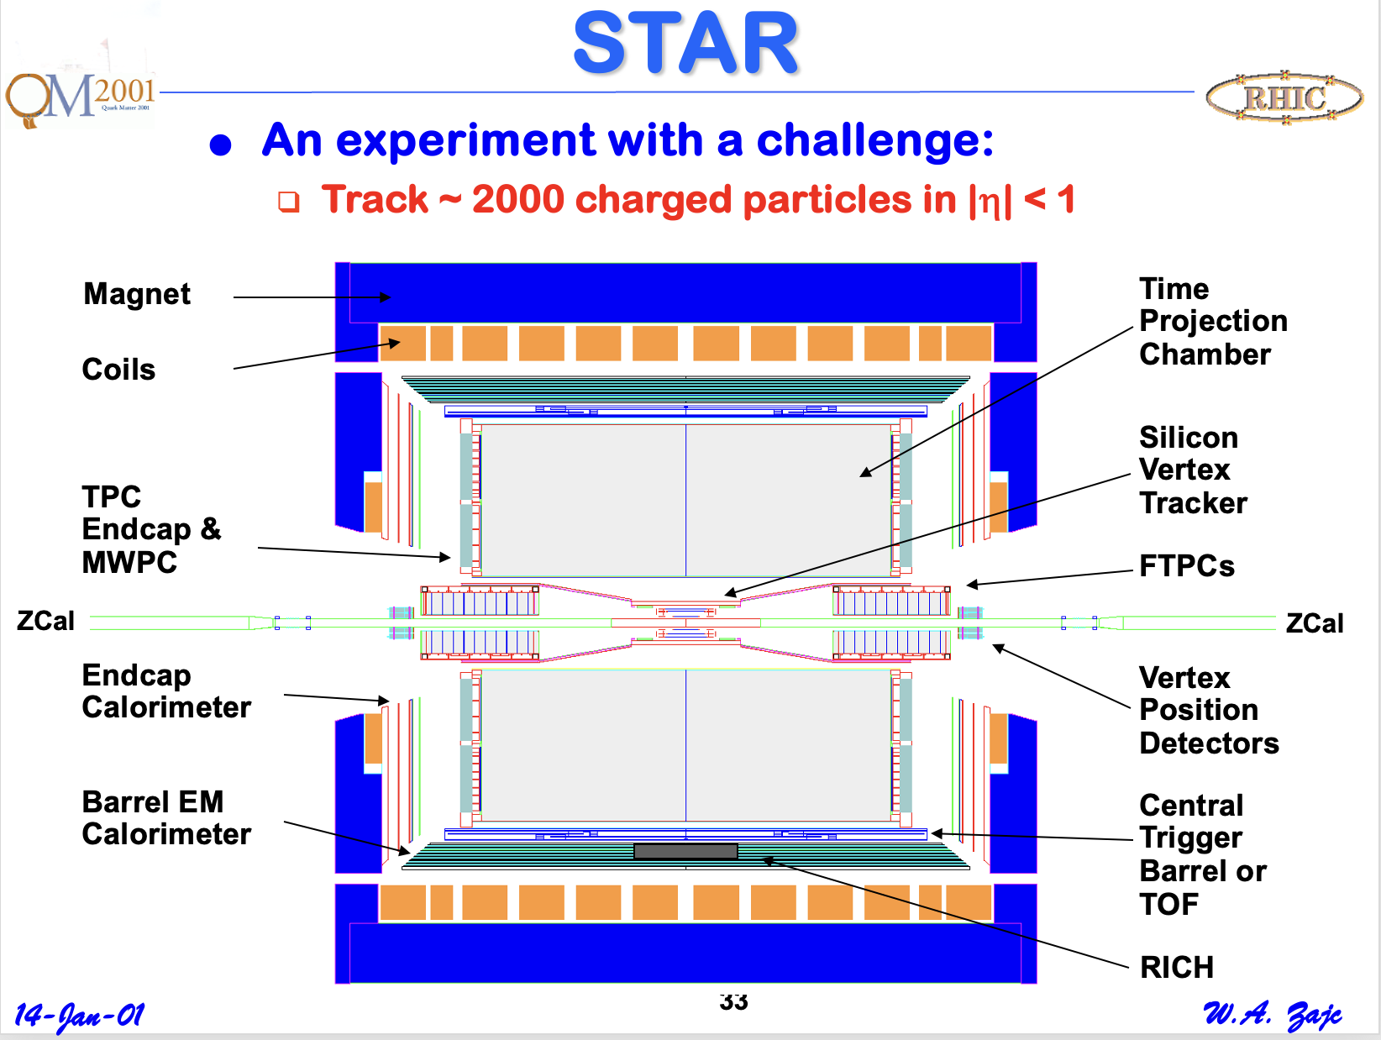
Quark Matter 2001

Slide 35
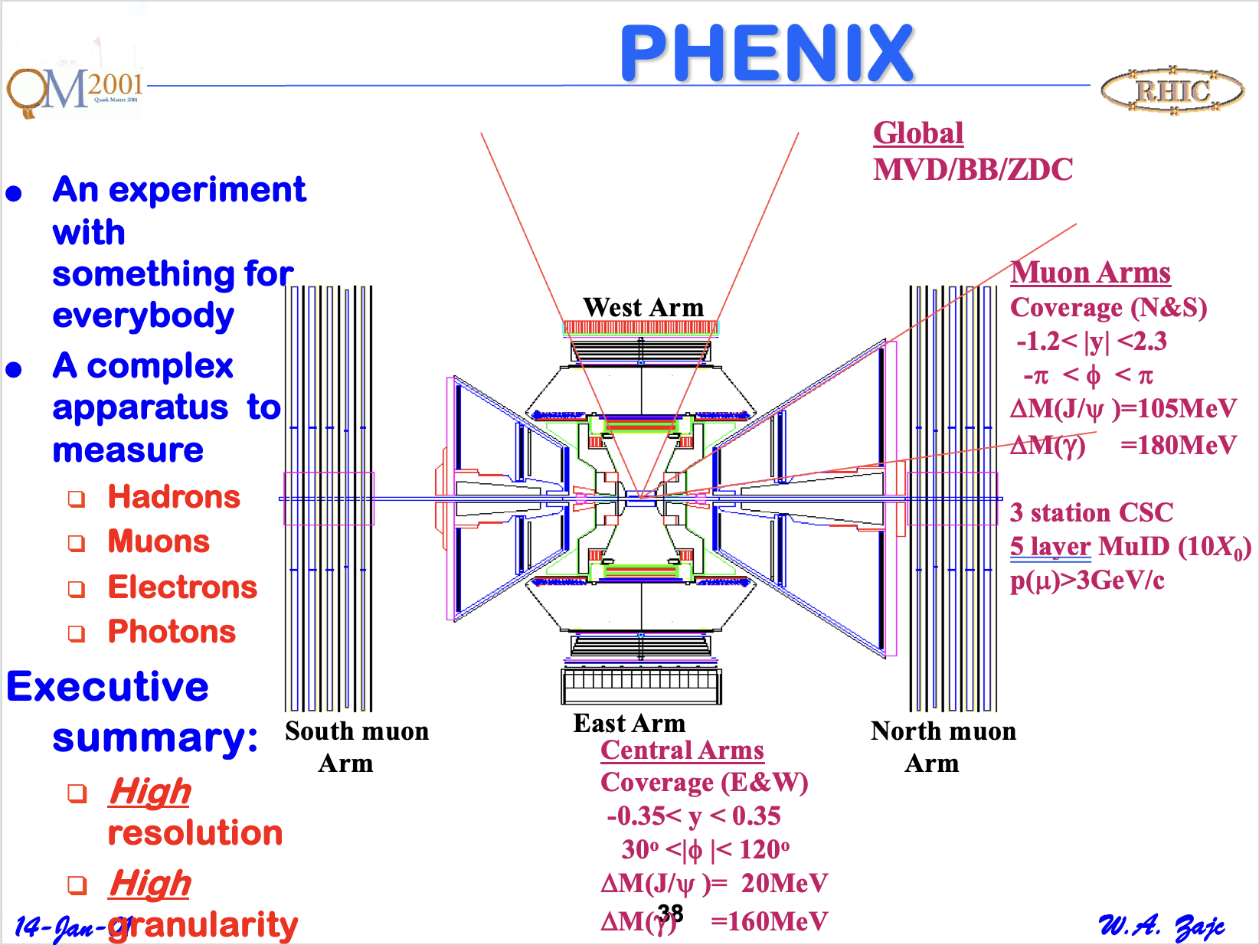
Quark Matter 2001

Slide 36
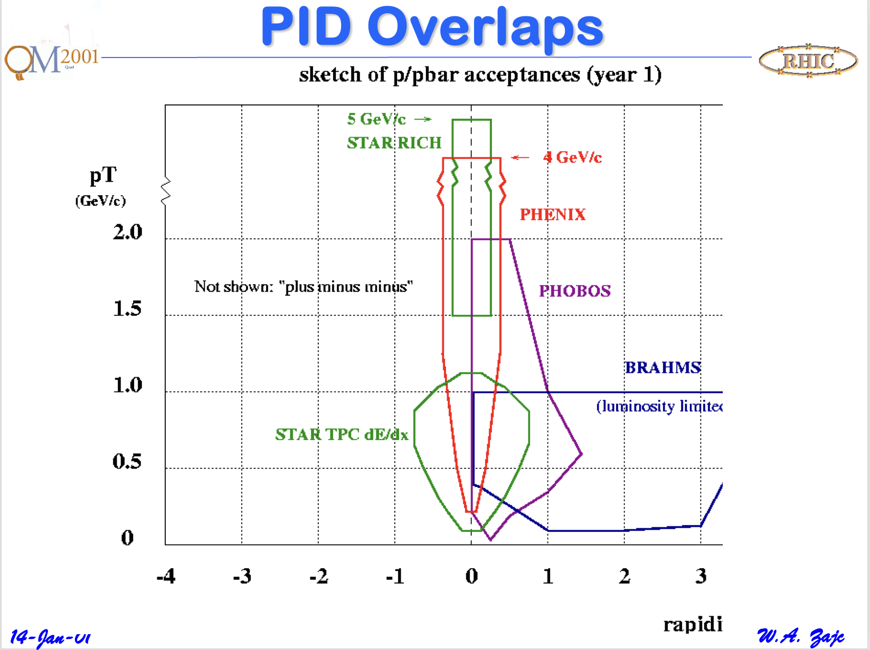
Quark Matter 2001

Slide 37
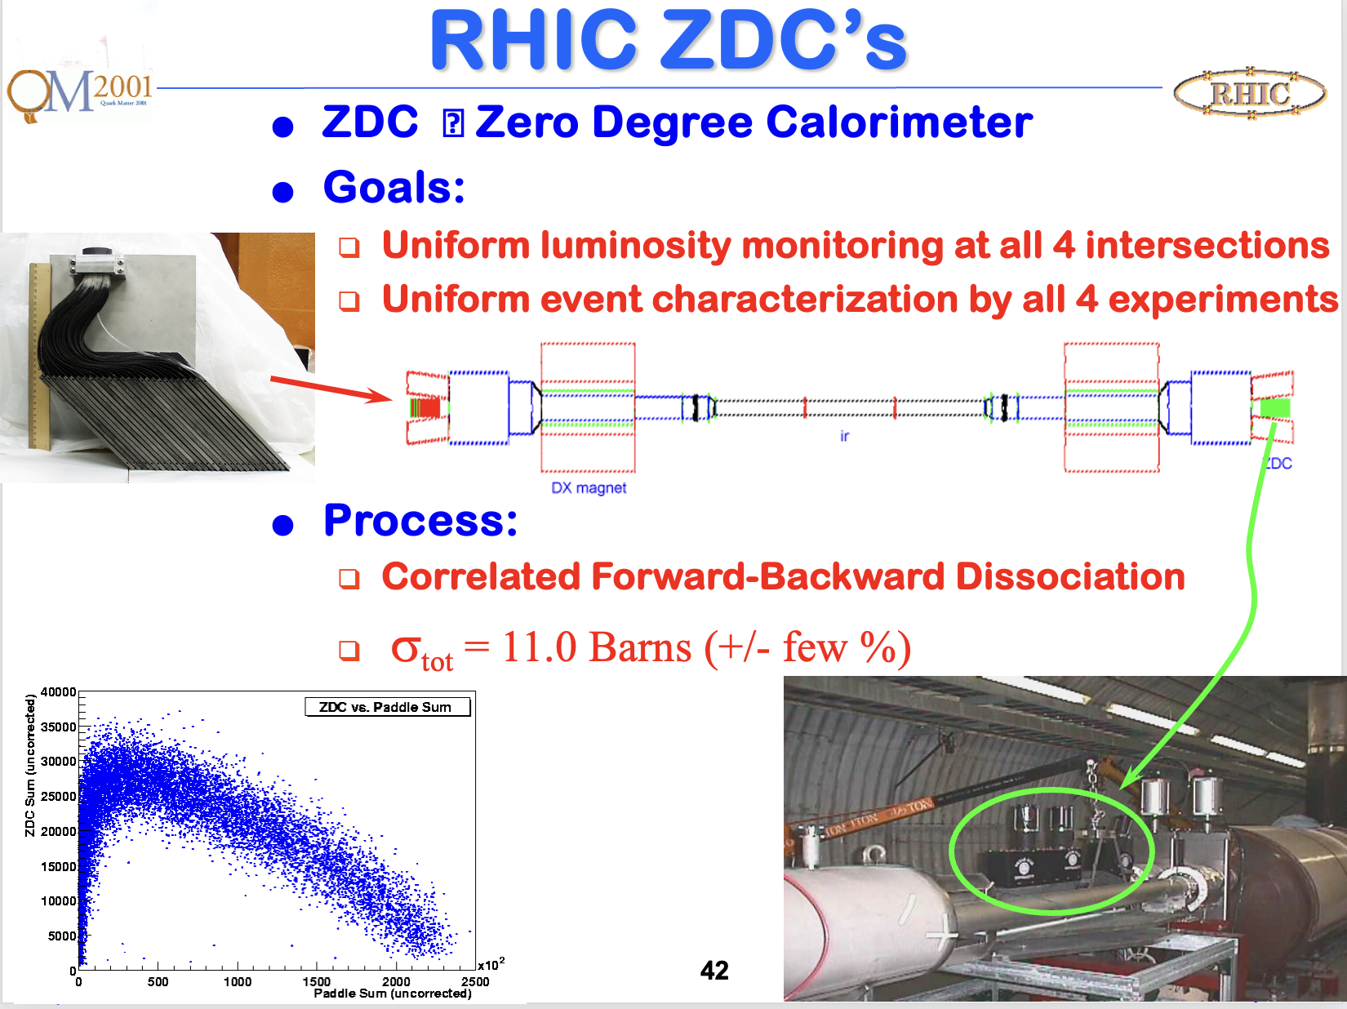
Quark Matter 2001

Slide 38
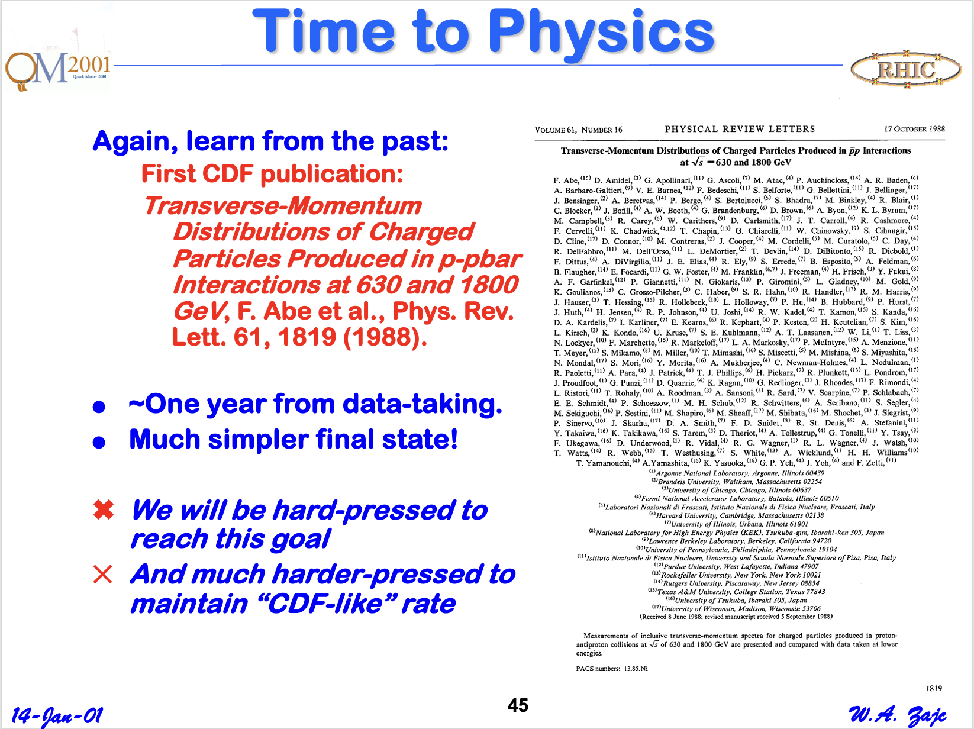
Prediction January, 2001

Slide 39
Wrong !!
Well – we were indeed hard-pressed.
But we pressed hard!

Slide 40
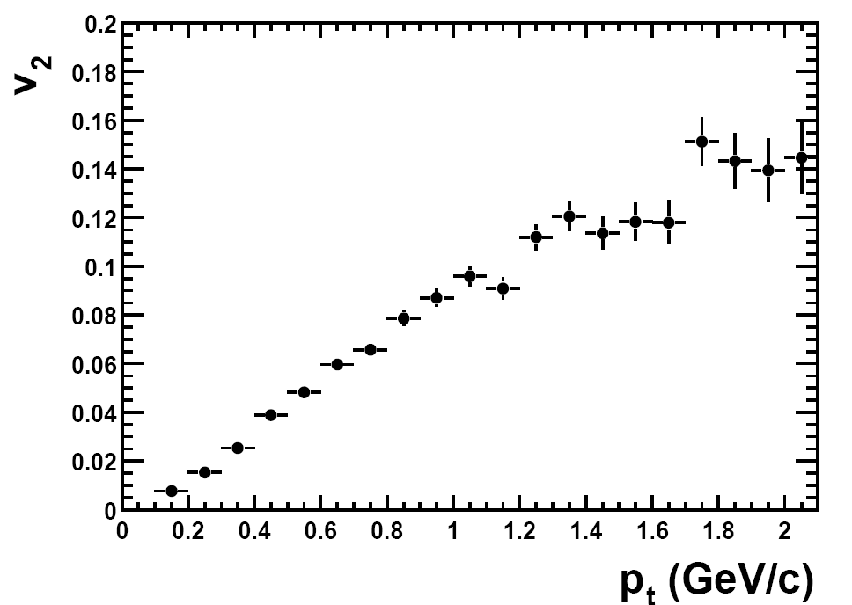
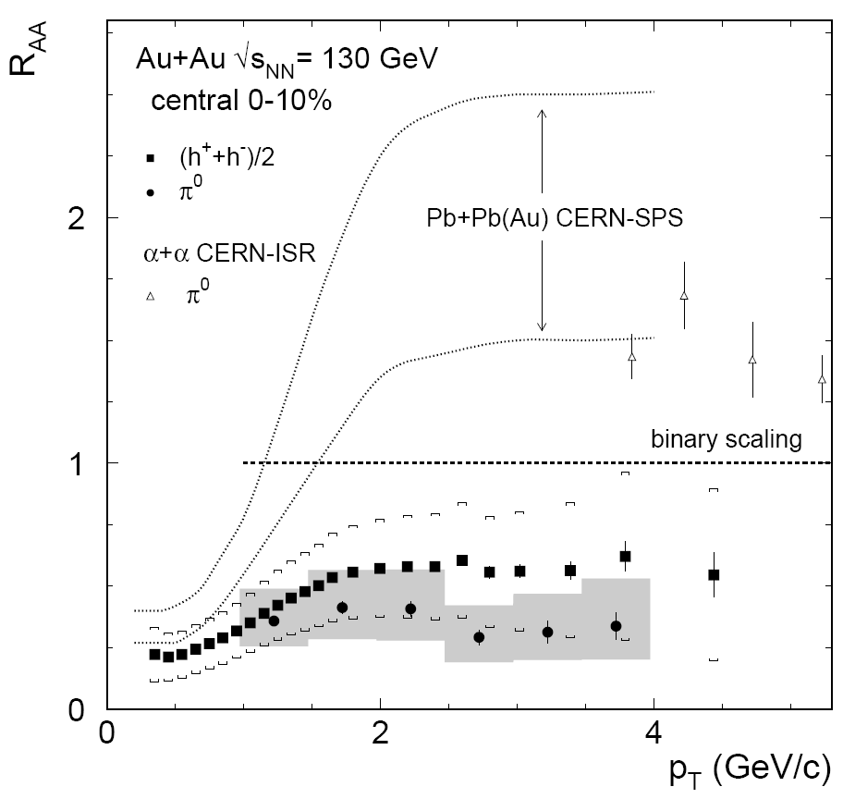
RHIC’s First Two Major Discoveries
Discovery of strong “elliptic” flow:
Elliptic flow in Au+Au collisions at √s_{NN}= 130 GeV, STAR Collaboration, Phys.Rev.Lett.86:402-407,2001
882 citations
Discovery of “jet quenching”
Suppression of hadrons with large transverse momentum in central Au+Au collisions at √s_{NN} = 130 GeV, PHENIX Collaboration, Phys.Rev.Lett.88:022301,2002
1265 citations

Slide 41
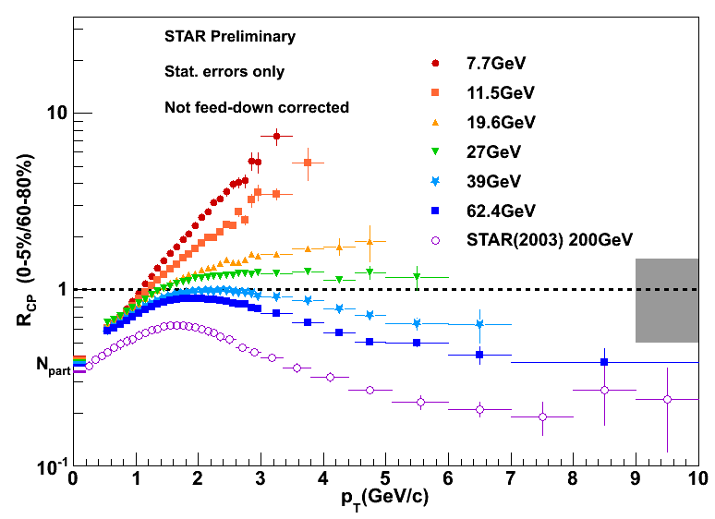
How Fortunate !
Suppression effect not present at lower √s ’s
ISR
VENUS

Slide 42
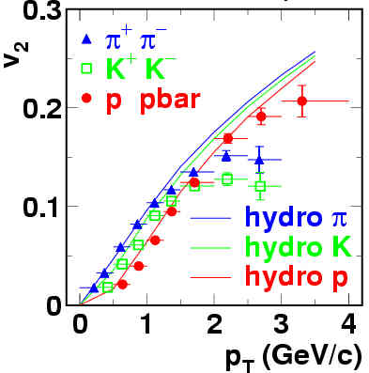

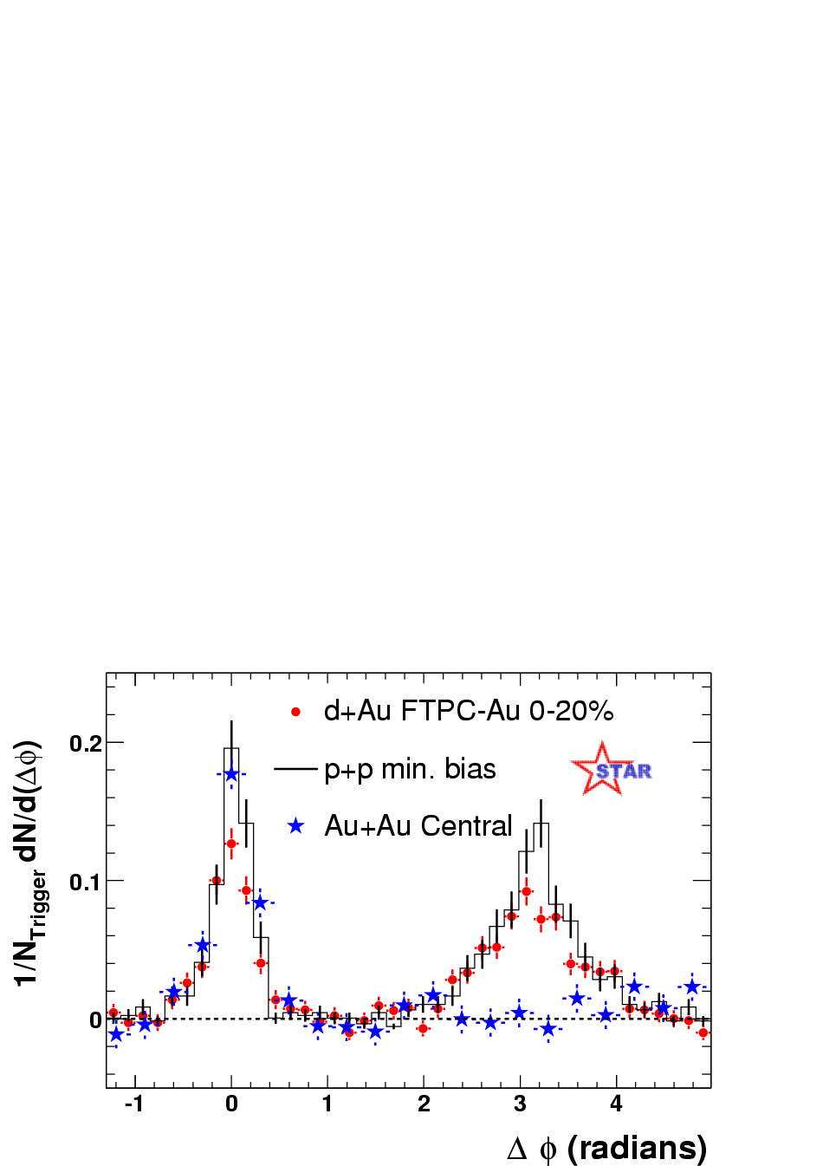
Extending Those Major Discoveries
Hydro from P. Huovinen et al., Phys. Lett. B503, 58 (2001)
“Fine structure” in elliptic flow:
Elliptic flow of identified hadrons in Au+Au collisions at √s_{NN}= 200 GeV, PHENIX Collaboration, Phys.Rev.Lett.91:182301,2003
908 citations
Disappearance of away-side “jet”
Disappearance of back-to-back high p_{T} correlations in central Au+Au collisions at √s_{NN} = 200 GeV, STAR Collaboration, Phys.Rev.Lett.90:082302,2003
946 citations
Pedestal&flow subtracted

Slide 43
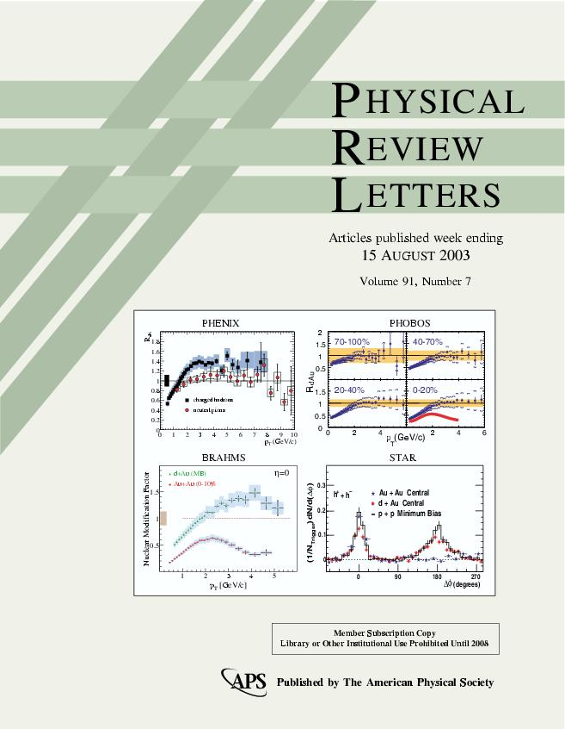
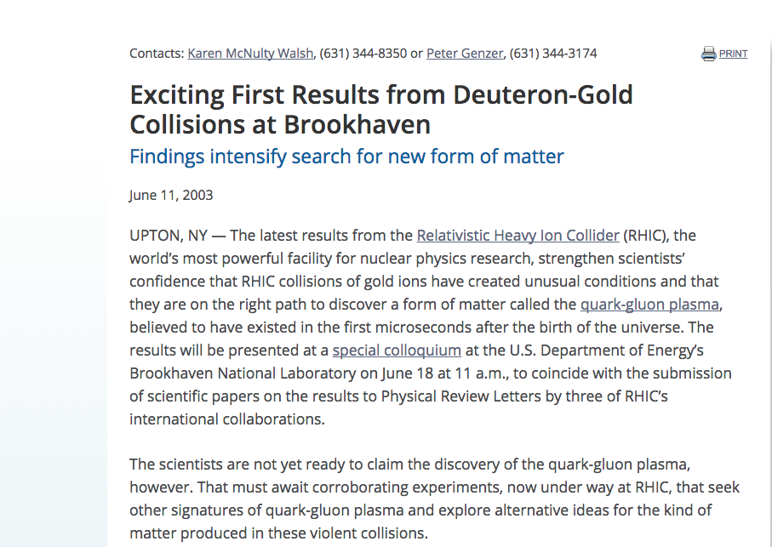
Critical in situ Control Measurement
2000 – first collisions
2001 – major results from all 4 collaborations
2002 – first full-energy Au+Au run
2003 – d+Au control run

Slide 44
Critical in situ Control Measurement
2000 – first collisions
2001 – major results from all 4 collaborations
2002 – first full-energy Au+Au run
2003 – d+Au control run

Slide 45

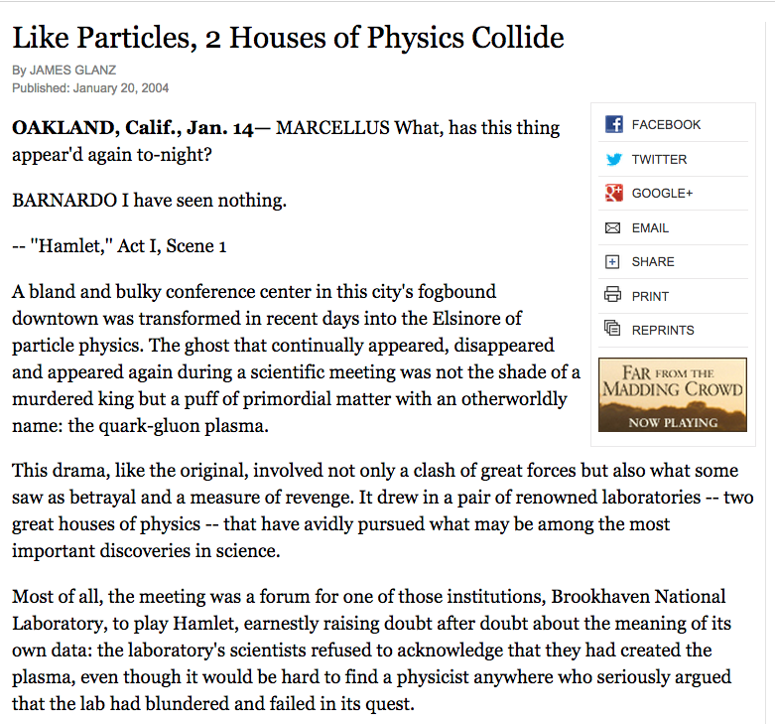
Jan-24: 97 RHIC publications
but . . .
New York Times article by Jim Glanz emphasized “reluctance” to announce QGP discovery.
This was enormously polarizing . . .

Slide 46
From That Article
…the CERN announcement ''added more confusion than light to the story’’ (RHIC scientist)
Those words were like daggers . . .
“They (BNL) were just starting a half-billion-dollar operation and we (CERN) are saying: ‘Bye-bye. We have stolen your child’ ”
(Senior CERN scientist)
To announce a discovery now, Dr. Xyyyyyy said, ‘'the very same people who were very critical have to eat their words.’’
''It's no mystery to me why they haven't announced it,’’ Dr. Mueller said. ''I think the lab has been appropriately cautious.''

Slide 47
Causality in the White Paper Process
12-Feb-04: Discussion Sam Aronson, Tim Hallman, WZ “RHIC Science Retreat”
20-Feb-04: Tim Hallman, WZ discuss possible “white papers”
25-Feb-04: Spokesperson’s meeting, WZ charged to draft a process
27-Feb-04: Experiments invited to contribute ~15-page paper to RBRC Series
29-Feb-04: Draft process for White Papers’s distributed to other spokespersons + Sam Aronson
02-Mar-04: Spokespersons discuss politely declining publication in RBRC Series
Unrealistic time scale (April 5)
Interference with existing White Paper process
Would replicate rather than address CERN announcement
04-Mar-04: Draft response circulated (7 AM); revised draft (3 PM)
(Extraordinary period of work, writing, negotiations)
04-Oct-04: PHENIX WP posted to archive, other experiments to follow
( Another extraordinary period consolidating understanding strong coupling ←→ η / s…)
18-Apr-05: Perfect liquid announcement

Slide 48
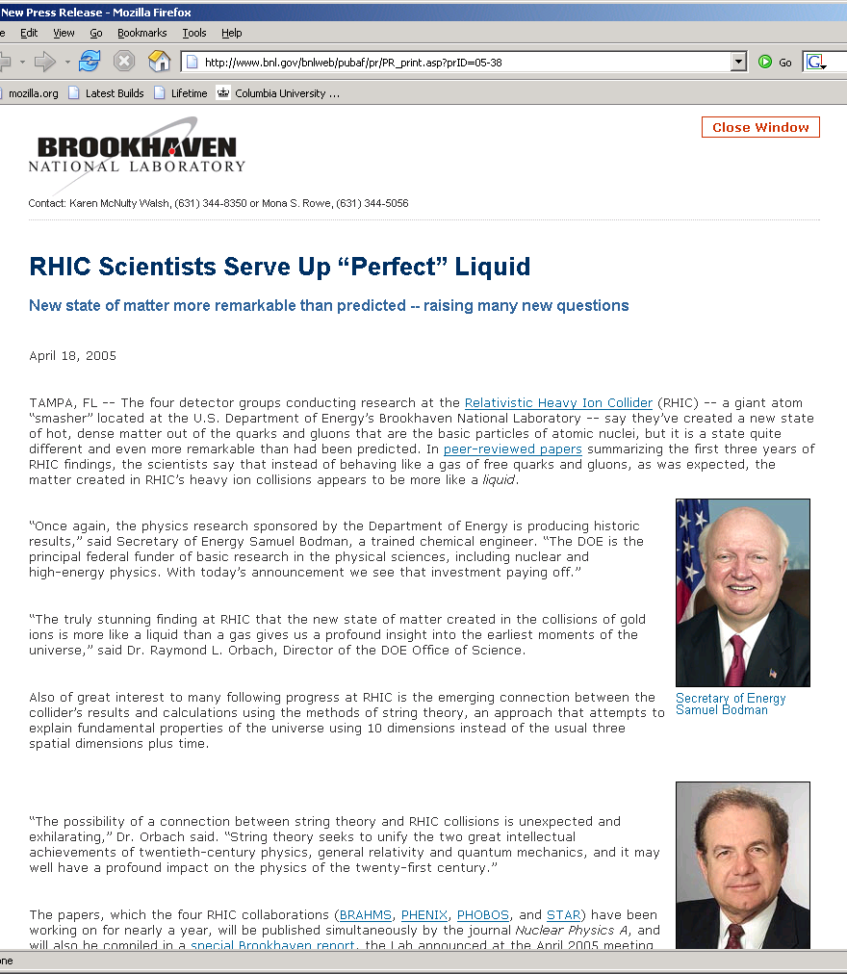
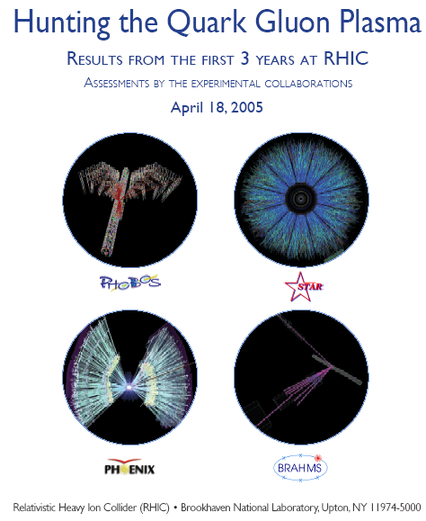
RHIC Success !!

Slide 49
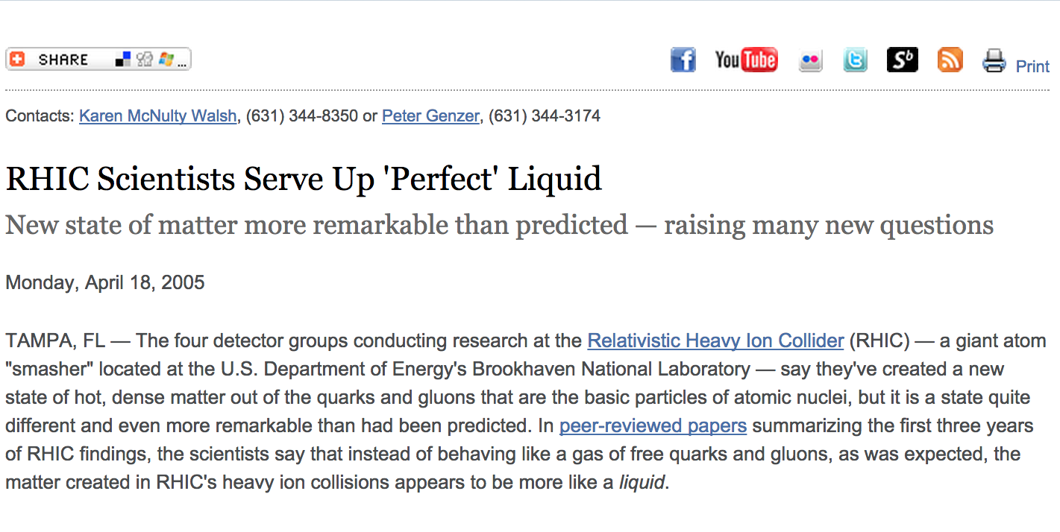
RHIC Scientists Serve Up ‘Perfect’ Liquid

Slide 50
An Unfortunate Affair - 2000 CERN Press Release
”Good” news (from the RHIC perspective): It did not directly claim discovery of the quark-gluon plasma.
Bad news:
Was not linked to publication of peer-reviewed findings.
Nonetheless stated
“the experiments on CERN's Heavy Ion programme presented compelling evidence for the existence of a new state of matter in which quarks, instead of being bound up into more complex particles such as protons and neutrons, are liberated to roam freely.”

Slide 51

Current Perspective - 2000 CERN Press Release
”Good” news (from the RHIC perspective): It did not directly claim discovery of the quark-gluon plasma.
Bad news:
Was not linked to publication of peer-reviewed findings.
Nonetheless stated
“the experiments on CERN's Heavy Ion programme presented compelling evidence for the existence of a new state of matter in which quarks, instead of being bound up into more complex particles such as protons and neutrons, are liberated to roam freely.”
An assessment of the insights gained from the heavy-ion program at the CERN SPS during the 1980s and 1990s [48] concluded that compelling evidence for the creation of “a new form of matter” had been found but stopped short of claiming unambiguous discovery of the quark-gluon plasma, nor did it comment on its perfectly liquid collective dynamical properties. The latter became only obvious after theory had progressed to a quantitative understanding of the bulk of the very comprehensive and precise experimental data collected at RHIC.

Slide 52
Since That Time . . .
The RHIC “perfect liquid” paradigm has prevailed.
The discoveries have continued to ``flow” from RHIC.
Quantitative precision has increased enormously.
Can now confidently attest to uniqueness of QGP.

Slide 53
It Is Only Appropriate . . .
To take a moment to offer our profound thanks to
The visionary leadership that made RHIC possible
The incredible operation of RHIC by the Collider-Accelerator Dept.
The superb skills of the BNL technical staff
The humbling efforts of our graduate students and postdocs
The theory community that has risen to the challenge from RHIC data
The organizers of this meeting.

Slide 54









Boulder Workshop Mar-05

Slide 55
VENUS ??

Slide 56

VENUS ??

Slide 57

Addressing the nature of QGP discovery
From the PHENIX “White Paper”
nucl-ex/0410003
(1958 citations)
Q: What is the most relevant “experimentally observed property”?
A. Viscosity (suitably normalized)

