Slide 1




Probing Dense Nuclear Matter: Connecting Neutron Stars and Heavy-Ion Collisions
Nanxi Yao
Annual RHIC & AGS Users' Meeting, May 20th, 2025
Notes:
Hello Everyone one, my name is Nanxi Yao and I am a 4th year graduate student from UIUC, today I am going to talk about probing dense nuclear matter: connecting neutron stars and heavy-ion collisions

Slide 2
Outline of the Talk
Introduction of Nuclear Equation of State (EOS)
Isospin-asymmetry Expansion of the Nuclear EOS from Chiral Effective Field Theory(CEFT)
Converting Neutron Star(NS) EOS to HIC using Symmetry Energy Expansion
Probing Dense Matter from pQCD
Notes:
I will first explain how my talk is organized as I plan to go over different perspectives on making connections between neutron stars and heavy ion collisions. I will first give a brief introduction about the nuclear equation of state. Then I will first talk about the isospin asymmetry expansion using chiral EFT. I will then spend most of the time talking about the symmetry energy expansion, which is my first phD project and I will explain in details how the conversion is done and how we can compare neutron star data directly with HIC observables. Lastly I will go over another way to make connections between neutron stars and HIC using pQCD.

Slide 3
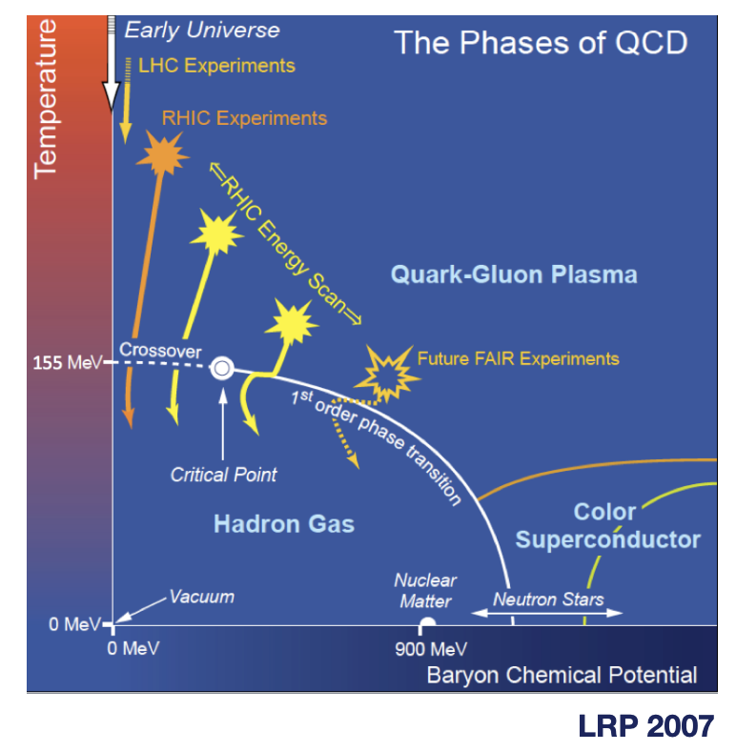
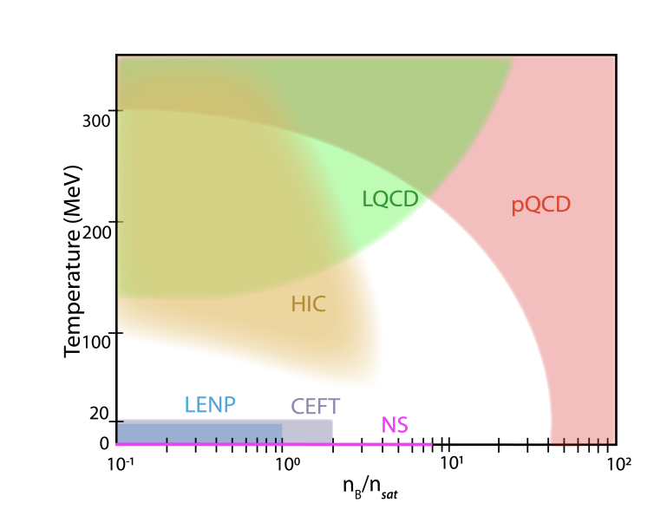
Phase Diagram of Nuclear Matter
Kumar et al. arXiv:2503.23413
Notes:
At high temperatures and low baryon densities, we usually use lattice QCD and they show that the transition from hadronic matter to quark-gluon plasma is a smooth crossover. This approach works well for temperatures above about 125 MeV, but it breaks down at large baryon densities due to what’s called the sign problem. At very high densities or chemical potentials, the strong force becomes weaker, and we can use analytic techniques. pQCD works at densities above ~40 times nuclear saturation density at zero temperature, and at temperatures above 300 MeV when the chemical potential is small.
In the low-density and low-temperature regime, we rely on chiral effective field theory (χEFT). This is a model-independent approach that systematically expands nuclear interactions based on QCD symmetries. It works well for densities up to about 2 times saturation density and temperatures below ~20 MeV. One of the advantages here is that we can estimate theoretical uncertainties from the order-by-order expansion.
Now, between these three regimes—lattice QCD, pQCD, and χEFT—there’s a big chunk of the QCD phase diagram that remains uncertain. This intermediate region is exactly where neutron star interiors, mergers, and heavy-ion collisions at intermediate energies lie. So, to constrain the equation of state in this gap, we rely heavily on experimental data from HICs and astrophysical observations, like neutron star masses, radii, and gravitational wave signals.

Slide 4
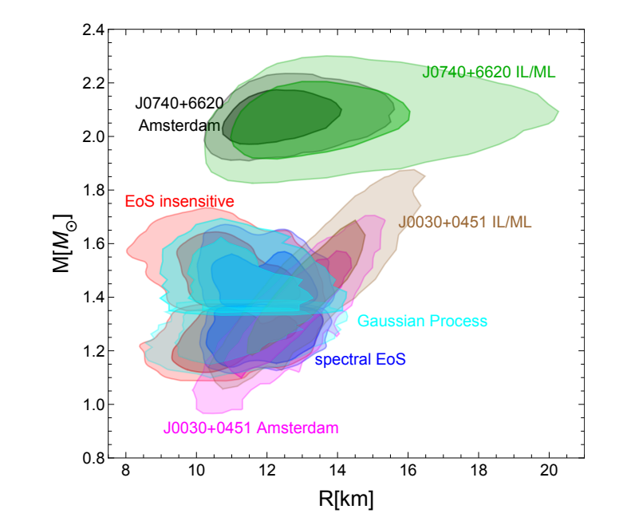
Nuclear Equation of State (EOS)
To describe the relationship between properties of nuclear matter (e.g. energy density, pressure) and quantifies the structure of different nuclear matter and the interactions
Constraining the EoS: Two regimes of reliability
Low Density (~nₛ to 2nₛ): Chiral Effective Theory (CET)
High Density (≥ 40nₛ): Perturbative QCD (pQCD)
M-R constraints on the right from T=0 NS EOS
MUSES Collaboration. Rajesh Kumar (Kent State U.) et al. 2303.17021.
Notes:
The equation of state—or EoS—describes how fundamental properties of nuclear matter, like energy density and pressure, are related. It has the information about the structure and interactions of matter under extreme conditions, such as those found in neutron stars and heavy-ion collisions. But we can’t calculate it from first principles in intermediate-density regime. And this is exactly where astrophysical observations of neutron stars become critical. Observables like mass-radius relations and tidal deformabilities at T = 0 provide constraints on the EoS in this intermediate regime. On the right hand side I am showing a MR constraint from T=0 NS EOS. This is a Bayesian analysis from different observations such as LIGO and NICER. For example, we have the regions with numbers next to it from NICER constraints. Shaded regions show the 68% and 95% confidence region.

Slide 5
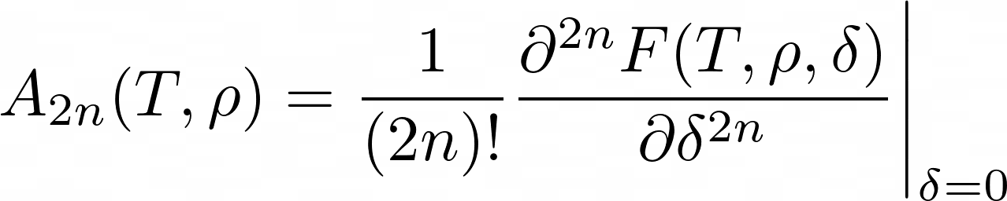
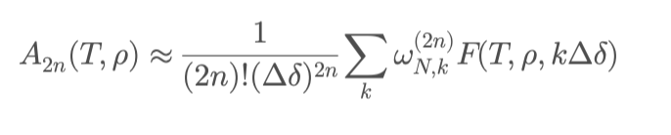
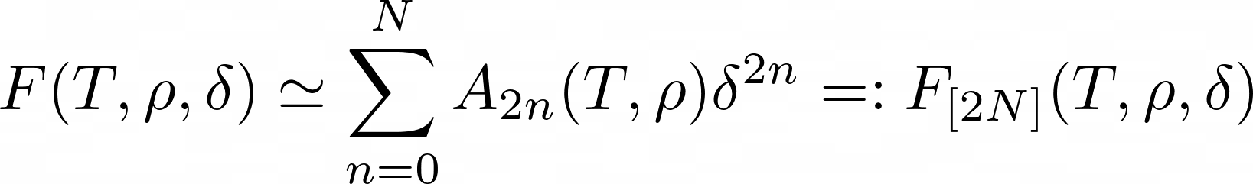

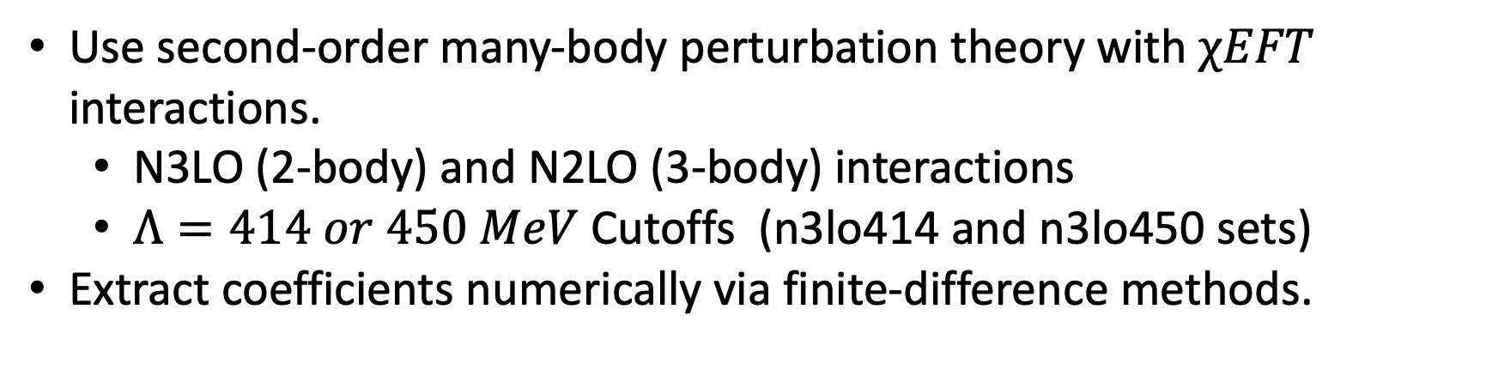
Isospin expansion of nuclear EOS with $χEFT$
C. Wellenhofer, J. W. Holt, N. Kaiser. Phys. Rev. C 93 (2016), 055802
Free energy per particle: F(T, ρ, δ), $δ={(ρ}_{n}−ρ_{p})/ρ$
Use second-order many-body perturbation theory with $χEFT$ interactions.
N3LO (2-body) and N2LO (3-body) interactions
$Λ=414 or 450 MeV$Cutoffs (n3lo414 and n3lo450 sets)
Extract coefficients numerically via finite-difference methods.
Notes:
So first I will start with the framework done by Wellenhofer, holt and Kaiser that is used to describe the EOS of nuclear matter with isospin asymmetry. We define the free energy per particle F(T, \rho, \delta), where \delta = (\rho_n - \rho_p)/\rho is the isospin asymmetry. Assuming charge symmetry, we expand F in even powers of \delta — which is the Maclaurin expansion. Each coefficient A_{2n}(T, \rho) is directly related how sensitive the EoS is to isospin asymmetry at a given order. These are extracted numerically using finite-difference methods. We use chiral EFT interactions at N3LO for 2-body and N2LO for 3-body forces, with two cutoff choices — 414 and 450 MeV to calculate the free energy and use the finite difference approximation to calculate the coefficients.

Slide 6
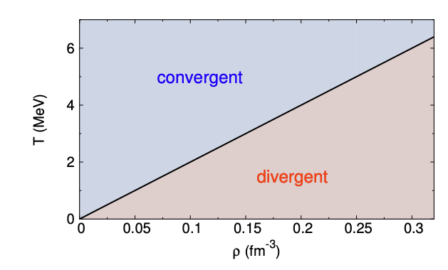
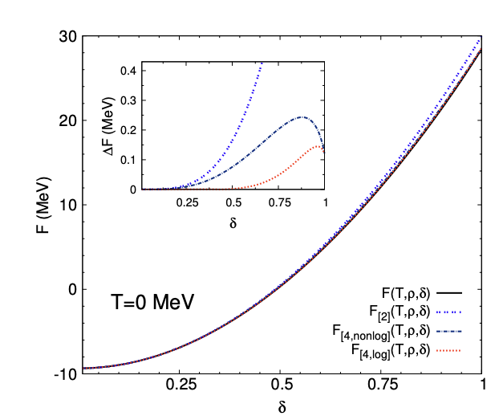
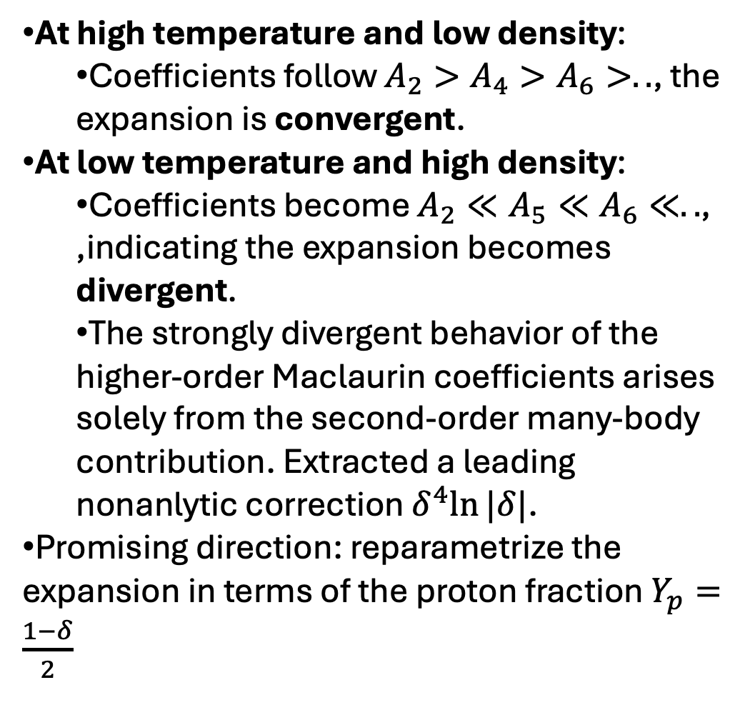
C. Wellenhofer, J. W. Holt, N. Kaiser. Phys. Rev. C 93 (2016), 055802
At high temperature and low density:
Coefficients follow $A_{2}>A_{4}>A_{6}>..$, the expansion is convergent.
At low temperature and high density:
Coefficients become $A_{2}≪A_{5}≪A_{6}≪..$, ,indicating the expansion becomes divergent.
The strongly divergent behavior of the higher-order Maclaurin coefficients arises solely from the second-order many-body contribution. Extracted a leading nonanlytic correction $δ^{4}ln⁡|δ|$.
Promising direction: reparametrize the expansion in terms of the proton fraction $Y_{p}=\frac{1−δ}{2}$
Notes:
Next, let’s take a closer look at how this expansion behaves across the phase diagram. At high temperatures and low densities, the Maclaurin expansion converges nicely. The coefficients are hierarchically ordered — A_2 > A_4 > A. But as we move into the low-temperature, high-density regime, relevant for neutron stars, the expansion breaks down. At T=0, in the neutron-proton (np) channel, higher-order coefficients like A_4 and A_6 diverge due to a logarithmic singularity which is proportional to the delta^4 ln delta. The author also emphasizes that this term is intrinsic to the physics of the many body theory as they tried to test out the structure of divergences.
What does this mean for our modeling strategies? In high-temperature environments, such as supernovae or the early stages of heavy-ion collisions, it’s more accurate to calculate the noninteracting contribution exactly, and apply polynomial expansions only to the interacting terms. For neutron stars where we have low temperature and high density, even though we do not have a convergent expansion, we can include the nonanalytical term, the log delta explicity to improve the description of NS. So one possible way to connect NS to HIC, in my own understanding, is that, NS can provide constraints in the high density region to at least A_2 where it is directly related to the symmetry energy. And the coefficients are directly related to HIC observables.
And finally, there’s a promising direction being explored now — including in my current work — which is to reparametrize the expansion in terms of the proton fraction, Y_p = \frac{1 - \delta}{2}. This could offer improved convergence and greater physical transparency in neutron-rich systems.

Slide 7
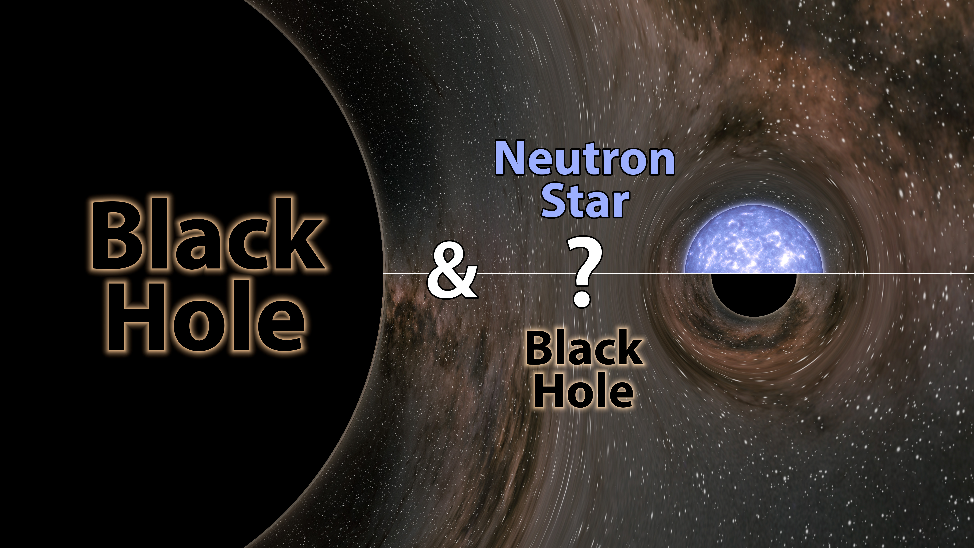
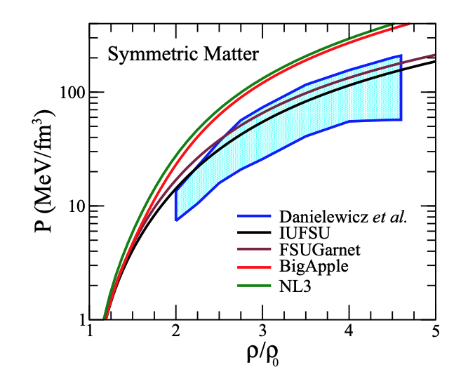
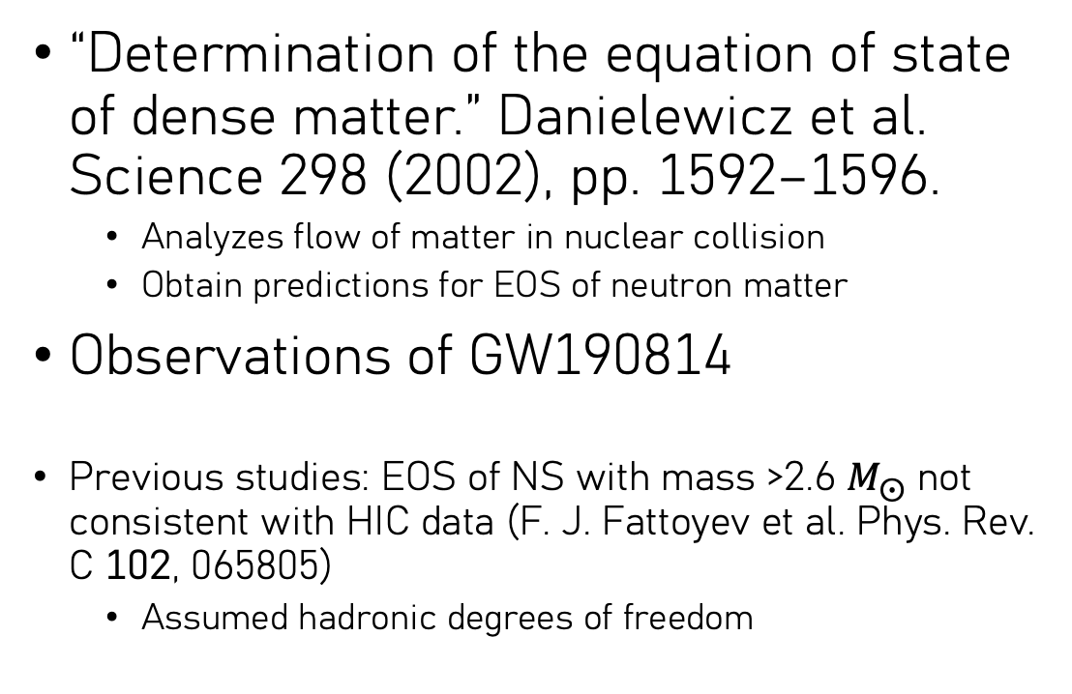
Is NS compatible with HIC data?
“Determination of the equation of state of dense matter.” Danielewicz et al. Science 298 (2002), pp. 1592–1596.
Analyzes flow of matter in nuclear collision
Obtain predictions for EOS of neutron matter
Observations of GW190814
Previous studies: EOS of NS with mass >2.6 $M_{⨀}$ not consistent with HIC data (F. J. Fattoyev et al. Phys. Rev. C 102, 065805)
Assumed hadronic degrees of freedom
Notes:
So my first project is to figure out a systemetic method to directly compare NS with HIC. In order to do that, we first thought of the famous paper where they extract the flow of matter in nuclear collisions to constrain the neutron star equation of state. So we want to do the opposite, where we can somehow use NS eos to constrain the HIC collisions because we nowadays have more data from gravitational wave detectors. Especially the observation of GW190814 shows a binary merger where one of them has mass of 2.6 times the solar mass and we don’t know if it’s a black hold or a neutron star. But if it were a neutron star, it would be the heaviest ever known. Here has been a.previous study on this and they concluded that neutron star with mass larger than 2.6 times the solar mass is actually not compatible with HIC data. However, the NS eos they were considering only has hadronic degrees of l . Recently there have been constraints from NS observations such that in order to have a heavy neutron star, we need a large rapid rise in the speed of sound. So in our case, we would like to investigate if a NS EOS with a large bump at the speed of sound is compatible with heavy-ion collision data.

Slide 8
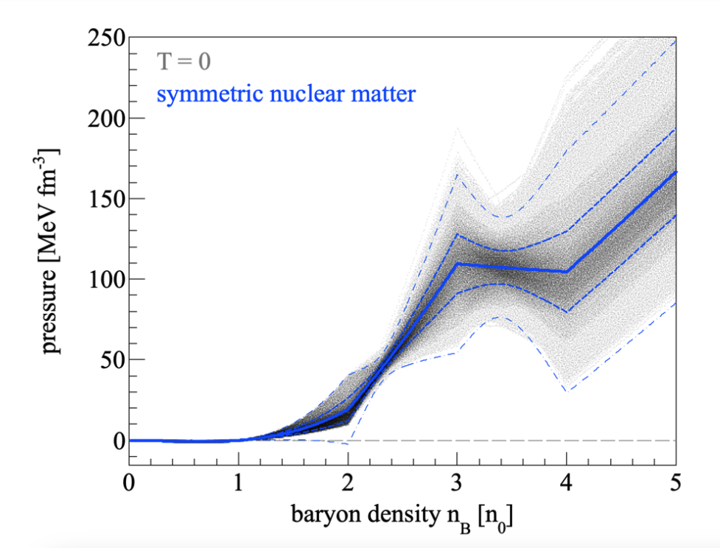
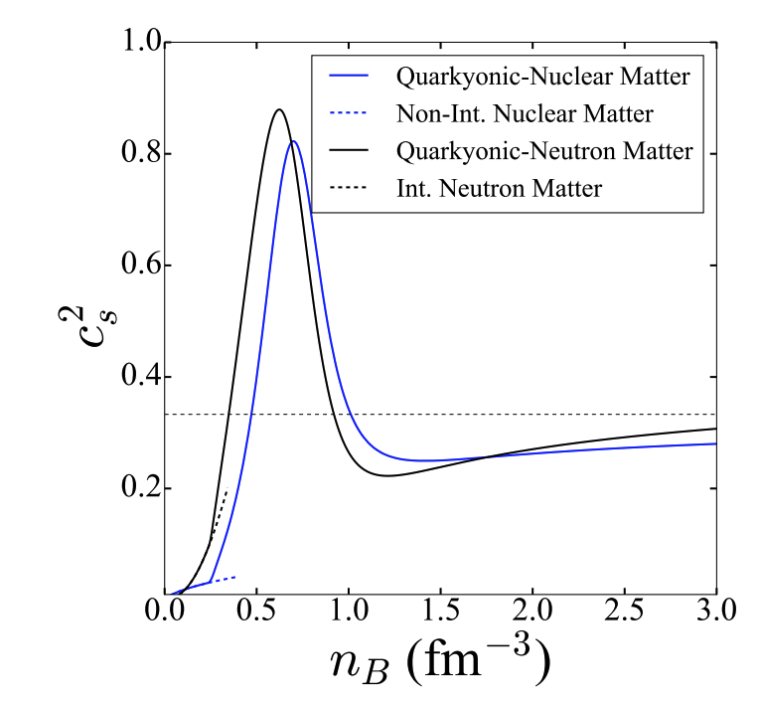
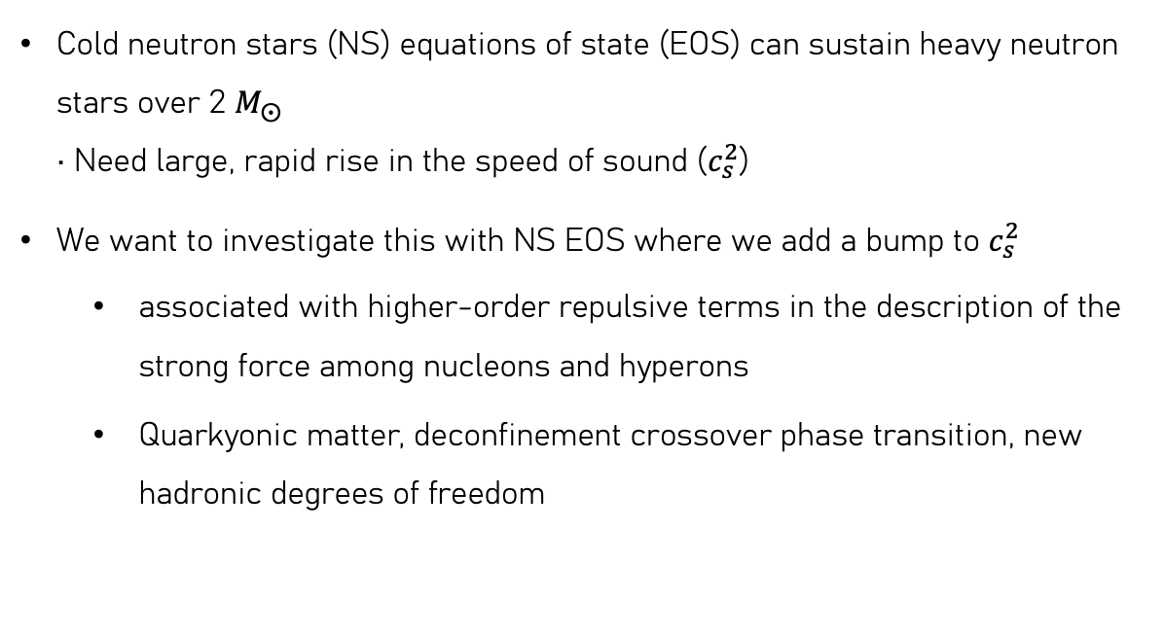
Is NS compatible with HIC data?
D. Oliinychenko, A. Sorensen, V. Koch, and L. McLerran, Phys. Rev. C 108, 034908 (2023)
Cold neutron stars (NS) equations of state (EOS) can sustain heavy neutron stars over 2 $M_{⨀}$ • Need large, rapid rise in the speed of sound ($c_{s}^{2}$)
We want to investigate this with NS EOS where we add a bump to $c_{s}^{2}$
associated with higher-order repulsive terms in the description of the strong force among nucleons and hyperons
Quarkyonic matter, deconfinement crossover phase transition, new hadronic degrees of freedom
L. McLerran and S. Reddy, Phys. Rev. Lett. 122, 122701 (2019)
Notes:
We were able to make the connection to an EOS with a large bump at the cs2 as we saw on the right, this is a bayesian analysis done by olinchenko and Sorensen, that recent flow data from the STAR experiment at the center-of-mass energies √ sNN = {3.0, 4.5} GeV indicates a hard equation of state at nB ∈ (2, 3)n0. also, a bump at the speed of sound might be from quarkyonic matter, as shown in the lower right. Also from the neutron star side we were able to construct this kind of EOS which passes all the MR and tidal deformalbillity constraints from neutron star and it susbtain a really heavy mass.

Slide 9
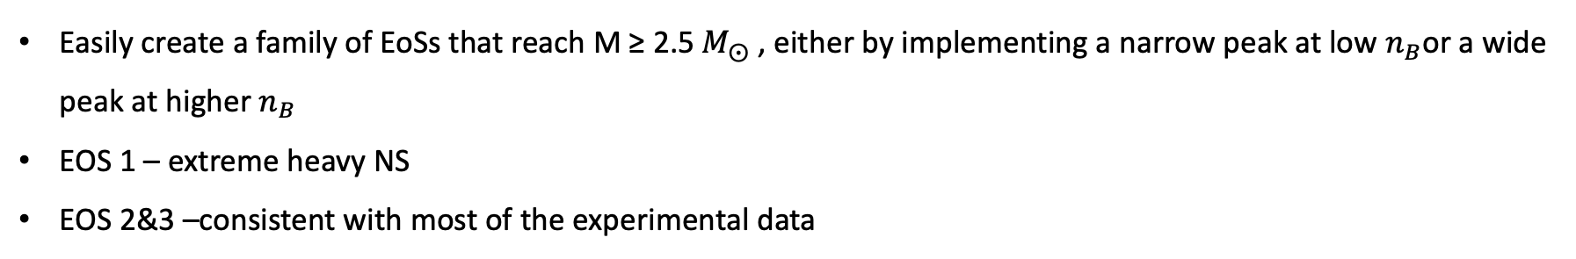
Neutron Star EOS of Interest
Easily create a family of EoSs that reach M ≥ 2.5 $M_{⨀}$ , either by implementing a narrow peak at low $n_{B}$or a wide peak at higher $n_{B}$
EOS 1 – extreme heavy NS
EOS 2&3 –consistent with most of the experimental data
H. Tan, J. Noronha-Hostler, and N. Yunes, Phys. Rev. Lett. 125, 261104 (2020)
Notes:
The NS equation of state is artificially constructed, but it passes all the astrophysical constrains and we also have several nuclear physics motivations for such neutron star eos. A steep rise in the speed of sond can be associated with higher-order repulsive terms in the description of the strong force and it could be quarkyonic matter, deconfinment crossover phase transition, or new hadronic degrees of freedom. We are also able to generate really heavy neutron stars with this kind of EOS, by adjusting the position and width of the peak. So We picked two EOS, the blue one has more extreme features as it indicates ultra-heavy NS, and it has a bump at lower density whereas the EOS2 is a more regular EOS passing most of the experimental data regions.
Choose purple – goes through all experimental data regions blue – more extreme
Physics motivation for the bump – quarkyonic matter – read nico paper

Slide 10
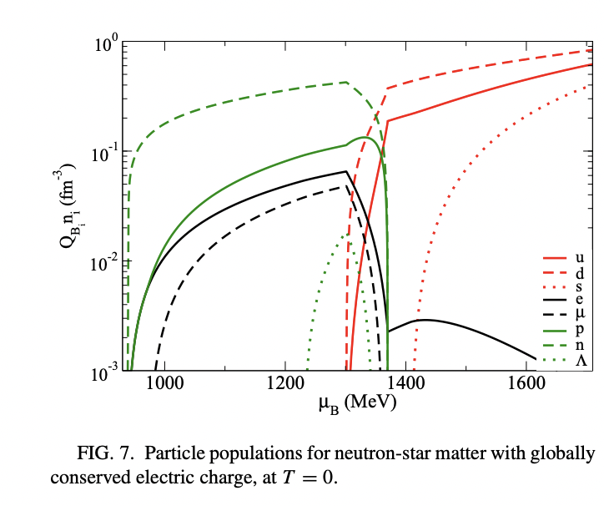
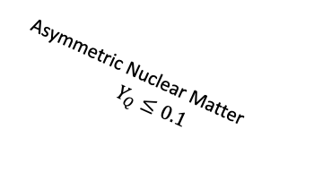
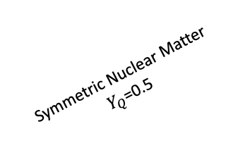

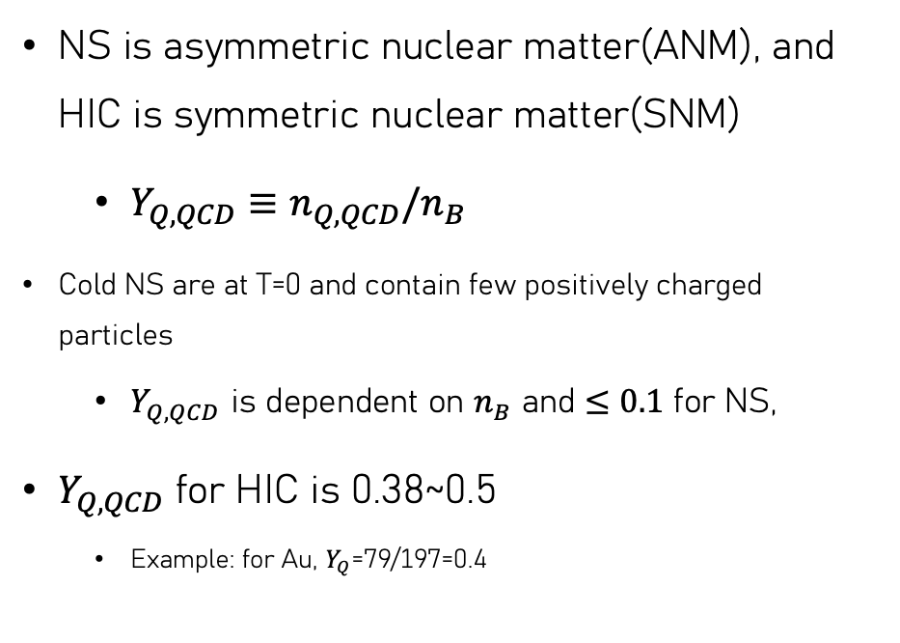
HIC vs Neutron Star
Pure Neutron Matter
$Y_{Q}$=0
Asymmetric Nuclear Matter
$$Y_{Q}≤0.1$$
NS is asymmetric nuclear matter(ANM), and HIC is symmetric nuclear matter(SNM)
$Y_{Q,QCD}≡n_{Q,QCD}/n_{B}$
Cold NS are at T=0 and contain few positively charged particles
$Y_{Q,QCD}$ is dependent on $n_{B}$ and $≤0.1$ for NS,
$Y_{Q,QCD}$ for HIC is 0.38~0.5
Example: for Au, $Y_{Q}$=79/197=0.4
J. Roark and V. Dexheimer. PRC 98 (2018).
Symmetric Nuclear Matter
$Y_{Q}$=0.5
Notes:
For neutron star EOS, we have the charge fraction less then 0.2, which is defined as the ratio between protons and nucleons. For symmetric matter we would have yq = 0.5, but for HIC we would have yq around 0.39 on average, for example for gold gold collision we have yq roughly at 0.4. Here I can see that the scale of YQ for ns is below 0.2. We are going to convert the NS eos to hic es using the charge fraction and symmetry energy expansion.

Slide 11
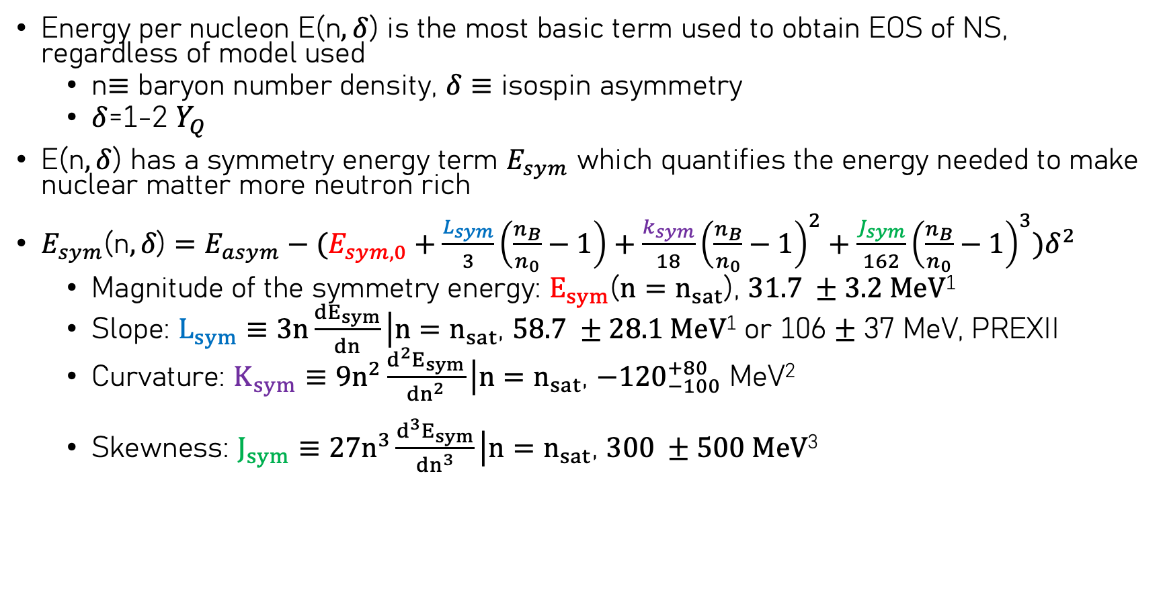
Symmetry Energy Expansion
Energy per nucleon E(n$, δ$) is the most basic term used to obtain EOS of NS, regardless of model used
n$≡$ baryon number density, $δ≡$ isospin asymmetry
$δ$=1-2 $Y_{Q}$
E(n$, δ$) has a symmetry energy term $E_{sym}$ which quantifies the energy needed to make nuclear matter more neutron rich
${E_{sym}\text{(}\text{n}, δ\text{)}=E_{asym}−(E}_{sym,0}+\frac{L_{sym}}{3}\left(\frac{n_{B}}{n_{0}}−1\right)+\frac{k_{sym}}{18}{\left(\frac{n_{B}}{n_{0}}−1\right)}^{2}+\frac{J_{sym}}{162}{\left(\frac{n_{B}}{n_{0}}−1\right)}^{3})δ^{2}$
Magnitude of the symmetry energy: $E_{sym}$(${n=n}_{sat}$), $31.7 ±3.2 MeV$¹
Slope: $L_{sym}$ $≡3n\frac{dE_{sym}}{dn}\left|{n=n}_{sat}\right.$, $58.7 ±28.1 MeV$¹ or 106 $±$ 37 MeV, PREXII
Curvature: $K_{sym}$ $≡9n^{2}\frac{d^{2}E_{sym}}{dn^{2}}\left|{n=n}_{sat}\right.$, ${−120}_{−100}^{+80}$ MeV²
Skewness: $J_{sym}$ $≡27n^{3}\frac{d^{3}E_{sym}}{dn^{3}}\left|{n=n}_{sat}\right.$, $300 ±500 MeV$³
¹M. Oertel et al. Rev. Mod. Phys. 89, 015007 (2017)
²W.-J. Xie et al, Astrophys. J. 899, 4 (2020)
³I, TEWS et al. Astrophys. J. 848, 105 (2017)
Notes:
We can define the difference between the energy per nucleon of NS and of HIC by the symmetry energy and isospin asymmetry delta. Delta can be expressed by the charge fraction. The coefficient of the 2nd order term can be taylor expanded, which is the symmetry energy expansion. The Esym 0 is the magnitude of the symmetry energy at saturation density, and its 31.7 MeV plus minus 3.2 MeV. The slope is Lsym which takes value at 58.7 plus 28.6 MeV or according to PreX2 106 plus minus 37 MeV. The higher order coefficients are poorly known so we have a much larger range for the curvature K sym and skewness J sym.

Slide 12

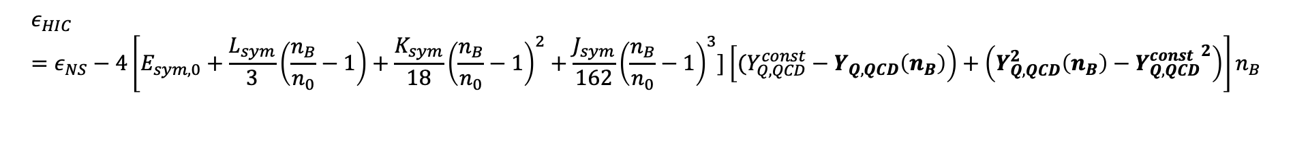
Nuclear Symmetry Energy Expansion
For HIC, we do not have perfectly symmetry nuclear matter
$Y_{Q, HIC}=0.39$
Thus, we obtain the asymmetric energy density for HIC from symmetric energy density through a double expansion:
$$ε_{HIC}=ε_{NS}−4\left[E_{sym,0}+\frac{L_{sym}}{3}\left(\frac{n_{B}}{n_{0}}−1\right)+\frac{K_{sym}}{18}{\left(\frac{n_{B}}{n_{0}}−1\right)}^{2}+\frac{J_{sym}}{162}{\left(\frac{n_{B}}{n_{0}}−1\right)}^{3}]\left[(Y_{Q,QCD}^{const}−Y_{Q,QCD}\left(n_{B}\right)\right)+\left(Y_{Q,QCD}^{2}\left(n_{B}\right)−{Y_{Q,QCD}^{const}}^{2}\right)\right]n_{B}$$
Notes:
With the symmetry energy expansion we are going to do a double expansion , as we first expand from the NS to symmetry matter and then to HIC as we do not have perfectly symmetric nuclear matter. After some algebra we would have the conversion dependent on the symmetry energy expansion and on two charge fraction, for which the YQ is the density dependent charge fraction for NS and the YHIC is the charge fraction for HIC and we are also going to vary this term to see how the EOS varies.

Slide 13
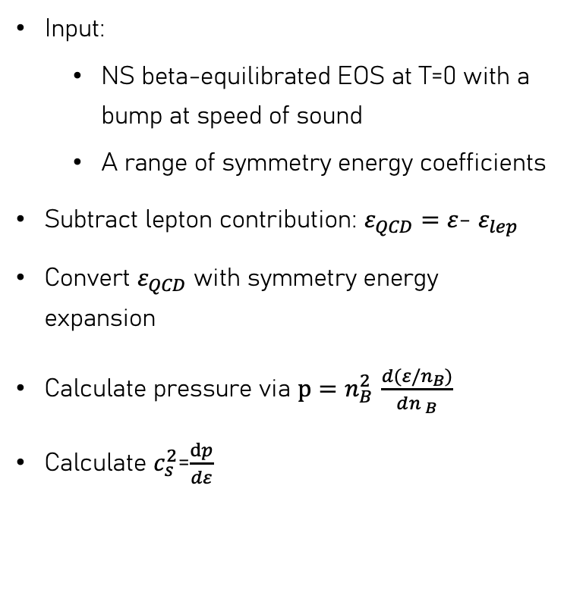
Conversion Process
Phys. Rev. C 109, 065803
Input:
NS beta-equilibrated EOS at T=0 with a bump at speed of sound
A range of symmetry energy coefficients
Subtract lepton contribution: $ε_{QCD}=ε$- $ε_{lep}$
Convert $ε_{QCD}$ with symmetry energy expansion
Calculate pressure via $p=n_{B }^{2}\frac{d(ε/n_{B})}{d{n }_{B}}$
Calculate $c_{s}^{2}$=$\frac{dp}{dε}$
Notes:
Here I am going to talk about the entire conversion process. Since in HIC we only care about the QCD degrees of freedom, we need to subtract the leptons from the energy density of NS because we assume there are electrons existing. We can approximate the lepton contributions can be described by a non-interacting quantum gas so we use with free fermi gas to calculate the contribution. Then we have a range of symmetry energy coefficients to see how the final cs2 look like.
We just use thermodynamic relations to get the pressure and speed of sound.
talk about lepton contribution: we only care about QCD degrees of freedom when converting into HIC EOS, so subtract the lepton contributions. We did proof-of-principle in the paper

Slide 14
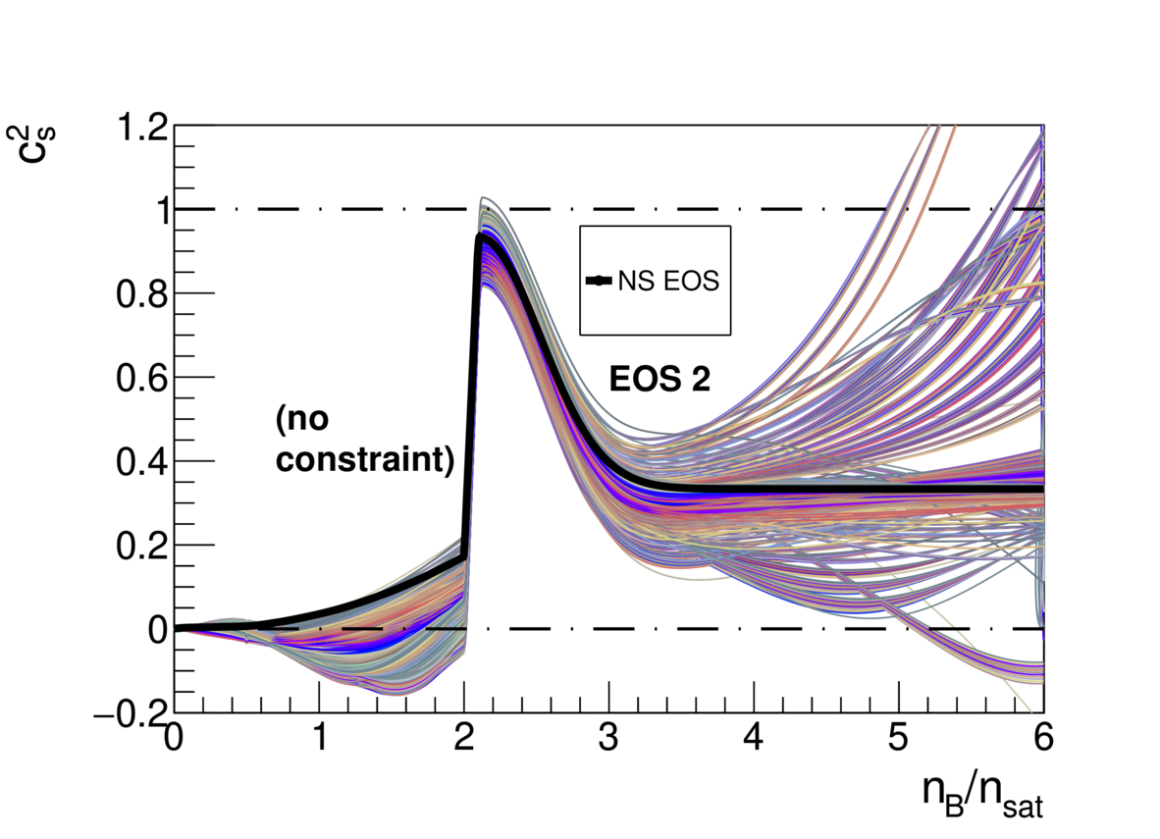
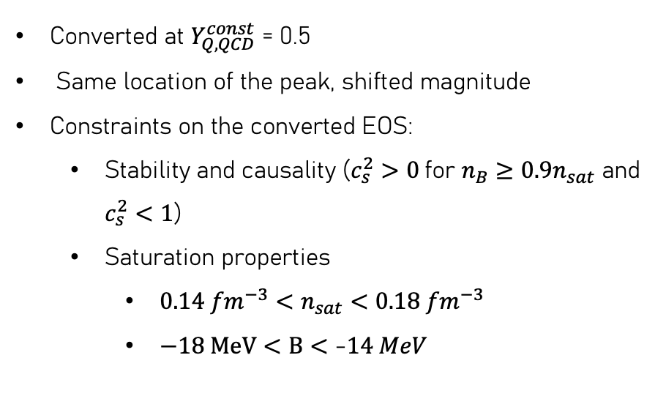
Converted EOS Band
Phys. Rev. C 109, 065803
Converted at $Y_{Q,QCD}^{const}$ = 0.5
Same location of the peak, shifted magnitude
Constraints on the converted EOS:
Stability and causality ($c_{s}^{2}>0$for $n_{B}≥0.9n_{sat}$ and $c_{s}^{2}<1$)
Saturation properties
${0.14 {fm}^{−3}<n}_{sat}<$ $0.18 {fm}^{−3}$
$−18 MeV<B<$ -$14 MeV$
Notes:
So because we input a bunch of different symmetry energy coefficients, we get a band of converted cs2.
What I am showing here are EOSs that have passed my constraints. So I make sure the converted EOSs are causal so it’s larger than 0 and smaller than 1. Also, I check the saturation properties. The new saturation density where I defined to be where pressure becomes positive from negative has to be within the range of 0.14 and 0.18. Also, the binding energy has to be larger than -18 and smaller than -14.
We can see that we have the peak at the same location but we do see a shift in magnitude of the bump. We also see that following the bump, we get a wide range of different EOS as we are moving further from the expansion point which is the nuclear saturation density.
Show without constraints
Back-up slides for saturation properties

Slide 15
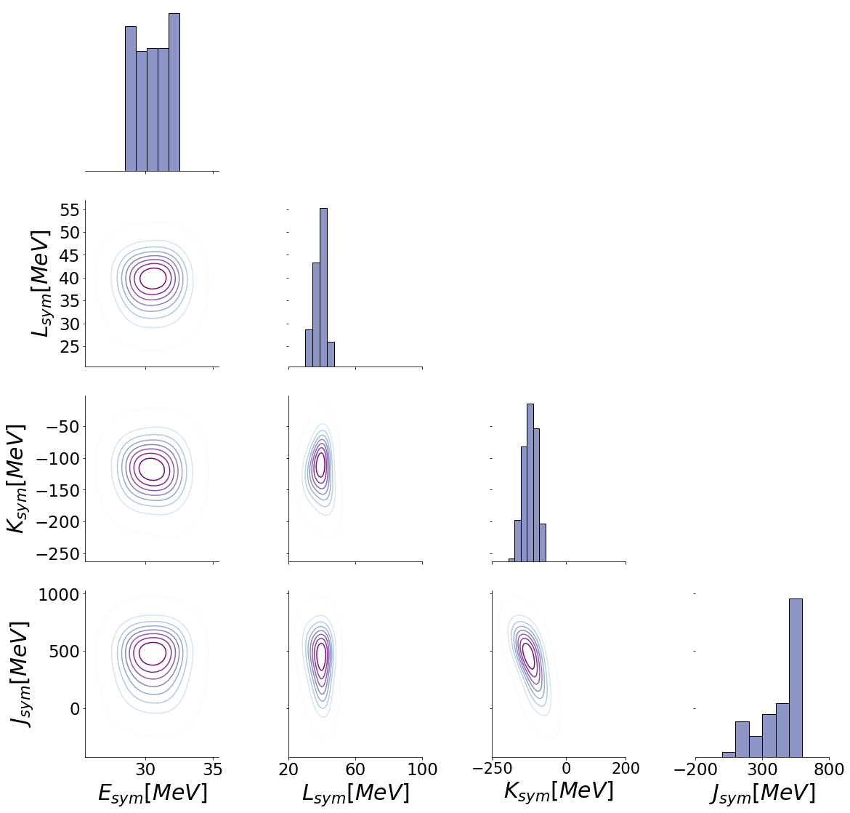
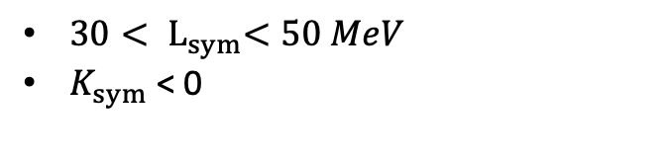
Symmetry Energy Coefficients
Phys. Rev. C 109, 065803
$30{< L}_{sym}<50 MeV$
$K_{sym}$ < 0
Notes:
By eliminating some of the EOSs that didn’t pass my constarints, we are able to constrain the symmetry energy as well. So we see that for Esym, there isn’t much difference between the proposed range and the posterior. But for Lsym, there is a strong preference for Lsym to be from 30 to 50, and ksym is preferred to be negative, and Jsym is preferred to have a larger value but it still has a large range of values.
Consider this as a back-up?

Slide 16
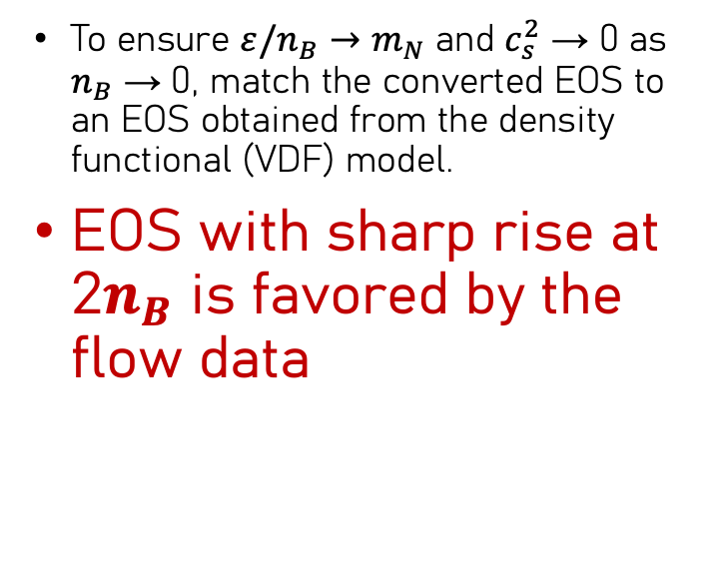
Comparison with HIC experimental data
Phys. Rev. C 109, 065803
To ensure $ε/n_{B}→m_{N}$ and $c_{s}^{2}$ → 0 as $n_{B}$ → 0, match the converted EOS to an EOS obtained from the density functional (VDF) model.
EOS with sharp rise at 2$n_{B}$ is favored by the flow data
Notes:
So after I converted the EOS, I sent the converted EOS to my collaborator Agnieszka at INT who runs hadronic transport code SMASH. Before I send my EOS to her, I matched my EOS with an EOS from the VDF model to make sure that we have reasonbe low density behavior such that ….
Because the parametrized EOS which serves as the input to SMASH is construted from the low density and it’s very important to have the right behavior at low density and it’s not affecting what we have at higher density where the bump appears.
So she put the maximum and minimum of the bands we obtained as input to SMASH, and we obtain the flow data and we see that EOS2 where we have the bump at middle density is actually favored by the flow data. The eos2 minimum band matches with the experimental data points. So in conclusion, we do find the NS EOS with a large peat at 2n0 is compatible with the HIC data.
However, we have to note that the SMASH simulation does not implement momentum implemented potentials so we might have a smaller elliptic flow.
the slope of the directed flow
Here, however, the used EOSs have been shown to not only describe heavy-ion measurements, but also satisfy all constraints from neutron star observations as well as support extremely heavy neutron stars. Thus our results show that NS EOS with large peaks in the speed of sound can be compatible with EOS extracted from heavy-ion data as long as the simulation framework used for that extraction allows for similarly nontrivial behavior of the EOS with density.
Talk about SMASH
Talk about flow
Fixed-target

Slide 17
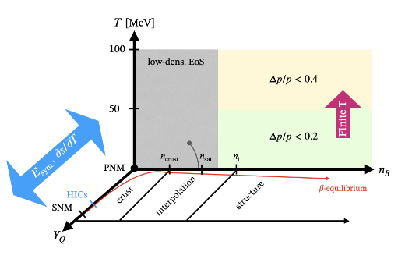
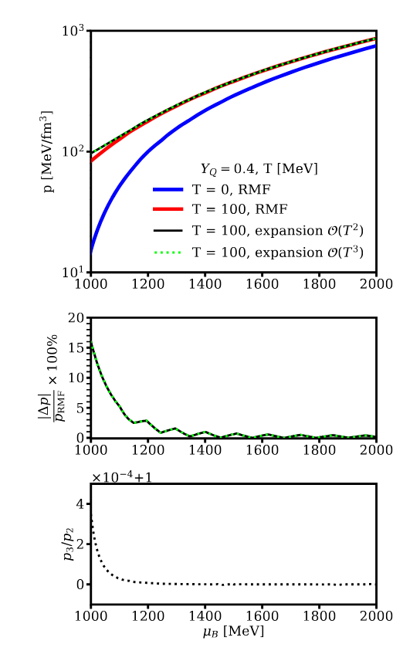
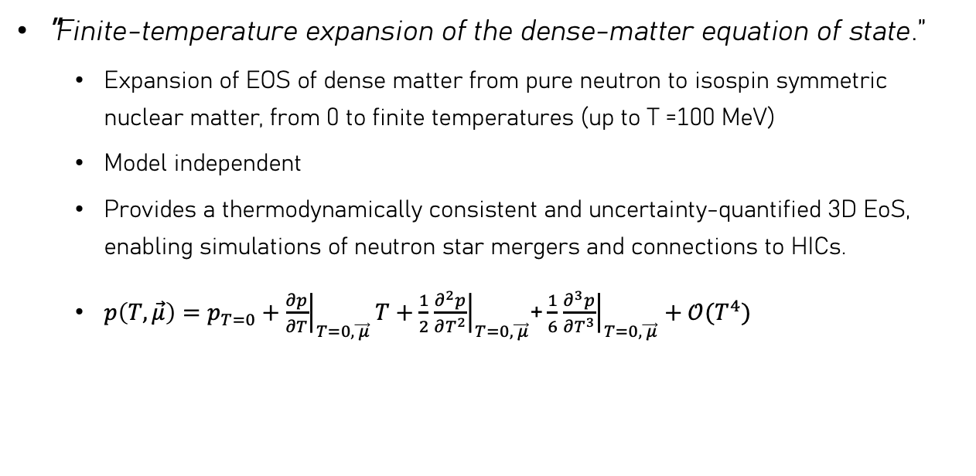
Temperature Expansion?
Mroczek et al.arXiv:2404.01658.
"Finite-temperature expansion of the dense-matter equation of state.”
Expansion of EOS of dense matter from pure neutron to isospin symmetric nuclear matter, from 0 to finite temperatures (up to T =100 MeV)
Model independent
Provides a thermodynamically consistent and uncertainty-quantified 3D EoS, enabling simulations of neutron star mergers and connections to HICs.
$p\left(T,\vec{μ}\right)=p_{T=0}+{\left.\frac{∂p}{∂T}\right|}_{T=0,\vec{ μ}}T+\frac{1}{2}$ ${\left.\frac{∂^{2}p}{∂T^{2}}\right|}_{T=0,\vec{ μ}}$+ $\frac{1}{6}$ ${\left.\frac{∂^{3}p}{∂T^{3}}\right|}_{T=0,\vec{ μ}}+𝒪(T^{4})$
Notes:
In addition to doing the symmetry energy expansion, we are currently working on a 3D expansion where we extend in the temperature dimension. Our main tool is a power series expansion in the ratio T over mu_B, which behaves well near zero temperature and enables consistent thermodynamic extrapolation.
We found that just a single non-zero term in this expansion beyond the zero-temperature EoS can reproduce the pressure up to 100 MeV in temperature for high enough baryon chemical potentials. This makes the framework not only accurate but also computationally efficient.
This framework is model-independent but here we are using a relativistic mean field model to do a sanity check and we quantified the uncertainties involved. We are planning to have an opensource code in the future, and this can provide us a themodynamically consistent and well-controlled 3D EOS of the nuclear matter where we can use for neutron star mergers in numerical relativity simulations and possibly make connections to HICs as well.

Slide 18
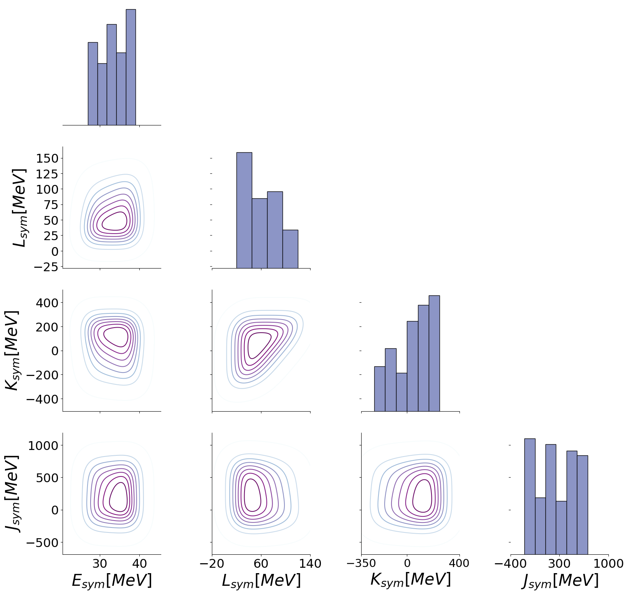
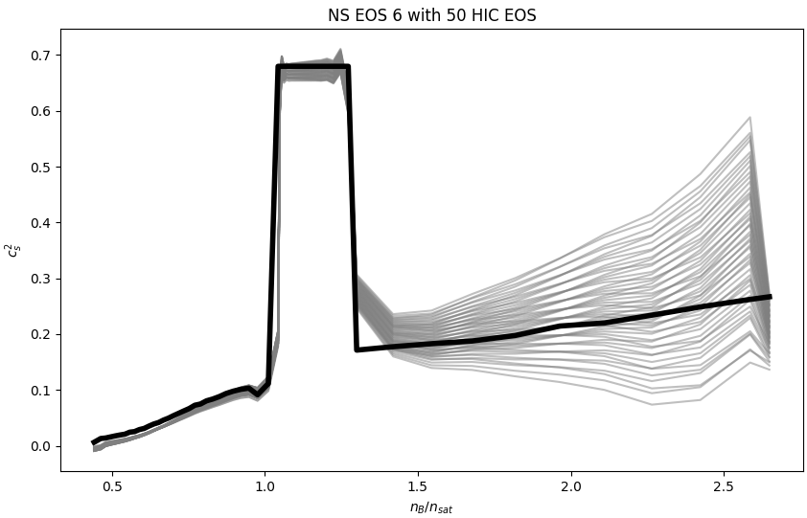
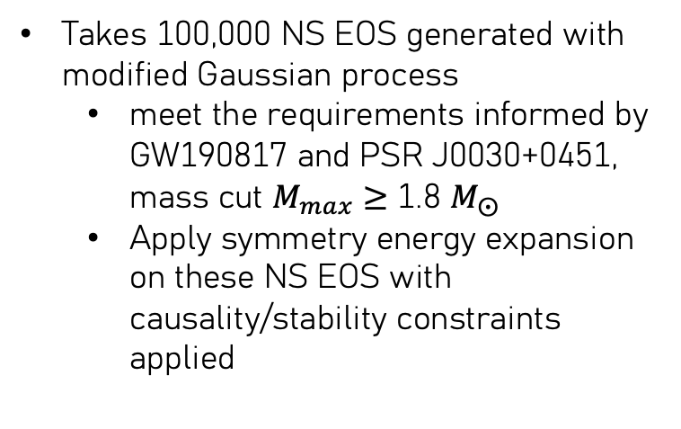
Coupled with EOS from Modified Gaussian Process(In Progress)
Takes 100,000 NS EOS generated with modified Gaussian process
meet the requirements informed by GW190817 and PSR J0030+0451, mass cut $M_{max}$ ≥ 1.8 $M_{⨀}$
Apply symmetry energy expansion on these NS EOS with causality/stability constraints applied
Notes:
Another project I am currently working on based on the symmetry energy expansion is that we are gonna take a bunch of NS EOS from modified Gaussian processes with prior constraints from the astrophysics, and we are going to do a Bayesian analysis to get a posterior on symmetry energy coefficients using the symmetry energy expansion we just talked about. So we will have a posterior that’s based on both astrophysics, saturation property and causality/stability constraints.

Slide 19
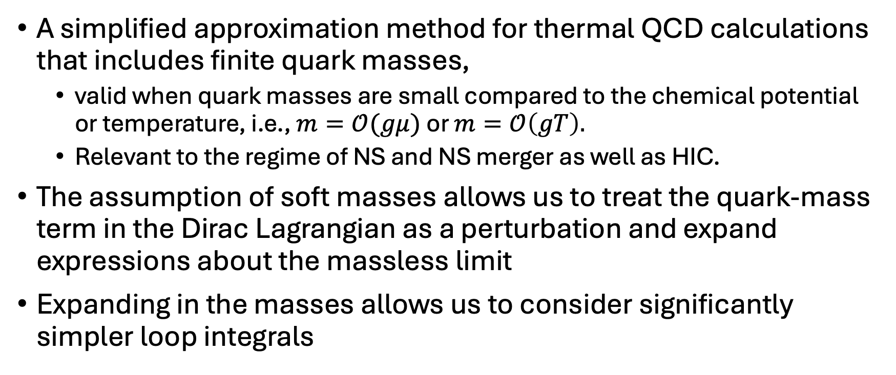
Probe Dense Nuclear Matter Using pQCD with Soft Quark Masses
T. Gorda and S. Säppi. Phys. Rev. D 105, 114005
A simplified approximation method for thermal QCD calculations that includes finite quark masses,
valid when quark masses are small compared to the chemical potential or temperature, i.e., $m=𝒪(gμ)$ or $m=𝒪\left(gT\right).$
Relevant to the regime of NS and NS merger as well as HIC.
The assumption of soft masses allows us to treat the quark-mass term in the Dirac Lagrangian as a perturbation and expand expressions about the massless limit
Expanding in the masses allows us to consider significantly simpler loop integrals
Notes:
And lastly I will briefly talk about possible directions to probe dense nuclear matter using pQCD. So pQCD is theoretically valid at very high temperatures and/or chemical potentials due to asymptotic freedom (small coupling). However, most previous pQCD calculations neglect quark masses, especially those of the lightest three quarks (up, down, strange), assuming they are negligible.
While that assumption works well at high energies, in astrophysical contexts like neutron stars or their mergers, where matter is cold but dense, the strange quark mass becomes non-negligible—especially when imposing β-equilibrium and charge neutrality.
The problem is that including quark masses in full generality in pQCD is very complicated: the resulting integrals are messy, numerically intensive, and hard to use . In the work by Gorda and Sappi, they introduce a simplifying expansion scheme, valid when the quark masses (especially m_s) are of the same order as g\mu or gT. This is true for most practical cases where pQCD is used.
Instead of performing full massive loop calculations, they expand the pressure in powers of the quark masses, treating mass terms as a perturbation around the massless case.
This gives semi-analytic, closed-form expressions up to order g^5, which are much easier to implement, evaluate, and include in practical models like neutron star merger simulations or high-temperature QCD studies.

Slide 20
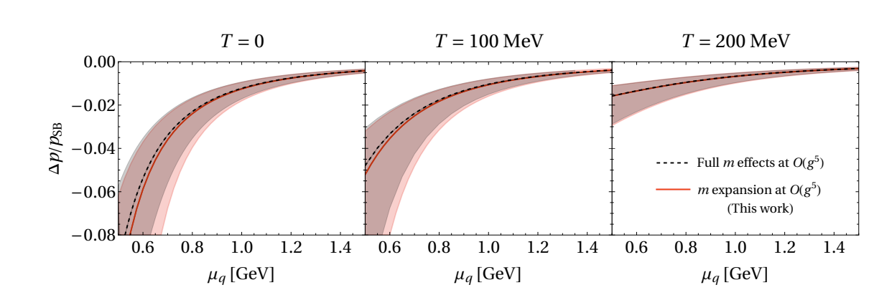
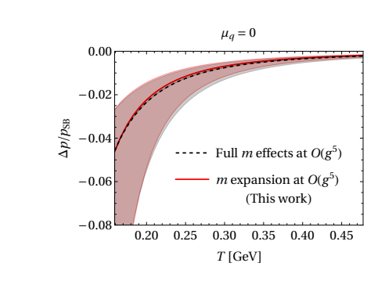
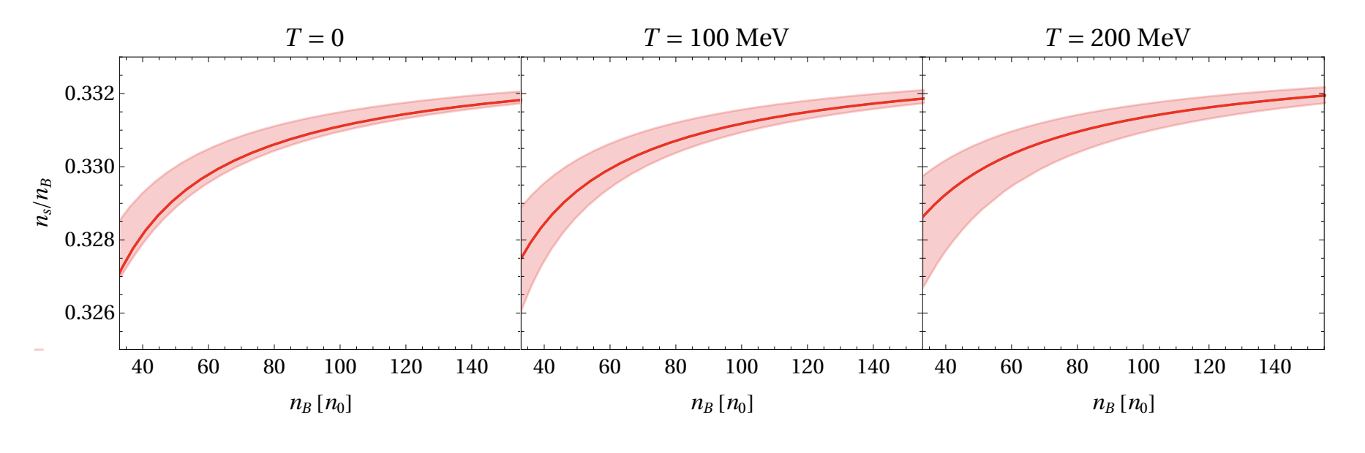
T. Gorda and S. Säppi. Phys. Rev. D 105, 114005
For hot quark-gluon-plasma:
Notes:
These plots show that this approach agrees remarkably well with full numerical evaluations that has full quark-mass dependence. For both cold dense matter and hot quark-gluon plasma, the difference in pressure remains below 2–3% even at extreme values of chemical potential or temperature. the shaded regions show the renormalization-scale variation. This confirms that the soft-mass approximation is a controlled expansion and highly useful in practice.
Also, on the bottom right, you can see strangeness fraction remains remarkably stable across a range of densities and temperatures. That’s great news because it means we can realistically model matter that contains strange quarks—exactly the kind of conditions we expect in neutron star cores or even hypothetical strange quark stars.
Since these results are valid for an arbitrary vector of quark chemical, they can be used for symmetric nuclear matter as well as for beta-equilibrated matter. Therefore, the author provided a framework that supports EoS interpolation across regimes relevant to both NS interiors and HICs.

Slide 21
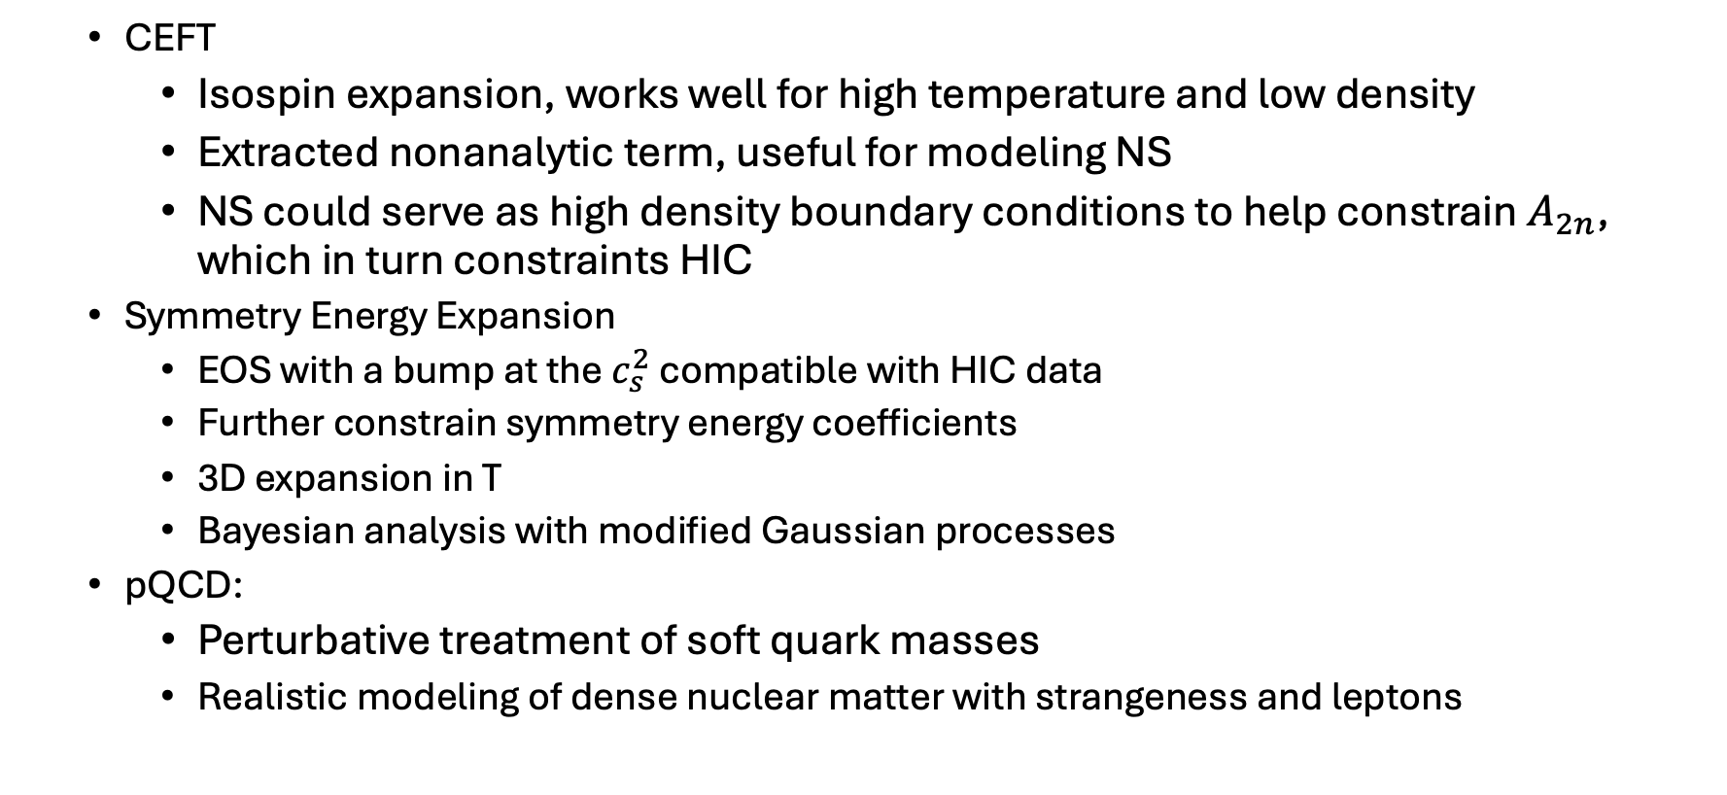
Conclusion & Outlook
CEFT
Isospin expansion, works well for high temperature and low density
Extracted nonanalytic term, useful for modeling NS
NS could serve as high density boundary conditions to help constrain $A_{2n}$, which in turn constraints HIC
Symmetry Energy Expansion
EOS with a bump at the $c_{s}^{2}$ compatible with HIC data
Further constrain symmetry energy coefficients
3D expansion in T
Bayesian analysis with modified Gaussian processes
pQCD:
Perturbative treatment of soft quark masses
Realistic modeling of dense nuclear matter with strangeness and leptons

Slide 22
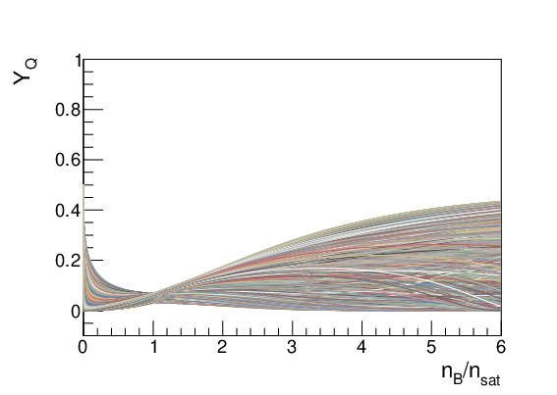
Back-up slides

Slide 23
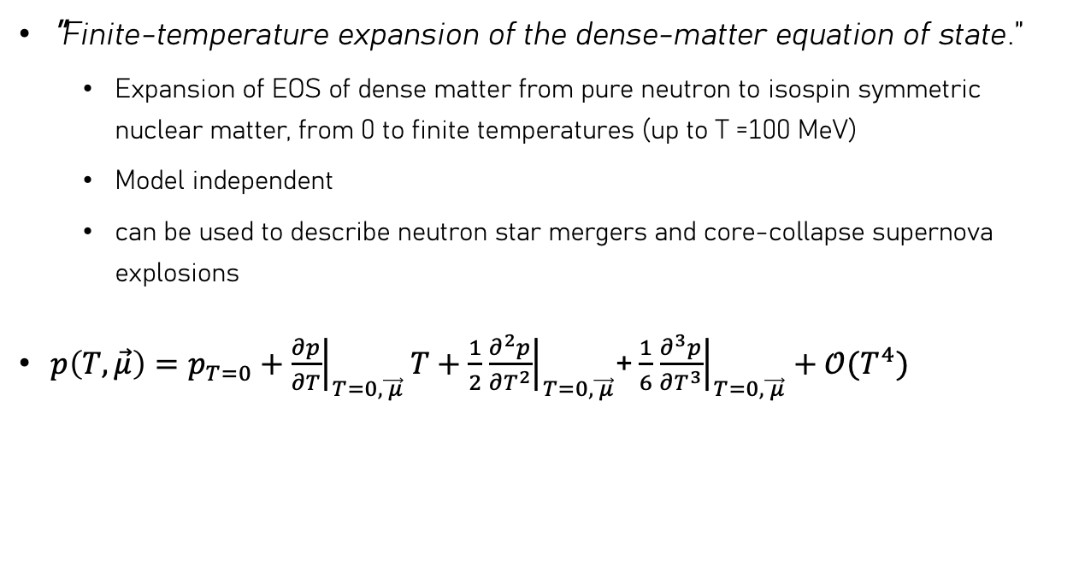
Temperature Expansion?
Mroczek et al.arXiv:2404.01658.
"Finite-temperature expansion of the dense-matter equation of state.”
Expansion of EOS of dense matter from pure neutron to isospin symmetric nuclear matter, from 0 to finite temperatures (up to T =100 MeV)
Model independent
can be used to describe neutron star mergers and core-collapse supernova explosions
$p\left(T,\vec{μ}\right)=p_{T=0}+{\left.\frac{∂p}{∂T}\right|}_{T=0,\vec{ μ}}T+\frac{1}{2}$ ${\left.\frac{∂^{2}p}{∂T^{2}}\right|}_{T=0,\vec{ μ}}$+ $\frac{1}{6}$ ${\left.\frac{∂^{3}p}{∂T^{3}}\right|}_{T=0,\vec{ μ}}+𝒪(T^{4})$
Mroczek et al.arXiv:2404.01658.

Slide 24
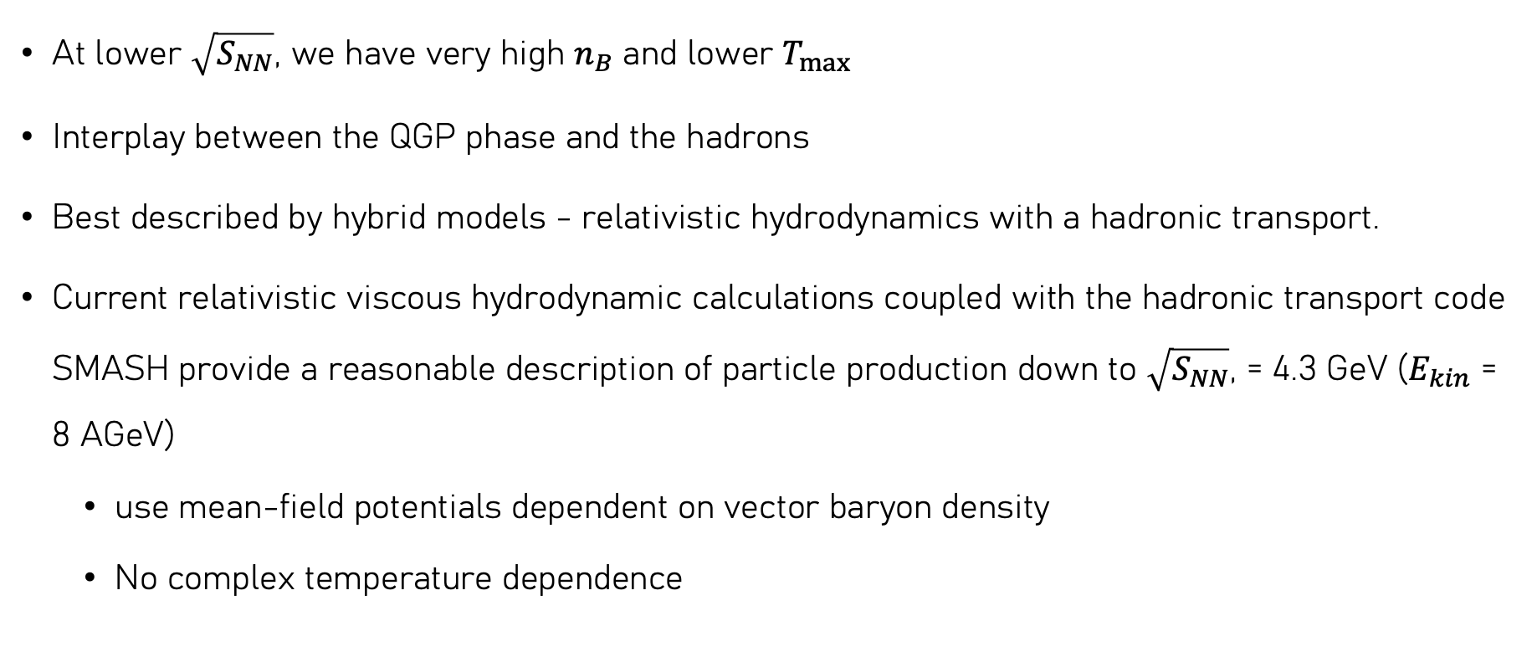
Comparison with HIC data
At lower $\sqrt{S_{NN}}$, we have very high $n_{B}$ and lower $T_{max}$
Interplay between the QGP phase and the hadrons
Best described by hybrid models - relativistic hydrodynamics with a hadronic transport.
Current relativistic viscous hydrodynamic calculations coupled with the hadronic transport code SMASH provide a reasonable description of particle production down to $\sqrt{S_{NN}}$, = 4.3 GeV ($E_{kin}$ = 8 AGeV)
use mean-field potentials dependent on vector baryon density
No complex temperature dependence

Slide 25
