Slide 1
Sambamurti Award
John Haggerty
May 23, 2025

Slide 2
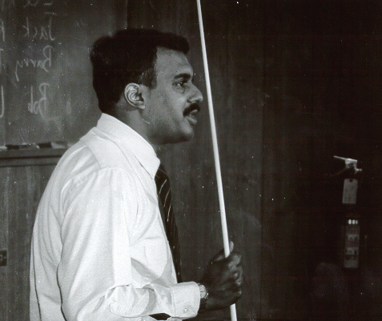
Aditya Sambamurti
Adit was an experimental physicist who was an Assistant Physicist in the Physics Department who worked on an AGS experiment searching for the extremely rare decay K⁺ →π⁺νν when he died of cancer at 31 years old.
I worked with him on that experiment, which eventually won the Panofsky Prize for the spokespersons (Laurie Littenberg, Doug Bryman, and Stew Smith) in 2011, and came to know him as ever curious, ever willing to learn new things, ever thinking about what the most interesting experiments to do next will be.

Slide 3
Sambamurti Award
Adit’s family endowed a lectureship at BNL that would commemorate his unique personality, his curiosity, his willingness to explain the science that interested him
Starting in 2025, the award is made by a committee chosen by the chair of the RHIC/AGS Users Executive Committee
Raghav (Rithya) Kunnawalkam Elayavalli from Vanderbilt was the subcommittee chair
For more information see https://sambamurti.phy.bnl.gov/
1992 - John Haggerty (BNL)
1993 - Jack Ritchie (Texas)
1994 - Thomas Roser (BNL)
1995 - Brian Winer (Rochester)
1996 - Ziping Chen (BNL)
1997 - Greg Landsberg (FNAL)
1998 - Akira Konaka (TRIUMF)
1999 - Emlyn Hughes (Cal Tech)
2000 - Ralf Prigl (BNL)
2001 - Jeffery Mitchell (BNL)
2002 - James Olsen (Princeton)
2003 - Joshua Klein (Texas)
2004 - Michael Lisa (Ohio State)
2005 - Saskia Mioduszewski (BNL)
2006 - Ivan Furic (Chicago)
2007 - Dugan O'Neil (Simon Fraser University)
2008 - Christine Aidala (U. Mass Amherst)
2009 - Michael Begel (BNL)
2010 - Geralyn Zeller (FNAL)
2011 - Paul Sorensen (BNL)
2012 - Dan Dwyer (LBNL)
2013 - Elliot Lipeles (Pennsylvania)
2014 - Anne Sickles (UIUC)
2015 - Xin Qian (BNL)
2016 - Lijuan Ruan (BNL)
2017 - James Hirschauer (FNAL)
2018 - Jin Huang (BNL)
2019 - Thomas Langford (Yale University)

Slide 4
Sambamurti Award 2025
This year’s award is to JaeBeom Park at the University of Colorado Boulder for his work on the sPHENIX experiment at RHIC.
The Sambamurti Lecture will be Thursday, July 31 at 1:30pm in the Large Conference Room in the Physics building (510)
The Final Mission of RHIC: Unveiling the Last Chapter of the Quark-Gluon Plasma with sPHENIX
Thanks to the BNL Physics Department for hosting!

