Slide 1





eRD108: MPGD for ePIC
Progress Report
ePIC EIC Project R&D Day
Apr 16th 2025
F. Jeanneau on behalf of
eRD108 consortium

Slide 2
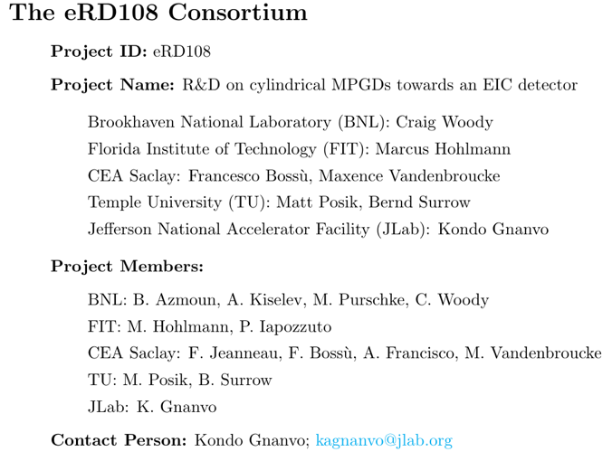





eRD108 Consortium and ePIC MPGD-DCS
eRD108
ePIC MPGD Detector Subsystem Collaboration

Slide 3
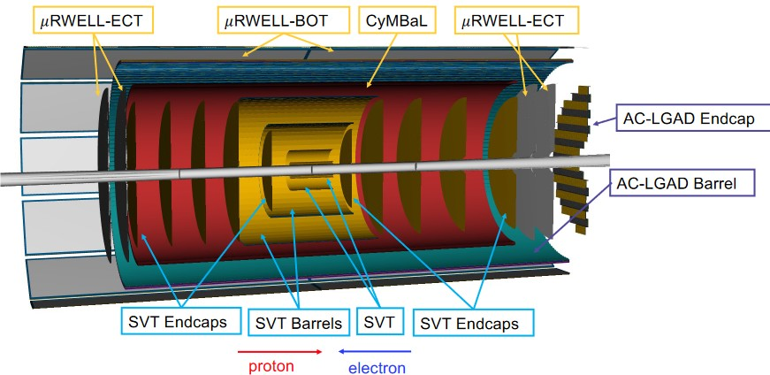
MPGD in ePIC tracking system
MPGDs complement the silicon tracker:
- redundancy hit points
- faster hits for track finding
Three systems:
- CyMBaL: Cylindrical Micromegas Barrel Layer at R=55cm
- µRWELL Barrel Outer Tracker: planar detectors at the DIRC surface
- µRWELL End Cap Tracker: disks in the forward and backward regions
eRD108 program about Cylindrical MPGD detectors with 2D readout:
Development of 2D cylindrical Micromegas detectors: funded in FY24
Development of a cylindrical μRWELL prototype: completing the FY23 program

Slide 4
Cylindrical Micromegas R&D
Update on 2D readout R&D
and scale 1:1 prototype
CEA Saclay

Slide 5
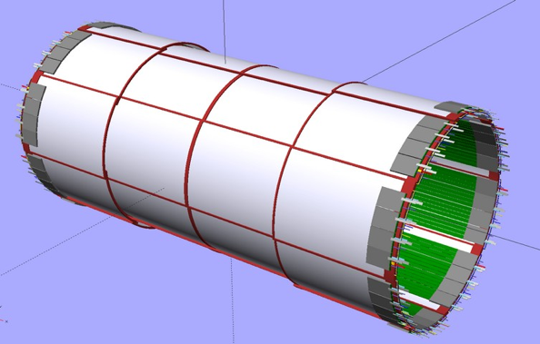
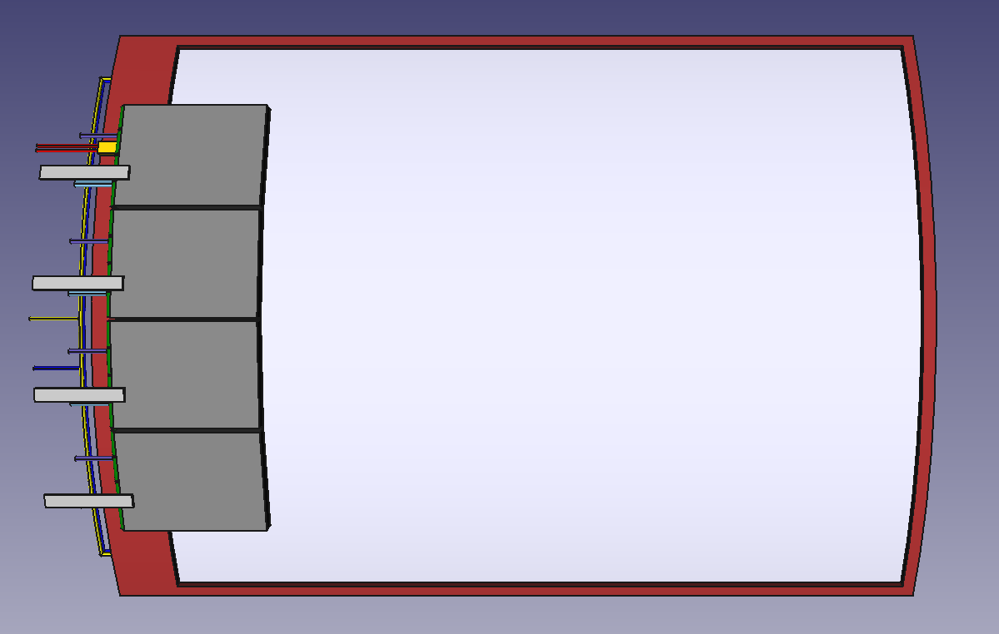
CyMBaL
CyMBaL: Cylindrical Micromegas Barrel Layer
Design of a module
46 cm
59 cm
67 cm
32 module: 8 modules in ϕ times 4 modules in z
Overlaps in ϕ and in z for hermeticity
1024 readout channels/module
32K readout channels
Requirements:
Spatial resolution ~150µm
Time resolution ~20ns
Light, less than 1% X0
Hermetic
Tight space: ~5cm in R
Magnetic field: ~2T
Ongoing:
Rethinking and validating requirement assumptions.
Do we need the same resolution in both directions?
  R*Phi ≤ 500 μm
  Z ≤ 300 μm
Time resolution better than 20ns needed?

Slide 6
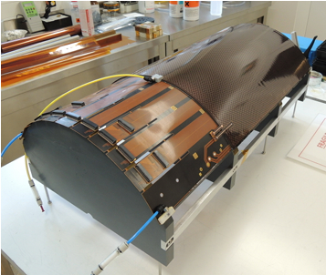
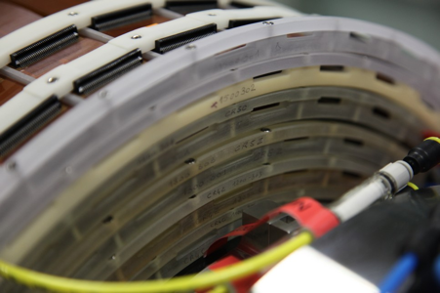
CyMBaL – Technology and planned R&D
CLAS12 resistive Micromegas
  Material budget ~0.4%
  Working in high radiation environment and in B=5T
  Taking data since 2017
  Fit in tight spaces
Upgrade for ePIC: 2D readout
R&D ongoing activities
Analysis of the 2023 test beam data: too much multiple scattering to draw firm conclusions
Standard photoresist material no more produced → R&D to adapt process to new material (Dynamask) resulting in delays
New prototypes production to complete the previous tests (November 2025 test beam):
  resistive patterns
  2D readout
  inclined tracks (1 mm drift) vs clustering with time information
Design of a scale 1 prototype (2D readout)

Slide 7
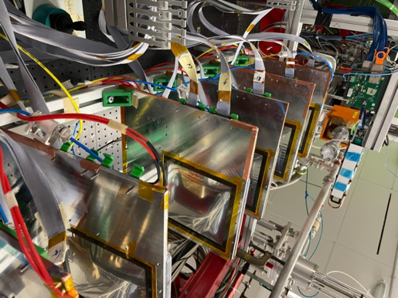
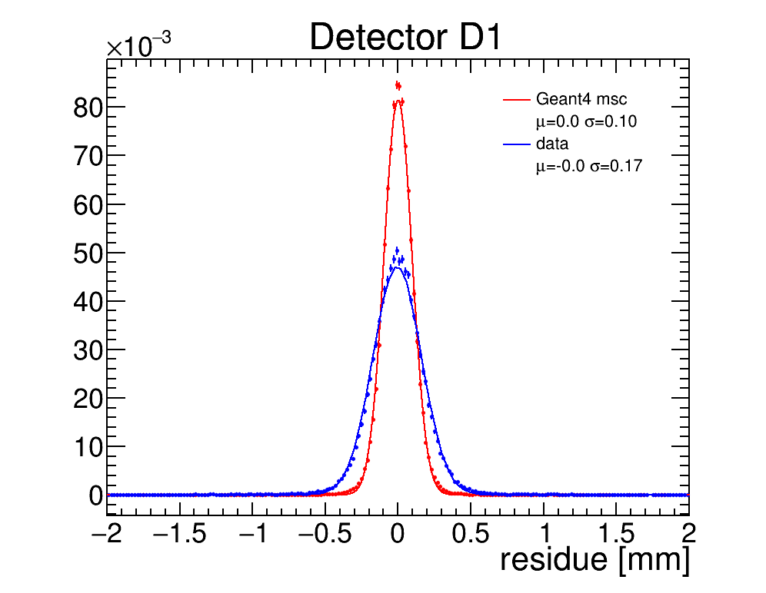
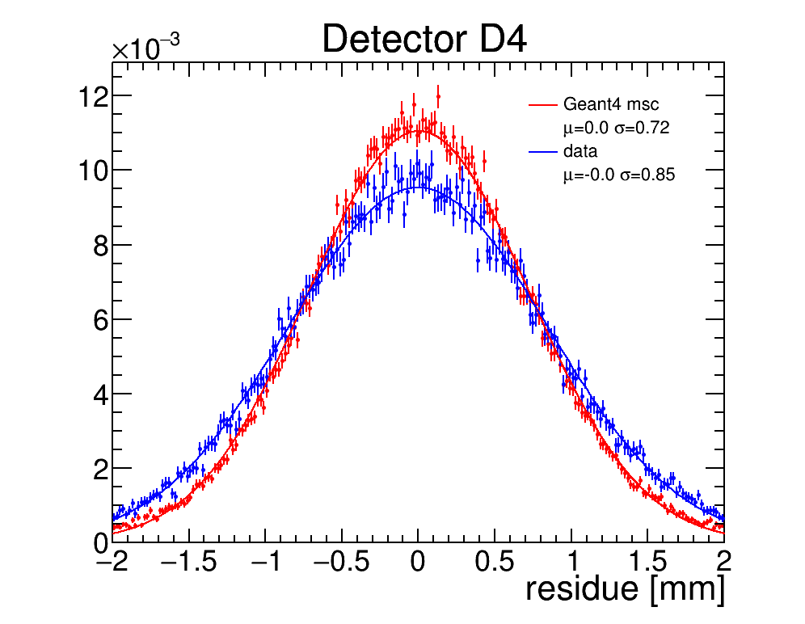
CyMBaL – 2023 Test Beam analysis -- recap
Data taken in June 2023 at MAMI
880 MeV electron beam
ALPIDE-based reference telescope
Tested several prototypes
Important multiple scattering effect
Geant4 simulations to cross check
Data
MC
~30cm from ref tracker
~78cm from ref tracker

Slide 8
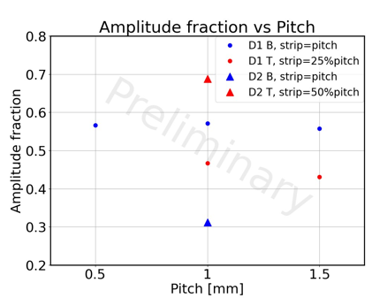
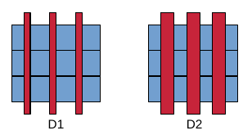
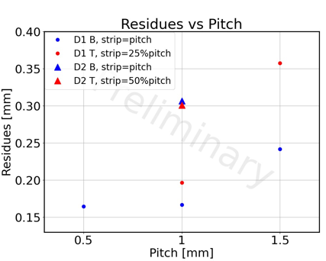
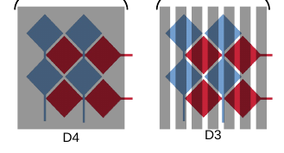
CyMBaL – Test 2D prototypes
12x12 cm2 prototypes to test:
2D readout patterns
Resistive layer motifs
very-low material budget (0.2% X0)
More info: S. Rafael Plocher QNP proceedings
Amplitude fraction, 25% low, 50% too high: the sharing of the signal is not uniform, interstrip with values round 30% should work better
Residues (uncorrected):
D1 (closest to beam exit) provides less than 200µm with 1mm pitch, with high resistiviy
R/O Patterns and resistive motifs
Pitch and interstrip variations
ASACUSA like motifs
Variation of resistive layer (full, strips, grid)

Slide 9
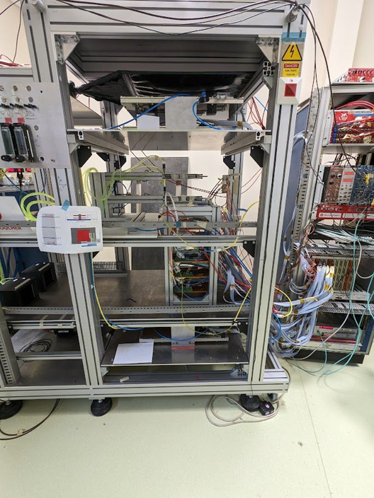
CyMBaL – Tests in Saclay
Cosmic rays test bench refurbished
Silicon telescope (same as in beam test) added to the system
Mechanical structure to hold up to six prototypes
Synchronization of MM and ALPIDE DAQs
Development of software tool for the data taking and analysis optimization
The DAQ system is now adapted to be portable to a next beam test

Slide 10
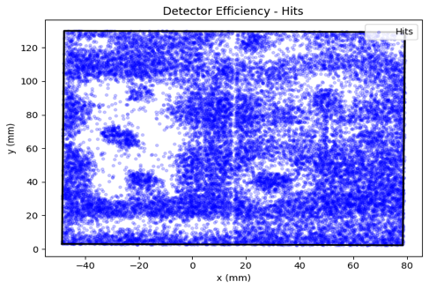
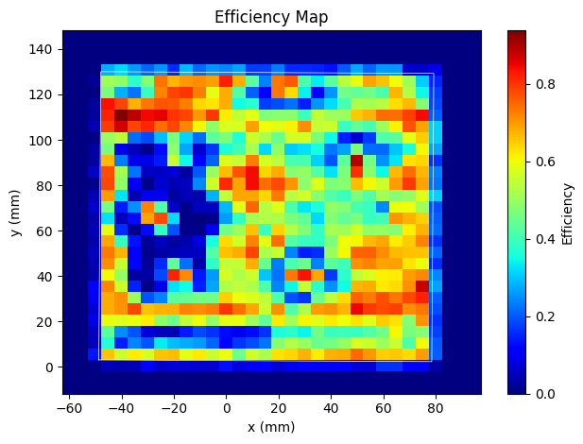
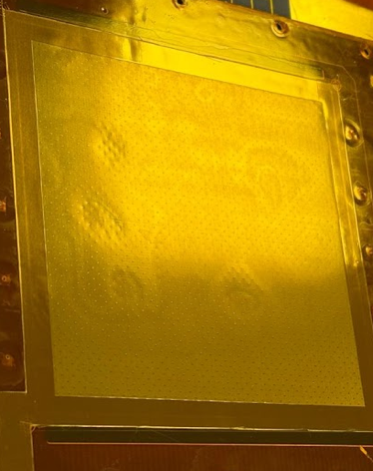
CyMBaL – Tests in Saclay
In order to improve the bulk process feasibility we glue our readout Kapton on FR4 substrate and we can see the gluing defects !
Credit: Dylan Neff

Slide 11
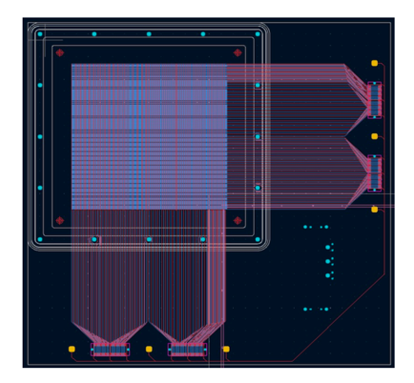
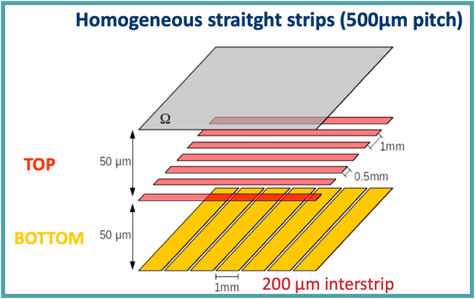
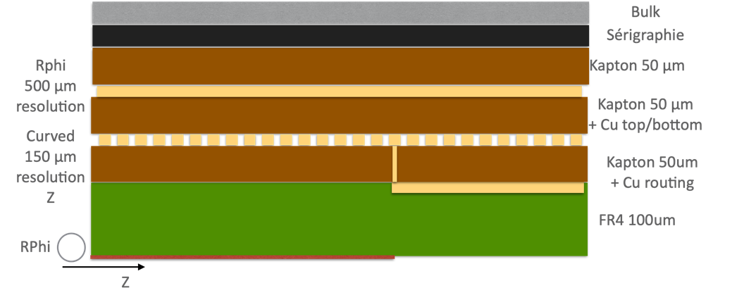
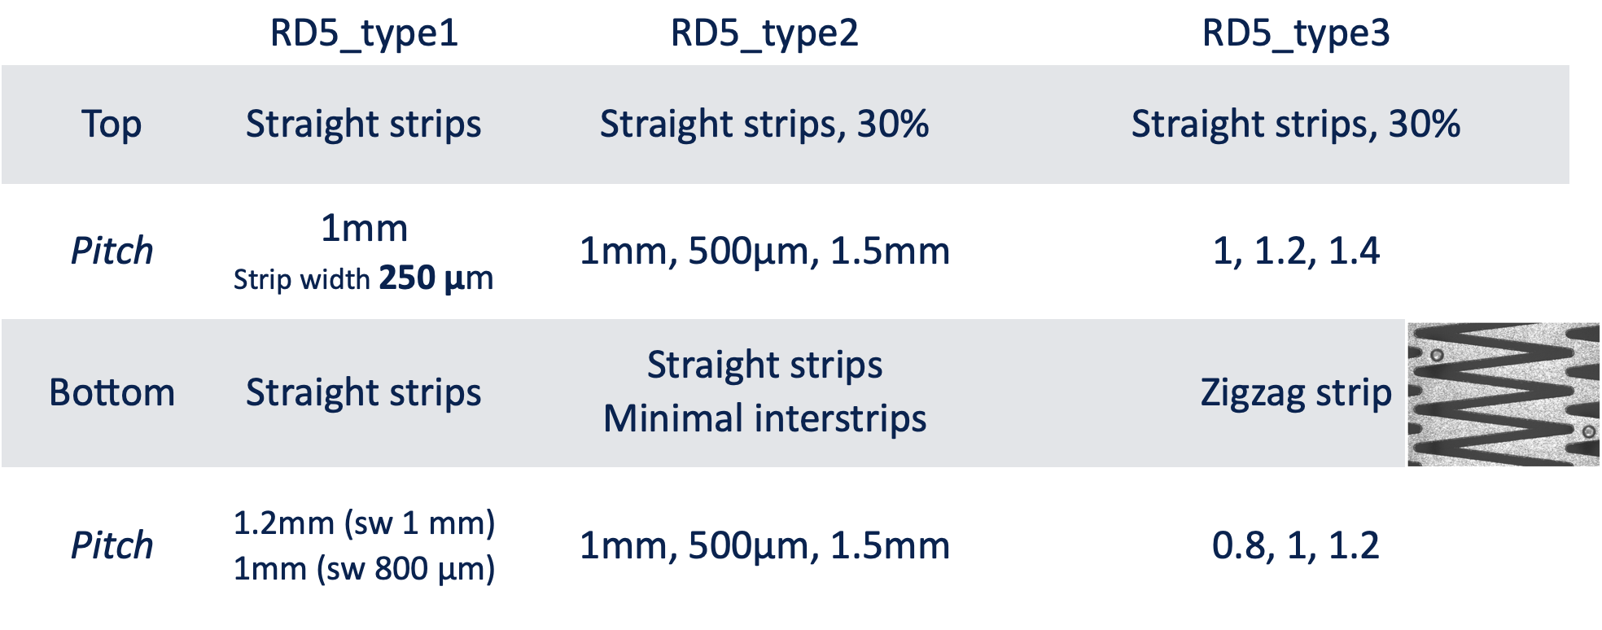
CyMBaL – new prototypes RD5

Slide 12
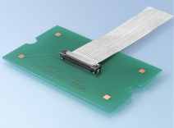
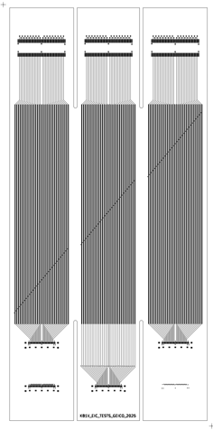
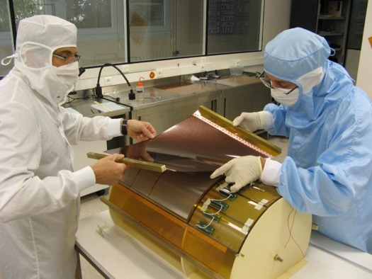
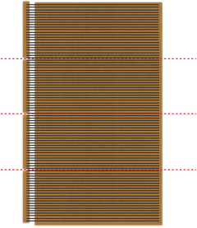
CyMBaL – Toward a scale 1:1 prototype
Based on CLAS12 construction process
Small mechanical prototype
Connector KEL validation
Different connectors orientations
Robustness of soldering
Connection feasibility
Holders needed?
Size 1 prototype:
Working prototype
  Readout plane validation
  HV segmentation
  Drift design
Mechanical prototype
  Curving tooling and procedure
  Interfaces design (fixation, cooling, gas,…)
Top / Top
MEC8
Face to face
Top / Bottom
Bulk of a metallic and a resistive CLAS12 PCB
Bent in shape
Segmented resistif

Slide 13
CyMBaL – Milestones
T2/25: Small mechanical proto to test connectors vs geometry vs bending
T3/25: re-manufacturing of RD4 PCB to tune bulk process and prepare test beam
T3/25: new protos design and manufacturing in preparation of november test beam
T4/25: test beam
T4/25: Finalisation design size 1 prototype 0 (GEIC0)
T1/26: production and test of GEIC0
T3/26: developement and production of size 1 prototype 1 (GEIC1), including feedback from RDx test beam and GEIC0

Slide 14
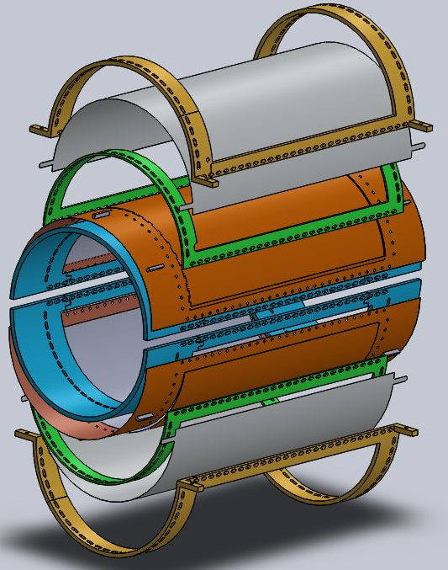

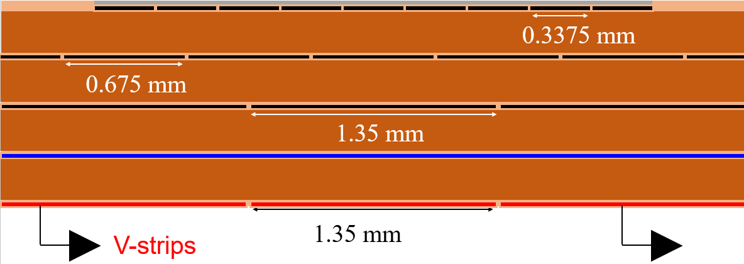
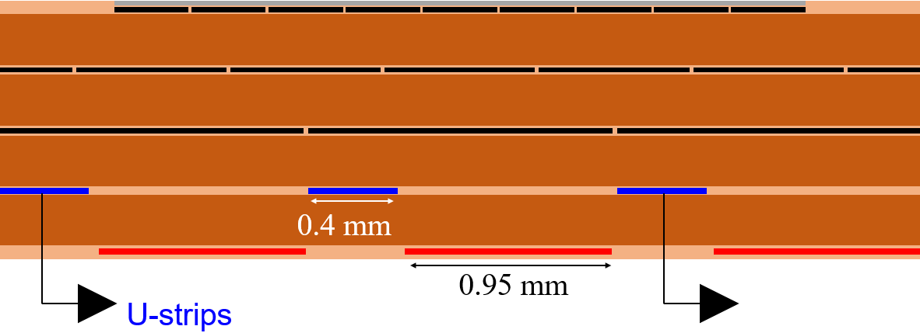
eRD108: R&D on Cylindrical µRWELL Prototypes
Design features & Goal
Prototype consists of 2 half-cylinder chambers with two different capacitive-sharing readout structures
            2D capaSh proto: µRWELL/readout foil with straight U-V strips
2D zigzag proto: µRWELL/readout foil with zigzag U-V strips
Goal is to study performance of two readout options for cylindrical µRWELL
Exploded 3D view of detector design
Outer clamp
40 cm
Cathode foil
U-V zigzag readout concept (BNL)
U-V capacitive-sharing readout (JLab)
26 cm
µRWELL-R/O
U-strip
1.35 mm
pitch
1.35 mm
pitch
V-strip
Main frame
Inner clamp

Slide 15
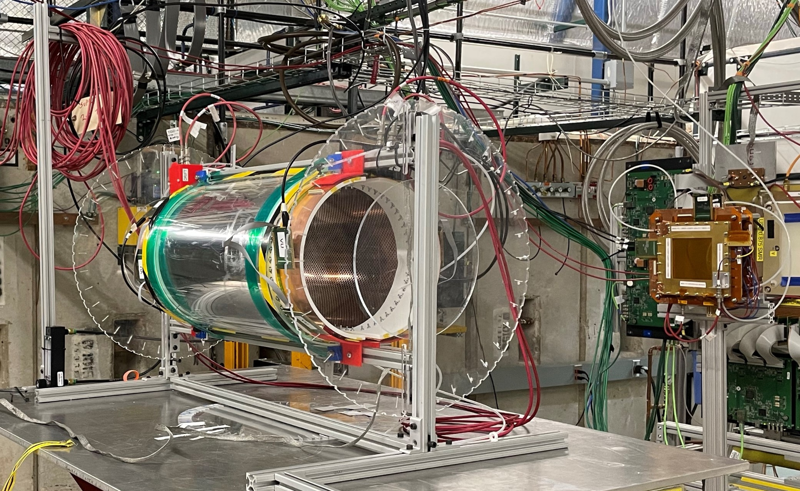
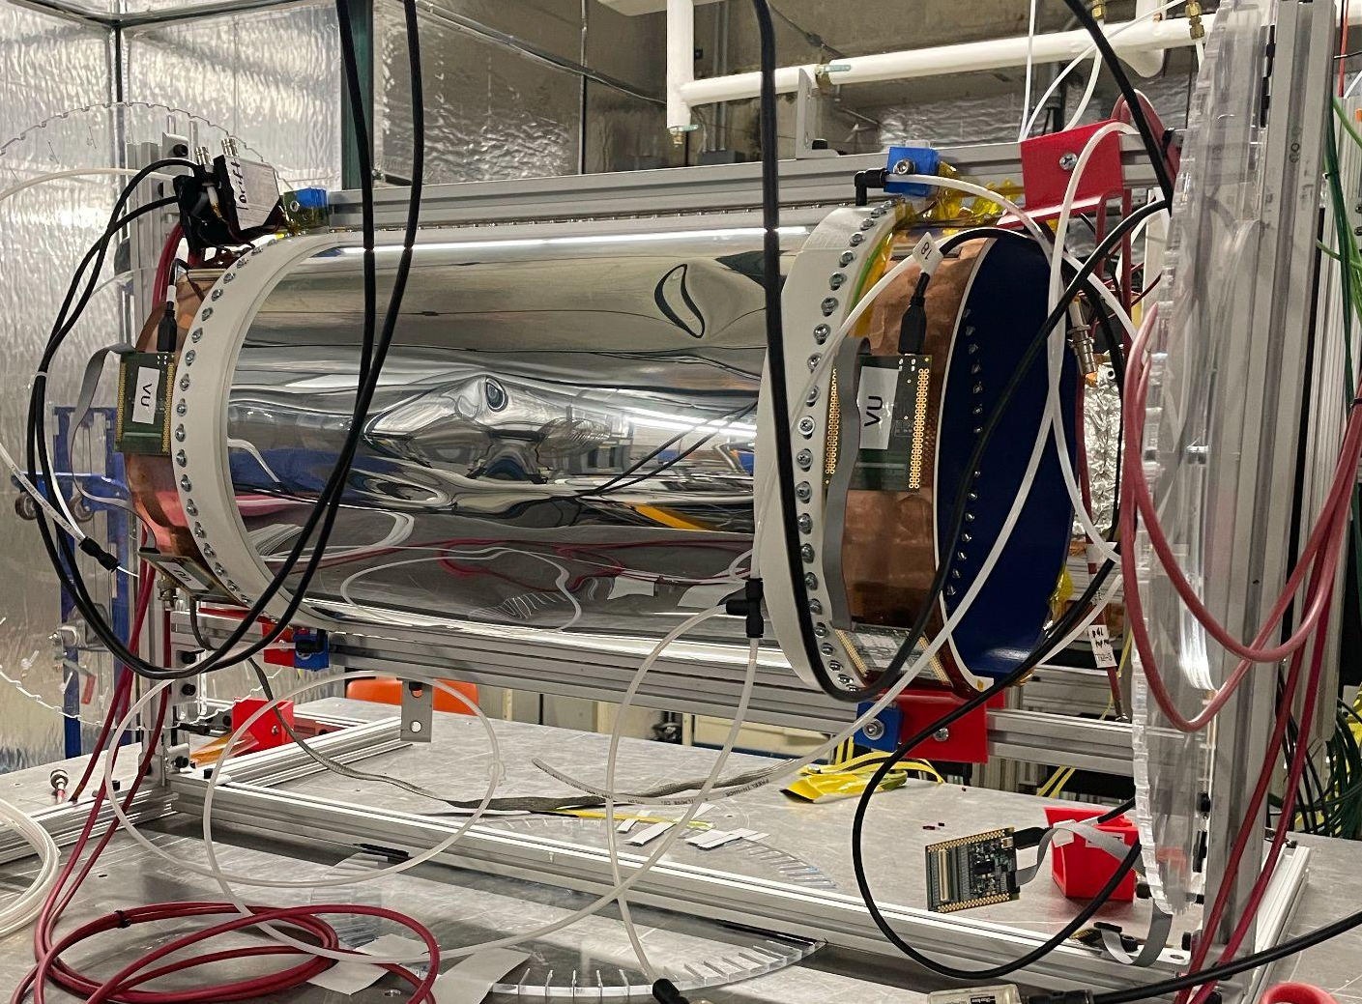
Earlier Work on Cylindrical µRWELL prototypes
Cyl. µRWELL prototype at Fermilab test beam setup, June 2023
Initial prototype with Al-mylar foil drift cathode
Dents on cathode foil
Cyl. µRWELL
Downstream
GEM Trackers
Consequently, detector rebuilt & refurbished in 2024/25
      Honeycomb support to consolidate to Al/Mylar cathode foil ➔ completed August 2024
      Gas tightness & HV test ➔ completed Dec 2024
        Observe larger leakage currents (tens of µA) than expected for both prototypes
Unable to operate and take data at the Fermilab 2023 test beam
      Fermilab shut down that week for safety concerns at the lab
      HV instabilities caused by dents on the Al cathode during operation

Slide 16
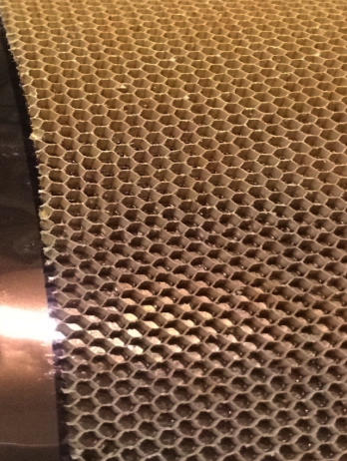
New Material Budget for Reinforced Cathode Drift Foil
Component | Mass (g) | Thickness (cm) | X₀ (g/cm²) | Material Budget (X/X₀)
Nomex honeycomb (Drift Cathode Support Structure) | 10 | 0.5 | 29.6 | 0.025%
Al/mylar + epoxy (Original Drift Cathode) | 70 | 0.03 | ~30 | 0.168%
Total Reinforced Cath. Drift Foil | 80 | ~0.53 cm | — | ≈ 0.193% X₀
Area = 36.7 cm × 36.7 cm
Height = 5mm
Wall thickness = 0.11mm

Slide 17
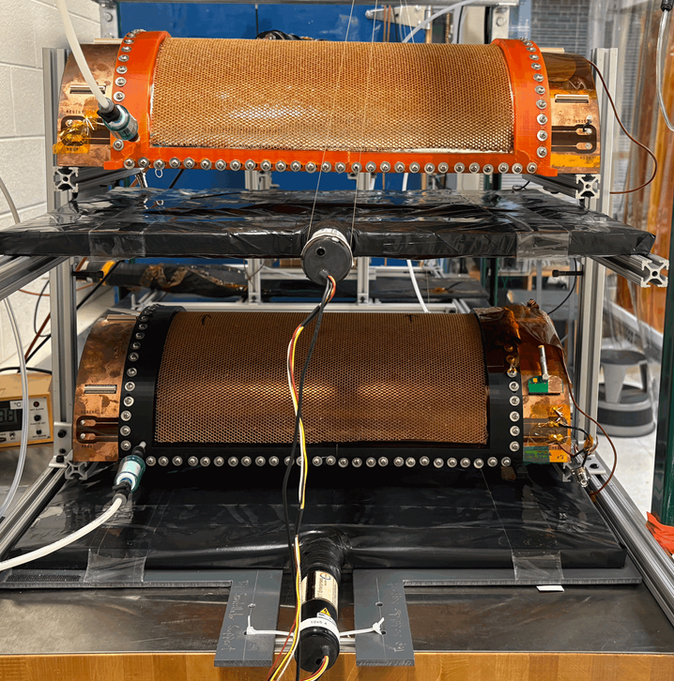
Commissioning of the Prototypes @ UVa
Straight-Strip U-V Prototype
Orange Detector Frame
ZigZag U-V Prototype :
Black Detector Frame
Two Scintillators
Trigger Rate: ~ 10 Hz
CODA-based SRS DAQ with APV25 readout
March 21st, 2025
Both prototypes moved to UVa for preliminary HV test and hunt for signal in the chambers in preparation for Hall D beam test at JLab
      Repeat HV test in N₂ (April 2027)
      Check pedestal data with APV25-SRS electronics
      HV conditioning with Ar-CO₂
            Some HV instabilities observed
  Prototypes will be sent to JLab on April 21st for installation in the Hall D Pair Spectrometer for two-week beam test

Slide 18
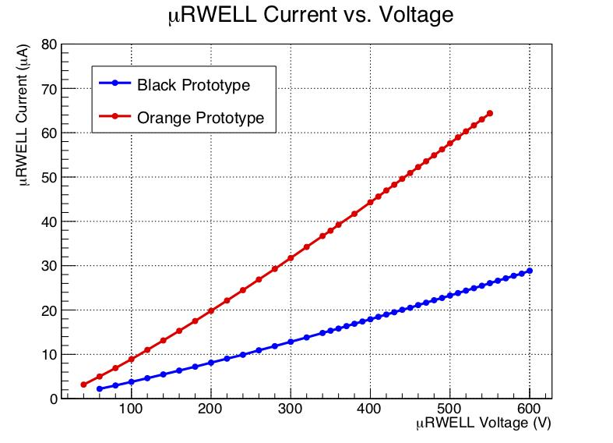
Measured Leakage Currents
HV scans in N2 Gas
N2 Gas flowing rate
  140 units
Dew Point: -48.7
I_drift :
  Zigzag-Strip: <0.02 µA
  Straight-Strip: <0.3 µA

Slide 19
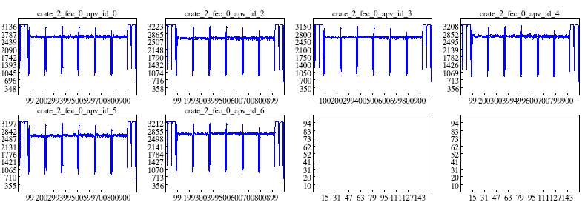
Pedestal Data Taken with One of the Prototypes
Six (6) APVs for each detector
Pedestal data were taken in N₂ gas with V_{uRWELL} = 250V, V_{drift} = 600V
DAQ working

Slide 20
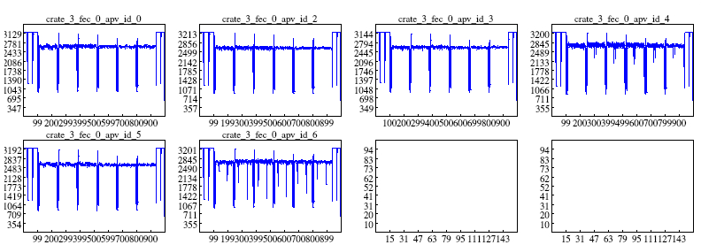
First hits from Cosmic
Cosmic data for Straight-Strip Detector
  ArCO2 (80/20) Gas flowing rate: 140 units; Dew Point: -49.9
  μRWELL =540 V; Drift =1240 V
  μRWELL current fluctuated at the first 10 mins, then stabilized at the expected value (64.8 µA)

Slide 21
Timeline for closure
Detector rebuild and refurbishment August 2024
Gas tightness test December 2024
HV tests January 2025
Transport detector to UVA March 21
Repeat HV Test April 7
Taking cosmics data at UVA April 18 -20
Transport detectors from UVA and mount setup at JLab and flush gas April 21
Data taking at JLab in beam test April 23 - May 7
Data analysis May – Aug
Prepare publication Sep – Dec

Slide 22
ePIC MPGD Outer Tracker: Update on the Engineering Test Article

Slide 23
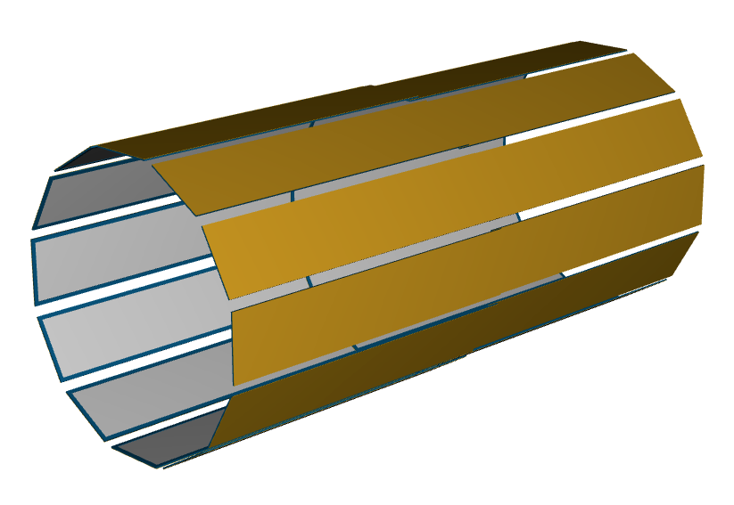
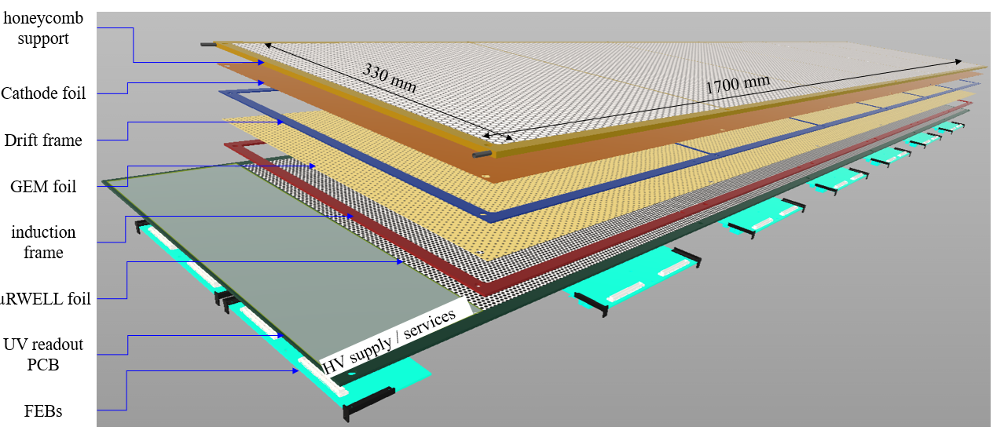
ePIC Barrel Outer Tracker: PED Test Article
µRWELL-BOT module
Thin-gap (1-mm drift) hybrid amplification GEM-µRWELL detector
On-detector Front End Boards (FEBs) based on SALSA chips
Requirements:
Spatial resolution:
  100 µm (normal tracks), < 150 µm @ 45^{O}
Time resolution: 10 ns
Efficiency ~97%
https://wiki.bnl.gov/eic/upload/ERD_tgMPGD_FY22_endOfYearReport_final.pdf
Active area 36 cm
Active area 34 cm
3 mm honeycomb
G10 frames
µRWELL
GEM
cathode
readout PCB
FEB
cross-section view of thin-gap GEM-µRWELL detector

Slide 24
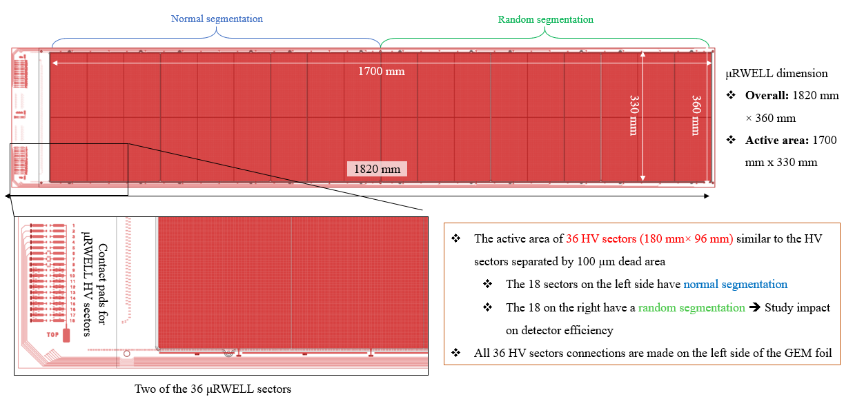
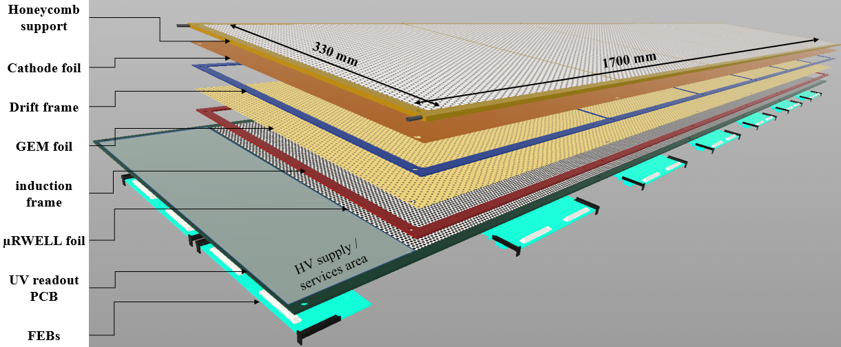
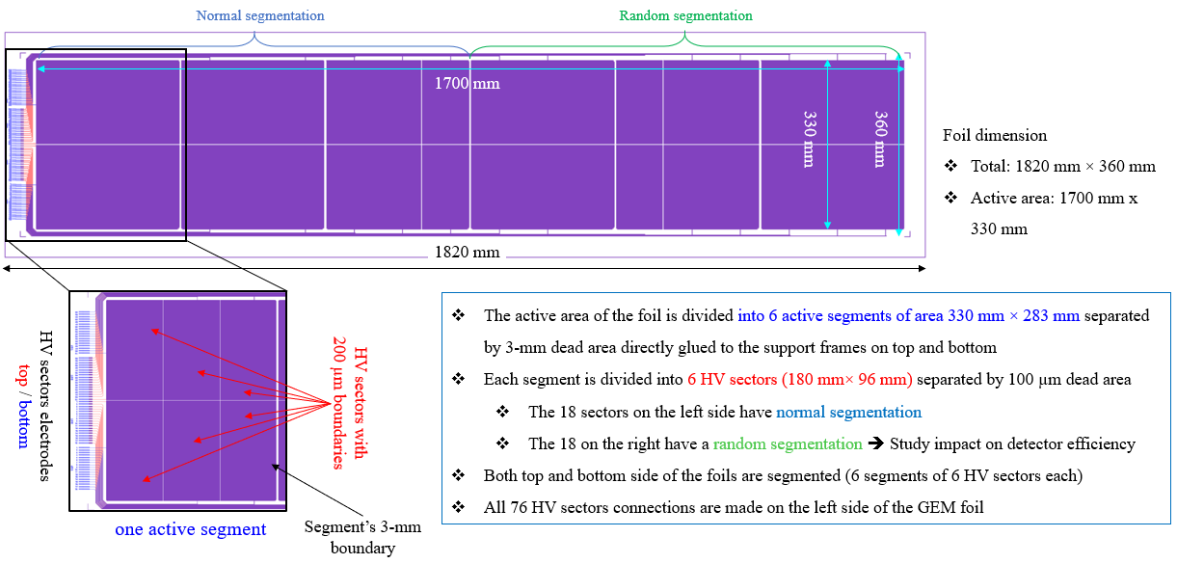
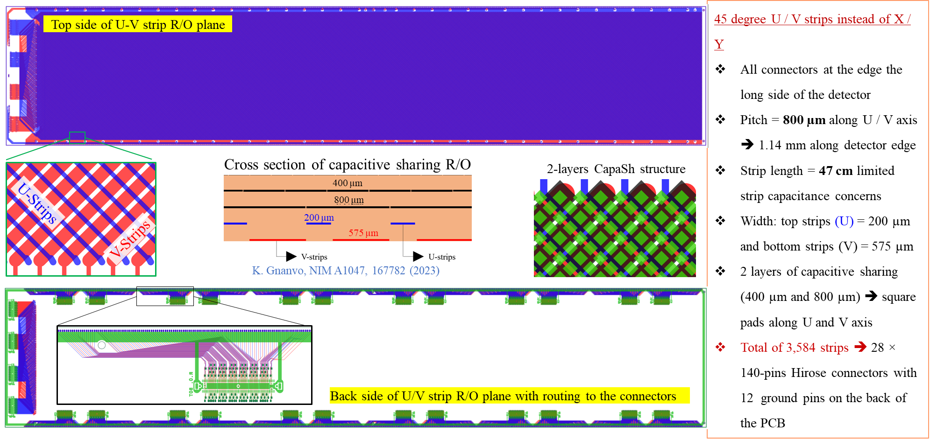
ePIC Barrel Outer Tracker: PED Test Article
CAD design of thin-gap GEM-µRWELL engineering test article
μRWELL foil Design
GEM foil Design
Capacitive-sharing U/V strip readout plane Design

Slide 25
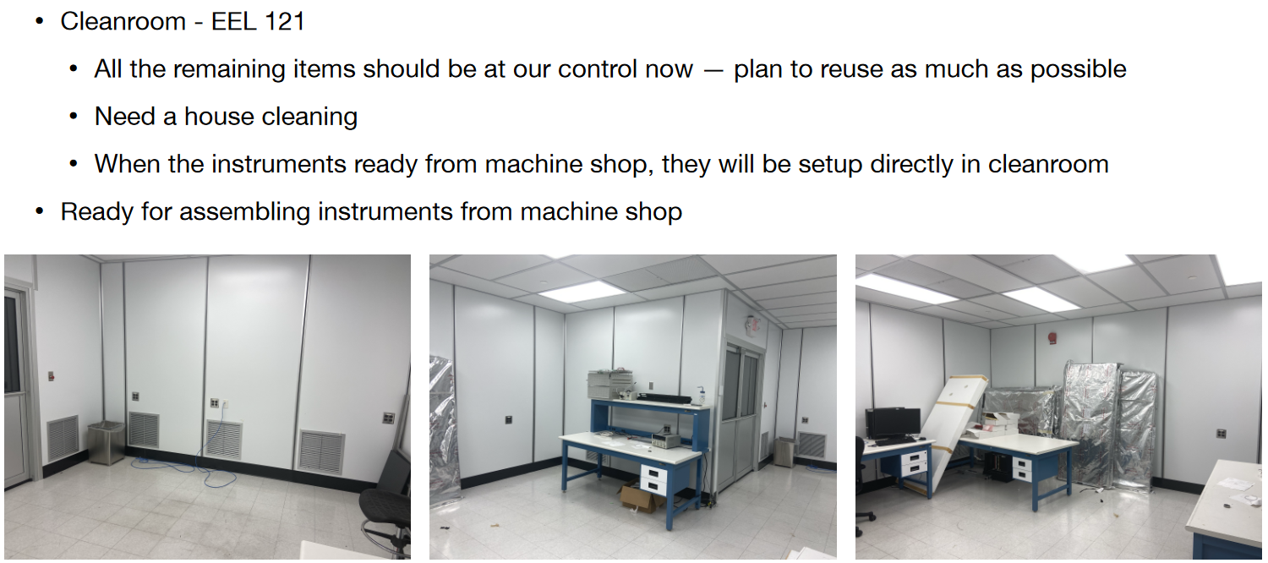
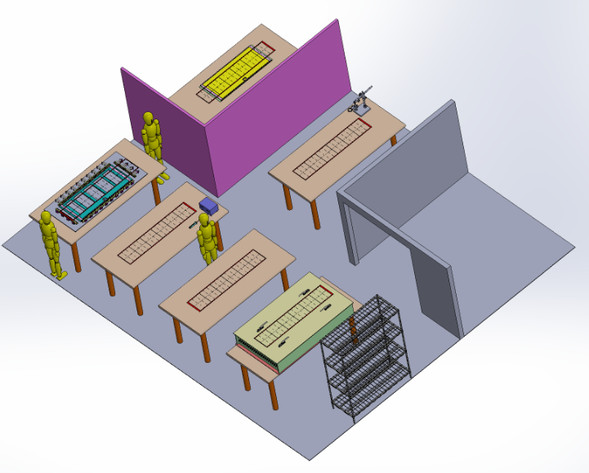
PED Test Article: Assembly clean room @ JLab
Clean room floor plan

Slide 26
PED Test Article: Timeline & Milestones
GEM foil and μRWELL PCB at the CERN workshop: Delivery expected June 2025 (instead of January)
Support frames for the detector parts (RESARM (Belgium): Delivered early March 2025
Clean room space allocated and equipment for the assembly of the test article at JLab
  Design of mechanical stretcher completed: Procurement of parts ongoing
  Design of HV test box for GEM foil and μRWELL completed: Procurement of parts ongoing
If GEM and μRWELL are delivered “in time” by May 2025 ➔ assembly will be completed by August / September 2025
  In time for test in beam at CERN in Fall 2025

