Slide 1
ePIC/EIC Project Detector R&D Day
eRD109 (ASICs/FEEs) – Progress & Outlook
Fernando Barbosa
16 - 17 April 2025

Slide 2
Outline
Readout – Scale & Technology summary
eRD109 - ASIC & Electronics R&D Initiatives
Status
Progress Reports
Schedules
R&D Milestones and PED Outlook
Summary

Slide 3
Streaming Readout - Channels – Scale & Technology
Detector System |  | Channels | SensorTechnology | Redout Technology
Si Tracking
 | 3 vertex layers | 7 m^2 | MAPS | lpGBT, VTRX+
 | 2 sagitta layers | 368 pixels | MAPS | lpGBT, VTRX+
 | 5 backward disks | 5,200 MAPS sensors | MAPS | lpGBT, VTRX+
 | 5 forward disks |  | MAPS | lpGBT, VTRX+
MPGD Tracking
 | Barrel, e & H Endcaps | 202 k | uRWELL, MicroMegas | SALSA
Forward Calorimeters
 | LFHCAL | 63,280 | SiPM | CALOROC
 | HCAL Insert | 8 k | SiPM | CALOROC
 | pECAL W/SciFi | 16,000 | SiPM | Discrete
Barrel Calorimeters
 | HCAL | 7,680 | SiPM | CALOROC
 | ECAL SciFi/Pb | 5,760 | SiPM | CALOROC
 | ECAL Imaging Si ASTROPIX | 500 M pixels | Astropix | Astropix
Backward Calorimeters
 | nHCAL | 3,256 | SiPM | CALOROC
 | ECAL (PWO) | 2,852 | SiPM | Discrete
Far Forward
 | B0: 3 Crystal Calorimeter | 135 | SiPM/APD | Discrete
 | B0: 4 AC-LGAD layers | 688,128 | AC-LGAD Pixel | EICROC
 | 2 Roman Pots (RP) | 524,288 | AC-LGAD Pixel | EICROC
 | 2 Off Momentum (OMD) | 294,912 | AC-LGAD Pixel | EICROC
 | ZDC: Crystal Calorimeter | 900 | SiPM/APD | Discrete
 | ZDC: HCAL | 9,216 | SiPM | CALOROC
Far Backward
 | Low Q Tagger 1 | 33,030,144 | Timepix4 | Timepix4
 | Low Q Tagger 2 | 33,030,144 | Timepix4 | Timepix4
 | Low Q Tagger 1+2 Cal | 420 (2x210) | SiPM | CALOROC
 | 2 Lumi PS Calorimeter | 3,360 (2x1680) | SiPM | Discrete
 | 2 Lumi PS Tracker | 128,000 (2x64,000) | AC-LGAD Strip | FCFD
 | Lumi Direct Photon Calorimeter | 100 | SiPM | Flash250
PID-TOF
 | Barrel bTOF | 2,359,296 | AC-LGAD Strip | FCFD
 | Hadron Endcap fTOF | 3,719,168 | AC-LGAD Pixel | EICROC
PID-Cherenkov
 | dRICH | 317,952 | SiPM | ALCOR, VTRX+
 | pfRICH | 69,632 | HRPPD | FCFD Variant
 | hpDIRC | 73,728 | MCP-PMT or HRPPD | FCFD Variant
CERN
eRD109
KIT, NASA (GSFC), ANL
eRD109 Initiatives:
Discrete COTS – SiPM, 14-bit
CALOROC – SiPM, 10-bit
ALCOR – SiPM, 1 pe
EICROC – AC-LGAD, pixel
FCFD – AC-LGAD, strip
SALSA - MPGD
eRD109
U. Glasgow
eRD109
JLab
eRD109
FCFD variant
3

Slide 4
eRD109 – ASIC & Electronics R&D Initiatives
FY23 Proposals submitted in October 2022 (DAC R&D Review August 2022)
Contract awards took longer than expected.
FY24 Proposals submitted in July 2023 (DAC R&D Review August 2023)
Contract awards took longer than expected.
Continuation of previous work.
FY25 Proposals submitted in July 2024 (DAC R&D Review August 2024)
Continuation of previous work with PED (P6) onwards.
ASIC & Electronics:
Discrete COTS – Calorimeters, SiPMs, 14 bit
CALOROC/H2GCROCv3 – Calorimeters, SiPMs, 10 bit
EICROC - AC-LGAD, pixel
FCFD – AC-LGAD, strip
Low-Mass Hybrid – AC-LGAD Barrel TOF
High Precision Clock Distribution – AC-LGAD, all
ALCOR – dRICH, SiPM, 1 p.e.
SALSA – MPGD.
Readiness reviews prior to start of production phase.
4

Slide 5
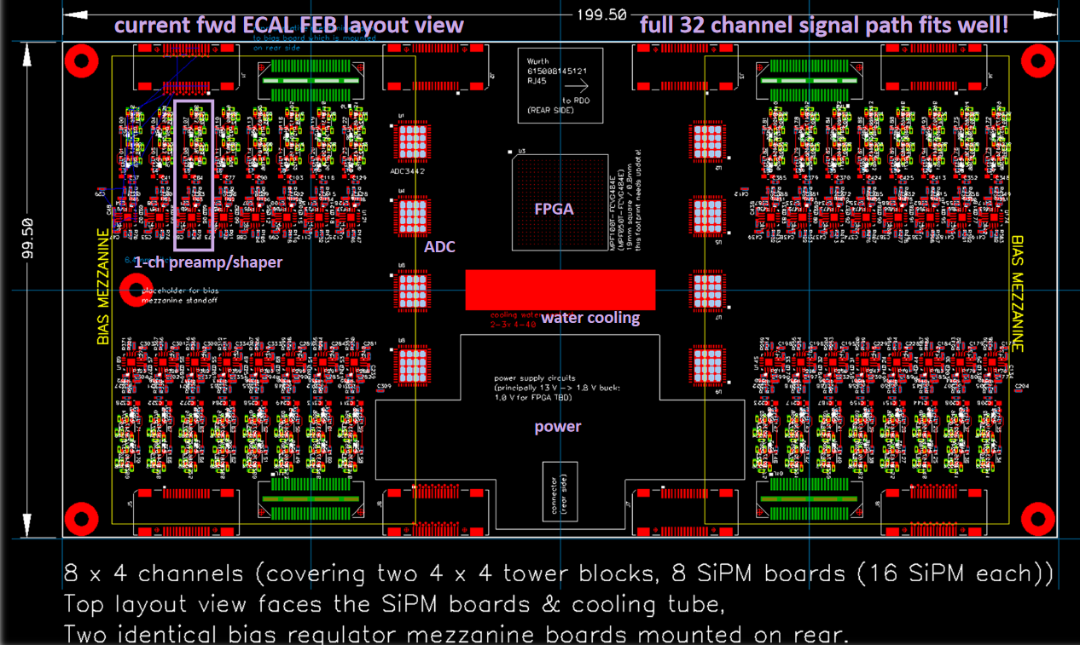
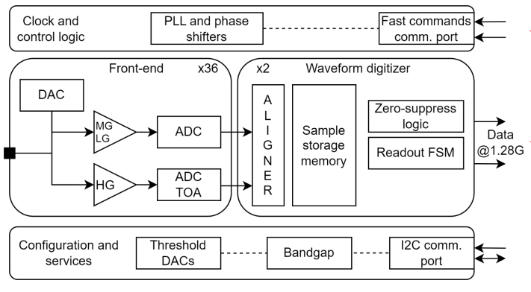
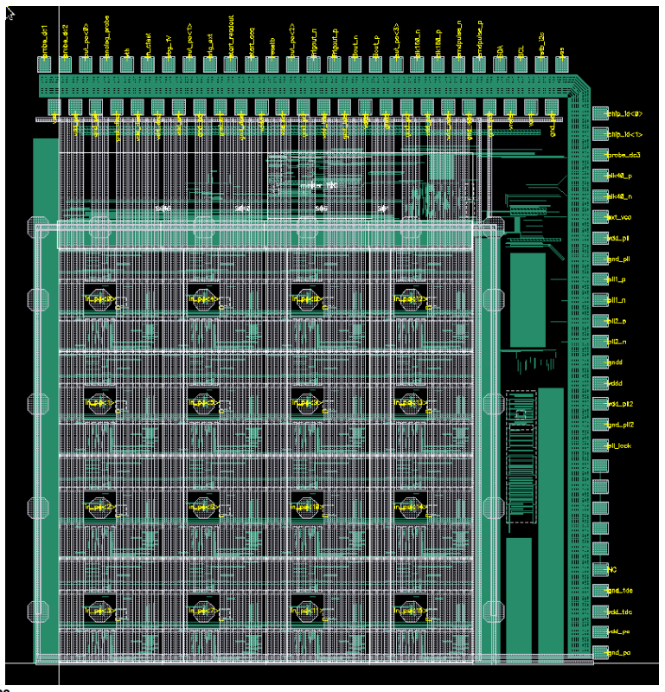
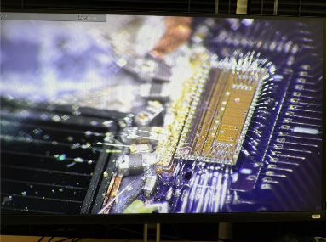
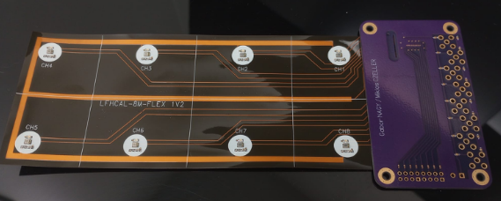
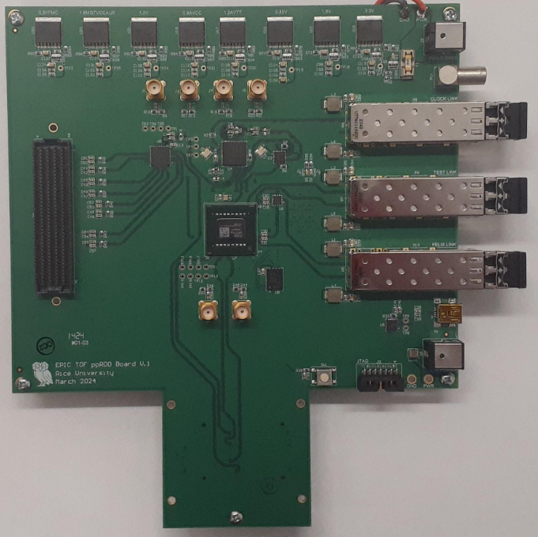
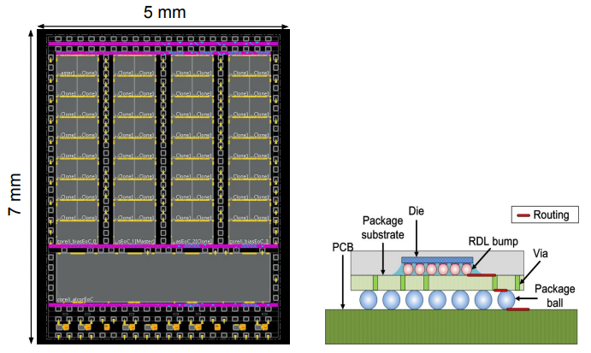
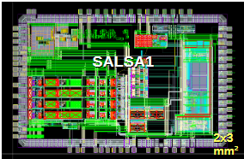
ASICs & Electronics – Component Status
 | Readout Technology | Status & Development Summary | Production | Institution
Discrete/COTS | Calorimeters, SiPM, 14-bit | Devices selected, PCB design practically completed. Beam tests FY24-FY25, Eng. Article FY26 | FY27 | Indiana University
CALOROC | Calorimeters, SiPM, 10-bit | Interface design FY23- FY24, CALOROC1A/B designed FY24-FY25, CALOROC2 (64 ch) FY25-FY26 | FY27 | OMEGA/IN2P3/IJCL, ORNL
EICROC (32x32) | AC-LGAD, pixel | EICROC0A (4x4) designed FY24-FY25, EICROC1 (8x32) (32x32) FY25, EICROC2 (32x32) FY26 | FY27 | OMEGA/IN2P3/IJCL/CEA-Irfu, AGH
FCFD (128) | AC-LGAD, strip | Front end characterized, FCFDv1 (6 ch) FY23-FY24 characterized, FCFDv1.1 FY25, FCFDv2 FY25-FY26 | FY27 | FNAL
Low-Mass Hybrid | AC-LGAD TOF | Pre-prototypes fabricated and co-cured onto Barrel TOF stave prototypes. Develop low cost hybridization techniques FY25-FY26 | - | ORNL
High Precision Clock Distribution | AC-LGAD, all | ppRDO PCB (6) complete, Jitter = 3 ps. Finalize development for TOFs, FF, FB detectors with use of EICROC and FCFD ASICs in FY25-FY26 | - | BNL/LBNL/RICE
ALCOR | dRICH, SiPM, 1 p.e. | ALCORv2.1 (32 ch) beam tests FY24, ALCOR v3 (64 ch) FY24-FY26 | FY26 – FY27 | INFN
SALSA | MPGD | SALSA0/1 FY24, SALSA2 (32 ch) designed FY23-FY25, SALSA3 (64 ch) FY25-FY26 | FY27 – FY28 | CEA-Saclay, U Sao Paulo
ASIC production is ~1 Year: Fab, Packaging, Test. Additional information is included in the following slides.
Complete.
Fab submission is imminent.
5

Slide 6




ASICs & Electronics - Scope of the Effort
Approximate quantities and costs.
Costs include mask sets, fabrication and packaging, wrt quantities needed.
 | #Ch | #Ch/Unit | #ASICs/Wafer | #Wafers | Node (nm) | Packaging | Cost/ch ($) | Institution
Discrete/COTS | 24 k | 32 | NA | 740 Digitizers | COTS | NA | 91 (Includes FE Adapter) | Indiana University
CALOROC | 97 k | 64 | 480 | 5 | 130 | BGA | 3.2 | OMEGA/IN2P3/IJCL, ORNL
EICROC | 5.2 M | 1,024 | 160 | 42 | 130 | Wafer Bump | 0.1 | OMEGA/IN2P3/IJCL/CEA-Irfu, AGH
FCFD + Variant | 2.6 M | 128 | 180 | 149 | 65 | Wire Bond | 0.5 | FNAL
ALCOR | 318 k | 64 | 800 | 8 | 110 | BGA | 0.9 | INFN
SALSA | 202 k | 64 | 500 | 9 | 65 | BGA | 4.1 | CEA-Saclay, U Sao Paulo
Production
65 nm: $750 k masks + $3.5 k per wafer
110 nm: $190 k masks + $4 k per wafer
130 nm: $250 k masks + $4 k per wafer
Packaging BGA: $3-$7.5 per chip.
ASIC Costs Total: ~$3.3 M
Masks: ~$2.2 M; Chips: ~$1.1 M
6

Slide 7
eRD109 Progress
eRD109 Addresses EIC ASIC and Electronics R&D needs.
FY23 Proposals - DAC R&D Review August 2022
FY24 Proposals - DAC R&D Review August 2023
FY25 Proposals - DAC R&D Review August 2024
ASIC & Discrete – Nominal Solutions: (FY23, FY24, FY25)
Discrete/COTS – Calorimeters, SiPMs, 12-14 bit
CALOROC (H2GCROC revision for EIC) – Calorimeters, SiPMs, 10 bit *
EICROC - AC-LGAD, pixel *
FCFD – AC-LGAD, strip**
ALCOR – dRICH, SiPM, 1 p.e.
SALSA – MPGD.
3rd Party Evaluations: (FY23)
HPSoC, HDSoC – NALU
ASROC – Anadyne
FAST – INFN
Services: Barrel TOF Low-Mass Service Hybrid, (FY23, FY24)
High Precision Timing, (FY24); TOF Readout (FY25, FY26)
R&D Phase
PED Phase - P6 - onwards
* Considerable commitment of resources by OMEGA/IN2P3.
** Considerable synergy with FNAL

Slide 8
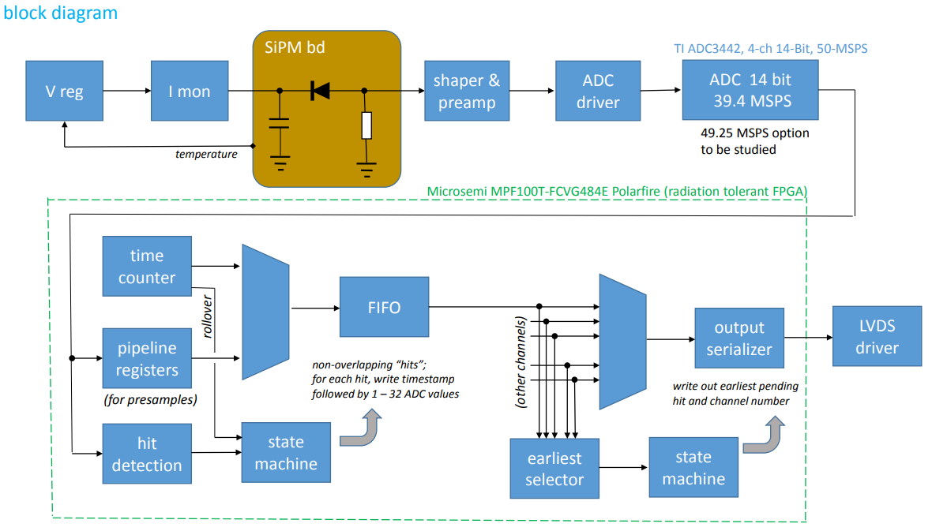
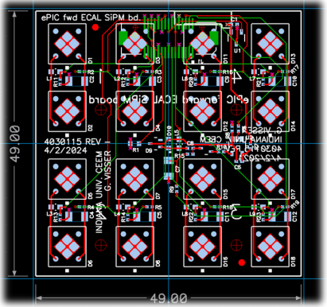
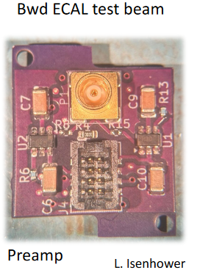
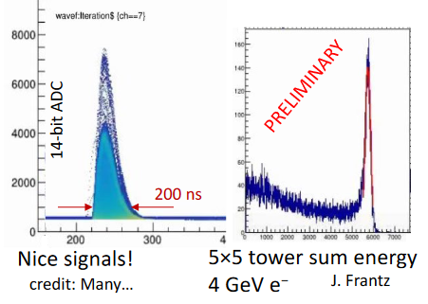
FY25 Status & Progress Calorimeters, SiPMs – Discrete/COTS/ASIC (IU)
Adapter PCBs
Adapter PCB (Fwd ECAL)
FEB PCBs
FEB PCBs
32 ch Waveform Digitizer
12/14-bit TI ADC3422
Microsemi MPF100T-FCVG484E Polarfire (radiation hard FPGA)
CERN DC/DC converter bPOL12V/bPOL48V or LTC3601
Cabling (CAT6), Power (DC-DC), Cooling (liquid), Packaging (rack).
Progress Summary:
Developments on fwd, bwd ECALs – DESY tests Feb 2025
COTS DC/DC converters radiation tested in May 2024.
Shaping (80 ns peaking time), 12 mW/ch PA
PCB design practically complete, Adapter PCB prototype under tests.
Design, Fab: FY23 –FY24
Tests + Beam: FY24 – FY25
Engineering Article: FY26
Production: FY27
8

Slide 9
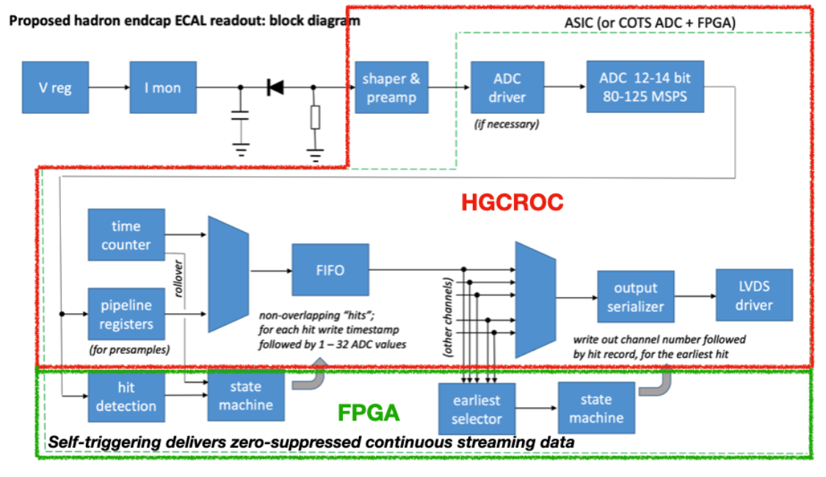
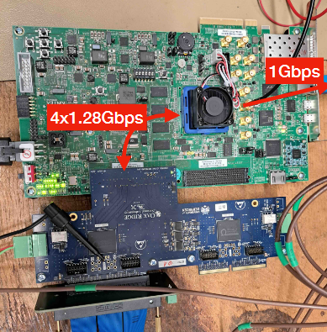
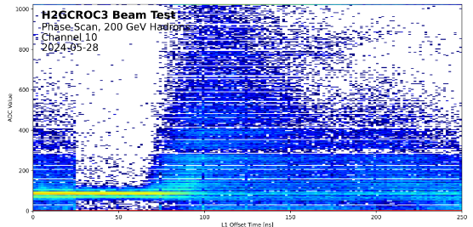
FY25 Status & Progress – cont. Calorimeters, SiPMs – H2GCROCv3 (ORNL)
Develop a readout solution for the calorimeters with SiPMs by:
Employing existing H2GCROCv3 ASIC
Developing PCBs for full readout chain
Developing cabling infrastructure
Input to CALOROC design.
Adapter PCBs
FEB PCBs
Beam Tests, Waveforms
RDO PCBs
H2GCROCv3
Progress Summary:
H2GCROCv3 PCBs (6) from OMEGA with KCU105 FPGA eval kit – Beam tests validating streaming readout operation algorithms.
I2C and DAQ GUI interfaces done.
Cabling studies for interconnects from FEBs to RDOs are progressing (SAMTEC connectors).
LED tests using H2GCROC pulser.
Testing SiPM summing PCBs for full characterization with multiple sensors under way.
9

Slide 10
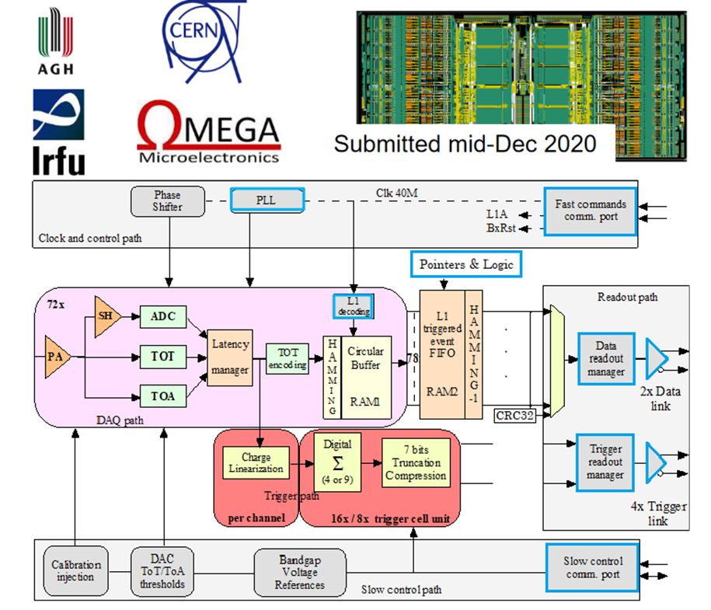
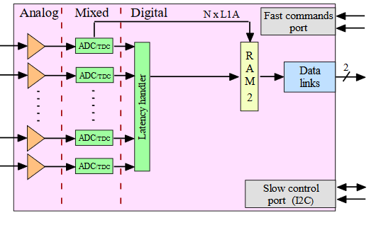
FY25 Status & Progress – cont. Calorimeters, SiPMs – CALOROC (OMEGA/IN2P3/IJCL)
CALOROV1A
H2GCROCv3
No Change
Modify trig, mem, CLK dist.
1D, 64 ch.
130 nm CMOS
Charge (ADC+TOT) + Time (TOA)
Cdin: 500 pF-10 nF
Dynamic Range: up to 12 nC
Timing: <500 ps (1 MIP)
ADC: 10b; TOT: 15b
39.4 MHz operation from BX 98.5 MHz
Links: 1260.8 Mbps @ 39.4 MHz, multiple
Power: 10 mW/ch
Radiation tolerant.
Progress Summary:
CALOROC1A and 1B – different FE (TOT or switched gain), same backend.
Ready for submission – February 2025 – Pending funding.
Available in June 2025, depending on funding.
Backend designed and under simulation:
Streaming Readout logic
Memory
Clock pre-scaling & distribution.
Design Backend: FY23 - FY24
CALOROC1A/B: FY24 – FY25
CALOROC2: FY25 – FY26
CALOROC3: FY27 Production
10

Slide 11
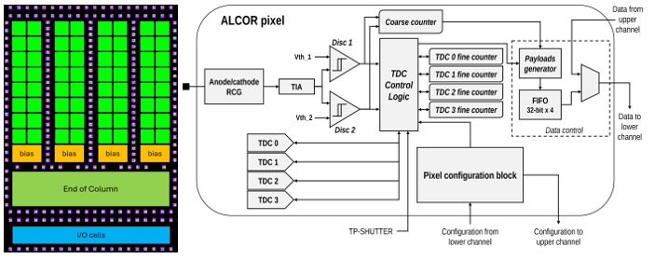
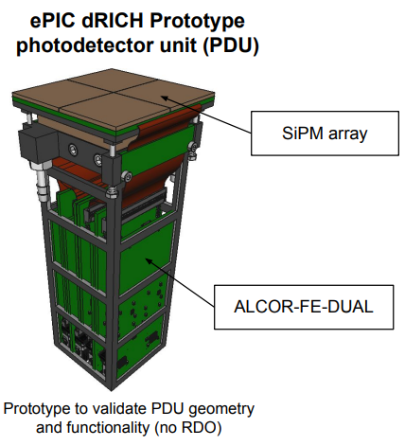
FY25 Status & Progress – cont. dRICH – SiPMs – ALCOR (INFN)
Originally developed by INFN for DARKSIDE.
Progress Summary:
ALCOR v2: 32-pixel,
ALCOR v2.1 delivered in Jan 2024 and currently in beam tests.
Two 32 ch ALCOR on PCB (FE-DUAL) for PDU tests.
ALCOR 64 ch fabricated.
ALCOR v3 characterization – September 2025.
FEB v1 – May 2025.
RDO v1 – Simulations and layout on-going.
2D 8x8 pixel readout
110 nm CMOS
Dual polarity, RCG Amplification, conditioning, inhibit , digitization.
Modes of operation: single-photon tagging or time and charge.
Triggerless and triggered operation; Digital Shutter; Timing: <150 ps
20-40 ps TDCs, TOA+TOT
5 MHz input
788 Mbps LVDS links.
SPI Configuration.
Power: 12 mW/Ch
Radiation tolerant.
ALCOR v2.1 (32 pixel): FY24
ALCOR v3: FY24 – FY26
ALCOR: FY26 – FY27 Production
11

Slide 12
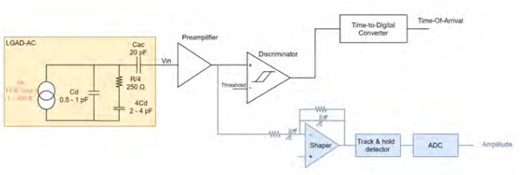
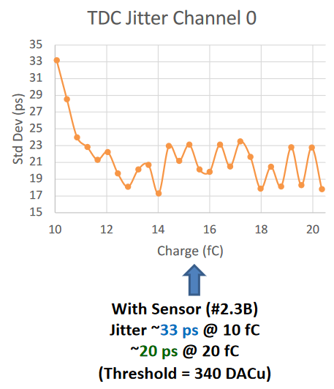
FY25 Status & Progress – Cont. AC-LGAD pixel – EICROC (OMEGA/IN2P3/IJCLab/CEA-IRFU/AGH)
One pixel – EICROC0
2D, 32x32 pixel readout
130 nm CMOS
Preamp, Discriminator, TOA, ADC, TDC
Cdin: 1-5 pF; Dynamic Range: 1-50 fC
Timing: 30 ps; ADC: 8b; TDC: 10b
39.4 MHz operation from BX 98.5 MHz
Links: 1260.8 Mbps @ 39.4 MHz, multiple
Power: <2 mW/ch
Packaging: Bump+Wire bonds
Radiation tolerant.
Sensor
Plus backend as CALOROC
Progress Summary:
EICROC0 (4x4) full characterization complete.
EICROC0,A,B – intermediate iteration for low power complete.
EICROC1A 8x32, EICROC1 32x32 - complete.
Ready for submission – February 2025 – Pending funding.
Available in June 2025, depending on funding.
Wire
EICROC0 (4x4): FY23 – FY24
EICROC0A (4x4): FY24 – FY25
EICROC1A (8x32), EICROC1 (32x32): FY25
EICROC2 (32x32): FY27 – FY28 Production
Wire
Bump
4x4 500 um pixels
12

Slide 13
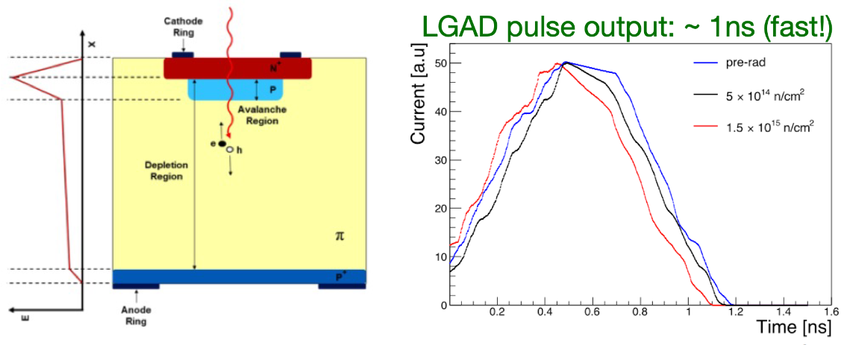
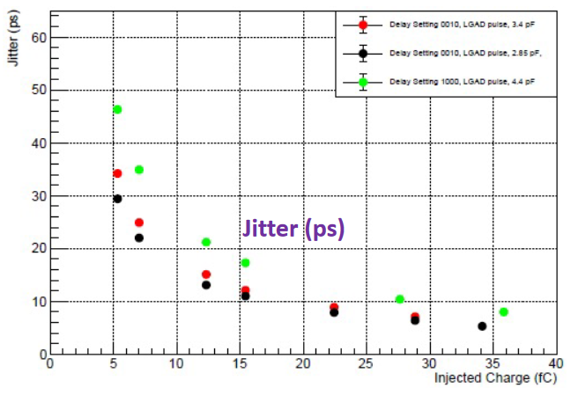
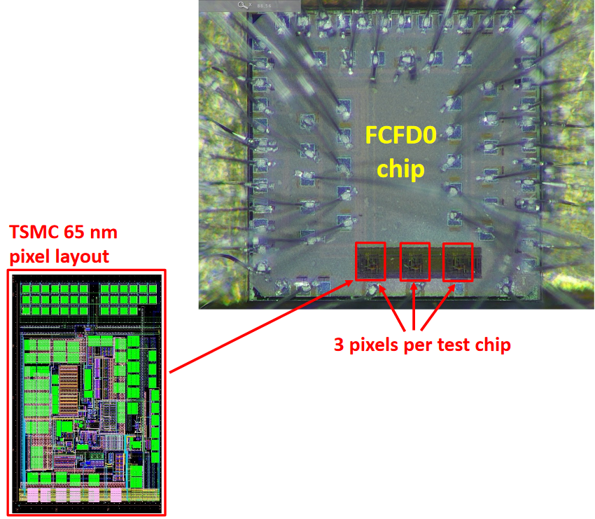
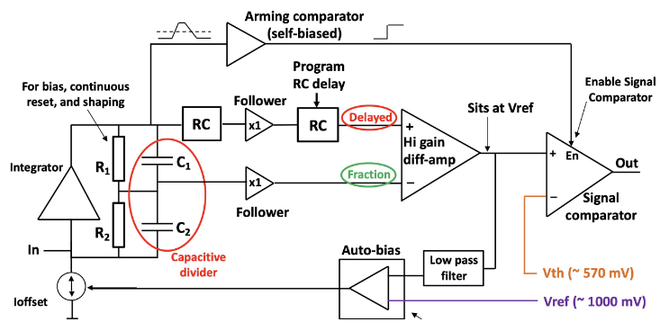
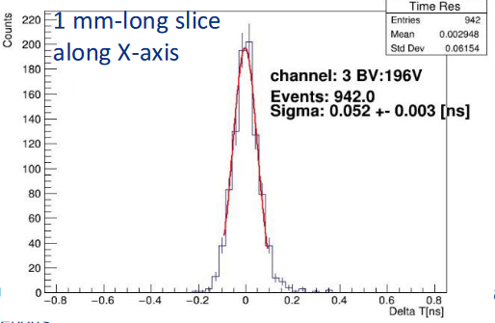
FY25 Status & Progress – Cont. AC-LGAD strip – FCFD (FNAL)
Progress Summary:
FCFDv1 – 6 channel received Jan 2024.
Tested at FNAL in May & June 2024, AC & DC-LGAD (1 mm):
DC-LGAD @ 50 ps; AC-LGAD @ 52 ps
AC-LGAD should get ~35 ps with improved comparator.
FCFDv1.1 – TSMC May 2025; DESY tests in July 2025.
128 ch strip readout
65 nm CMOS
Constant Fraction Discriminator
Plus TDC, ADC, interfaces
Cdin: <15 pF
Dynamic Range: 5-40 fC
Timing: 10-30 ps
Links: ~Gbps, multiple
Radiation tolerant.
FCFDv1 (6 ch): FY23 – FY24
FCFDv1.1 (6ch): May 2025
FCFDv2: FY25 – FY26
FCFDv3: FY27 Production
13

Slide 14
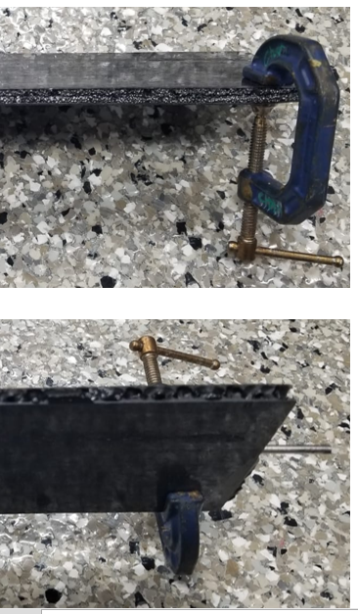
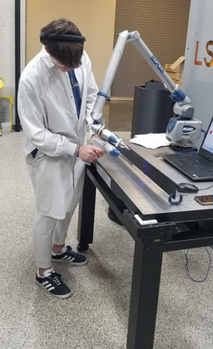
FY25 Status & Progress – Cont. AC-LGAD – Barrel Low-Mass Hybrid (ORNL)
Flex with LV, HV, Temperature sensors
2-layer and multi-layer Kapton with different stack-ups
With peel-off Kapton to protect ENIG pads
Flex-PCB
Barrel TOF Carbon Fiber Test Structures
Progress Summary:
Pre-prototypes fabricated and successfully co-cured onto the TOF prototype staves at Purdue.
Full characterization under way.
Materials and equipment procured for flip-chip assembly (~$2M from ORNL).
Started making test assemblies with Flex-PCB pre-prototypes.
14

Slide 15
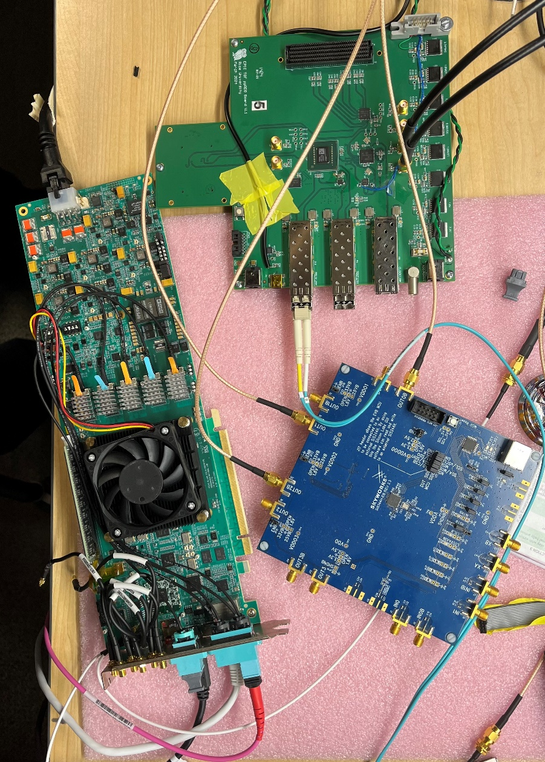
FY25 Status & Progress – Cont. AC-LGAD – High Precision Clock Distribution (BNL/LBNL/RICE)
ppRDO – pre-prototype Readout Board:
Generalized to allow readout from various ASICs – FMC connector
Xilinx Artix+ FPGA (low cost, CERN TCLink compatible
Clock Jitter cleaner – 5 ps
Clock recovery on Rx of SFP or direct clock on dedicated fiber
Establish procedures to readout ePIC’s ASICs prototype PCBs
Develop common streaming readout scheme with DAQ’s protocols
Platform for radiation tests (SEU measurement and handling)
ppRDO
(ADCLK944)
Progress Summary:
Produced and tested 6 PCBs.
Jitter measured at 3 ps (Ref clock – FLX182 Tx serializer – ppRDO)
In Progress:
General firmware
Readout of CMS ETROC ASIC, as a test
DAQ readout firmware
Planning tests with VTRX+ transceiver.
FLX182
Si5344H
(ref Clock)
15

Slide 16
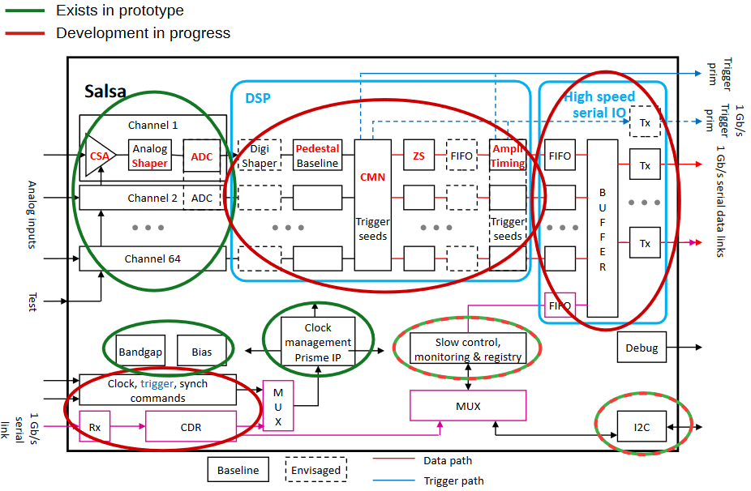
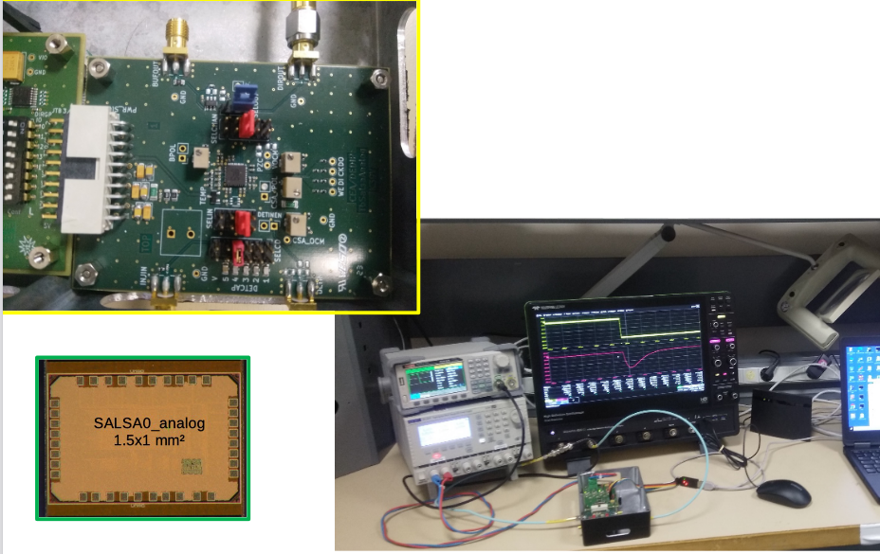
FY25 Status & Progress – Cont. MPGD – SALSA (CEA-Saclay, U. Sao Paulo)
Progress Summary:
SALSA0_analog and SALSA0_digital blocks fully characterized.
PLL block + services prototyped under PRISME. PRISMEv1 – April 2025.
SALSA1 (full frontend and ADC chain) – under tests.
SALSA2 (32 ch fully featured with DSP) design in progress for submission in October 2025.
Tests in 2026, available to users.
64 Ch
65 nm CMOS
Peaking time: 50 – 500 ns;
Inputs: Cdin<200 pF; Dual polarity; Q: 3 – 250 fC
ADC: 12 bits, 5 – 50 MSPS.
Extensive data processing capabilities
I2C configuration.
Triggerless and triggered operation;
Several 1 Gbps links.
Power: 15 mW/Ch
Radiation tolerant.
SALSA0 (IP blocks): FY23
SALSA1: FY23 – FY24
SALSA2: FY23 – FY25
SALSA3: FY25 – FY26
SALSA: FY27 – FY28 Production
16

Slide 17
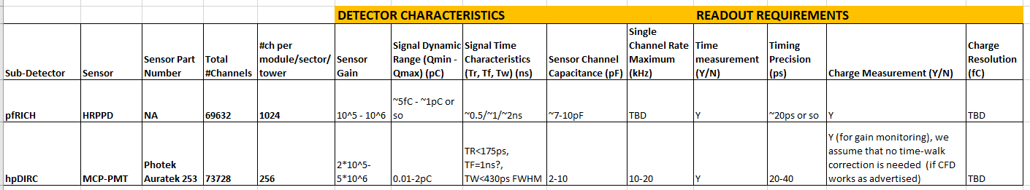
FY25 Status & Progress – Cont. FCFD Variant for pfRICH, hpDIRC
Specifications & Requirements - Preliminary
FCFD Variant under consideration by FNAL group, covering:
Detectors operational characteristics and needs
ASIC preliminary specifications and requirements
Packaging (64 ch?)
Additional resources from FNAL.
Dynamic range requirements for pfRICH possibly narrower and agreeable with FCFD design for the bTOF AC-LGADs and wrt timing precision and signal charge envelope
FNAL will provide a project outline very soon
Establishing regular meetings.
17

Slide 18
Schedule: WBS 6.10.08 – Electronics - Development
Example of development (not to scale)
Construction
FY23 through FY26
ASIC Development
FY26 – FY28 – 1 Year
ASIC Fab Production & Testing
NOTE: FEB designs are contingent upon final ASIC pinout/package design.
6 Months
ASIC Testing
Eng. Article Development
Eng. Article Tests
Installation
<1 Year
PCB Production
First Production ASICs
<1 Year
Production Tests
<3 Months
Integration Tests
<3 Months
R&D FY23 - FY24
PED FY25 - FY26
System Tests
Design
18

Slide 19
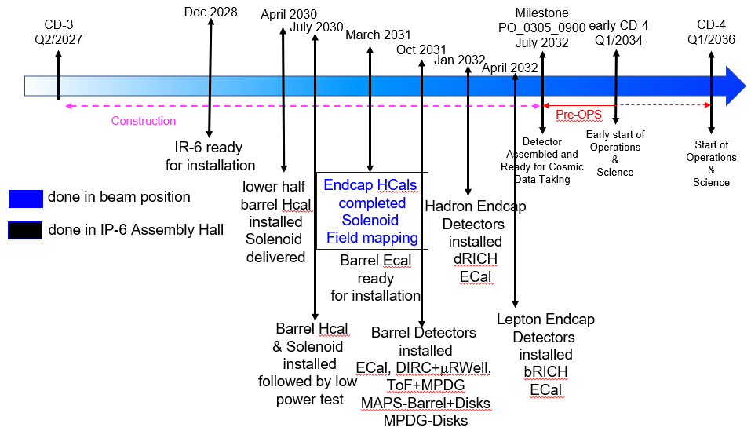
Schedule: WBS 6.10.08 – Electronics - Installation
WBS6.10.02 | eRD109 | Milestones | FEB QC Complete
Calorimeters | Discrete, CALOROC | 30 September 2025 | Mar 2028 – Jan 2030
AC-LGAD | EICROC, FCFD | 30 September 2025 | Nov 2027 – Jan 2029
dRICH | ALCOR | 2 January 2026 | Nov 2028
MPGD | SALSA | 31 March 2026 | Sep 2028 – Jun 2029
HRPPD/MCPMT | FCFD/EICROCx | 23 December 2026 | Sep 2028 – Jan 2029
Installation
Apr 2030 – Jan 2032
WBS 6.10.02 – Electronics for detectors R&D.
eRD109 – Readout R&D.
Milestones – ASICs ready for production.
ASIC Production FY26 – FY28.
FEB QA/QC Complete – Ready for integration.
FY23 – FY26
FY26 – FY28
R&D, PED (eRD109)
ASIC Production
11/2027 – 1/2030
FY26 – FY29
Readout Production & QC
QC Complete
19

Slide 20
R&D Milestones & PED Outlook
Develop a streaming readout solution for the EIC calorimeters with SiPMs and the associated PCBs and cabling infrastructure. Decide between options using COTS devices or directly starting from existing ASICs. [September 2025]
Done. Discrete implementation with COTS devices was selected for forward and backward EM calorimeters with specifications completed in 2024, beam tests at DESY in 2025; engineering article planned as supported by PED in FY26 and production in FY27. The CALOROC ASIC is under development by OMEGA/IN2P3 group as in-kind, benefitting from evaluation with the H2GCROC ASIC, and selected for the LFHCAL. Tests were performed at CERN in May 2024. The CALOROC is compatible with streaming readout and development is supported by PED: CALOROC1A and 1B in FY24 – FY25, CALOROC2 (final version) in FY26 and production in FY27.
Develop a streaming readout solution specific to the Ring-Imaging Cherenkov (RICH) particle identification detectors with SiPMs. This may require a modification of an existing ASIC design. [December 2025]
Done. The ALCOR ASIC was selected. The ALCOR development is done as in-kind by INFN. ALCORv2 32 pixel 8 x 4 was completed in FY24. Further development is supported by PED: ALCORv3 64 pixel 8 x 8 in FY25, ALCORv4 ready for production in FY26.

Slide 21
R&D Milestones & PED Outlook (cont.)
Develop a streaming readout solution specific to particle identification detectors with LAPPDs and/or MCPMTs. This requires a novel ASIC in 130 nm CMOS technology that meets the requirements set by EIC providing a precise time measurement with a TDC combined with an Analog Digital Converter (ADC) for the amplitude measurement. [December 2026]
Done. A variant of the FCFD ASIC was selected, benefitting from the development of the FCFD (65 nm) for the AC-LGAD strip readout. This work will be supported by PED in FY25 and FY26; production of the FCFD variant for the pfRICH and the hpDIRC is planned for FY27.
Develop a low-mass streaming readout solution specific to the barrel-region AC-LGAD at an EIC Detector, including design of the power delivery and readout service system. This includes a decision between redesign of existing ASICs or use of third-party ASIC solutions [September 2025].
Done. The EICROC ASIC has been selected for AC-LGAD pixel readout. The EICROC is based on the previously developed HGCROC ASIC and will conform to streaming readout requirements. The EICROC is done as in-kind by OMEGA/IN2P3. EICROC0 exist with 4 x 4 channels, power reduction is implemented in EICROC0A and 0B. Design of EICROC1A (8 x 32) and EICROC1 (32x32) are complete and ready for submission in FY25. The final version, EICROC2 (32 x 32) will be completed in FY26 with production in FY27. For barrel AC-LGAD strips the FCFDv1 has been completed in FY24 with added interfaces in FY24/FY25 (FCFDv1.1) and with synergies with FNAL/DUNE. FCFDv2, the final version under PED, will occur in Fy26 and is expected to be ready for production in FY27.

Slide 22
R&D Milestones & PED Outlook (cont.)
Develop a streaming readout solution specific to the MPGD-based tracking detectors. This requires a modification based on previous ASIC designs to include compatibility with streaming readout, a new CMOS technology, and 64-channels. [March 2026].
Done. Much work has been done as in-kind by CEA/USP. 4-channel SALSA submitted April 2024. The SALSA2 and final SALSA3 implementations in 65 nm technology will be supported as PED in FY25 and FY26. Production is anticipated in FY27.

Slide 23
Summary
Considerable progress:
ASIC interfaces for FEB-RDO – iterative process with designers, on-going
ASIC workshop with project 2-3 June 2025 @ Saclay.
Resources needed for the next 1-2 years:
Expect a few prototype MPW runs per design ($)
Pre-production run per design ($$$) (masks: $250k/130 nm, $750k/65 nm)
Tests are resource intensive (EE, Tech, prototypes)
pfRICH, hpDIRC readout – FCFD Variant in progress.
Contracts
FY23 – Completed
FY24 - Some requested extensions, still underway in FY25
FY25 – All PED (P6) onward, all submitted but funds are constrained.

