Slide 1
Physics Motivation for the Backward Hadronic Calorimetry in ePIC
Daniel Brandenburg (OSU)
for the ePIC nHCAL Group
March 25, 2025
nHCAL DSC Meeting

Slide 2
Electron Ion Collider Mission
Low-x measurements are crucial to the EIC physics mission

Slide 3
Physics central to EIC Mission
Key question: Why put hadronic calorimetry in the electron going direction (backward)?
Answer: Low-x physics
Backward region = high gluon densities
“the EIC will be the first experimental facility capable of exploring the internal 3-dimensional sea quark and gluon structure of a nucleus at low x” – EIC White paper

Slide 4
Backward (negative Eta) HCAL Coverage
For leading order processes event kinematics determine the final state
nHCAL = low-x, low-Q², ~mid to high-y

Slide 5
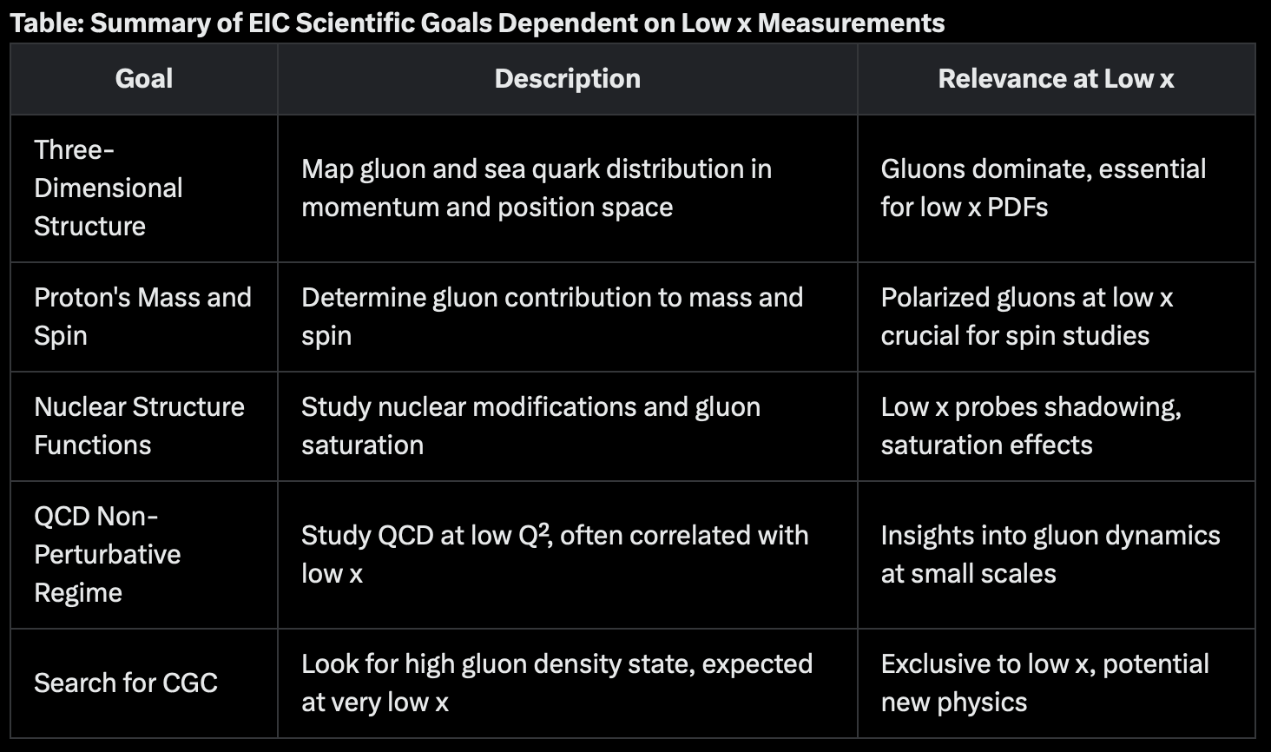
Backward (negative Eta) HCAL Coverage
For leading order processes event kinematics determine the final state
nHCAL = low-x, low-Q², ~mid to high-y

Slide 6
Physics central to EIC Mission
Key question: Why put hadronic calorimetry in the electron going direction (backward)?
Answer: Low-x physics
Specifically, nHCAL improves/allows:
  Hermiticity + Electron tagging in low-x
  Diffractive Processes (Vector Mesons + Dijets)
  Neutron detection and neutral veto
Backward region = high gluon densities
“the EIC will be the first experimental facility capable of exploring the internal 3-dimensional sea quark and gluon structure of a nucleus at low x” – EIC White paper

Slide 7
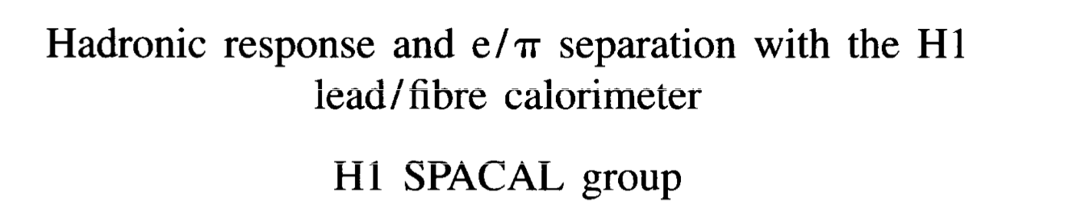
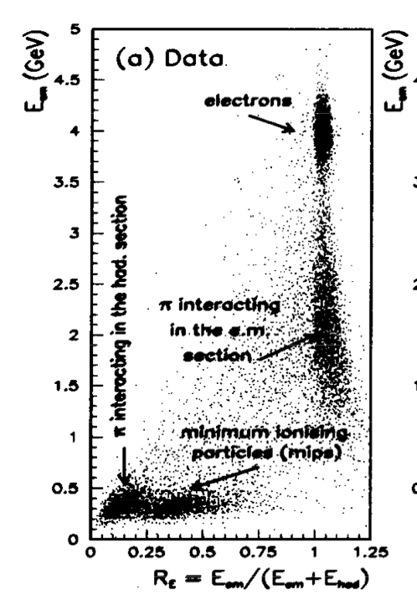
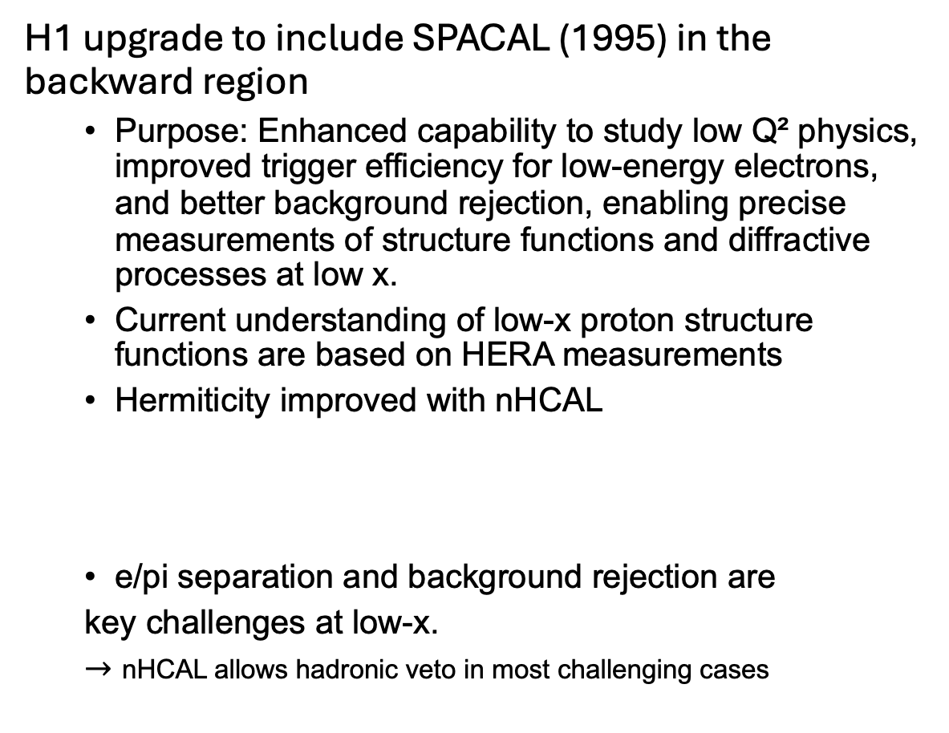
Lessons from HERA : Hermiticity + Electron Tagging
H1 upgrade to include SPACAL (1995) in the backward region
  Purpose: Enhanced capability to study low Q² physics, improved trigger efficiency for low-energy electrons, and better background rejection, enabling precise measurements of structure functions and diffractive processes at low x.
  Current understanding of low-x proton structure functions are based on HERA measurements
  Hermiticity improved with nHCAL
  e/pi separation and background rejection are
  key challenges at low-x.
  $→$ nHCAL allows hadronic veto in most challenging cases
Tyler Kutz
+ Precision event shape measurements
Potential benefit with nHCAL
Low-x and low-Q^2

Slide 8
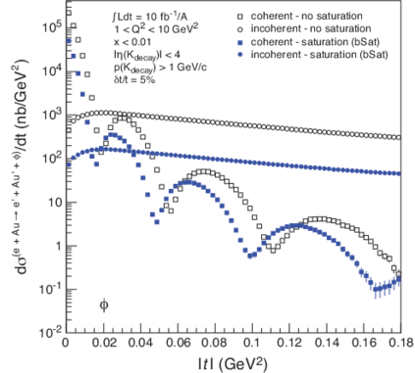
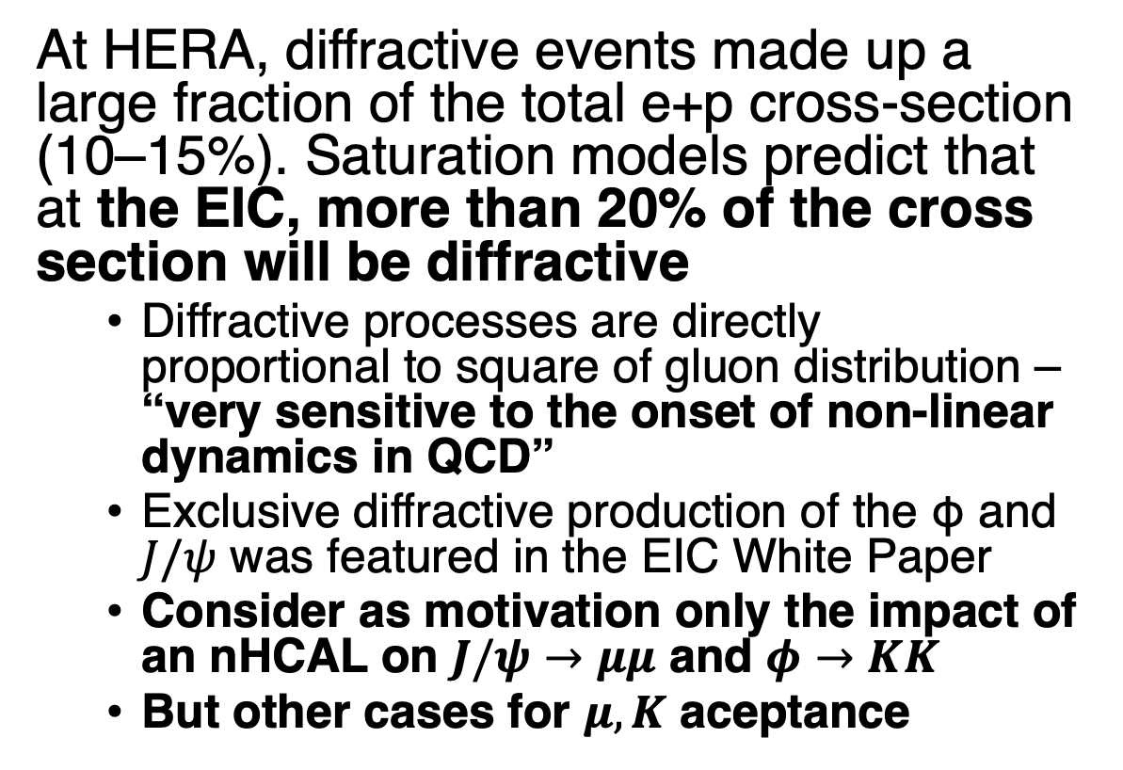
Diffractive Events
At HERA, diffractive events made up a large fraction of the total e+p cross-section (10–15%). Saturation models predict that at the EIC, more than 20% of the cross section will be diffractive
  Diffractive processes are directly proportional to square of gluon distribution – “very sensitive to the onset of non-linear dynamics in QCD”
  Exclusive diffractive production of the φ and $J/ψ$ was featured in the EIC White Paper
  Consider as motivation only the impact of an nHCAL on $J/ψ$ $→μμ$ and $φ→KK$
  But other cases for $μ, K$ aceptance
H.Mantysaari,B.Schenke PRC 101 (2020) 015203
https://arxiv.org/pdf/2103.05419

Slide 9
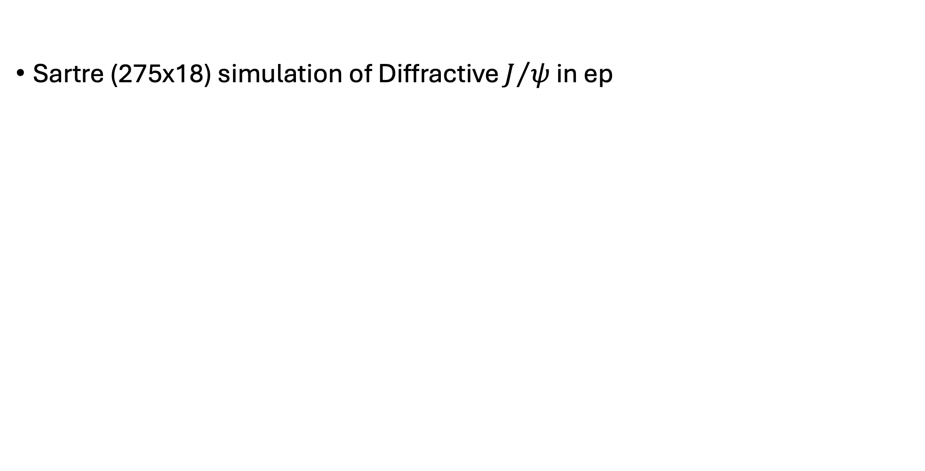
VM Kinematic Distributions
Sartre (275x18) simulation of Diffractive $J/ψ$ in ep
Additional backward acceptance has a multiplication effect. Access to various VM decay topologies:
nHCAL x nHCAL
nHCAL x Barrel
nHCAL x LFHCAL
Backward acceptance is crucial for accessing fully available diffractive cross section
-4.05 < eta < -1.2

Slide 10


nHCAL Impact for $J/{ψ→μμ}$
40% = nHCAL + any: J/psi send one or both muons into backward HCAL acceptance
Virtually all $x<{\sim 10}^{−3}$ events require nHCAL acceptance
Bonus: muon channel compliments electron channel, reduced Bremsstrahlung + Sudakov
UIUC
Study
98.30%
nHCAL
Needed

Slide 11

nHCAL Impact on $φ→KK$
25% = nHCAL + any: $φ$ sends one or both Kaon into backward HCAL acceptance
Virtually all $x<{\sim 10}^{−3}$ events require nHCAL acceptance
Bonus: muon channel compliments electron channel, reduced Bremsstrahlung + Sudakov
UIUC
Study
97.30%
nHCAL
Needed

Slide 12
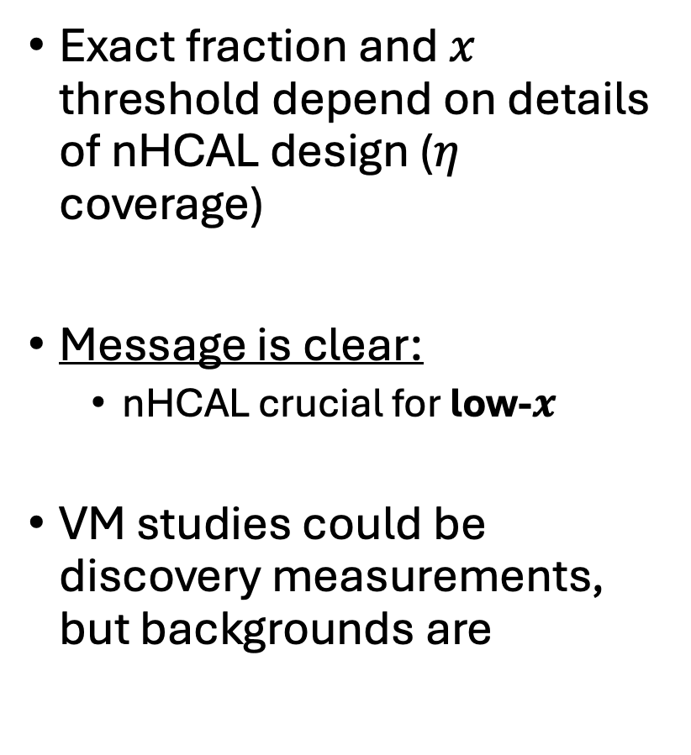
nHCAL for Low-x VM Production
Exact fraction and $x$ threshold depend on details of nHCAL design ($η$ coverage)
Message is clear:
  nHCAL crucial for low-$x$
VM studies could be discovery measurements, but backgrounds are
UIUC
Study
Phys. Rev. D 104, 114030

Slide 13
Difractive Dijets – Another Crucial Component
“Studies of (dijet) diffraction in high-energy electron-proton scattering is one of the highlights of the HERA heritage”
Low-x, high-y processes -> Jets in negative eta
Hi inelasticity events = activity BOTH forward & backward
“The importance of jet probes was reflected in
the EIC Yellow Report where they touched on
nearly every major physics topic (Nucl. Phys.
A, Vol 1026, 122447)”
CHARGED Hadrons
Neutral Hadrons
nHCAL – improve Jet Energy Resolution + Jet energy scale for large range of low-x measurements
https://arxiv.org/pdf/1911.00657

Slide 14
Neutral
nHCAL – improve Jet Energy Resolution (JER) + Jet Energy Scale (JES) for large range of low-x measurements
Vetoing jets with neutral
hadrons using the nHCal
could substantially
improve resolution + scale
nHCAL can provide low energy neutron detection
EIC Yellow Report Fig. 8.57

Slide 15

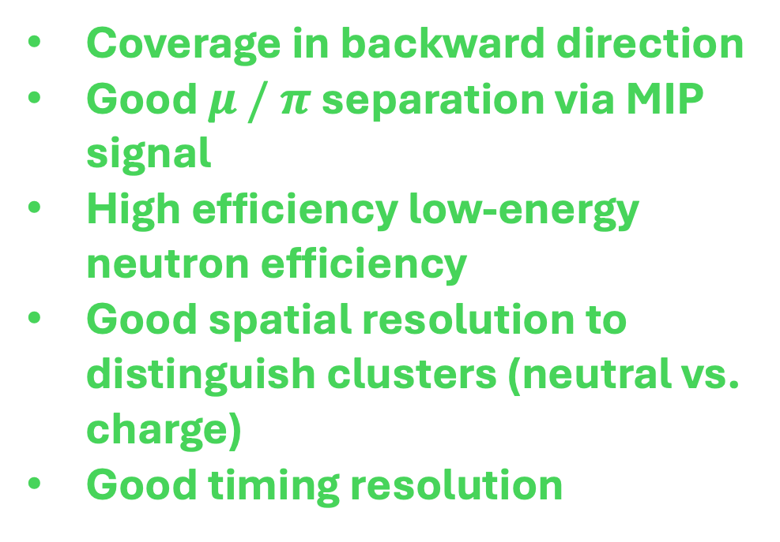
ePIC nHCAL: Physics $→$ Detector Requirements
=
We want to do this physics + crucial to EIC Mission
Detector Requirements
nHCAL Crucial for:
Low-x & Q^2, high y
Diffraction
Vector Mesons
Dijets
Charged Jet Measurements
Neutral Jet / Neutral VETO
Scattered Electron ID (h VETO)
Improved Hermiticity (benefit kinematic resolution in CC)
Coverage in backward direction
Good $μ / π$ separation via MIP signal
High efficiency low-energy neutron efficiency
Good spatial resolution to distinguish clusters (neutral vs. charge)
Good timing resolution
nHCAL: crucial for core aspects of EIC Physics Mission

Slide 16
Summary nHCAL
Electron Track
Electron Cluster
Tyler Kutz

Slide 17
Kinematic Resolution
Tyler Kutz

Slide 18
Low x physics:
  Proton structure
  Nuclear structure

Slide 19
Neutral jets impact

