Slide 1
Air Flow Vibration Studies

Slide 2
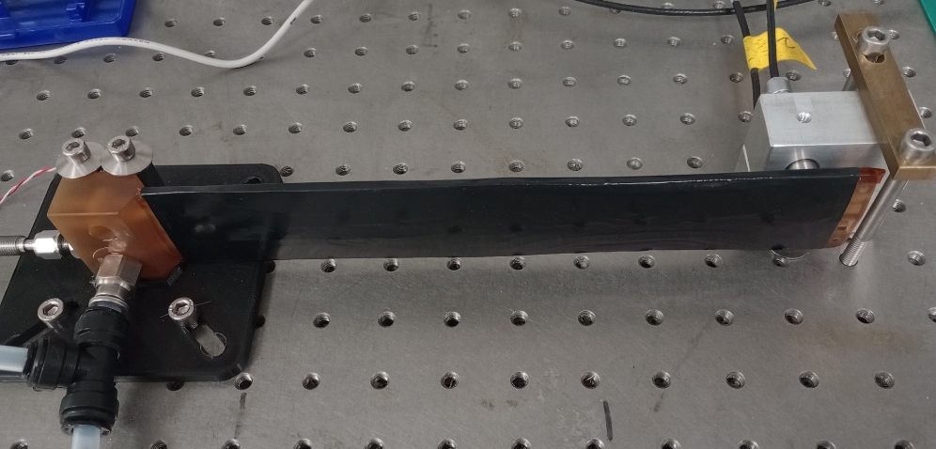
Setup
Use quarter stave prototypes
For now use one flow channel (one half) of the quarter stave
Quarter stave prototype 2 (QSP2)
Prototype which erroneously has only one layer of CF prepreg in each skin (no transverse layer)
To stabilize this was put into heat shrink, which makes a close air channel
Quarter stave prototype 3 (QSP3)
Using thin steel shim stock to replace modules, first again with shrink wrap, then glued
Found that facesheet was damaged next to C-channel
For now mostly proof of principle
Sensors & readout
Flow meter (up to 100 l/min) + needle valve to adjust flow, flow measurement in DAQ
2 capacitive displacement sensors, in DAQ
Pressure sensor (up to 0.350 bar_{d}) – standalone, no connection to DAQ
Fixed edge
Displacement sensors

Slide 3
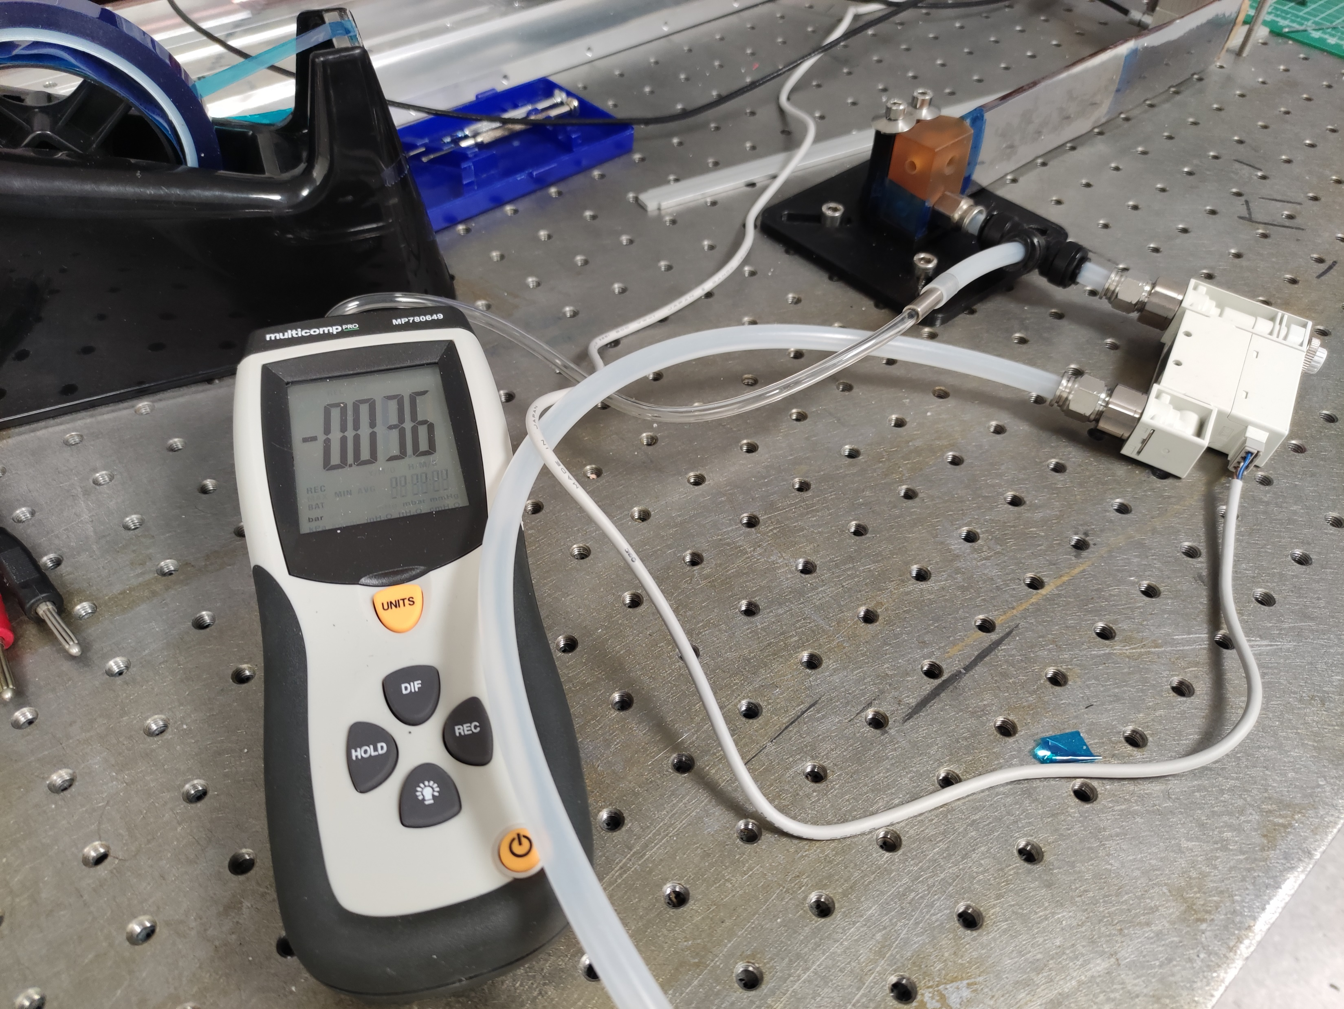
Setup

Slide 4
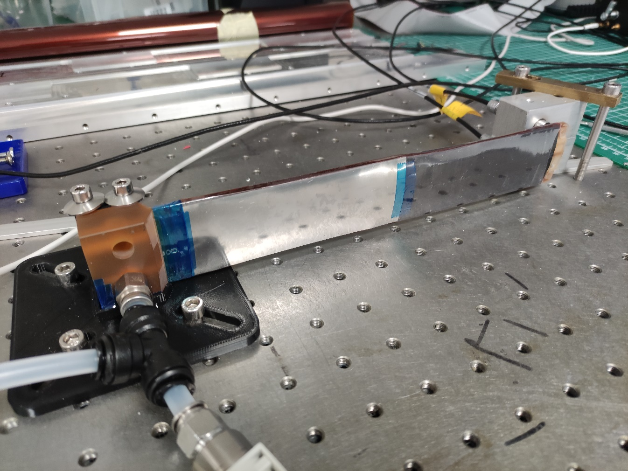
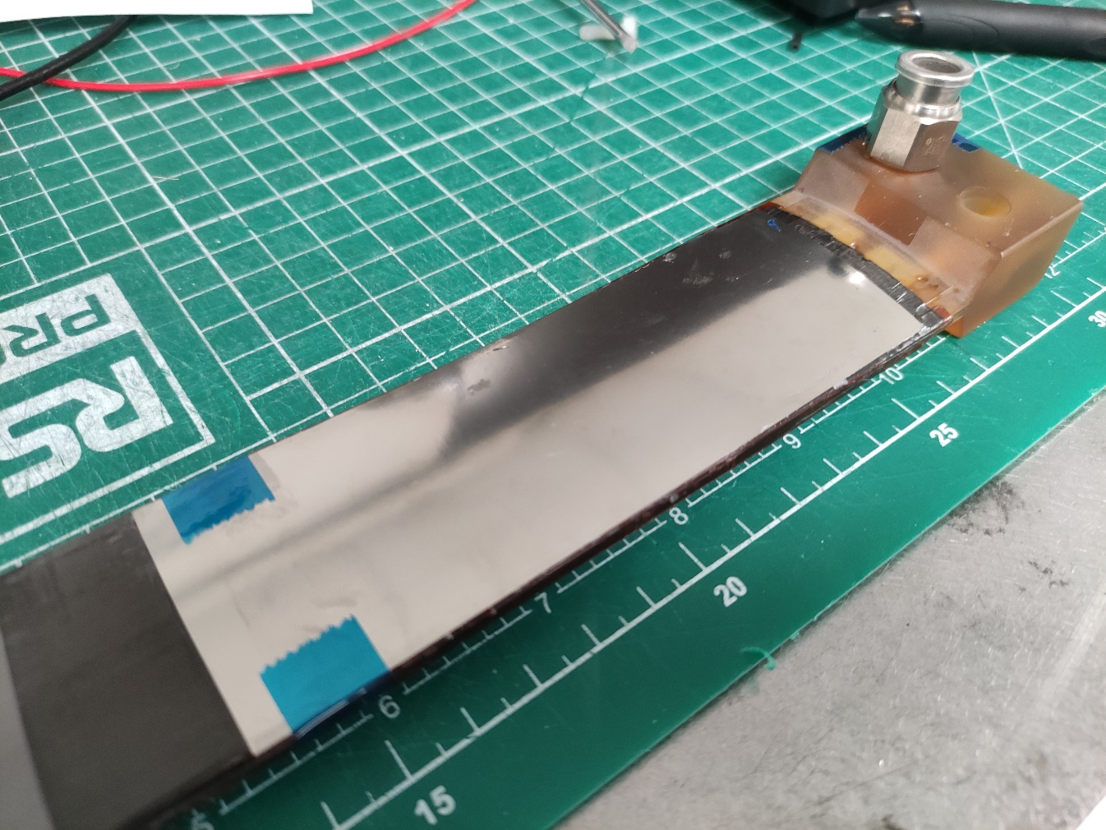
QSP3
Steel shim taped on, and heat shrink wrapped
Steel shim glues to stave structure with Araldite Rapid

Slide 5
What do we need?
Target flow rates
Still defined by coolant ΔT = 10˚C and sensor /chip power numbers from Iain @ Frascati
for max power scenario & L4 (2×8 5-RSU LAS + AncAsic + FPC ohmic loss): P_{stave} = 48.2 W or 223 l/min (about 15.5 m/s)
Nominal: P_{stave} = 31.4 W or 145 l/min (about 10.1 m/s)
Per channel (one half of the stave): Max flow about 112 l/min, nominal flow about 73 l/min
RMS displacement not really known
Needs to come from alignment and tracking studies
Different for different directions
Probably more demanding in-plane vs out-of-plane
Here only measure out-of-plane displacements at worst point

Slide 6
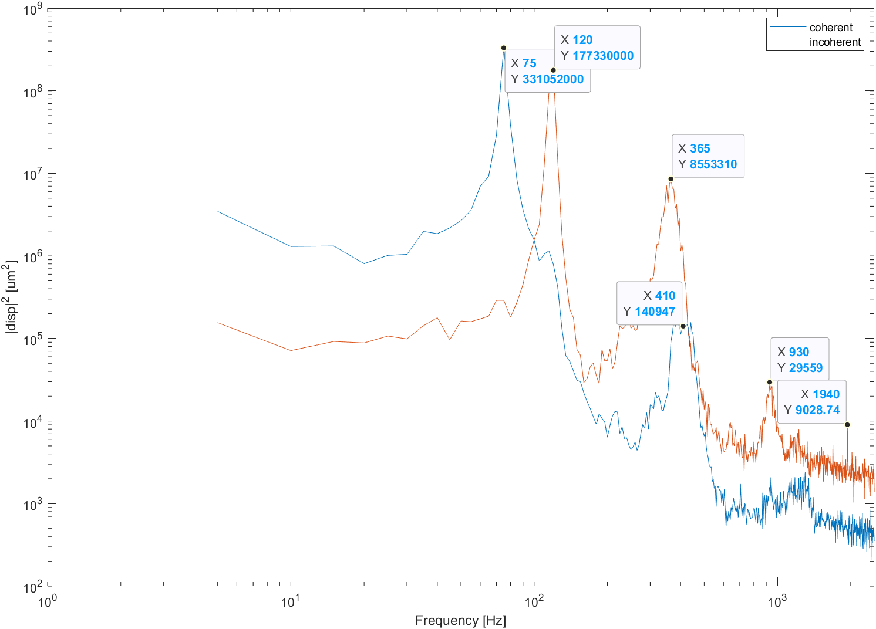
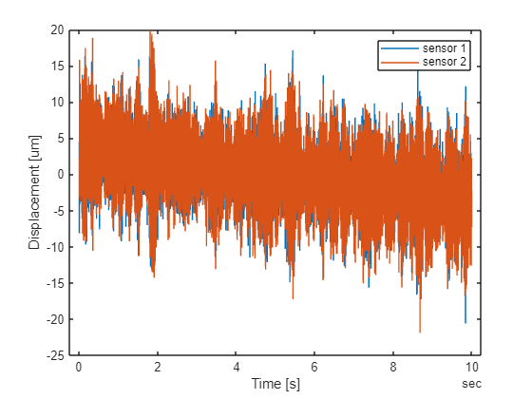
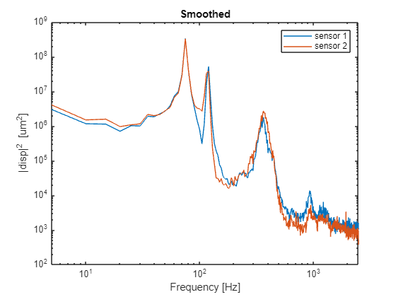

Single shot QSP2
f_{s} = 5 kHz, fl = 92.9 l/min, T = 10 s
d_{RMS}¹ = 7.9 µm, d_{RMS}¹ = 8.2 µm
$d_{coh}=\frac{d_{1}+d_{2}}{2}$, for longitudinal (beam) modes
$d_{incoh}=d_{1}−d_{2}$, for transverse (torsional) modes
First longitudinal mode is consistent with frequency scan on shaker table for QSP3

Slide 7
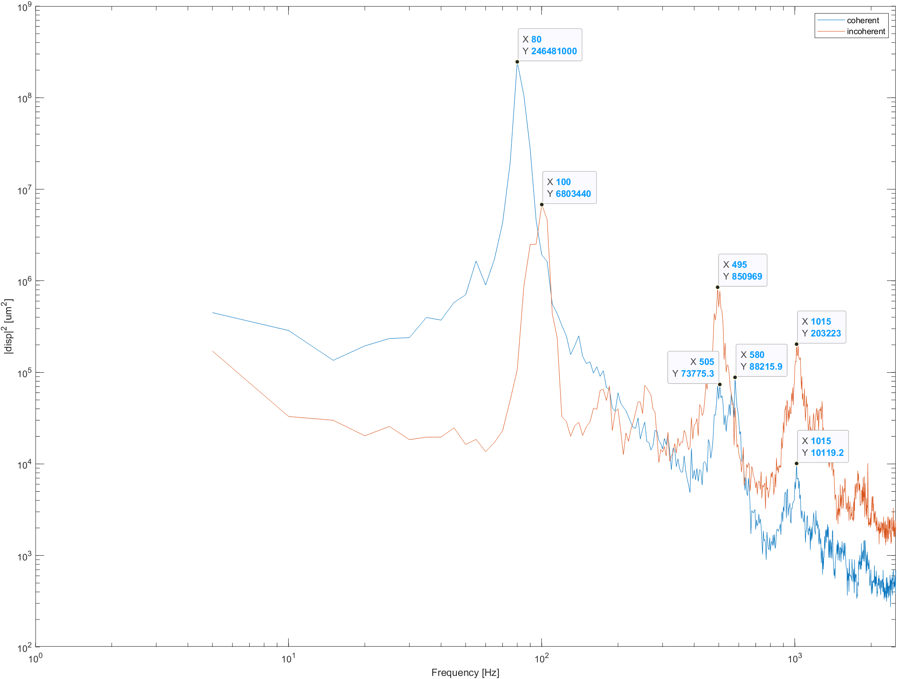
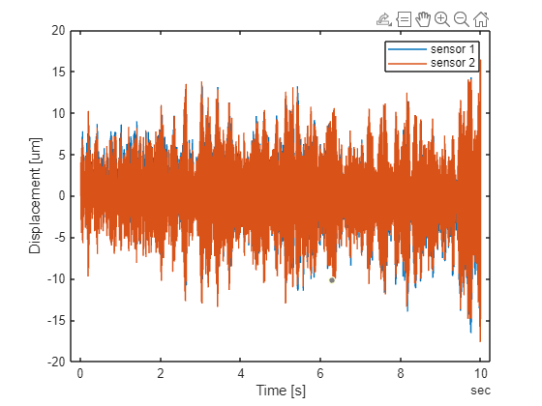
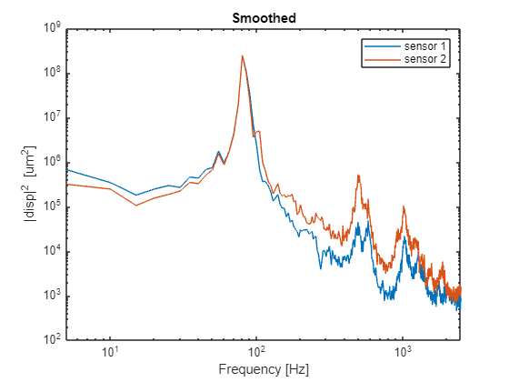

Single shot QSP3
f_{s} = 5 kHz, fl = 68.1 l/min, T = 10 s
d_{RMS}¹ = 4.2 µm, d_{RMS}¹ = 4.2 µm
$d_{coh}=\frac{d_{1}+d_{2}}{2}$, for longitudinal (beam) modes
$d_{incoh}=d_{1}−d_{2}$, for transverse (torsional) modes
First longitudinal mode is consistent with frequency scan on shaker table for QSP3

Slide 8
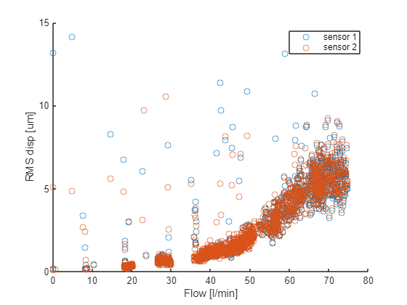
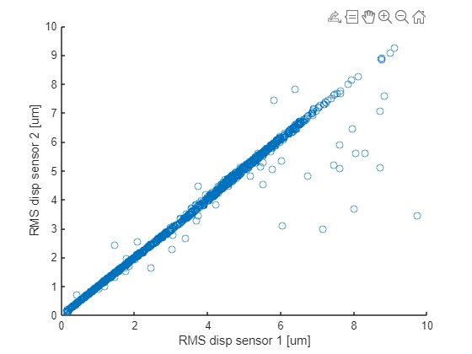
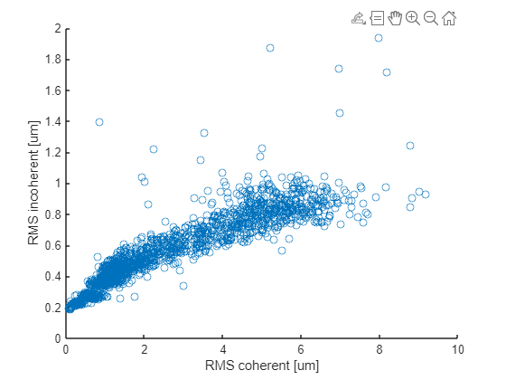
Varying flow rate QSP2
f_{s} = 5 kHz, T = 10 s, 2000 points

Slide 9
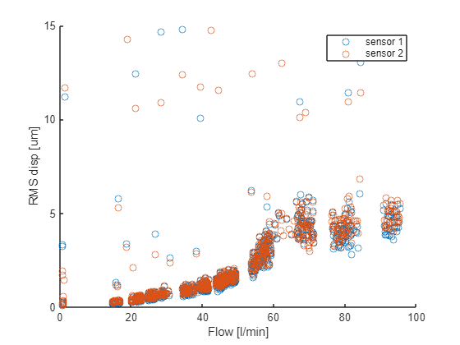
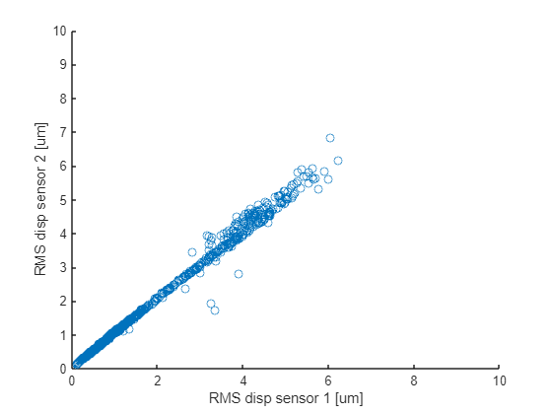
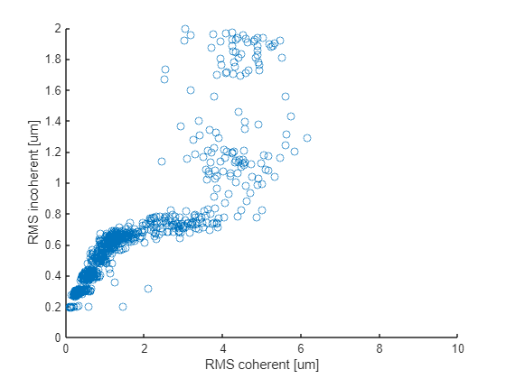
Varying flow rate QSP2
f_{s} = 5 kHz, T = 10 s, 2000 points

Slide 10
Pressure drop vs flow
Nominal
Max
Scale by 4 for full stave: nominal 0.668 bar, max 1.568 bar

Slide 11
Conclusions and next steps
Qualitative conclusions
The pressure drops are much more than we expected
Containing this pressure will be challenging
Staves are vibrating, but not shaking violently
We can do the mechanical measurements that we planned to do
Quantitative conclusions
None of the results shown here do have a final relevance, as the prototypes used show signs of structural damage
Next steps
Will need to make more prototypes
We have made a first set of simple Cu-on-Kapton heaters (incl. heat for AncASIC), use thermal camera to survey temperatures
Also have in-flow temperature sensors
Still need to be included into DAQ
Mould parts for full length stave prototype are in preparation

