Slide 1
Update for imaging validation
Xuyang Ning

Slide 2
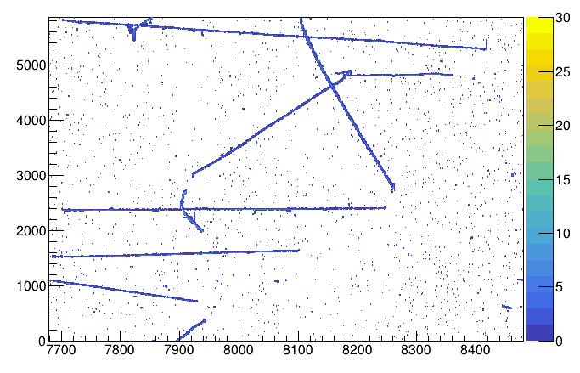
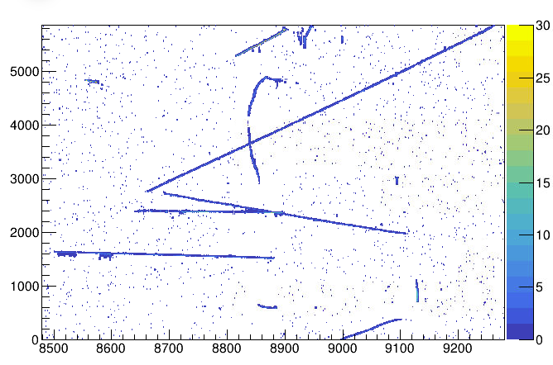
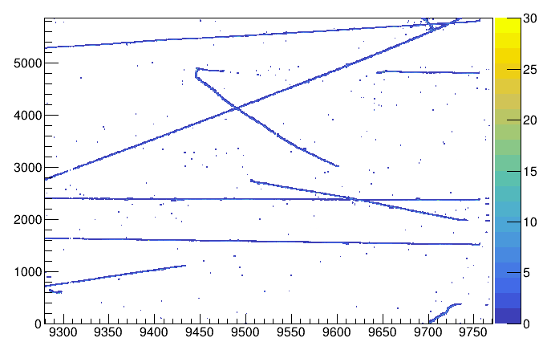
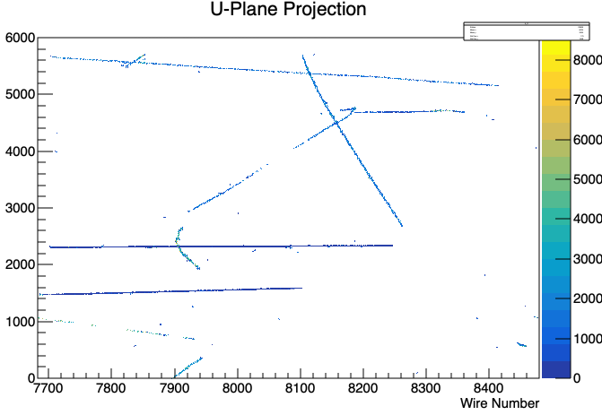
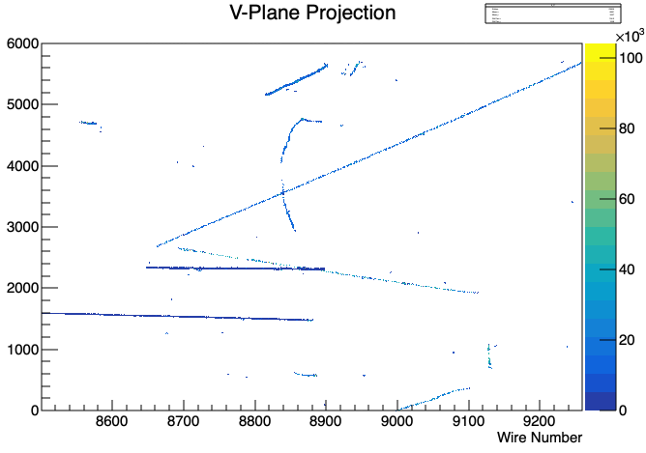
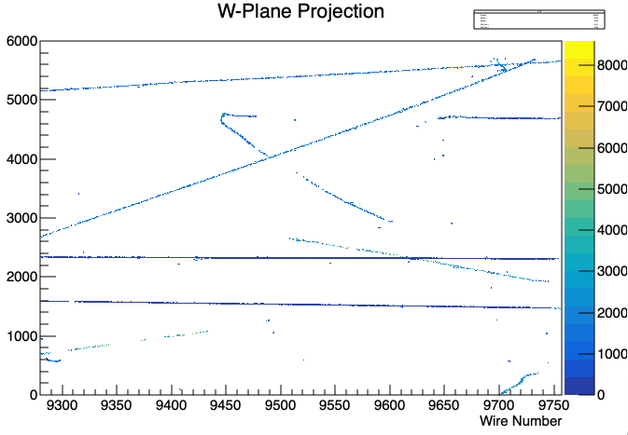
Previous
t0 = 489.0; // us
Decon result from signal processing
Project back after wire-cell-imaging

Slide 3
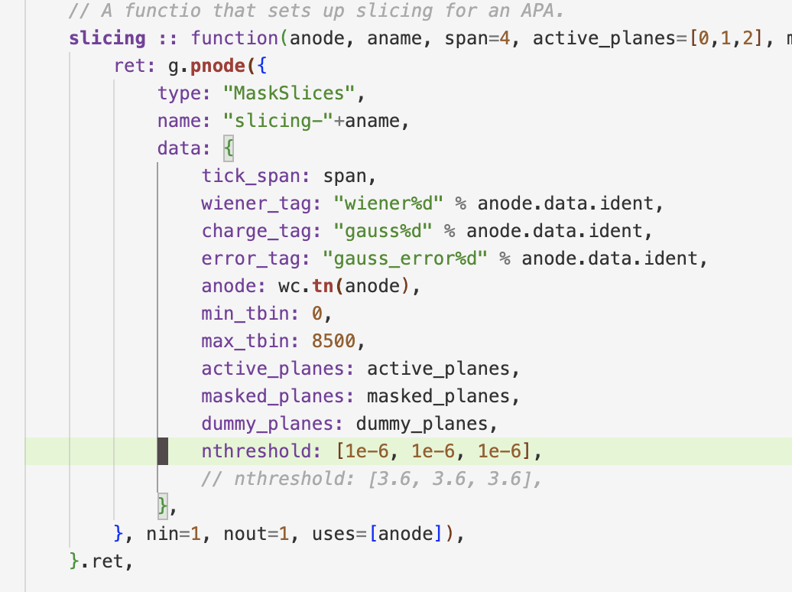
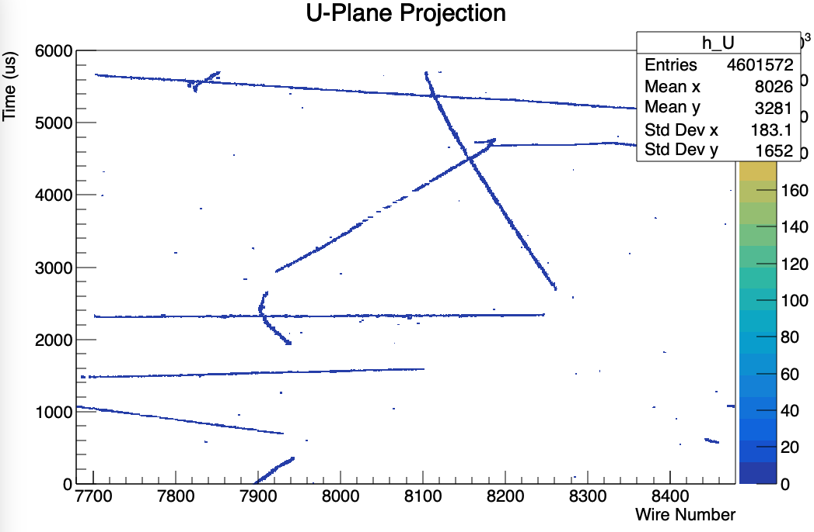
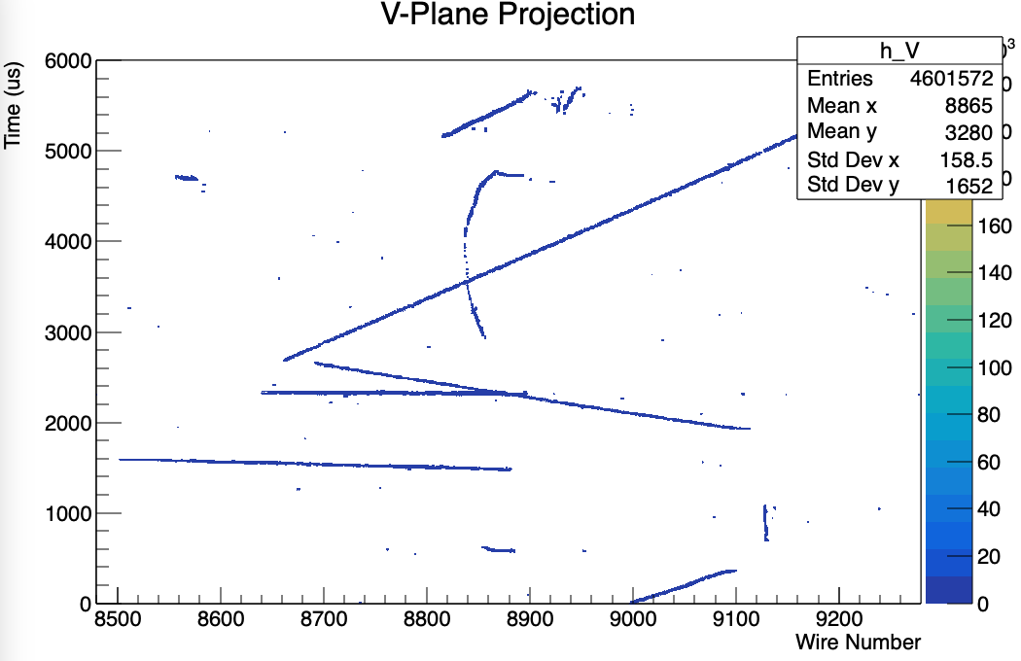
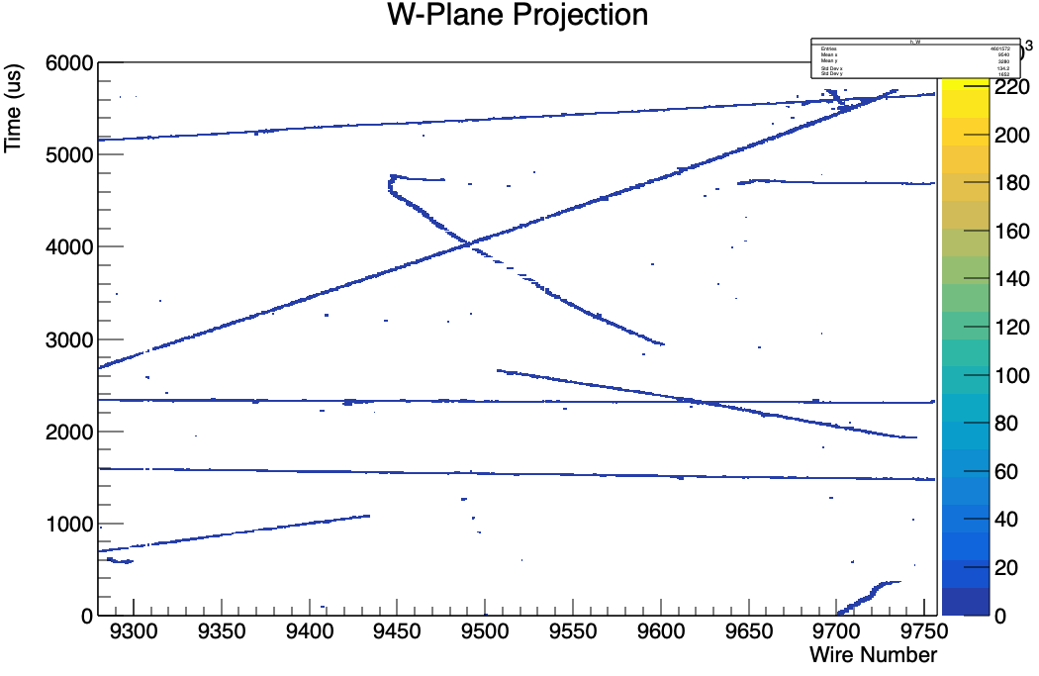
For the disconnected track
Lower the charge threshold
Position of the blob is an overlap region between 5 strips,
When upload to bee, points are randomly sampled with certain density in the blob region.
Change density=100.

Slide 4
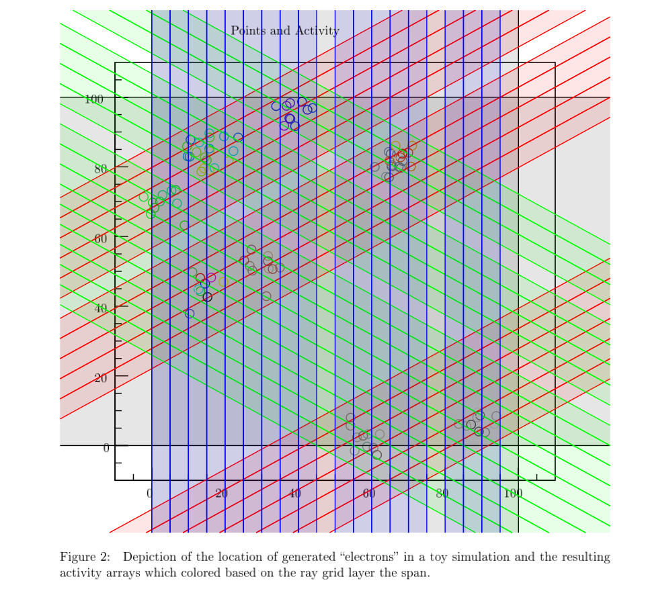

Slide 5
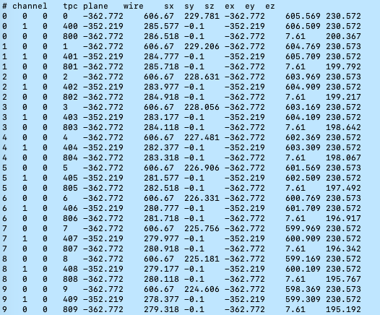
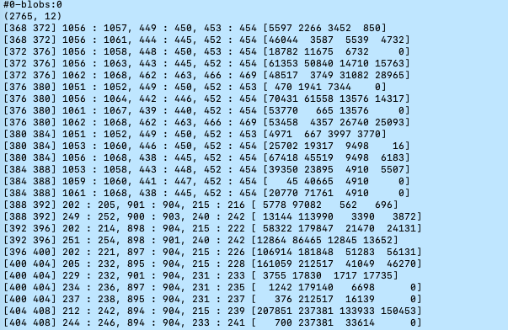
Blobs geometry check
wirecell-img dump-blobs clusters-apa-apa0.tar.gz -o clusters-apa-apa0.txt
Geometry file:
protodunehd-wires-larsoft-v6.txt
u_wire
v_wire
w_wire
[tick_start tick_end] start: end, start: end, start: end, [charges]
For a blob, I expect to see strips in u v w will be overlapped in a region.

Slide 6
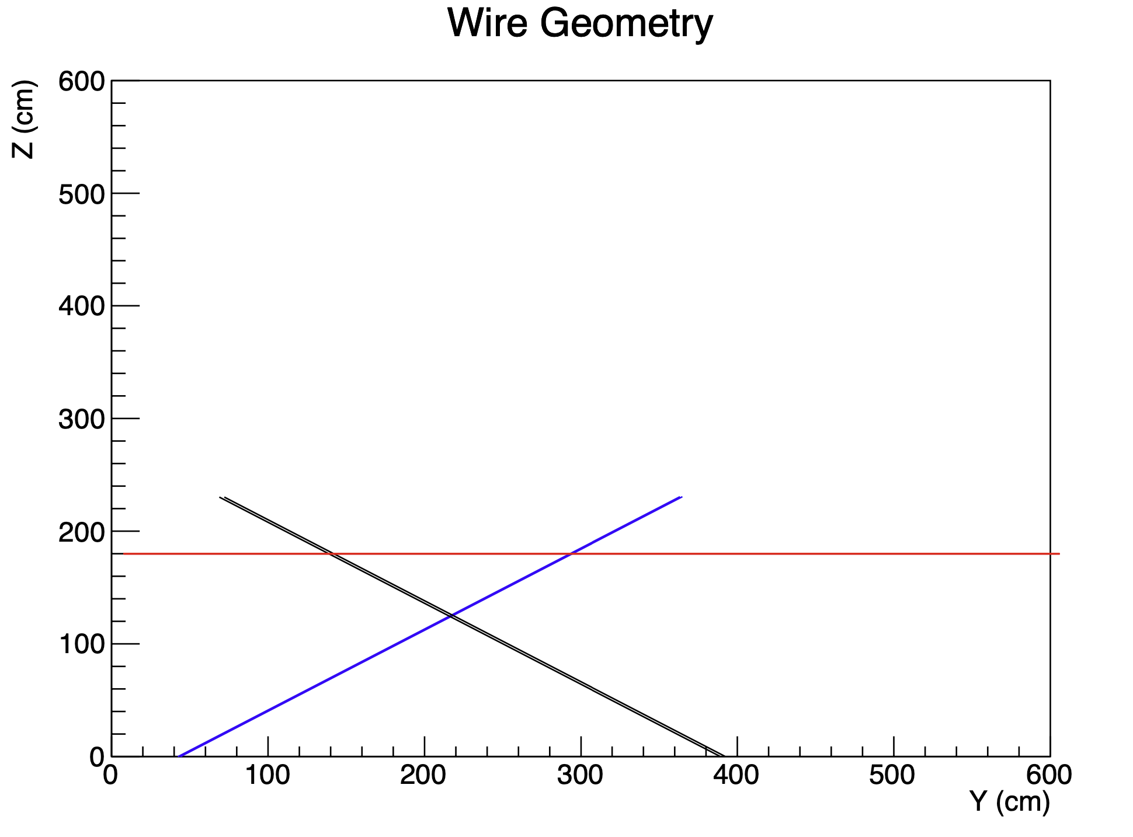
I am still debugging this…

Slide 7
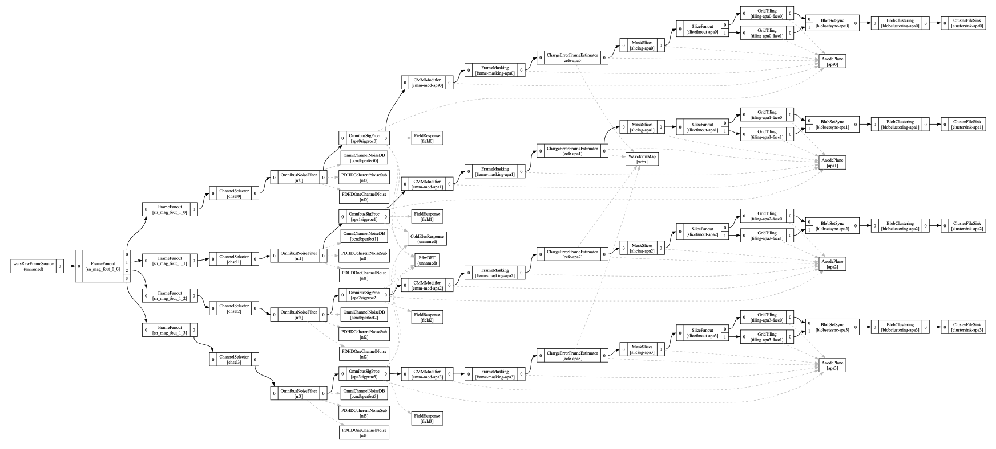
Flow for imaging process
JSONNET_PATH=$WIRECELL_PATH jsonnet --ext-code DL=4 --ext-code DT=8.8 --ext-code driftSpeed=1.565 --ext-code elecGain=14 --ext-code lifetime=35 --ext-code reality='"data"' wcls-nf-sp-img.jsonnet --ext-code raw_input_label='"tpcrawdecoder:daq"' --ext-code signal_output_form='"dense"' --ext-code use_magnify='"false"' -o a.json
wirecell-pgraph dotify --jpath -1 --no-params a.json flow-simple.pdf

Slide 8
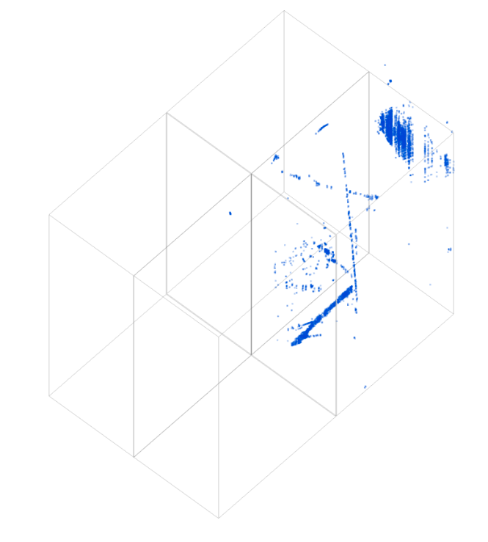
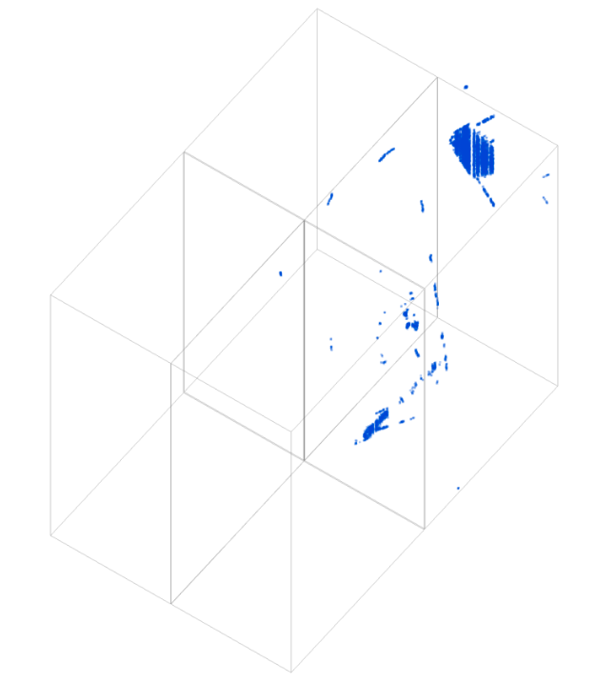
Imaging in APA1
https://www.phy.bnl.gov/twister/bee/set/0625c215-8b46-44e3-b07f-088093360924/event/0/
https://www.phy.bnl.gov/twister/bee/set/b0c89584-b971-4122-a7a0-4a63560e183d/event/0/

