Slide 1

27th Accelerator Test Facility (ATF) Users' Meeting
LWIR Laser Status and Upgrades
Misha Polyanskiy
2025-05-01
Accelerator Facilities Division

Slide 2
Overview & Statistics
Recent System Developments
Near-Term Improvement Plans
Strategic Outlook

Slide 3
ATF’s 5 TW LWIR laser
Gas
Solid
state
Polyanskiy et al. OSA Continuum 3, 459 (2020)

Slide 4
LWIR Spec Sheet v.2025
---------------------------------------------------------------------
Typical* Extreme**
---------------------------------------------------------------------
Central wavelength 9.22 μm
Pulse duration 2 ps
Pulse energy in IP 5 J 10 J
Peak power in IP 2.5 TW 5 TW
Shot-to-shot delay 90 sec 20 sec
---------------------------------------------------------------------
* Typical
Proven reliable operation. Recommended for most experiment designs.
** Extreme
Demonstrated performance. Can be attempted in limited number of shots. Not guaranteed.

Slide 5
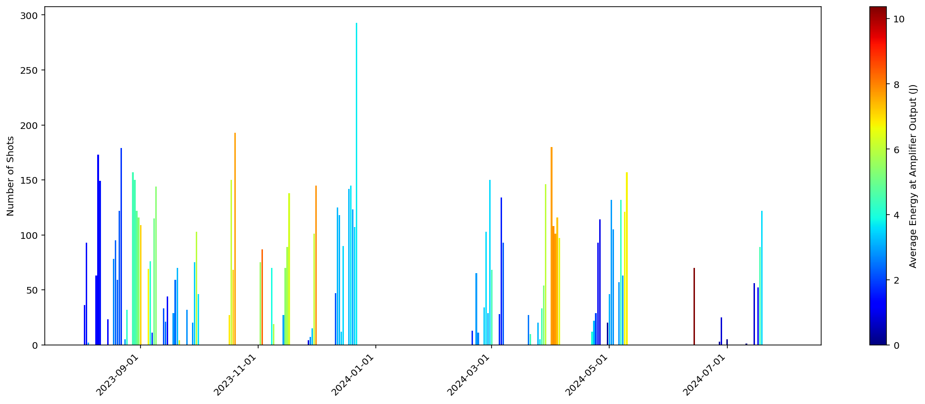
Shot statistics
3,500 shots
AE-100
AE-119
AE-138
AE-134
AE-127
AE-132
Summer down
User mtg. 2024

Slide 6
Overview & Statistics
Recent System Developments
Near-Term Improvement Plans
Strategic Outlook
Goals
Ramp up delivered energy
Improve beam quality
Increase system reliability

Slide 7
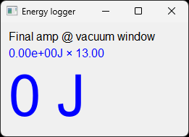
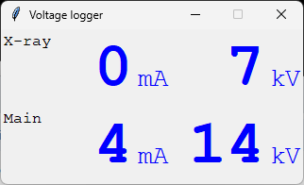
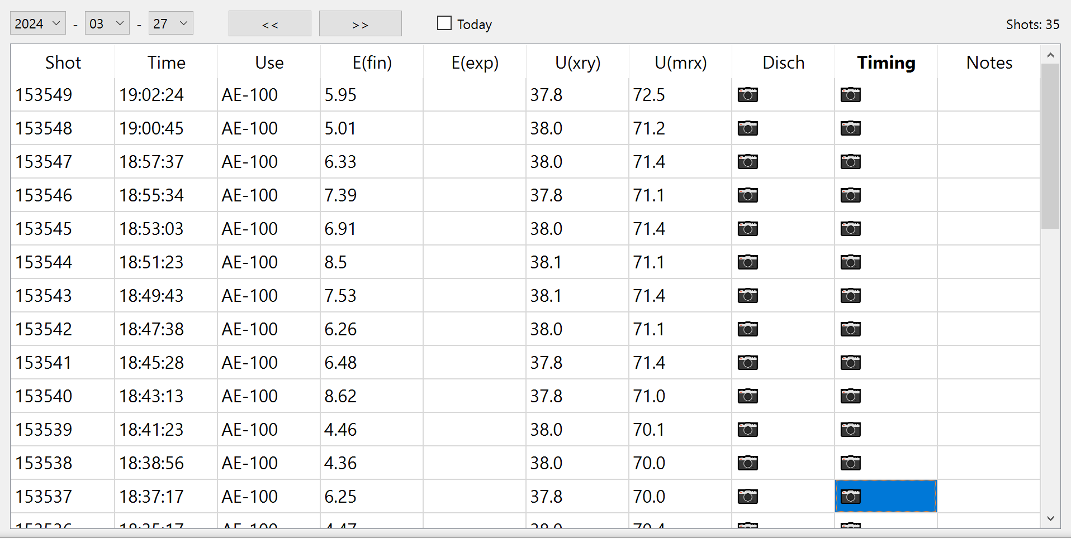
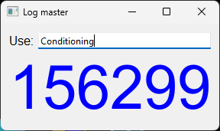
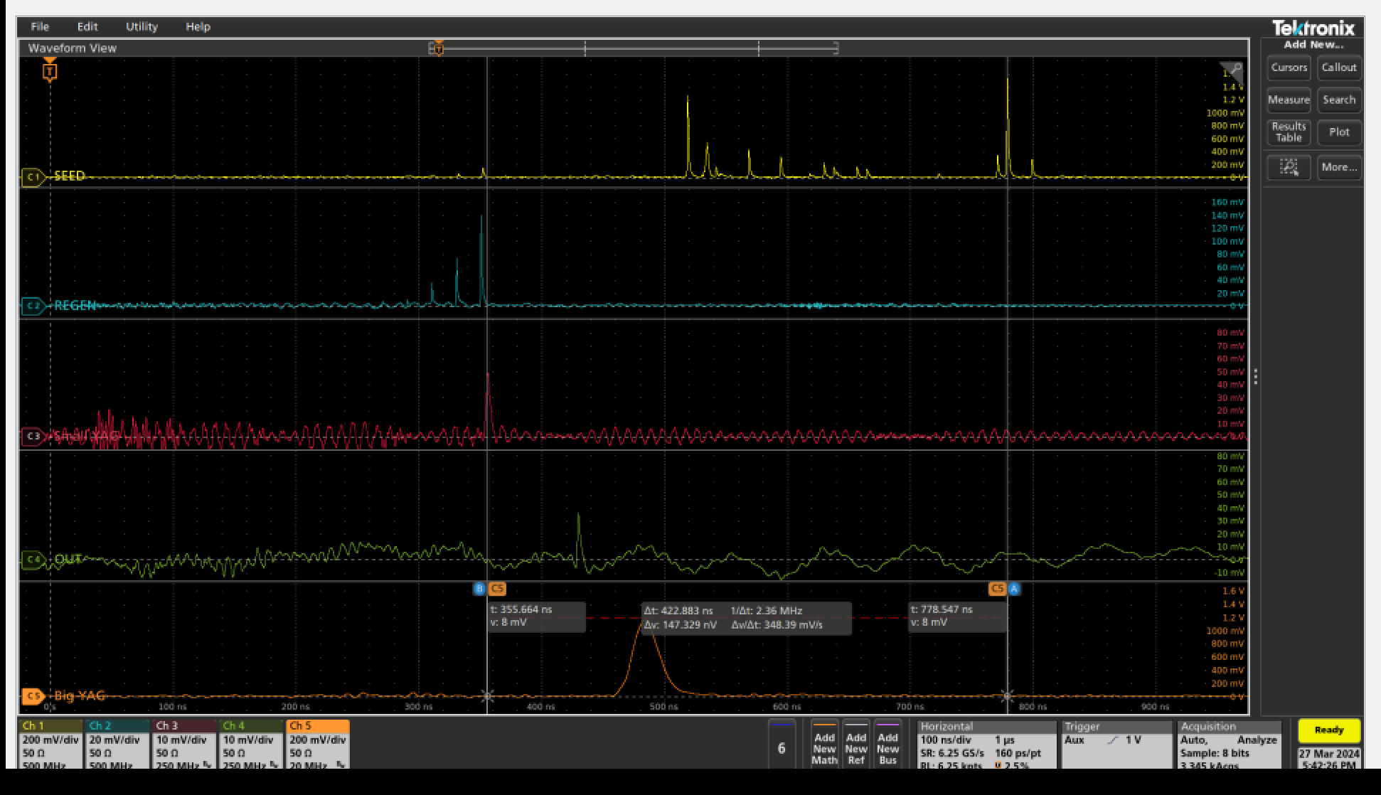
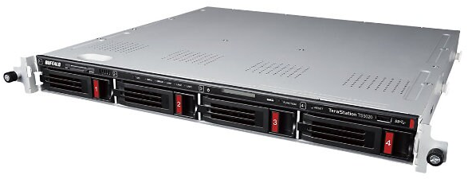
Instrument
“Loggers”
Shot logger
Asynchronous and Expandable Logging Scheme
Each HV discharge in the final amplifier triggers the shot counter
“Log master” script monitors the shot counter; upon update:
  Creates an HDF5 file
  Emits a ZMQ signal with the file name
Each instrument’s “Logger” script writes its data to the HDF5 file
Flexible Data Types
Currently supported:
Float (e.g., energy, charge voltage)
Bitmap (e.g., scope screenshot)
Text (e.g., experiment ID, notes)
Data Storage
All data is stored on a dedicated NAS server
Unique ID is assigned to every shot
One file / shot
“Log master”
“Log display” GUI

Slide 8
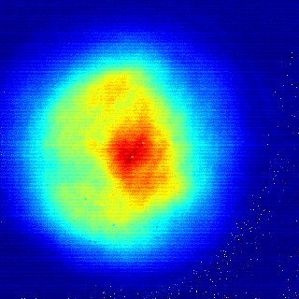
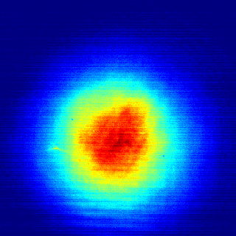
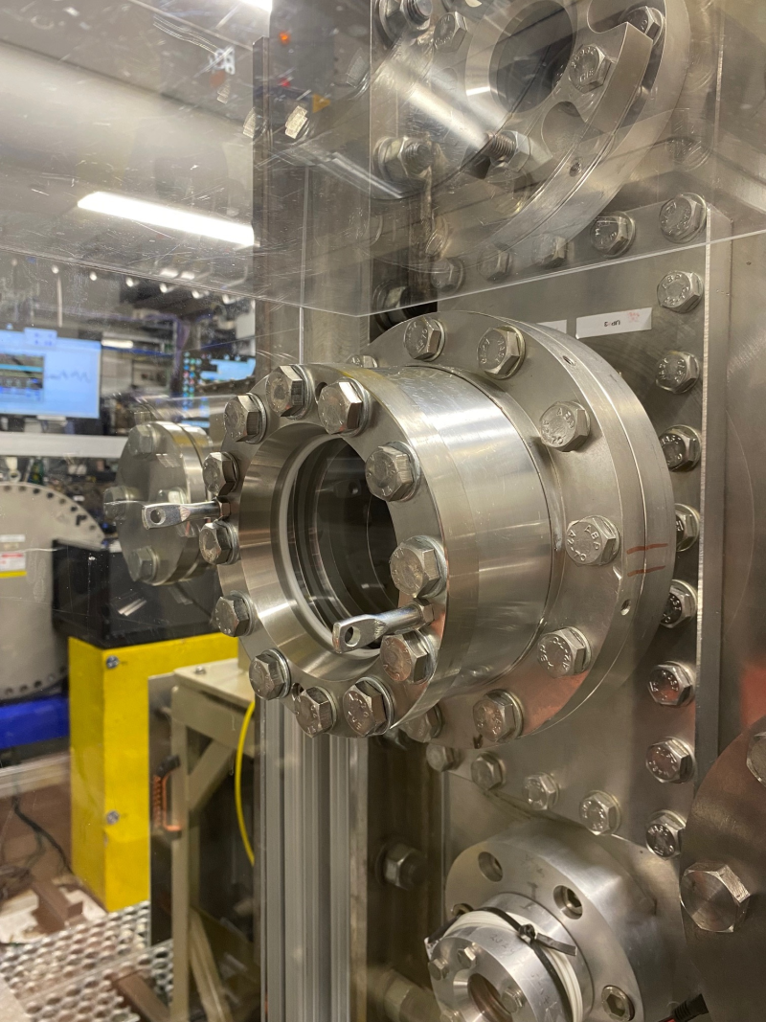
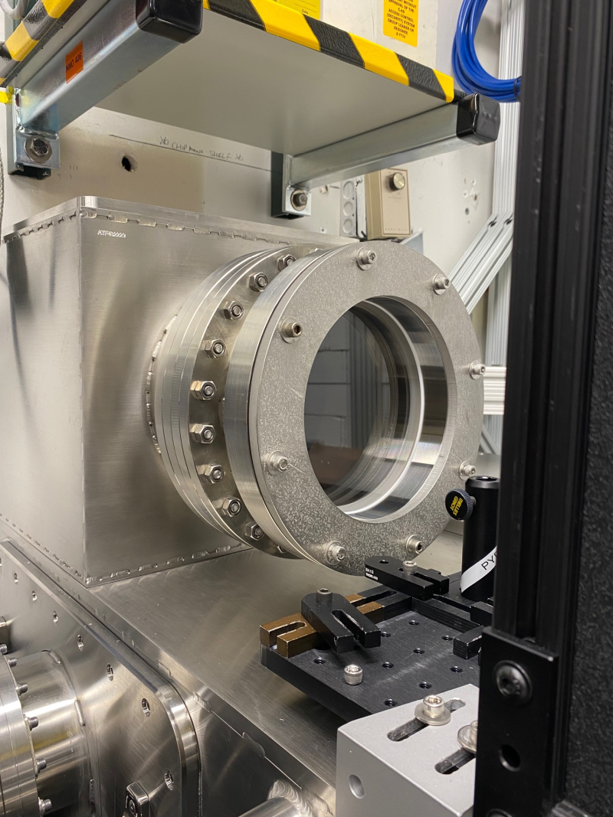
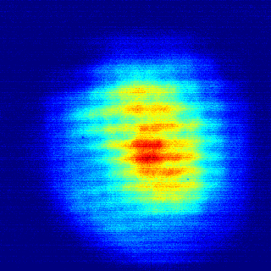
Parameter (at 9.2 μm) | Unit | NaCl | BaF2
Solubility in water | g/L | 360 | 1.61
Modulus of rupture | MPa | 2.4 | 26.9
Refractive index | - | 1.500 | 1.412
Fresnel reflection | % | 4.0 | 2.9
Volume absorption | % / cm | 0.0 | 2.8
Nonlinear index | 10⁻²⁰ m²/W | 3.5 | 1.7
Group-velocity dispersion | fs²/mm | -1010 | -2340
NaCl → BaF₂ transition
NaCl windows tend to degrade beam quality
Gradual degradation of surface quality upon contact with the atmosphere.
Permanent crystal lattice shift caused by even moderate mechanical stress
One window
Amplifier output
Amplifier output
high pressure
Compressor input
vacuum
25 m
Two windows
100 mm → 35 mm
38 mm → 14 mm

Slide 9
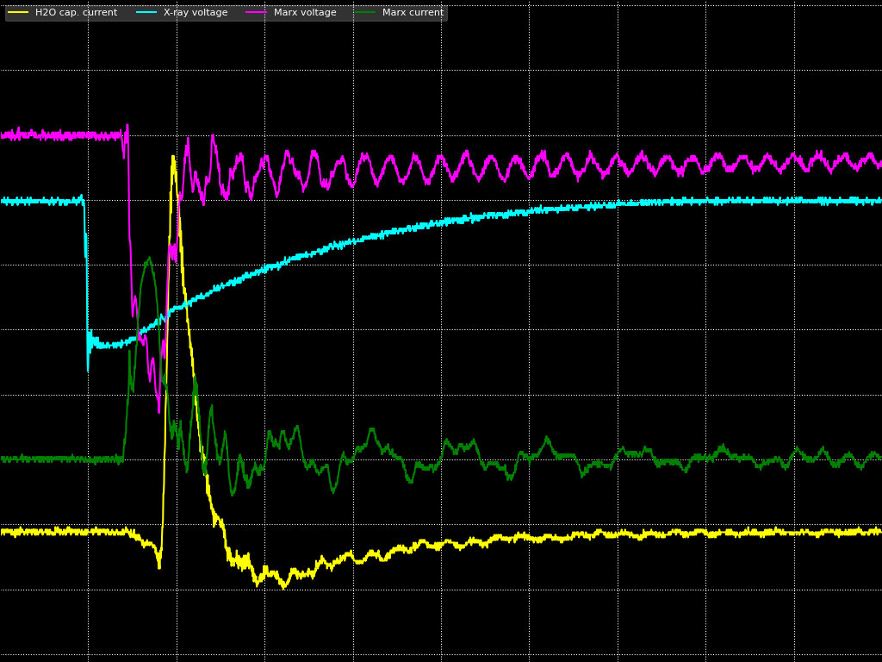
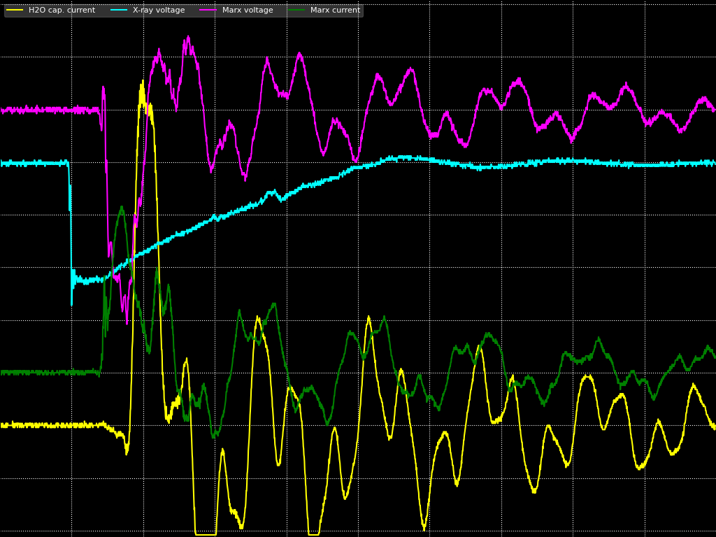
P(CO₂) 0.5 → 0.6 bar
Old Gas Composition – Final Amplifier
P(CO₂) = 0.50 bar | P(N₂) = 0.25 bar | P(He) = 7.50 bar
Role of He: buffer gas for discharge stabilization
Improvements Over The Years
Repeated cleaning of the pressure vessel interior
Added particle filter in gas circulation loop (removes dust from discharge)
Reduced outgassing by pumping with turbo pump overnight at each vessel refill
Switched to fully DI water in H₂O capacitor tank with HV spark-gap optimization
Introduced “threaded” electrode-supporting insulator to prevent surface discharge
Replaced diffusion pump with a turbo in the pre-ionizer chamber
Optimized dry-air pressure in Marx generator spark-gaps:
  Lower, adjustable pressure in actively triggered SG1
  Higher, constant pressure in self-triggered SG2–SG10
Implemented 90-second delay between shots for spark-gap purge and cooldown
New Gas Composition – 2025 Run Campaign
P(CO₂) = 0.60 bar | P(N₂) = 0.25 bar | P(He) = 7.40 bar
Good discharge
P(CO₂) = 0.7 bar
Arc (during conditioning)
Expected Outcome
20% higher gain and stored energy, or improved reliability at reduced voltage

Slide 10
Overview & Statistics
Recent System Developments
Near-Term Improvement Plans
Strategic Outlook
Goals
Ramp up delivered energy
Improve beam quality
Increase system reliability
Provide post-compressed pulses
to early-adopter experiments

Slide 11
Ongoing work & near-term plans
Working wish-list
(items to tackle as time / resources allow, no fixed order or hard deadlines)
BaF₂ windows for the regen section and at the final-amplifier input
Small in-air plasma shutter separating the regen from the final amplifier
Bypass for the “big” plasma shutter (remove potential beam distortion with two off-axis parabolas)
Herriott-cell (“zig-zag”) optical arrangement for the regen
New mount for the lower periscope mirror in the compressor chamber
Target deployment: 2025
Post-compressor pulse shortening: 2 ps → 500 fs (Part of AE-138)

Slide 12
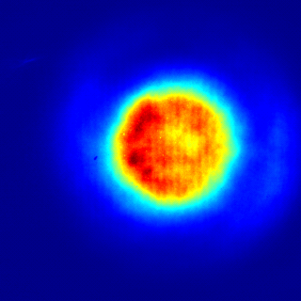
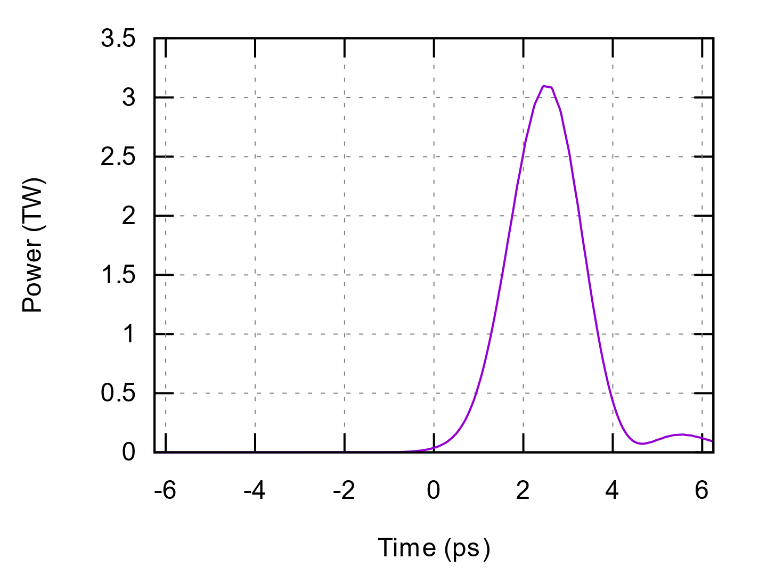
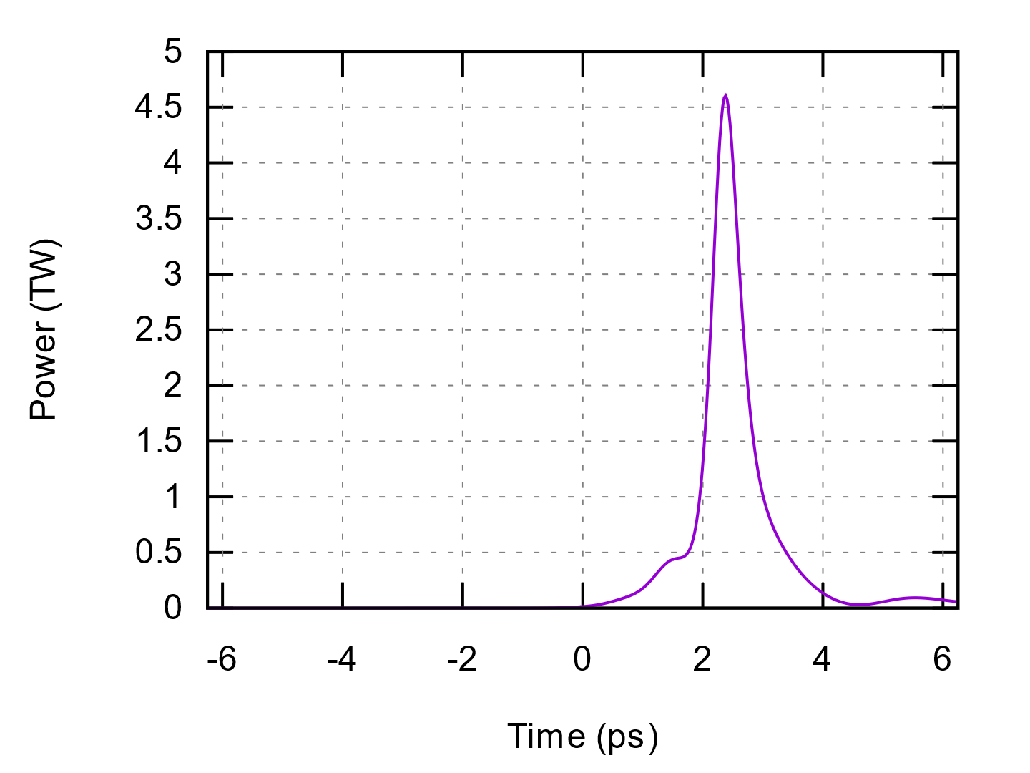
Polyanskiy et al. Opt. Express 29, 31714 (2021)
Pogorelsky et al. Front. Phys. 12, 1390225 (2024)
R&D in progress: Deployment in 2025
Input
Compressed
2 ps
560 fs

Slide 13
Overview & Statistics
Recent System Developments
Near-Term Improvement Plans
Strategic Outlook
Goal
Develop and deploy a next-generation LWIR laser system:
  Few-cycle pulse duration
  Hz-level repetition rate
  24/7 operation capability

Slide 14
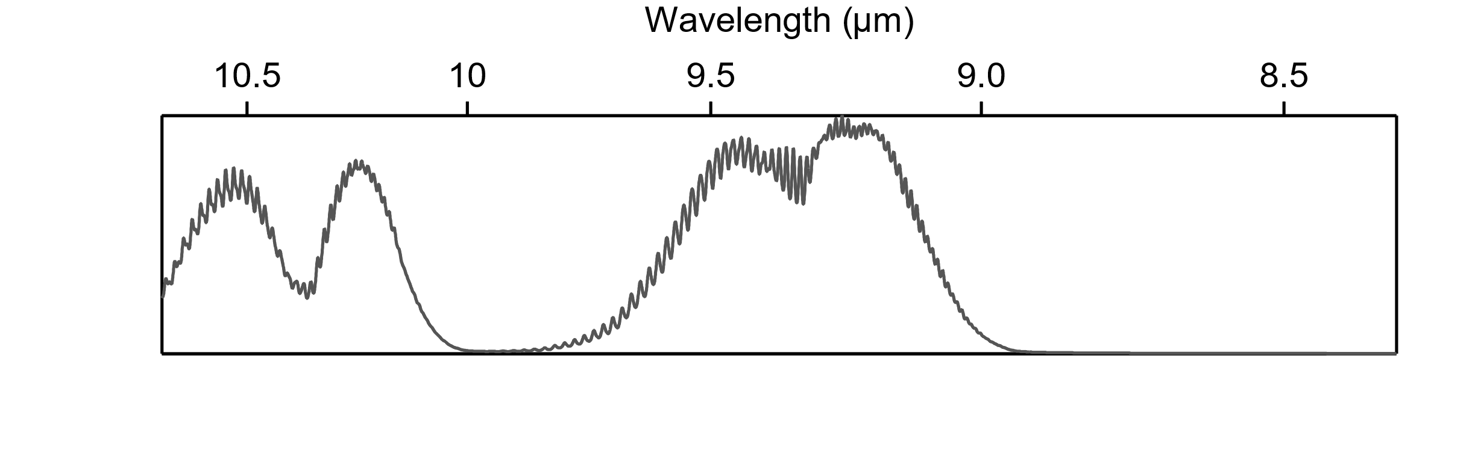
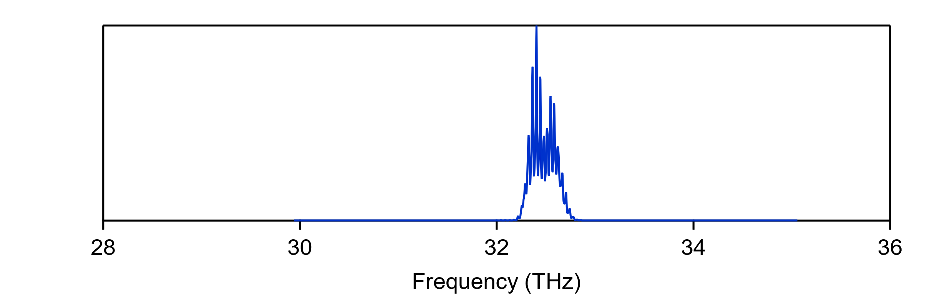
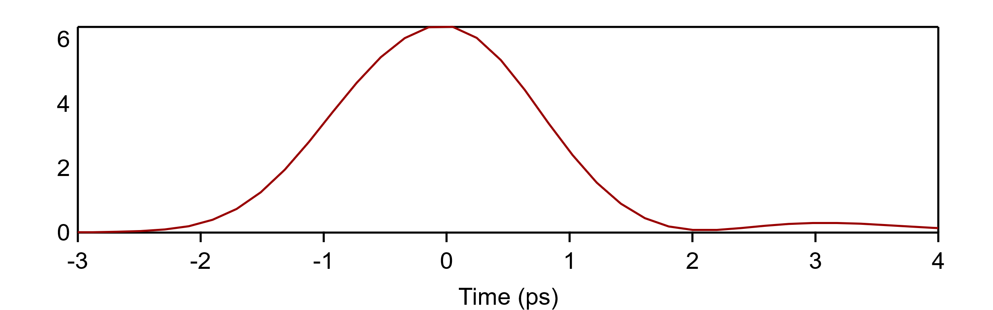
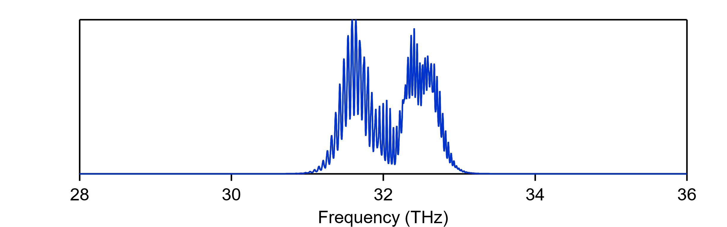
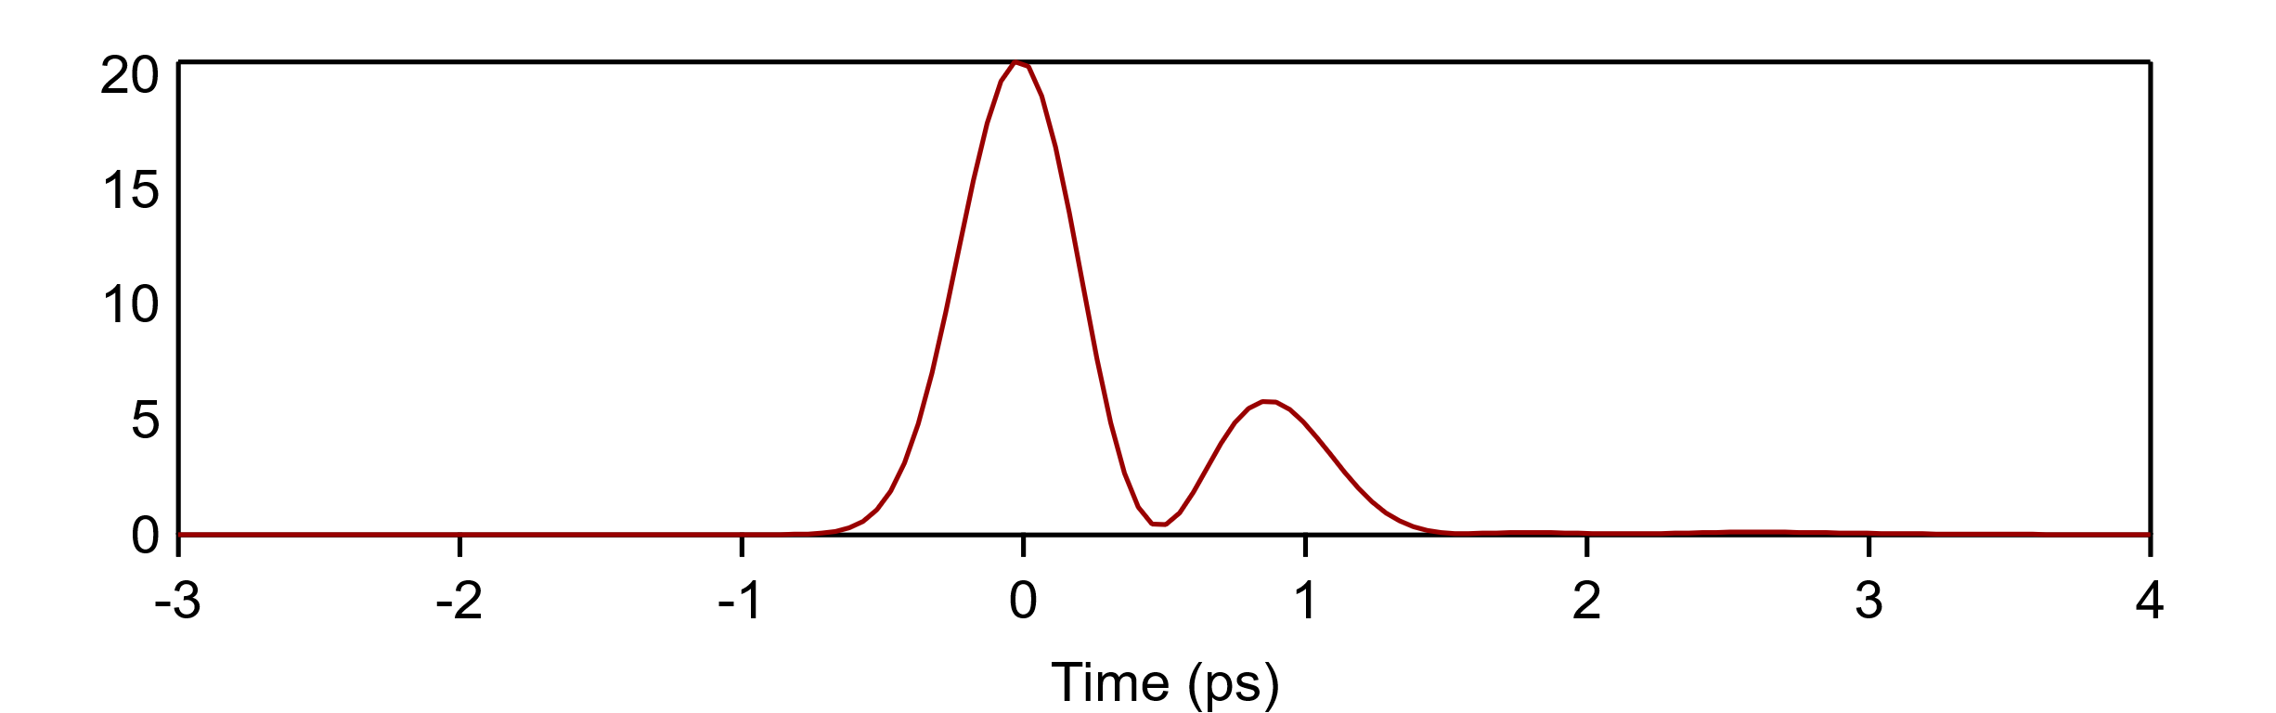
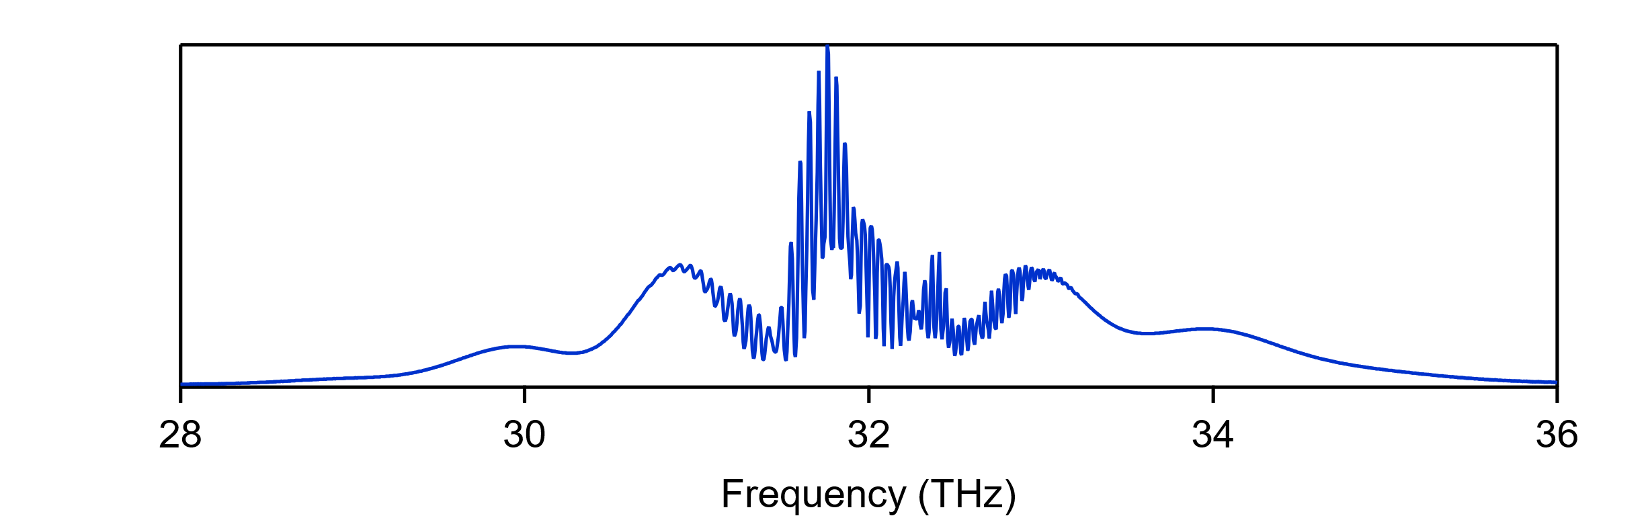
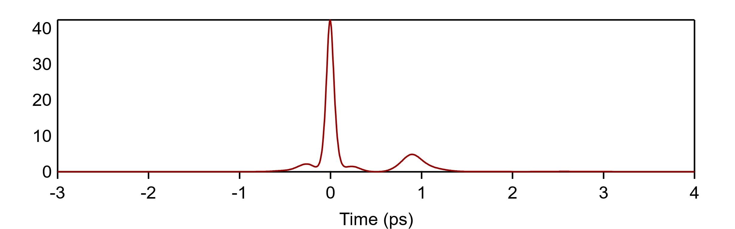
Roadmap for pulse shortening
Polyanskiy et al. Photonics 8, 101 (2021)
9R
Gain spectrum
With 20% contingency
9P
Now
(10 µJ seed)
9.2 μm
2 ps
5 TW
10 mJ seed
9.3 μm
500 fs
15 TW
Power (TW)
Post-compression
100 fs
25 TW
1 optical cycle = 31 fs

Slide 15
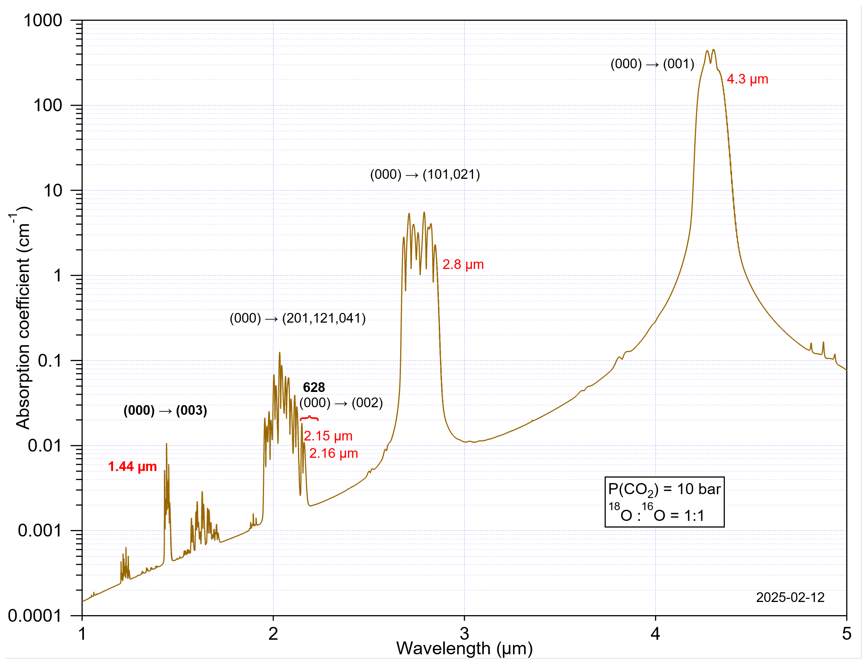
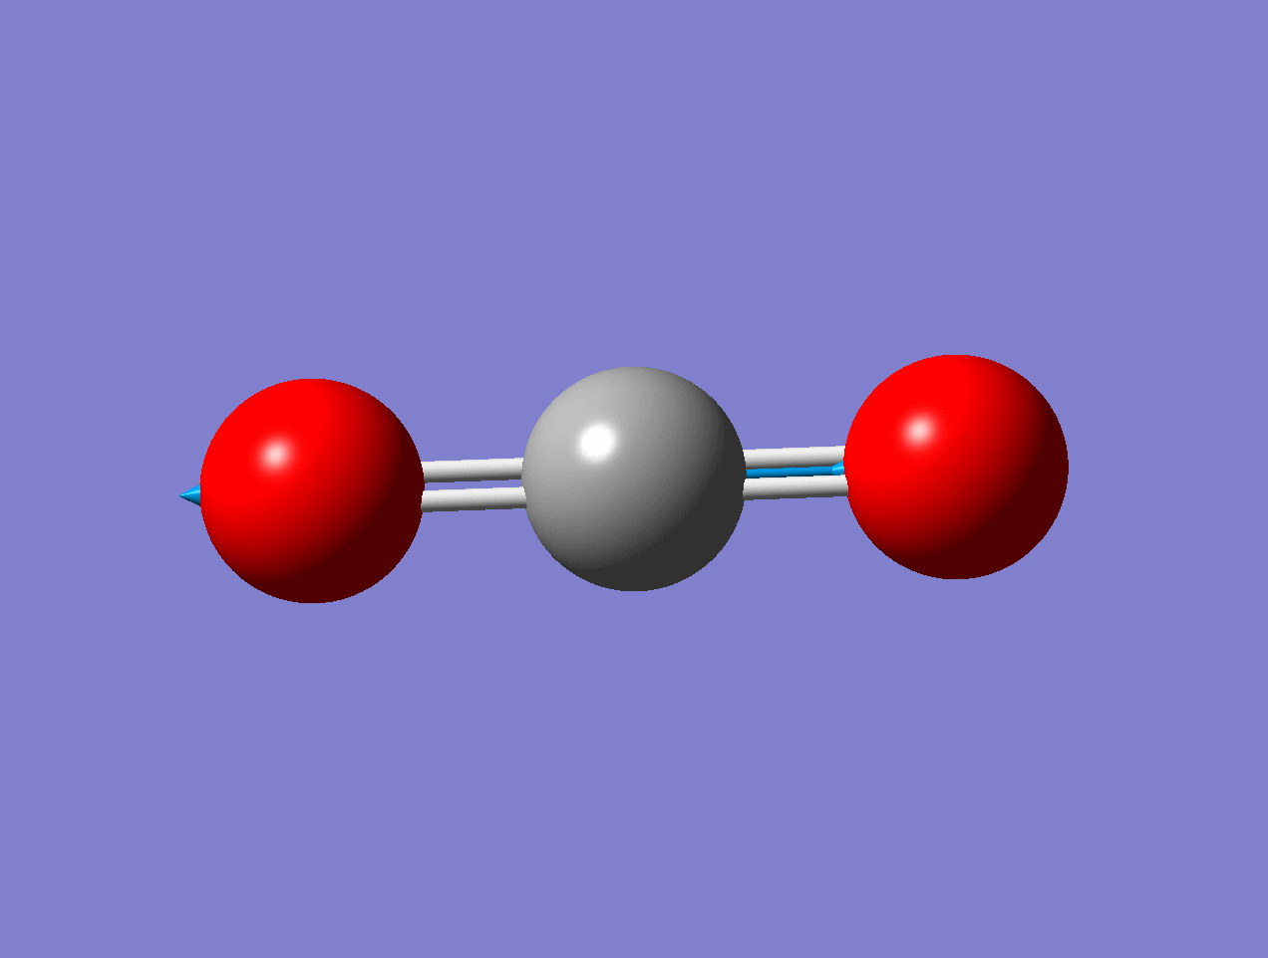
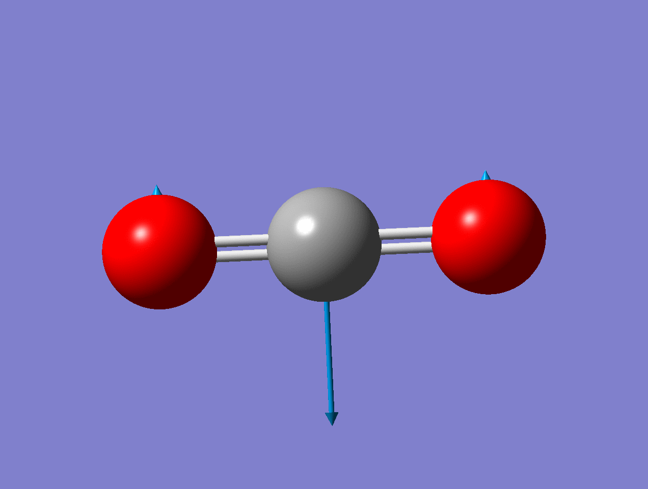
Optical pumping: Now within reach!
Stenersen & Wang IEEE J. Quant Electron. 25, 147 (1989)
Tovey et al. Appl. Opt. 21, 5756 (2019)
O C O
O C O
O C O

Slide 16
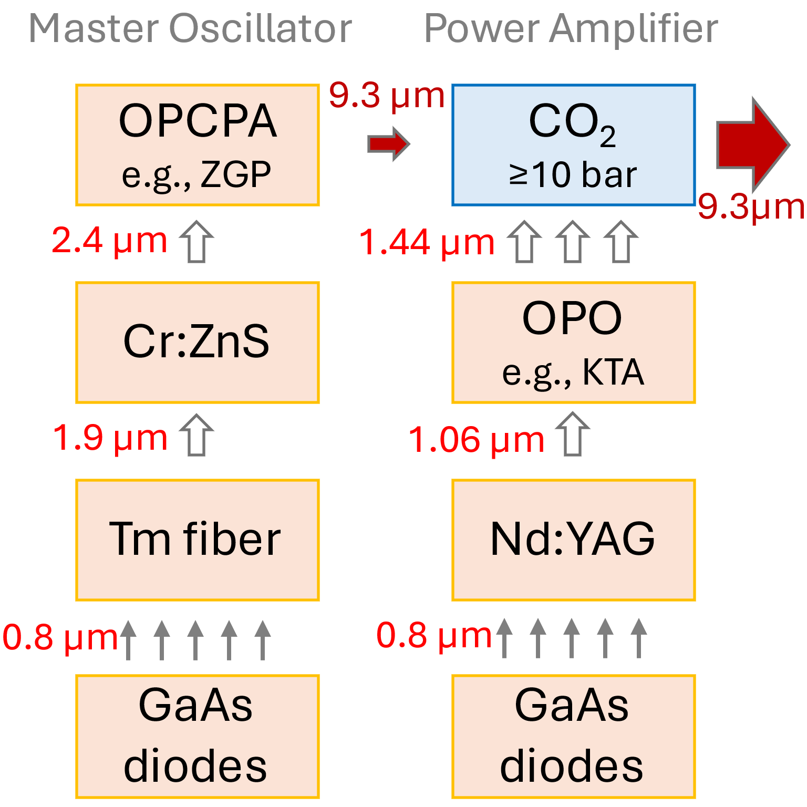
Next-generation multi-TW LWIR laser architecture
MASTER OSCILLATOR
Requirements:
  10 mJ, 300 fs , 9.3 µm
High efficiency
  not critical
Cr:ZnS(ZnSe)
147 mJ, 126.7 fs reported in China
Lu et al. Optica 10, 1567 (2023)
Two 1-TW systems “100 mJ; 100 fs”
under construction in Germany & US
ZGP crystals
Domestic supplier available (BAE)
POWER AMPLIFIER
Requirements:
  >100 J, <100 ns , 1.44 µm
  (can be in multiple beams)
High efficiency
  very desirable for future practical applications
Nd:YAG
High energies achievable
e.g., NIF: 20 kJ per beam, 20 ns,
OPO
Large KTA crystals, e.g., 20x20 mm
available, larger crystals can be grown.
1.44 µm
ALL CRITICAL TECHNOLOGIES ARE AVAILABLE

Slide 17
Overview & Statistics
Recent System Developments
Near-Term Improvement Plans
Strategic Outlook
Routine delivery of 2—3 TW
Ramping-up energy and
improving reliability
Next-generation LWIR laser:
  Femtosecond
  Optically pumped
  Based on existing technologies
Thank you,
ATF Team, Users & Sponsors!
QUESTIONS?

