Slide 1

27th Accelerator Test Facility (ATF) Users' Meeting NP-318747: Efficient and Stable Acceleration of Electrons in Laser Wakefield Accelerators
N. Vafaei-Najafabadi^{1,2}, W. Li^{1*}, N. Pathak², A. Jain², R. Zgadzaj³, Z. Ouyang³, M. Downer³, A. Gaikwad², B. Romasky², E. Trommer², M. Babzien¹, M. Polyanskiy¹, I. Pogorelsky¹, M. Palmer¹
¹Brookhaven National Laboratory
²Stony Brook University
³University of Texas at Austin
^{*PI}
Accelerator Facilities Division
Funding received: Department of Energy (Accelerator Stewardship) Grant DE-SC0024277

Slide 2
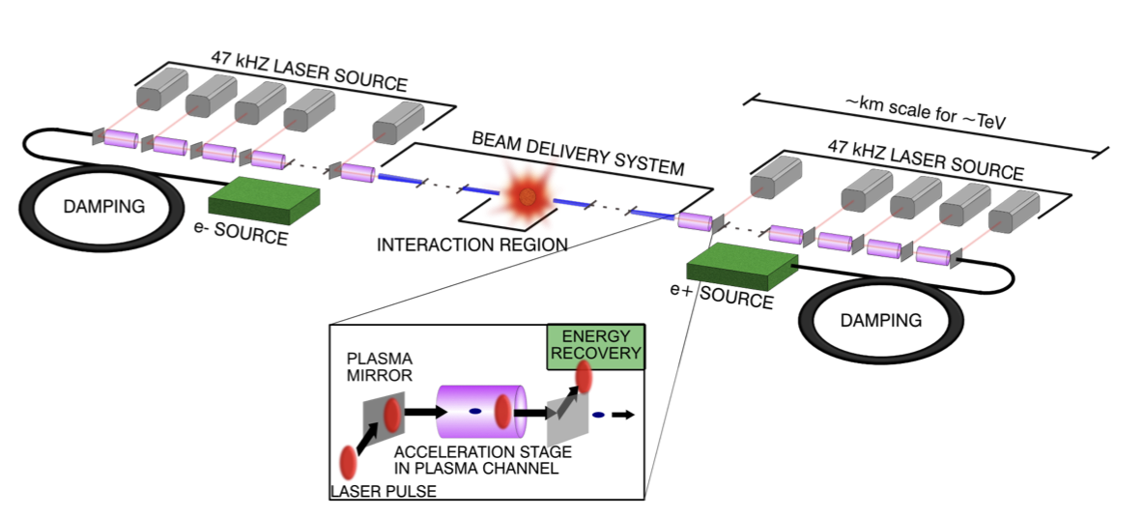
LWFAs Offer a Compact Path Toward TeV-Scale Colliders.
C. Benedetti, Linear colliders based on laser-plasma accelerators, 2022, arXiv:2203.08366 [physics.acc-ph]
Notes:
Visual choices: high fields of lwfa/colliders

Slide 3


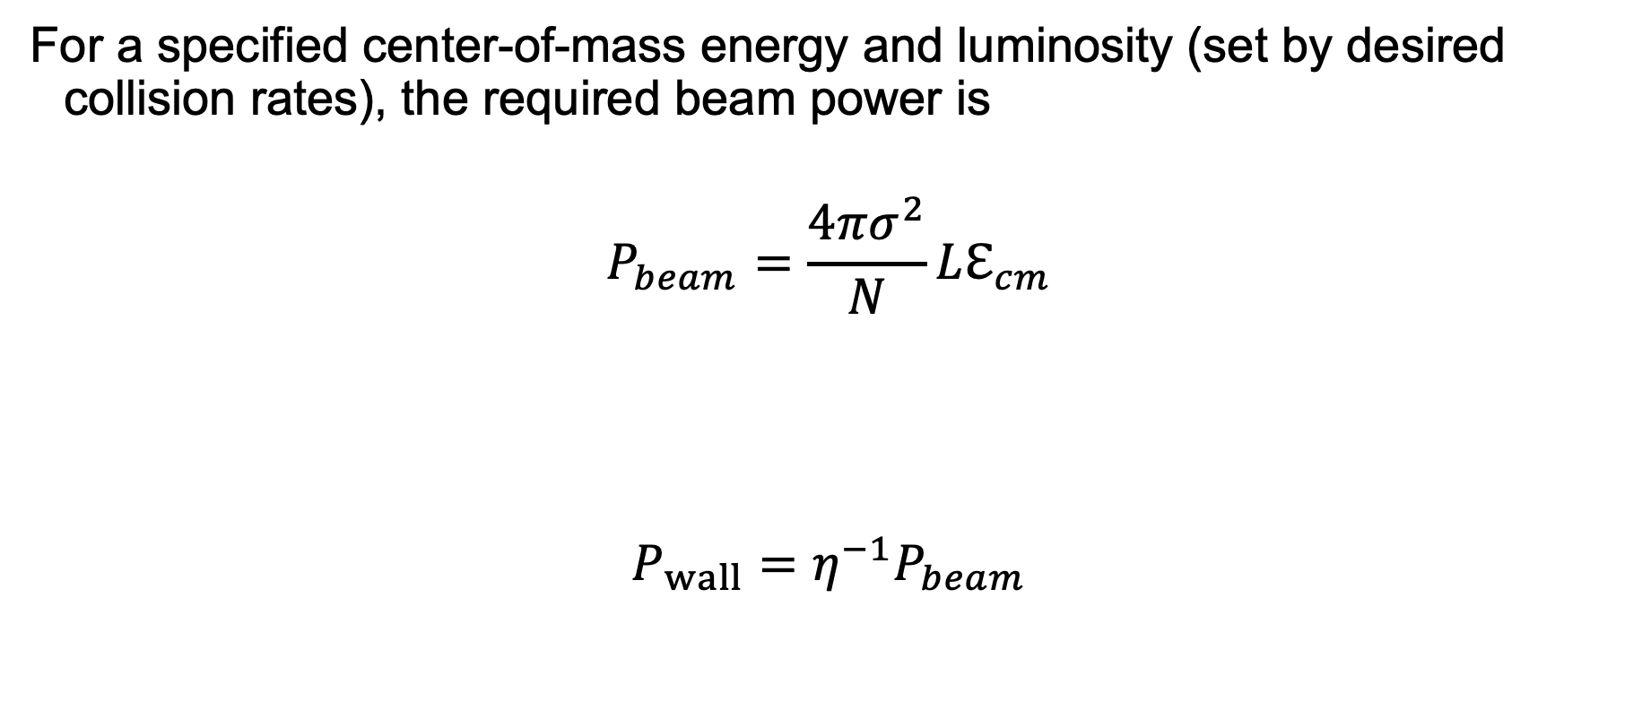


Key Parameter Considerations for Collider Applications
For a specified center-of-mass energy and luminosity (set by desired collision rates), the required beam power is
$$P_{beam}=\frac{4πσ^{2}}{N}Lℇ_{cm}$$
$$P_{wall}=η^{−1}P_{beam}$$
Focusability $⟹$ low emittance and energy spread
PWFA Collider:
Emittance, $ε_{n}\sim 50$ nm
Energy spread, $ΔE/E<$ 1%
Beam charge $⟹$High charge
LWFA Collider:$Q\sim 0.5$ nC
Efficiency
Efficient acceleration is critical for keeping wall-plug power manageable.
E. Esarey, C. B. Schroeder, 2021 International Workshop on Future Linear Colliders

Slide 4
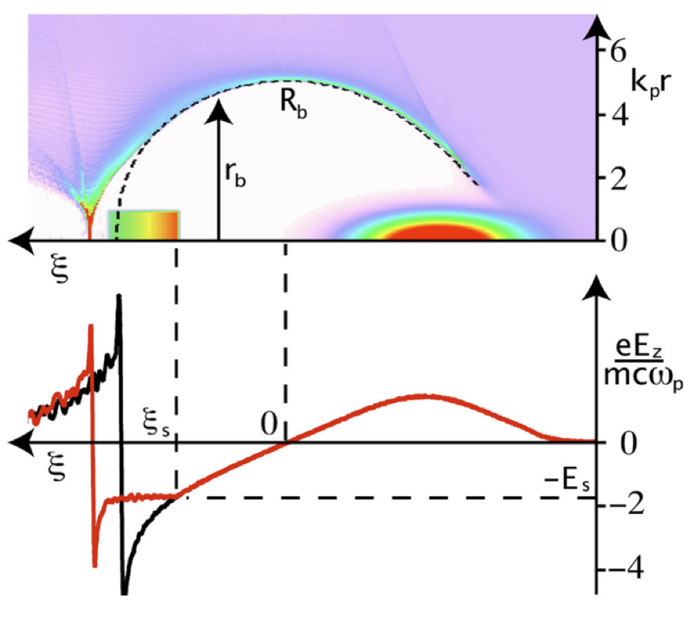
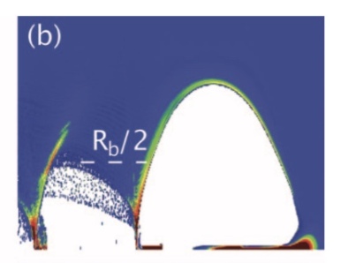
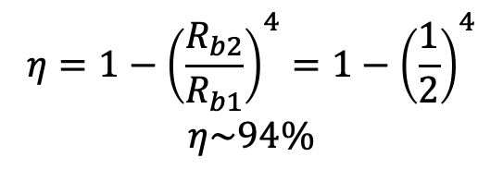
Beam Loading of nC-scale charge at High Efficiency in Blowout Regime
$$η=1−{\left(\frac{R_{b2}}{R_{b1}}\right)}^{4}=1−{\left(\frac{1}{2}\right)}^{4}$$
$$η\sim 94\%$$
M. Tzoufras, Physics of Plasmas 16, 056705 (2009)
A trailing beam with a trapezoidal density profile result in flattening of the wakefield.

Slide 5
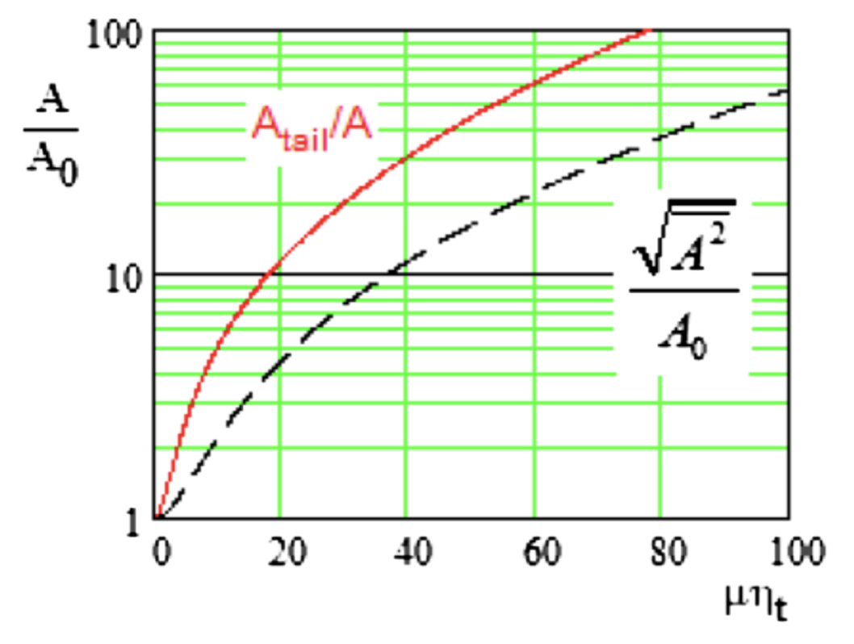
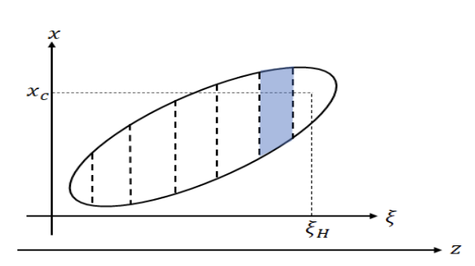
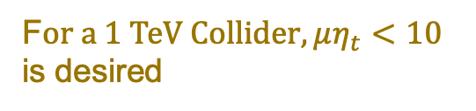
Stability: The Critical Weakness in an Otherwise Compelling Solution
Amplitude growth
A proxy for efficiency
F$or a 1 TeV Collider, μη_{t}<10$ is desired
V. Lebedev, Phys. Rev. ST Accel. Beams 20, 121301 (2017)
Based on short-range wakefield theory, this paper proposed a limit on the combination of low energy spread, efficient acceleration, and transverse stability in plasma accelerators

Slide 6
This proposal seeks to experimentally examine the short-range wakefield underlying the theoretically proposed connection between low energy spread, efficient acceleration, and transverse stability

Slide 7
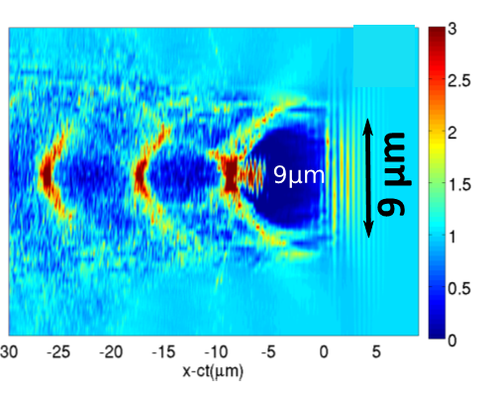
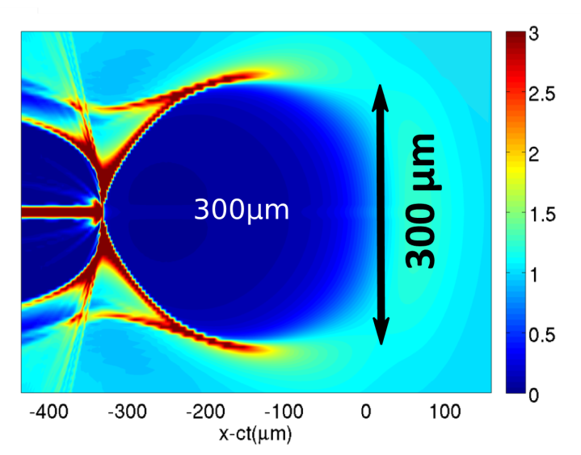
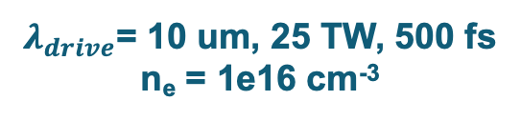
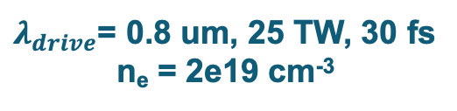
ATF Facilities Are Ideal For Carrying Out This Experiment – Suitability of LWIR Laser
$λ_{drive}$= 0.8 um, 25 TW, 30 fs
n_{e} = 2e19 cm⁻³
$λ_{drive}$= 10 um, 25 TW, 500 fs
n_{e} = 1e16 cm⁻³
Courtesy of Gennady Shvets
Courtesy of Gennady Shvets
LWIR CO₂ laser drives plasma wakefield efficiently at low density, creating large structures that are highly suitable for injection experiments

Slide 8
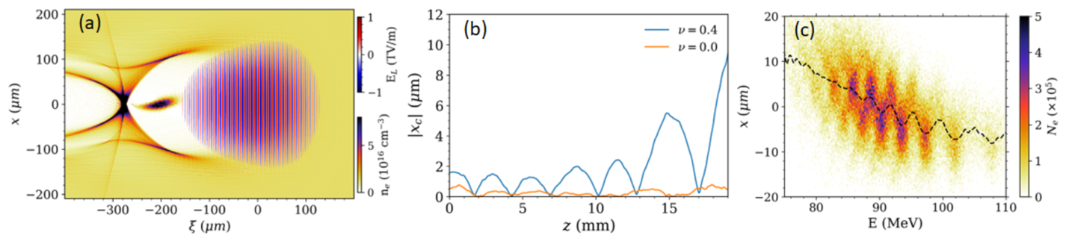
ATF Facilities Are Ideal For Carrying Out This Experiment – Growth of e-beam Oscillation Amplitude During Acceleration
Z=5mm
Laser: $a_{0}=2.57$, $τ=0.5$ ps, $λ=9.2 μm$, $w_{0}∼100 μm$, Power = 20 TW, $n_{e}=1.2×{10}^{16}$cm⁻³
e-beam: $Q=0.2 nC$, $σ_{z}=20 μm$, $σ_{x}=10μm$, linear tilt: $x_{c}=ν(ξ−ξ_{0})$
The instability grows along the beam and is a function of tilt in the beam.
Electron energy correlation with position within the wakefield may allow for mapping of slice positions

Slide 9
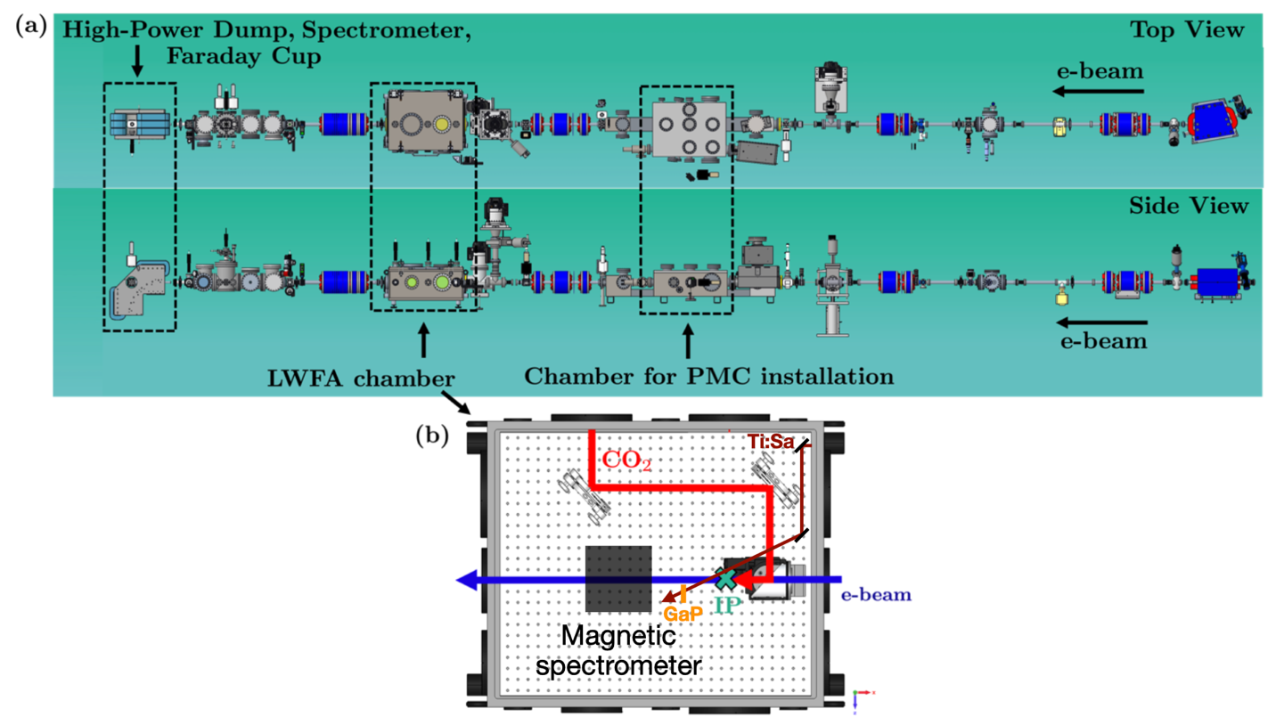
Experiment Layout

Slide 10
Experimental Milestones
Year 1
Investigation of short-range wake physics in LWFA in simulations
LWFA Characterization – AE 136 experiment
Electron beam Compression and focusing – design and implementation
Year 2
Tilt Characterization
Alignment and Synchnorization between CO₂ and e-beam in a longitudinal configuration
First experiments: Commissioning diagnostics and attempt to observe the instability
Year 3
Experimental characterization of short-range wake function (and BBU) at various energy spread and efficiency values

Slide 11
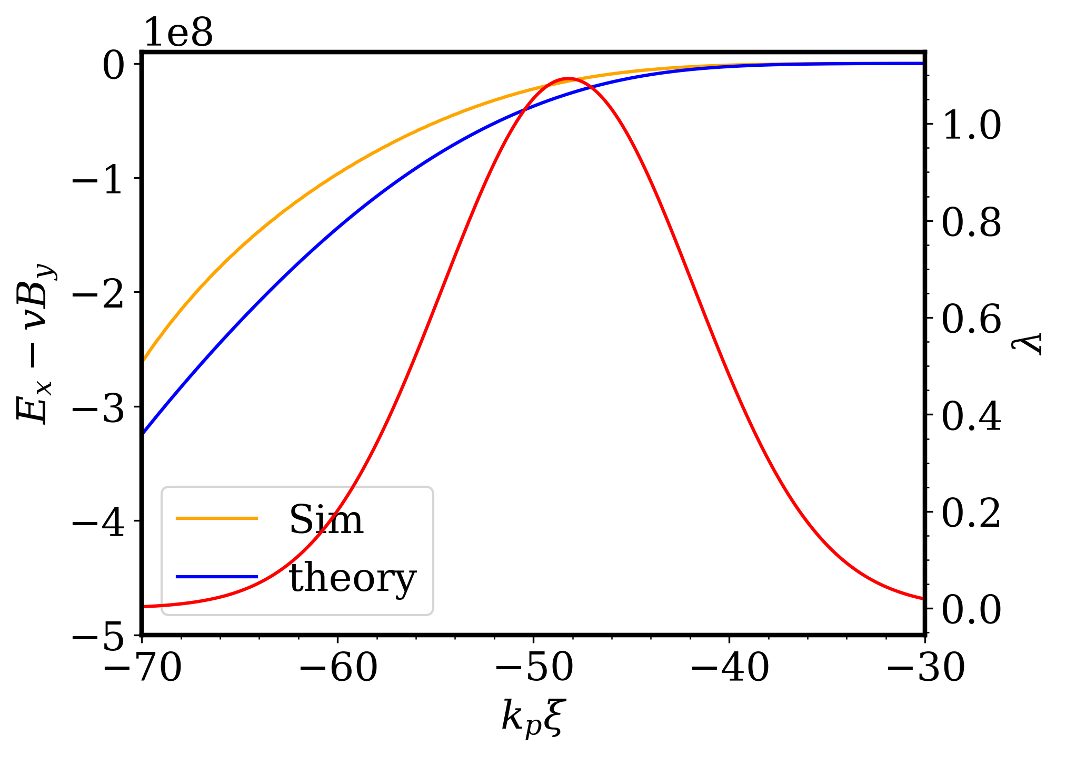
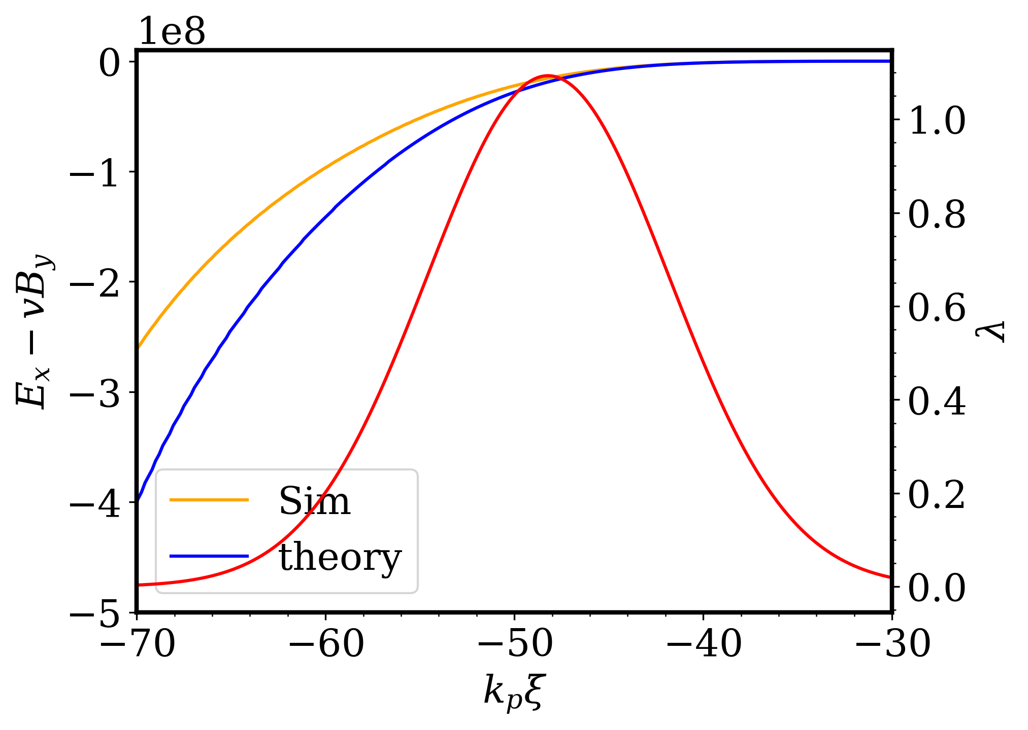
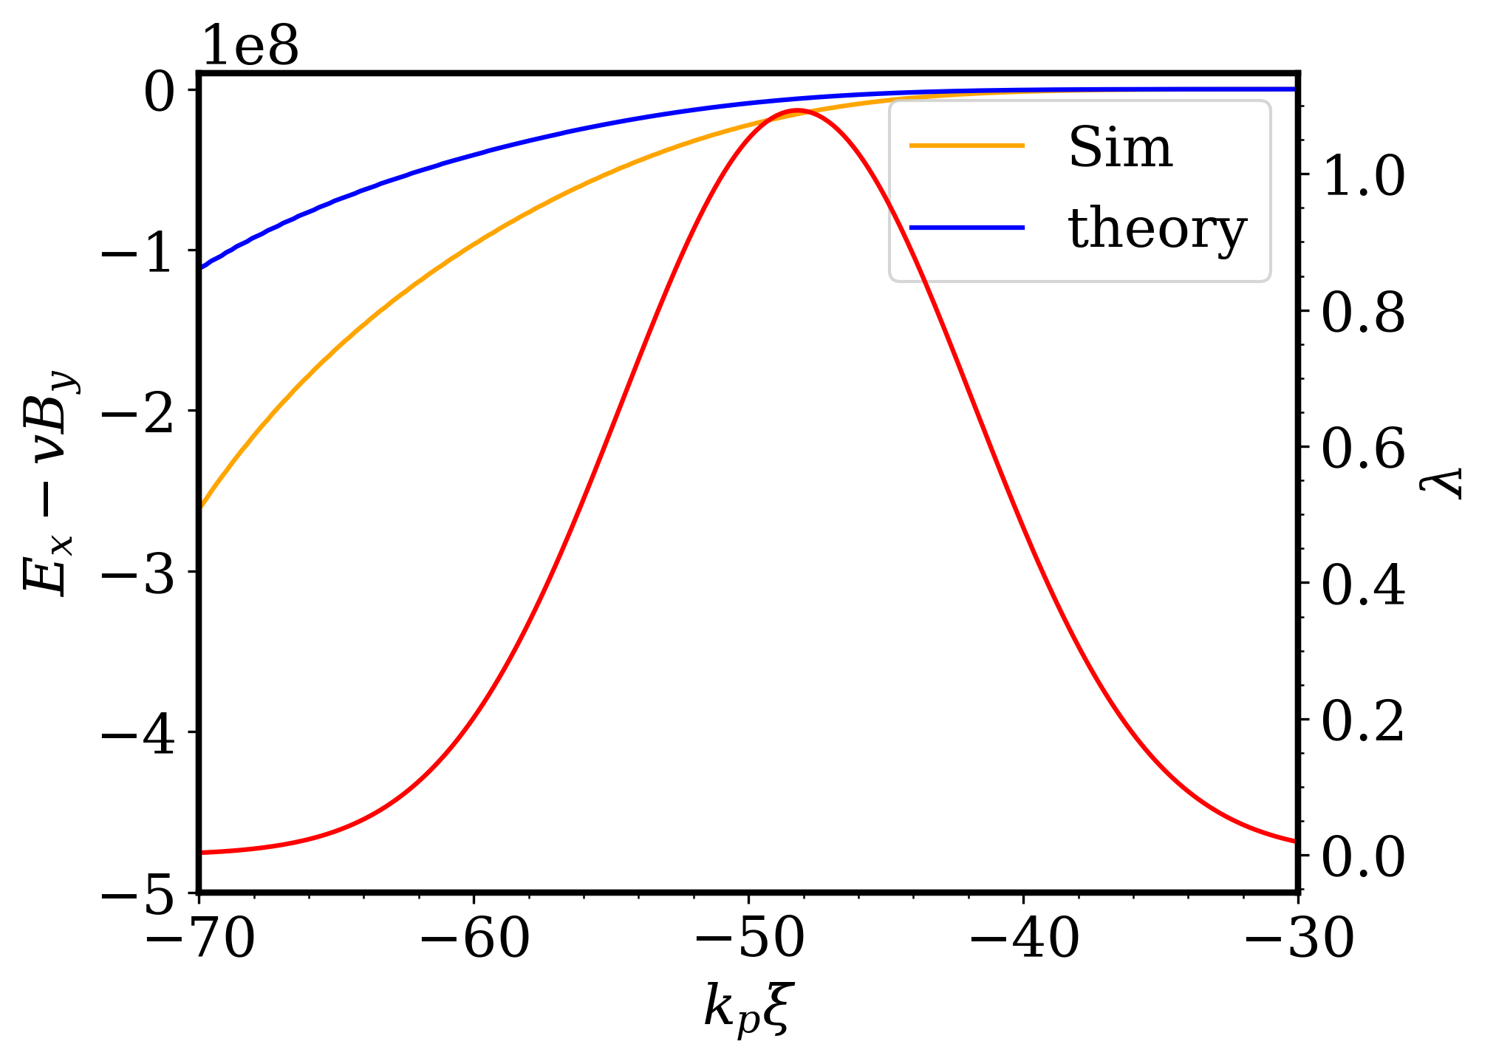
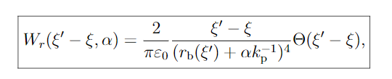


Developing Theory: Current Theories for Short Range Wakefield in LWFA are Inadequate
$$W_{⊥}=−\frac{2}{r_{b}^{2}} (ψ\left(ξ^{′}\right)−ψ\left(ξ\right))$$
V. Lebedev, Phys. Rev. ST Accel. Beams 20, 121301 (2017)
G. Stupakov, Phys. Rev. Accel. Beams 21, 041301 (2018)
SBU (unpublished)

Slide 12
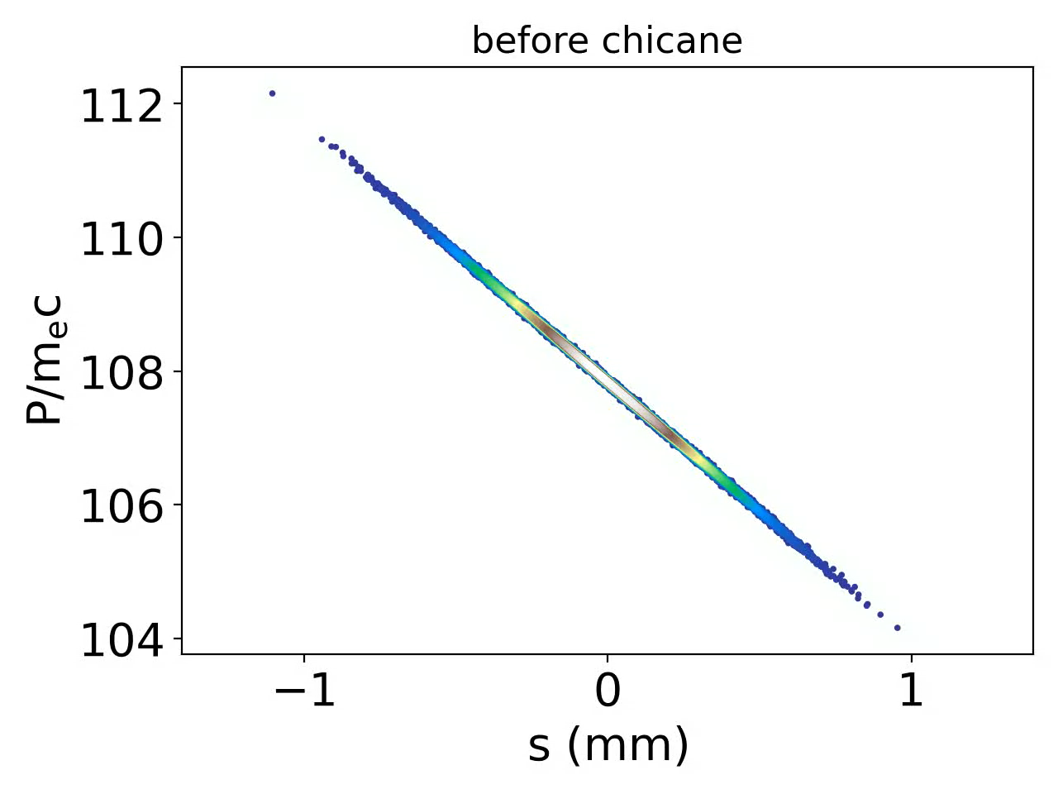
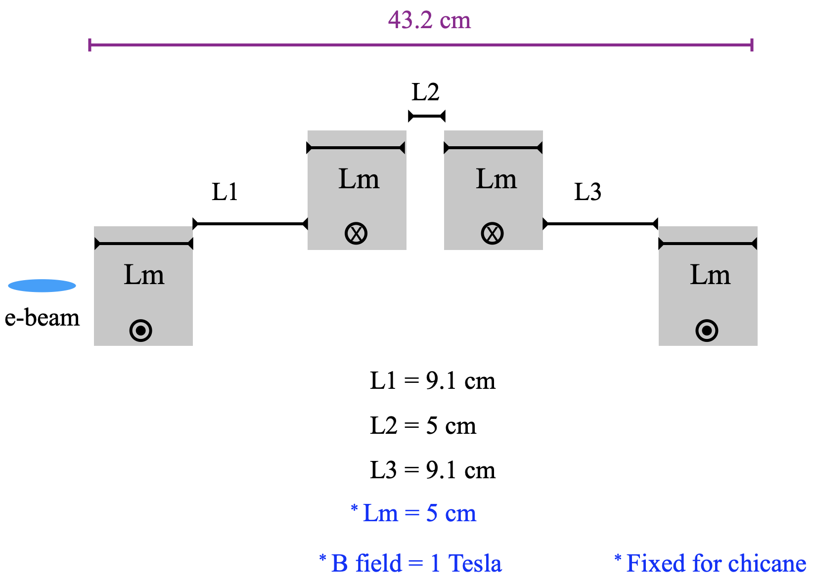
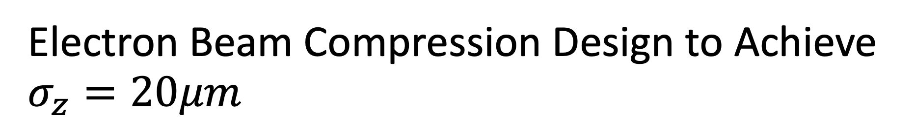
Electron Beam Compression Design to Achieve $σ_{z}=20μm$

Slide 13
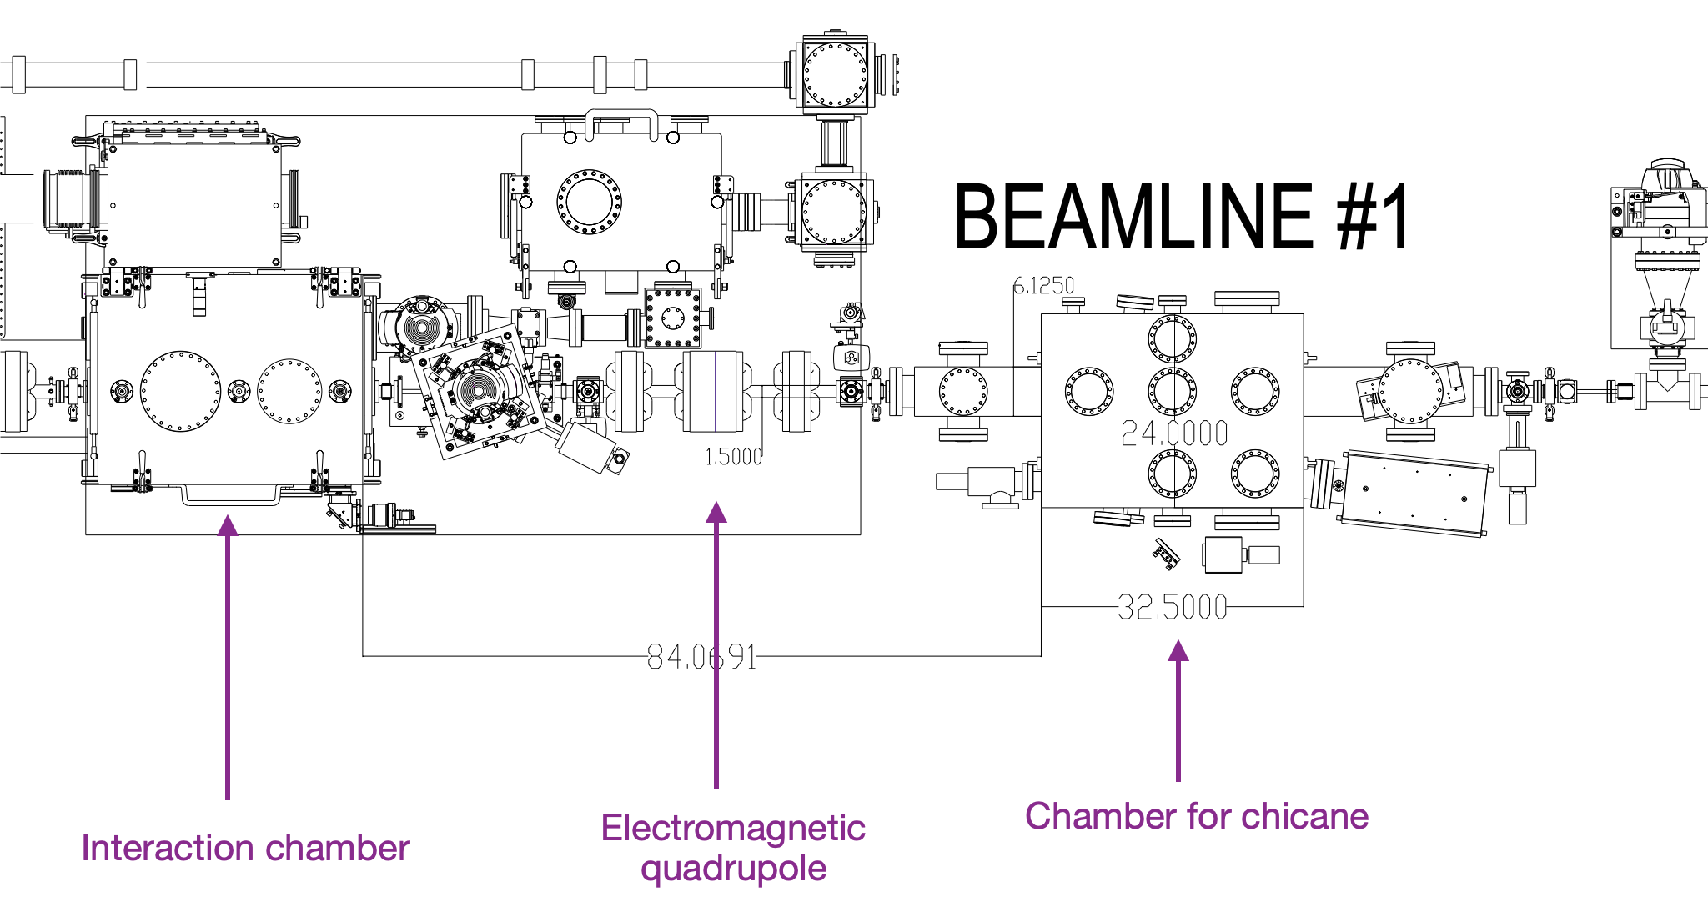
Electron Beam Compression
Beam direction

Slide 14
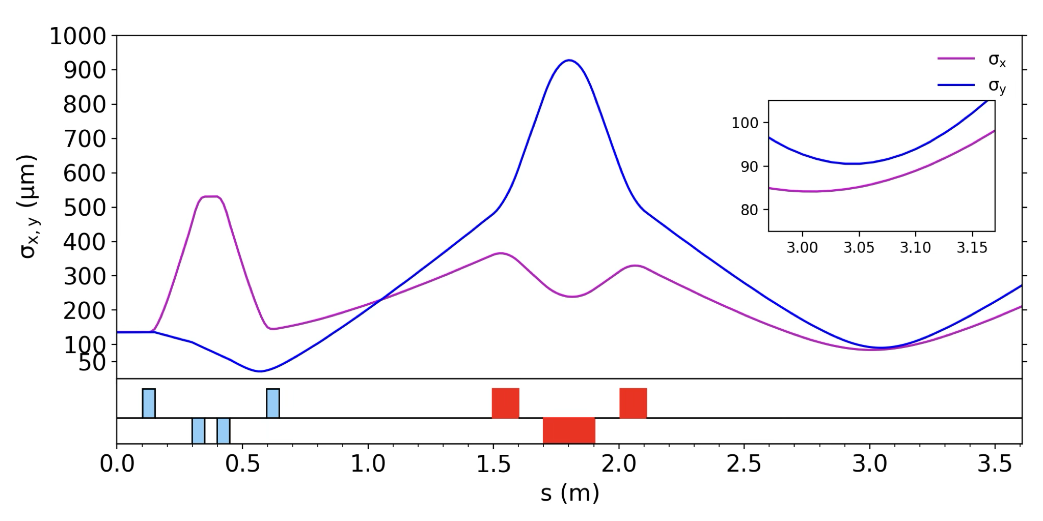
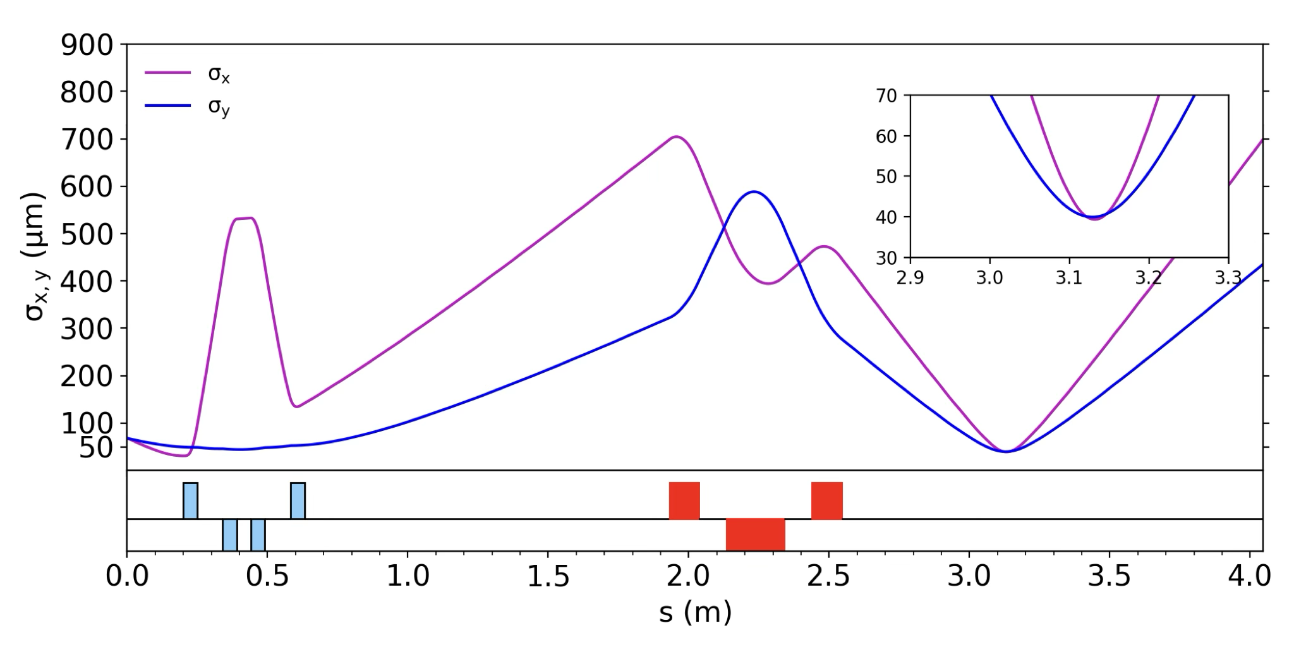

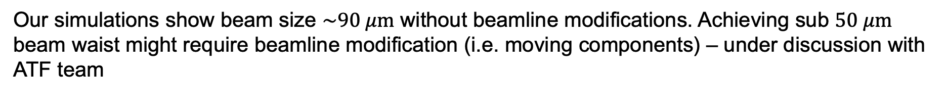
Electron Beam Focusing to $\sim 20μm$ is still Under Investigation
Without Beamline Modification
With Beamline Modification
Our simulations show beam size $\sim 90 μm$ without beamline modifications. Achieving sub $50 μm$ beam waist might require beamline modification (i.e. moving components) – under discussion with ATF team

Slide 15
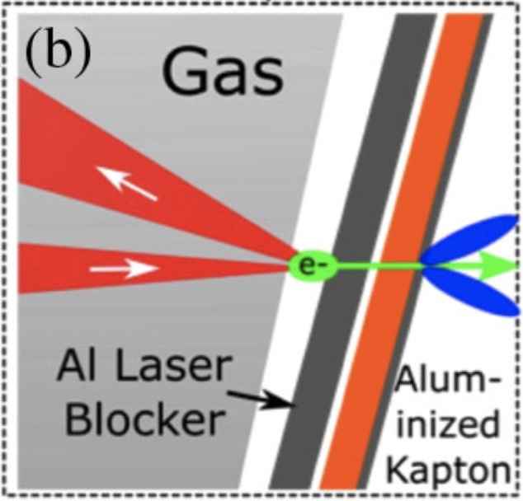
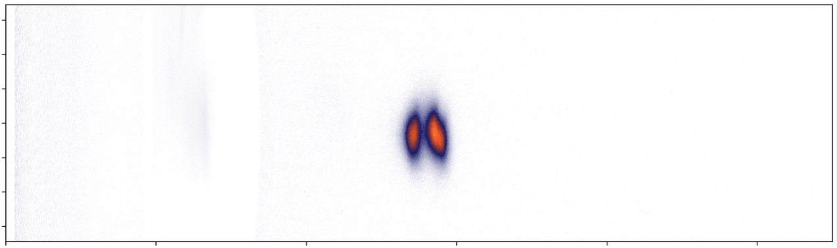
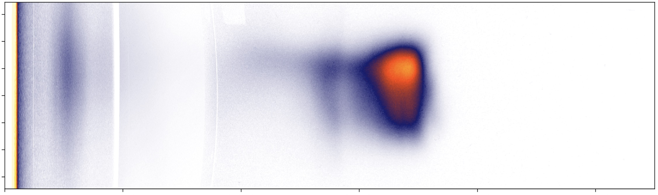
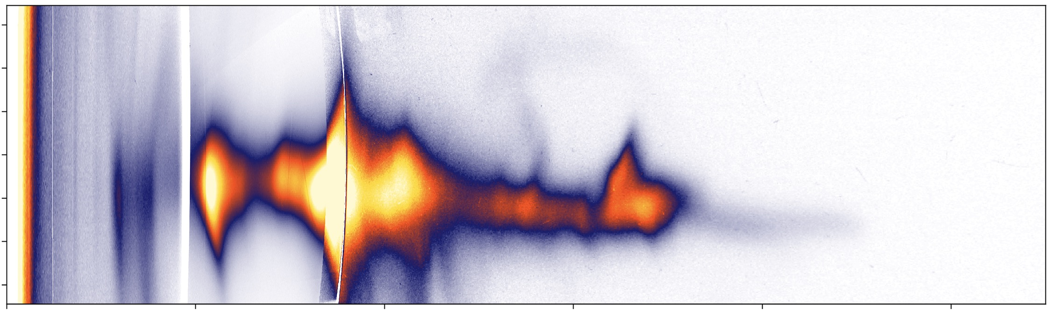
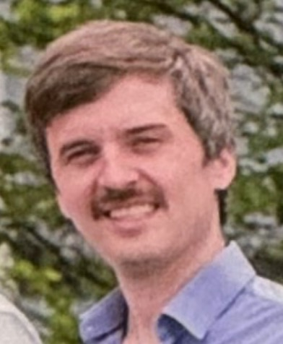
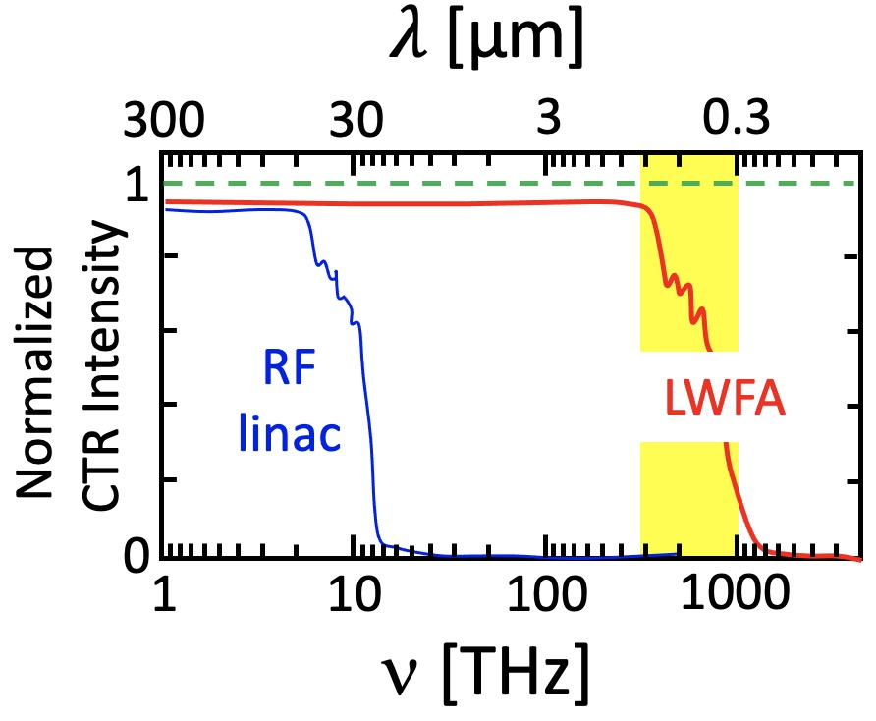
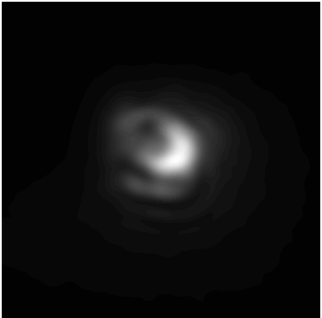
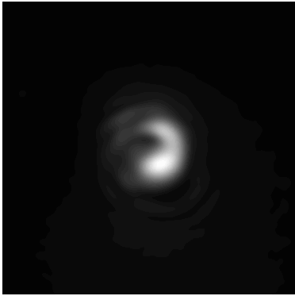
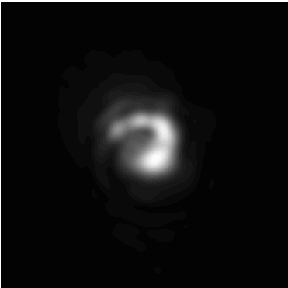
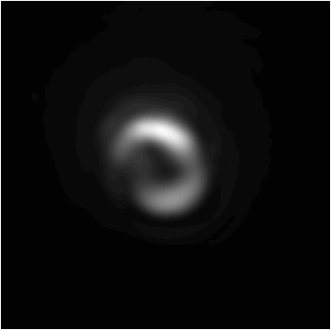
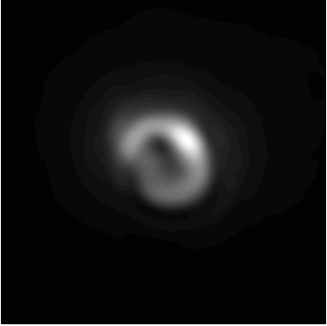
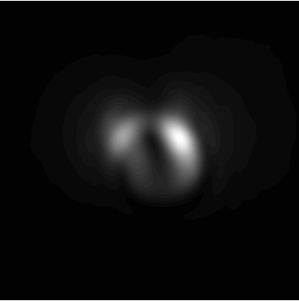
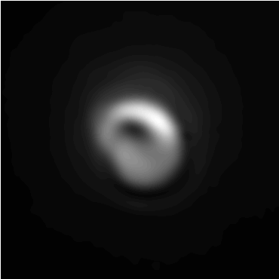
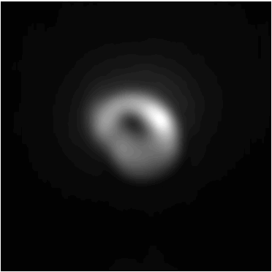
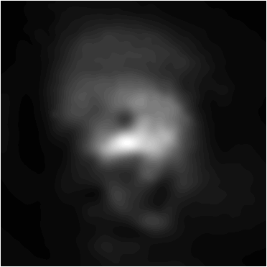
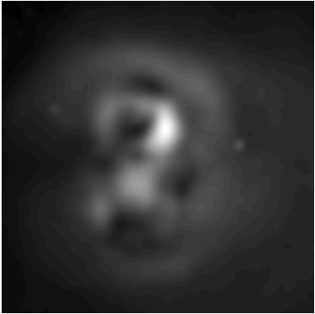
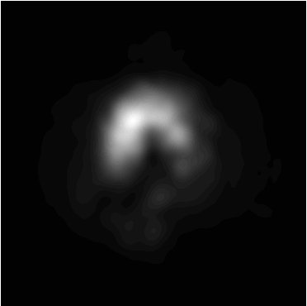
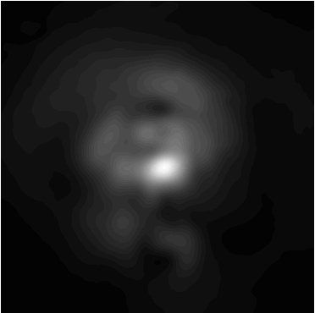
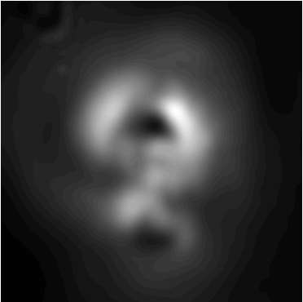
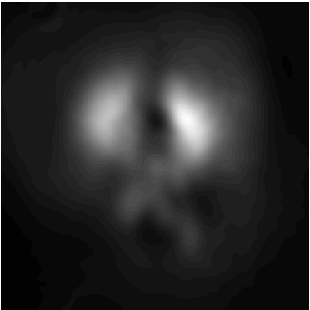
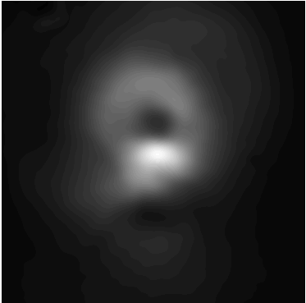
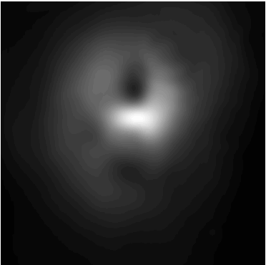
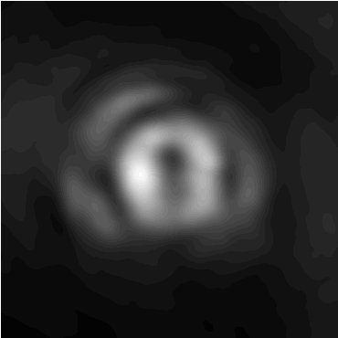
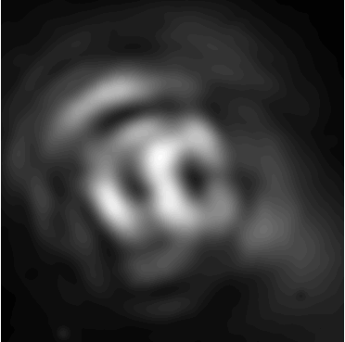
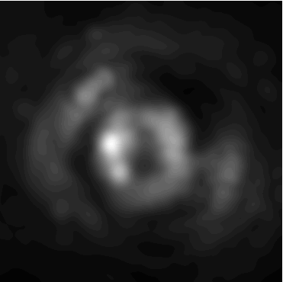





Multi-spectral COTR imaging:
experimental setup and data
-10
1
0.5
0
Down-ramp
10
-10
2
pC/MeV-mrad
0
STII
0.25
Divergence (mrad)
10
-10
self
LaBerge et al.,”Revealing the 3D structure of LPA e-bunches,”
Nat. Photonics 18, 952 (2024).
0
Gas Jet
10
200
400
0
10
COTR foil
Electron Energy (MeV)
e-beam
Electron
Spectrometer
¹ Schmid, PR-STAB 13, 091301 (2010)
Laser Pulse
Si
² Self-Truncated Ionization Injection:
[Mirzaie, Sci. Rpts. 5, 14659 (2015)]
Gas
Nozzle
Achromatic
Objective
bandpass
filters
beam
splitters
COTR
Dichroic
Max LaBerge
UT-PhD 2022
COTR
400
450
500
630
680
700
750
800 nm
1
Down-ramp
OTR images recorded
in a spectral range in
which OTR transitions
from fully coherent
(longer 𝜆) to fully inco-
herent (shorter 𝜆), thus
providing maximum
structural information.
COTR imaged
from foil surface
to each of 8
𝜆-filtered CCDs
0.5
STII
Normalized COTR fluence
Self
0
22
50 µm

Slide 16







3D Snapshot of Downramp-Injected LWFA e-bunch
• not separable [i.e. $ρ(x,y,z)≠ρ(x,y)ρ(z)]$
• not symmetric
Single-shot reconstruction!
How do we know this solution is unique?
• Reconstruction algorithm was run hundreds of
times with randomly-varied initial parameters.
• The resulting cluster of reconstructions reveals
reproducible common characteristics.
• The cluster-averaged structure reproduces the
COTR data with fidelity equivalent to individual
reconstructions, providing a quanitative
“uniqueness” evaluation.
Check list:
Measured
COTR
✓
reproduces COTR data
Q ≈ Q_{m}
Q negative
$$U^{(COTR)}≈ U_{m}^{(COTR)}$$
longitudinal profile
✓
✓
✓
Calculated
COTR
✓
23

Slide 17
Questions?

Slide 18




Expected Experimental Regimes with 5 TW Laser Pulse
$$n_{e}∼{10}^{14} {cm}^{−3}$$
“Classic” Blowout Regime
Primarily used in LWFA research at $1μm$
High acceleration and focusing fields
Structure radius ~ 200 $μm$
$$n_{e}∼{10}^{16} {cm}^{−3}$$
“Wakeless” Blowout Regime ($E_{z}∼0$)
Onset of “Forced” LWFA
High focusing fields only
Structure radius ~ 50 $μm$

Slide 19


Changing e-Beam Current Modifies Both Energy Spread and Efficiency
Calculations of $E_{z}$based on 1D nonlinear LWFA theory
$$Q=90pC$$
Laser: $a_{0}=1.7$, $τ=0.5$ ps, $λ=9.2 μm$, $n_{e}=1.7×{10}^{16}$cm⁻³

Slide 20
Electron Beam Parameters Used in Compression Design
Initial electron beam parameters
Energy | 55 MeV
Normalized emittance | 1 mm-mrad
Beam charge | 200 pC
std(tau) / sigma_tau [ Pulse length (fwhm) ] | 0.25 mm [ 0.552 mm ]
std(p) / sigma_p [ with Energy chirp ] | 3.0e-4 [ 1.98 GeV/m ]
beta_x | 2
beta_y | 2
alpha_x | 0
alpha_y | 0

Slide 21


Leveraging Wavelength Scaling
n_{e} ≈ 5 × 10¹⁸ cm⁻³
n_{e} ≈ 2 × 10¹⁶ cm⁻³
10
not previously demonstrated
5
electron density (10¹⁸ cm⁻³)
x = 0 mm
x = 0.3 mm
x = 0.6 mm
0
λ [µm]:
1 (NIR)
10 (LWIR)
λ [µm]:
1
10
τ [fs]:
30
30
(τ ≈ 1 cycle)
τ [fs]:
500
500
w₀ [µm]:
8
8
(w₀ < λ)
w₀ [µm]:
120
120
Laser Energy [J]:
0.7
0.007
Energy [J]:
2500
25
Max e⁻ energy gain [GeV]:
0.6
(impractical)
Max e⁻ energy gain [GeV]:
1.6
Pogorelsky et al., Plasma Phys. Control. Fusion 58, 034003 (2016).
Driving the wake efficiently requires laser size and field strength matched to plasma wavelength
Courtesy of Michael Downer (UT Austin)
Notes:
Read tag line first
For example at two different densities shown here, you need to match the pulse length and spot size to these values

Slide 22

Large Bubble Size Makes Injection Feasible
V_{injection} determined by:
100
n_{e} ≈ 2 × 10¹⁶ cm⁻³
• e-bunch compressibility & focusability
n_{e} ≈ 5 × 10¹⁸ cm⁻³
10
injection
point
5
0
electron density (10¹⁸ cm⁻³)
y (µm)
after
acceleration
x = 0.6 mm
x = 0 mm
0
-100
Courtesy of Michael Downer (UT Austin)
* Xu et al., PR-STAB (2014)
Notes:
The bubble sizes at two densities are not equal and if scaled, it looks something like this

Slide 23
Electron Beam Requirements
Parameter | Units | Typical Values | Comments | Requested Values
Beam Energy | MeV | 50-65 | Full range is ~15-75 MeV with highest beam quality at nominal values | Nominal
Bunch Charge | nC | 0.1-2.0 | Bunch length & emittance vary with charge | 0.2-0.5 nC
Bunch Length | ps | 1-10 | Bunch charge & emittance vary with length | Varied as part of experiment
Peak current | A | 100 | Variable with bunch charge and length | Varied as part of experiment
Compression | fs | Down to 100 fs (up to 1 kA peak current) | A magnetic bunch compressor available to compress bunch down to ~100 fs. Beam quality is variable depending on charge and amount of compression required. NOTE: Further compression options are being developed to provide bunch lengths down to the ~10 fs level | Varied as part of experiment (down to 60 fs)
Focused transverse size at IP (σ) | μm | 30 – 100 (dependent on IP position) | It is possible to achieve transverse sizes below 10 um with special permanent magnet optics. | Down to 10 micron
Normalized Emittance | μm | 1 (at 0.3 nC) | Variable with bunch charge | nominal
Rep. Rate (Hz) | Hz | 1.5 | 3 Hz also available if needed | nominal
Trains mode | --- | Single bunch | Multi-bunch mode available. Trains of 24 or 48 ns spaced bunches. | Single Bunch

Slide 24
CO₂ Laser Requirements
Configuration | Parameter | Units | Typical Values | Comments | Requested Values
CO₂ Regen. Amplifier | Wavelength | μm | 9.2 | Wavelength determined by mixed isotope gain media
 | Peak Power | GW | ~3
 | Pulse Mode | --- | Single
 | Pulse Length | ps | 2
 | Pulse Energy | mJ | 6
 | Repetition Rate | Hz | 1.5 | 3 Hz also available if needed
CO₂ CPA Beam | Wavelength | μm | 9.2 | Wavelength determined by mixed isotope gain media | 9.2
Note that delivery of full power pulses to the Experimental Hall is presently limited to Beamline #1 only. | Peak Power | TW | 2-3 | Up to 5 TW operation will be available in a limited number of shots upon the user's request. | Max available
 | Pulse Mode | --- | Single |  | Single
 | Pulse Length | ps | 2 | 3-year development effort to achieve <500 fs at >10 TW and deliver to users is in progress. | Min available
 | Pulse Energy | J | ~5 | 10J will be available in a limited number of shots upon the user's request. | Max available
 | Strehl Ratio | --- | ~0.5 | Recommended conservative estimate subject to verification. | nominal
 | Repetition Rate | Hz | 0.01 | Burst operation at up to 0.05 Hz for a limited period is possible upon user’s request. This regime should be avoided to extend the lifetime of the HV spark gaps in the amplifier’s PFN | nominal
 | Polarization |  | Linear | Adjustable linear polarization along with circular polarization can be provided upon request | Linear

Slide 25
Other Experimental Laser Requirements
Ti:Sapphire Laser System | Units | Stage I Values | Stage II Values | Comments | Requested Values
Central Wavelength | nm | 800 | 800 | Stage I parameters are presently available and setup to deliver Stage II should be available summer 2025 | N/A
FWHM Bandwidth | nm | 20 | 13 |  | N/A
Compressed FWHM Pulse Width | fs | <50 | <75 | Transport of compressed pulses will initially include a very limited number of experimental interaction points. Please consult with the ATF Team if you need this capability. | N/A
Chirped FWHM Pulse Width | ps | ≥50 | ≥50 |  | N/A
Chirped Energy | mJ | 10 | 200 |  | N/A
Compressed Energy | mJ | 7 | ~20 | 20 mJ is presently operational with work underway this year to achieve our 100 mJ goal. | N/A
Energy to Experiments | mJ | >4.9 | >80 |  | N/A
Power to Experiments | GW | >100 | >1000
Nd:YAG Laser System | Units | Typical Values | Comments | Requested Values
Wavelength | nm | 1064 | Single pulse | N/A
Energy | mJ | 100 |  | N/A
Pulse Width | ps | 14 |  | N/A
Wavelength | nm | 532 | Frequency doubled | N/A
Energy | mJ | 0.5 |  | N/A
Pulse Width | ps | 10 |  | N/A

Slide 26
Special Equipment Requirements and Hazards
Electron Beam
Please indicate any special equipment that you expect to need, including (but not limited to) the transverse deflecting cavity, shaped bunch using mask technique, plasma capillary discharge system, bolometer/interferometer setup etc.:
CO₂ Laser
Please note any specialty laser configurations required here:
Ti:Sapphire and Nd:YAG Lasers
Please note any specialty non-CO₂ laser configurations required here:
Hazards & Special Installation Requirements
Large installation (chamber, insertion device, etc.):
Cryogens:
Introducing new magnetic elements:
Introducing new materials into the beam path:
Any other foreseeable beam line modifications:

