Slide 1

27th Accelerator Test Facility (ATF) Users' Meeting
AE138
Enabling R&D for Advanced M/L-WIR Laser Concepts
M. N. Polyanskiy, Dismas Choge, I. V. Pogorelsky, M. Babzien,
W. Li, M. A. Palmer
May 29, 2025
Accelerator Facilities Division

Slide 2
AE-138
Title | Enabling R&D for Advanced M/L-WIR Laser Concepts
Status | Succession of AE-101
PI | Mikhail Polyanskiy
Team | D. Choge, M. Babzien, W. Li, I. Pogorelsky
Funding | DOE ARDAP grant Phase II (2022—2025; PI: M. N. Polyanskiy) ATF laser R&D funding
Funding Status | Received

Slide 3
Experimental goals
Systematically study laser-damage characteristics of infrared materials and laser optics under the action of intense LWIR laser irradiation
Deploy a full-scale working prototype of a post-compressor for a 2 ps to 500 fs compression
Initiate a pump/probe study of free carrier dynamics in semiconductor materials relevant for M/L-WIR lasers
Provide a framework for “small” research tasks needed for the development of M/L-WIR lasers

Slide 4
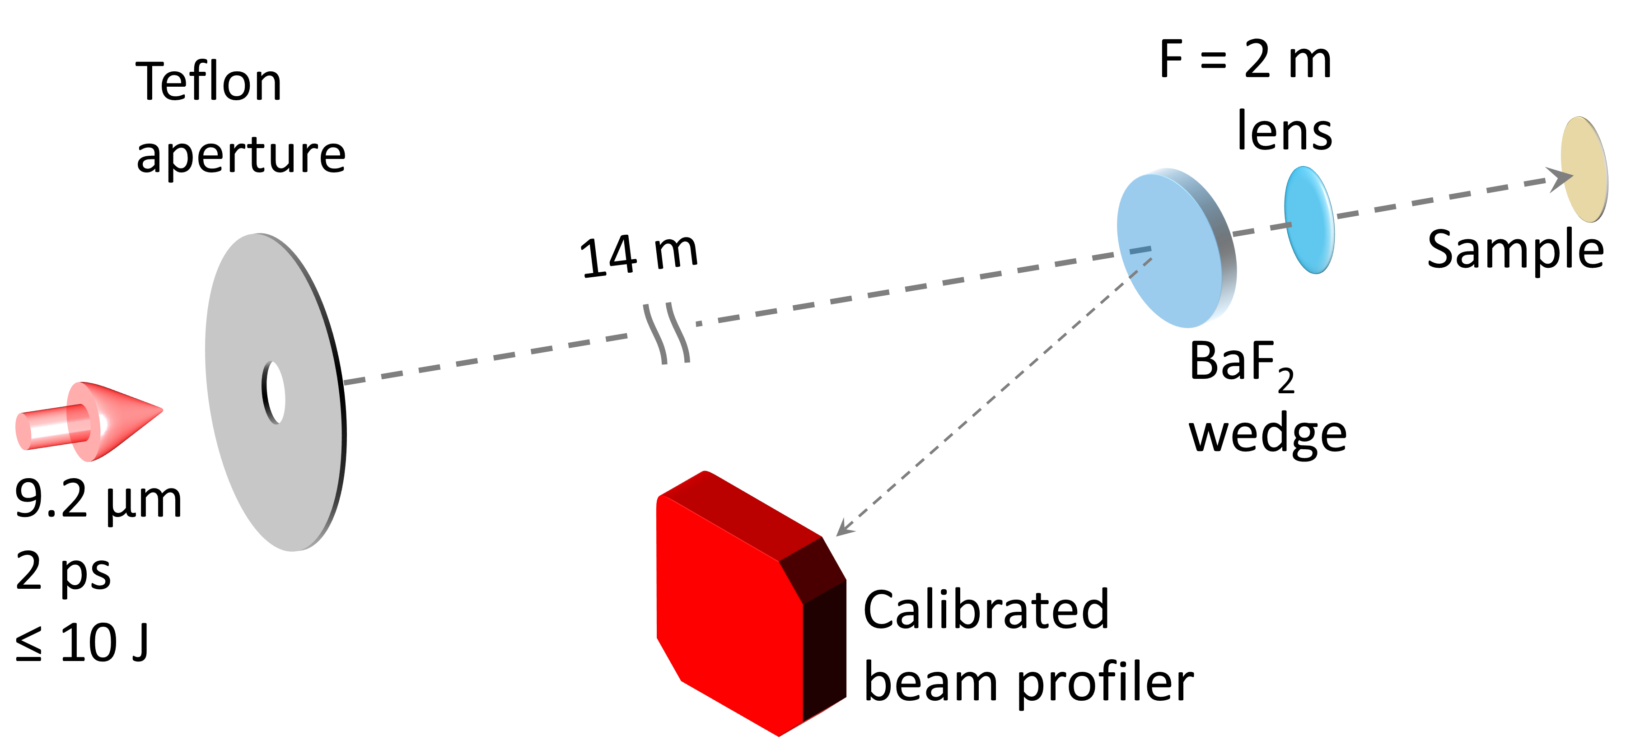
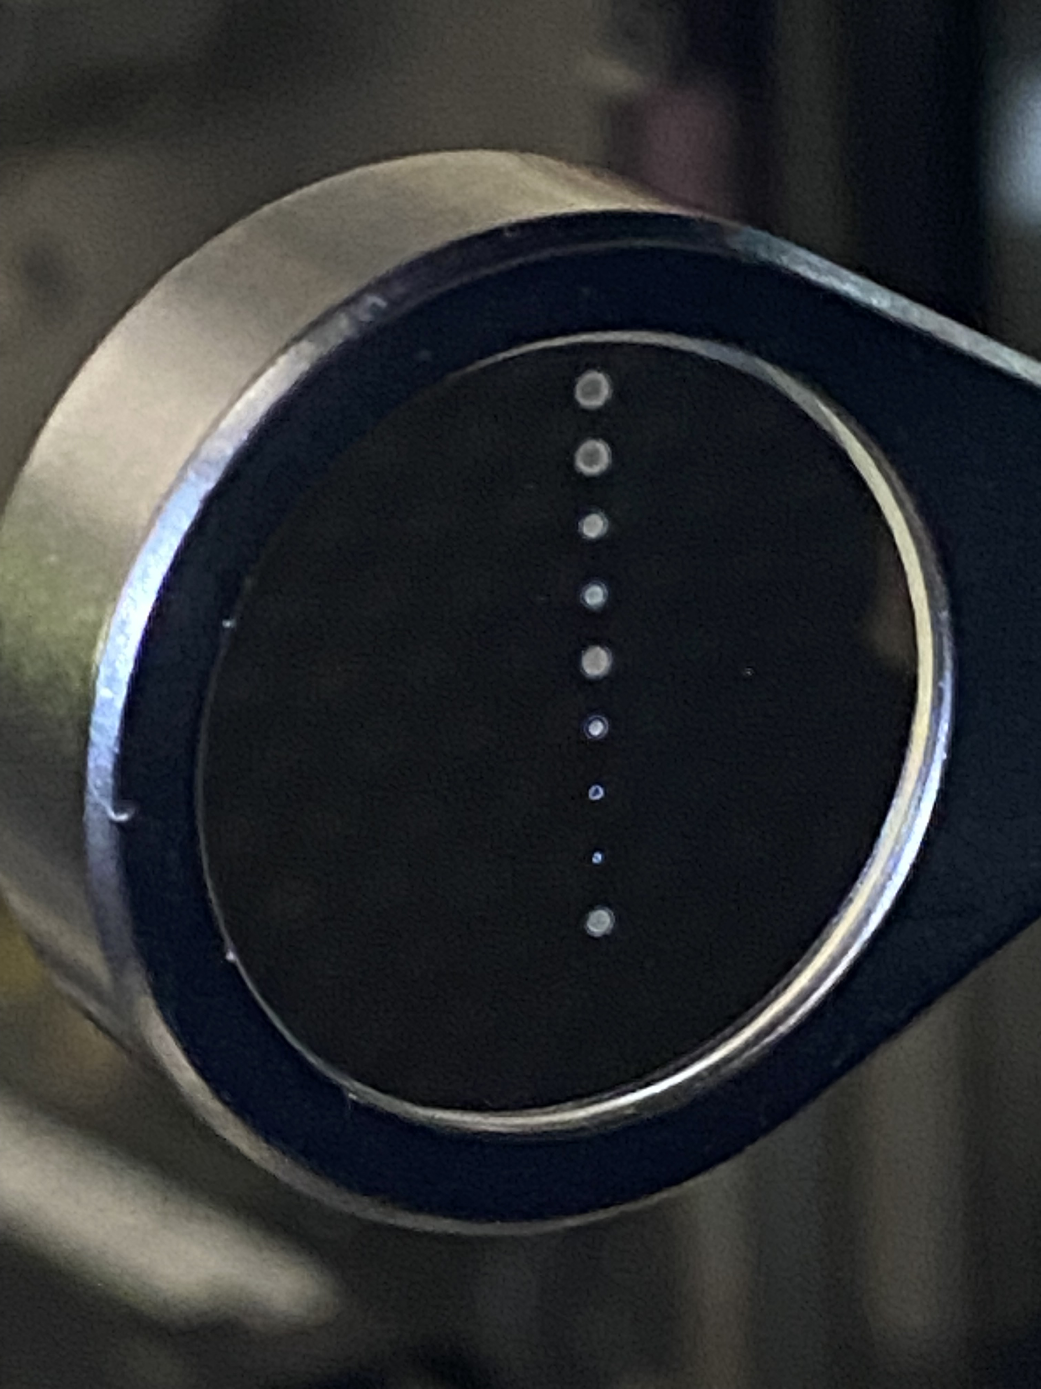
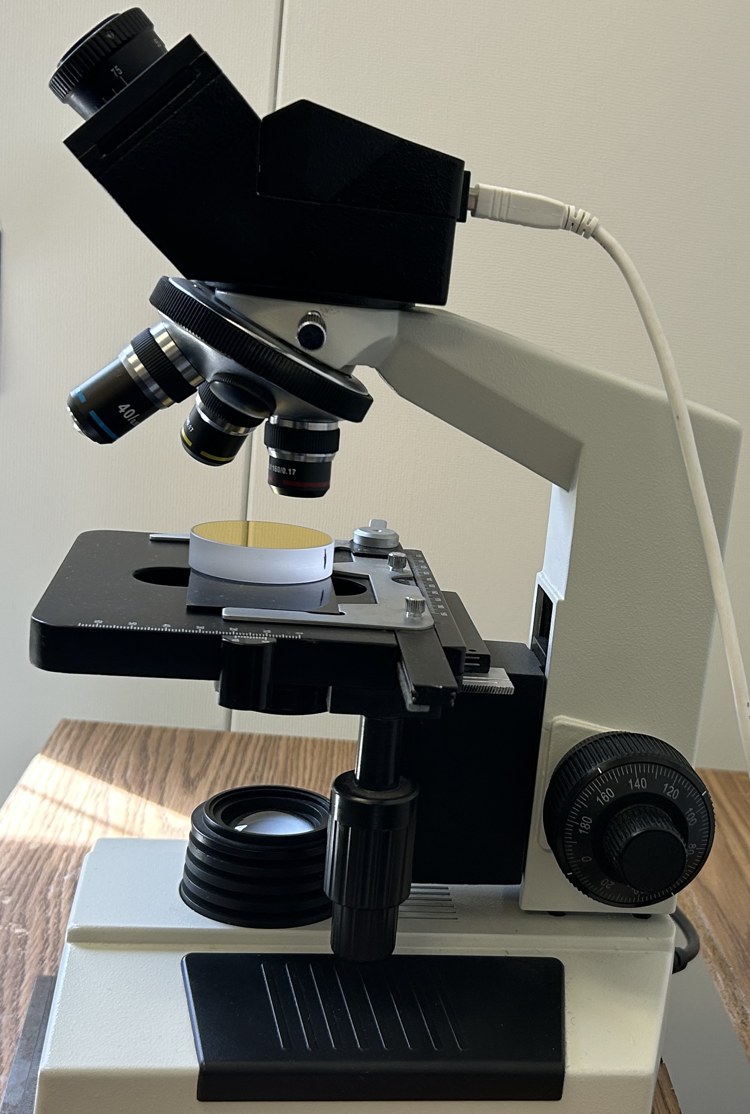
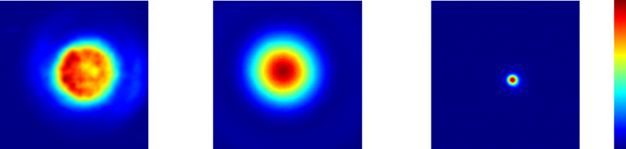
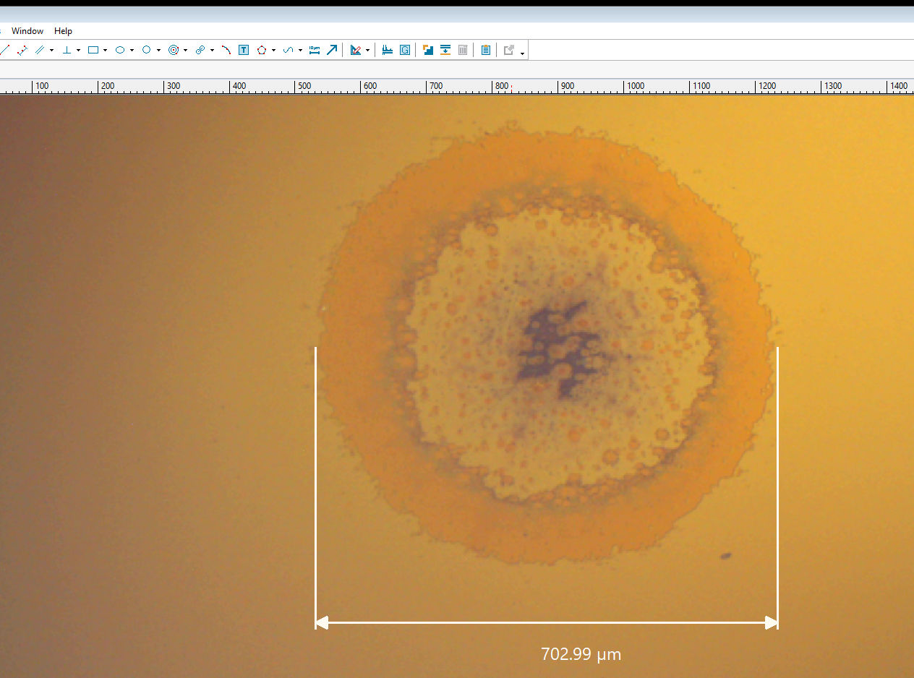
Set-up for laser-damage characterization
⌀12.88 mm
(a)
(b)
Al mirror
(c)
Input profile
Sampled profile
Focused spot
~700 µm (FWHM)
(d)

Slide 5
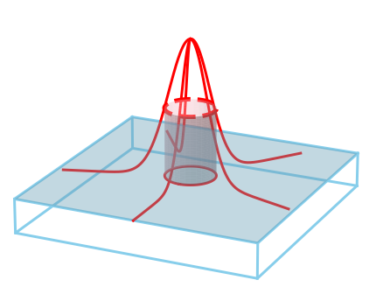
Single-shot LIDT extraction
Real space
Line-out profile of the damage spot
Local fluence
Left center right
F_{th}
Protected Au mirror sample imaged with optical microscope
Damage
profile
F_{th} is deduced as the maximum fluence just outside the damaged area where no damage occurs
Beam spatial distribution at focus

Slide 6
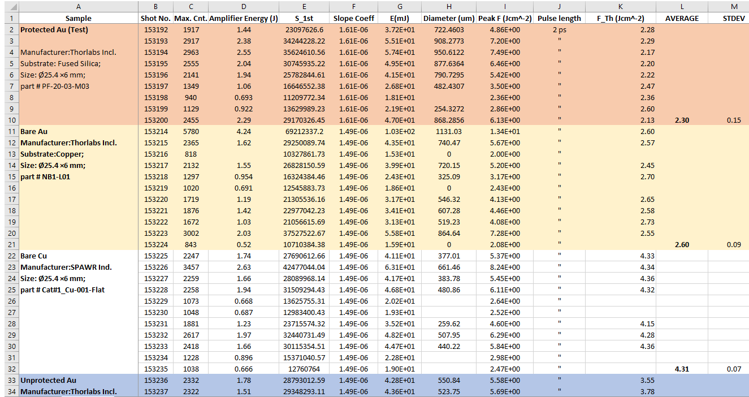
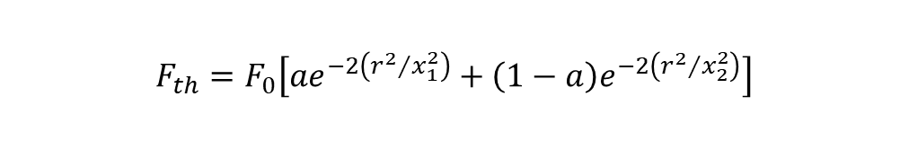
Data analysis
1
Measure pulse energy E
2
Compute the on‐sample peak fluence
3
Inspect the sample under the microscope.
Measure and record damage diameter D(=2r).
r=radius of damaged spot
x=beam spot size
Assemble all (𝐹, D) pairs and fit them with double‑Gaussian damage‑threshold model
$$F_{th}=F_{0}\left[ae^{−2\left({r^{2}}/{x_{1}^{2}}\right)}+\left(1−a\right)e^{−2\left({r^{2}}/{x_{2}^{2}}\right)}\right]$$
4

Slide 7
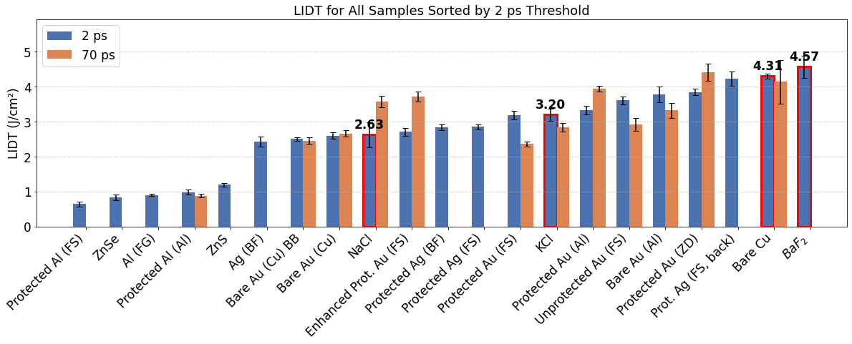
LIDT Results Summary

Slide 8
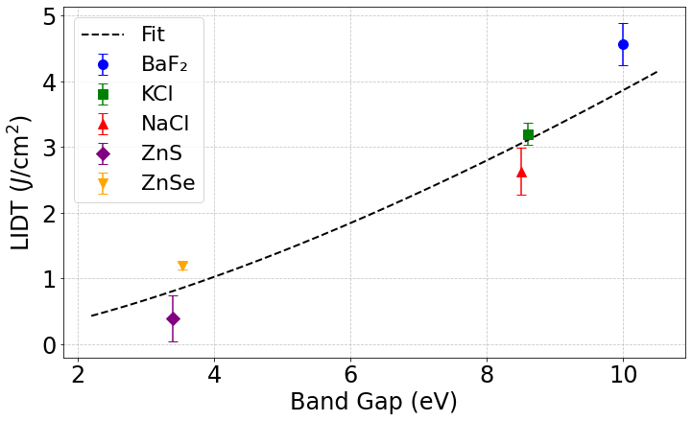

Strong positive correlation between band gap and LIDT
BaF₂
F₀=9.8 Jcm⁻²
KCl
F₀=9.6 Jcm⁻²
Wider band‑gap → higher multiphoton threshold → fewer seed electrons → higher damage fluence
@9.2 µm, Keldysh parameter, $γ\sim 0.04$

Slide 9
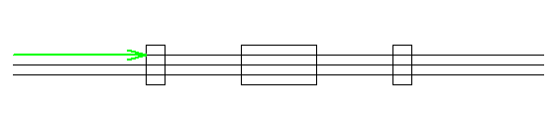
Experimental plans
1) Systematically study laser-damage of LWIR materials
Continue using full power CO₂ laser to test >100 samples (mirrors/windows/gratings)
2) Deploy a full-scale working prototype of a post-compressor
2 ps to 500 fs compression
3) Pump/probe study of free carrier dynamics in semiconductor materials
Requires ps pulse
4) Framework for “small” research tasks for the development of M/L-WIR lasers
Generation of 1.4 µm via wavelength down-conversion in PPLN
KCl lens
t=85 mm
Spatial filter
⌀2.5 mm
4.98 m
4.50 m
BaF₂ lens
t=110 mm
D
PPLN
1064 nm
1064 nm (e) = 1440 nm (e) + 4075 nm (e)
M1
M2
50 mm

Slide 10
Products delivered
Conference proceedings/presentations:
  M. N. Polyanskiy, I. V Pogorelsky, D. K. Choge, M. Babzien, W. Li, and M. A. Palmer, “Post-compression of multi-terawatt long-wave-infrared pulses,” in SPIE Optics and Optoelectronics, Prague (Czech Republic), April 7 – 10, 2025
  Dismas K. Choge, I. V Pogorelsky, M. N. Polyanskiy, M. Babzien, W. H. Li ,M. A. Palmer. “Accurate characterization of optical materials enables femtosecond LWIR pulses with terawatt-level peak power via bulk-material post-compression,” APS Joint March and April meeting: Global Physics Summit, Anaheim, CA (USA), March 16–21, 2025
  Mikhail N. Polyanskiy, D. K. Choge, I. V. Pogorelsky, M. Babzien, W. H. Li, and M. A. Palmer "Nonlinear properties of bulk optical materials for high-peak-power long-wave-infrared lasers", Proc. SPIE 13347, Nonlinear Frequency Generation and Conversion: Materials and Devices XXIV, 133470K (21 March 2025)
  Dismas. K. Choge, M. N. Polyanskiy, I. V. Pogorelsky, M. Babzien, W. H. Li, and M. A. Palmer "Picosecond laser damage thresholds of materials for high-peak-power LWIR laser applications", Proc. SPIE PC13190, Laser-Induced Damage in Optical Materials 2024, PC1319010 (18 December 2024)
  Dismas. K. Choge, M. N. Polyanskiy, I. V. Pogorelsky, M. Babzien, W. H. Li, and M. A. Palmer, “Single-shot laser induced damage thresholds of optical mirrors for high-peak-power LWIR laser applications,” Advanced Accelerator Concepts (AAC) workshop, Naperville, Illinois (USA), July 21 - 26, 2024

Slide 11
Electron Beam Requirements
Parameter | Units | Typical Values | Comments | Requested Values
Beam Energy | MeV | 50-65 | Full range is ~15-75 MeV with highest beam quality at nominal values | -
Bunch Charge | nC | 0.1-2.0 | Bunch length & emittance vary with charge | -
Compression | fs | Down to 100 fs (up to 1 kA peak current) | A magnetic bunch compressor available to compress bunch down to ~100 fs. Beam quality is variable depending on charge and amount of compression required. NOTE: Further compression options are being developed to provide bunch lengths down to the ~10 fs level | -
Transverse size at IP (s) | mm | 30 – 100 (dependent on IP position) | It is possible to achieve transverse sizes below 10 um with special permanent magnet optics. | -
Normalized Emittance | mm | 1 (at 0.3 nC) | Variable with bunch charge | -
Rep. Rate (Hz) | Hz | 1.5 | 3 Hz also available if needed | -
Trains mode | --- | Single bunch | Multi-bunch mode available. Trains of 24 or 48 ns spaced bunches. | -

Slide 12
CO₂ Laser Requirements
Configuration | Parameter | Units | Typical Values | Comments | Requested Values
CO₂ Regenerative Amplifier Beam | Wavelength | mm | 9.2 | Wavelength determined by mixed isotope gain media | 9.2
 | Peak Power | GW | ~3 |  | ~3
 | Pulse Mode | --- | Single |  | Single
 | Pulse Length | ps | 2 |  | 2/70
 | Pulse Energy | mJ | 6 |  | 6
 | M² | --- | ~1.5 |  | ~1.5
 | Repetition Rate | Hz | 1.5 | 3 Hz also available if needed | 1.5
 | Polarization | --- | Linear | Circular polarization available at slightly reduced power | Linear
CO₂ CPA Beam | Wavelength | mm | 9.2 | Wavelength determined by mixed isotope gain media | 9.2
Note that delivery of full power pulses to the Experimental Hall is presently limited to Beamline #1 only. | Peak Power | TW | 5 | ~5 TW operation will become available shortly into this year’s experimental run period. A 3-year development effort to achieve >10 TW and deliver to users is in progress. | 2
 | Pulse Mode | --- | Single |  | Single
 | Pulse Length | ps | 2 |  | 2/70
 | Pulse Energy | J | ~5 | Maximum pulse energies of >10 J will become available within the next year | ~5
 | M² | --- | ~2 |  | ~2
 | Repetition Rate | Hz | 0.05 |  | 0.05
 | Polarization |  | Linear | Adjustable linear polarization along with circular polarization can be provided upon request | Linear

Slide 13
Other Experimental Laser Requirements
Ti:Sapphire Laser System | Units | Stage I Values | Stage II Values | Comments | Requested Values
Central Wavelength | nm | 800 | 800 | Stage I parameters are presently available and setup to deliver Stage II parameters should be complete during FY22 | TBD
FWHM Bandwidth | nm | 20 | 13 |  | TBD
Compressed FWHM Pulse Width | fs | <50 | <75 | Transport of compressed pulses will initially include a very limited number of experimental interaction points. Please consult with the ATF Team if you need this capability. | TBD
Chirped FWHM Pulse Width | ps | ≥50 | ≥50 |  | TBD
Chirped Energy | mJ | 10 | 200 |  | TBD
Compressed Energy | mJ | 7 | ~20 | 20 mJ is presently operational with work underway this year to achieve our 100 mJ goal. | TBD
Energy to Experiments | mJ | >4.9 | >80 |  | TBD
Power to Experiments | GW | >98 | >1067 |  | TBD
Nd:YAG Laser System | Units | Typical Values | Comments | Requested Values
Wavelength | nm | 1064 | Single pulse | TBD
Energy | mJ | 5 |  | TBD
Pulse Width | ps | 14 |  | TBD
Wavelength | nm | 532 | Frequency doubled | TBD
Energy | mJ | 0.5 |  | TBD
Pulse Width | ps | 10 |  | TBD

Slide 14
Special Equipment Requirements and Hazards
Electron Beam
  Please indicate any special equipment that you expect to need, including (but not limited to) the transverse deflecting cavity, shaped bunch using mask technique, plasma capillary discharge system, bolometer/interferometer setup etc.:
CO₂ Laser
  Please note any specialty laser configurations required here:
Ti:Sapphire and Nd:YAG Lasers
  Please note any specialty non-CO₂ laser configurations required here:
  ns Nd:YAG @ 1064 nm
Hazards & Special Installation Requirements
  Large installation (chamber, insertion device, etc.):
  Cryogens:
  Introducing new magnetic elements:
  Introducing new materials into the beam path:
  Any other foreseeable beam line modifications:

Slide 15
CY2025 Time Request
Capability | Setup Hours | Running Hours
Electron Beam
NIR Laser
LWIR Laser | 40 | 2 x 40 = 80
Total Time Request for the 3-year Experiment (including CY2024-26)
Capability | Setup Hours | Running Hours
Electron Beam
NIR Laser
LWIR Laser | 40 x 3 = 120 | 80 x 3 = 240

Slide 16
Questions?

