Slide 1





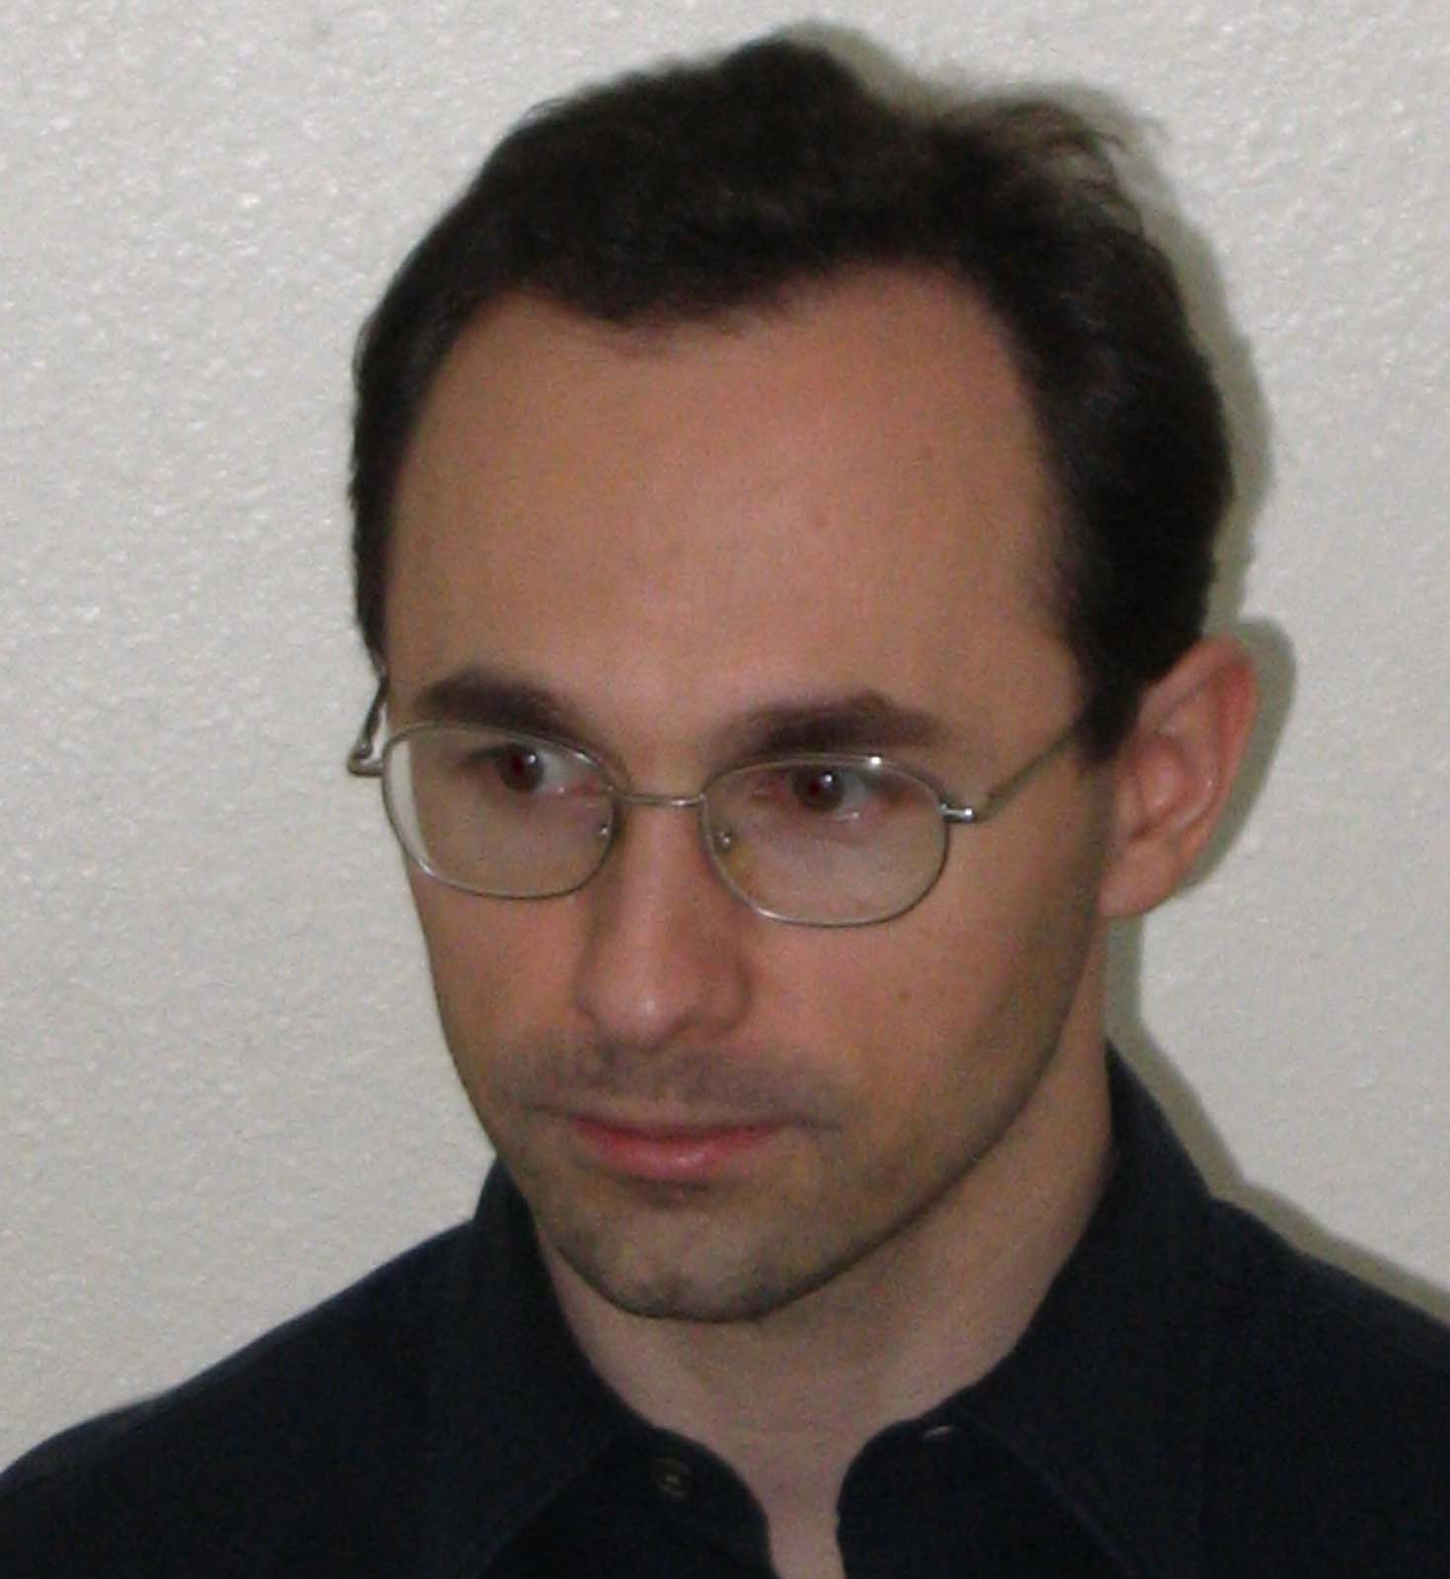
ATF User’s Meeting
30 April 2025
AE-137: Toward bubble-regime
CO₂-laser-driven wakefield acceleration
PI: Mike Downer, University of Texas at Austin
Yuxuan Cao, PhD student
Collaborators:
Dr. Rafal Zgadzaj
University of Texas at Austin:
Faculty: M. C. Downer
Research Scientist: R. Zgadzaj
PhD students: Y. Cao, B. Dinh
Stony Brook University:
Faculty: Navid Vafaei-Najafabadi
Roman Samulyak
V. N. Litvinenko
Postdoc: N. Pathak, W. Li
PhD Students: A. Cheng, A. Gaikwad,
B. Romasky, E. Trommer
Brookhaven NL:
ATF Director: M. A. Palmer
Research Scientists: M. Babzien,
M. Fedurin, R. Kupfer, K. Kusche,
W. Li, I. V. Pogorelsky,
M. N. Polyanskiy
UCLA:
Faculty: C. Joshi
Main Group Funding: US Department of Energy grant DE-SC0014043 (received thru 2025, renewal pending)
Additional Individual Support: DE-SC0011617 (UT-Austin); DE-SC0012704 (BNL)
1

Slide 2
Goal: develop LWFAs that routinely produce e-beams
with ∆E_{e}/E_{e} and ℇ_{n} low enough to drive XFELs
Key ingredients:
*
1) Large plasma bubbles (R_{b} ≳ 0.3 mm)
⇒ n_{e} ≲ 10¹⁶ cm⁻³
**
2) External injection of low ∆E_{e}/E_{e}, low ℇ_{n} e-bunches
*
Efficiently excited by LWIR laser pulses uniquely realizeable at ATF
**
• Pogorelsky et al., Phys. Rev. Accel. Beams 19, 091001 (2016);
Kumar et al., Phys. Plasmas 28, 013102 (2021)
Synchronized, compressed ATF linac bunches uniquely enable 1st-generation experiments.
The AE-137 Project builds upon AE71 and AE95 success.
Project # | CO₂ laser parameters | Main results
AE-71 | 2 J, 4 ps, 0.5 TW, 10.3 µm | • Generation, characterization of self-modulated (SM) wakes. No electrons.
AE-95 | 4 J, 2 ps, 2 TW, 9.2 µm | • Self-injected MeV electrons produced at n_{e} ≳ 3 × 10¹⁶ cm⁻³ • Quasi-monoenergetic, collimated features observed.
AE-137 | 5-20 J, < 2 ps, 5-20 TW | • Excite, characterize R_{b} ~ 0.3 mm bubbles at n_{e} ~ 10¹⁶ cm⁻³ w/o self-injection • Inject e⁻ from ATF linac, characterize ∆E_{e}/E_{e} and ℇ_{n}
[1]
[2]
[1] Predicted by Kumar et al., Phys. Plasmas 26, 083106 (2019)
[2] Zgadzaj et al., Nat. Comms. 15, 437(2024)
2

Slide 3
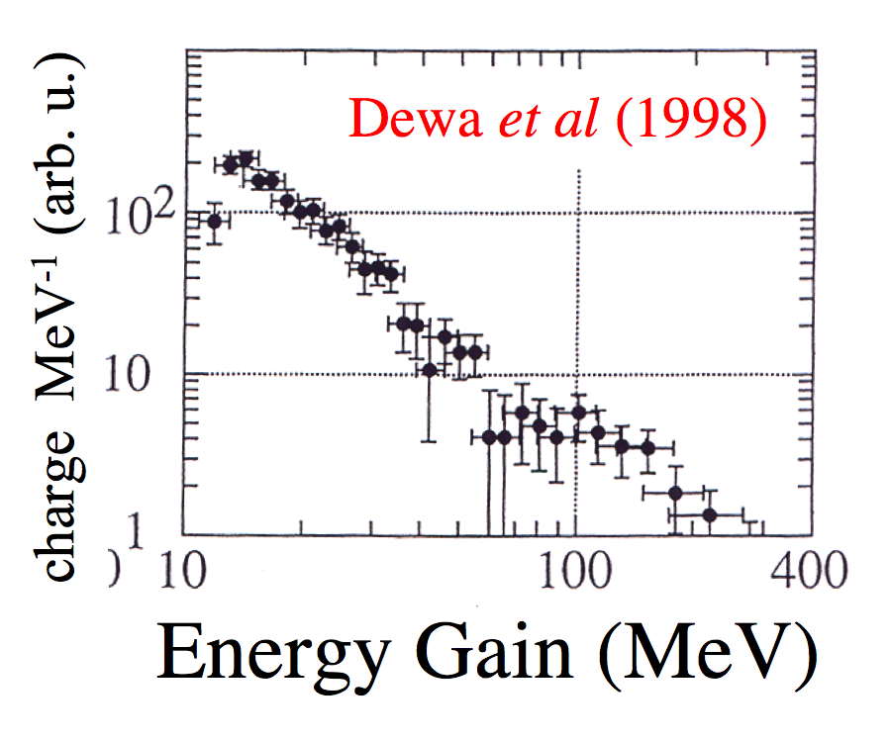
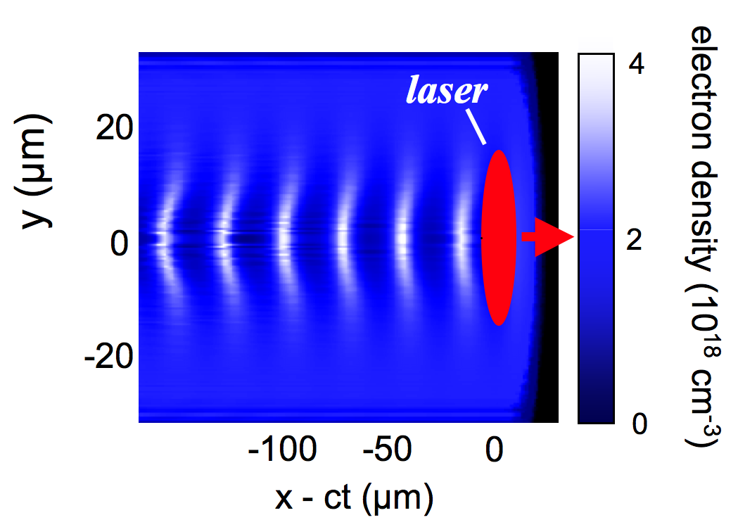
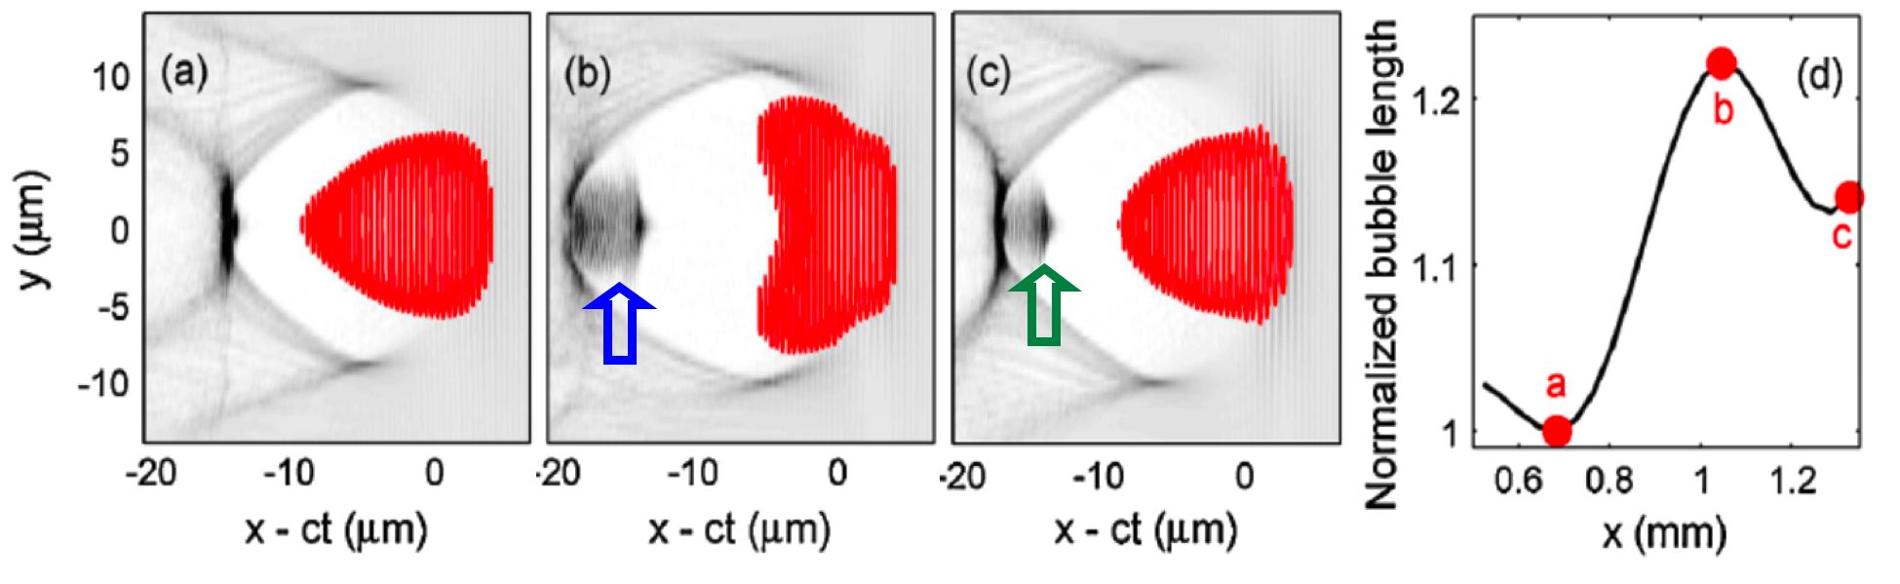
Discovery of the “bubble” regime and “quasi”-monoenergetic “dream” beams
was an occasion for community-wide celebration...
...in 2004.
Pukhov and Meyer-ter-Vehn, Appl. Phys. B 74, 355 (2002); Kostyukov, Phys. Plasmas 11, 5256 (2004)
Review: Esarey, Rev. Mod. Phys. 81, 1229 (2009)
sinusoidal wake
Before 2004:
Leemans, Nat. Phys.(2006)
plasma bubble
After 2004:
500
Kalmykov (2009)
10
Kalmykov, Shvets PRL (2009)
E = 1 GeV
∆E/E = 5 %
θ_{div} = 5 mrad
Q ~ 0.03 nC
t_{bunch} < 10 fs
I_{peak} ~ 10 kA
Kalmykov (2009)
Geddes, Nature (2004)
Faure, Nature (2004)
Mangles, Nature (2004)
250
5
pC GeV⁻¹
electron density (10¹⁸ cm⁻³)
x = 0.3 mm
x = 0.6 mm
0
x = 0 mm
0
0
500
1000
Energy Gain (MeV)
... but improving on ∆E/E ~ few % since 2004 has proven challenging.
3
Notes:
Lead-in: One of the most important discoveries along the 20-year path to mature TW-LPA was that the quasi-linear sinusoidal waves depicted in the previous slide produced electrons with wide energy spread, because of the difficulty of injecting electrons into the wave with sub-plasma-wavelength precision.
• In 2004, we learned that a highly nonlinear regime in which the drive pulse creates an electron density “bubble”, in a remarkable act of self-organization, gives rise to highly mono-energetic electrons up to 1 GeV in energy, as depicted here.

Slide 4
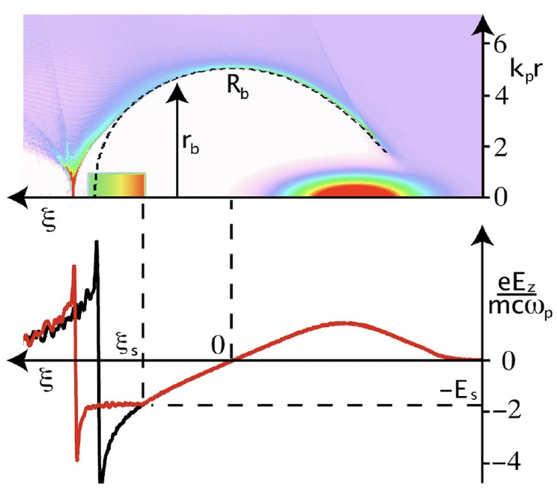

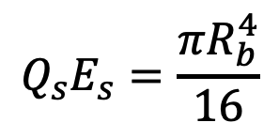
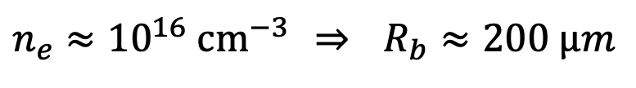

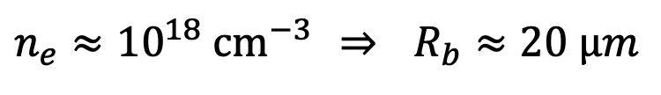
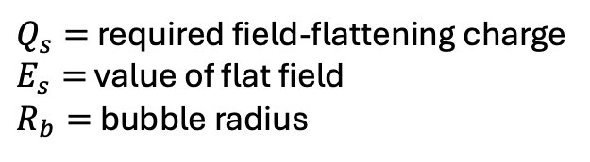
The conventional approach to monoenergetic plasma acceleration
is based on longitudinal beam-loading by a nC injected bunch
Tzoufras et al., “Beam loading in the nonlinear regime of plasma-based acceleration,” Phys. Rev. Lett.101, 145002 (2008)
$$Q_{s}E_{s}=\frac{πR_{b}^{4}}{16}$$
$Q_{s}=$ required field-flattening charge
$E_{s}=$ value of flat field
$R_{b}=$ bubble radius
$n_{e}≈{10}^{18} {cm}^{−3}$ ⇒ $R_{b}≈20 µm$
$$⇒ Q_{s}\sim 1 nC$$
with
beamload
$n_{e}≈{10}^{16} {cm}^{−3}$ ⇒ $R_{b}≈200 µm$
w/o beamload
$$⇒ Q_{s}\sim 10 nC$$
Promising for high-Q monoenergetic acceleration...
... but challenging to achieve at ATF in the short term.
4

Slide 5
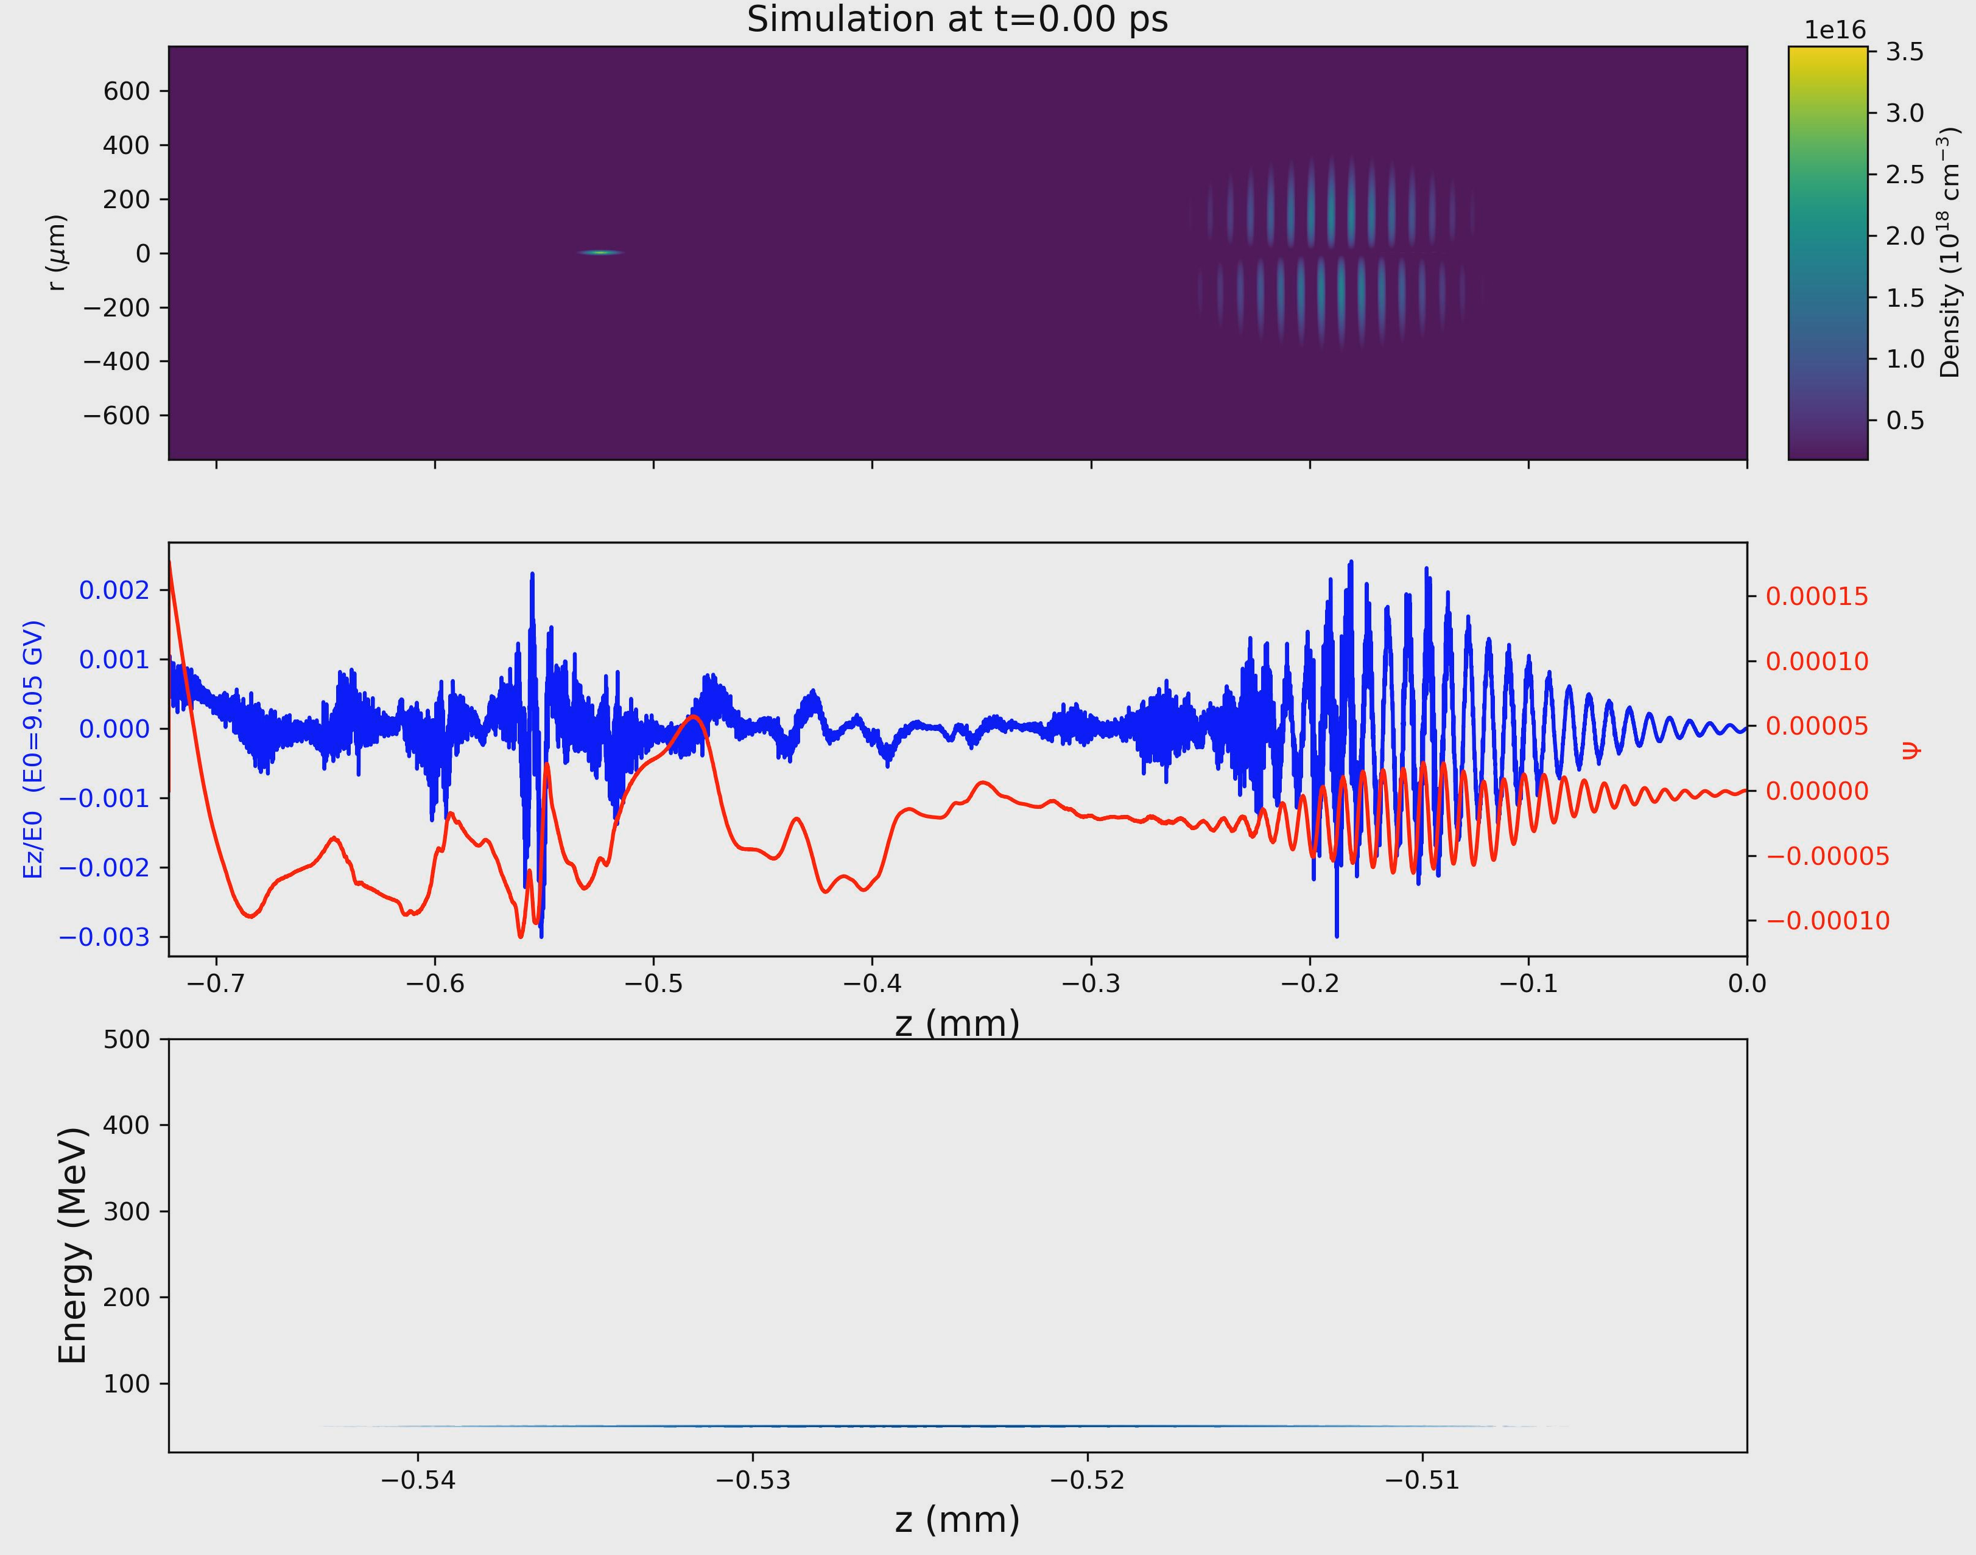
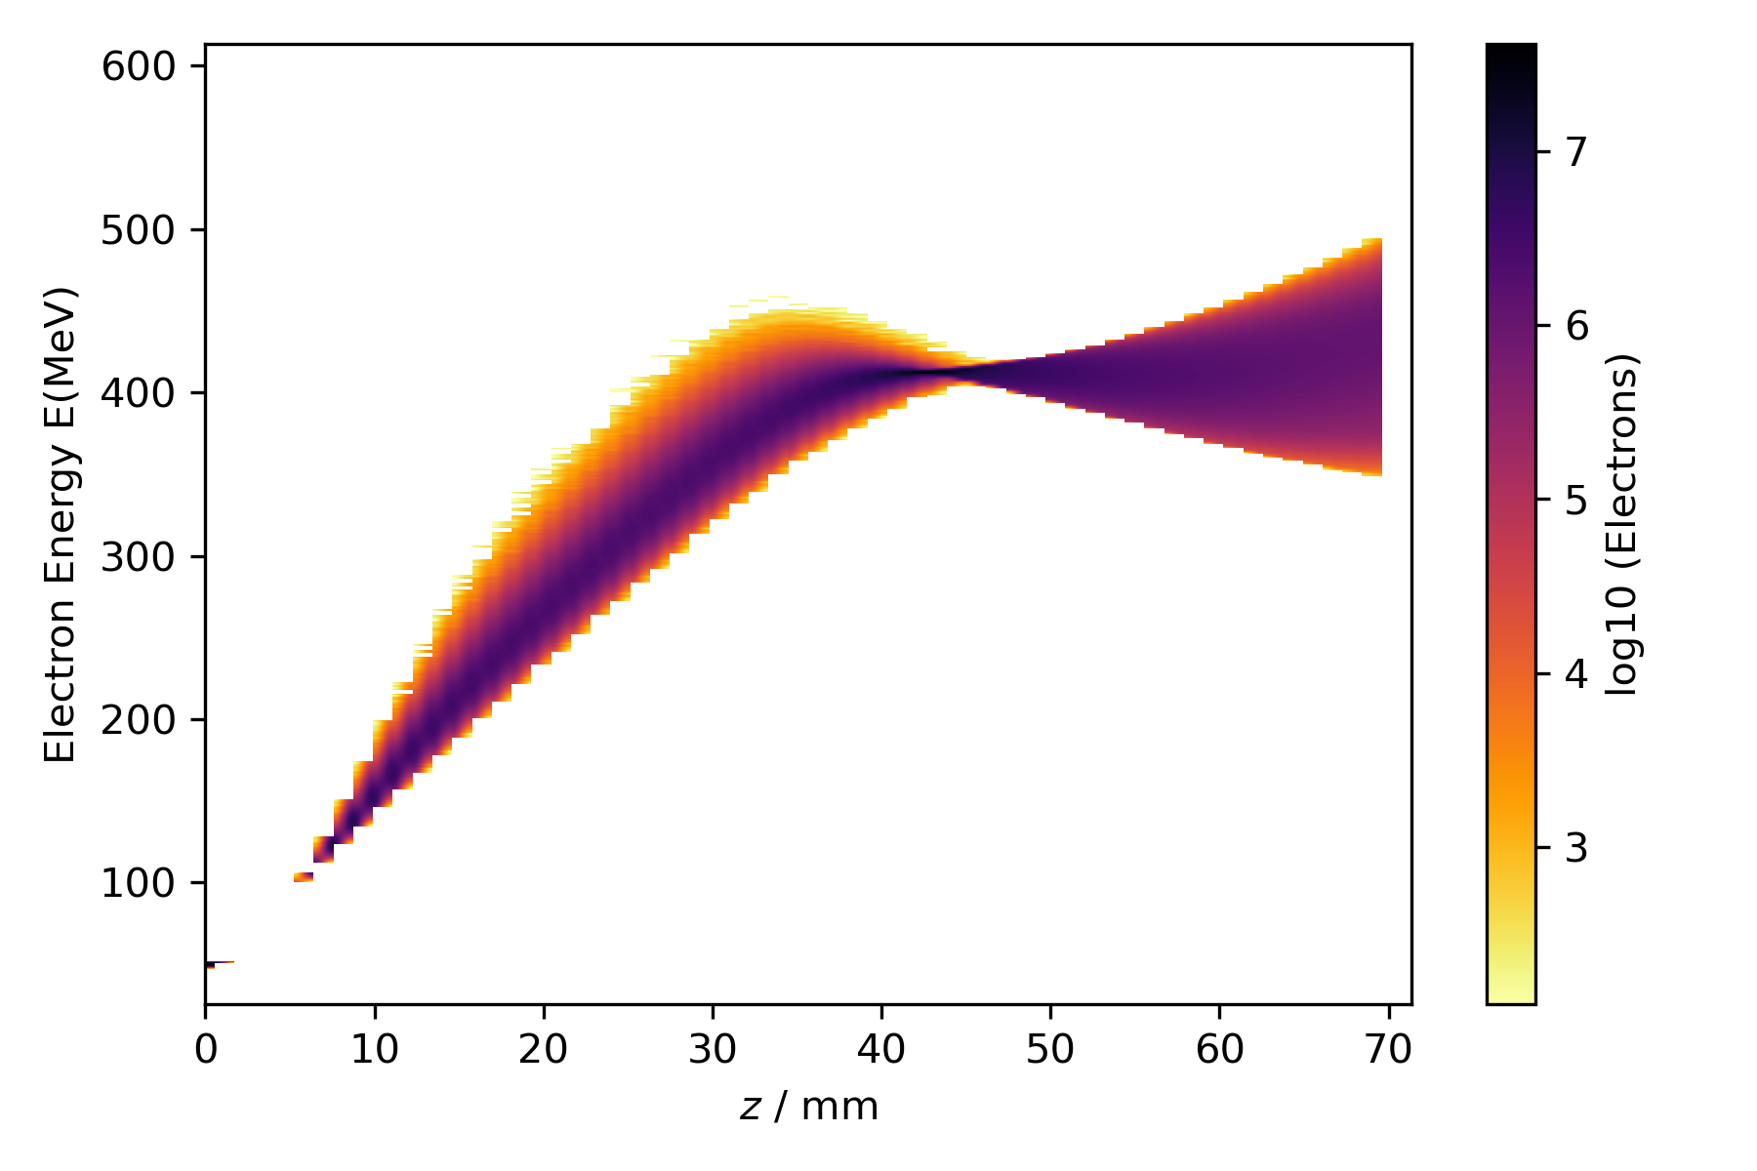
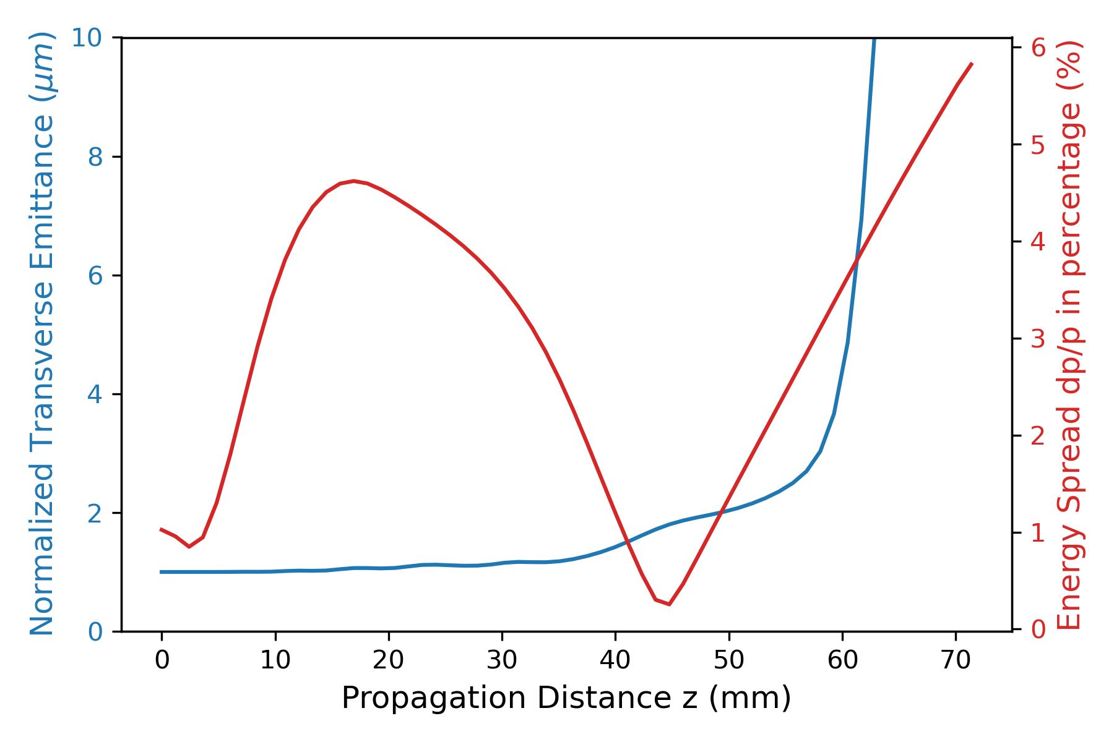







Chirped Bunch Acceleration (CBA)
+ Plasma Compression (PC)
plasma: $n_{e}=0.9 × {10}^{16} {cm}^{−3}$
laser: E = 30 J, $τ_{FWHM}=372 fs$
matched focus: $w_{0}=190µm$; $a_{0}=2.9$
injected e⁻: 10 pC; $ε_{n }\sim 1 µm;1\%$ div;
new 2025 simulations
with FB-PIC
$λ_{p}−$20µm behind laser peak
Yuxuan Cao, PhD student
CBA
PC
Electron energy (MeV)
minimal emittance
growth
$$\frac{∆E}{E}$$
Electron
Energy
Chirp
Normalized emittance (µm)
$$ε_{n}$$
Propagation distance z (mm)
5

Slide 6
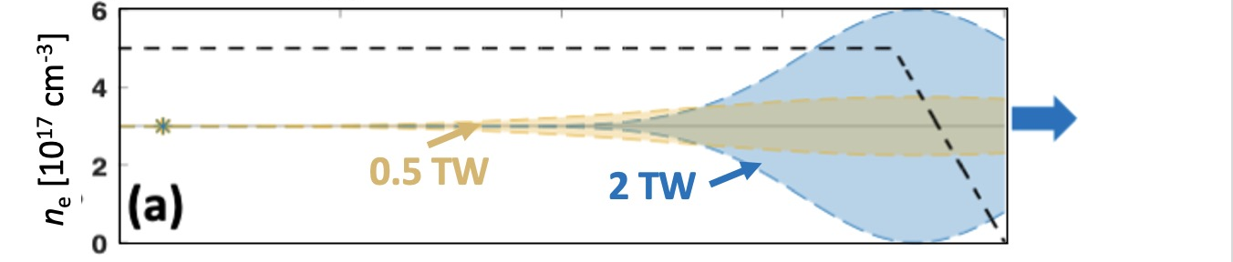
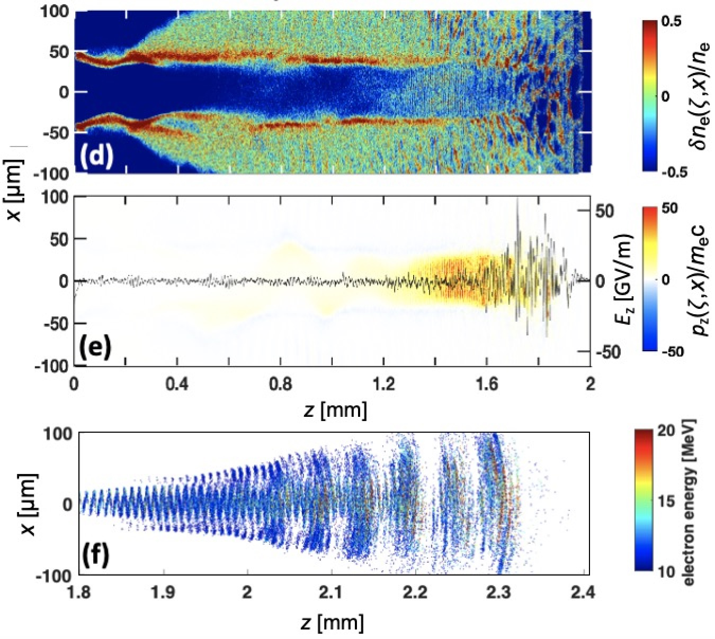

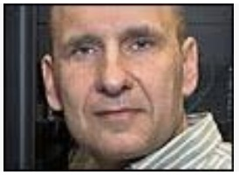


SPACE simulations predicted electron injection
and acceleration for P_{L} = 2 TW (4 J, 2 ps) CO₂ pulses
simulations by A. Cheng & R. Samulyak
Zgadzaj et al., Nat. Commun. 15, 4037 (2024)
P_{L} = 2 TW (4 J, 2 ps)
n_{e} = 5 × 10¹⁷ cm⁻³
above e⁻ injection threshold
0
1
2
z (mm)
p_{z} from trapped,
accelerated e- observed
simulations by...
e⁻ output
Q ≈ 50 pC
$\left\langle E_{e}\right\rangle ≈8$ MeV
Prof. Roman Samulyak
$∆θ_{HWHM}$~ 75 mrad
Aiqi Cheng
6

Slide 7
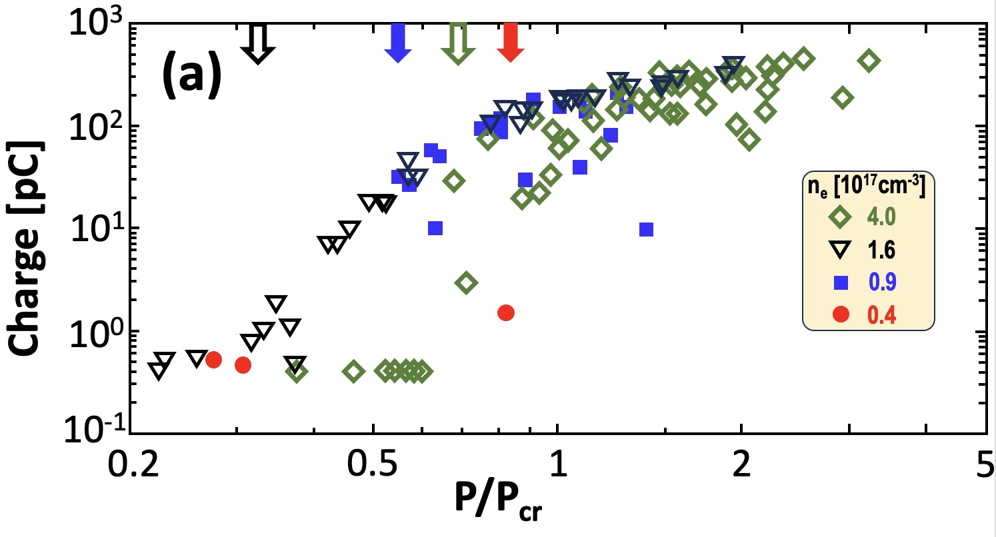
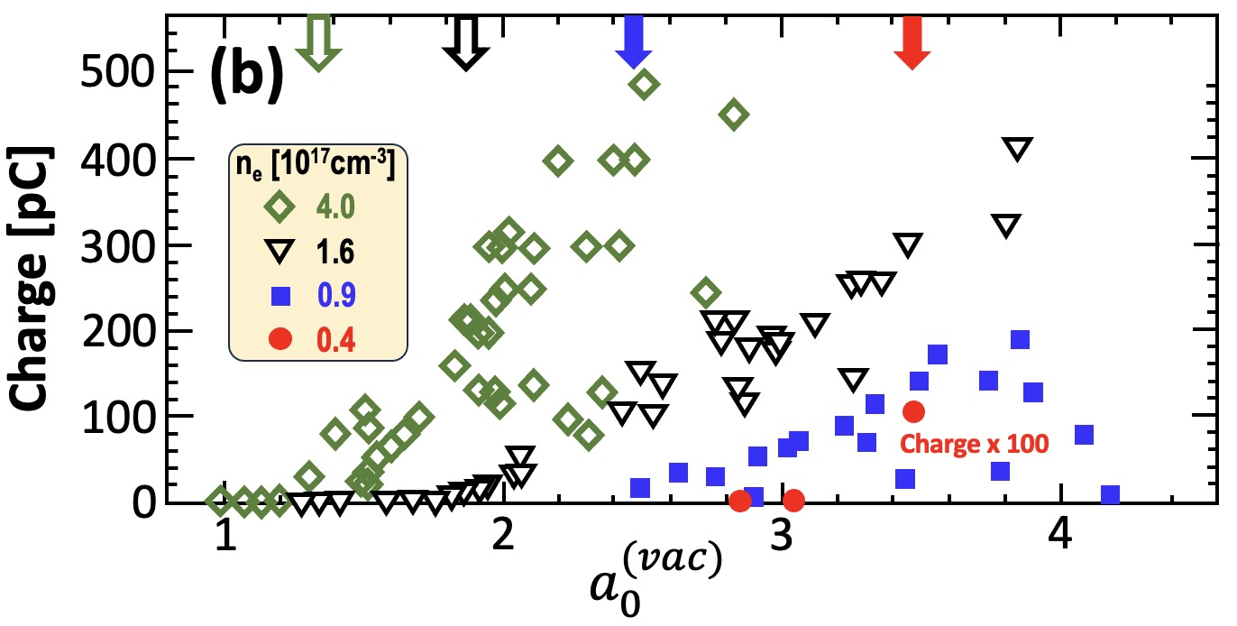

Detection and Characterization of
relativistic electron beams
P appearance thresholds
⇒ all are sub-P_{cr}
Q_{max} ≈ 500 pC
For 2 TW pulses,
self-focusing no
longer essential
to trigger LWFA.
H₂
jet
e⁻
$a_{0}^{(vac)}$appearance thresholds
⇒ all are relativistic
Lanex
CO₂ pulse
2-5 J, 2ps
CCD
integrated luminescence
⇒ total charge Q
Zgadzaj et al., Nat. Comms. 15, 437 (2024)
7

Slide 8
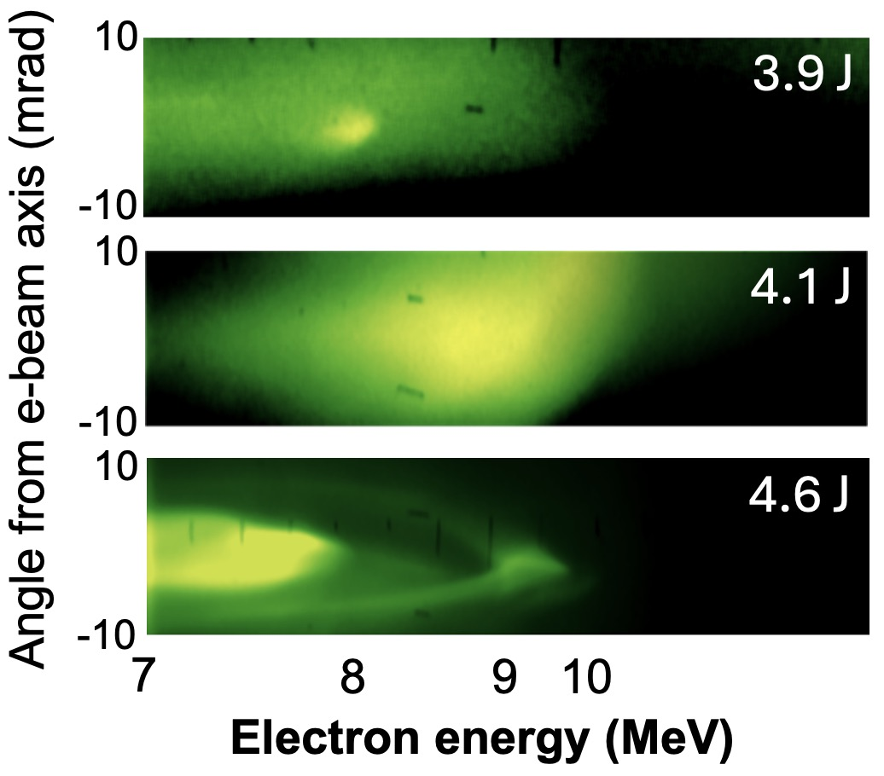
Electron energy spectra have
2 corresponding components
Zgadzaj et al., Nat. Comms. 15, 437 (2024)
n_{e} = 4 × 10¹⁷ cm⁻³
*
H₂
jet
*
magnet
CCD
Lanex
*
CO₂ pulse
2-5 J, 2ps
*
Collimated quasi-monoenergetic
e-spectral features
⇒ transition from
SM-LWFA → bubble regime
12

Slide 9
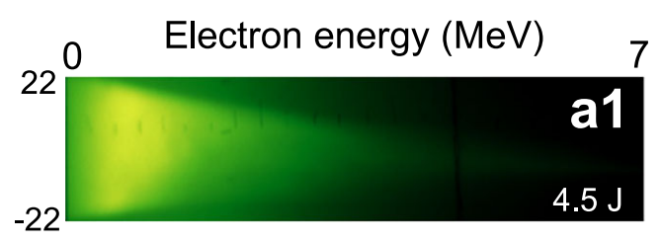
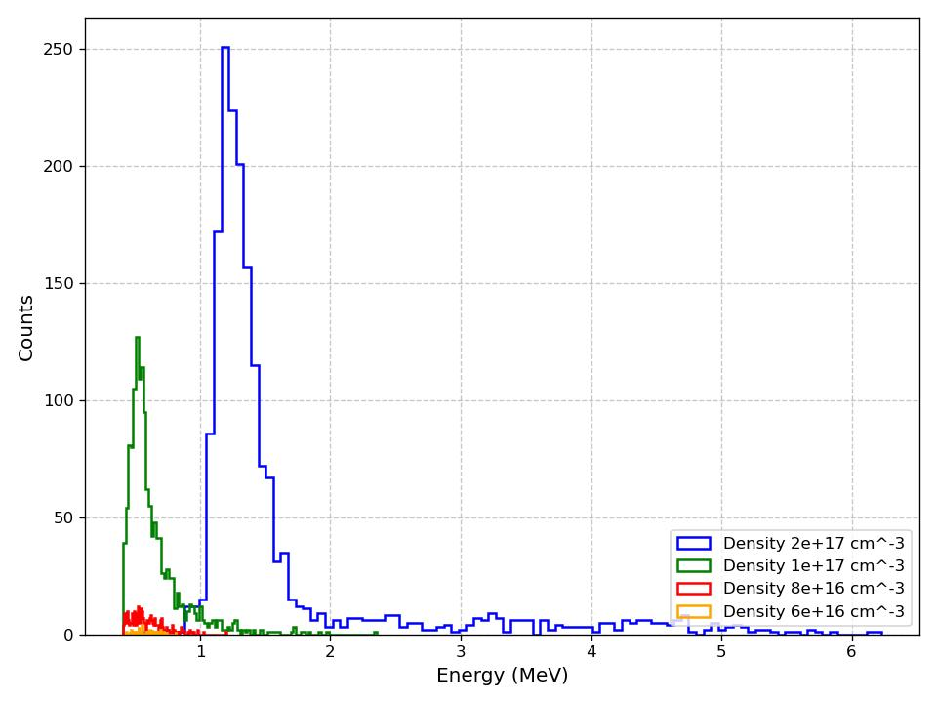
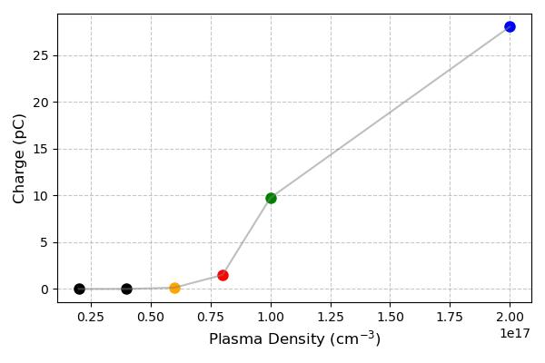
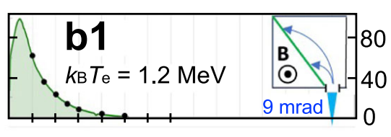
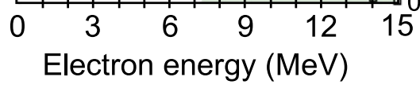
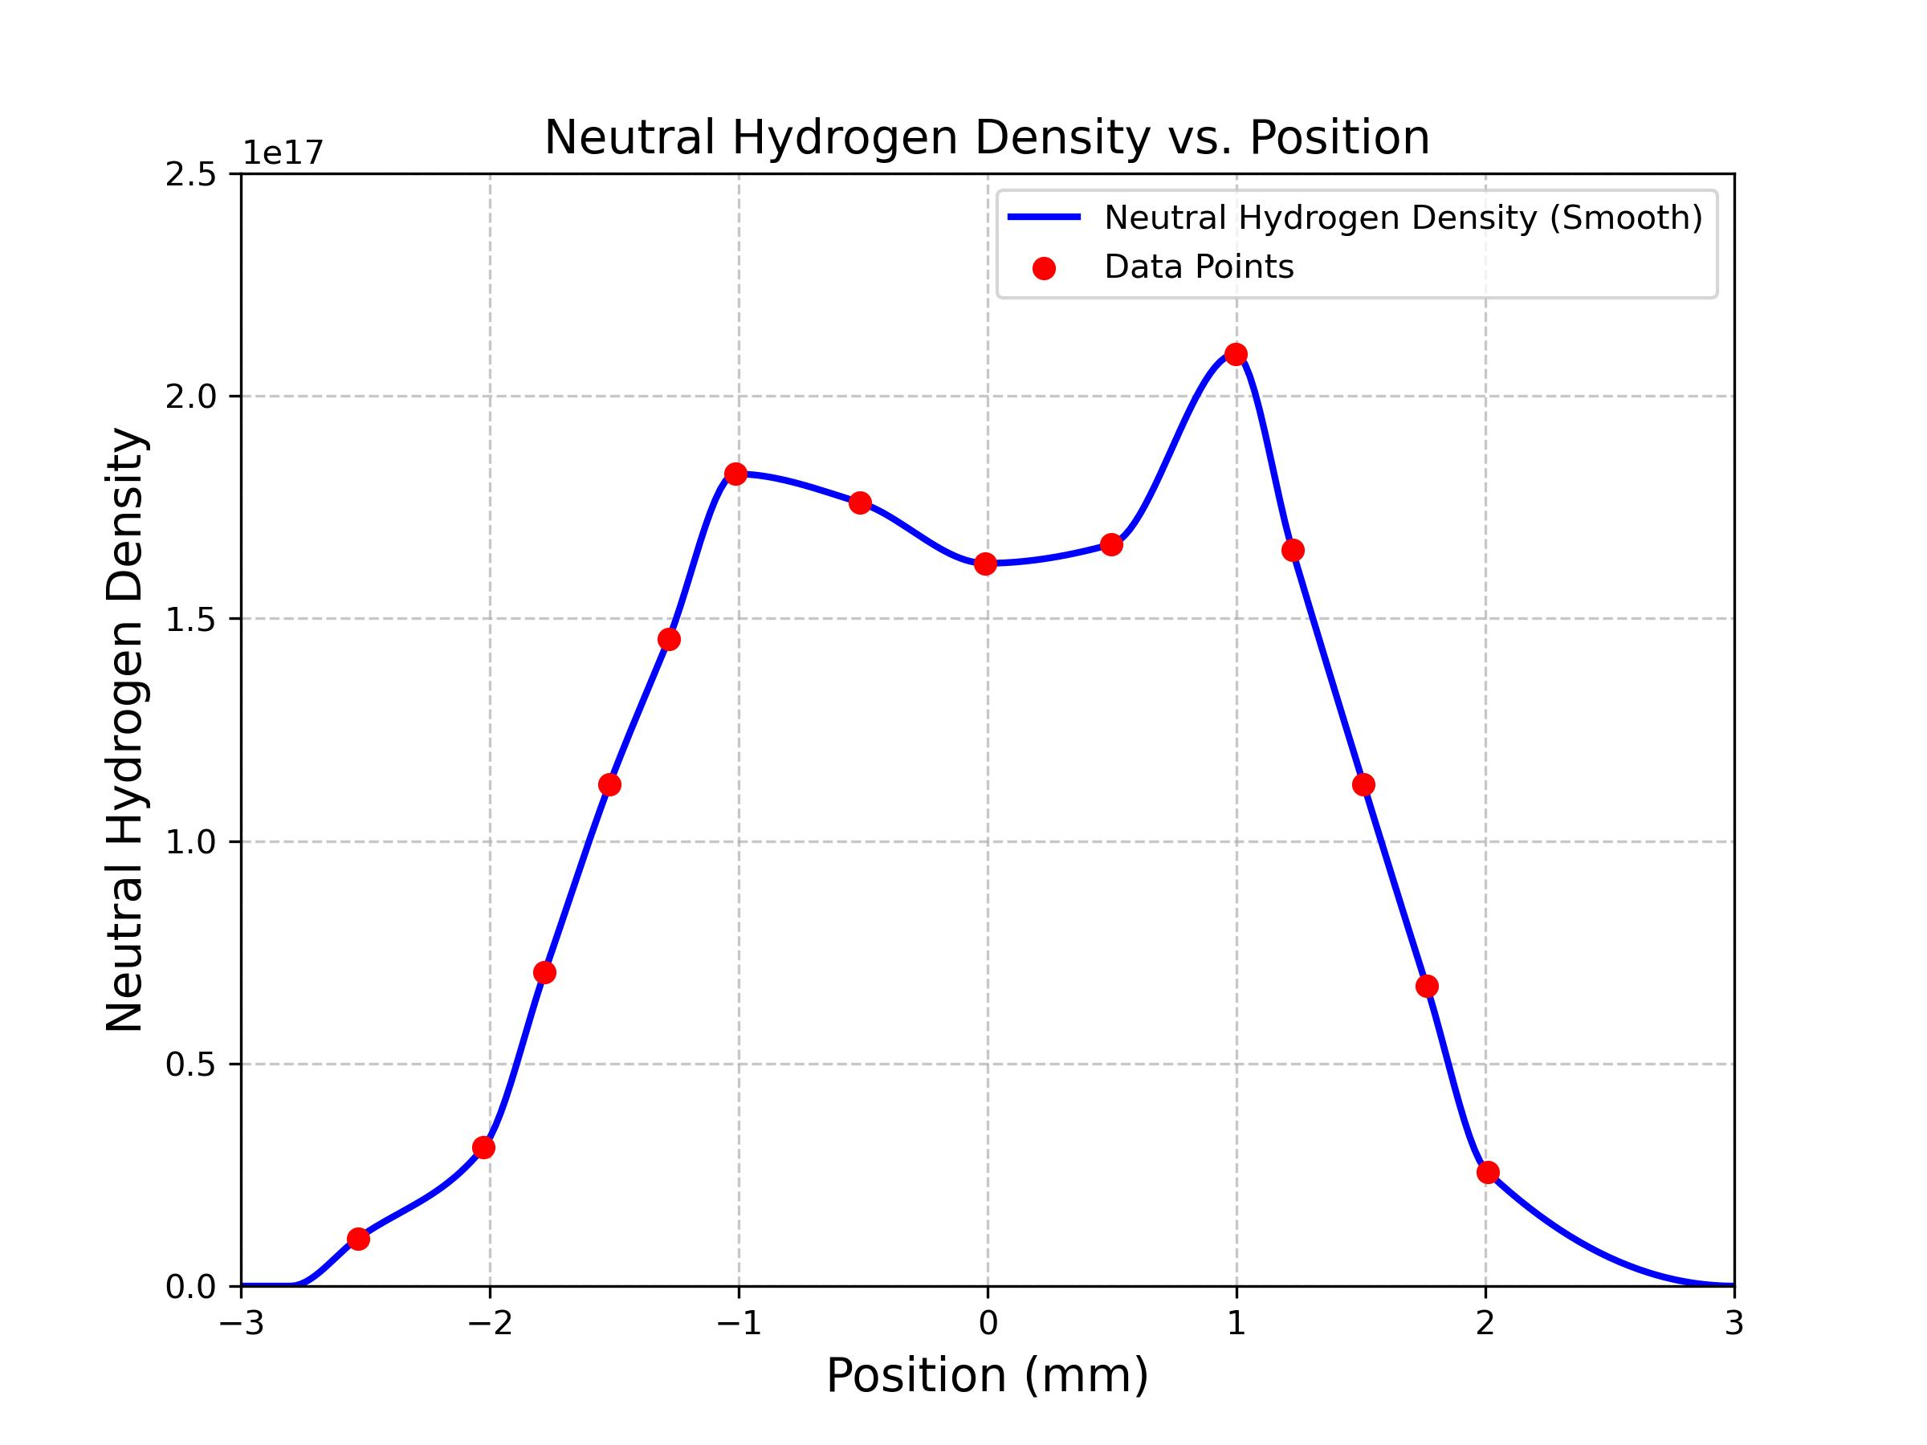
New FB-PIC simulations have confirmed self-injection thresholds and
energy spectral in Self-Modulated LWFA Expts.
Laser focus at 0mm
E=5J, a0=3.5,
FWHM = 2ps, w0=27.5um,
Wavelength=9.2um

Slide 10
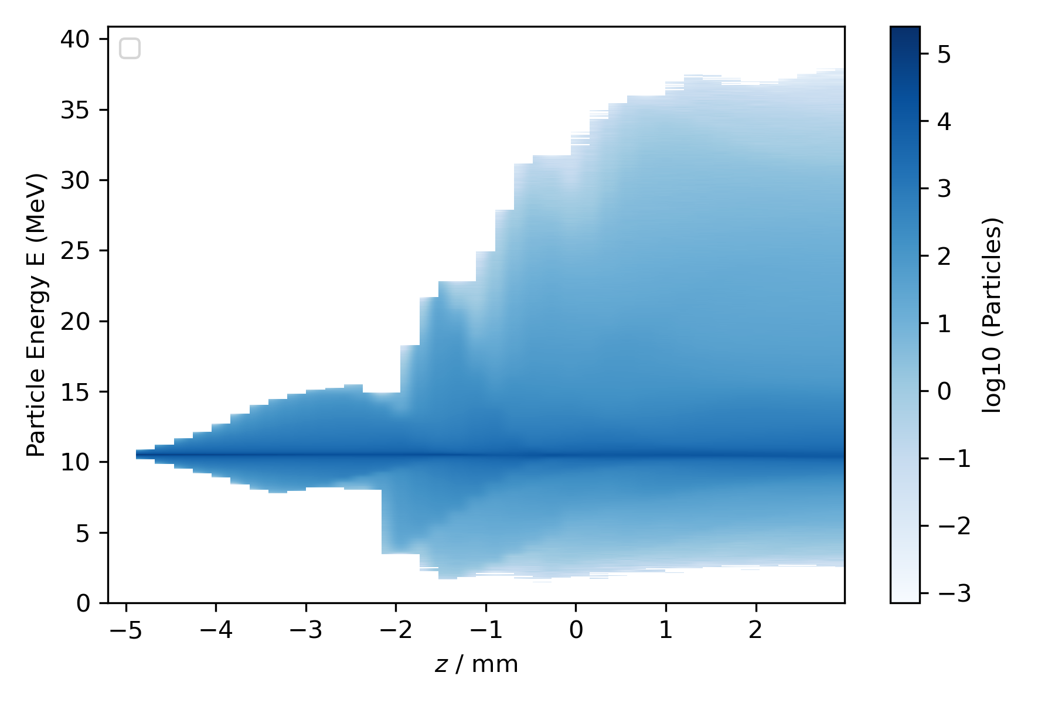
New FB-PIC simulations have generated predictions for 1st-generation ATF
experiments: external injection
into SM-LWFA
Electrons within highlighted green rectangle corresponds to highlighted green bunch in the animation on the previous slide;
Energy of these small bunch is above 36MeV. (26MeV energy gain)
This is the waterfall plot of externally injected electron cylinder with 10MeV energy. Injected bunch energy spectrum vs z position. Portion of energy below 10MeV signifies energy loss.
Laser focus at 0mm
E=5J, a0=3.5,
FWHM = 2ps, w0=27.5um,
Wavelength=9.2um

Slide 11
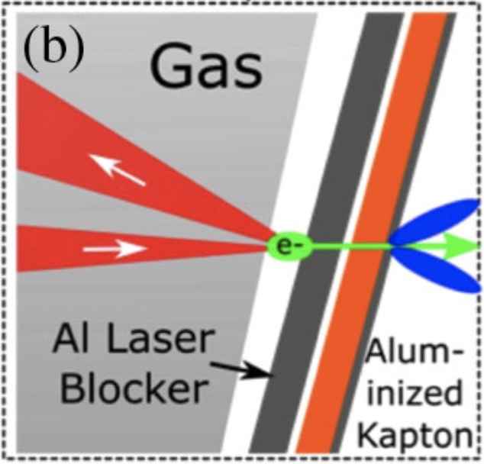
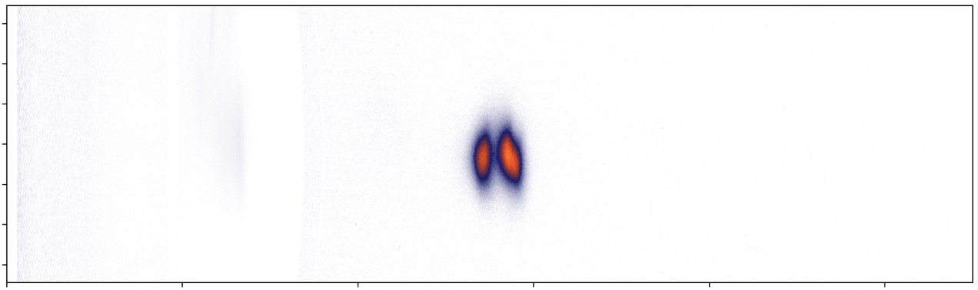
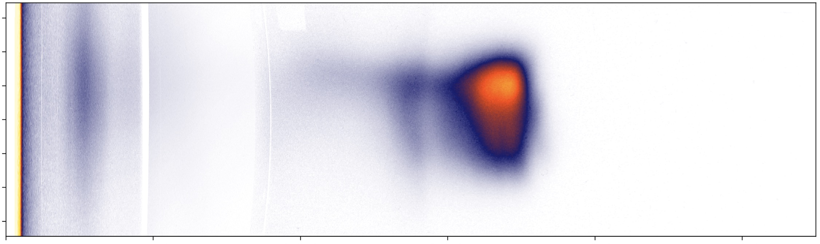
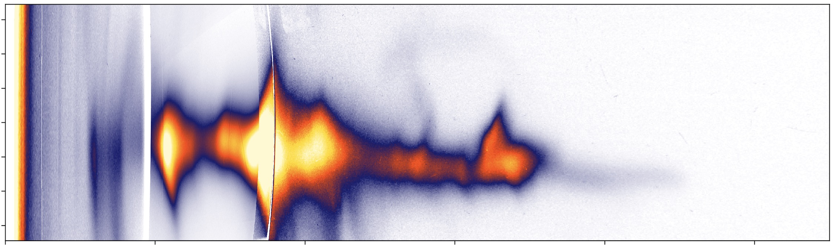
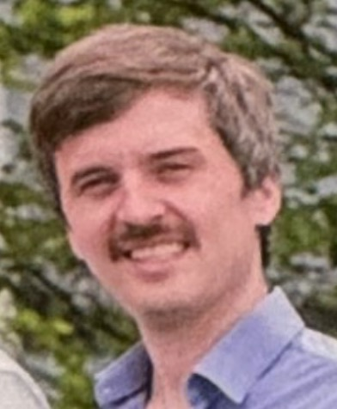
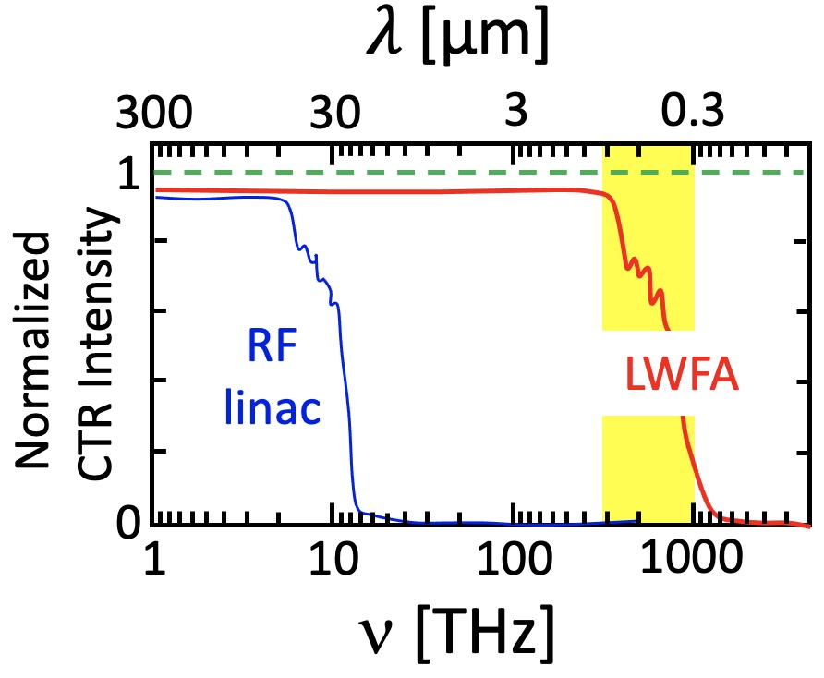
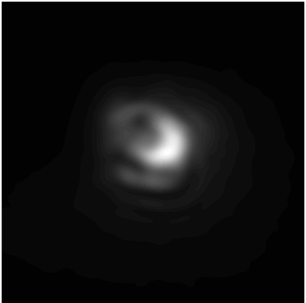
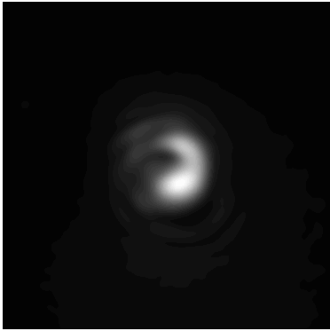
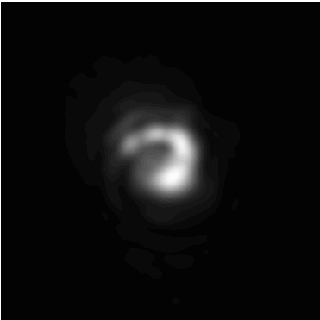
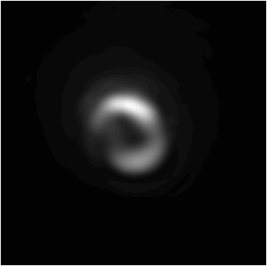
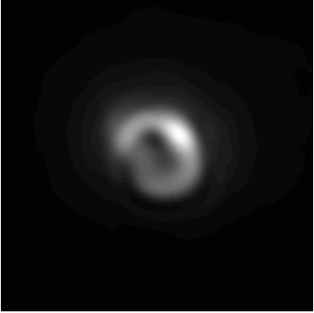
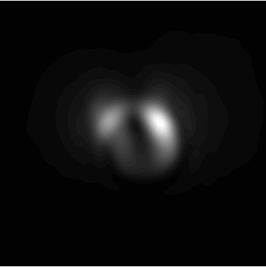
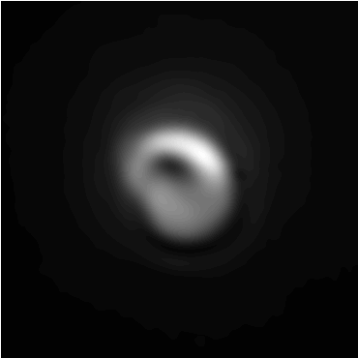
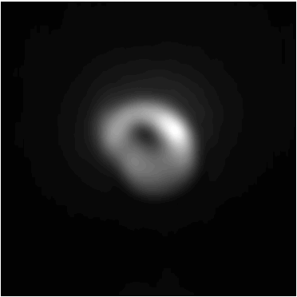
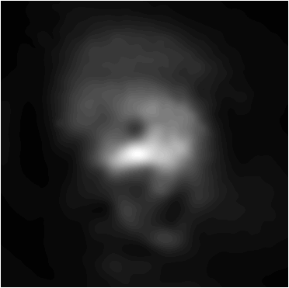
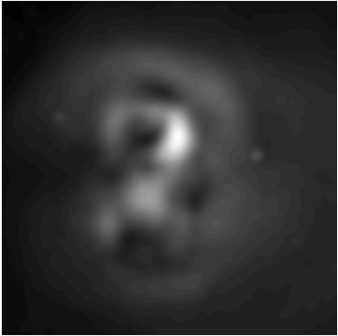
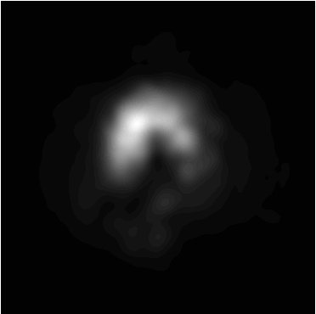
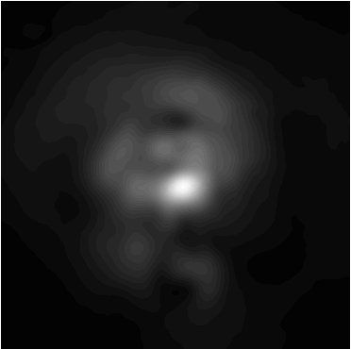
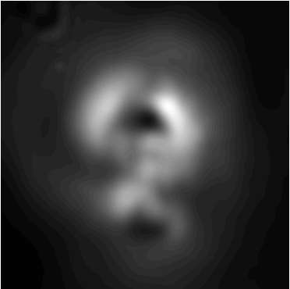
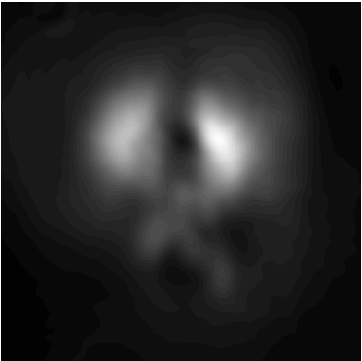
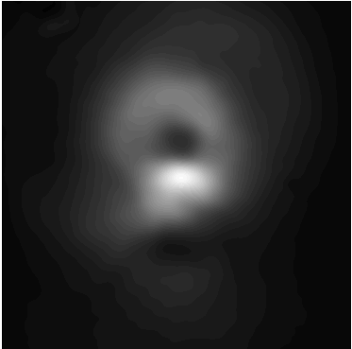
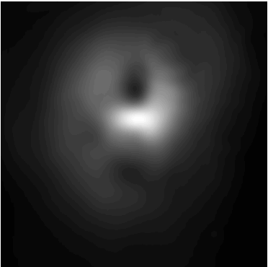
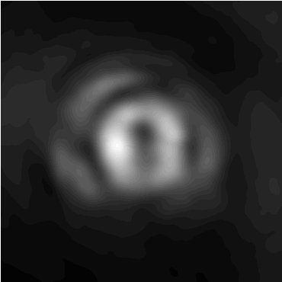
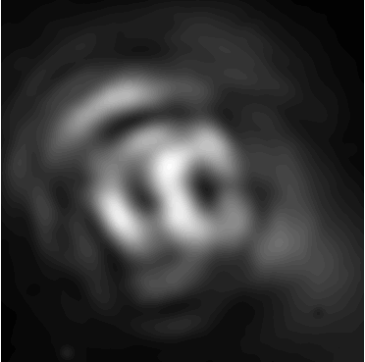
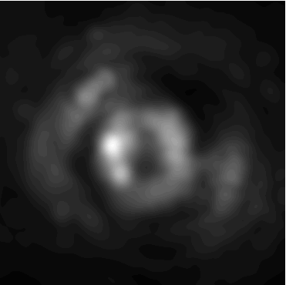





Multi-spectral COTR imaging:
experimental setup and data
-10
1
0.5
0
Down-ramp
10
-10
2
pC/MeV-mrad
0
STII
0.25
Divergence (mrad)
10
-10
self
LaBerge et al.,”Revealing the 3D structure of LPA e-bunches,”
Nat. Photonics 18, 952 (2024).
0
Gas Jet
10
200
400
0
10
COTR foil
Electron Energy (MeV)
e-beam
Electron
Spectrometer
¹ Schmid, PR-STAB 13, 091301 (2010)
Laser Pulse
Si
² Self-Truncated Ionization Injection:
[Mirzaie, Sci. Rpts. 5, 14659 (2015)]
Gas
Nozzle
Achromatic
Objective
bandpass
filters
beam
splitters
COTR
Dichroic
Max LaBerge
UT-PhD 2022
COTR
400
450
500
630
680
700
750
800 nm
1
Down-ramp
OTR images recorded
in a spectral range in
which OTR transitions
from fully coherent
(longer 𝜆) to fully inco-
herent (shorter 𝜆), thus
providing maximum
structural information.
COTR imaged
from foil surface
to each of 8
𝜆-filtered CCDs
0.5
STII
Normalized COTR fluence
Self
0
22
50 µm

Slide 12






3D Snapshot of Downramp-Injected LWFA e-bunch
• not separable [i.e. $ρ(x,y,z)≠ρ(x,y)ρ(z)]$
• not symmetric
Single-shot reconstruction!
How do we know this solution is unique?
• Reconstruction algorithm was run hundreds of
times with randomly-varied initial parameters.
• The resulting cluster of reconstructions reveals
reproducible common characteristics.
• The cluster-averaged structure reproduces the
COTR data with fidelity equivalent to individual
reconstructions, providing a quanitative
“uniqueness” evaluation.
Check list:
Measured
COTR
✓
reproduces COTR data
Q ≈ Q_{m}
Q negative
$$U^{(COTR)}≈ U_{m}^{(COTR)}$$
longitudinal profile
✓
✓
✓
Calculated
COTR
✓
23

Slide 13
AE-137 SUMMARY
Year 1-accomplishments:
1) Discovered a chirped-beam acceleration/plasma-compression regime
- achieves acceleration to ~0.5 GeV with sub-% ∆E seen so far in simulations
- appears compatible with current ATF parameters
- using machine-learning algorithms to hasten search for optimum laser-plasma parameters
2) Achieved good simulation-experiment agreement w/ current ATF parameters
self-injection threshold
simulations of 1st generation experiments completed: external injection into self-modulated wakes
2) Strengthened optical wake diagnostics for n_{e} ~ 10¹⁶ cm⁻³ plasma
improved CTS, Faraday probes; MIR harmonics of CO₂ drive pulse
developed single-shot COTR-based diagnostic of ultrashort e-bunches (LaBerge, Nat. Phot. (2024))
Over-arching goal:
1) External e—injection into bubble-regime CO₂-laser-driven LWFA.
• take advantage of CO₂ power upgrades & e-beam synchronization/compression advances
• leverages Navid’s work in developing e-beam probes
• a preparatory “Mercury” mission to build experience for a future “Apollo” moon-landing mission
10

Slide 14

Electron Beam Requirements
Parameter | Units | Typical Values | Comments | Requested Values
Beam Energy | MeV | 50-65 | Full range is ~15-75 MeV with highest beam quality at nominal values | Nominal (~55 MeV)
Bunch Charge | nC | 0.1-2.0 | Bunch length & emittance vary with charge | ~0.1 to ~1nC
Compression | fs | Down to 100 fs (up to 1 kA peak current) | A magnetic bunch compressor available to compress bunch down to ~100 fs. Beam quality is variable depending on charge and amount of compression required. NOTE: Further compression options are being developed to provide bunch lengths down to the ~10 fs level | 100 fs
Transverse size at IP (σ) | μm | 30 – 100 (dependent on IP position) | It is possible to achieve transverse sizes below 10 um with special permanent magnet optics. | 2 mm (hor.) 0.5 mm (vert.) 0.01 mm (diameter)
Normalized Emittance | μm | 1 (at 0.3 nC) | Variable with bunch charge | 1
Rep. Rate (Hz) | Hz | 1.5 | 3 Hz also available if needed | 1.5
Trains mode | --- | Single bunch | Multi-bunch mode available. Trains of 24 or 48 ns spaced bunches. | Single bunch

Slide 15
CO₂ Laser Requirements
Configuration | Parameter | Units | Typical Values | Comments | Requested Values
CO₂ Regenerative Amplifier Beam | Wavelength | μm | 9.2 | Wavelength determined by mixed isotope gain media
 | Peak Power | GW | ~3
 | Pulse Mode | --- | Single
 | Pulse Length | ps | 2
 | Pulse Energy | mJ | 6
 | M² | --- | ~1.5
 | Repetition Rate | Hz | 1.5 | 3 Hz also available if needed
 | Polarization | --- | Linear | Circular polarization available at slightly reduced power
CO₂ CPA Beam | Wavelength | μm | 9.2 | Wavelength determined by mixed isotope gain media | 9.2
Note that delivery of full power pulses to the Experimental Hall is presently limited to Beamline #1 only. | Peak Power | TW | 5 | ~5 TW operation is planned within the next year (requires further in-vacuum transport upgrade). A 3-year development effort to achieve >10 TW and deliver to users is in progress. | 2-5
 | Pulse Mode | --- | Single |  | Single
 | Pulse Length | ps | 2 |  | 2 or less
 | Pulse Energy | J | ~5 | Maximum pulse energies of >10 J will become available within the next year | 10
 | M² | --- | ~2 |  | ~2
 | Repetition Rate | Hz | 0.05 |  | 0.05
 | Polarization |  | Linear | Adjustable linear polarization along with circular polarization can be provided upon request | Linear

Slide 16
Other Experimental Laser Requirements
Ti:Sapphire Laser System | Units | Stage I Values | Stage II Values | Comments | Requested Values
Central Wavelength | nm | 800 | 800 | Stage I parameters are presently available and setup to deliver Stage II parameters should be complete during FY22 | 800
FWHM Bandwidth | nm | 20 | 13 |  | 20
Compressed FWHM Pulse Width | fs | <50 | <75 | Transport of compressed pulses will initially include a very limited number of experimental interaction points. Please consult with the ATF Team if you need this capability. | 50
Chirped FWHM Pulse Width | ps | ≥50 | ≥50 |  | N/A
Chirped Energy | mJ | 10 | 200 |  | N/A
Compressed Energy | mJ | 7 | 100 |  | 5
Energy to Experiments | mJ | >4.9 | >80 |  | 5
Power to Experiments | GW | >98 | >1067 |  | 100
Nd:YAG Laser System | Units | Typical Values | Comments | Requested Values
Wavelength | nm | 1064 | Single pulse | N/A
Energy | mJ | 5 |  | N/A
Pulse Width | ps | 14 |  | N/A
Wavelength | nm | 532 | Frequency doubled | N/A
Energy | mJ | 0.5 |  | N/A
Pulse Width | ps | 10 |  | N/A

Slide 17
Experimental Time Request
CY2025 Time Request
Capability | Setup Hours | Running Hours
Electron Beam Only |  | 0
Laser* Only (in FEL Room) |  | 0
Laser* + Electron Beam | 80 | 240

