Slide 1
AE132: Benchmarking the Radiation Dose Simulations Around the CO₂ Laser IP
SLAC Team: S. Rokni, J. Liu, A. Rosenstrom, P. Connolly, J. Bauer, M. Santana, H. Tran
ATF Team: M. Palmer, K. Kusche, A. Simmonds, K. Roy, C. Schaefer, S. Harling,
A. Emrick, L. Hammons, K. Yip
4/30/2025
Work supported by Department of Energy contract DE-AC02-76SF00515 and DE-SC0012704

Slide 2
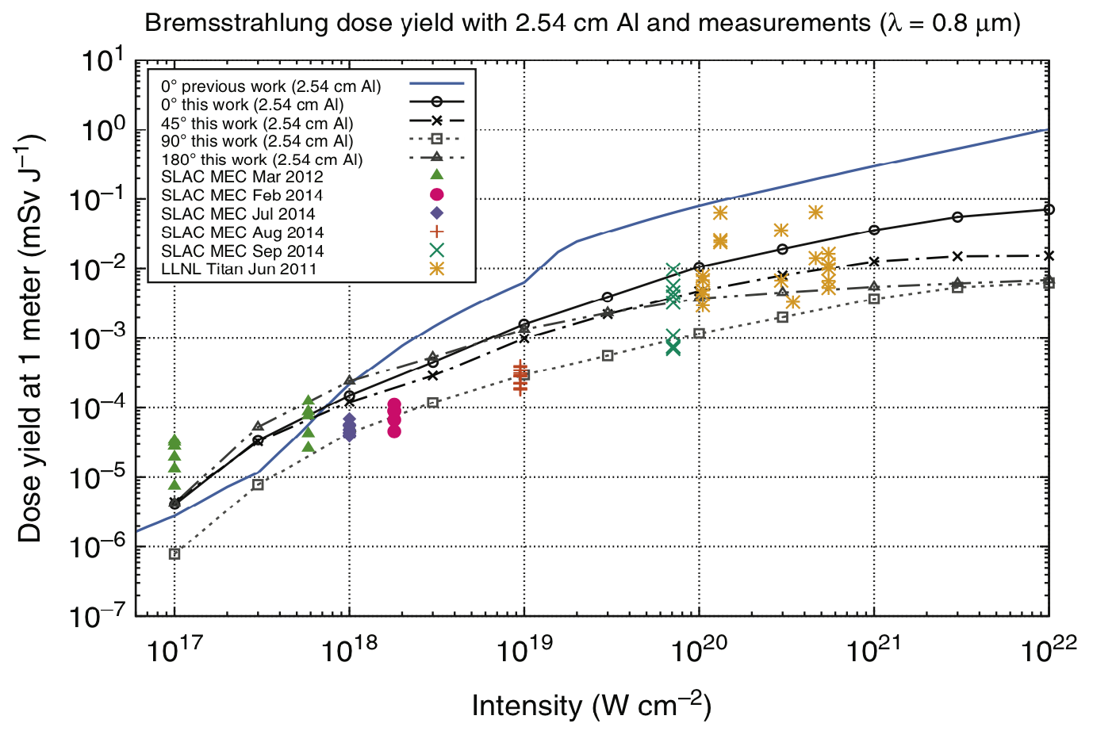
Experiment Motivation
Increasing intensity and number of lasers will continue to push their operation into regimes where ionizing radiation can be generated, and radiation protection methodologies and understanding need to adapt to meet the unique characteristics of this ionizing radiation source
  Wide variety of unique system properties (wavelength, focus size, pulse energy, pulse length, etc) affect the ionizing radiation source
  Mixed electron, ion/proton, and photon source
Current state-of-the-art models at SLAC rely on coupling PIC and MC radiation transport codes
  however, models were developed and benchmarked using a limited set of laser parameters.
The SLAC model was used to assess the operation of the CO₂ Laser at ATF (9200 nm) and has been used to investigate potential upgrades to the ATF
T. Liang, J. Bauer, J. Liu & S. Rokni, Bremsstrahlung Dose Yield for High-Intensity Short-Pulse Laser-Solid Experiments”. In: Radiation Protection Dosimetry 175 (3 2017), pp. 304–312.
doi: 10.1093/rpd/ncw325.
To be confident models are producing a reasonable estimate of ionizing radiation when accounting for $Iλ^{2}$ scaling, experimental benchmarks with a variety of laser parameters are needed.
Notes:
5 kW- PPS for fence? – ARR4

Slide 3
Experiment Overview
Overview: Produce high intensity laser interactions using the CO₂ laser and Solid targets. Measure ionizing radiation generated
Through the measurement of ionizing radiation, we aim to capture the following information, which are key parameters used in RP analysis:
  Angular distribution of the radiation generated
  Spectrum of hot electrons ejected from the plasma
  In conjunction with simulations, we hope to gain insight into the conversion efficiency of lasers to hot electrons

Slide 4
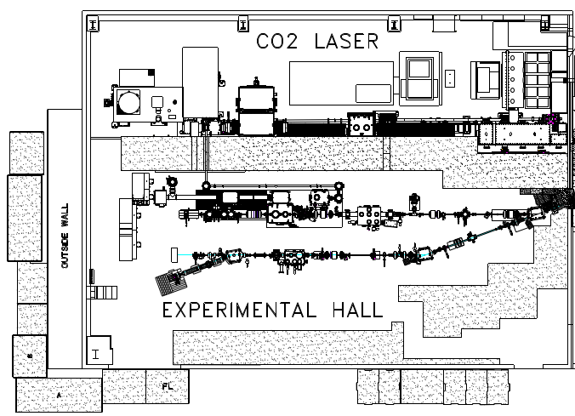
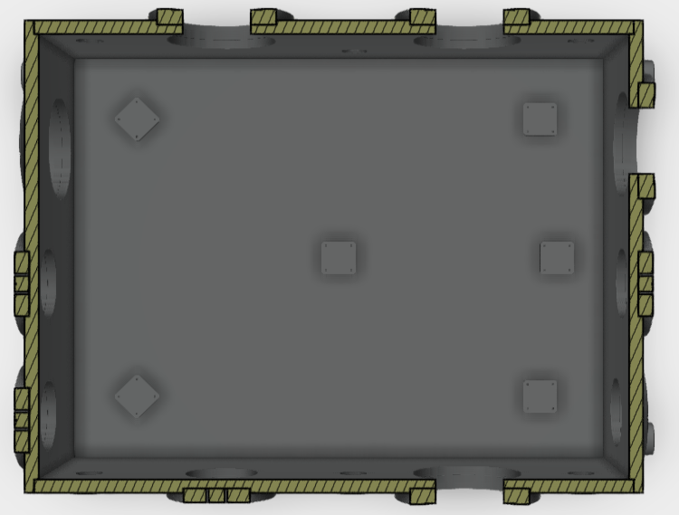


Experiment Overview: Detector Configuration In Chamber
Measurements of the distribution of ionizing radiation will use passive dosimeters for angular and spectral measurements
Mirror
$←$ Laser Stay Clear
Mirror
Translation Stage
Target
$←$ Laser Stay Clear
Single Dosimeter
Stacked Dosimeter (for spectral measurements)

Slide 5
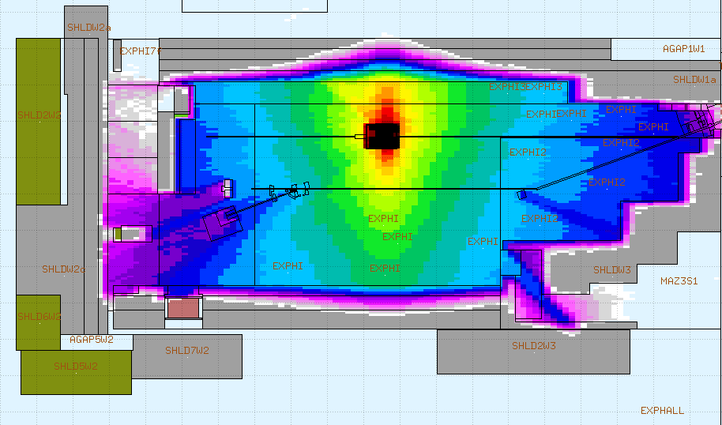
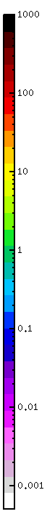
Experiment Overview: External Detector Configuration
Measurements of the distribution of ionizing radiation throughout the facility will supplement in-chamber measurements and use passive dosimeters and active radiation detectors
Passive Dosimeter
Active Detectors
Maximum level of ionizing radiation that could be achieved during the experiment
mSv/h
@ 0.05 Hz

Slide 6
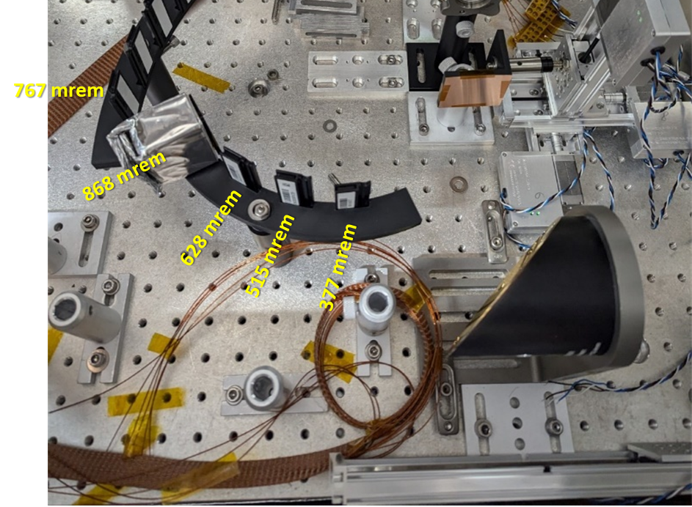
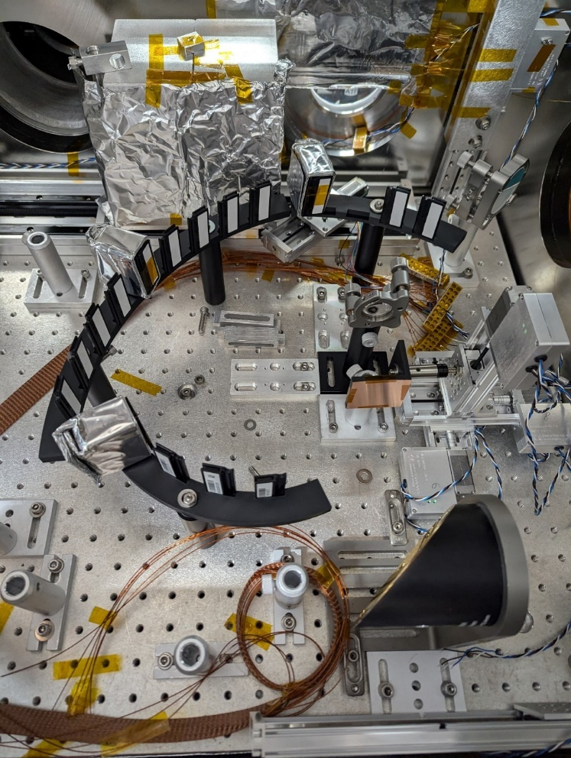
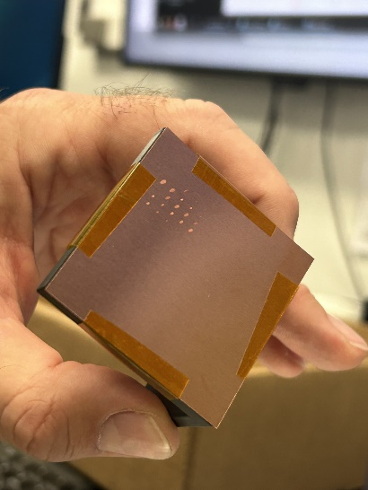
Summary of Results from Previous Beamtime
Run at previous beam time was limited due to laser operation issues, and learning curve with laser alignment led to minimal results from the previous run
Only had sufficient time perform a scan along the laser axis, while monitoring prompt radiation monitors for indications of being near the focus.
Significant backward-going radiation was measured

Slide 7
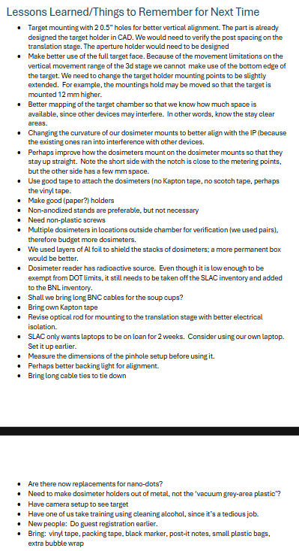
Experimental Plans for Next Year
Experiment Plans for next year will be to continue the previous run plan with a few minor changes focused on implementing lessons learned for the first attempt:
Revised target mounting structure with two mounting points instead of 1
Revised target holder design
  Thinner Targets will also be considered for use
Revised dosimeter mounting design
Time Request:
Capability | Set-up Hours | Running Hours
Electron Beam | -- | --
Laser Only* | 24 | 56
Laser + Electron beam | -- | --
*Experiment will require Experimental Hall to be searched and set to No Access due to ionizing radiation hazard

Slide 8
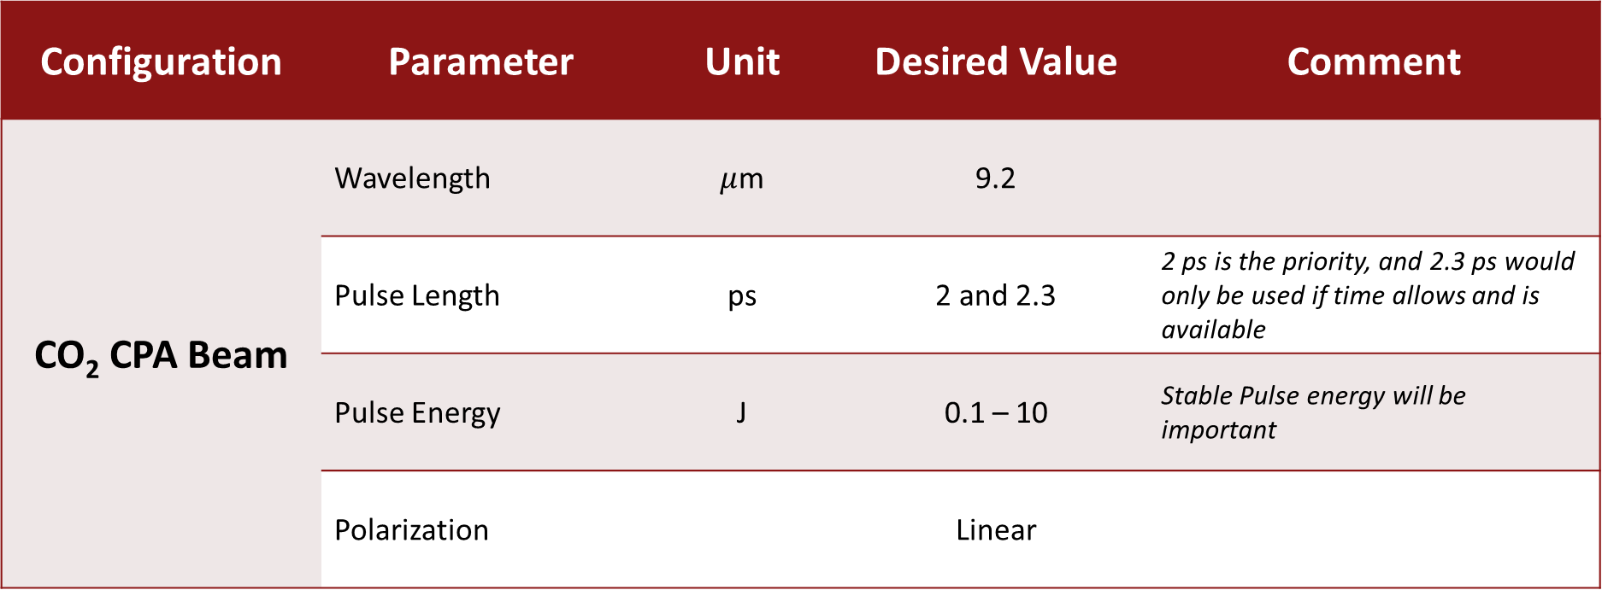
Desired Laser Beam Parameters
Configuration | Parameter | Unit | Desired Value | Comment
CO₂ CPA Beam | Wavelength | $μ$m | 9.2
 | Pulse Length | ps | 2 and 2.3 | 2 ps is the priority, and 2.3 ps would only be used if time allows and is available
 | Pulse Energy | J | 0.1 – 10 | Stable Pulse energy will be important
 | Polarization |  | Linear

Slide 9
Summary of Products Delivered
While no products have been delivered to date, work will be used in the PhD thesis of Patrick Connolly, who works with the SLAC Radiation Physics Group and is working to develop models of ionizing radiation from high intensity laser target interactions for use in radiation protection
If the experiment is successful, we anticipate a publication to be produced in a high impact radiation protection journal.

Slide 10
Conclusion
The AE132 experiment will be an important benchmarking experiment for the ionizing radiation source term model currently used at SLAC and will inform the shielding of future CO₂ laser operation at the ATF.
With the experience gained during the previous beam time, we are well-positioned to efficiently and successfully conduct the experiment!

