Slide 1

27th Annual
Accelerator Test Facility (ATF) Users' Meeting
AE129 “Stony Brook Accelerator Laboratory Course”
Presenter: William Li
Mikhail Fedurin, Dmitry Kayran, Vladimir Litvinenko (PI)
Brookhaven National Laboratory and Stony Brook University
Accelerator Facilities Division
April 30th, 2025

Slide 2
CASE course: PHY542 “Fundamentals of Accelerator Physics and Technology with Simulations and Measurements Lab”
Instructors affiliated at Stony Brook University and Brookhaven National Laboratory:
Mikhail Fedurin (2014-present)
Dmitry Kayran (2014-present)
William Li (new instructor, SBU in process)
Accelerator Facilities Division

Slide 3
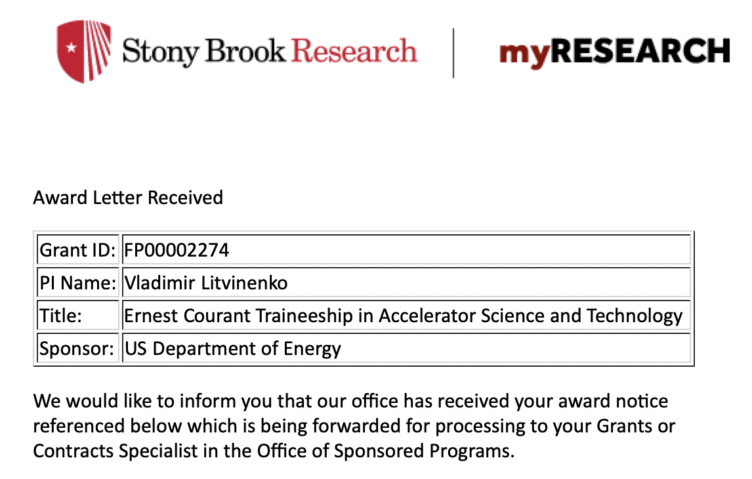
CASE at SBU, Ernest Courant Traineeship
CASE – The Center for Accelerator Science and Education has been established established as a Type I Institute within the University on November 19, 2008 as a Joint venture of BNL and SBU,
  To train scientists and engineers with the aim of advancing the field of accelerator science;
  To develop a unique program of educational outreach that will provide broad access to a research accelerator; and,
  To attract Federal and industrial funding for an expanding interdisciplinary research and education program that utilizes accelerators.
The Stony Brook University / BNL connection provides an ideal educational environment. The close proximity to BNL and the BSA connection provides for a superb combination of both university and national laboratory environment.
http://case.physics.stonybrook.edu/index.php/Main_Page
$2.9M over 5 years
Collaboration of BNL, FNL, Cornell and
Stony Brook Universities

Slide 4
Course goals
Introduce students to the field of experimental Accelerator Physics
Demonstrate e-beam techniques and diagnostics used in Advanced Accelerator Concept experiments at Accelerator Test Facility
Teach students to model experiments, compare model results with measurements.
http://case.physics.stonybrook.edu/index.php/PHY542_spring_2025

Slide 5
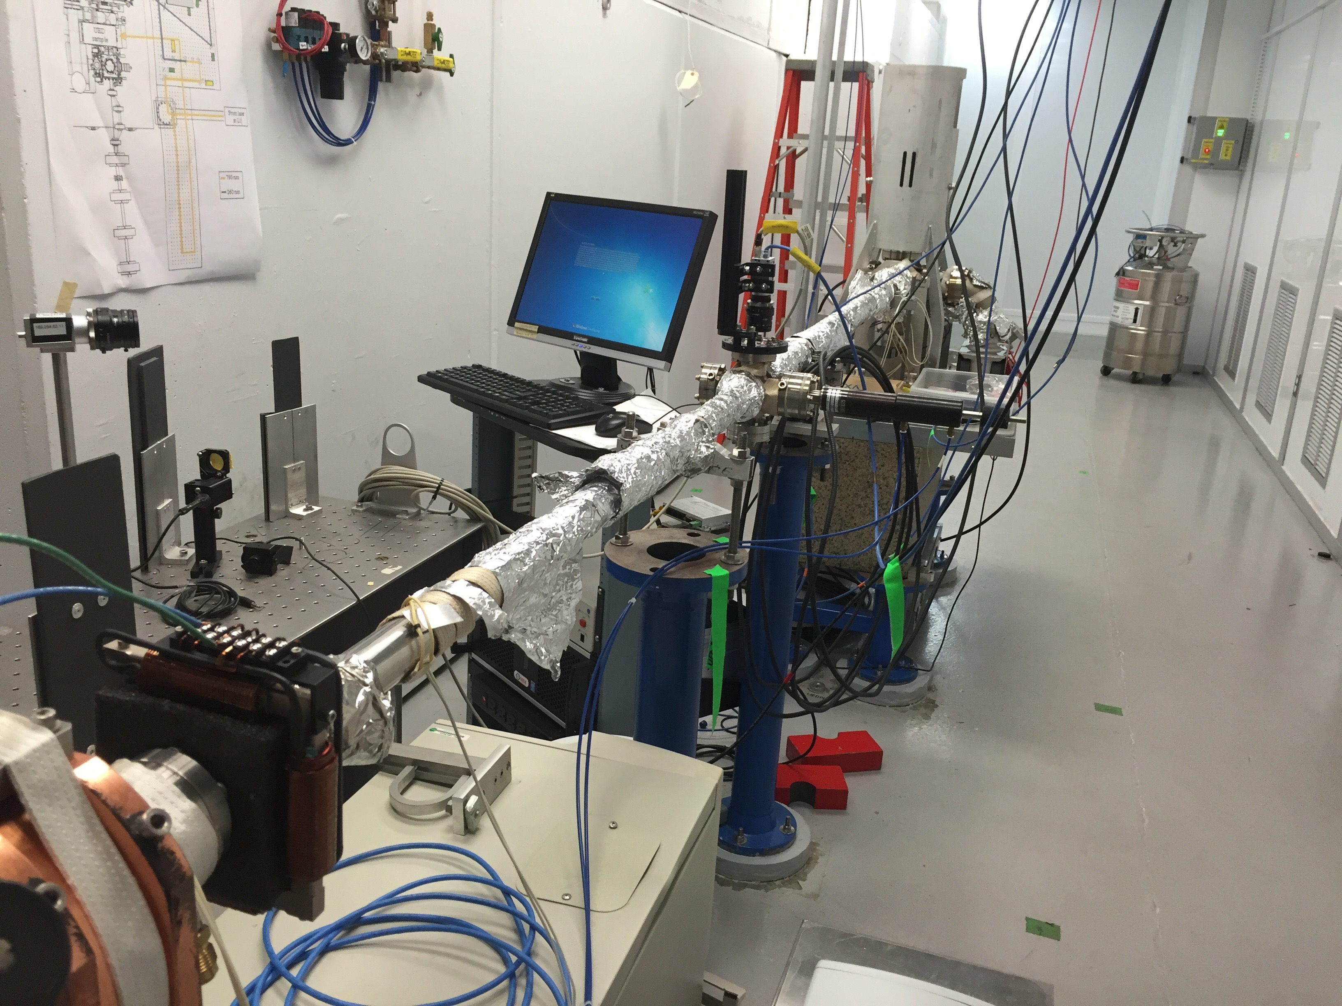
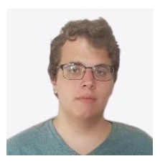
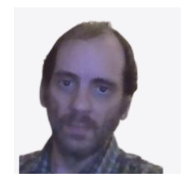
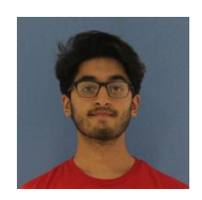
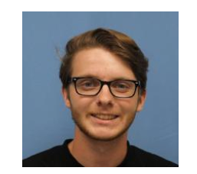
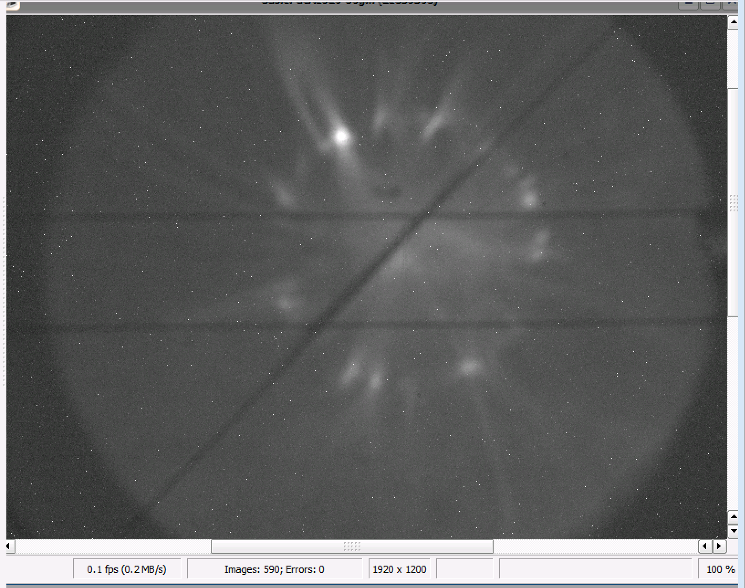
Spring 2025 class, in progress
Accelerator-based measurements performed at UED, due to ATF being down for IRR/ARR process
4 enrolled students

Slide 6
Spring 2025, topics covered
Introduction to accelerators
Modeling photoinjectors
Beamline components
Photocathodes and photoemission
Beam dynamics
Beam characterization (emittance measurements)
Electron cooling + tour of RHIC

Slide 7
Evaluation (May 5th, 2025)
Student’s performance was evaluated based on:
  active involvement in the laboratory (25% of final grade);
  lab presentation (75% of final grade)
Students prepared presentation during semester
  Presentation from one of the lab classes (see syllabus)
  Content should include: 1) theory of the experiment and explain the objectives; 2) technique used to obtain data; 3) detailed data analysis; 4) conclusion remarks
Presentations to be made at the end of the semester:
  4 topics: quantum efficiency measurement, dipole energy measurement, diffraction energy measurement, solenoid scan emittance measurement

Slide 8
Questions?

Slide 9
Electron Beam Requirements
Parameter | Units | Typical Values | Comments | Requested Values
Beam Energy | MeV | 50-65 | Full range is ~15-75 MeV with highest beam quality at nominal values | 55
Bunch Charge | nC | 0.1-2.0 | Bunch length & emittance vary with charge | 0.2
Bunch Length | ps | 1-10 | Bunch charge & emittance vary with length | 2
Peak current | A | 100 | Variable with bunch charge and length
Compression | fs | Down to 100 fs (up to 1 kA peak current) | A magnetic bunch compressor available to compress bunch down to ~100 fs. Beam quality is variable depending on charge and amount of compression required. NOTE: Further compression options are being developed to provide bunch lengths down to the ~10 fs level
Focused transverse size at IP (σ) | μm | 30 – 100 (dependent on IP position) | It is possible to achieve transverse sizes below 10 um with special permanent magnet optics.
Normalized Emittance | μm | 1 (at 0.3 nC) | Variable with bunch charge
Rep. Rate (Hz) | Hz | 1.5 | 3 Hz also available if needed
Trains mode | --- | Single bunch | Multi-bunch mode available. Trains of 24 or 48 ns spaced bunches.

Slide 10
Special Equipment Requirements and Hazards
Electron Beam
  No special requirements
CO₂ Laser
  No special requirements
Ti:Sapphire and Nd:YAG Lasers
  No special requirements
Hazards & Special Installation Requirements
  No special requirements

Slide 11
Experimental Time Request
CY2025 Time Request
Capability | Setup Hours | Running Hours
Electron Beam Only |  | 80
Laser* Only (in Laser Areas)
Laser* + Electron Beam
Total Time Request for the Experiment remaining duration
Capability | Setup Hours | Running Hours
Electron Beam Only |  | 160
Laser* Only (in Laser Areas)
Laser* + Electron Beam
* Laser = Near-IR or LWIR (CO₂) Laser

