Slide 1

27th Accelerator Test Facility (ATF) Users' Meeting AE127: Two Color Injection of Bright Electron Beams
N. Vafaei-Najafabadi^{1,2*}, W. Li¹, I. Petrushina², R. Zgadzaj³, M. Downer³, A. Gaikwad², B. Romasky², E. Trommer², M. Babzien¹, M. Polyanskiy¹, I. Pogorelsky¹, M. Palmer¹
¹Brookhaven National Laboratory
²Stony Brook University
²University of Texas at Austin
^{*PI}
Accelerator Facilities Division
Funding received: National Science Foundation Grant 2238840

Slide 2
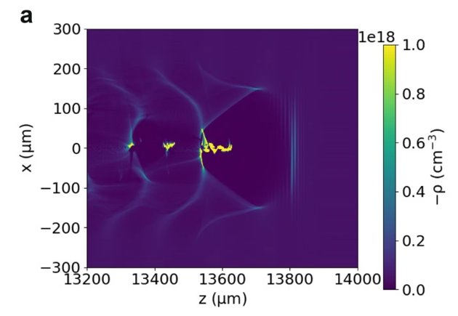
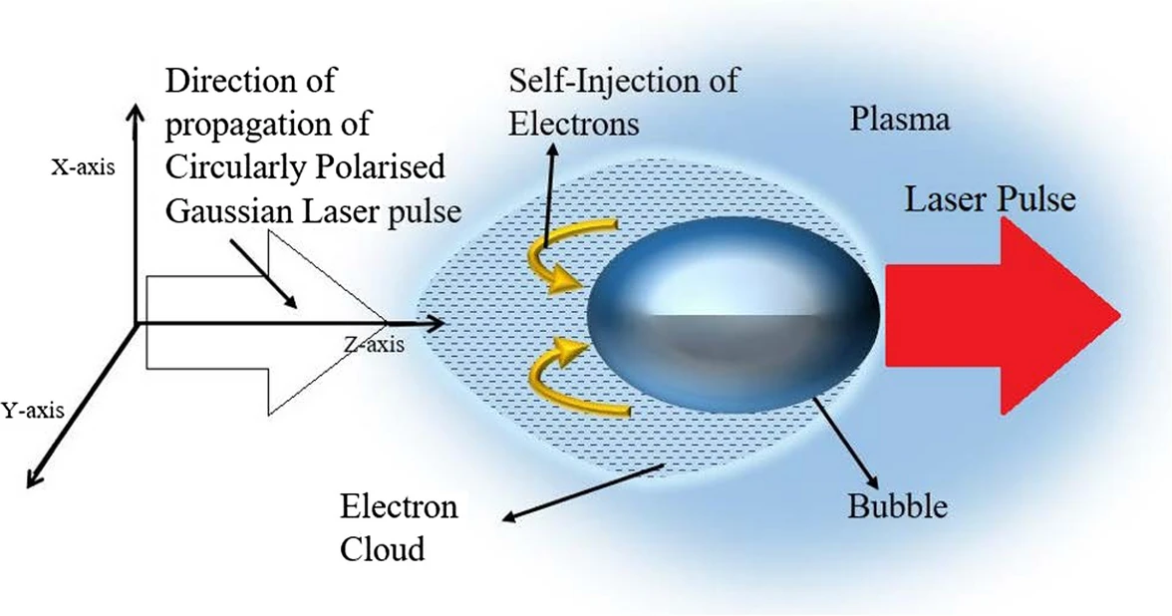
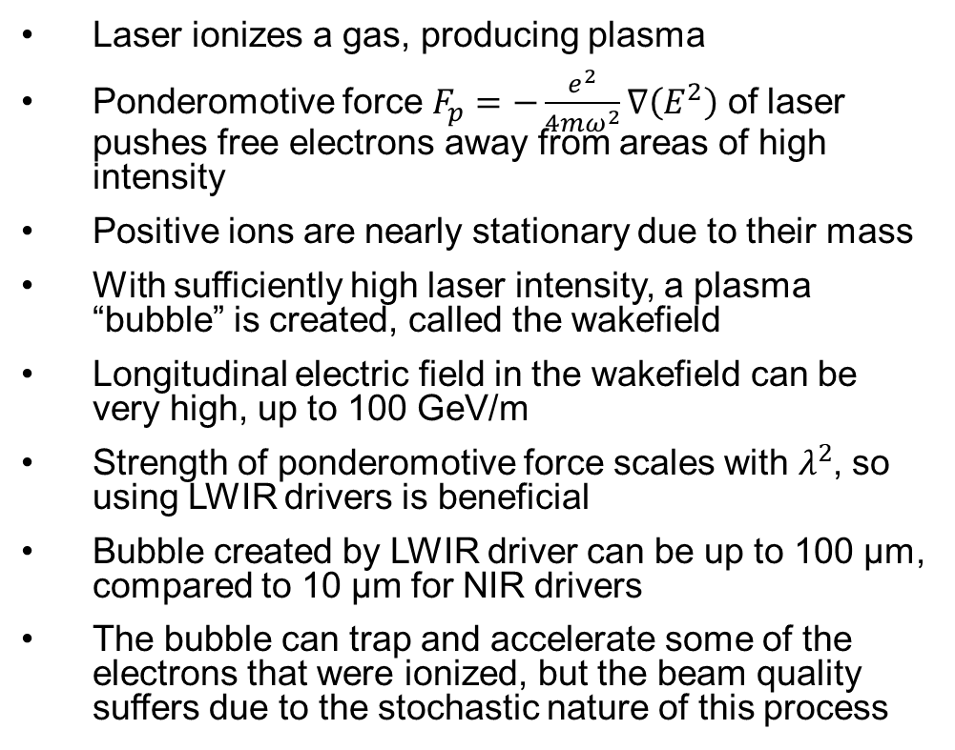
Laser wakefield acceleration
Laser ionizes a gas, producing plasma
Ponderomotive force $F_{p}=−\frac{e^{2}}{4mω^{2}}∇\left(E^{2}\right)$ of laser pushes free electrons away from areas of high intensity
Positive ions are nearly stationary due to their mass
With sufficiently high laser intensity, a plasma “bubble” is created, called the wakefield
Longitudinal electric field in the wakefield can be very high, up to 100 GeV/m
Strength of ponderomotive force scales with $λ^{2}$, so using LWIR drivers is beneficial
Bubble created by LWIR driver can be up to 100 µm, compared to 10 µm for NIR drivers
The bubble can trap and accelerate some of the electrons that were ionized, but the beam quality suffers due to the stochastic nature of this process
Brunetti, Scientific Reports 12, 6703 (2022)
Kumar, Optical and Quantum Electronics, (2021)

Slide 3
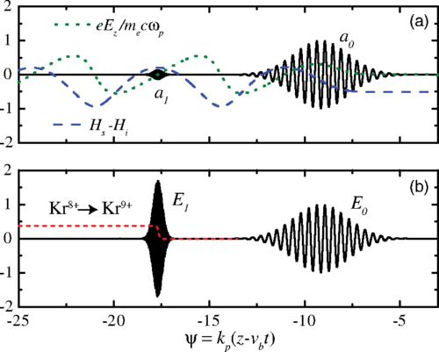
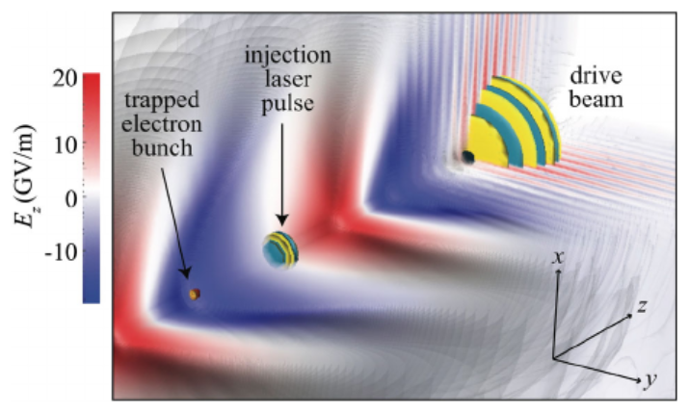
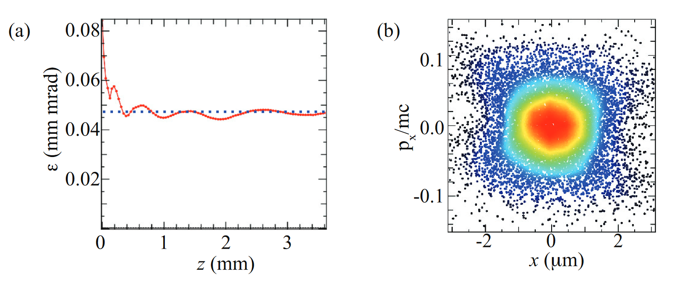


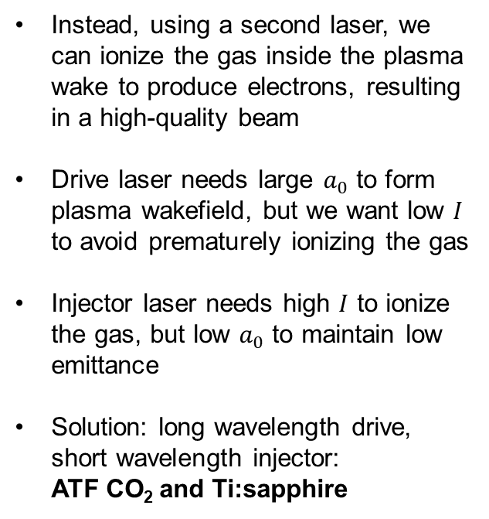
Two-color ionization injection
Very intense, small $a_{0}$
Less intense, large $a_{0}$
Instead, using a second laser, we can ionize the gas inside the plasma wake to produce electrons, resulting in a high-quality beam
Drive laser needs large $a_{0}$ to form plasma wakefield, but we want low $I$ to avoid prematurely ionizing the gas
Injector laser needs high $I$ to ionize the gas, but low $a_{0}$ to maintain low emittance
Solution: long wavelength drive, short wavelength injector:
ATF CO₂ and Ti:sapphire
Schroeder, PRSTAB 17, 101301 (2014)
Yu, PRL 112, 125001 (2014)
Excellent phase space
Low emittance
Schroeder, European Conference on Lasers and Electro-Optics (2015)

Slide 4
Trapping electrons
The electrons start at rest, while the plasma wake is moving at ~c
Race: electrons need to be accelerated to the wake velocity before the wake leaves them behind
Minimum accelerating gradient is called trapping threshold
Low gradient, electron slips behind wake
High gradient, electron trapped inside wake

Slide 5
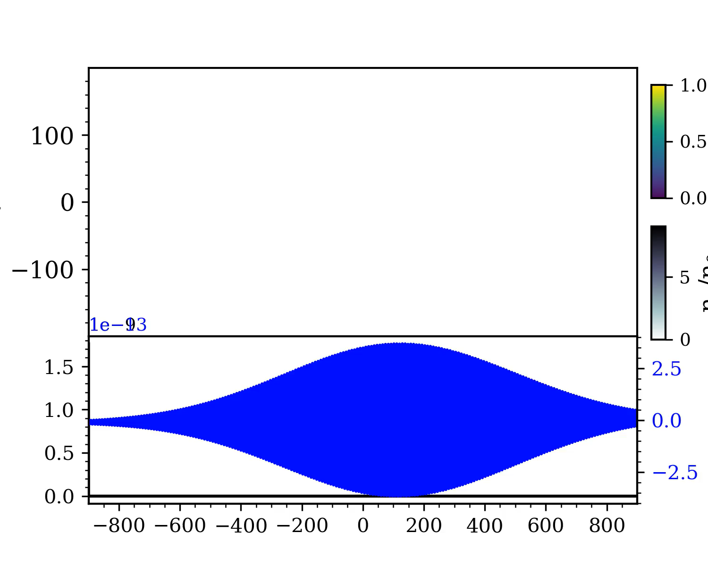
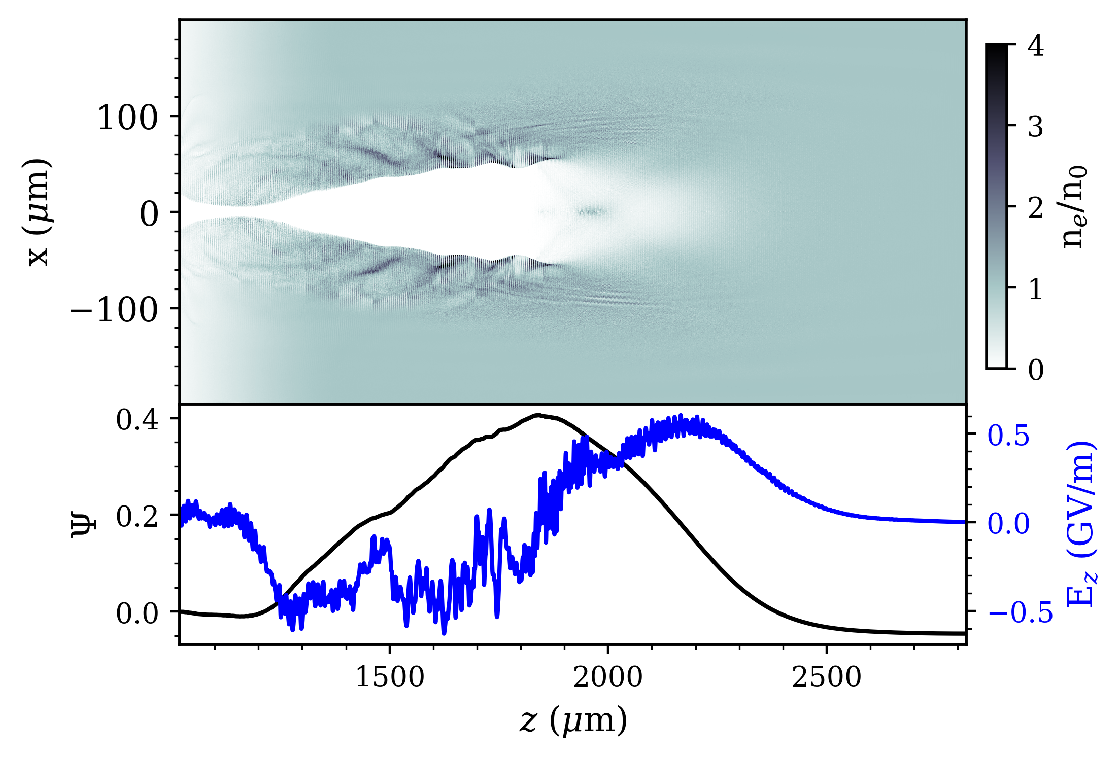
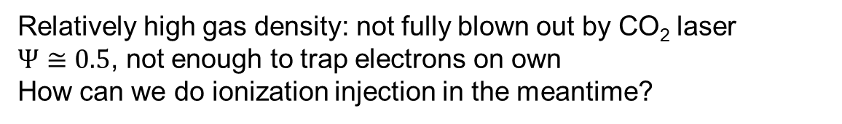
Wakefield with current CO₂ parameters
Relatively high gas density: not fully blown out by CO₂ laser
$Ψ≅0.5$, not enough to trap electrons on own
How can we do ionization injection in the meantime?
Pulse energy = 7.5 J, $a_{0 }$= 3.275, $w_{0}=36$ µm, $τ_{FWHM}=2$ps, $n_{0}=1×{10}^{16}$cm⁻³

Slide 6
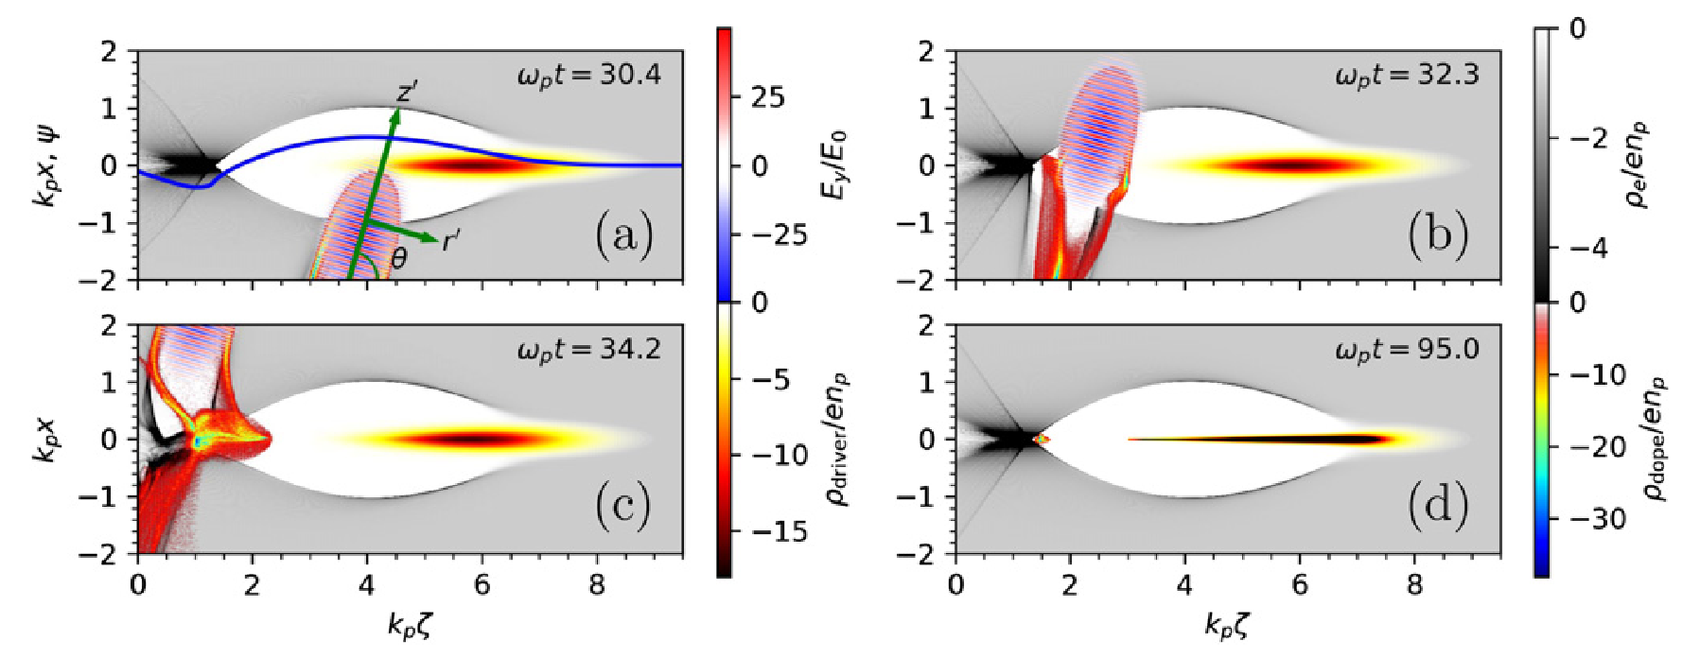
Ponderomotive assistance
We can use the injector laser to help!
Below figure is an e-beam driver, but the same principle applies
Ponderomotive force of injector laser at oblique angle accelerates the ionized electrons
The electrons have an initial momentum, lowering the necessary trapping potential
Zeng, New J. Phys. 22, 123003 (2015)

Slide 7
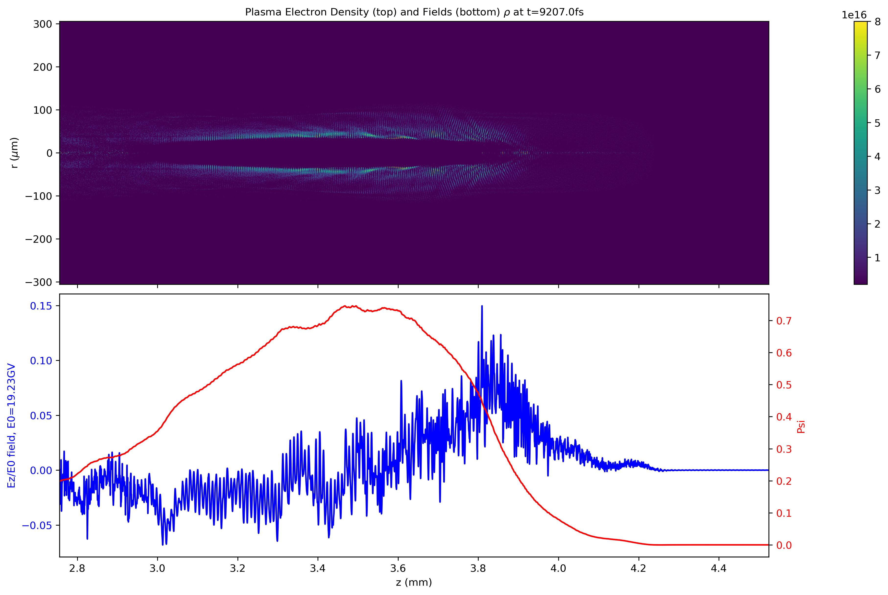
Lower energy → higher density
Pulse energy = 5 J, $a_{0 }$= 2.675, $w_{0}=36$ µm, $τ_{FWHM}=2$ps, $n_{0}=4×{10}^{16}$cm⁻³

Slide 8
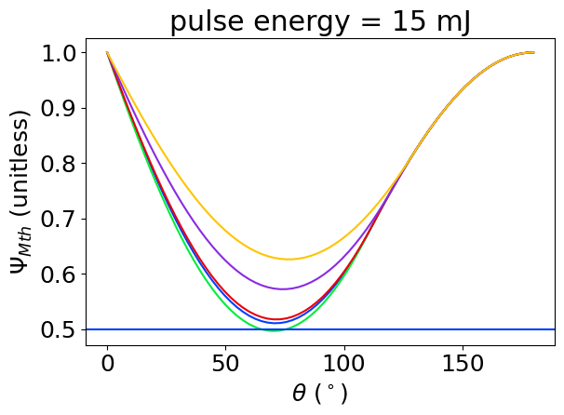
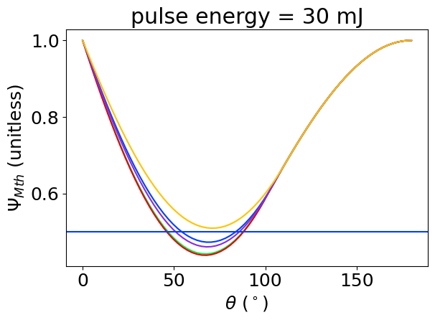
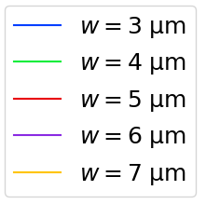
Ti:Sapphire parameters
Before ATF upgrade
After ATF upgrade
0.5
Sufficient for trapping

Slide 9
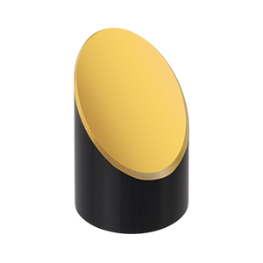
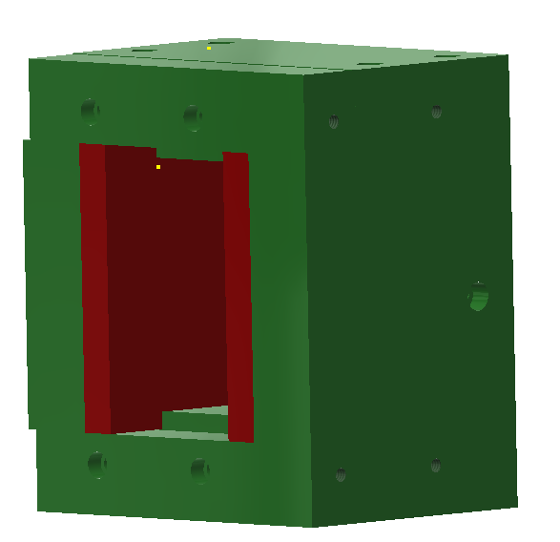
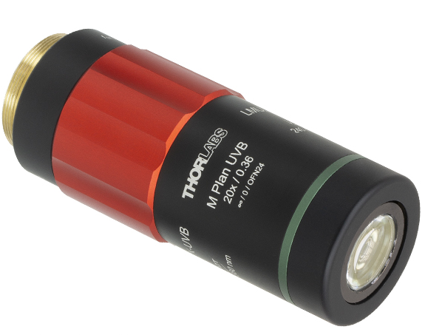
Experimental setup
NIR pulse
LWIR pulse
AOI rotation
Dipole
magnet
Pepperpot
LANEX
Slit
f/#1.5 focusing
Nozzle
LWIR focus diagnostic
NIR focus diagnostic
f/#2 focusing

Slide 10
2024 run
Encountered and overcame several challenges (broken motorized stages, HVAC issues, etc.)
Used this run as a “test run” for developing alignment techniques and finding issues to fix before the next run
Able to align OAP and achieve small spot with purely manual stages: will have working motorized stages for next run

Slide 11
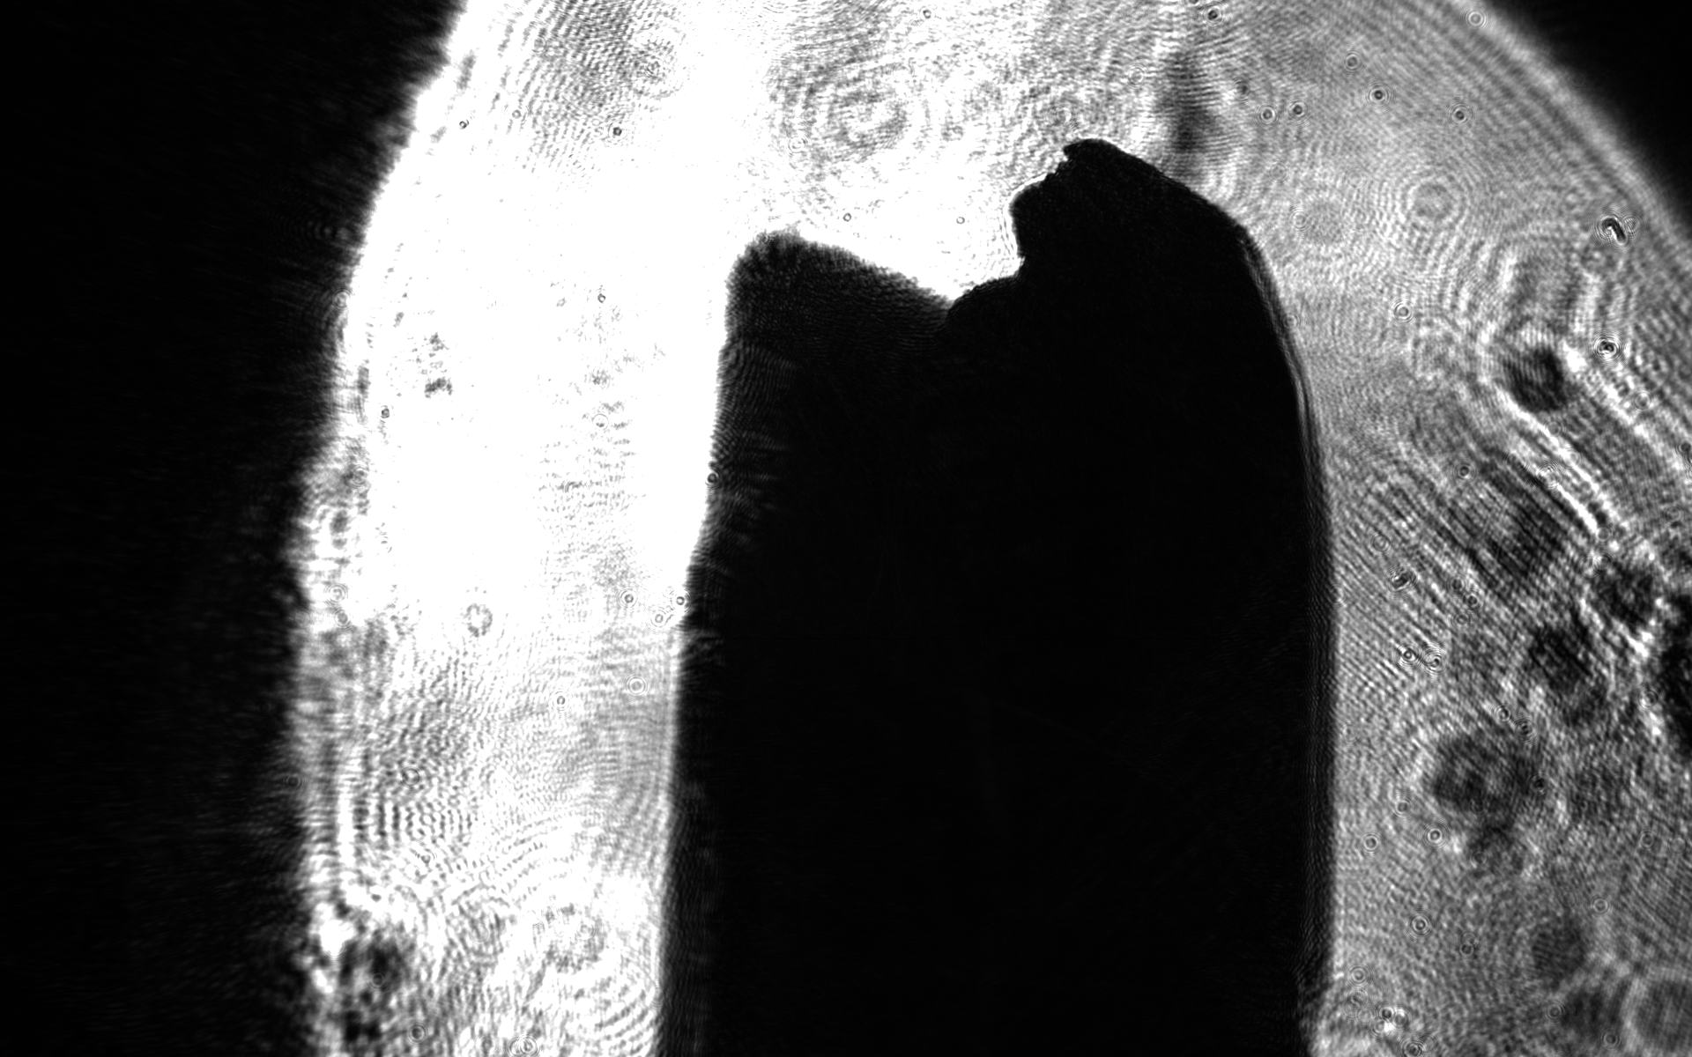
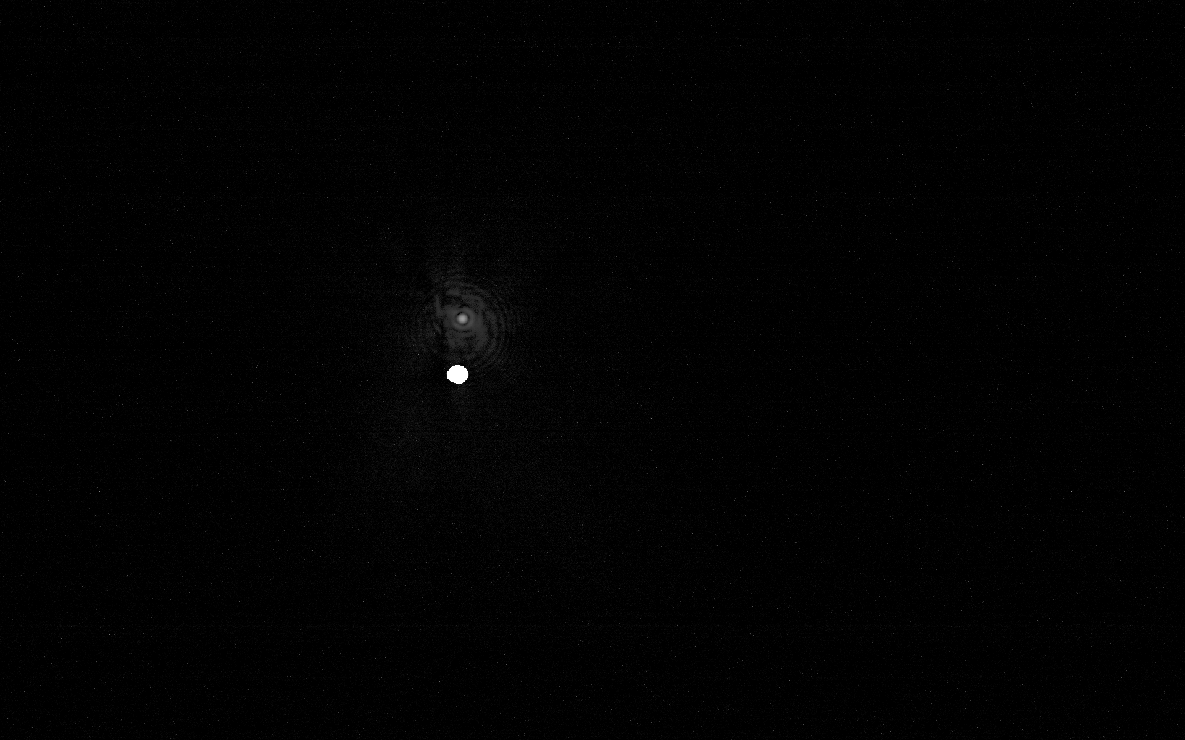
Preliminary alignment tests
515 um pin
10 um Ti:Sa focus

Slide 12
Conclusion
Two-color ionization injection has been shown in simulation to produce high quality electron beams
Ponderomotively assisted injection allows us to study ionization injection now
Stepping stone to experiments post-ATF upgrade to produce low emittance, high brightness beams

Slide 13
Questions?

Slide 14
Electron Beam Requirements
Parameter | Units | Typical Values | Comments | Requested Values
Beam Energy | MeV | 50-65 | Full range is ~15-75 MeV with highest beam quality at nominal values | 55
Bunch Charge | nC | 0.1-2.0 | Bunch length & emittance vary with charge | 0.2
Bunch Length | ps | 1-10 | Bunch charge & emittance vary with length | 2
Peak current | A | 100 | Variable with bunch charge and length
Compression | fs | Down to 100 fs (up to 1 kA peak current) | A magnetic bunch compressor available to compress bunch down to ~100 fs. Beam quality is variable depending on charge and amount of compression required. NOTE: Further compression options are being developed to provide bunch lengths down to the ~10 fs level
Focused transverse size at IP (σ) | μm | 30 – 100 (dependent on IP position) | It is possible to achieve transverse sizes below 10 um with special permanent magnet optics.
Normalized Emittance | μm | 1 (at 0.3 nC) | Variable with bunch charge
Rep. Rate (Hz) | Hz | 1.5 | 3 Hz also available if needed
Trains mode | --- | Single bunch | Multi-bunch mode available. Trains of 24 or 48 ns spaced bunches.

Slide 15
CO₂ Laser Requirements
Configuration | Parameter | Units | Typical Values | Comments | Requested Values
CO₂ Regen. Amplifier | Wavelength | μm | 9.2 | Wavelength determined by mixed isotope gain media
 | Peak Power | GW | ~3
 | Pulse Mode | --- | Single
 | Pulse Length | ps | 2
 | Pulse Energy | mJ | 6
 | Repetition Rate | Hz | 1.5 | 3 Hz also available if needed
CO₂ CPA Beam | Wavelength | μm | 9.2 | Wavelength determined by mixed isotope gain media | 9.2
Note that delivery of full power pulses to the Experimental Hall is presently limited to Beamline #1 only. | Peak Power | TW | 2-3 | Up to 5 TW operation will be available in a limited number of shots upon the user's request.
 | Pulse Mode | --- | Single
 | Pulse Length | ps | 2 | 3-year development effort to achieve <500 fs at >10 TW and deliver to users is in progress. | 2
 | Pulse Energy | J | ~5 | 10J will be available in a limited number of shots upon the user's request. | 7.5 - max
 | Strehl Ratio | --- | ~0.5 | Recommended conservative estimate subject to verification.
 | Repetition Rate | Hz | 0.01 | Burst operation at up to 0.05 Hz for a limited period is possible upon user’s request. This regime should be avoided to extend the lifetime of the HV spark gaps in the amplifier’s PFN
 | Polarization |  | Linear | Adjustable linear polarization along with circular polarization can be provided upon request

Slide 16
Other Experimental Laser Requirements
Ti:Sapphire Laser System | Units | Stage I Values | Stage II Values | Comments | Requested Values
Central Wavelength | nm | 800 | 800 | Stage I parameters are presently available and setup to deliver Stage II should be available summer 2025
FWHM Bandwidth | nm | 20 | 13
Compressed FWHM Pulse Width | fs | <50 | <75 | Transport of compressed pulses will initially include a very limited number of experimental interaction points. Please consult with the ATF Team if you need this capability. | 70
Chirped FWHM Pulse Width | ps | ≥50 | ≥50
Chirped Energy | mJ | 10 | 200
Compressed Energy | mJ | 7 | ~20 | 20 mJ is presently operational with work underway this year to achieve our 100 mJ goal.
Energy to Experiments | mJ | >4.9 | >80 |  | 30
Power to Experiments | GW | >100 | >1000
Nd:YAG Laser System | Units | Typical Values | Comments | Requested Values
Wavelength | nm | 1064 | Single pulse
Energy | mJ | 100
Pulse Width | ps | 14
Wavelength | nm | 532 | Frequency doubled
Energy | mJ | 0.5
Pulse Width | ps | 10

Slide 17
Special Equipment Requirements and Hazards
Electron Beam
No special requirements
CO₂ Laser
No special requirements
Ti:Sapphire and Nd:YAG Lasers
No special requirements
Hazards & Special Installation Requirements
Compressed gas: krypton for gas jet
Static magnetic field: electron spectrometer

Slide 18
Experimental Time Request
CY2025 Time Request
Capability | Setup Hours | Running Hours
Electron Beam Only
Laser* Only (in Laser Areas)
Laser* + Electron Beam | 40 | 80
Total Time Request for the Experiment remaining duration
Capability | Setup Hours | Running Hours
Electron Beam Only
Laser* Only (in Laser Areas)
Laser* + Electron Beam | 80 | 160
* Laser = Near-IR or LWIR (CO₂) Laser

