Slide 1







Remote detection of radioactive sources by long-wavelength laser-driven avalanche
A. Zingale, S. Waczynski, I. Pogorelsky, M. Polyanskiy, J. Sears, R. E. Lakis, H. M. Milchberg
ATF proposal number: 309983
ATF users meeting 4/29/2025

Slide 2


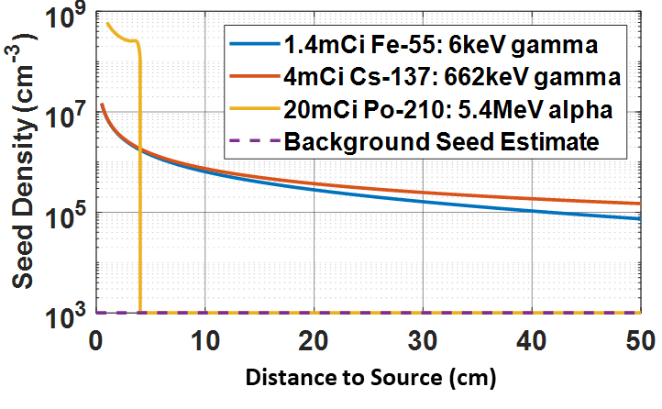
Overview and Goals
particle range
Near field
Current radioactive material detection technology is limited to the near field.
Primary goal of this project is to demonstrate detection of radioactive material relevant to the non-proliferation mission at distances >100 m… beyond the decay product range in air.
Accomplished using Laser-based electron avalanche breakdown technique.
Far field
Laser-based Ionization detection system
Notes:
Why we care about plasma optics

Slide 3
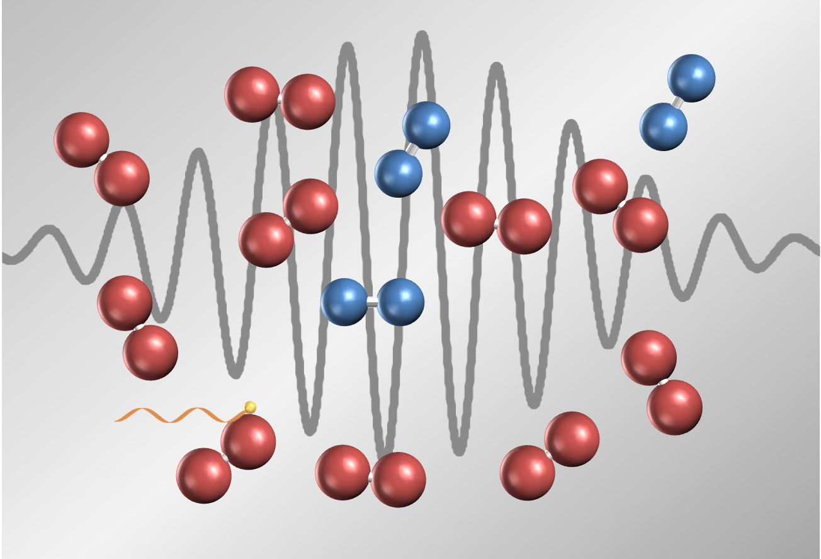
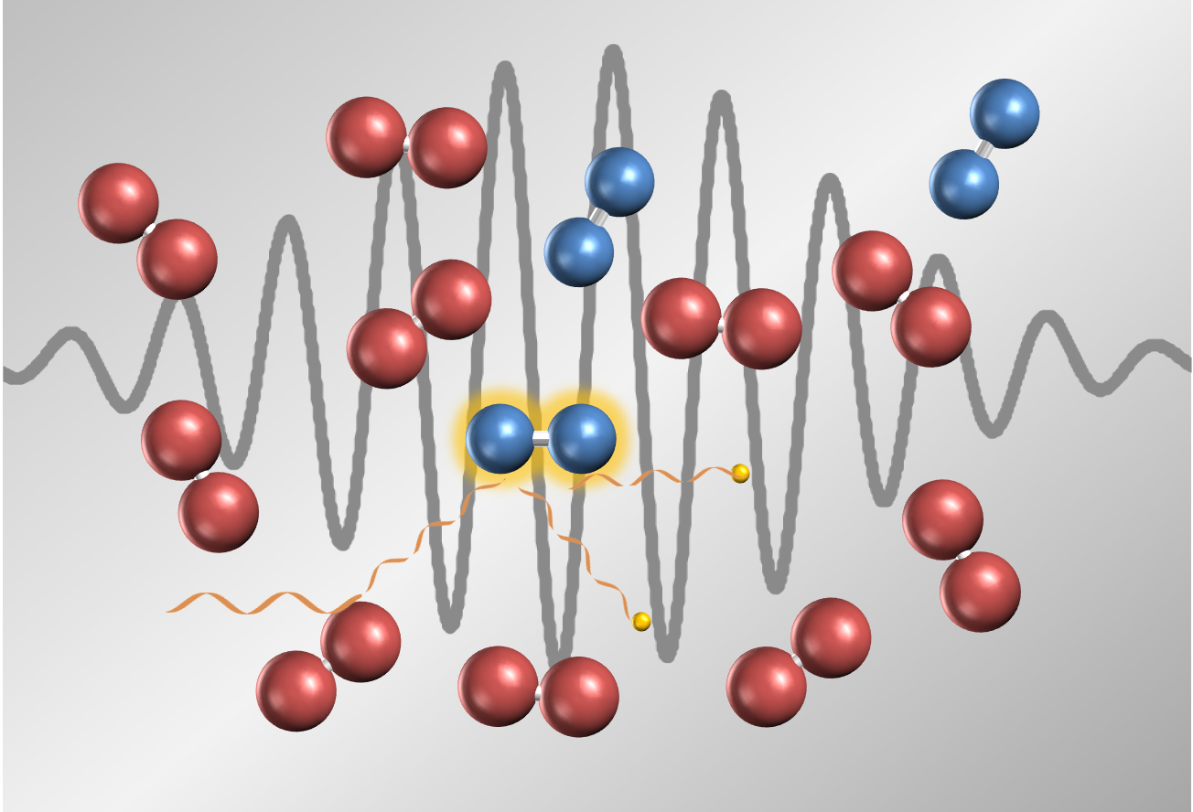
Laser Driven Electron Avalanche as a
Detection Mechanism
Propagate laser pulse from far field to near field
Drive avalanche in near field seeded by radiation generated free electrons and ions
Reflective avalanche plasma backscatters laser light
Detector near laser source collects scattered light to determine presence of radioactive source
Avalanche: Laser field heats free electrons which become capable of ionizing nearby molecules on impact, leading to exponential increase in ionization
Notes:
Why we care about plasma optics

Slide 4
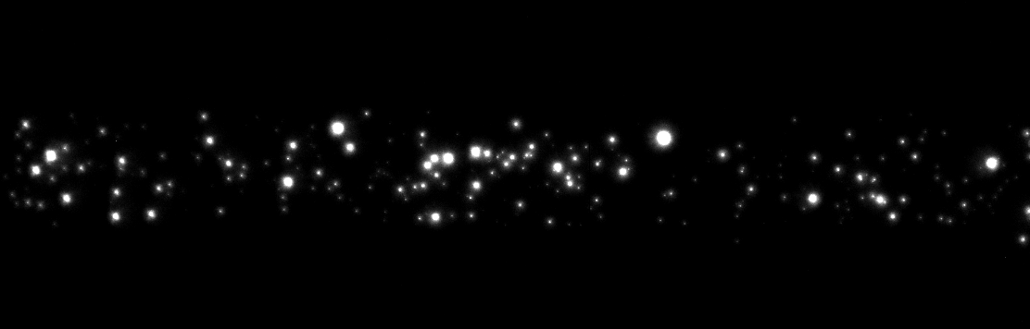

Method originally proven at short range ($\sim$ 1m)
λ=3.9 µm (mid-IR) laser at University of Maryland
5 mCi Po-210 source from ~1 m
5.3 MeV alphas with range in air ~3 cm
Distance to source can be derived from backscatter
R. Schwartz et al. Sci Adv. 2019
D. Woodbury et al., Optica 2019
~2 mm
Individual breakdown plasma sites seeded by ions
Notes:
Why we care about plasma optics

Slide 5
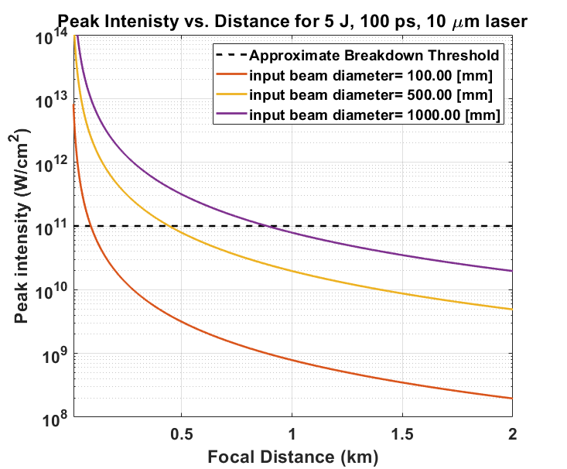
Extending to Longer Ranges
Going to longer standoff distances and laser requirements
Radiation Source:
Move from Po-210 to gamma sources.
Lasers Available:
9.2 µm (CO2) short pulse high power laser at Brookhaven National Laboratory
10.6 µm commercial TEA CO2 lasers installed at UMd: oscillator/amplifier configuration
Currently planning experiment at these parameters (~100 m propagation)
Notes:
experiments at the 100 m range requires ~1 J -scale pulses
Longer distances -> longer f/# focusing geometry ->larger focal spot size -> lower intensity. Increasing intensity requires more energy for the same pulse duration

Slide 6
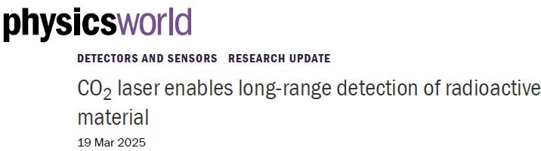
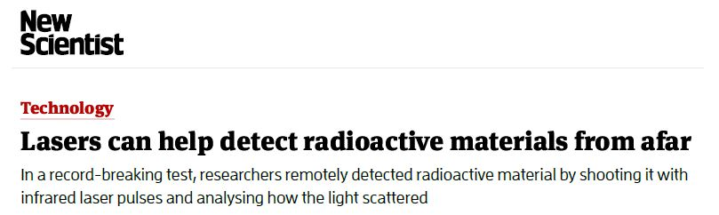
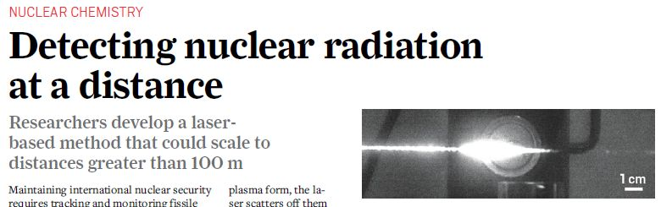
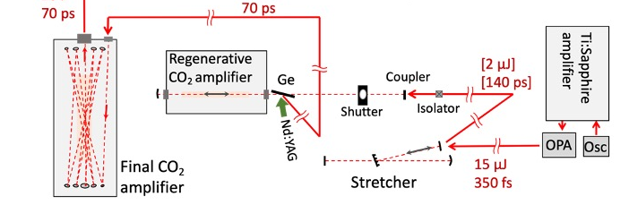
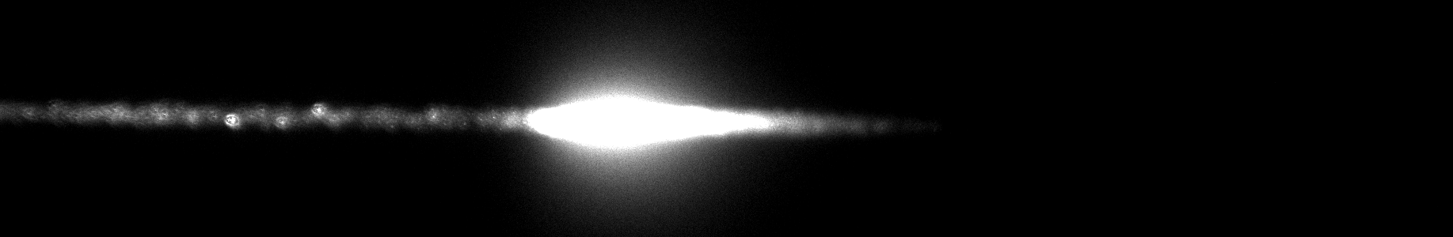
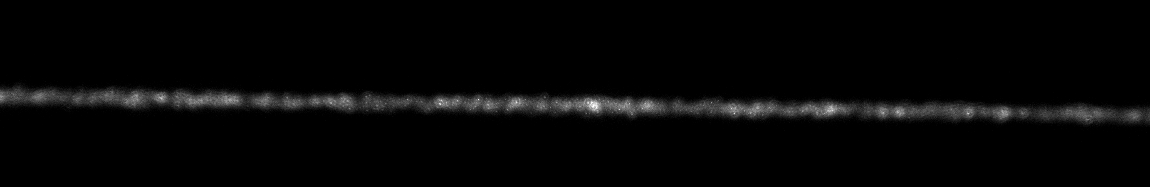
Successful detection from 10 m using Brookhaven
National Laboratory LWIR Laser system
A. Zingale et al., Phys Rev. Applied 2025
Laser: λ = 9.2 µm, 70 ps FWHM duration, 50 mJ - 1 J energy range
Diagnostics: back-reflection photodiodes (MCT) amplified by residual gain from laser (long range), images of plasma fluorescence (short range)
Both diagnostics successfully distinguish presence of Po-210
Successful 10 m stand-off detection of 3 mCi Po-210
Visible fluorescence also showed strong signal increase. Likely detectable at long range
~10 m
Po-210
~2 m
Breakdown plasma
Fluorescence imager
source open
source blocked
Brookhaven National Laboratory Accelerator Test Facility LWIR laser
Notes:
Why we care about plasma optics

Slide 7
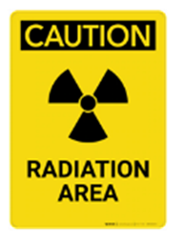
Planned BNL experiment at 100 meter stand-off
Beam focused at 100 m
Primary diagnostic: Amplified back-reflection MCT photodiode
We expect to successfully detect Cs-137 at 100 m with this experimental configuration
CO₂ amplifier
Tunable telescope to adjust focal location
High magnification fluorescence imager
Breakdown plasma
~10 cm
Cs-137 70 mCi
Optical telescope
off-normal MCT photodiode and collection optic
Notes:
Why we care about plasma optics

Slide 8
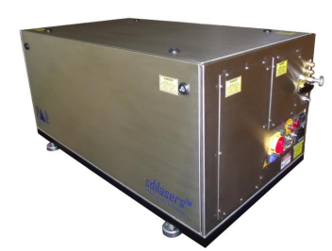
To explore portability, operation at UMd with TEA CO₂ lasers
~10 m
Dimensions: each 1.15 m x 0.65 m x 0.60 m
~5 m
CO₂ TEA lasers at UMd
Brookhaven National Laboratory Accelerator Test Facility LWIR laser
TEA lasers are higher TRL and lower SWaP (size, weight, and power)
Longer pulse, lower intensity, lower mode quality
Need to achieve high intensity at long range.
Going to longer range requires supplemental amplifiers—UMd built an oscillator/amplifier configuration w/spatial filter to achieve ~1.5 J in Gaussian mode
Notes:
TEA
Commercial availability at energies corresponding to ~100 meters or less
Footprint compatible with typical vehicles

Slide 9
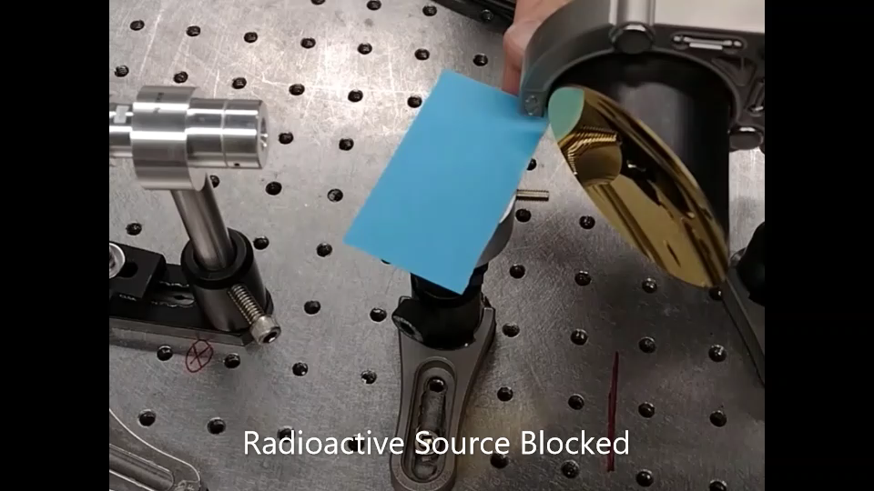
Proof of Principle for λ = 10.6 µm CO₂ TEA driver
breakdown
Laser pulse illustration added to video to show when laser is present
Notes:
Why we care about plasma optics

Slide 10
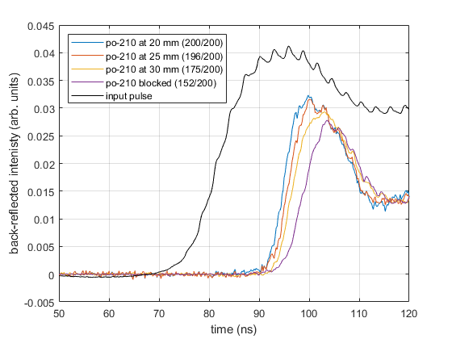
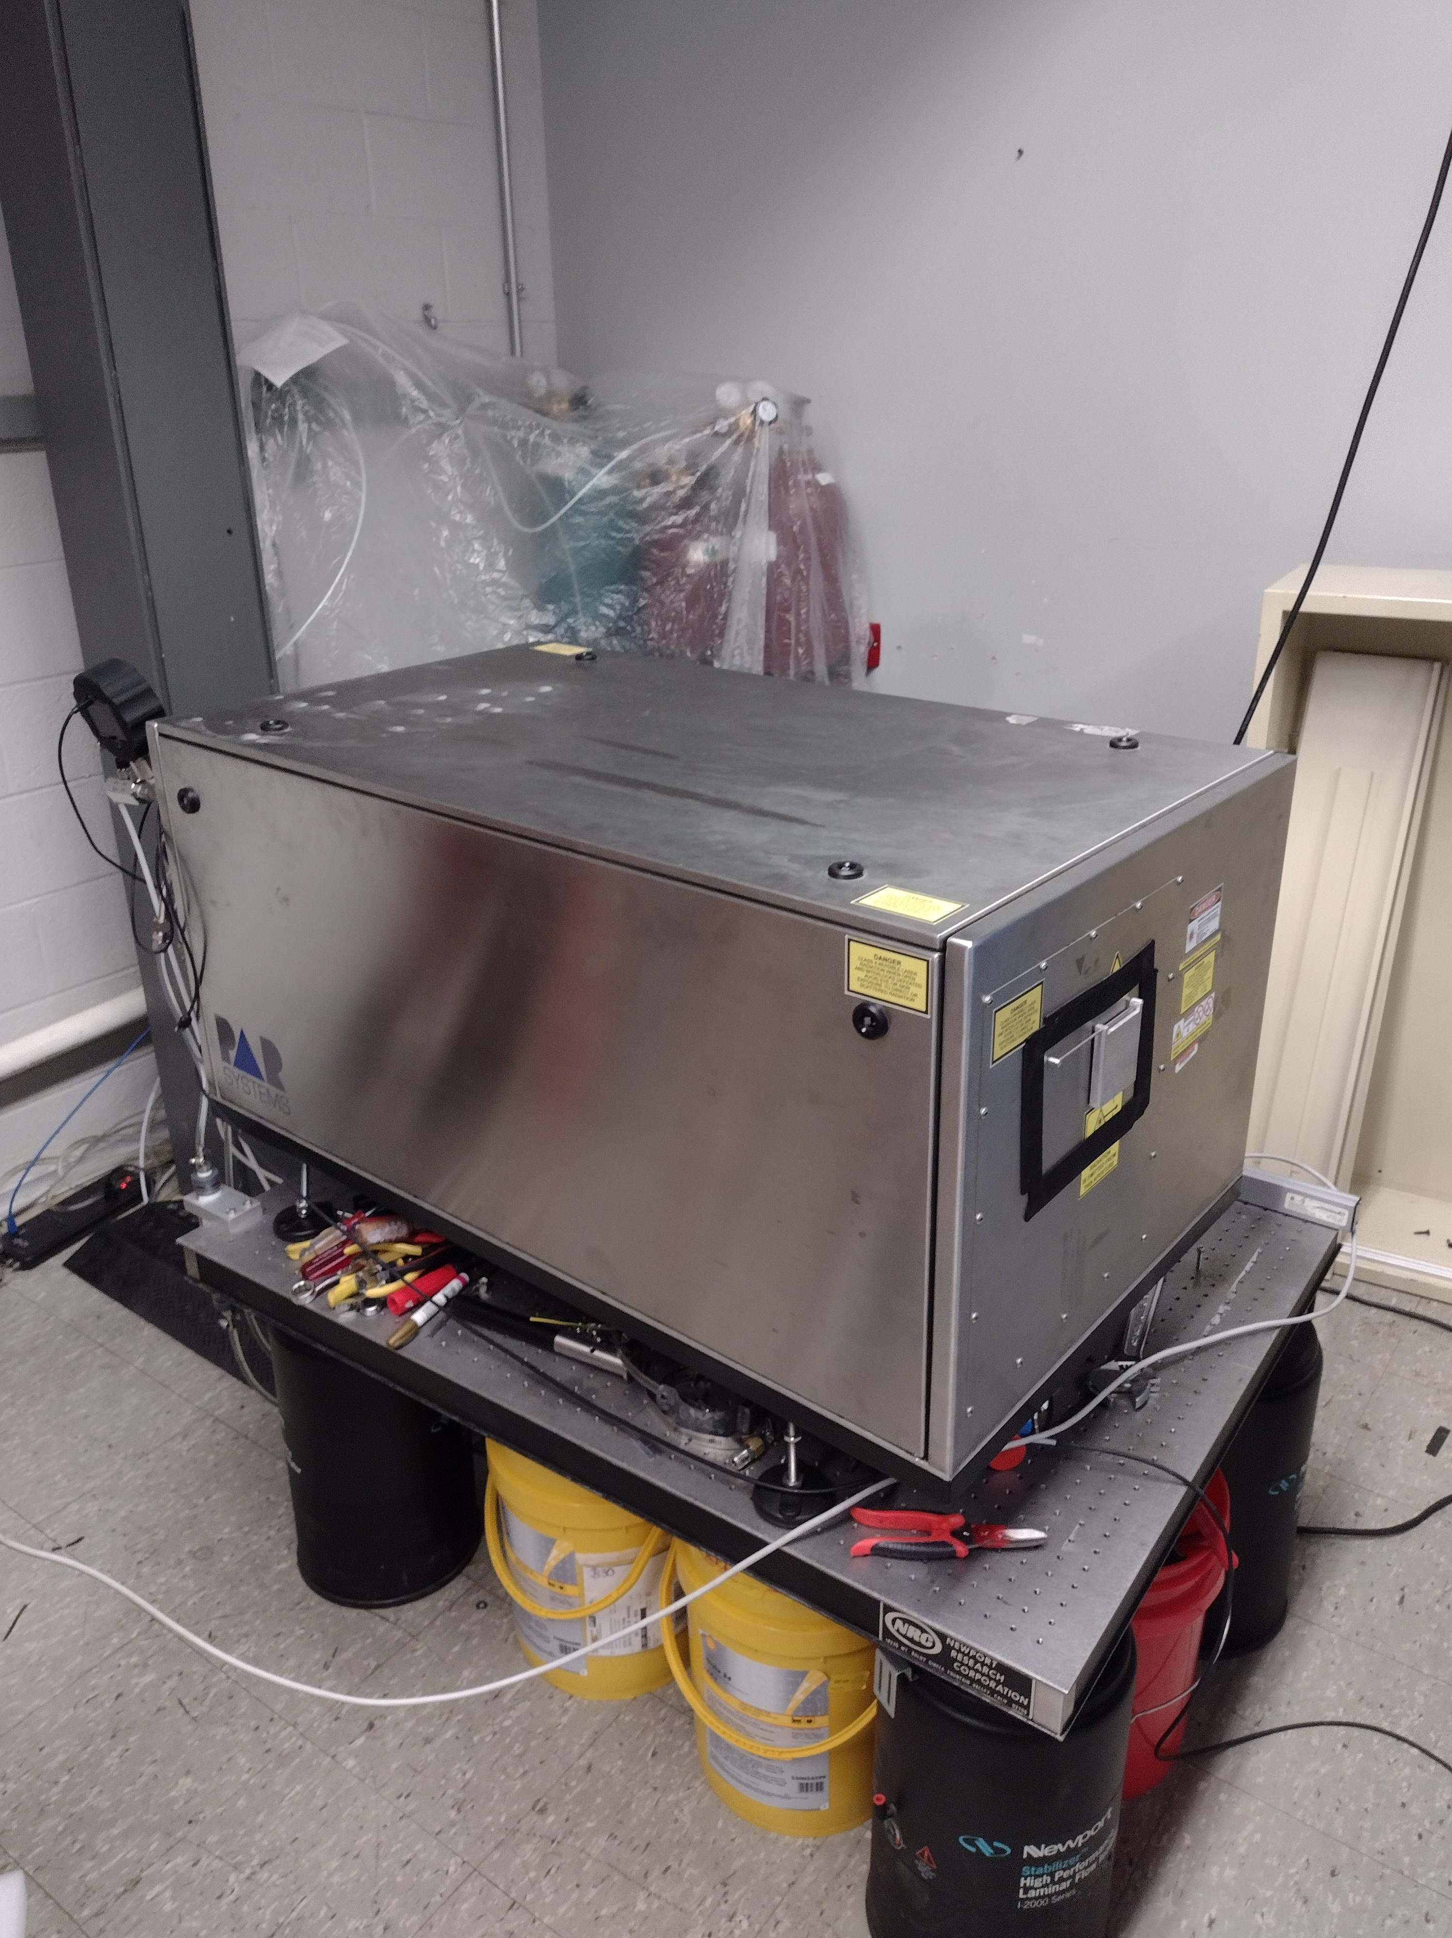
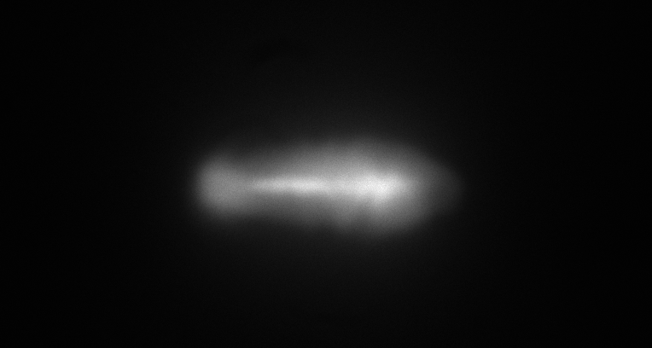
Recent success with TEA Laser
Distinguished presence of Po-210 with TEA laser at a stand-off distance of 26”
Now using increased focusing optic diameter (provided by LLNL) and added amplification (oscillator-amplifier) for experiments to 30 m and beyond
f = 2 m
Ø = 16.25 inch
> 10 meter
Sample breakdown plasma
5 mm
Beam from amplified
CO2 TEA Laser
Notes:
Why we care about plasma optics

Slide 11
Summary
Demonstrated the concept of Mid-IR laser driven avalanche of remote detection of α-source
Demonstrated detection at 10 m with LWIR system at BNL ATF
Planned experiment at ~100 m range using the ATF LWIR CO₂ laser system
Ongoing parallel research at UMd using commercial CO2 TEA lasers
In-house simulation work demonstrating applicability of methodology to > 1 km detection
Notes:
Why we care about plasma optics

Slide 12
Activities & impacts associated with this experiment
Invited Talks
A. Zingale and S. Waczynski @ LaserNet, DEPS conferences
Journal articles
Remote detection of radioactive material using a short-pulse CO2 laser
A. Zingale , S. Waczynski, I. Pogorelsky, M. Polyanskiy, J. Sears ,R.E. Lakis , and H.M. Milchberg, PHYSICAL REVIEW APPLIED 23, 034004 (2025)
Theses awarded
Stefan Waczynski (defense Jan. 2025)
Application of Ultrafast IR Lasers to Remote Detection, Beam Steering and Terahertz Generation
Other
significant coverage in science press

