Slide 1

27th Accelerator Test Facility (ATF) Users' Meeting
AE108: Development of wavelength conversion techniques for generation of coherent radiation at the XUV to LWIR
W. Li¹, R. Kupfer², F. Wang¹, J. Wishart¹, M. Babzien¹, M. Polyanskiy^{1*}, I. Pogorelsky¹, T. Rao¹, L. Cultrera¹, N. Vafaei-Najafabadi^{1,3}, M. Palmer¹
¹Brookhaven National Laboratory, ²Soreq Nuclear Research Center,
³Stony Brook University, *PI
Accelerator Facilities Division
April 29th, 2025
Funding: BNL LDRD-21-001 and U.S. DOE Office of Science DE-SC0012704 (received)

Slide 2
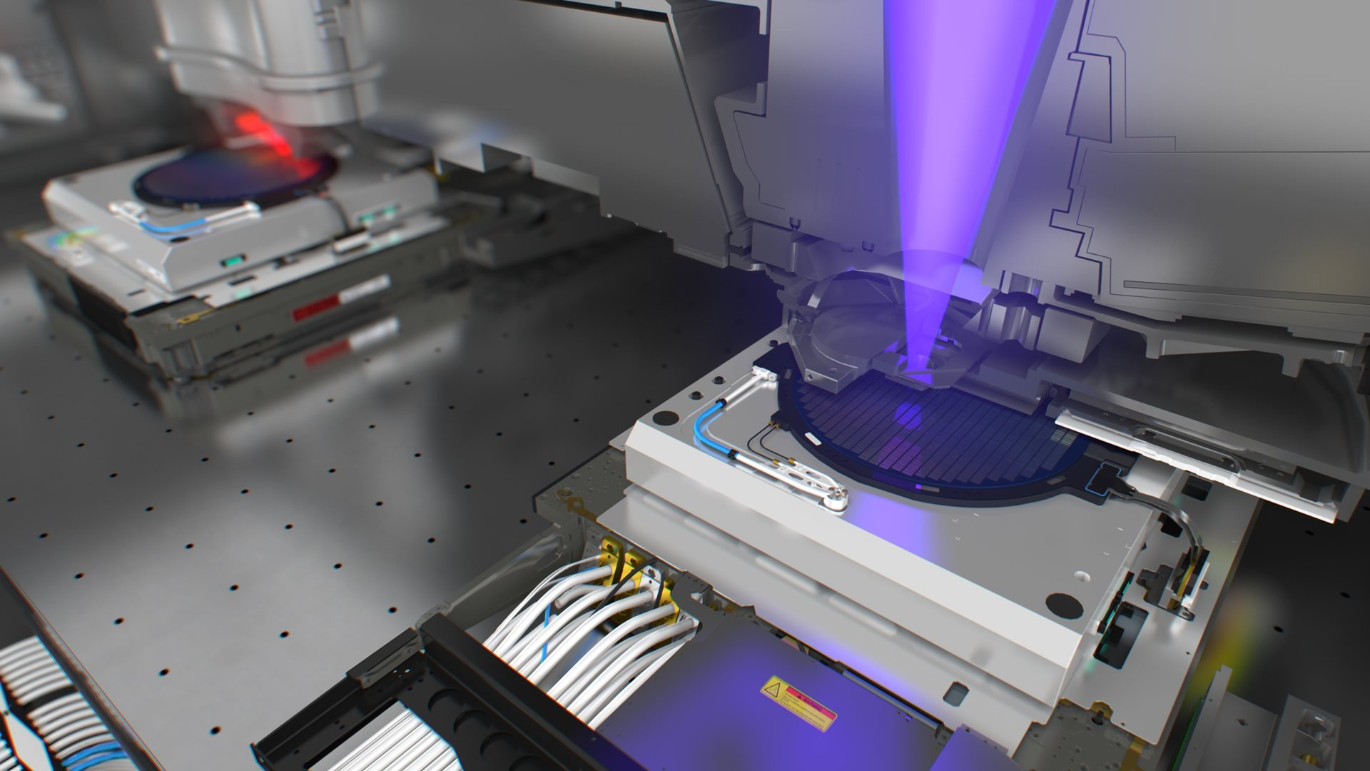
Experimental goals
CO₂ amplifier
10++ TW
~500 fs
Seed
few mJ
<500 fs
9.3 µm
Upgrading ATF CO₂ laser
  9.3 μm: better LWIR seed → shorter pulse length
  4.3 μm: optical pumping → much higher repetition rate
XUV for imaging and lithography
  HHG scales with wavelength: natural fit for ATF
  With CO₂ laser, potentially extend to zeptosecond hard x-rays
Pump
100s J, < 1 µs, 4.3 µm
CO₂
laser
Popmintchev, Nat. Photonics 4, 828 (2010)
Photo credit: ASML
Accelerator Facilities Division

Slide 3
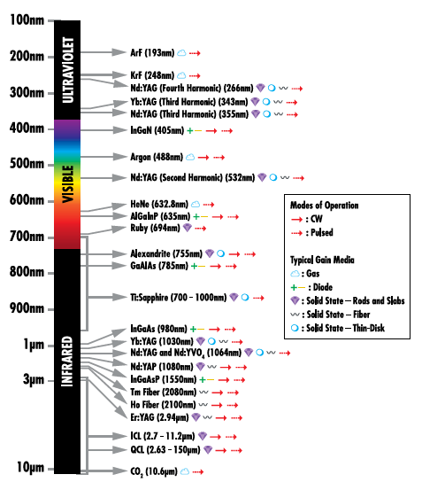
Mid- and long-wave infrared
Commonly available lasers are limited to specific wavelengths
Generating mid- or long-wave infrared usually requires relatively inefficient OPA
Is there a better option?
Photo credit: Edmund Optics
Accelerator Facilities Division

Slide 4


Raman + DFG
Raman Scattering →
Difference-frequency
generation (DFG)
in
out
ω_{pump}
ω_{signal}
ΔE
ω_{DFG}
Residual pump ω_{p}
Residual pump ω_{p}
Raman Converter
$$ω_{vibration}=ω_{target}$$
Nonlinear crystal $χ^{(2)}≠0$
$$ω_{p}−\left(ω_{p}−ω_{target}\right)=ω_{target}$$
ω_{target}
‘Cheap’ high energy laser source ω_{p}
Converted pump ω_{p}- ω_{target}
Converted pump ω_{p}- ω_{target}
Typical Raman shifts are on the order of 1000 cm⁻¹
Perfect for generating LWIR!
Diagrams adapted from Welch, Opt. Express 26, 5145-5163 (2018)
Accelerator Facilities Division

Slide 5
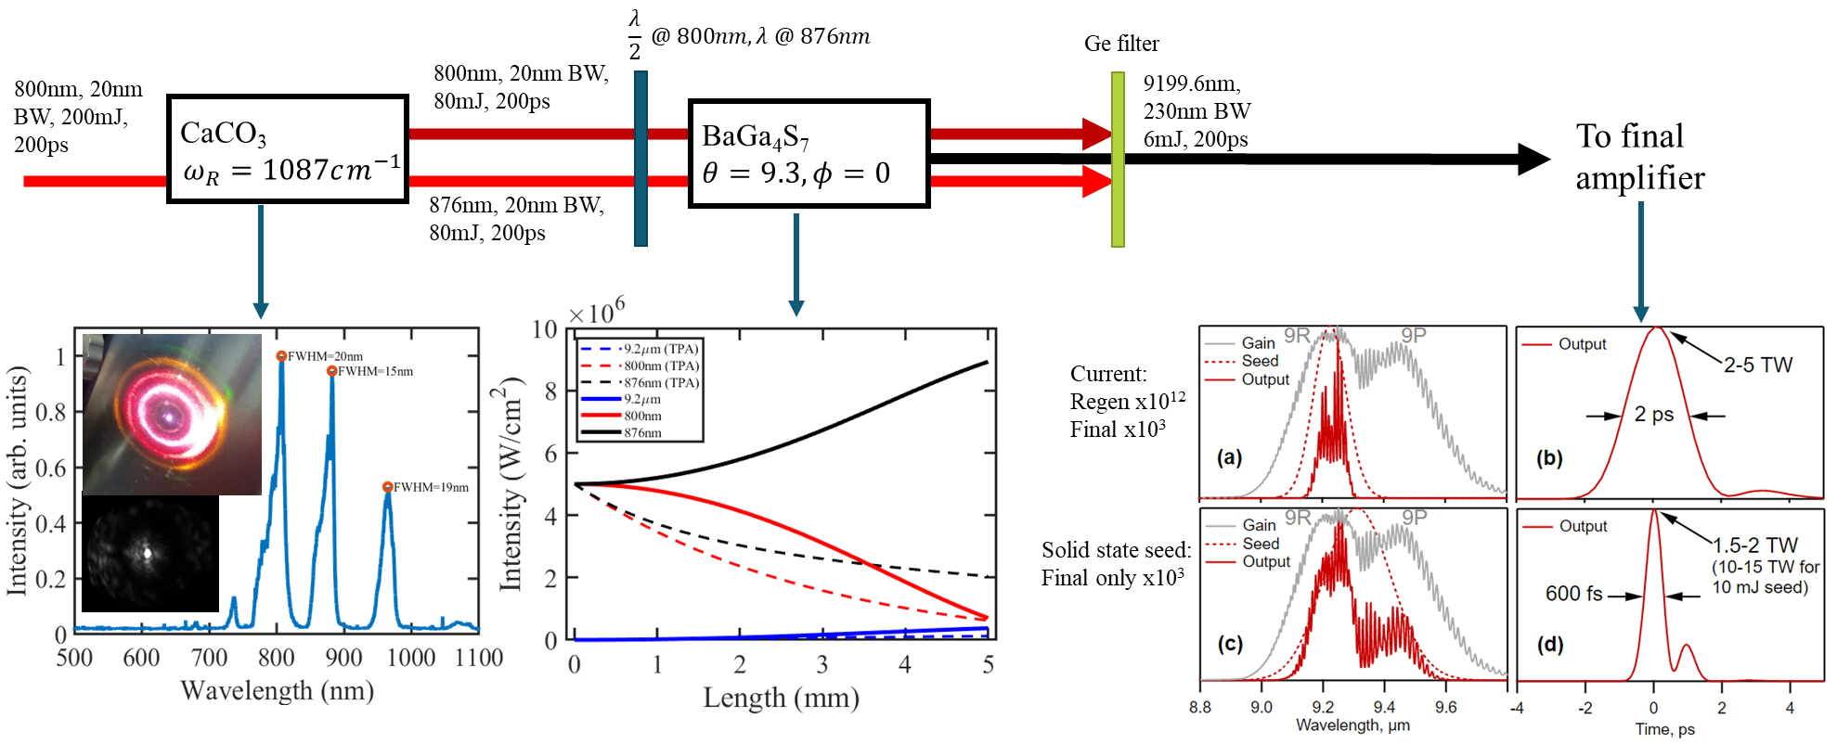
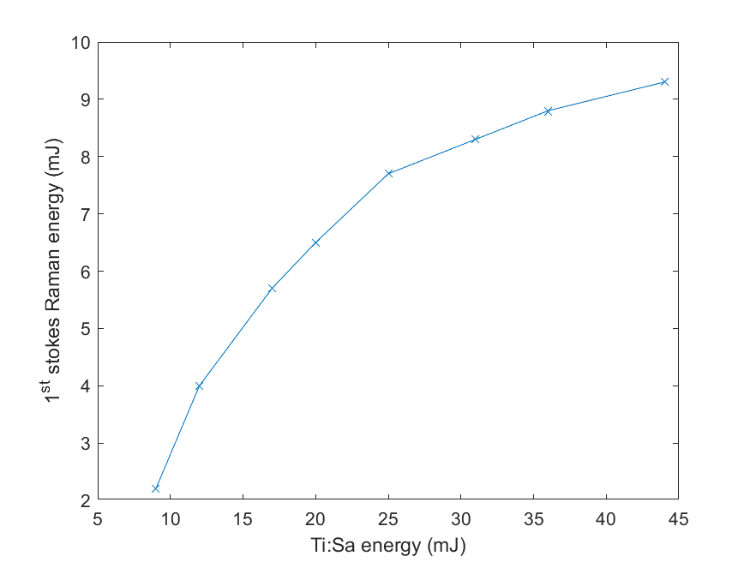
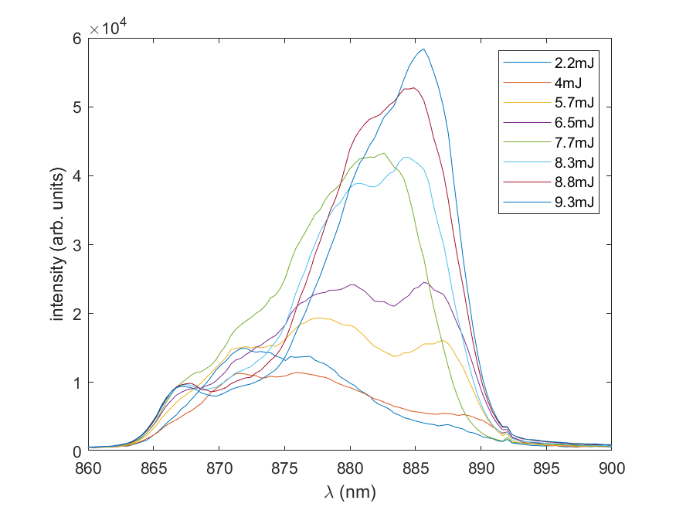
Seed generation in calcite
Possibly use 2 μm pump for better DFG efficiency
simulated
simulated
Correct peaks
BGS suppresses TPA
Effect on CO₂ laser
Good efficiency and energy scaling
Red-shifts at saturation
Accelerator Facilities Division

Slide 6
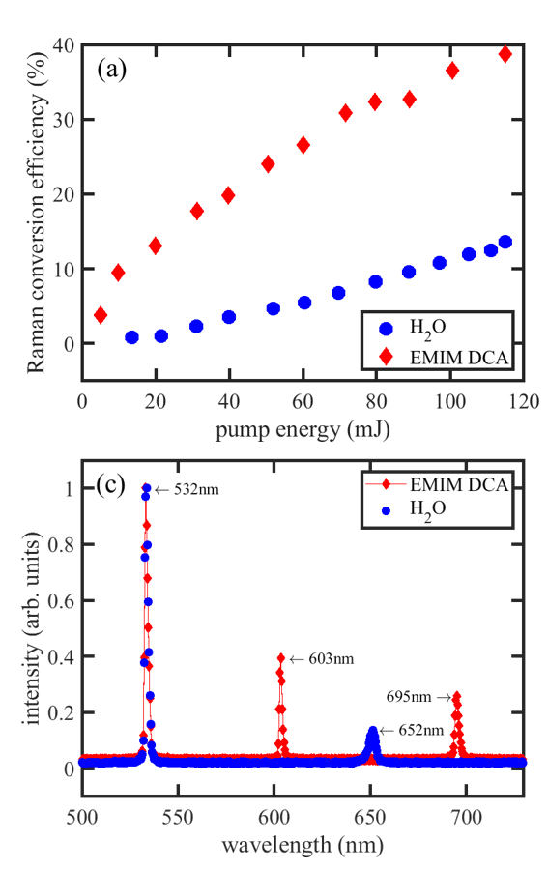
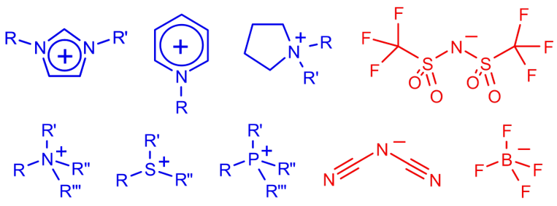
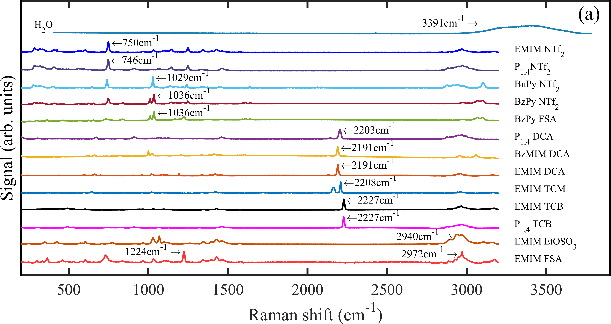
Pump (4.3 μm) generation in ionic liquid
Artificial salts that are liquid at room temperature
Can be designed to have specific properties
Settled on EMIM DCA
  Transparent at pump and Stokes wavelengths
  Peak Raman cross section at desired shift
  High viscosity (suppressing Brillouin scattering)
  Good stability
High efficiency
Good spectrum
Raman shifts of selected ILs
Accelerator Facilities Division
Plots from Kupfer, Phys. Rev. Applied 19, 014052 (2023)

Slide 7
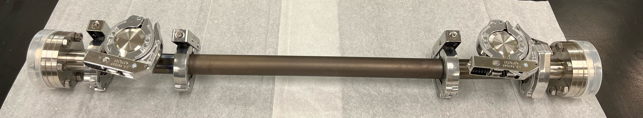
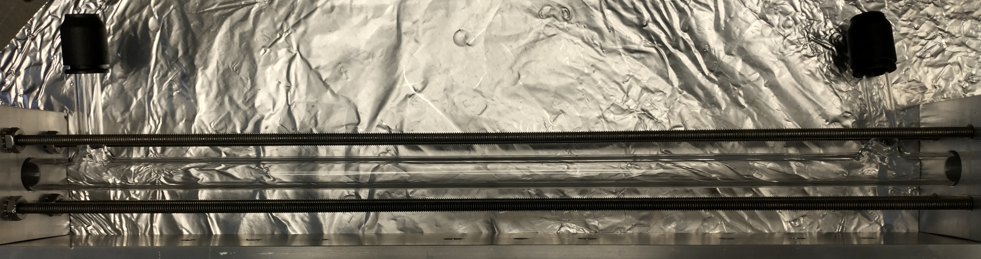
Open questions about ionic liquids
Cost effectiveness: how much liquid is necessary?
Repetition rate?
Other viable ionic liquids?
Original tube
New tube
~300 ml
~30 ml
Accelerator Facilities Division

Slide 8
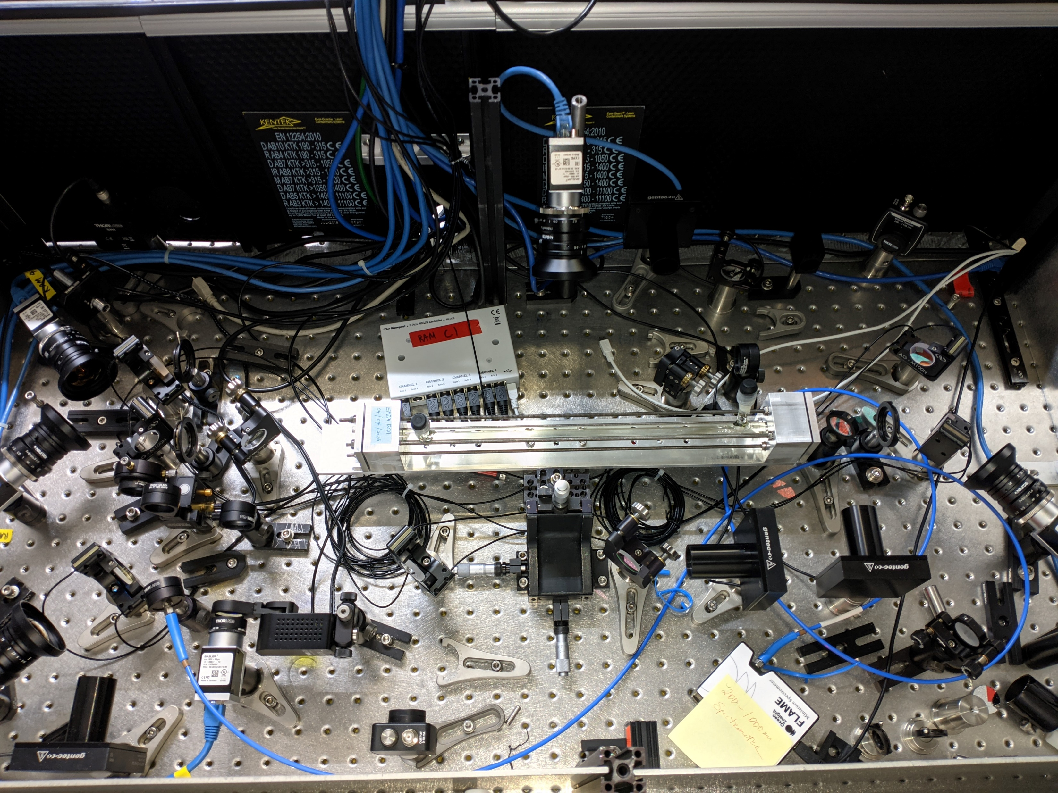
Ionic liquid test stand
Runs in parallel with Ti:S operations
Nd:YAG
(2nd harmonic)
Ionic liquid tube
Diagnostics
Accelerator Facilities Division

Slide 9
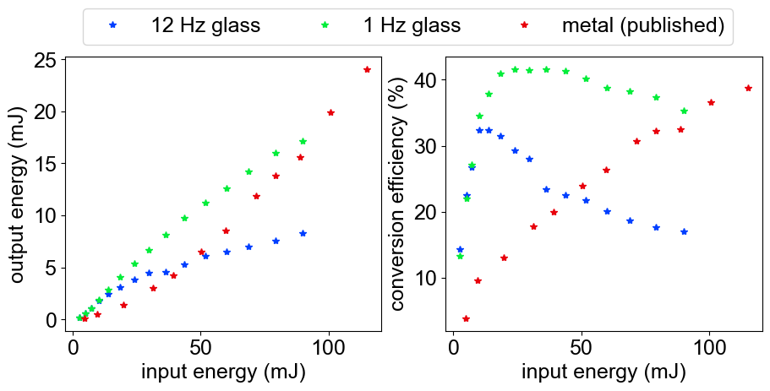
Repetition rate scaling
Glass tube saturates quickly at 12 Hz, compared to metal tube
Significant improvement at 1 Hz
Thermal effects: thermal conductivity of EMIM-based ionic liquids is around 0.2 W/m·K* (water is about 0.6 W/m·K)
For high repetition rates, need active cooling
*Fröba, Int. J. Thermophys. 31, 2059-2077 (2010)
Accelerator Facilities Division

Slide 10
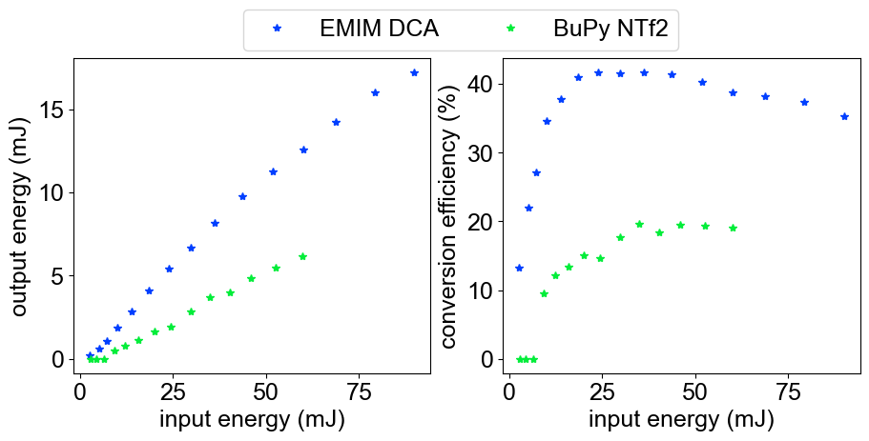
Alternative ionic liquids
Now testable due to smaller requisite volume
~2200 cm⁻¹ Stokes shift
  BenzMIM DCA, EMIM TCM: absorption at 532 nm too high
  No visible Stokes peak/burned liquid
~1000 cm⁻¹ Stokes shift
  BuPy NTf2
  Low conversion efficiency
Accelerator Facilities Division

Slide 11
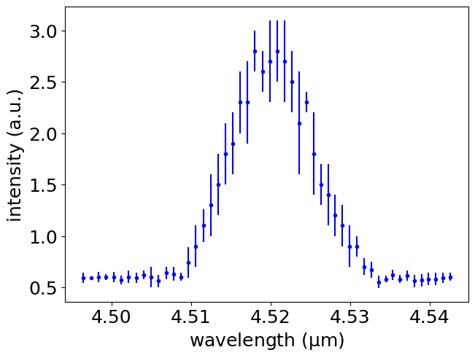
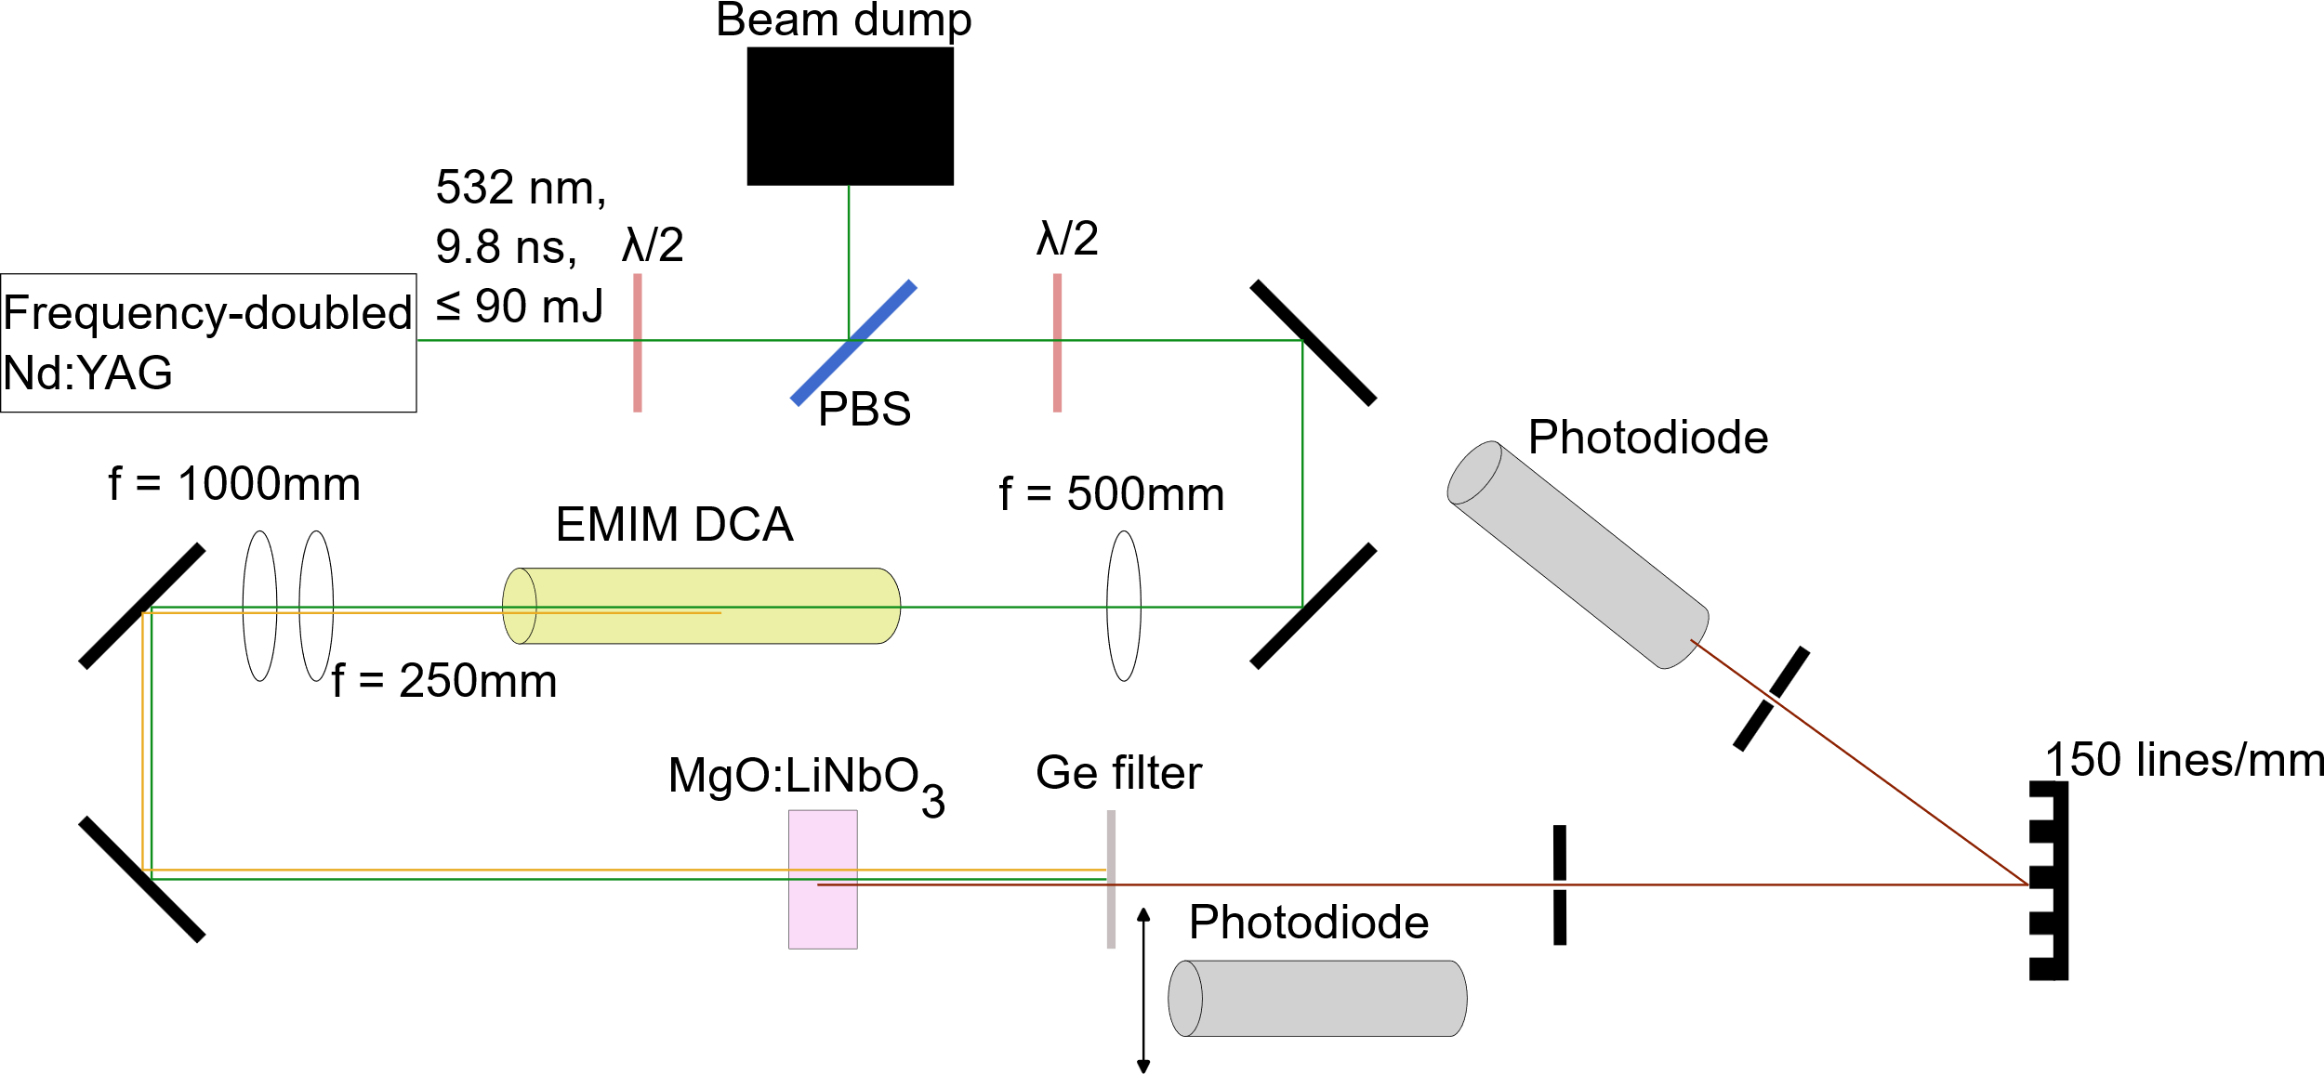
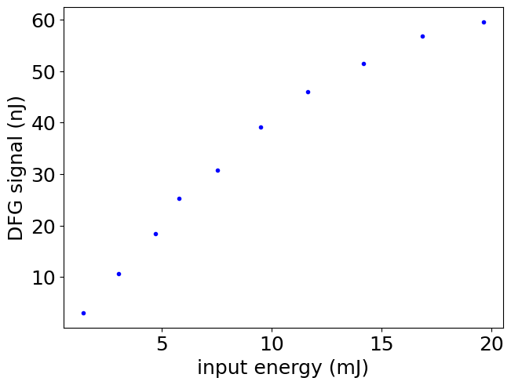
EMIM DCA + LiNbO₃ MIR generation

Slide 12
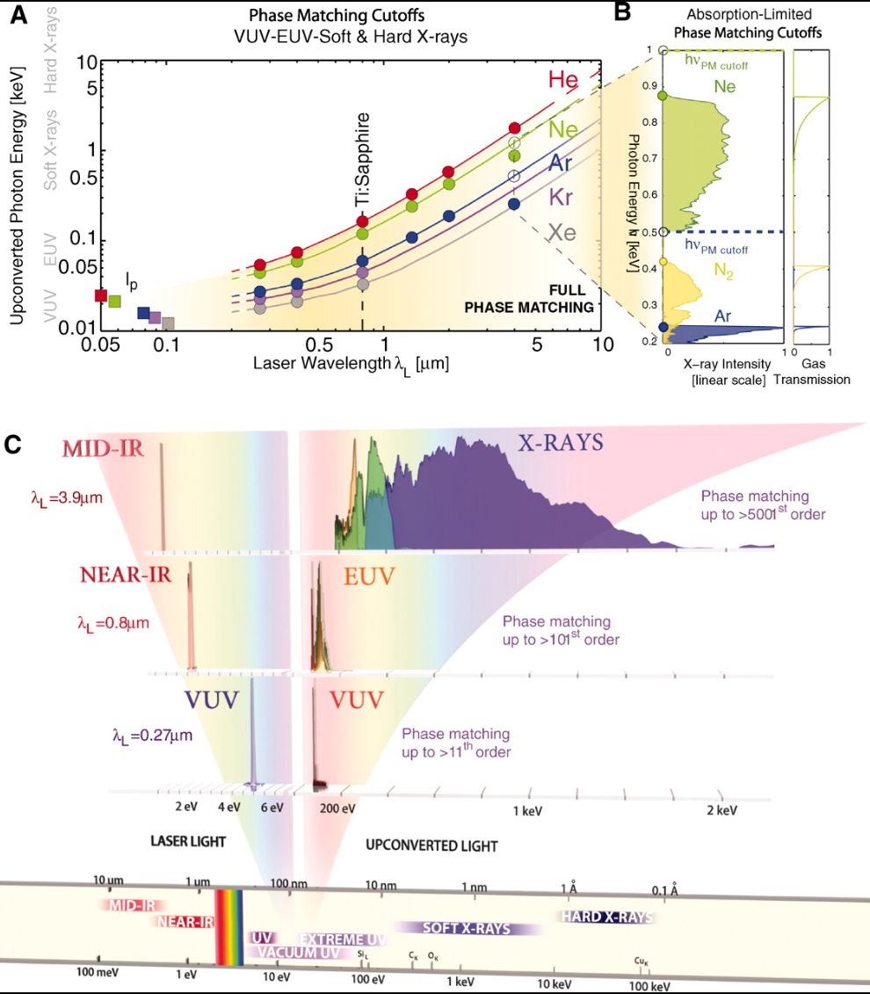
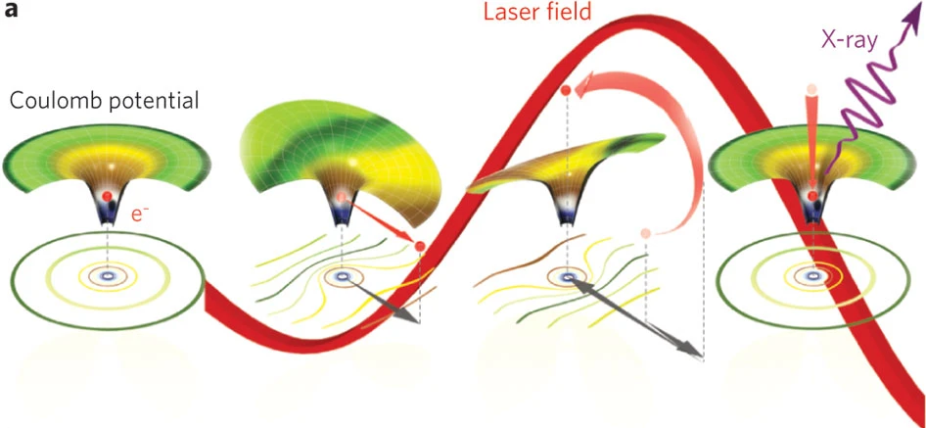
High harmonic generation
Intense laser field tunnel ionizes gas
Free electron is ponderomotively pushed away from ion
Laser field changes sign and electron collides with ion
Ponderomotive nature of interaction causes longer pump wavelengths to lead to shorter harmonic wavelengths
Popmintchev, Science 336, 1287-1291 (2012)
Popmintchev, Nat. Photonics 4, 828 (2010)
Accelerator Facilities Division

Slide 13
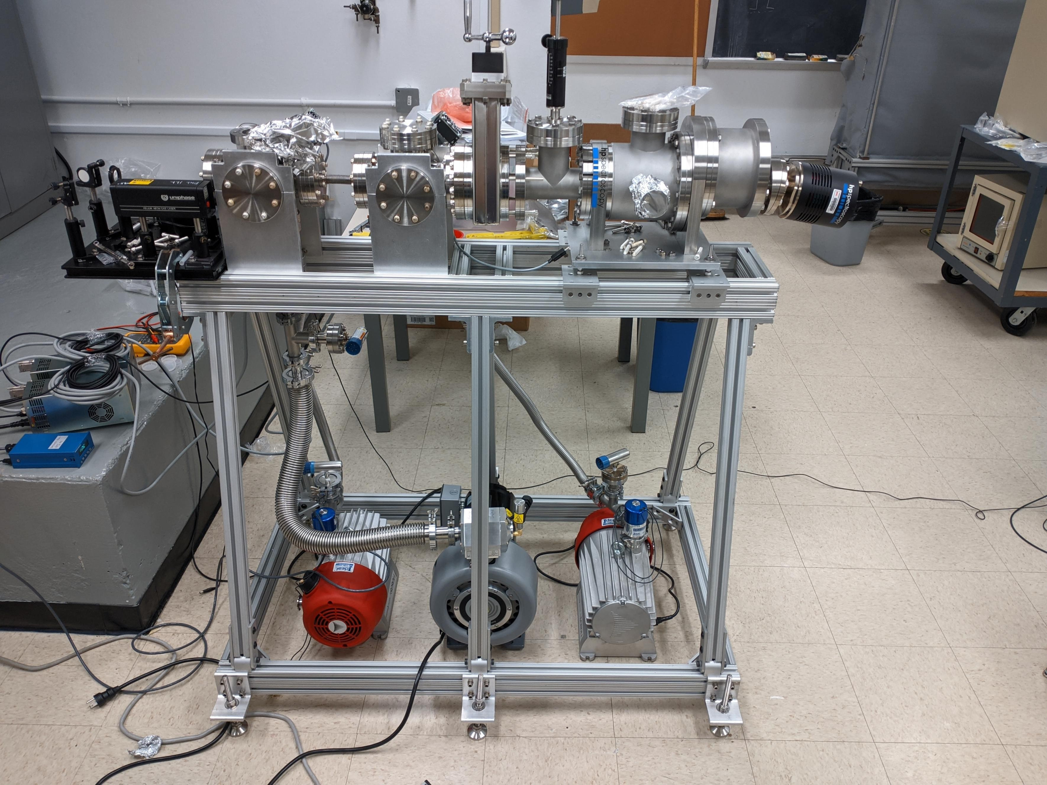
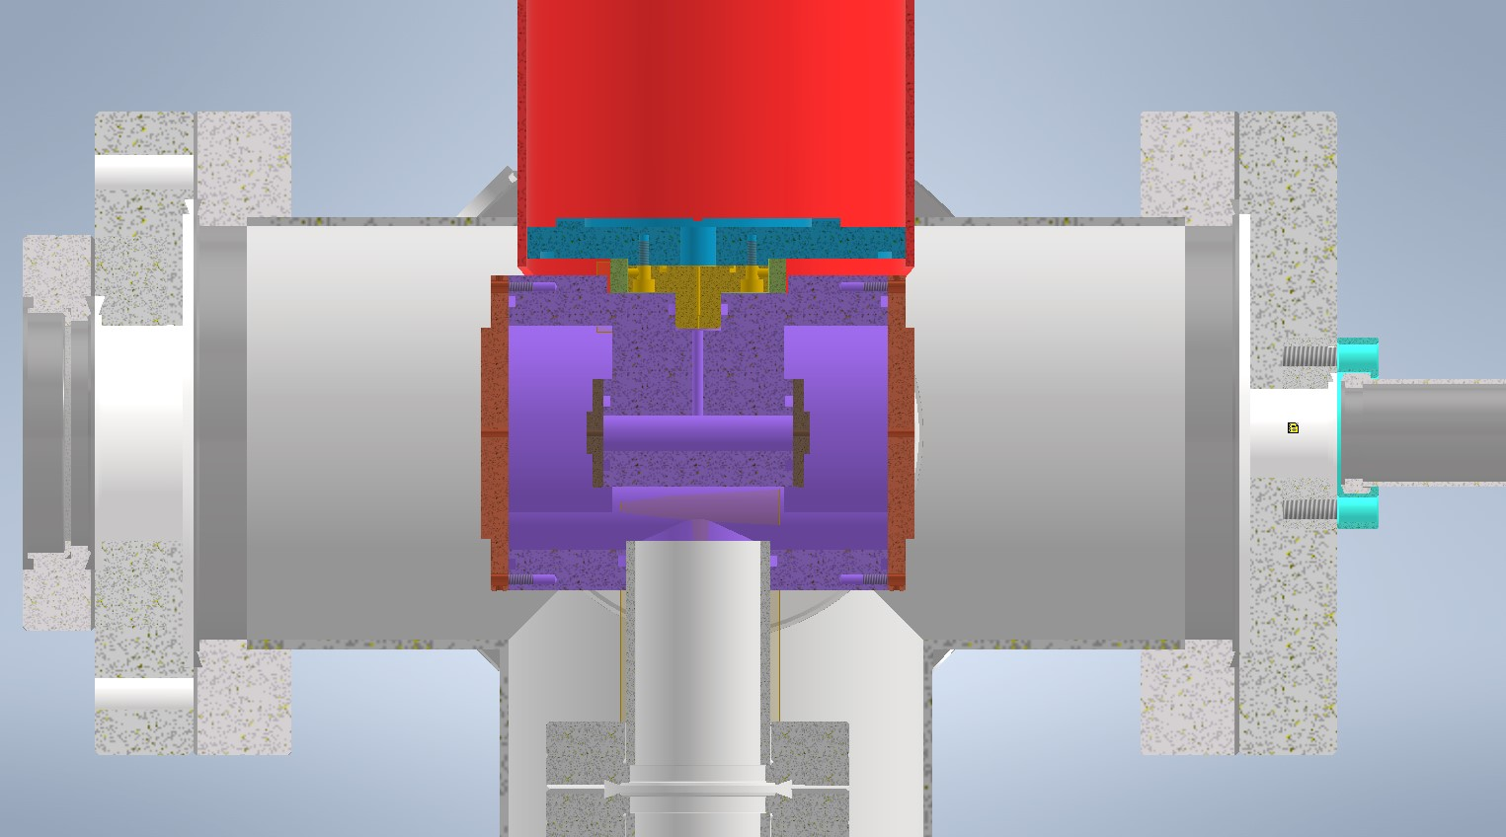
HHG apparatus
Kr, Ar
Ti:S
XUV
Gas cell schematic
Full HHG apparatus
Accelerator Facilities Division

Slide 14
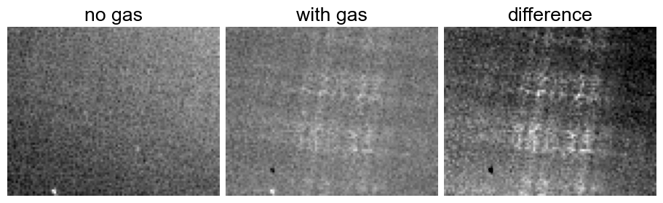
HHG commissioning
First HHG signal observed
Spectrometer camera had problems, manufacturer identified problem and repaired
Accelerator Facilities Division

Slide 15
Conclusion
Successfully demonstrated proof-of-principle generation of MIR light with Raman conversion + DFG
Characterized utility of ionic liquids for wavelength conversion
Demonstrated proof-of-principle high harmonic generation for XUV wavelengths

Slide 16
Products delivered
Journal publications
  R. Kupfer, F. Wang, J. F. Wishart, M. Babzien, M. N. Polyanskiy, I. V. Pogorelsky, T. Rao, L. Cultrera, N. Vafaei-Najafabadi, M. A. Palmer, “Raman Wavelength Conversion in Ionic Liquids”, Physical Review Applied 19, 014052 (2023)
Conference proceedings:
  W. H. Li, R. Kupfer, M. Babzien, L. Cultrera, M. N. Polyanskiy, I. V. Pogorelsky, T. Rao, N. Vafaei-Najafabadi, F. Wang, J. F. Wishart, and M. A. Palmer. "Raman Conversion in Calcite Crystals for Seeding CO2 Lasers," CLEO: Fundamental Science, San Jose, CA (USA), May 7-12, 2023
  W. H. Li, M. Babzien, M. Palmer, I. Pogorelsky, M. Polyanskiy, N. Vafaei-Najafabadi, F. Wang, and J. Wishart, “Optical Pump Generation for Long-wave Infrared Lasers for Advanced Acceleration”, International Particle Accelerator Conference, Nashville, TN, May 19-24, 2024
Conference presentations:
  R. Kupfer, F. Wang, J. F. Wishart, M. Babzien, M. N. Polyanskiy, I. V. Pogorelsky, W. Li, T. Rao, L. Cultrera, N. Vafaei-Najafabadi, and M. A. Palmer. "Raman Wavelength Conversions in Ionic Liquids," CLEO: Fundamental Science, San Jose, CA (USA), May 7-12, 2023
  W. H. Li, M. Babzien, L. Cultrera, R. Kupfer, I. V. Pogorelsky, M. N. Polyanskiy, F. Wang, J. F. Wishart, T. Rao, N. Vafaei-Najafabadi,, and M. A. Palmer. " Prospective methods for generating sub-picosecond long-wave infrared lasers for advanced accelerators," Physics and Applications of High Brightness Beams, San Sebastian, Spain, June 19-23, 2023
Poster presentations
  W. H. Li, M. Babzien, I. V. Pogorelsky, M. N. Polyanskiy, F. Wang, J. F. Wishart, N. Vafaei-Najafabadi, M. A. Palmer, “Optical pump generation for long-wave infrared lasers for wakefield accelerators”, Advanced Accelerator Concepts, Naperville, IL, July 21-26, 2024
Accelerator Facilities Division

Slide 17
Questions?
Accelerator Facilities Division

Slide 18
Backup slides
Accelerator Facilities Division

Slide 19
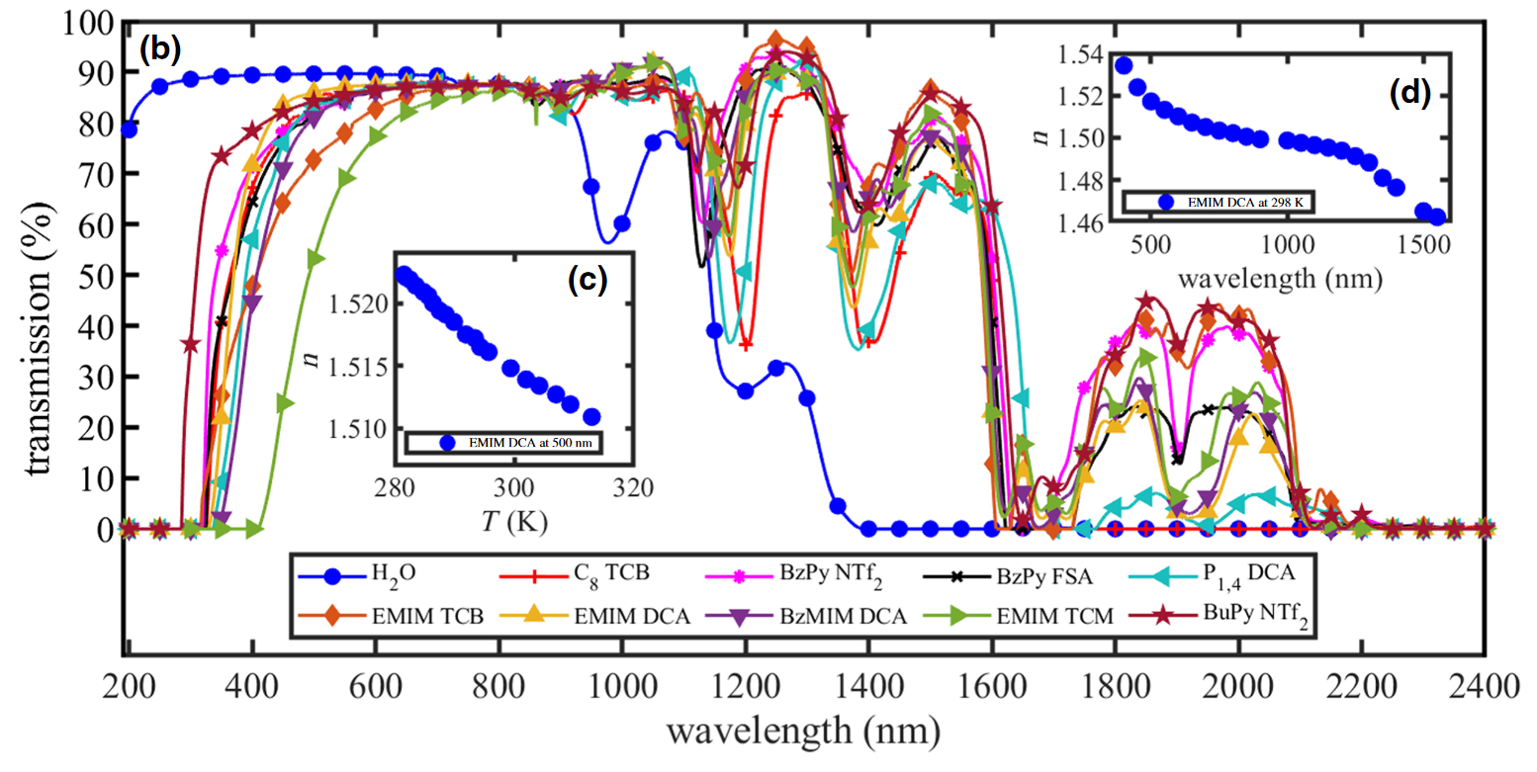
EMIM DCA transmission spectrum
Problem for using Nd:YAG fundamental
Absorption peak from overtones of aliphatic C-H bonds
Deuteration should shift this peak without affecting the Stokes shift, which comes from C-N triple bonds
Accelerator Facilities Division

Slide 20
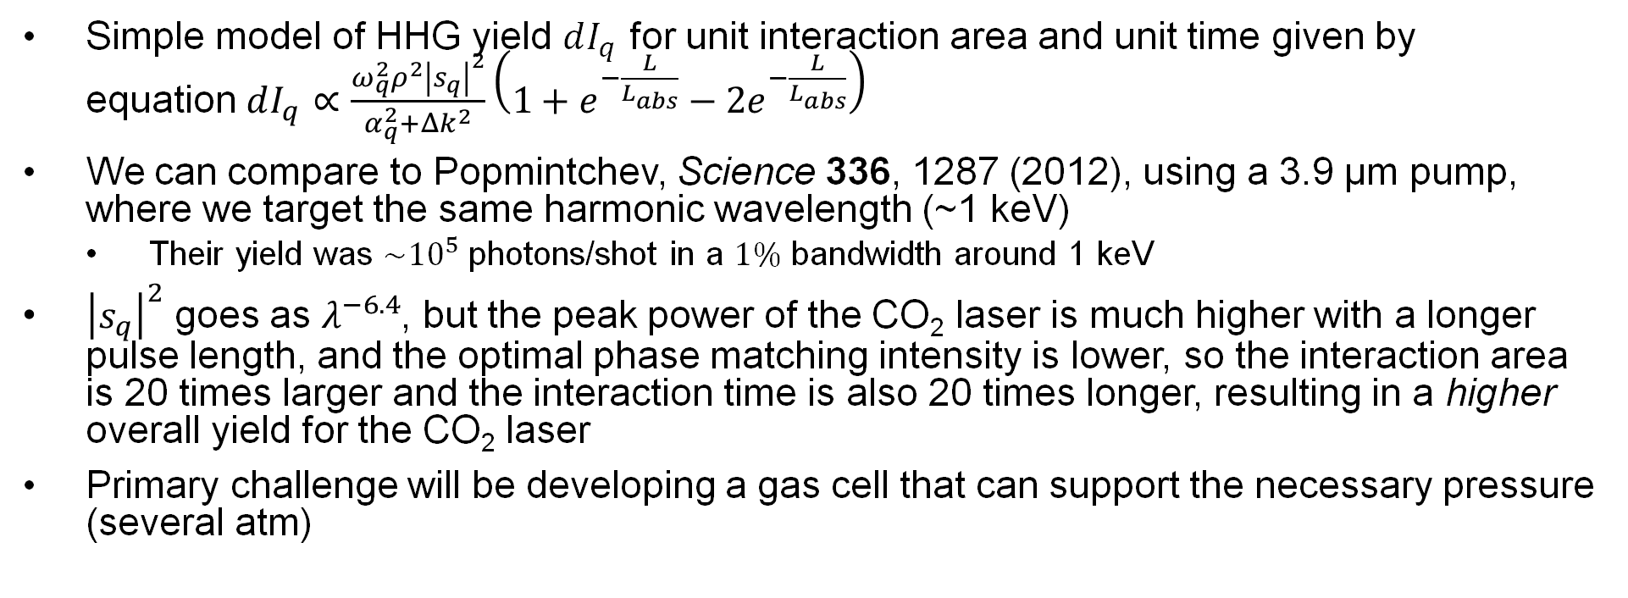
HHG Feasibility for CO₂
Simple model of HHG yield $dI_{q}$ for unit interaction area and unit time given by equation$dI_{q}∝\frac{ω_{q}^{2}ρ^{2}{\left|s_{q}\right|}^{2}}{α_{q}^{2}+Δk^{2}}\left(1+e^{−\frac{L}{L_{abs}}}−2e^{−\frac{L}{L_{abs}}}\right)$
We can compare to Popmintchev, Science 336, 1287 (2012), using a 3.9 μm pump, where we target the same harmonic wavelength (~1 keV)
  Their yield was $\sim {10}^{5}$ photons/shot in a $1\%$ bandwidth around 1 keV
${\left|s_{q}\right|}^{2}$ goes as $λ^{−6.4}$, but the peak power of the CO₂ laser is much higher with a longer pulse length, and the optimal phase matching intensity is lower, so the interaction area is 20 times larger and the interaction time is also 20 times longer, resulting in a higher overall yield for the CO₂ laser
Primary challenge will be developing a gas cell that can support the necessary pressure (several atm)
Accelerator Facilities Division

