Slide 1

27th Accelerator Test Facility (ATF) Users' Meeting ATF Introduction and FY24 Operations
Igor Pogorelsky
April 29 2025
Accelerator Facilities Division

Slide 2
ATF is now part of Discovery Technologies Directorate
Discovery Technologies Directorate
Gabriella Carini
Associate Laboratory Director
Instrumentation Department
Accelerator S&T Department
Mark Palmer
Department Chair
Microelectronics Department
Quantum Information S&T Department
Magnet Division
Accelerator Facilities Division
Mark Palmer (I)
Director
Accelerator Test Facility (bldg.820)
Igor Pogorelsky (I)
Director
LEAD Facility
(bldg. 912)
Sergey Schelkunov
Manager

Slide 3
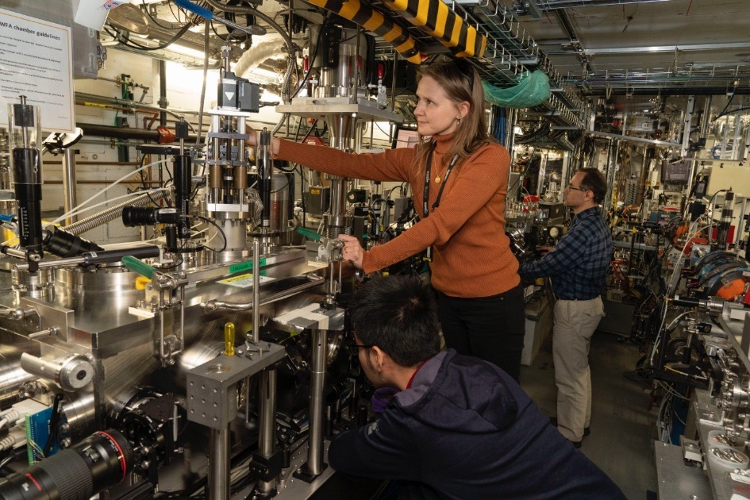
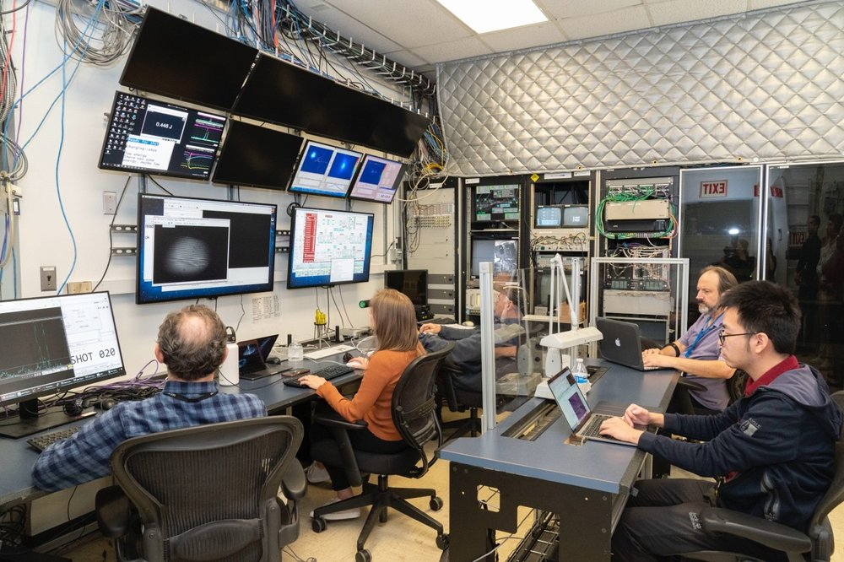
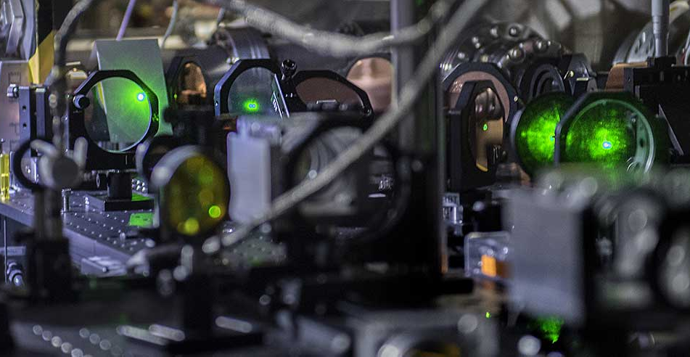
ATF provides users with…
Unique combination of high-peak-power lasers and
a high-brightness electron linac.
Facility footprint
Accelerator sections
Photocathode gun
Ti:Sapp and Nd:YAG lasers
operator
safety rep.
Experimental hall
users
Lasers
Control room

Slide 4
LWIR and NIR Laser Beam Delivery
Exp. Station #2
Exp. Station #3
Exp. Station #1
Polarization Rotator
Plasma Shutter
CPA Compressor
Notes:
High peak power requires in-vacuum laser beam delivery to experimental user stations. Gray pipes for LWIR, yellow for NIR beam delivery

Slide 5
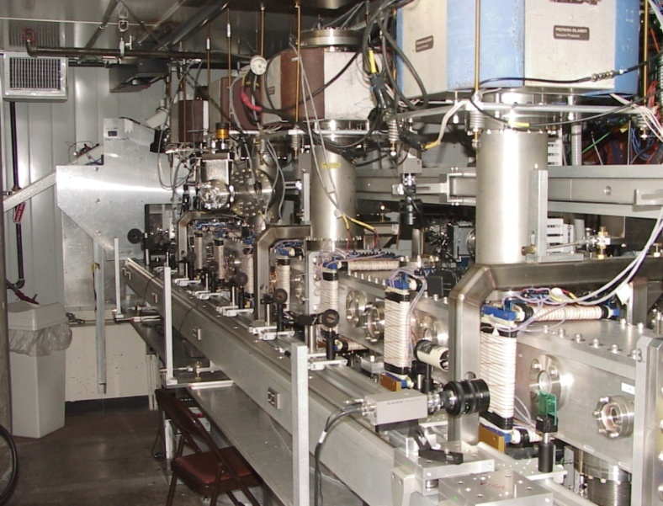
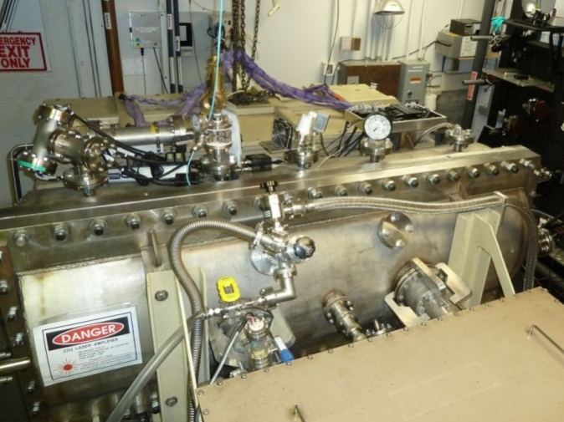
ATF Capabilities
LINAC
high-brightness photocathode
20-75 MeV,
energy spread 0.1%
norm. emittance 1μrad
repetition rate 1.5 Hz
single bunch 10 ps – 100 fs
charge ~1 nC
multi-bunch trains
LWIR Laser
high-pressure, isotopic, CPA, CO₂ λ = 9.2 μm
peak power 5 TW
pulse energy 10 J
max. repetition rate 0.05 Hz
NIR lasers
Ti:S λ = 0.8 μm and Nd:YAG λ = 1.06 μm
energy: 100 mJ 100 mJ
pulse width: 75 fs 14 ps
pulse FWHM 2.0 ps
single-shot
repetition rate 1.5 Hz

Slide 6
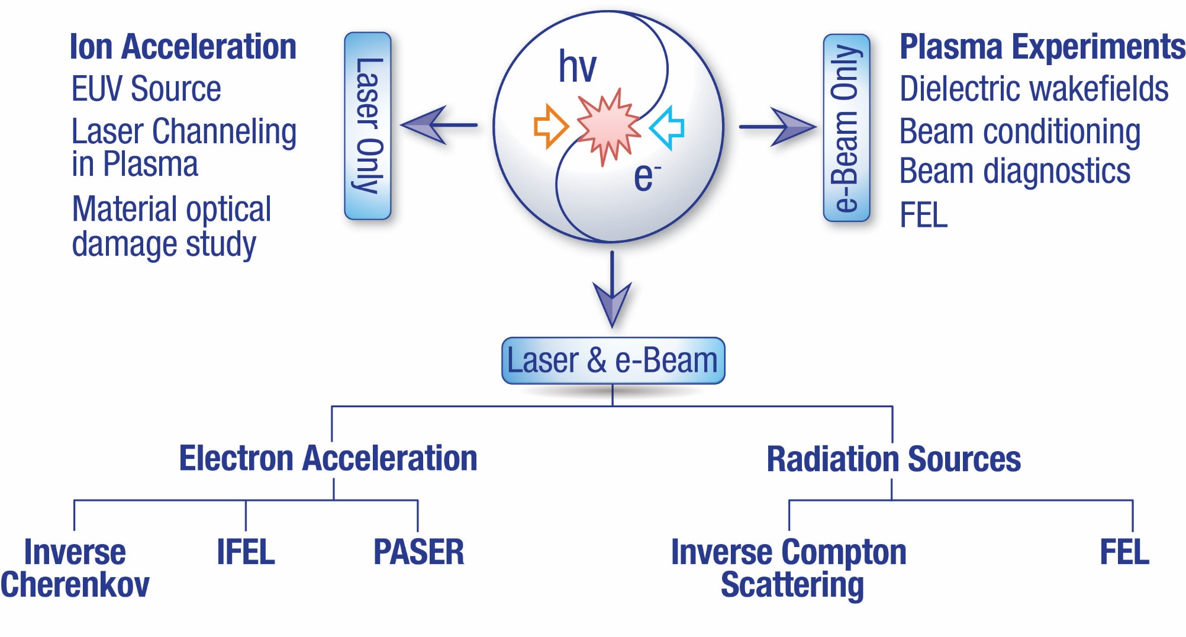
Combined laser and electron beams drive diverse program of user experiments
Active experiments grouped by capability use
AE108 – Development of Wavelength Conversion Techniques for Generation of Coherent Radiation at the Mid- to Long-wave Infrared, PI: M. Polyanskiy, BNL
AE119 – Radiofrequency Emission from 10 μm Short Pulse Laser Ionized Gases and Solids, PI: J. Elle, AFRL
AE125 – Broadband microwave emissions from LWIR picosecond laser ablation with pre-ionization, PI: A. Goers, JHU
AE126 – Remote detection of radioactive materials using long wave infrared laser-driven avalanche breakdown, PI: H. Milchberg, UMD
AE128 – Ionization Currents and Secondary Radiation from Two-Color Pulses at Long Laser Wavelengths, PI: A. Englesbe, NRL
AE132 – Benchmarking the Radiation Dose Simulator Around the CO2 Laser IP, PI:S. Rakhni, SLAC
AE133 – High‐intensity laser interactions with near‐critical density plasmas, PI: Z. Najmudin, Imperial College of London
AE138 – Enabling R&D for Advanced M/L-WIR Laser Concepts, PI: M. Polyanskiy, BNL
AE116 – Intelligent Laser Control with Uncertainty Quantification for Electron Beam Generation, PI: Aslam, UNM
AE124 – Simulation-aided Instrument Optimization using Artificial Intelligence and Machine Learning Methods, PI: M. Rakitin, BNL
AE130 – Novel Application of a Pulsed Electron Linear Accelerator as a Single Event Effects Simulator, PI:G. Allen, NASA-JPL
AE127 – Two Color Injection of Bright Electron Beams, PI: Vafaei-Hajafabadi, SBU
AE129 – Advanced Accelerator and Laser Laboratory Course, PI: M. Fedurin, BNL
AE131 – Harmonic Nonlinear Inverse Compton Scattering, PI: Y. Sakai, UCLA/BNL
AE134 – Optical probing of simultaneous Biermann battery and Weibel instability generated magnetic fields in over critical density plasma, PI: Chandu Joshi, UCLA
AF135 – Tunable Laser Positron Source, PI: Aakash Saha, University of Colorado – Denver
AE137 – Optical Diagnosis of CO2-laser Driven Plasma Wakes, PI: N. Vafaei-Hajafabadi, SBU

Slide 7
14 User Experiments received Beamtime in FY24
AE93 Direct Measurement of Fields and Radiation in the Self-Modulated Plasma Wakefield Regime, PI: N. Vafaei-Najafabadi, SUNY-SB
AE95 Optical Diagnosis of Self-Modulated CO2-laser Driven Plasma Wakes, PI: M. Downer, UT-Austin
AE100 The Study of High-Intensity Laser Pulse Interactions with Near-Critical Density Plasmas, PI: O. Ettlinger - Imperial College London
AE101 Optical Materials for Ultrahigh-Power Long-Wave Infrared Lasers, PI: M. Polyanskiy - BNL
AE108 Development of Wavelength Conversion Techniques for Generation of Coherent Radiation at the Mid- to Longwave Infrared, PI: W. Li, BNL
AE119 Radiofrequency Emission from 10 Micron Short Pulse Laser Ionized Gases and Solids, PI: J. Elle, AFRL
AE121 High-efficiency Laser-driven Electron Accelerator, PI: M. Fuchs, U. Nebraska-Lincoln
AE124 Simulation-aided Instrument Optimization using Artificial Intelligence and Machine Learning Methods, PI: M. Rakitin, BNL
AE127 Two Color Injection of Bright Electron Beams, PI: N. Vafaei-Najafabadi, SBU
AE128 Ionization Currents and Secondary Radiation from Two-Color Pulses at Long Laser Wavelengths, PI: A. Englesbe, NRL
AE131 Harmonic Nonlinear Inverse Compton Scattering, PI: Y. Sakai, UCLA
AE132 Benchmarking the Radiation Dose Simulator Around the CO2 Laser IP, PI:S. Rokni, SLAC
AE134 Optical probing of simultaneous Biermann battery and Weibel instability generated magnetic fields in over critical density plasma, PI: Chandu Joshi, UCLA
AE138 Enabling R&D for Advanced M/L-WIR Laser Concepts, PI: M. Polyanskiy, BNL
Notes:
ATF experiments receiving beam time in FY24:
AE93 Direct Measurement of Fields and Radiation in the Self-Modulated Plasma Wakefield Regime,
PI: N. Vafaei-Najafabadi, SUNY-SB
AE95 Optical Diagnosis of Self-Modulated CO2-laser Driven Plasm a Wakes, PI: M. Downer, UT-Austin
AE100 The Study of High-Intensity Laser Pulse Interactions with Near-Critical Density Plasmas,
PI: O. Ettlinger - Imperial College London
AE101 Optical Materials for Ultrahigh-Power Long-Wave Infrared Lasers, PI: M. Polyanskiy - BNL
AE108 Development of Wavelength Conversion Techniques for Generation of Coherent Radiation at the Mid- to Longwave
Infrared, PI: W. Li, BNL
AE119 Radiofrequency Emission from 10 Micron Short Pulse Laser Ionized Gases and Solids,
PI: J. Elle, AFRL
AE121 High-efficiency Laser-driven Electron Accelerator, PI: M. Fuchs, U. Nebraska-Lincoln
AE124 Simulation-aided Instrument Optimization using Artificial Intelligence and Machine Learning Methods, PI: M.
Rakitin, BNL
AE127 Two Color Injection of Bright Electron Beams, PI: N. Vafaei-Najafabadi, SBU
AE128 Ionization Currents and Secondary Radiation from Two-Color Pulses at Long Laser Wavelengths, PI: A.
Englesbe, NRL
AE131 Harmonic Nonlinear Inverse Compton Scattering, PI: Y. Sakai, UCLA
AE132 Benchmarking the Radiation Dose Simulator Around the CO2 Laser IP, PI:S. Rokni, SLAC
AE134 Optical probing of simultaneous Biermann battery and Weibel instability generated magnetic fields in over
critical density plasma, PI: Chandu Joshi, UCLA
AE138 Enabling R&D for Advanced M/L-WIR Laser Concepts, PI: M. Polyanskiy, BNL

Slide 8
ATF Operations in FY2024
26th UM
3rd SPW
Capability Plan Actual % of Planned
14 user experiments served in FY2024 adding to 130 user experiments served over three decades of ATF operation
2100 hours planned at the start of the fiscal year
We pushed to achieve 2531 of cumulative user hours (121% of planned) facing an extended ARR shutdown
Notes:
ATF schedule was affected by two shutdowns for remedial maintenance and ARR preparations. The ATF shut down on July 19, 2024 to start the transition to the new Accelerator Facilities Division Conduct of
Operations (ConOps) Program and to complete its legacy facility Accelerator Readiness Review process.
Karl will talk today in more detail.
Science Needs Workshop and annual User Meeting

Slide 9
Capability-by-Capability Statistics
Idle Time where setup for one capability precludes work on another
User Hours were maximized for the LWIR laser system exploiting its upgrades done in FY23.
Unscheduled Maintenance due to:
HVAC failure resulted in extended recovery of the LWIR front end
failure in our Nd:YAG laser amplifier heads with no commercial replacement which necessitated development of a custom repair
phase stability issues and output power degradation of LINAC and gun klystrons
Significant planned Down Time was incurred for both eBeam and NIR laser capabilities. This enabled upgrades, remedial maintenance work and extensive ARR preparations.
Notes:
Significant planned down time was incurred for both Electron Beam and NIR Laser Capabilities through the
course of year. This enabled remedial maintenance work and extensive ARR preparations to be carried out.
Operations time was maximized for the LWIR Laser system given the significant interest by users in exploiting its
upgraded capabilities that were commissioned in FY23.
the large fraction of experiments at the ATF
that now require access to multiple capabilities result in “Idle” time where setup for one capability may preclude
work on another. An example of this is laser setup being conducted in the ATF Experimental Hall such that
electron beam setup is precluded.

Slide 10
Dynamic Experimental Program
Active experiments prior UM #26
AE89 – Plasma Compression for Terawatt Long Wavelength Lasers, NRL (2018)
AE93 – Direct Measurement of Fields and Radiation in the Self-Modulated Plasma Wakefield Regime, SB (2018)
AE95 – Optical Diagnosis of Self-Modulated CO2-laser Driven Plasma Wakes, UT-Austin (2018)
AE98 – Probing Weibal istability , UCLA (2019)
AE99 – Directional X-ray radiation produced by an ultra-short period plasma magneto-static undulator, UCLA (2019)
AE100 – The Study of High-Intensity Laser Pulse Interactions with Near-Critical Density Plasmas, Imerial College (2019)
AE101 – Optical Materials for Ultrahigh-Power Long-Wave Infrared Lasers, BNL (2019)
AE108 – Development of Wavelength Conversion Techniques for Generation of Coherent Radiation at the Mid- to LWIR, BNL (2020)
AE116 – Intelligent Laser Control with Uncertainty Quantification for Electron Beam Generation, UNM (2020)
AE119 – Radiofrequency Emission from 10 Micron Short Pulse Laser Ionized Gases and Solids, AFRL (2021)
AE120 – Characterization of the Collinear Wakefield Accelerator Module, ANL (2021)
AE121 – High-efficiency Laser-driven Electron Accelerator, U. Nebraska-Lincoln (2021)
AE124 – Simulation-aided Instrument Optimization using Artificial Intelligence and Machine Learning Methods, BNL (2021)
AE125 – Broadband microwave emissions from LWIR picosecond laser ablation with pre-ionization, JHU (2022)
AE126 – Remote detection of radioactive materials using long wave infrared laser-driven avalanche breakdown, UMD (2022)
AE127 – Two Color Injection of Bright Electron Beams, SBU (2022)
AE128 – Ionization Currents and Secondary Radiation from Two-Color Pulses at Long Laser Wavelengths, NRL (2022)
AE129 – Advanced Accelerator and Laser Laboratory Course, BNL (2022)
AE130 – Novel Application of a Pulsed Electron Linear Accelerator as a Single Event Effects Simulator, NASA-JPL (2022)
AE131 – Harmonic Nonlinear Inverse Compton Scattering, UCLA (2022)
AE132 – Benchmarking the Radiation Dose Simulator Around the CO2 Laser IP, SLAC (2022)

Slide 11
Dynamic Experimental Program
At the UM #26
AE89 – Plasma Compression for Terawatt Long Wavelength Lasers, NRL (2018)
AE93 – Direct Measurement of Fields and Radiation in the Self-Modulated Plasma Wakefield Regime, SB (2018)
AE95 – Optical Diagnosis of Self-Modulated CO2-laser Driven Plasma Wakes, UT-Austin (2018)
AE98 – Probing Weibal istability , UCLA (2019)
AE99 – Directional X-ray radiation produced by an ultra-short period plasma magneto-static undulator, UCLA (2019)
AE100 – The Study of High-Intensity Laser Pulse Interactions with Near-Critical Density Plasmas, Imerial College (2019)
AE101 – Optical Materials for Ultrahigh-Power Long-Wave Infrared Lasers, BNL (2019)
AE108 – Development of Wavelength Conversion Techniques for Generation of Coherent Radiation at the Mid- to LWIR, BNL (2020)
AE116 – Intelligent Laser Control with Uncertainty Quantification for Electron Beam Generation, UNM (2020)
AE119 – Radiofrequency Emission from 10 Micron Short Pulse Laser Ionized Gases and Solids, AFRL (2021)
AE120 – Characterization of the Collinear Wakefield Accelerator Module, ANL (2021)
AE121 – High-efficiency Laser-driven Electron Accelerator, U. Nebraska-Lincoln (2021)
AE124 – Simulation-aided Instrument Optimization using Artificial Intelligence and Machine Learning Methods, BNL (2021)
AE125 – Broadband microwave emissions from LWIR picosecond laser ablation with pre-ionization, JHU (2022)
AE126 – Remote detection of radioactive materials using long wave infrared laser-driven avalanche breakdown, UMD (2022)
AE127 – Two Color Injection of Bright Electron Beams, SBU (2022)
AE128 – Ionization Currents and Secondary Radiation from Two-Color Pulses at Long Laser Wavelengths, NRL (2022)
AE129 – Advanced Accelerator and Laser Laboratory Course, BNL (2022)
AE130 – Novel Application of a Pulsed Electron Linear Accelerator as a Single Event Effects Simulator, NASA-JPL (2022)
AE131 – Harmonic Nonlinear Inverse Compton Scattering, UCLA (2022)
AE132 – Benchmarking the Radiation Dose Simulator Around the CO2 Laser IP, SLAC (2022)

Slide 12
Dynamic Experimental Program
At the UM #26
AE116 – Intelligent Laser Control with Uncertainty Quantification for Electron Beam Generation, UNM (2020)
AE119 – Radiofrequency Emission from 10 Micron Short Pulse Laser Ionized Gases and Solids, AFRL (2021)
AE120 – Characterization of the Collinear Wakefield Accelerator Module, ANL (2021)
AE121 – High-efficiency Laser-driven Electron Accelerator, U. Nebraska-Lincoln (2021)
AE124 – Simulation-aided Instrument Optimization using Artificial Intelligence and Machine Learning Methods, BNL (2021)
AE125 – Broadband microwave emissions from LWIR picosecond laser ablation with pre-ionization, JHU (2022)
AE126 – Remote detection of radioactive materials using long wave infrared laser-driven avalanche breakdown, UMD (2022)
AE127 – Two Color Injection of Bright Electron Beams, SBU (2022)
AE128 – Ionization Currents and Secondary Radiation from Two-Color Pulses at Long Laser Wavelengths, NRL (2022)
AE129 – Advanced Accelerator and Laser Laboratory Course, BNL (2022)
AE130 – Novel Application of a Pulsed Electron Linear Accelerator as a Single Event Effects Simulator, NASA-JPL (2022)
AE131 – Harmonic Nonlinear Inverse Compton Scattering, UCLA (2022)
AE132 – Benchmarking the Radiation Dose Simulator Around the CO2 Laser IP, SLAC (2022)
AE133 – High‐intensity laser interactions with near‐critical density plasmas, Imperial College of London (2024)
AE134 – Optical probing of Biermann battery and Weibel instability generated magnetic fields in over critical plasma, UCLA (2024)
AF135 – Tunable Laser Positron Source, University of Colorado – Denver (2024)
AE136 – Ultrafast Electron Radiography of LWFA, SBU (2024)
AE137 – Optical diagnosis of CO2-laser-driven plasma wakes, UT-Austin (2024)
AE138 – Enabling R&D for Advanced M/L-WIR Laser Concepts, BNL (2024)

Slide 13
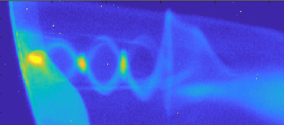
Recent Highlights
Plasma electron acceleration driven by
a long-wave-infrared laser, by AE95
Mapping the self-generated magnetic fields due to thermal Weibel instability, by AE98
Nature Communications
Proc. of National Acad. of Science

Slide 14
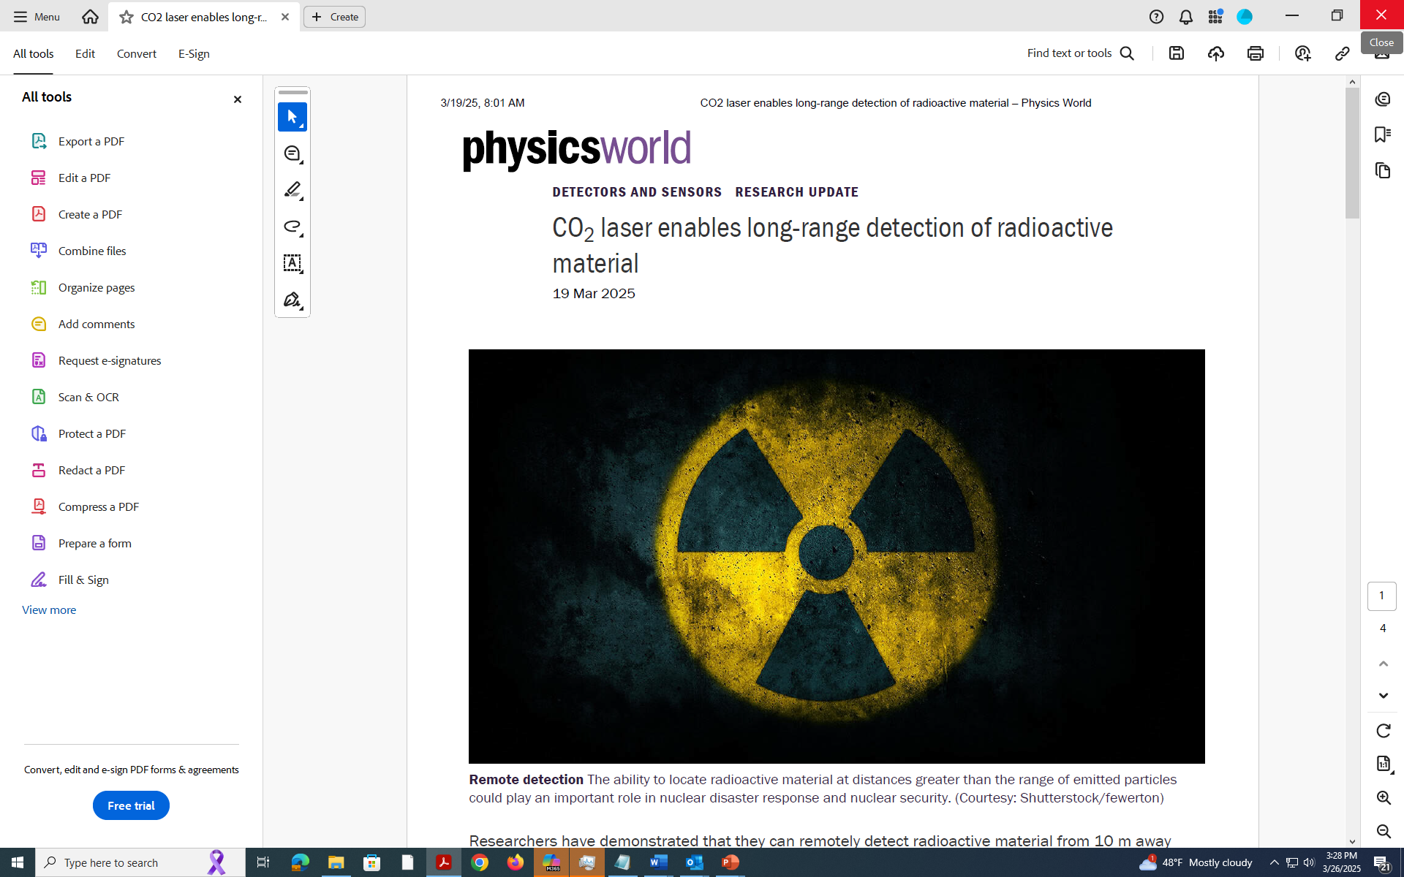
Recent Highlights
Remote Detection of Radioactive materials by AE126
700 fs
Post-compression of
TW LWIR Pulses by AE101
NaCl
BaF₂
KCl
2 ps
Frontiers in Physics

Slide 15
2024 ATF User and Facility Publications
Li, W. et al (2024). Direct Acceleration of an Electron Beam with a Radially Polarized Long-Wave Infrared Laser. Photonics, 11(11), 1066 https://dx.doi.org/10.3390/photonics11111066
Zholents, A. et al (2024). Fabrication and testing of the transition section between modules of a wakefield accelerator. Physical Review Accelerators and Beams https://dx.doi.org/10.1103/PhysRevAccelBeams.27.081303
Sakai, Y. et al (2024). Hard X-ray inverse Compton scattering at photon energy of 87.5 keV. Scientific Reports, 14(1), Article 18467 https://dx.doi.org/10.1038/s41598-024-68170-8
Polyanskiy, M. et al (2024). Plasma electron acceleration driven by a long-wave-infrared laser. Nature Communications, 15(1) https://dx.doi.org/10.1038/s41467-024-48413-y
Pogorelsky, I. et al (2024). Terawatt-Class Femtosecond Long-Wave Infrared Laser. Frontiers in Physics, 12 https://dx.doi.org/10.3389/fphy.2024.1390225
Polyanskiy, M. et al (2024). Nonlinear refraction and absorption properties of optical materials for high-peak-power long-wave-infrared lasers. Optical Materials Express, 14(3) https://dx.doi.org/10.1364/OME.513971
Polyanskiy, M. et al (2024). Refractiveindex.info database of optical constants. Scientific Data, 11, Article 94 https://dx.doi.org/10.1038/s41597-023-02898-2
Pogorelsky, I. et al (2024). Research Capabilities at Brookhaven Accelerator Test Facility, Bulletin of the American Physical Society, 2024 APS April Meeting, Abstract H16.00006, APS -2024 APS April Meeting - Event - Research Capabilities at Brookhaven Accelerator Test Facility
Wu, Y. et al (2024). Thermal Weibel instability induced magnetic fields co-exist with linear wakes in laser-ionized plasmas, Physics of Plasmas 31, 1070 https://doi.org/10.1063/5.0207697
Pogorelsky, I. et al (2024). Emerging Ultra-Fast Multi-Terawatt Long-Wave Infrared Lasers, High Intensity Lasers and High Field Phenomena, HTu2B. 6 https://doi.org/10.1364/HILAS.2024.HTu2B.6
Zgadzaj, R. et al (2024). I. Plasma electron acceleration driven by a long-wave-infrared laser, Nature Communications, 15, 4037 https://doi.org/10.1038/s41467-024-48413-y
Polyanskiy, M. et al (2024). n 2 Database and New Data on Nonlinear Optical Properties in Long-Wave Infrared, Conference on Lasers and Electro-Optics (CLEO) https://doi.org/10.1364/CLEO_SI.2024.SM2D.6
Zingale, A. & Pogorelsky, I. (2024). Remote detection of radioactive material using a short pulse CO2 laser, arXiv preprint arXiv:2408.13640 https://doi.org/10.48550/arXiv.2408.13640
Gaikwad, et al (2024). Field mapping of CO2-laser-driven LWFA at low density using electron beam probing, Bulletin of the American Physical Society INDICO-FNAL (Indico)
Choge, D. et al (2024). Picosecond laser damage thresholds of materials for high-peak-power LWIR laser applications, Laser-Induced Damage in Optical Materials PC1319010 https://doi.org/10.1117/12.3038369
We ask users to report publications and theses by the end of every year

Slide 16
Summary
NIR beam in-vacuum transport completed opening the feasibility to increase the deliverable power to 1 TW.
Successful tests of femtosecond LWIR regime.
ATF presently supports 19 active user experiments.
Cumulative user hours in FY2024 exceeded the plan by 21%.
Accelerator Readiness Review is the main topic of the ATF shutdowns in FY2024 and FY2025.

Slide 17
Questions?

