Slide 1

27th Accelerator Test Facility (ATF) Users' Meeting Facility Maintenance Status and Updates
Andrew Simmonds
April 29, 2025
Accelerator Facilities Division

Slide 2
ATF Facility Maintenance Status and Updates
Design Process
Configuration Control
B820
Laser Configuration
Capability and Safety Maintenance/Upgrades
Facility Upgrades
B912

Slide 3
Design Process
Scientific need is identified by the user community or AF staff member
A specification document is generated
Development of a conceptual design
Hold design review with AF staff and relevant outside experts
Conduct detailed design and structural analysis
Check & approval of drawings and critical analyses
Archival of drawings and analyses
Utilize matrixed support from Discovery Technologies for engineering and drafting

Slide 4
Configuration Control
For wider accessibility, SharePoint will host a drawing repository for reference only copies of relevant drawing packages
Radiation calculations are archived by the C-AD RSC
Shielding is approved by the C-AD RSC. The drawings are reviewed and approved before being archived in Windchill.
Utilize Windchill to release and archive controlled documents
The part numbering and controlled document release process are fully AF’s responsibility

Slide 5
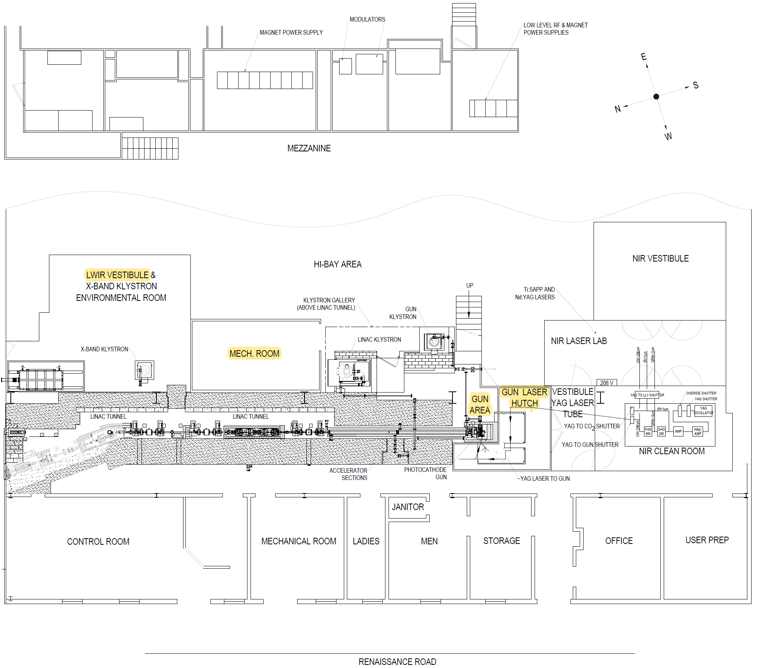
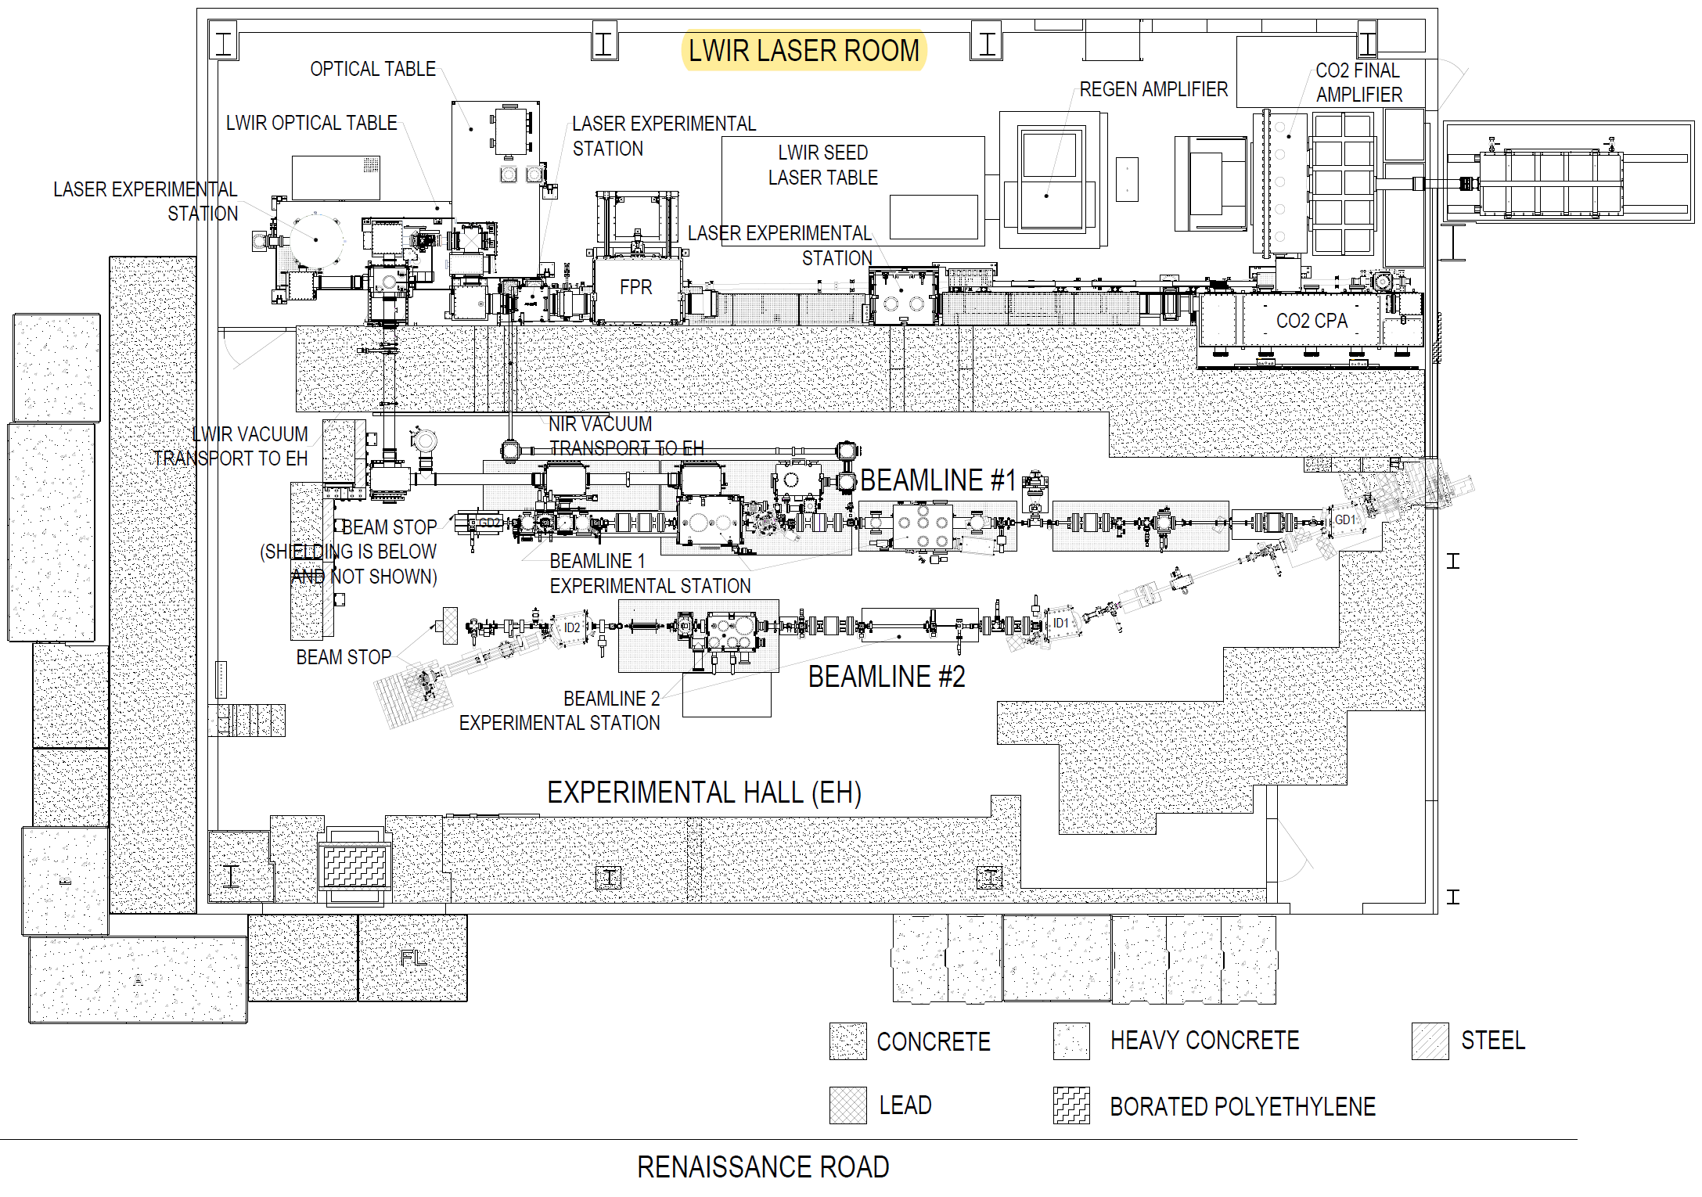
Room Names

Slide 6
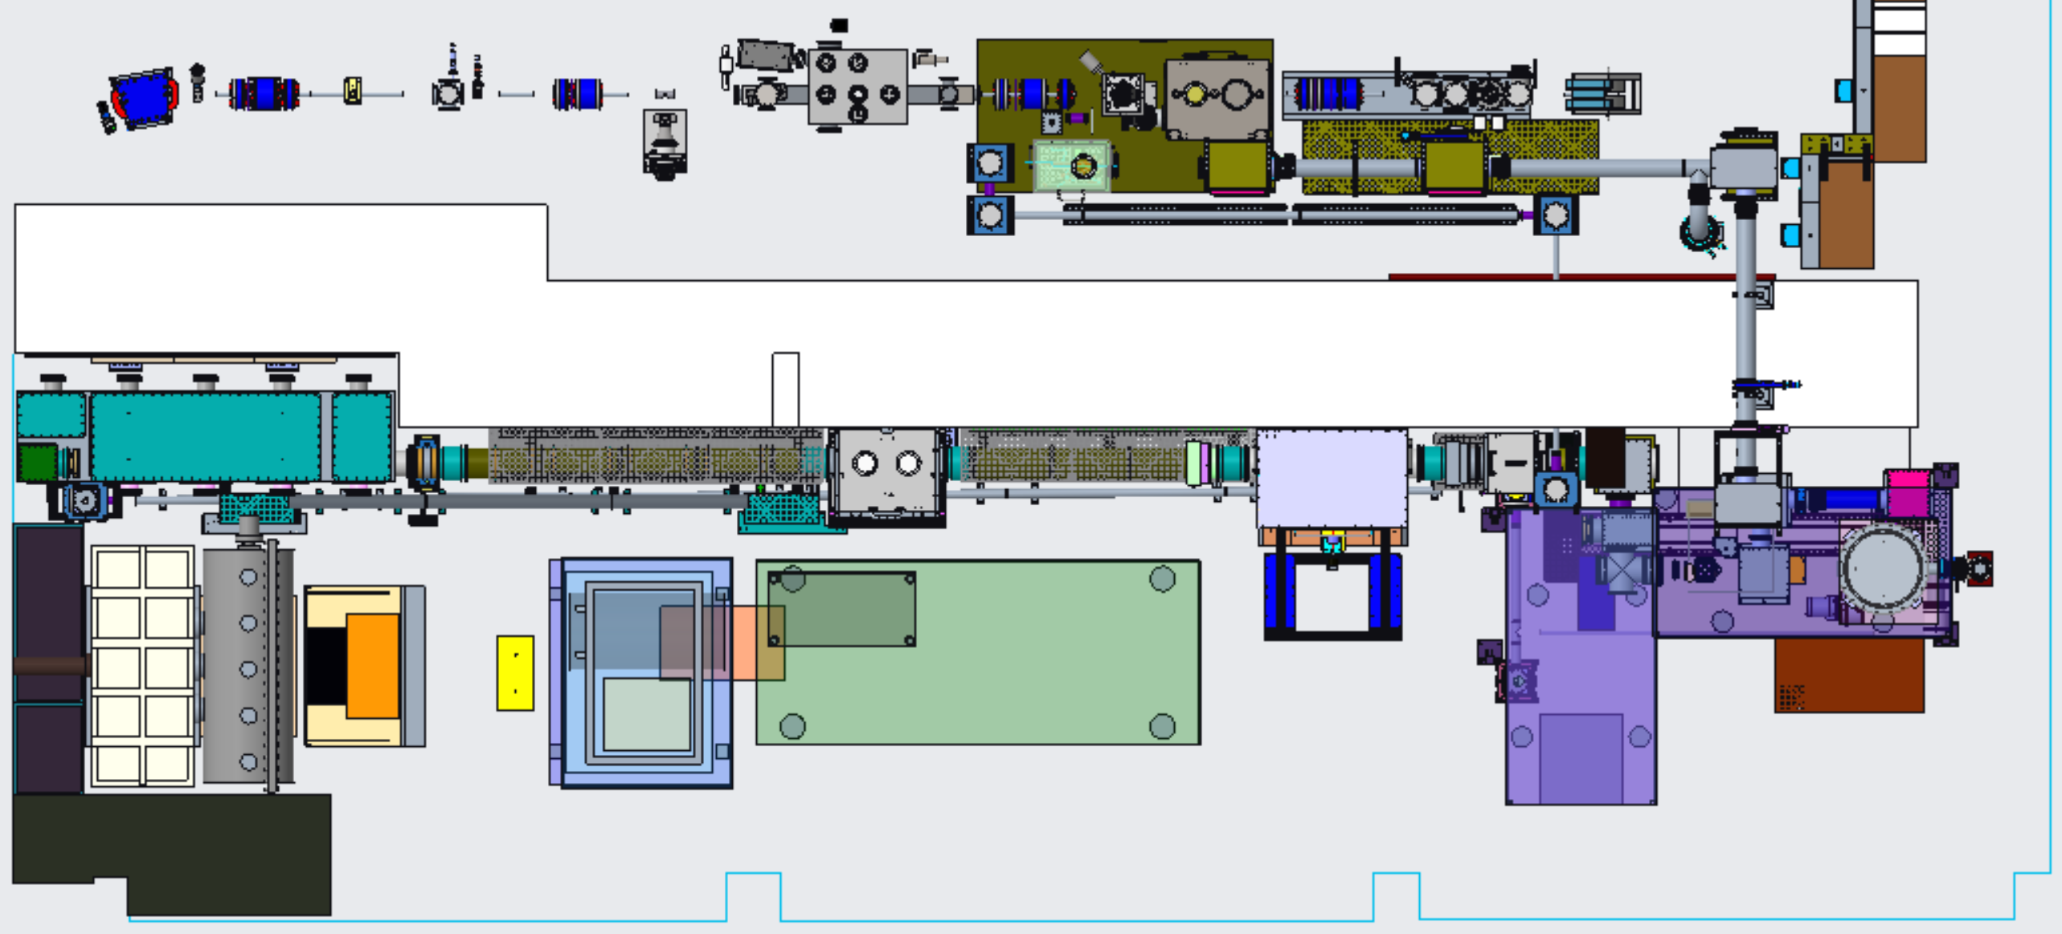
Present Laser Configuration
LWIR
Potential GV w/ window for LWIR alignment laser
NIR
Shielding wall
NLPC 1
NLPC 2
CPA Chamber
Seed Laser Table
Polarization Rotator Chamber
Final Amplifier

Slide 7
B820 Capability and Safety Maintenance/Upgrades
LWIR Final Amplifier exit window upgraded to BaF2. Jan 2025
Enables more favorable transmission properties.
LWIR Water Capacitor preventative maintenance inspection.
Previous repairs showed no signs of degradation and fluid was clear.
NIR upstream vacuum transport upgrade. Oct 2024
YAG laser head rebuilt after finding cracked flow tube.
Smoke alarms installed in the NIR and LWIR Vestibules. March 2025
Updated signage and labels throughout the facility.
B820 high bay blue room roof insulation material changed to meet fire codes, and roof load calculations performed for maintenance areas

Slide 8
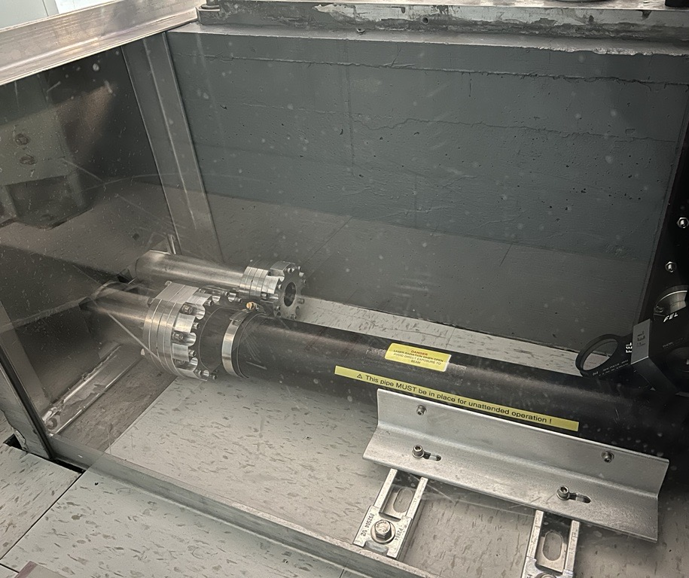
NIR Upstream Upgrade
Vacuum transport upgraded between the NIR Clean Room and the Gun Laser Hutch
Separated the two crossing beams into their own parallel vacuum transport lines
Increased aperture to alleviate clipping issues allowing for higher power transmission

Slide 9
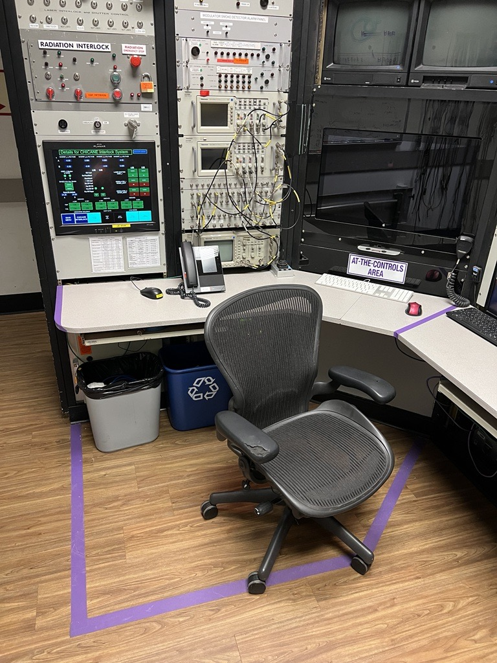
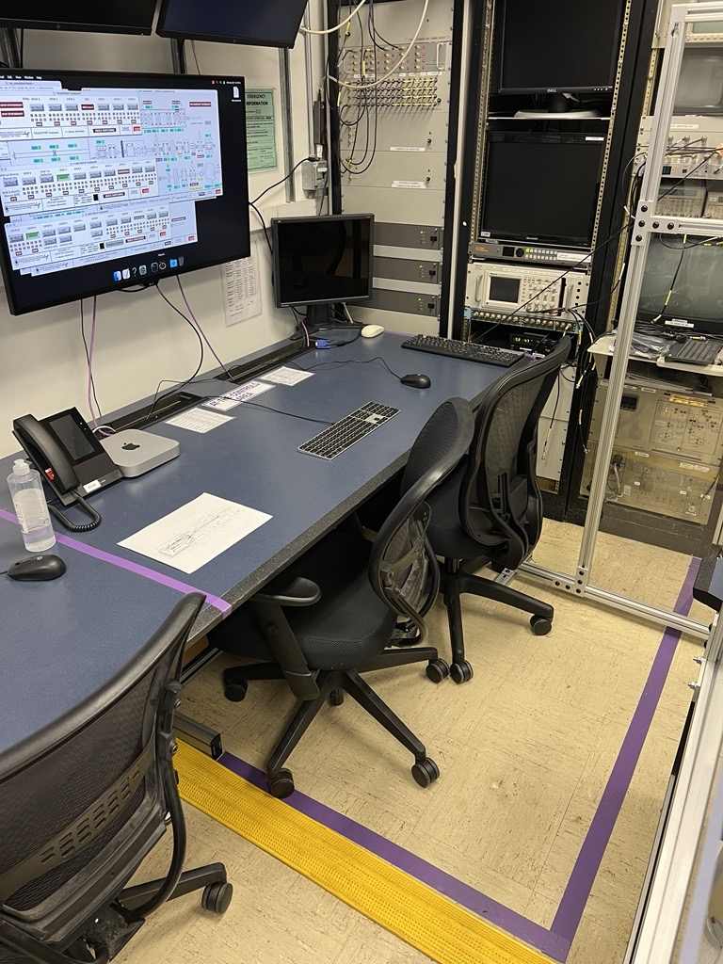
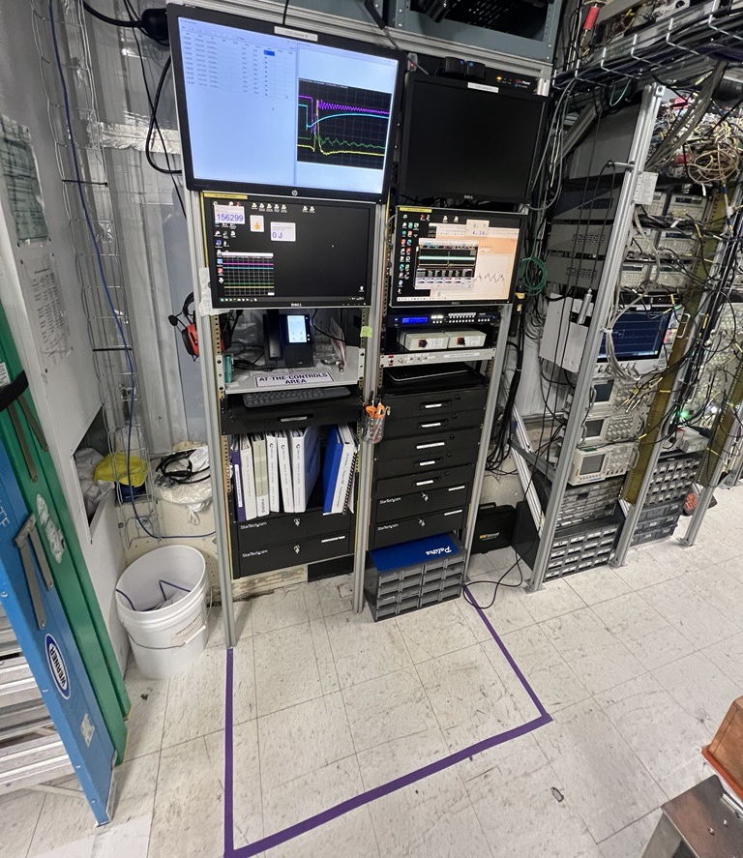
Updated signage
Notes:
As part of the updated ConOps we are updating our signage throughout the facility. These are the at the controls areas signifying that a capability is run from within the markings and that brings with it certain requirements.

Slide 10
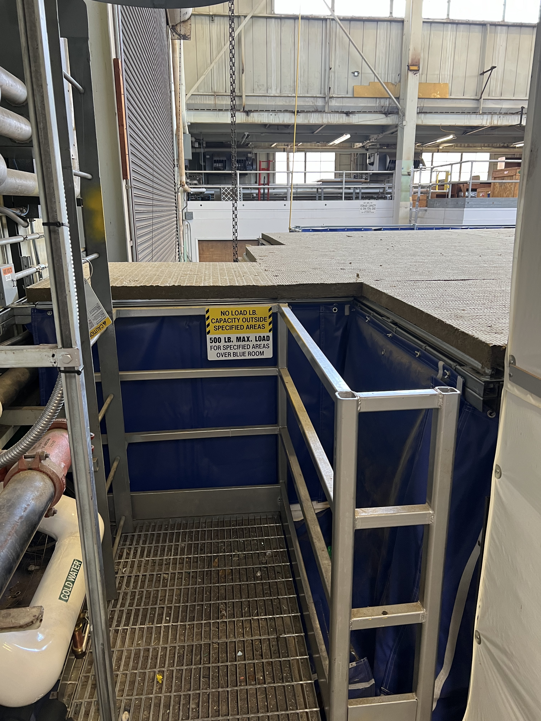
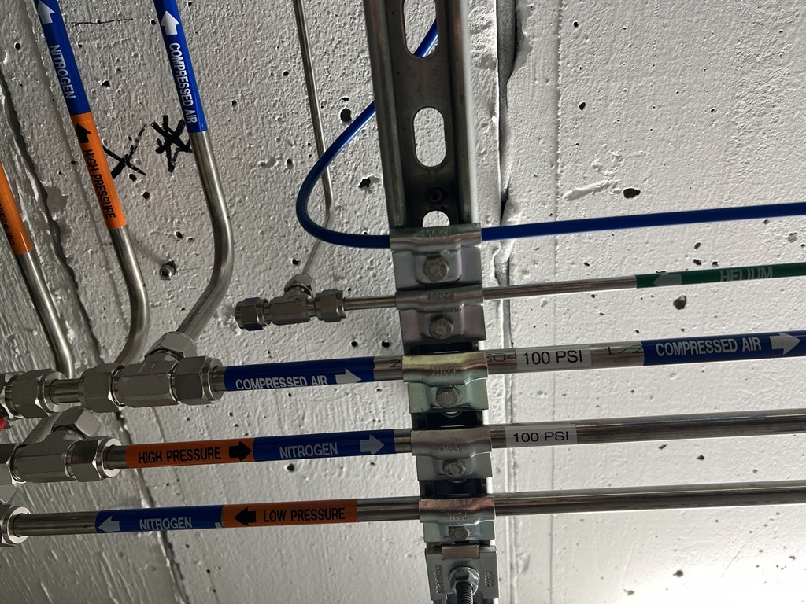
Updated signage cont’d
Notes:
These gas line markings and load sign are a couple more examples

Slide 11
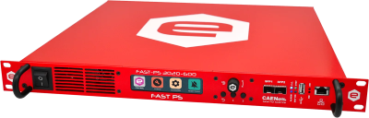
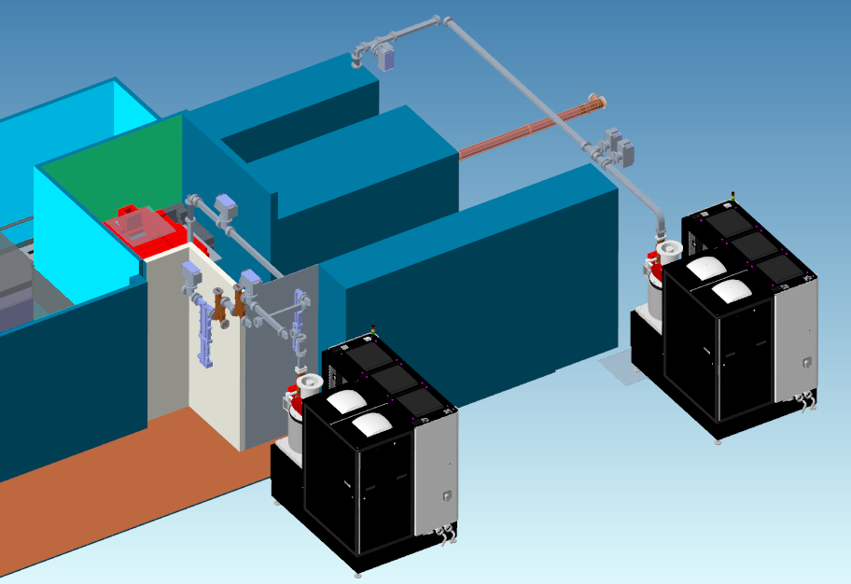
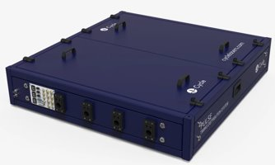
Future ATF LINAC Upgrades
Next Generation CAEN PS
System for ATF Magnets
Continuing focus on replacement of aging LINAC hardware (XK-5 klystron, old-style modulators, and magnet systems) and timing systems to enable a true multi-beam operations with 10s of femtoseconds resolution
Cycle- Femtosecond Class
Timing Distribution

Slide 12
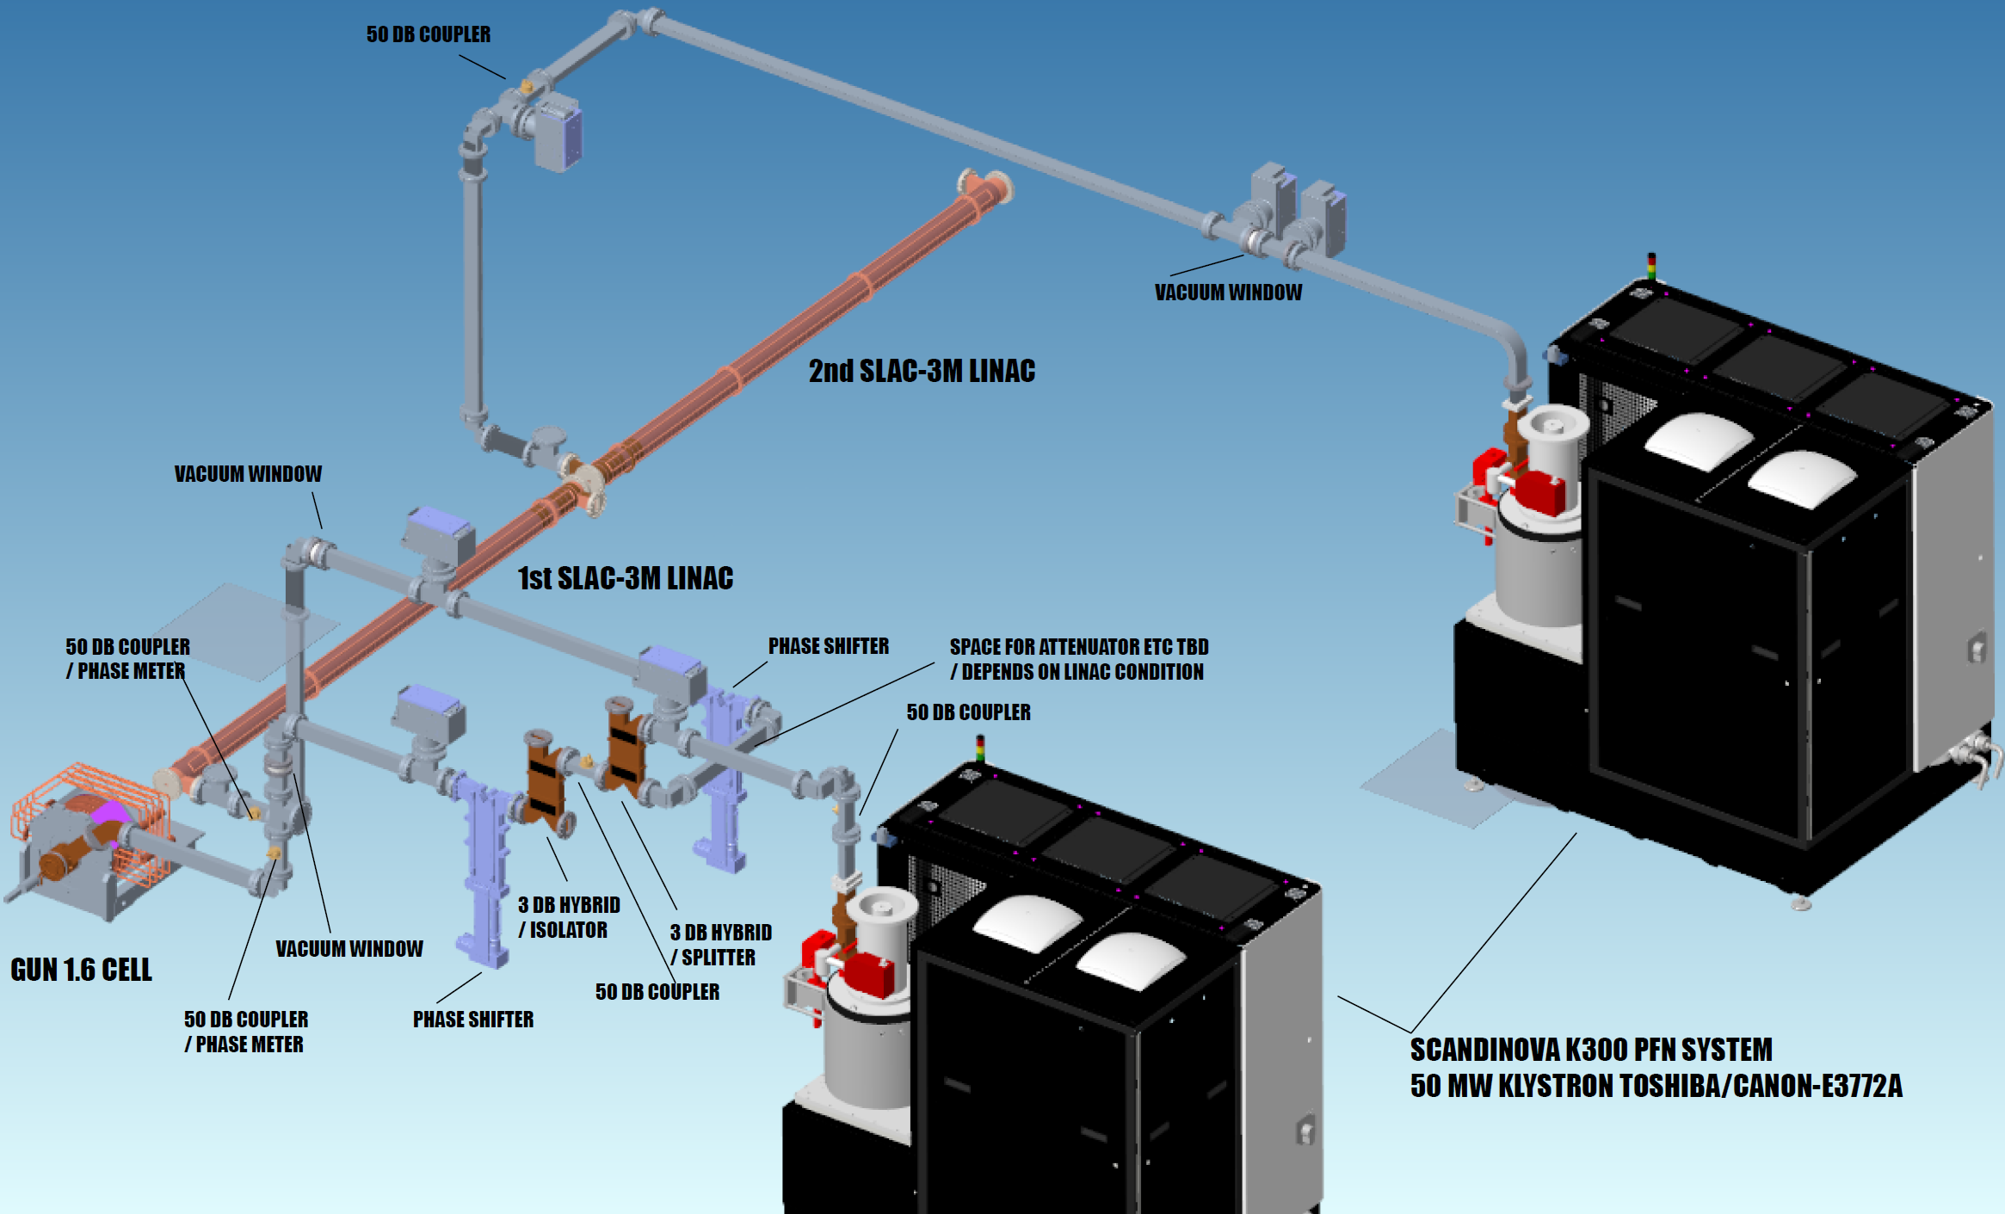
Future ATF LINAC Upgrades cont’d
Notes:
Current design includes 2 Scandinova K300s. The first powers the gun and LINAC section 1. The second powers the second LINAC section. These would be installed on the high bay floor rather than on the mezzanine to reduce the length of waveguide. This design also aims to minimize the amount of required shielding changes to retain as short as possible installation time

Slide 13
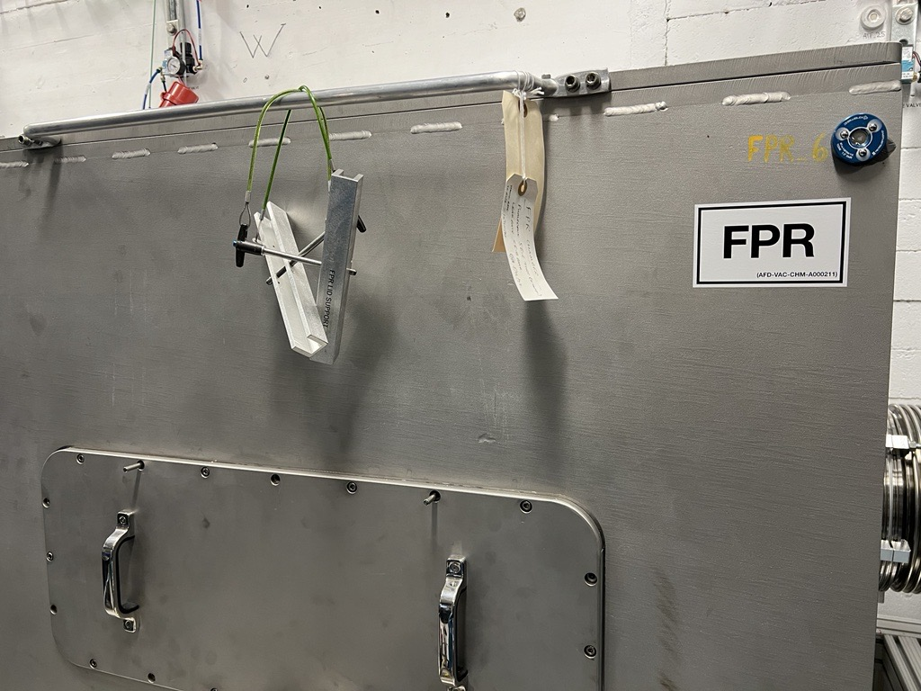
Updates to Areas Accessible by Users
Rolling out standard labels on key vacuum chambers
These identify the common name as well as the drawing number where more information can be found
Due to cybersecurity and operational requirements, more doors are required to be locked. LWIR room from the High Bay, push button lock matching the Control Room
Notes:
These drawings will be available on SharePoint once fully implemented.
Most notable to Users is the door into the LWIR room from the High Bay.

Slide 14
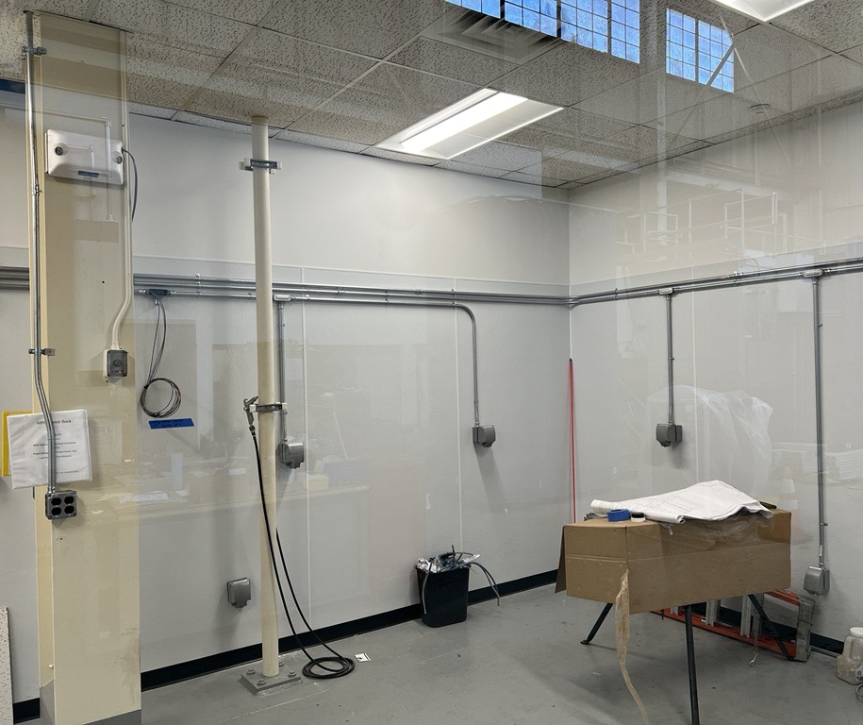
New Machine Shop Progress
Installation Underway
FRP wall panels installation complete. These aid in maintaining a clean shop.
Electrical installation is underway.
Machines are on hand awaiting installation.
Notes:
At least a few more weeks on electrical installation

Slide 15
HVAC systems
Carrier Chiller servicing the Experimental Areas
Previously unused immersion heaters were connected and put into service.
This should help with reducing failures.
Spare Parts Program
Introduced in response to an unacceptable number of interruptions due to down time of the HVAC system servicing the Experimental areas.
Spare parts are stored on site to reduce down time in the event of a failure
Notes:
Recently experienced many issues with our HVAC servicing Experimental areas

Slide 16
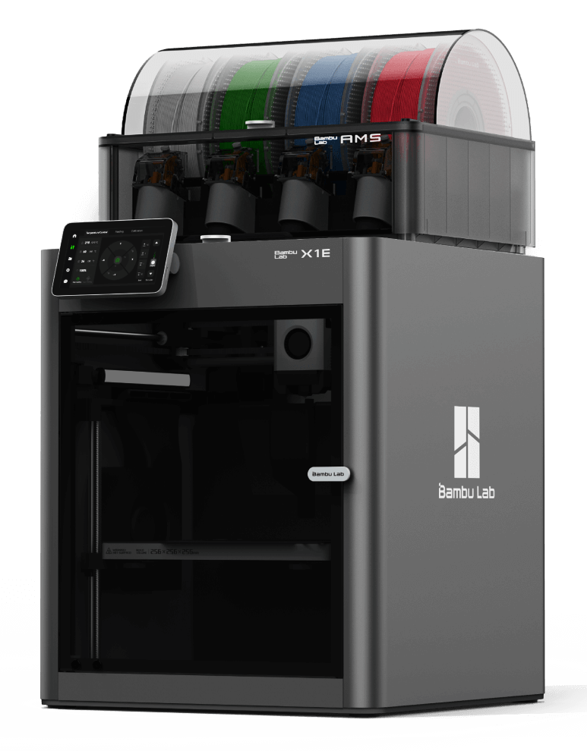
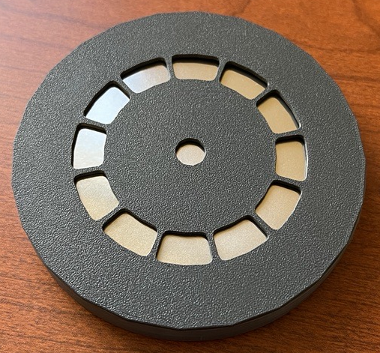
3D Print Capability
BambuLab X1E
FDM printer
AMS material changer
Notes:
Allows us an easier and faster prototyping. This is a printed foil clamp we used to practice installation of the foil for an upcoming project. We were able to quickly iterate the foil shape we start with to improve the final product much faster than with our traditional prototype machining.

Slide 17
Background efforts
The Engineering and Design group has been very busy updating our documentation
Long list of older documents are being reviewed and modernized
LINAC tunnel area
Gun area
Gun shielding
Klystron area
Radiation simulations are being performed with the new models to confirm old calculations in key areas
Notes:
Modernization includes higher fidelity models & drawings

Slide 18
ATF Summary Next Steps
FY25-26
Major focus on further improvements in Electron Beam Performance as strongly driven by user needs
LINAC RF system improvements
Pulse compression (to better match with combined e-beam/laser requests)
Short-pulse diagnostics
Continue facility-level corrective action plans (CAPs) as developed during ARR process
Example: Electrical Systems CAP will continue for multiple years
Facility Upgrade Proposal – a few identified thrusts
Path to <500 fs & >20 TW LWIR capabilities
Dedicated shielded research space to pursue laser-only particle source experiments
Further development of multi-beam research capabilities
Dedicated IPs
Improved multi-beam timing and synchronization
LWIR rep-rate path

Slide 19
B912 LEAD Facility
UED
Planning for beamline extension
Designing deployment of new highly stable solid-state modulator and klystron
AS&T Research Bunkers
Planning installation of a new shielding penetration for S-band waveguide

Slide 20
Questions?

