Slide 1

27th Accelerator Test Facility (ATF) Users' Meeting FY25-26 Running Plans
Igor Pogorelsky
April 29 2025
Accelerator Facilities Division

Slide 2
Impacts on FY25-26 planning
Main contributing factors and prerequisites:
Passing Accelerator Readiness Review (ARR) in 2025
Taking over the Conduct of Operations Program from the CAD safety management
Accelerator Facilities Division (AF) is part of a new BeamNet US
Part of a new Discovery Technologies Directorate
Office of Accelerator R&D and Production (ARDAP) is re-absorbed into HEP

Slide 3
Impacts on FY25-26 planning
Pre-start shutdown:
27th UM
IRR
ARR
The ATF is in shut down since July19 2024 in preparation to ARR and putting new ConOps in place.
IRR and ARR still impose major uncertainty on scheduling the FY25 experimental campaign (see K. Kusche talk)
Over the same time period, the ATF team has also invested significant effort in:
completing its review of as-built characteristics of the facility,
updating radiation simulations,
finalizing and executing corrective action plan,
conducting remedial maintenance program to reduce the facility exposure to aging hardware,
started executing a plan for major LINAC refurbishment
(see A. Simmonds talk)
Wrapping up the shutdown:
IRR – anticipated for May
ARR – tentatively take place in June
We hope that authorization to operate will be in hand by July
Highly dependent on whether there are required pre-start actions
.

Slide 4
FY25-26 Running Plans
FY25
27th UM
IRR
ARR
FY26
Our current planning assumptions:
Begin Return to Operations process in the July 2025 timeframe.
Provide User Operations during FY25 Q4.
Continue the run period through FY26 Q1
We target delivery of 1500 user hours in FY25.
We now have additional staff in place to support operations for 6 days/week, in contrast to the current 5 days/week model. The new staff members are in the process of being trained .
FY26 running plan under construction, tentatively 2000-3000 user hours subject to funding.
Ultimately, we would like to aim for delivery of 3500 user hours/year when our remedial maintenance program is completed

Slide 5
Investments into Future
In response to the scientific plan outlined by Science Planning Workshops (last one in June 2024), the facility is focused on development of capabilities with highest scientific payoff:
Implementation of integrated femtosecond (Ti:Sapphire) laser for enabling key experiments in accelerator science and plasma physics.
R&D in LWIR laser technologies to achieve ~20 TW, <1 ps in LWIR.
Improved stability of the e-beam to fully take advantage of its capability as a science driver as well as multi-beam integrated experiments.
Develop AI/ML for smarter integration of ATF capabilities in user experiments
Done
1 year
3-5 years
2-3 years
2 years and forward

Slide 6

ATF Engagement into New Initiatives
Separate from ATF User program
Targeted to communities not traditionally engaged largely unaware of DOE supported research opportunities
First BeamNetUS user proposals received for ATF and UED
1st pilot run in FY26 Q1
stronger engagement starting FY27 including LEAD facility
6

Slide 7
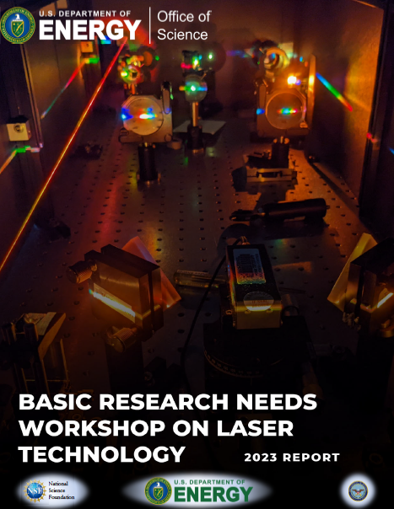
ATF Engagement into New Initiatives
In response to BRNW, we plan to submit the ATF upgrade proposal
Combined with the input from ATF Science Planning Workshops, the proposal will build up a long-term facility strategy
7

Slide 8

Questions?
Accelerator Facilities Division

