Slide 1

27th Accelerator Test Facility (ATF) Users' Meeting
Logistics and Opening Remarks
Igor Pogorelsky
April 29 2025
Accelerator Facilities Division

Slide 2
Welcome
It is great to see those who are here in person
We appreciate all of those participating remotely
We are looking forward to three days of presentations
  from active and completed experiments
  new ideas for next ATF experiments
  informative facility reviews

Slide 3
What to expect
~30 presentations:
  Status Reports - 9 x 20 min
  Closeouts - 5 x 25 min
  New Proposals - 7 x 30 min
  Facility Presentations - 8 x 15-20 min
  In order to streamline the agenda, experiments that did not receive time in the last year aren’t required to report unless they have special developments to relate.

Slide 4
Agenda at a Glance
Notes:
Tuesday
AM – General ATF and HEP updates
Lunch on your own
PM – Experimental Status and Closeout Reports
UM Dinner at Cooperage Inn
Wednesday
AM – Experimental Status Reports
Lunch on your own
PM – Experimental Status Reports
Thursday
AM – New Proposals
Lunch on your own
PM – Closeout talks
ATF Tour starting at 3pm

Slide 5
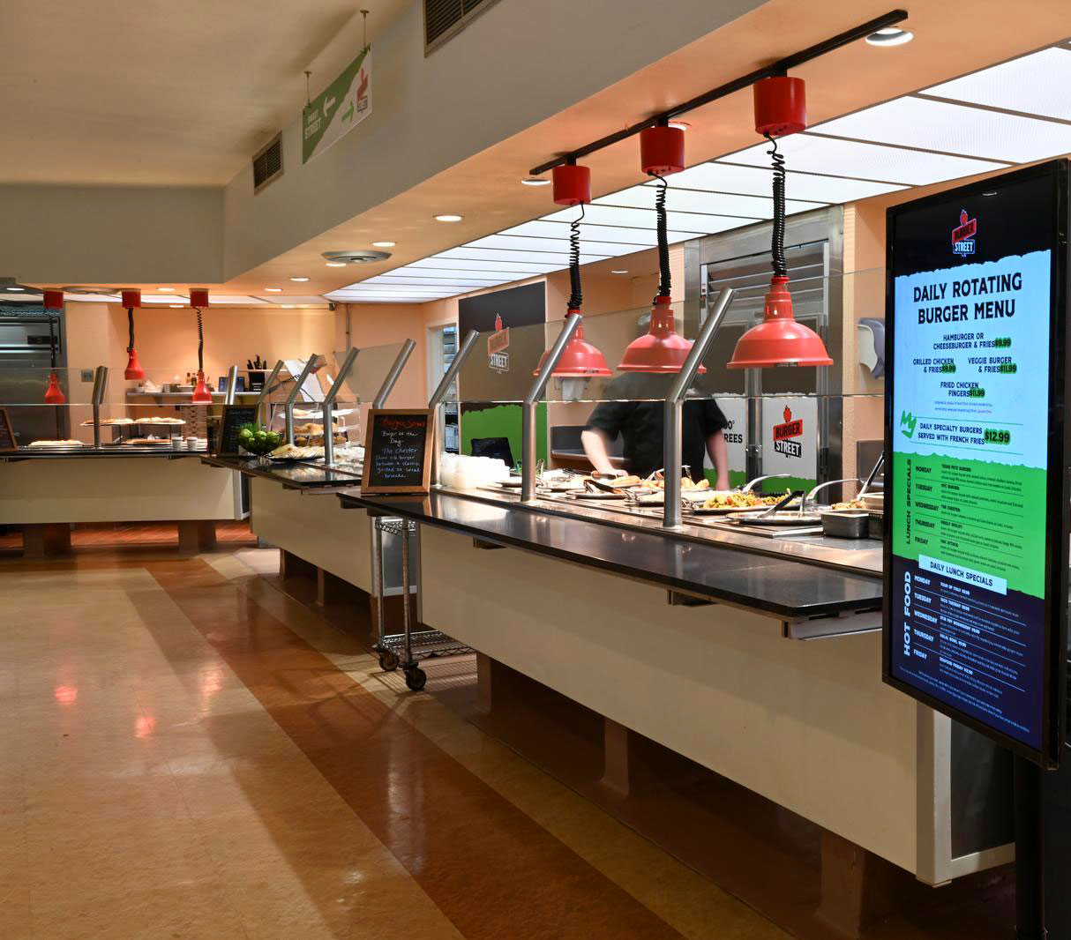
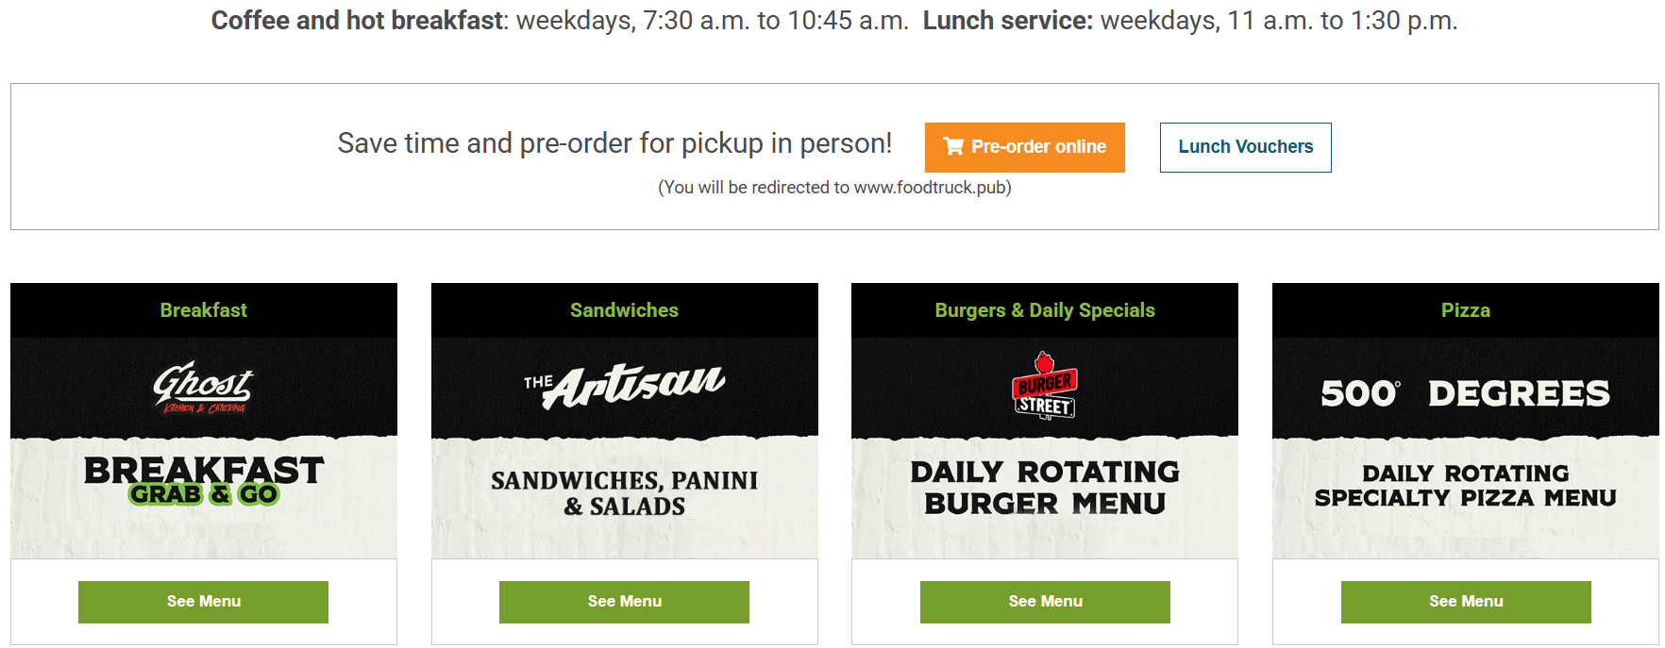
Lunch at Berkner Hall Cafeteria
BNL | Berkner Hall Cafeteria
www.foodtruck.pub

Slide 6
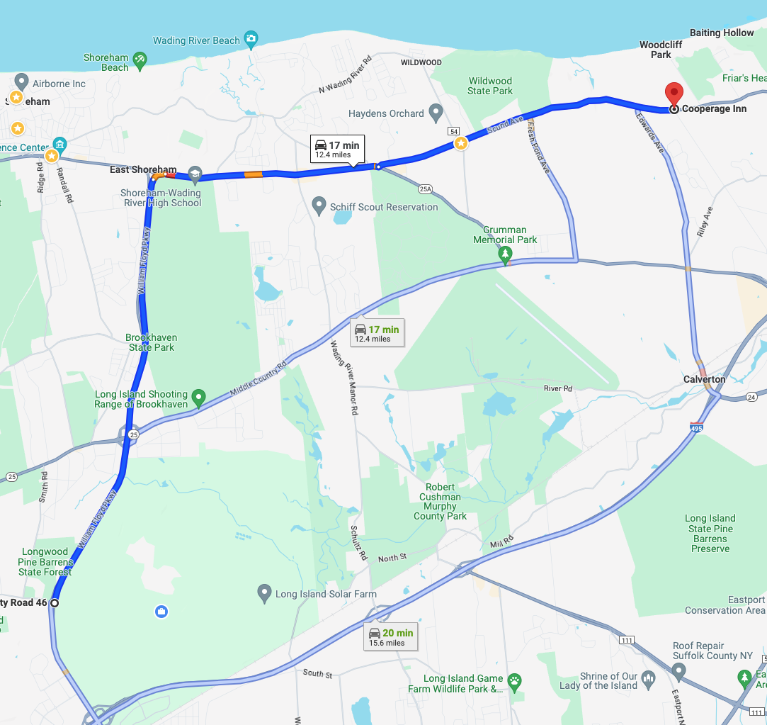
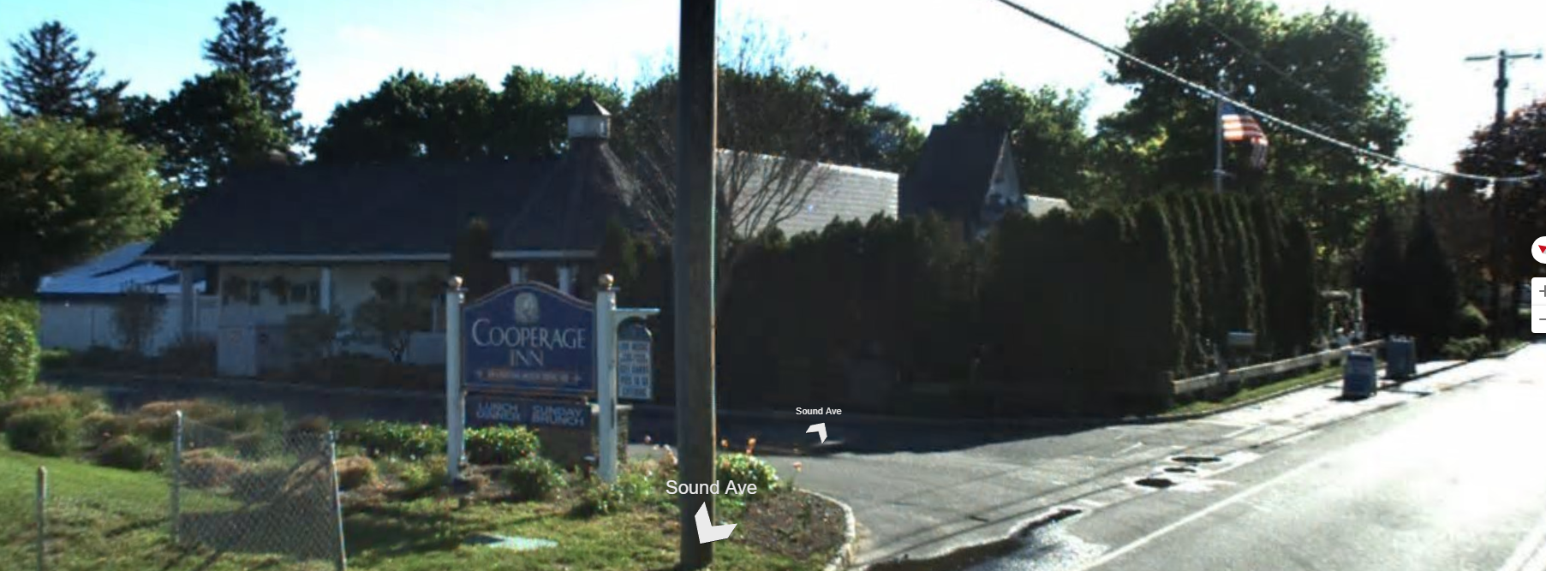
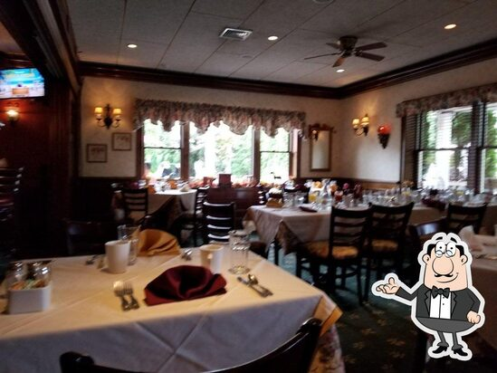
No-host Dinner
Cooperage Inn
6 pm this evening
2218 Sound Ave
Baiting Hollow, NY 11933
Lab main
entrance

Slide 7
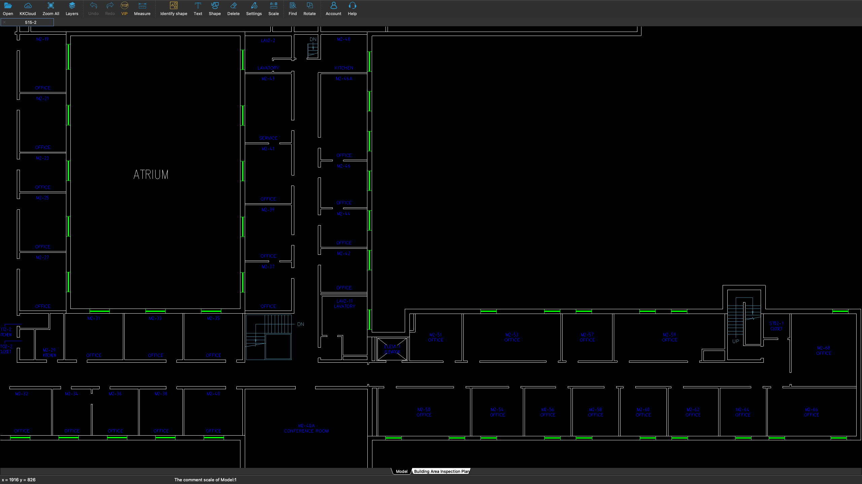
Safety First
Closest building exit is just down the stairs and out the front door.
Additional stairwells at ends of 2 hallways
We are here
7

