Slide 1
RCDAQ->Jana2 (mlp, Derek, Kolja)
Derek and I have tentatively agreed on a plan for an full ePIC in-house analysis chain
Kolja is now part-time with sPHENIX is often within a 30-foot radius of me in 1008, valuable local expertise
We will take the ePIC Barrel HCal data we took in 2022 and use them for the RCDAQ->Jana2 integration (right format, ePIC detector, etc etc)
The same chain will work for the ROC data that are now also in RCDAQ format
Here is from Derek’s and my email exchange -
Slide 3 in this presentation
here are the shortcuts -
/sphenix/data/data02/sphenix/hcal/1008/cosmics/cosmics_s2-00000073-0000.evt (before we were correctly timed in, that's the left plot on slide 18), and
/sphenix/data/data02/sphenix/hcal/1008/cosmics/cosmics_s2-00000100-0000.evt (now we were correctly timed in, right plot).
The copy of the code that was run in 1008 back then is preserved in /phenix/u/purschke/standalone_hcal

Slide 2
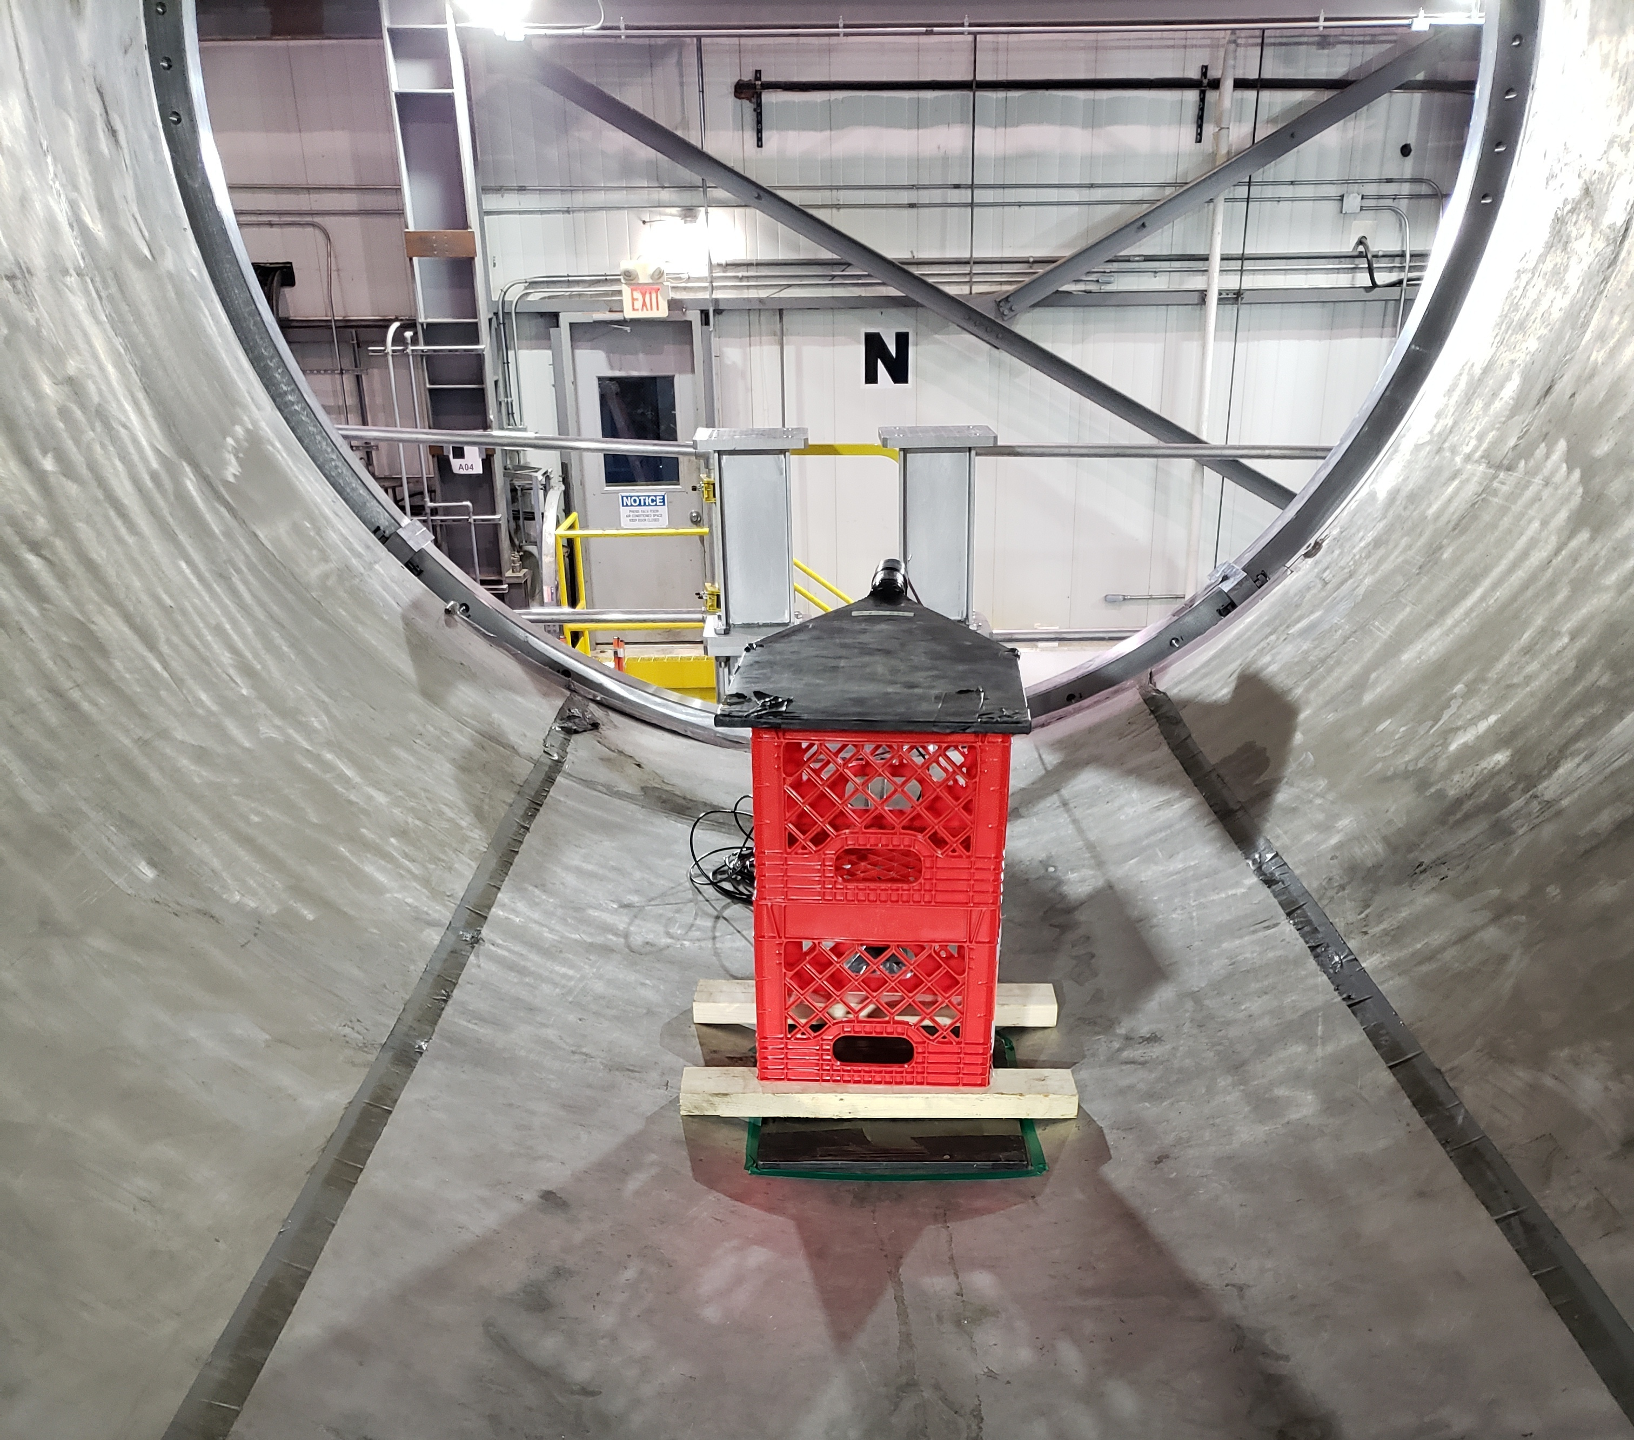
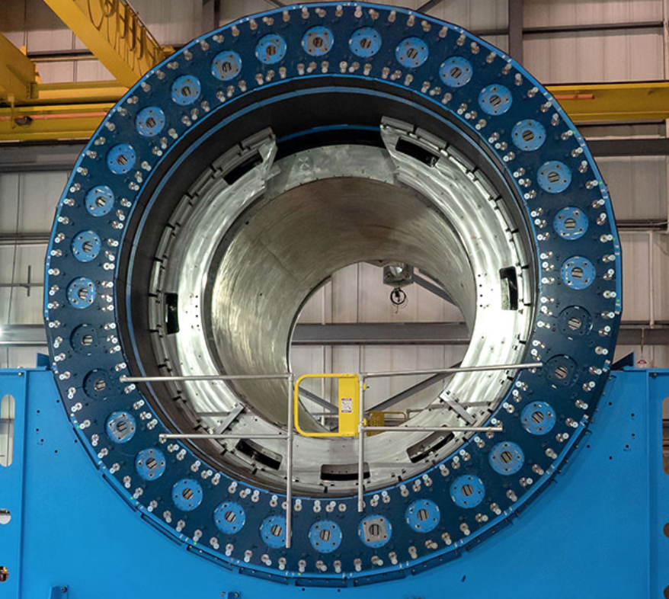
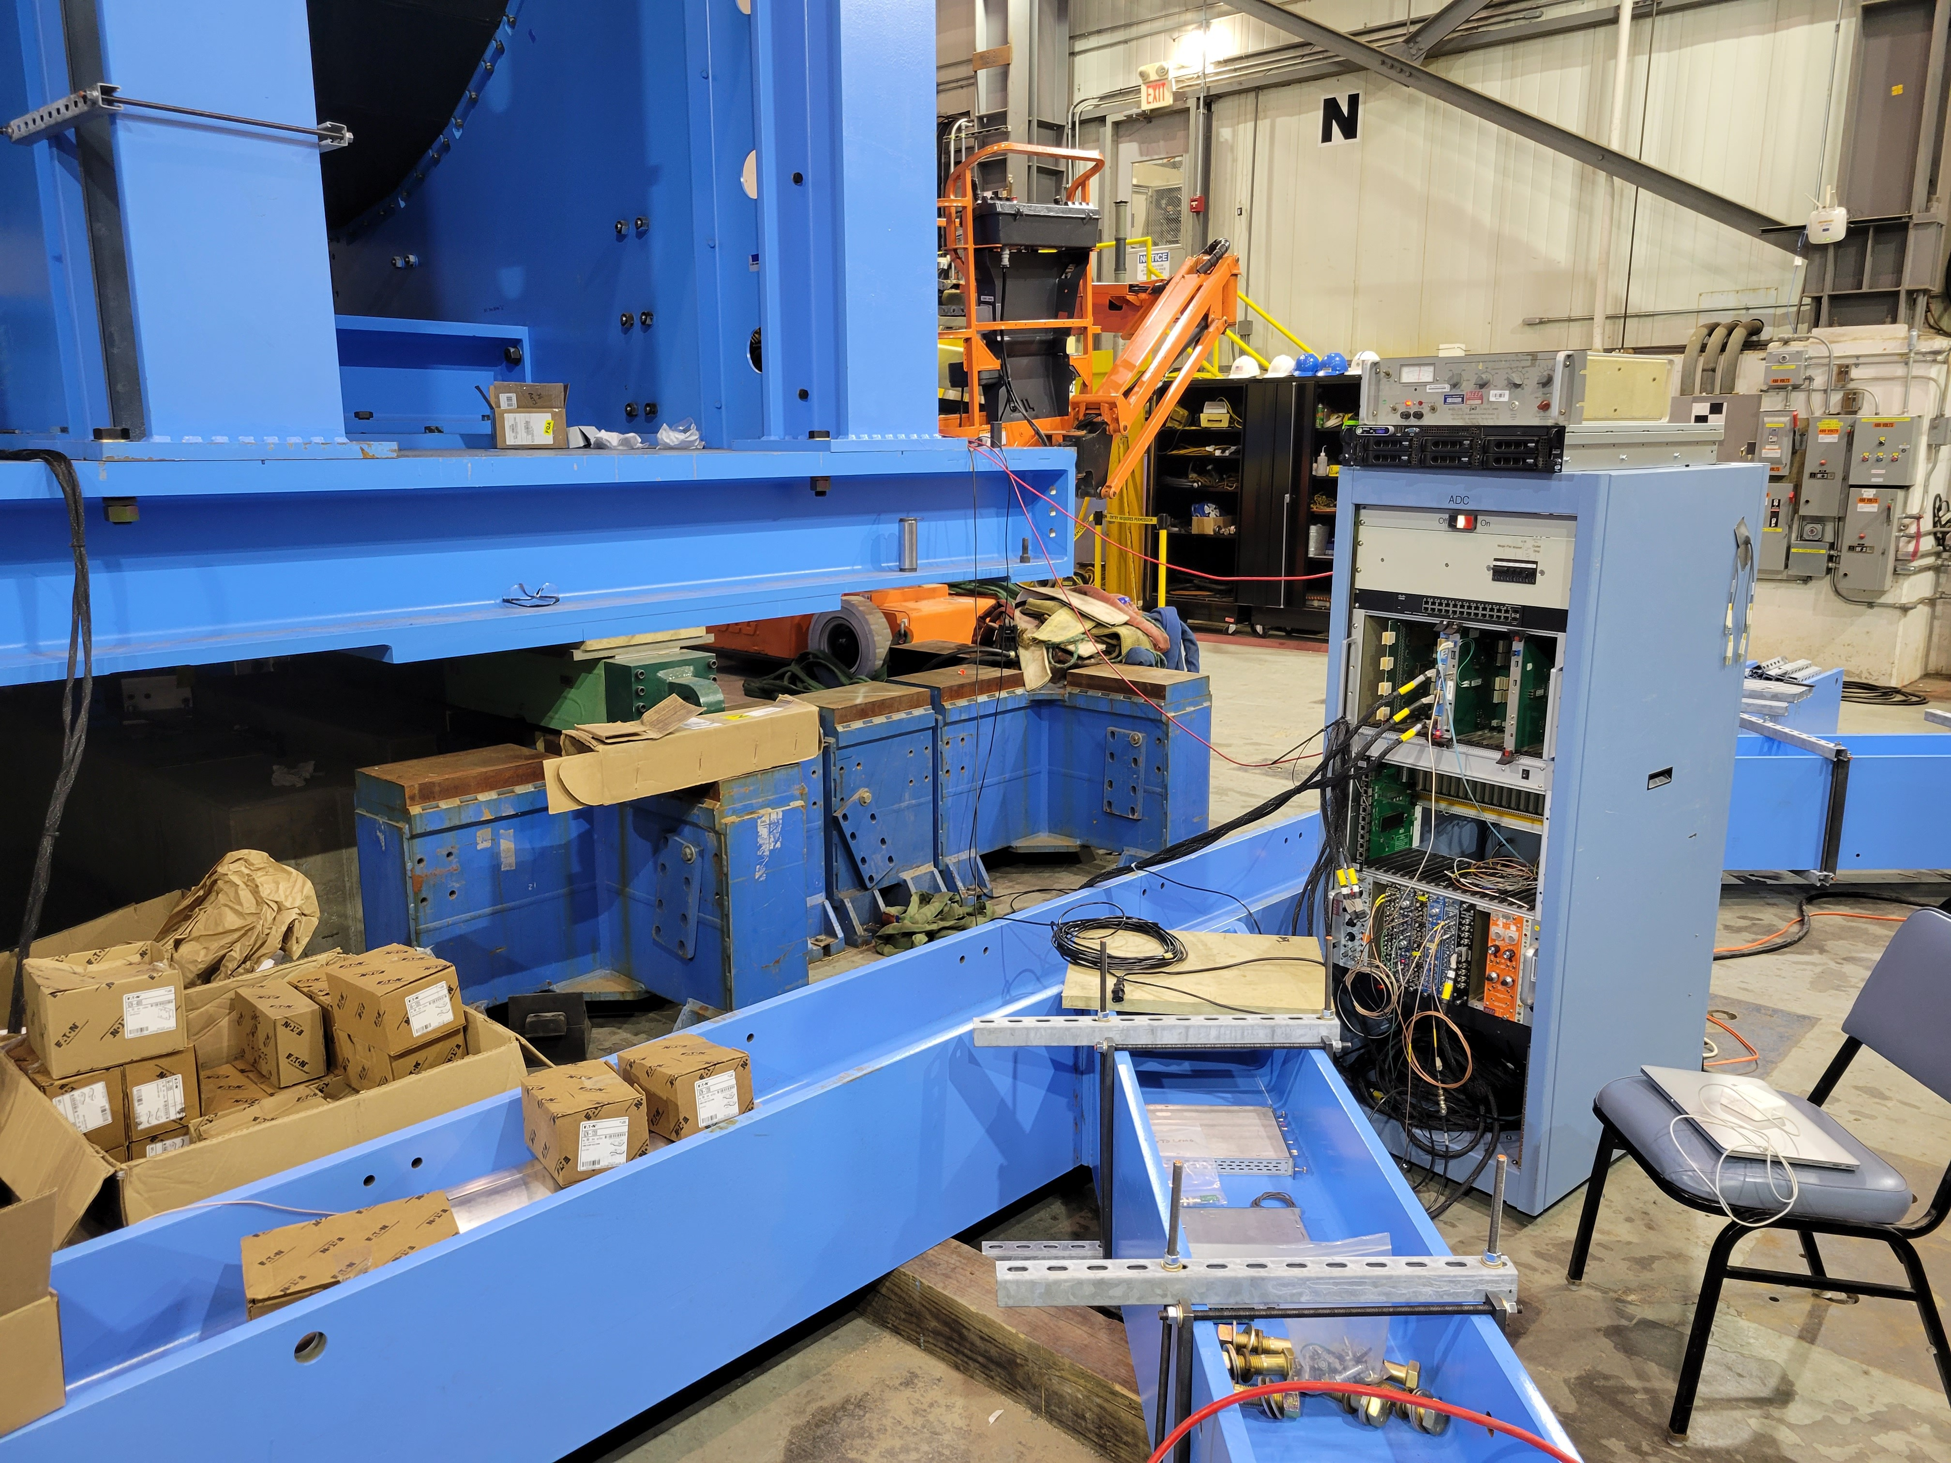
ePIC Barrel HCal data
In the summer of ‘22, we were able to power one oHCal sector (the 6 o’clock module) while the carriage was still in the Assembly Hall
We rigged up a cosmics trigger to see some signals – that was part publicity stunt, but also we had never mated an actual calorimeter with the real electronics (all testing in the factory had been done with different electronics)
I made that before-shown online monitoring code, plus one more histogram to aid in the timing-in back then (called it “saHCal”)

Slide 3
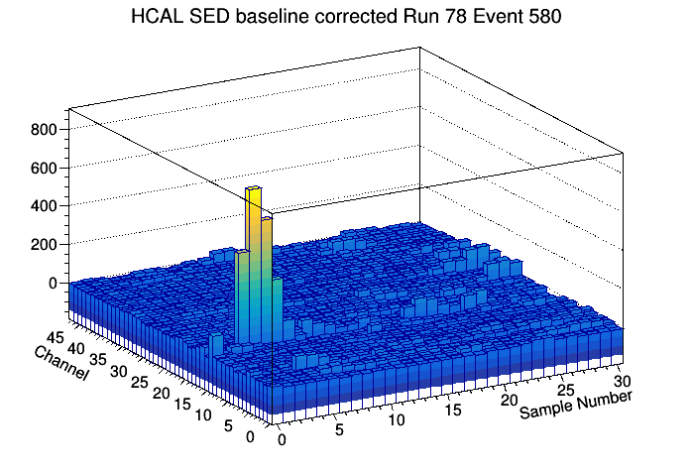
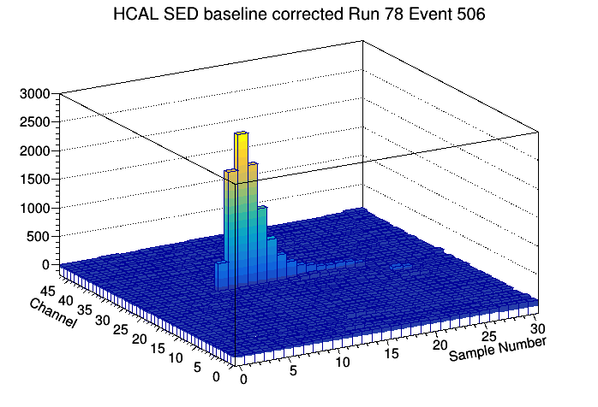
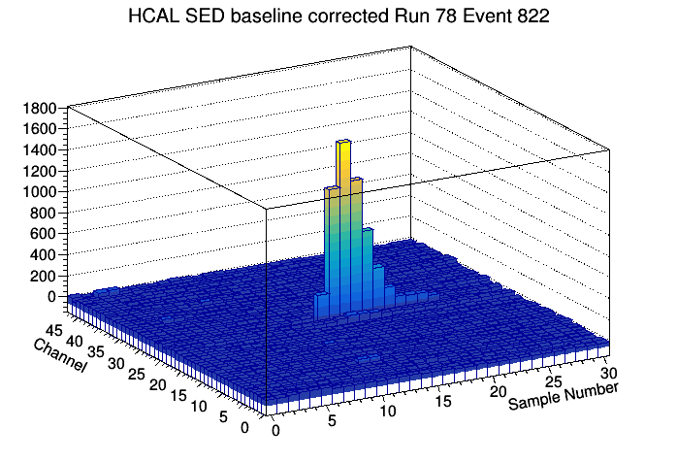
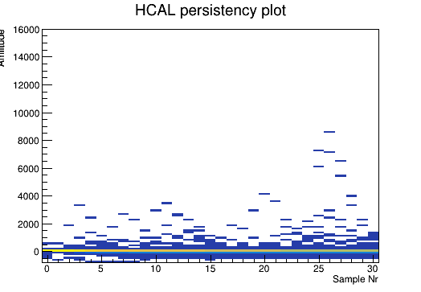
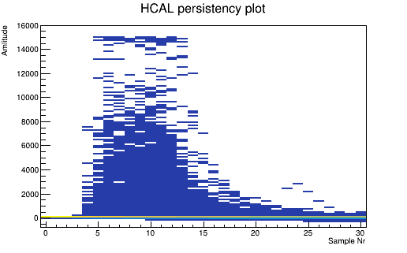
Some cosmics Single-Event Displays
I added one “persistency” plot (gleaned from a digital scope persistency mode) that projects all channels’ waveforms onto the sample/pulseheight plane
you don’t know which channels have seen a signal (also true with beam) so you look at all of them at one glance
Not correctly timed in
correctly timed in

Slide 4
Summary
As soon as practical, we will try to demonstrate an all in-house (ePIC in-house, that is) analysis chain
(currently usually RCDAQ->pmonitor or RCDAQ->Fun4All)
The data from the ROCs will then also be analyzable with that same chain
To state the obvious - it’s a two-fold benefit:
Many ePIC projects (us, the entire pfRICH universe, etc) are using RCDAQ
The in-house analysis chain will also give other people proficiency in Jana2
(mlp’s opinion – this will get Jana2 away from being almost exclusively simulation-centric)

