Slide 1
EDMS - CERN's Engineering Data Management Service

Slide 2
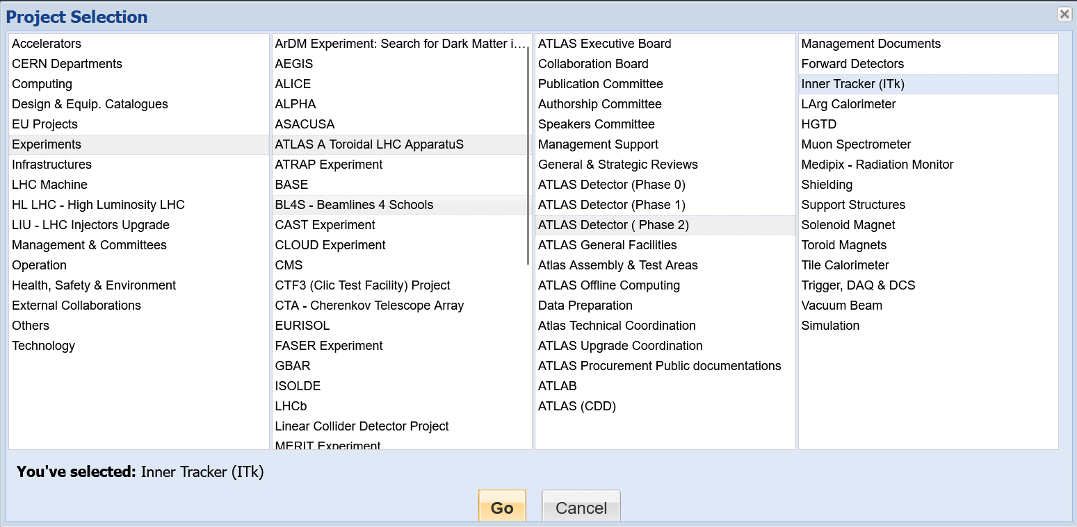
Introduction
EDMS is a document repository at CERN
Store, manage, organize and distribute large amounts of engineering information, covering a wide spectrum of fields
Files are kept in a tree
starting with experiment, then usually sub-detectors, then different aspects
Tree to ATLAS ITk

Slide 3
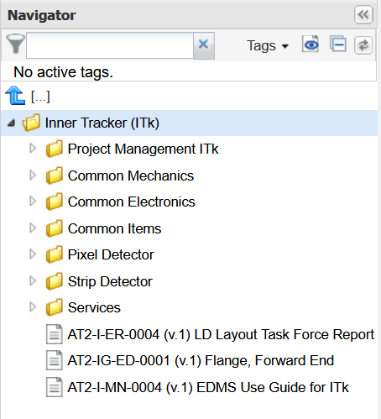
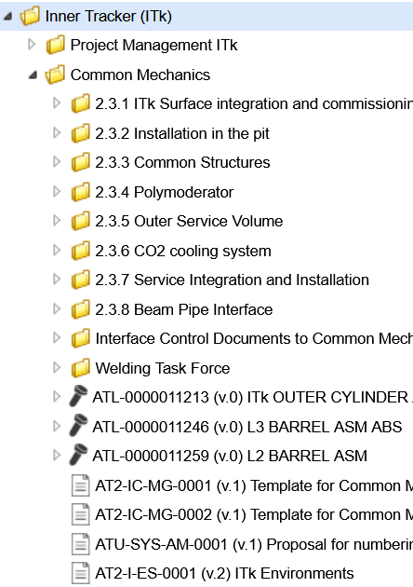
Then further in…
Subfolders (labelled by WBS numbers by choice)

Slide 4
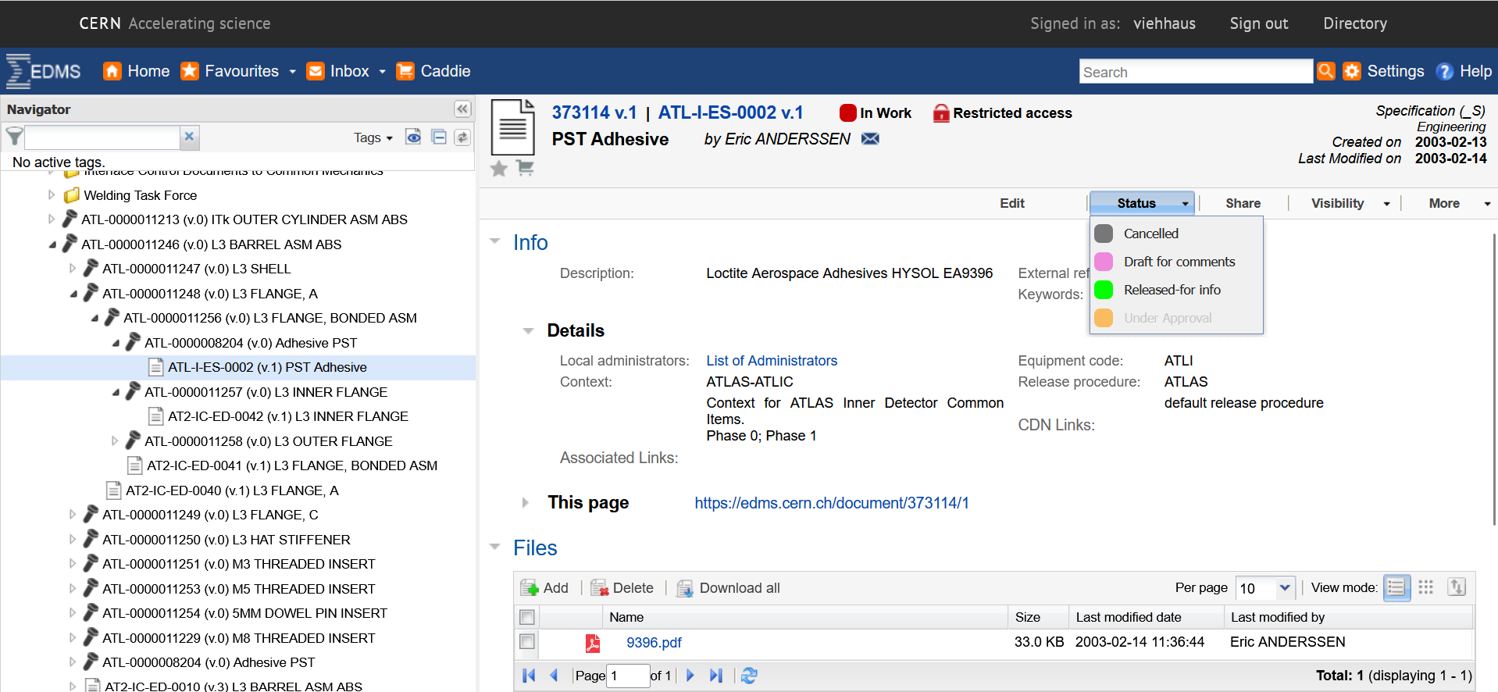
…Further in…
Status
Access restrictions
Document gets unique identifier from system
File with information

Slide 5
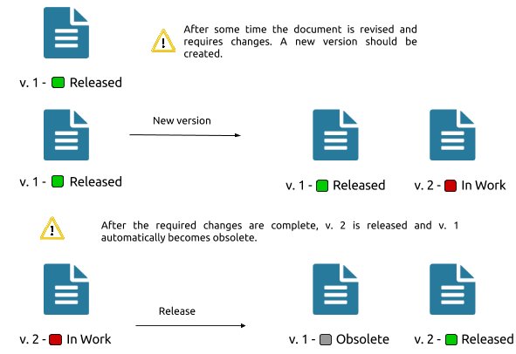
Version control
As usual, only as good as people maintaining the documents
In ATLAS many documents get stuck ‘in work’, but the documents are still kept safely and available for reference
Important documents do have proper version control

Slide 6
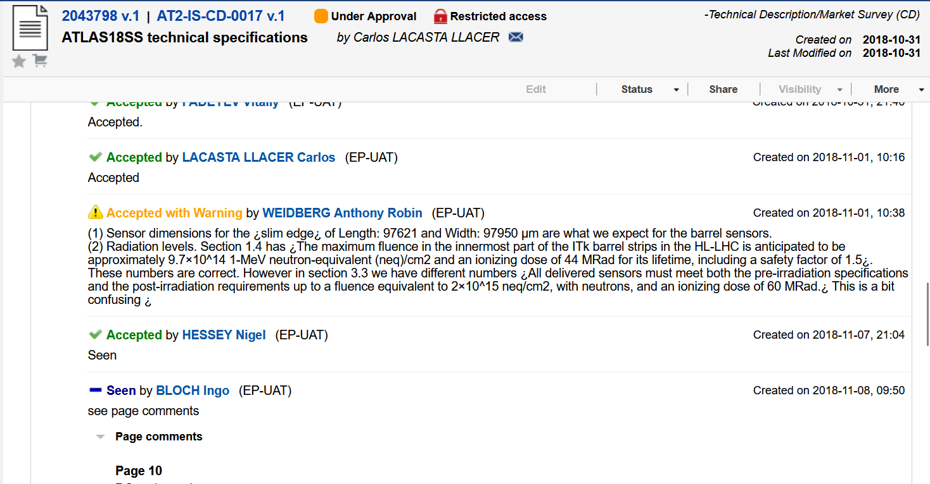
Approval
When the document is put in approval status, then you can specify reviewers
System keeps track of reviewer’s approval decision, comments etc.
Approval status
Comment

Slide 7
EDMS for ePIC?
In principle, as ePIC is a CERN-official experiment we should be able to set up an ePIC document tree at CERN
Need to provide a list of ePIC collaborators (for access restriction)
Need to verify: ePIC collaborators without CERN affiliation should be able to use Edugain or a CERN guest account (formerly CERN lightweight-account)
In the SVT collaboration we would like to use this if access issues are sorted
Not every sub-detector needs to use it

