Slide 1
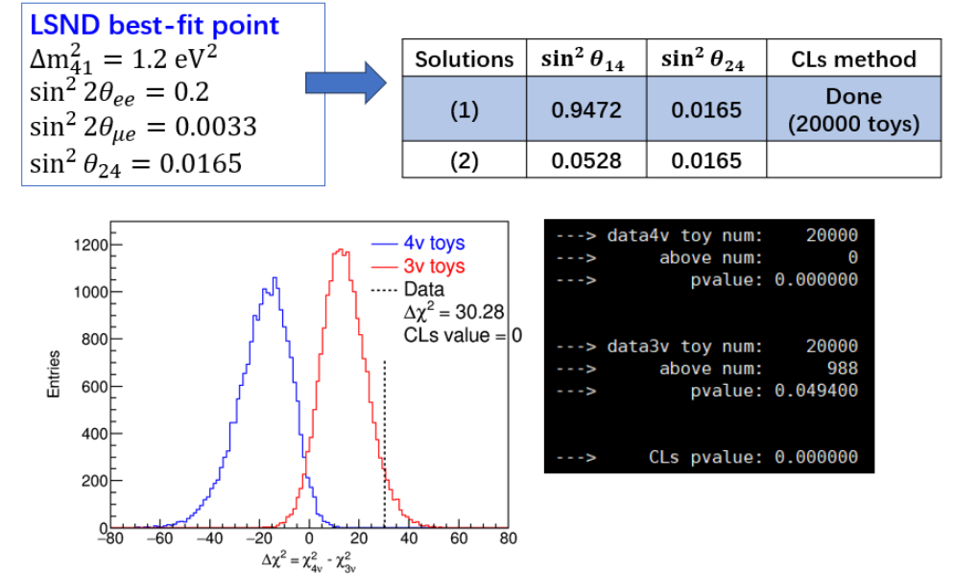
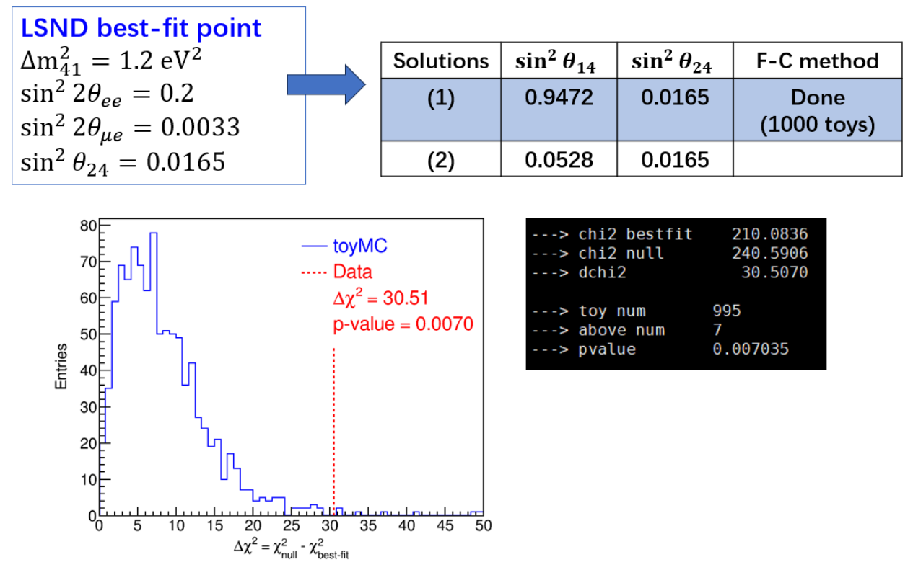
Do FC and CLs yield similar exclusion limits?
If so, it would be easier to answer Referee’s question
CLs: 4nu vs. 3nu
FC: 4nu vs. best-fit
No, FC’s exclusion is much weaker than that of CLs, why is that?

Slide 2
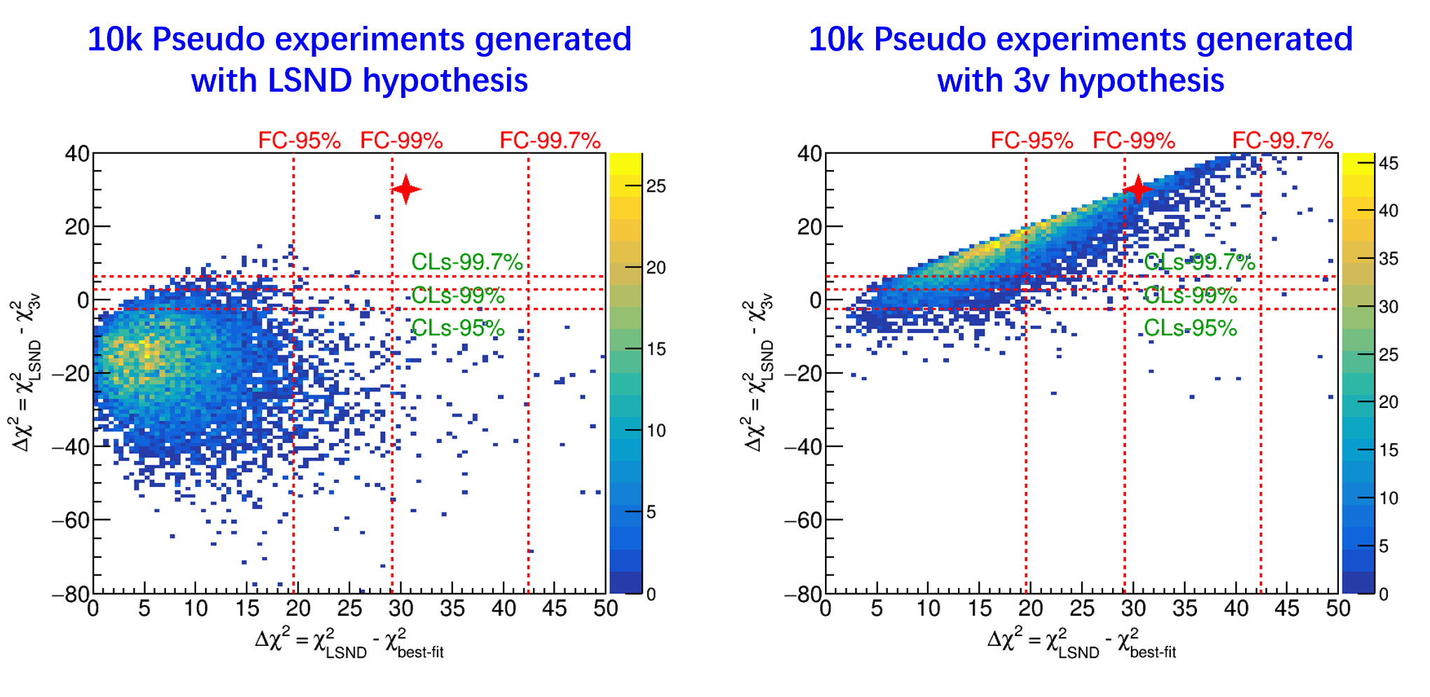
Comparison of CLs (4nu vs. 3nu) vs. FC (4nu vs. best-fit)?
The projection along the Y-axis represents the CLS exclusion, while the projection along the X-axis represents the FC exclusion
The observed data is compatible with the 3ν hypothesis but inconsistent with the LSND best-fit
CLs generally offer better sensitivity than FC

Slide 3
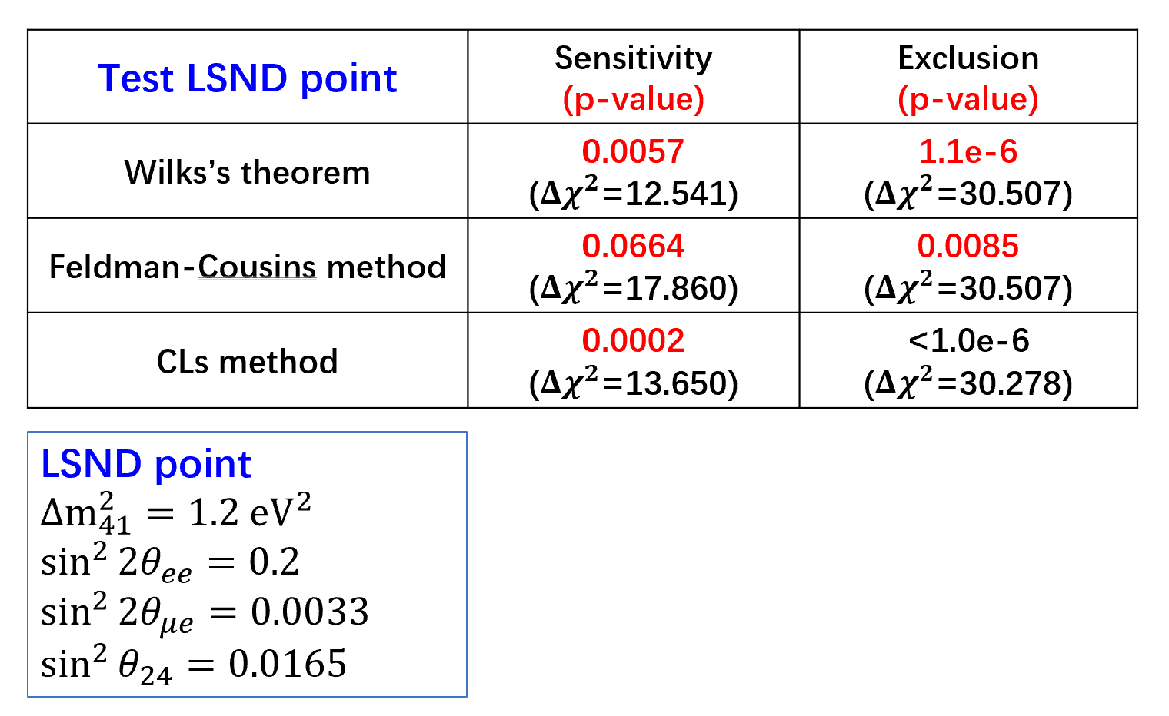
Comparison of Sensitivities
Wilks’ theorem relies on the Asimov dataset
Both FC and CLs follow the Frequentist approach using pseudo-data generation
In terms of sensitivity: FC < Wilks < CLs

Slide 4
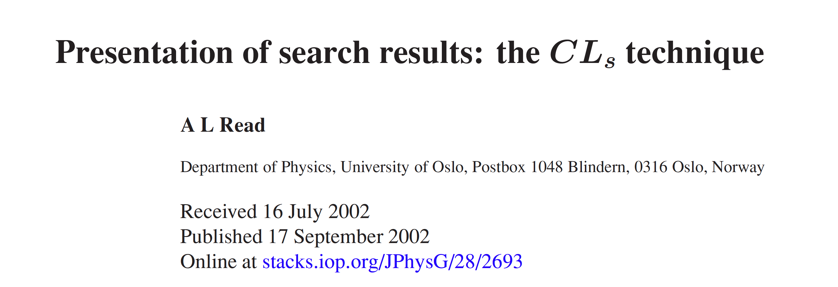
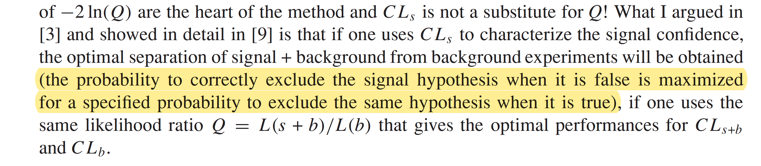
The CLs test statistic provides optimal performance for distinguishing 4ν (i.e., CL_{s+b}) from 3ν (CL_{b})
Provide the theoretical justification for why CLs achieves higher sensitivity

Slide 5
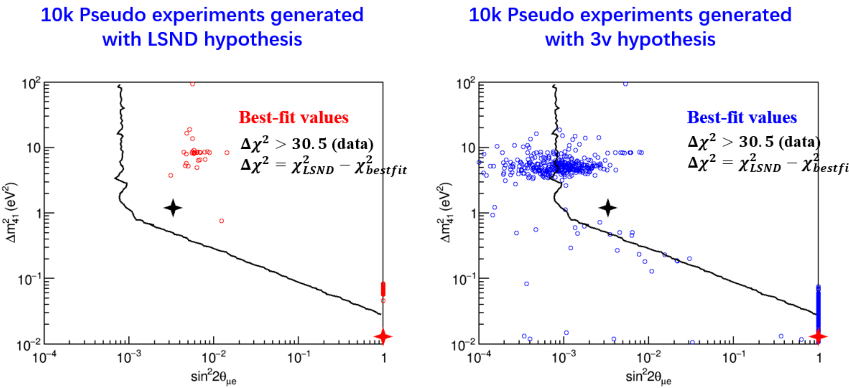
An Alternative Perspective on Why FC is Less Powerful
While the CLs test statistic (4ν vs. 3ν) is optimized, the FC test statistic (4ν vs. best-fit) is not.
As a result, FC must not fully utilize all available information, what is this?
Black star: LSND best-fit hypothesis
Red star: Data best-fit
The best-fit data is consistent with pseudo-data generated under the 3ν hypothesis
However, it is not consistent with pseudo-data generated under the 4ν hypothesis (e.g., the LSND best-fit)
The FC test statistic does not incorporate this critical information

