Slide 1
Integration, Installation and Infrastructure (Triple I Group)
TIC Update
Roland Wimmer

Slide 2
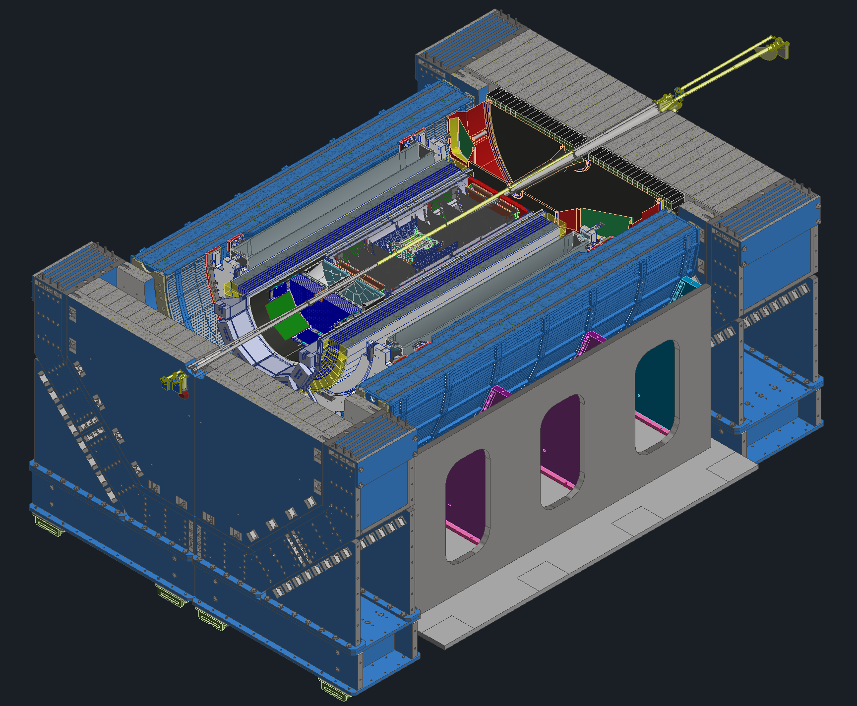
Detector Model Updates
GST Workshop
Cradle Updates
Services

Slide 3
GST Workshop
Summary
ToF
Where do the temperature requirements come from?
Why is it mounted at 18° angles?
Need to make the detector more serviceable
Should look into encapsulating wire bonds
Inner MPGD
Need to discuss FEB mounting and overall installation onto PST
MPGD Disks
Installation into PST should be compatible with SVT design needs
Once installation is figured out then services routing need to be looked at
There are temperature concerns surrounding beampipe bakeout
Need to reinvestigate beampipe bakeout temperatures
pfRICH
Need to float on one side to accommodate rails

Slide 4
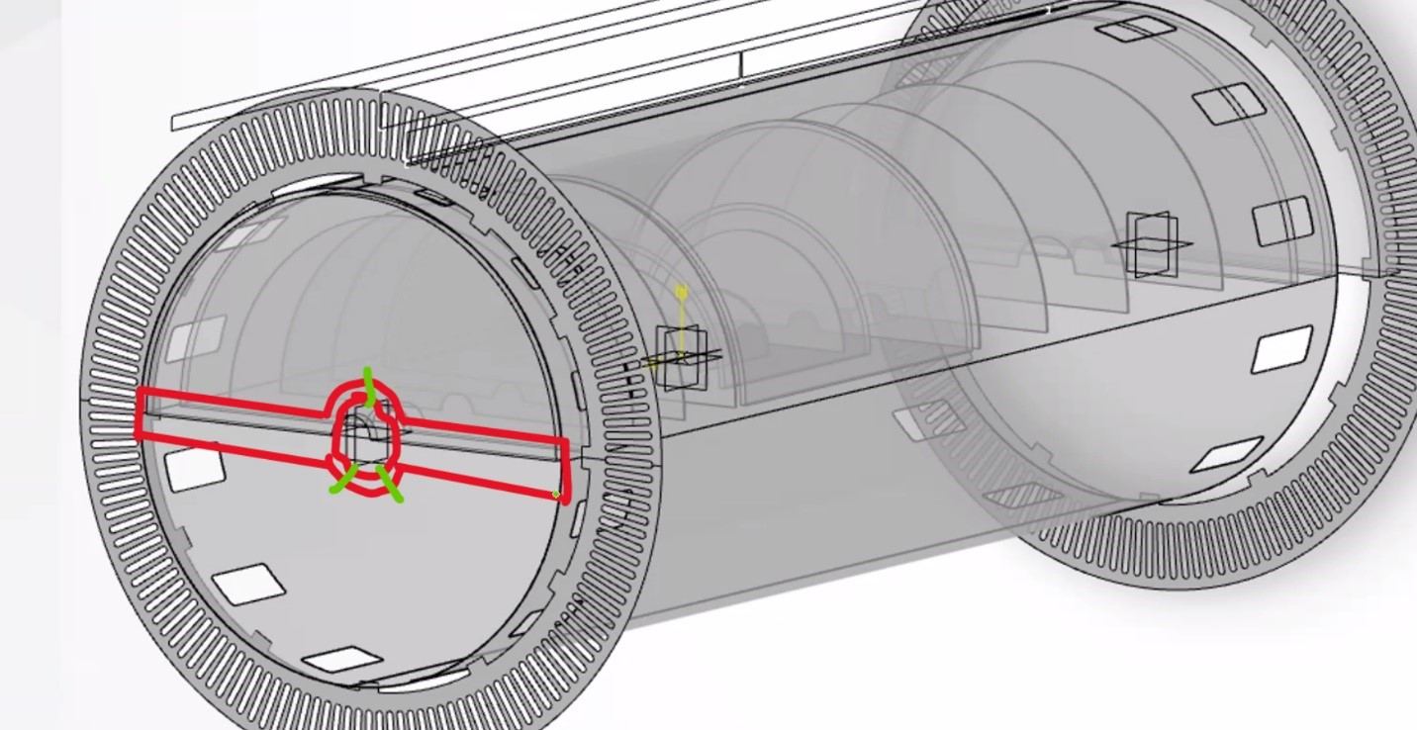
GST Workshop
Summary
EEEMCal
Beampipe clearance needs to be discussed further
ΔT across detector needs to be discussed, there are a few external factors that need to be considered
Insulating plate needs to be looked at
May need to include a break in the outer aluminum structure to accommodate for potential magnet quench
True for all subsystems with a metal support frame.
SVT
Need to figure out services routing out of the PST
Talked about enclosing the entire detector such that heat doesn’t escape
GST
Installation of PST and detectors into the GST needs to be looked at more
Services routing during installation is a major concern
PST
Beampipe support locations
Services routing

Slide 5
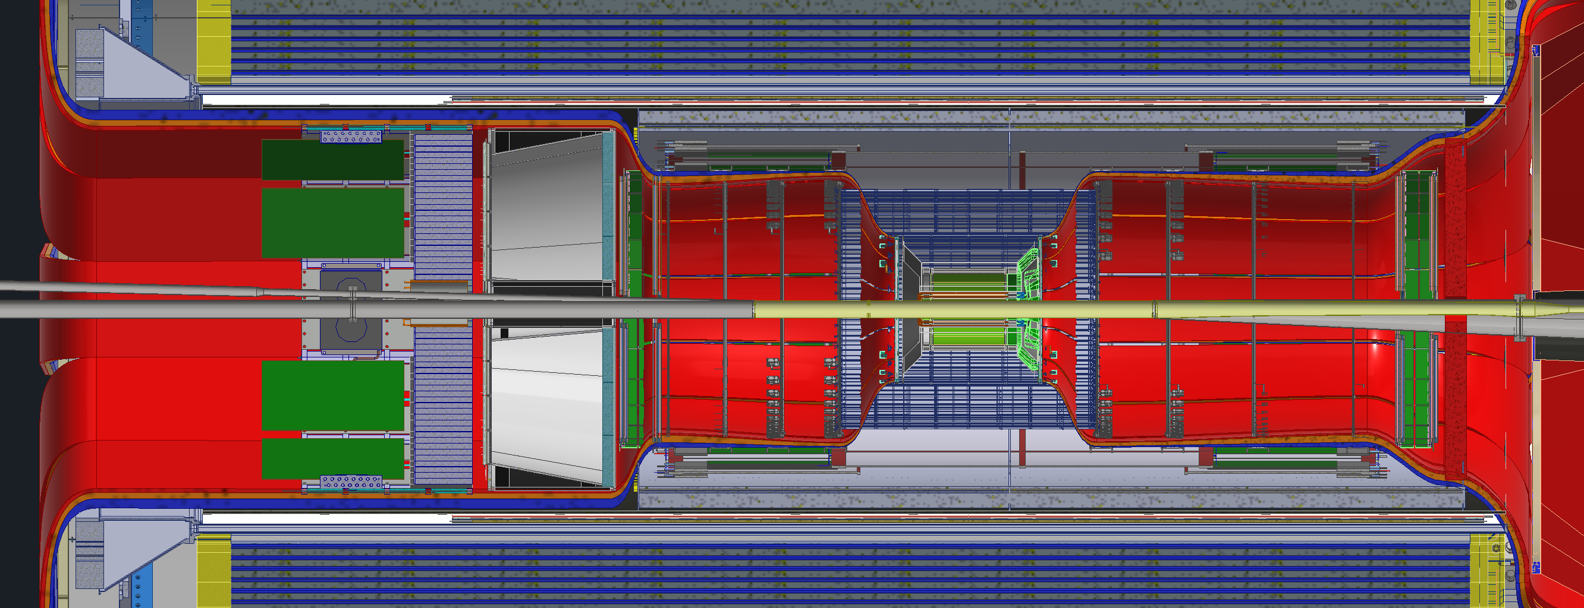
GST Workshop
Summary
Services
Currently do not fit around EEEMCal and pfRICH
Depending on adjustment needs, the space between the Barrel EMCal and dRICH may not be enough
Other
Must assign interface responsibilities to individual teams
Revisit ePIC interface control documentation with added responsibilities.

Slide 6
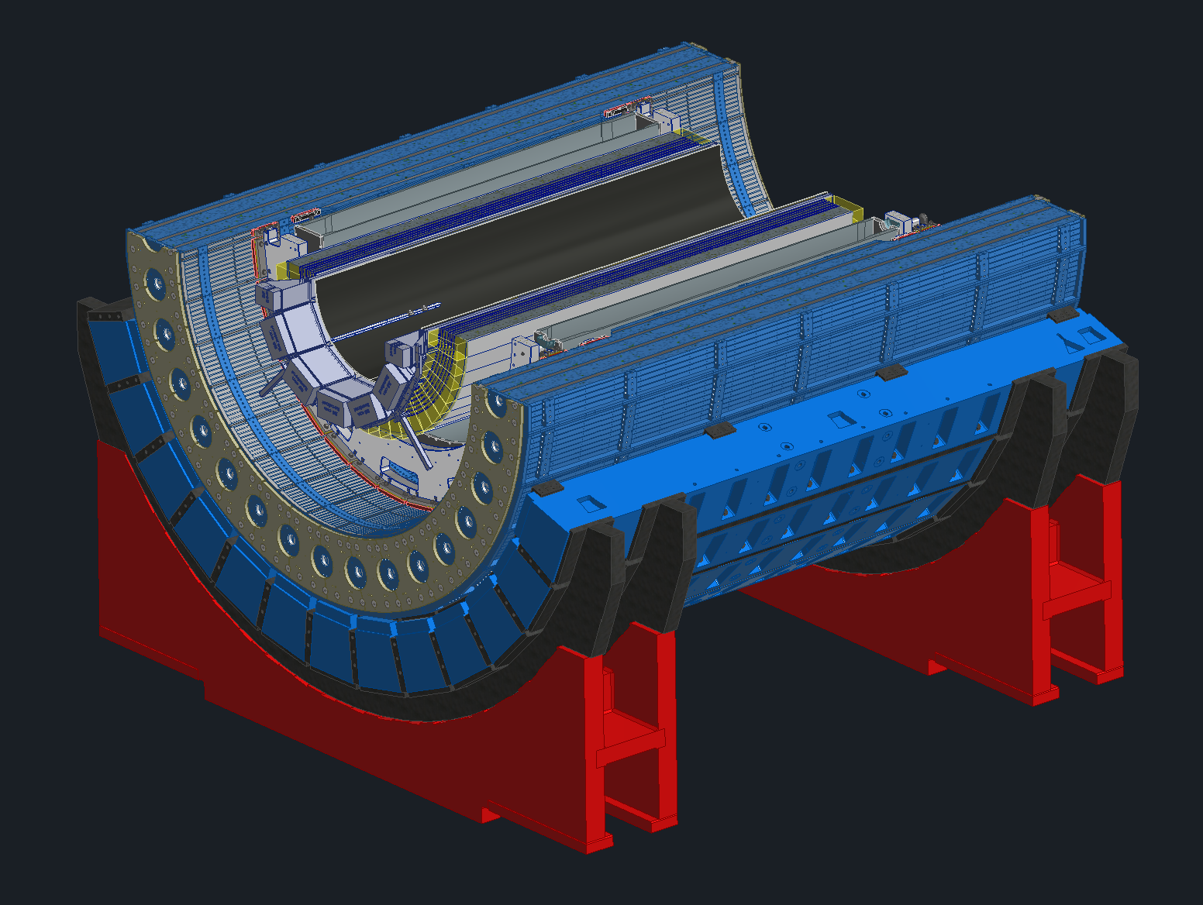
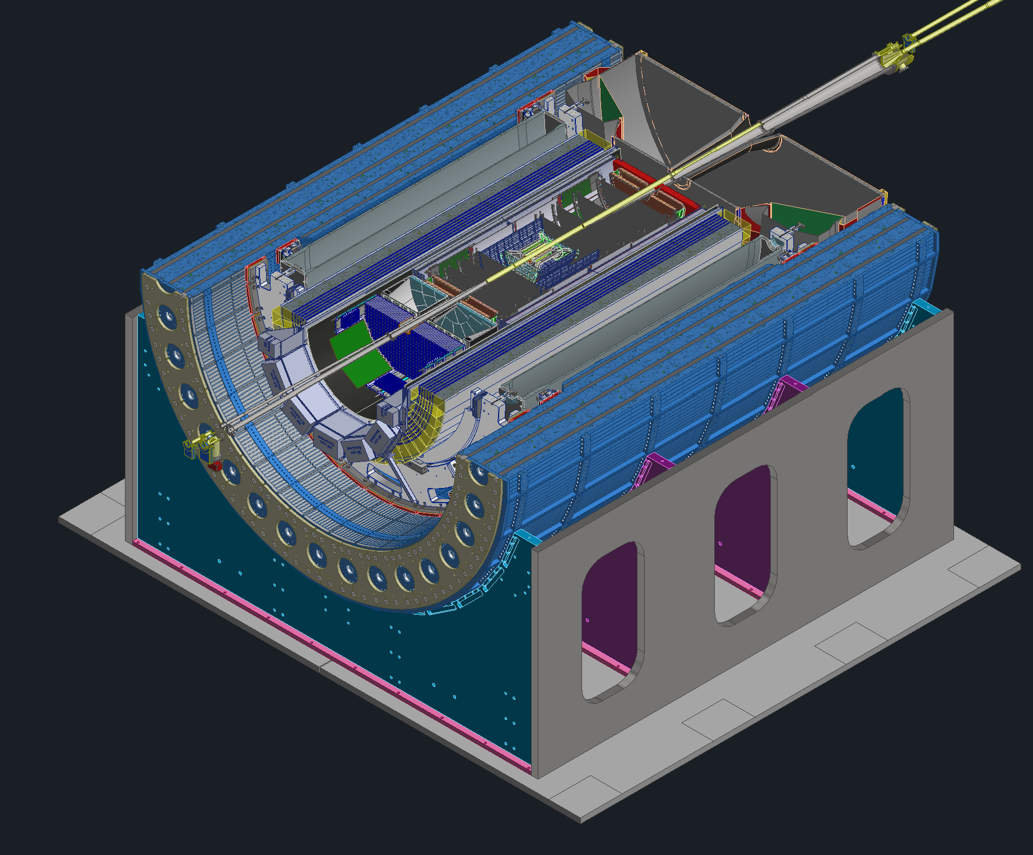
Cradle Updates
OLD
New proposed cradle design
Planning on reusing the sPHENIX support webs (shown in purple and teal)
Will use new base, the old sPHENIX base wont work with our track setup
New design pros
Incorporating 8mrad rotation will be much easier
Much less weight due to less steel
Magnet group had concerns about too much steel on the bottom of the detector
NEW

Slide 7
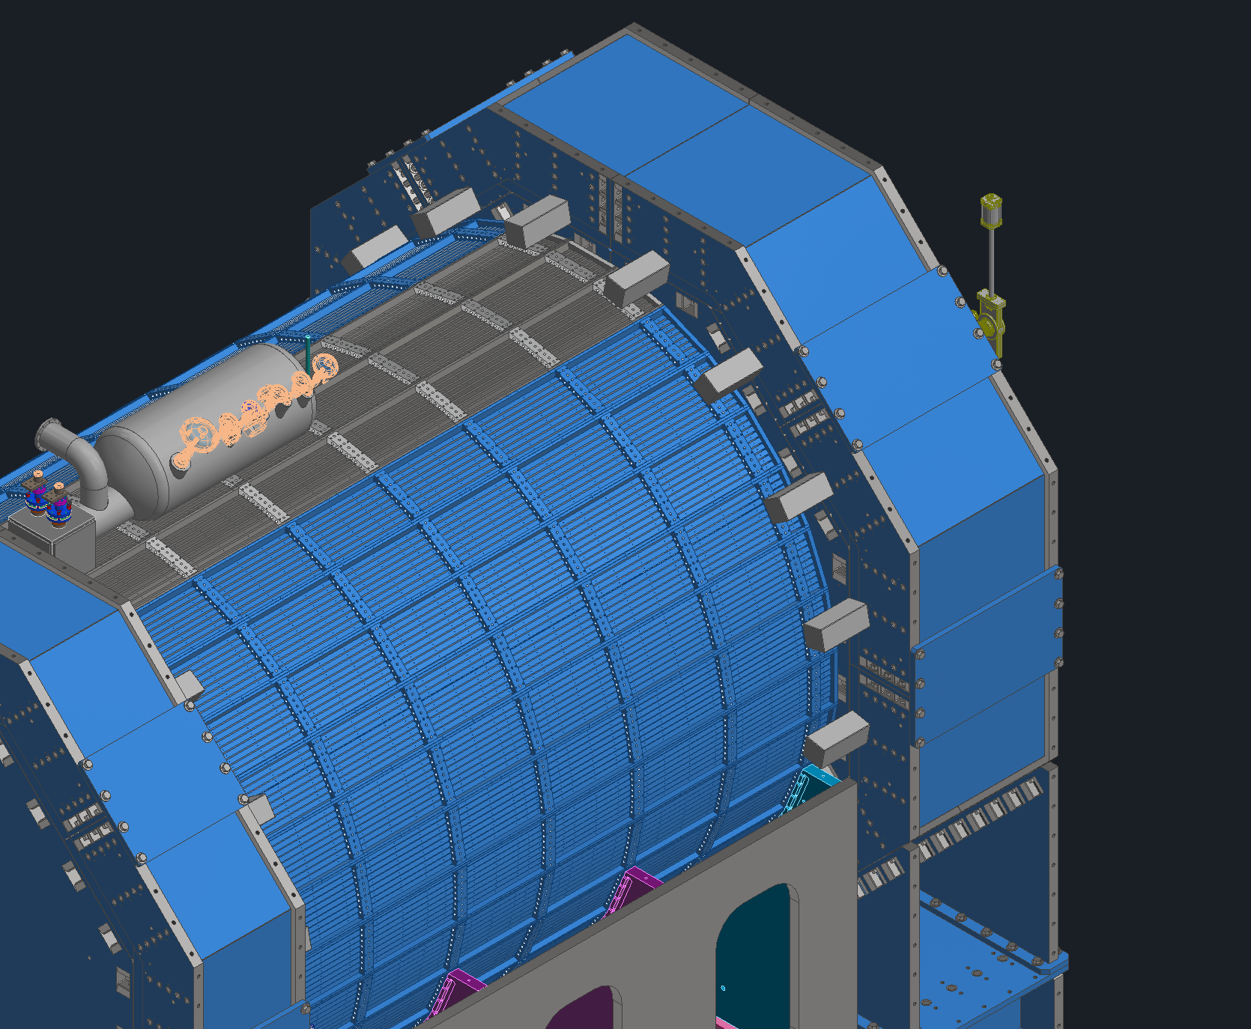
Magnet Simulations
New cradle design
Try to get away with less steel internally in Endcaps
Due to the removal of the Flux return steel new magnet links needed to be designed
Clearance concerns during endcap movement
Each link weighs about ~350lbs (~160kg)
Need to see if these Links will work so services can start being routed out

Slide 8
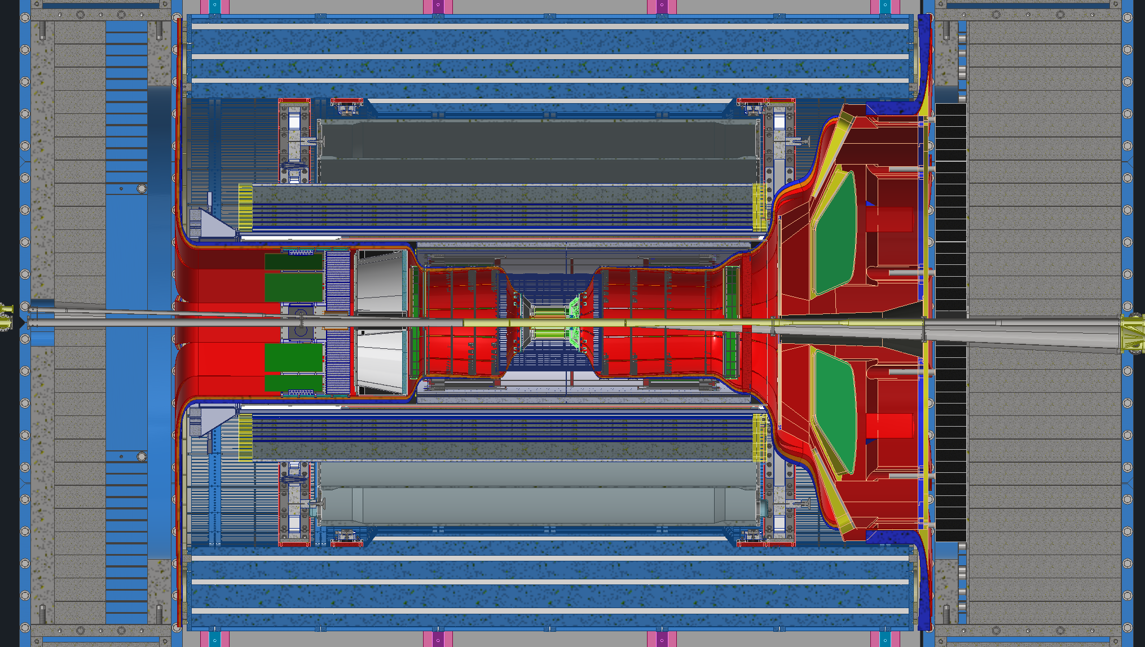
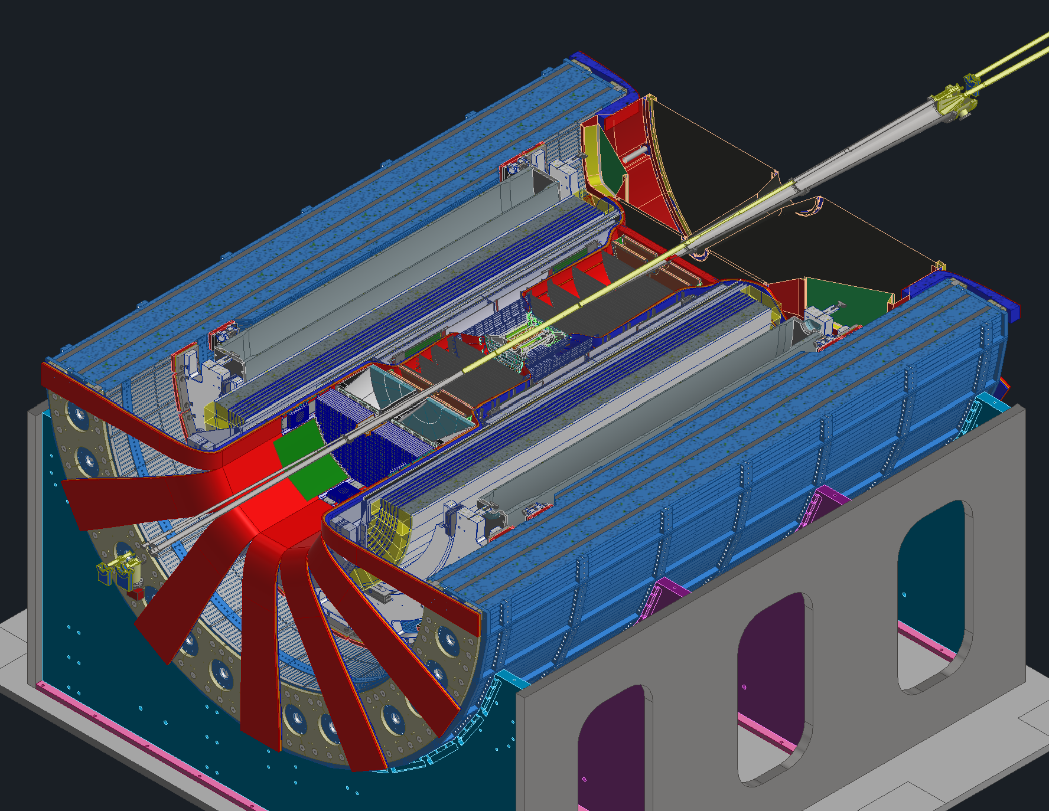
Services
After the recent updates there are some areas of concern
Not enough space around pfRICH and EEEMCal
Concerns regarding adjustments in-between barrel EMCal and dRICH
Services coming out at 3 & 9 O’clock from dRICH and fEMCal

Slide 9
Backup Slides

