Slide 1
SVT OB simulation software - update and next steps
Sam Henry
3 April 2025
Updates
Converting CAD to DD4HEP geometry
Quality checks and debugging
Material thickness mapping
Next steps
Further tests
Update standard epic simulation geometry? Use detailed model to show this is accurate
Tracking performance studies
Convince ourselves detector will perform
UK

Slide 2
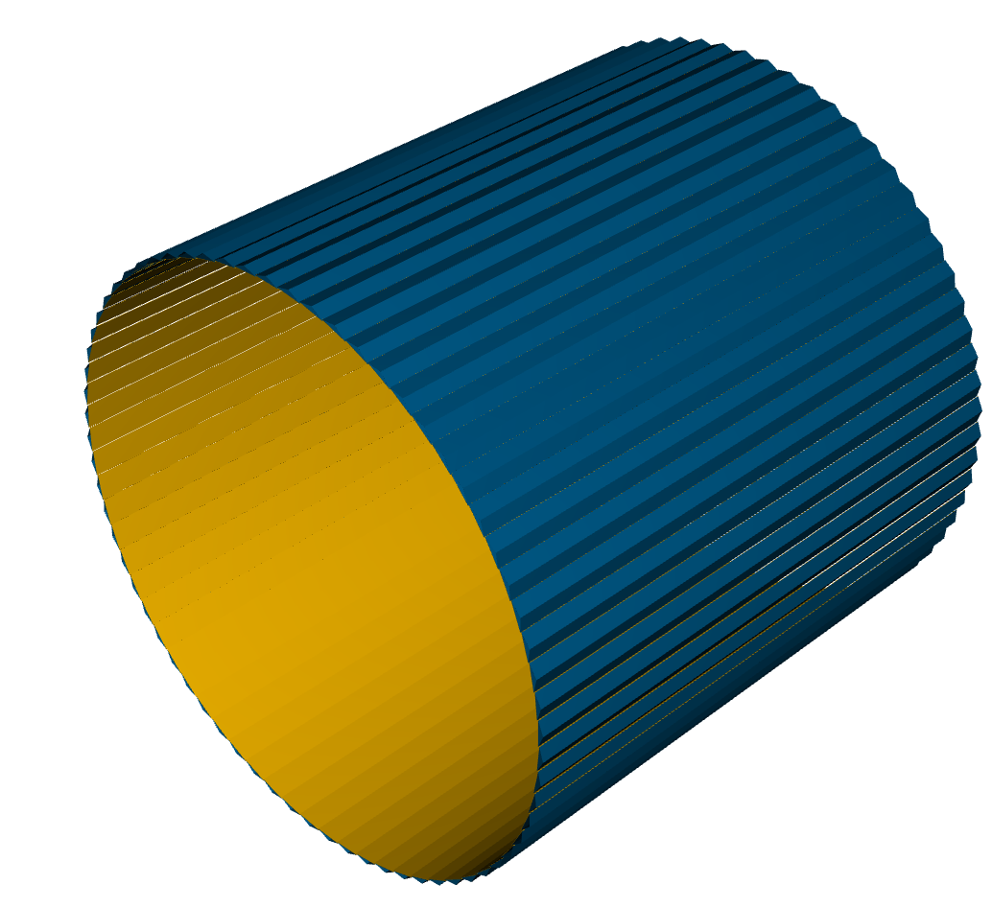
SVT – standard epic geometry
Simple model of L3, L4 outer barrels
Flat staves
Layers of silicon, carbon fibre, aluminium to give material thickness
X/X0 = 0.25% (L3)
X/X0 = 0.55% (L4)
SVT – detailed geometry
Detailed model of L3, L4 barrels from CAD drawing

Slide 3
ePIC SVT – detailed geometry from CAD files
Project work by Oxford intern student Tuna Tasali
(Mostly) automated process to convert CAD files to DD4HEP geometry
Conversion Script
FreeCAD API
.STL (mesh)
.gdml (mesh)
sensitive=«true»
Set automatically by the .gdml file name.
.STL (mesh)
.gdml (mesh)
.STEP
.FCStd
silicon_barrel.xml
.STL (mesh)
.gdml (mesh)
Sensitive volume handled differently by
.STL (mesh)
.gdml (mesh)
BarrelTrackerOuter_geo_standardized.cpp
https://github.com/Tunat66/epicUK/tree/UK_Contribution
See slides: https://indico.bnl.gov/event/23274/contributions/96308/attachments/57308/98404/InternationalPresentation_CADDesignsInDD4Hep.pptx

Slide 4
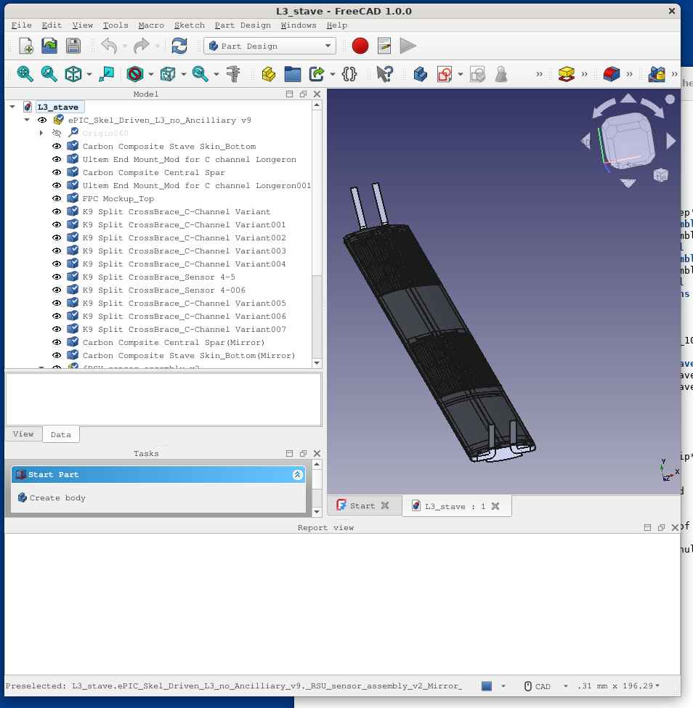
Start with .step file for single stave
Import .step file into FreeCAD
Save as .FCStd

Slide 5
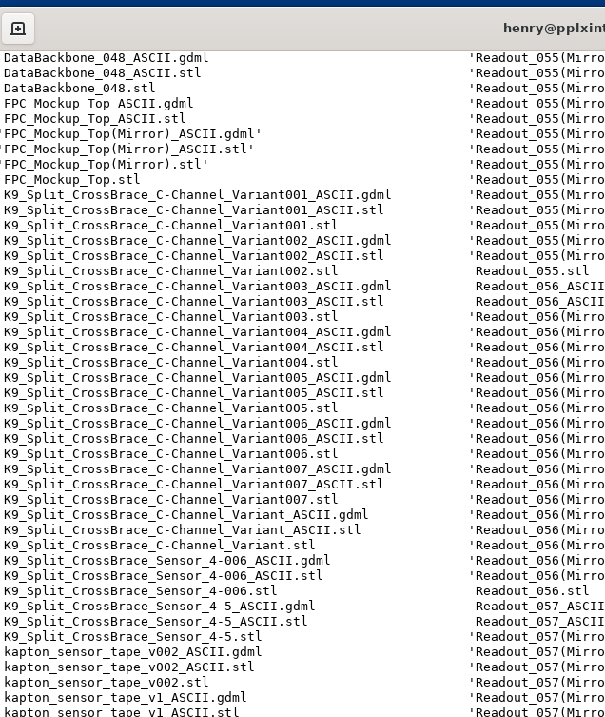
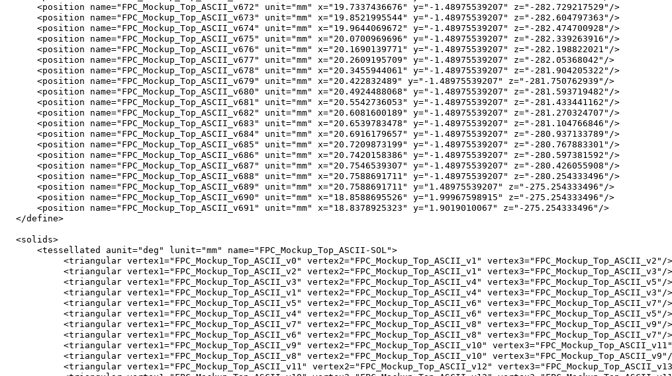
Run script to convert .FCStd to large number of .gdml files
Each containing the vertex points of a tessellated solid for one component

Slide 6
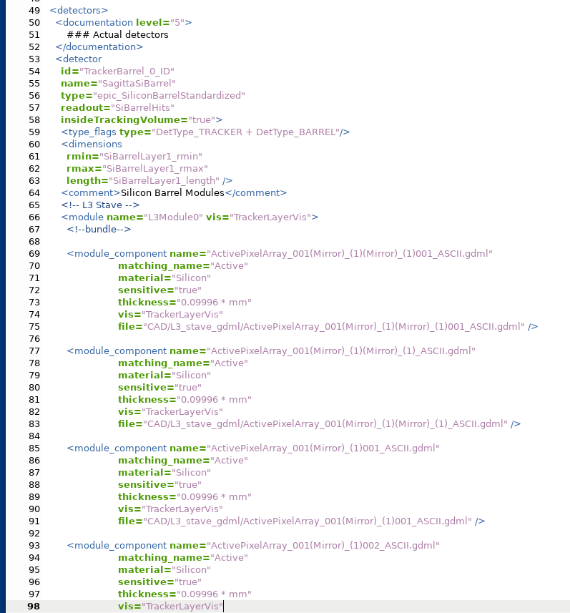
create_xml.py
silicon_barrel.xml
contains dict to link names to material and sensitive status

Slide 7
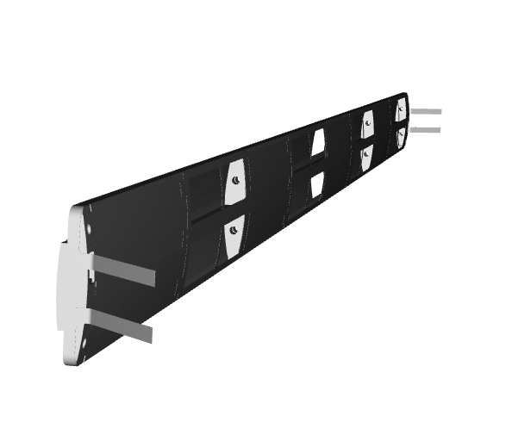
BarrelTrackerOuter_standardized_geo.cpp reads silicon_barrel.xml and assembles geometry for stave
Staves placed to form Outer Barrel cylinders

Slide 8
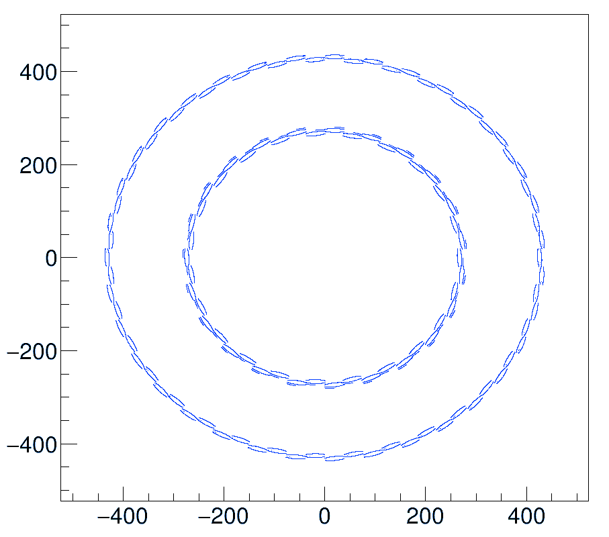
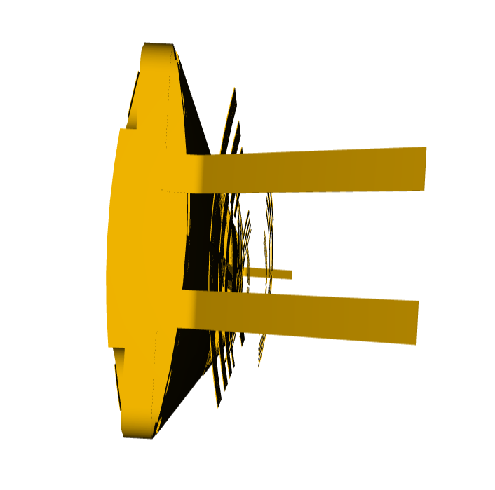
CAD – DD4HEP – issues noted September 2024

Slide 9
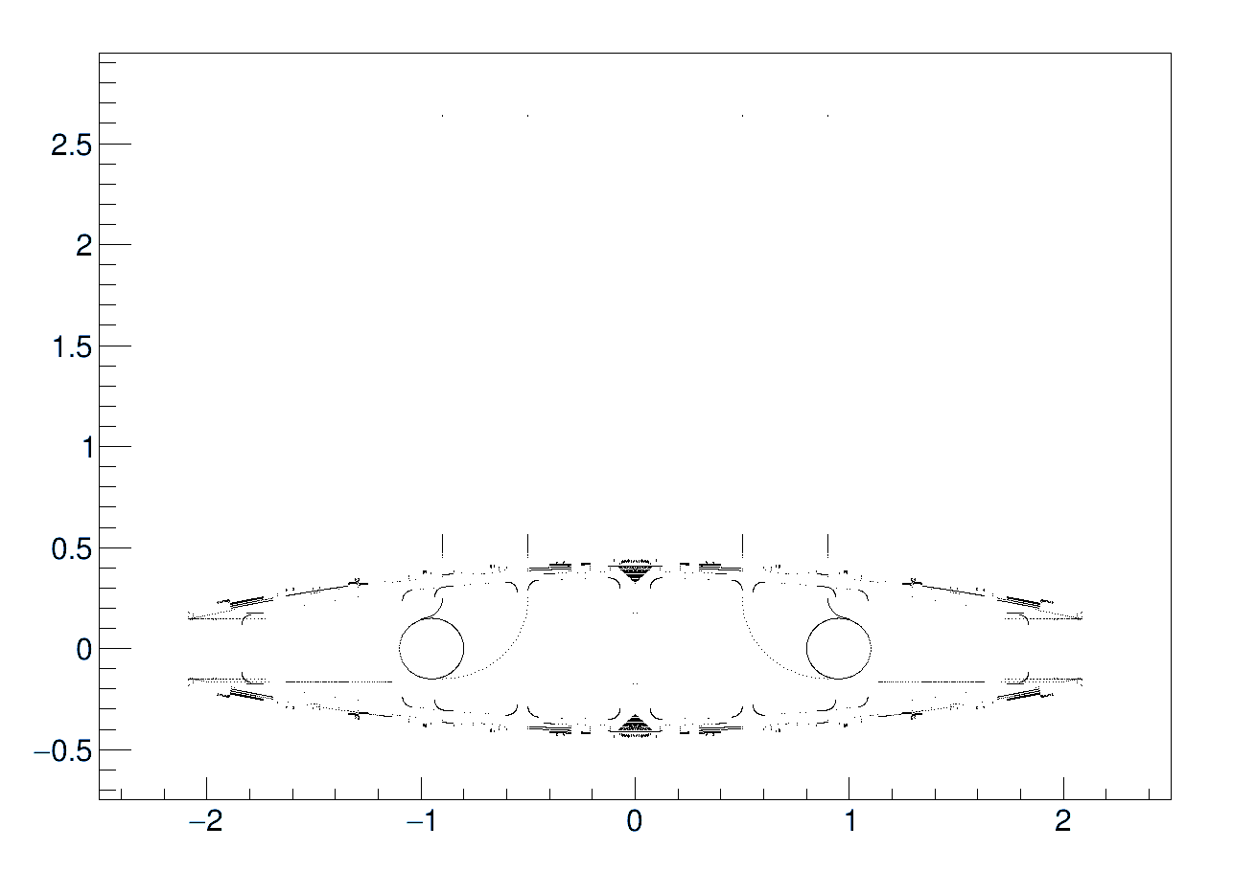
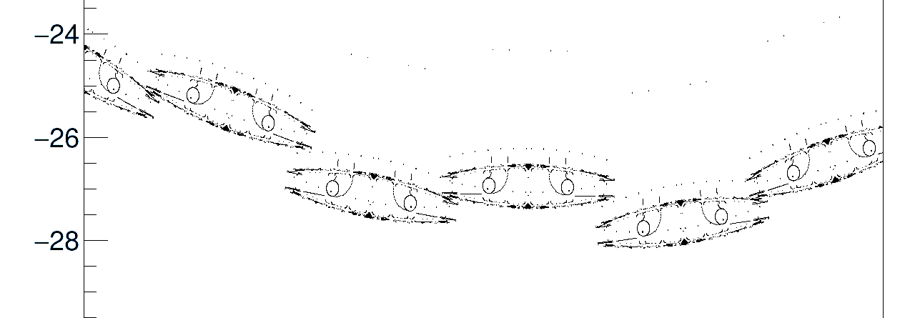
Debugging tools to plot vertex coordinates at each stage
.stl
.gdml
TGeoVolume
detector_geometry.root
Additional offset introduced by obsolete code

Slide 10
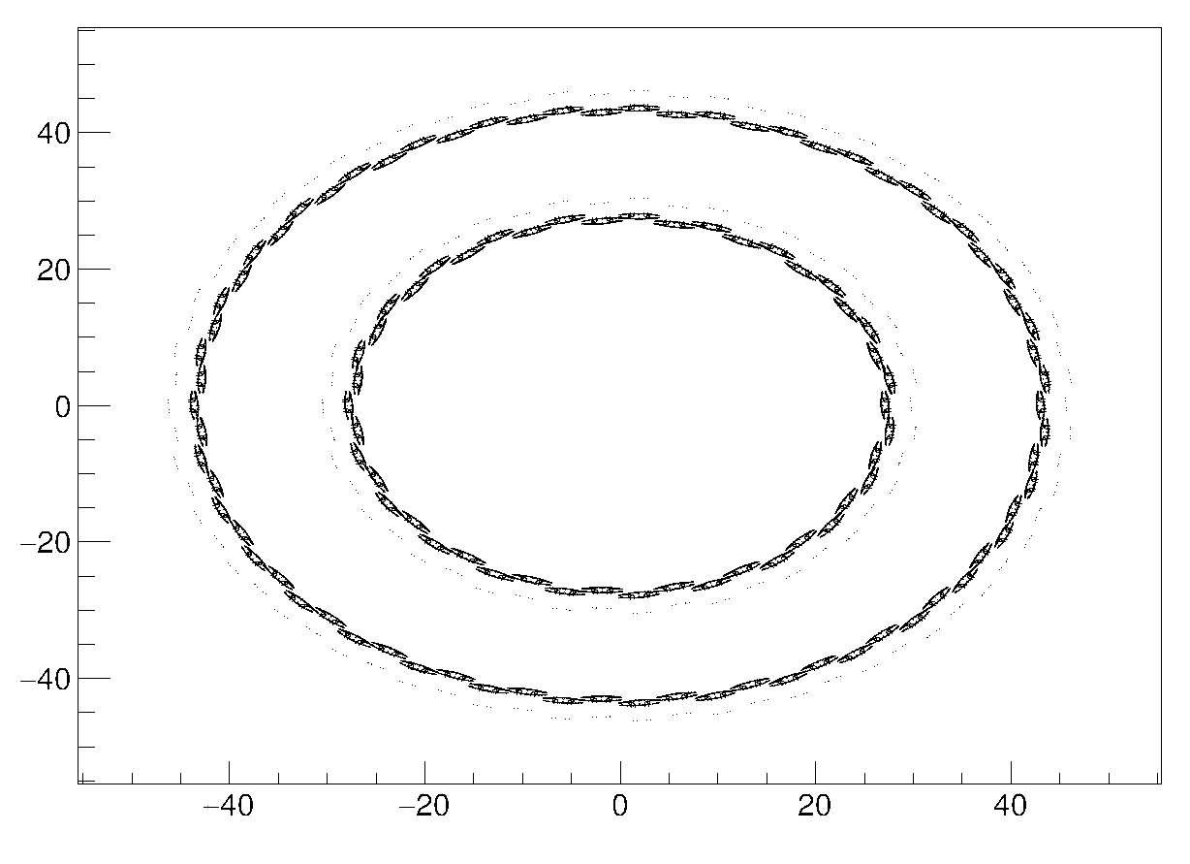
Fixed?

Slide 11
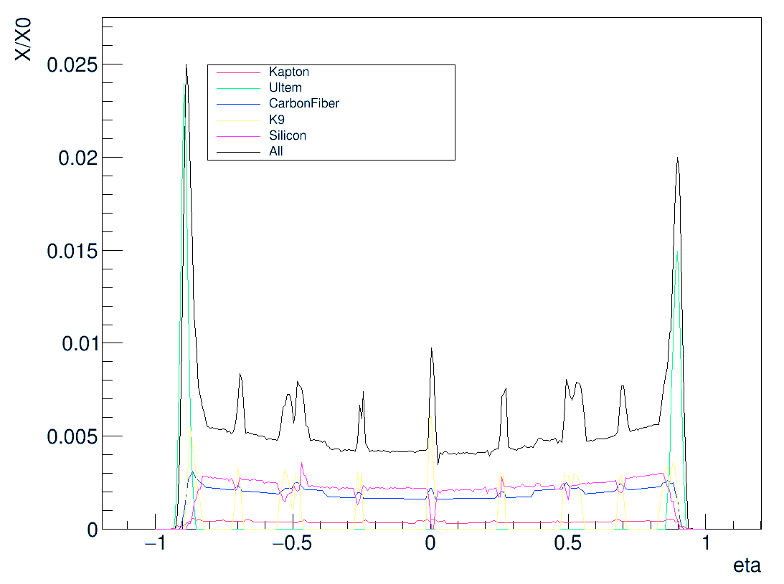
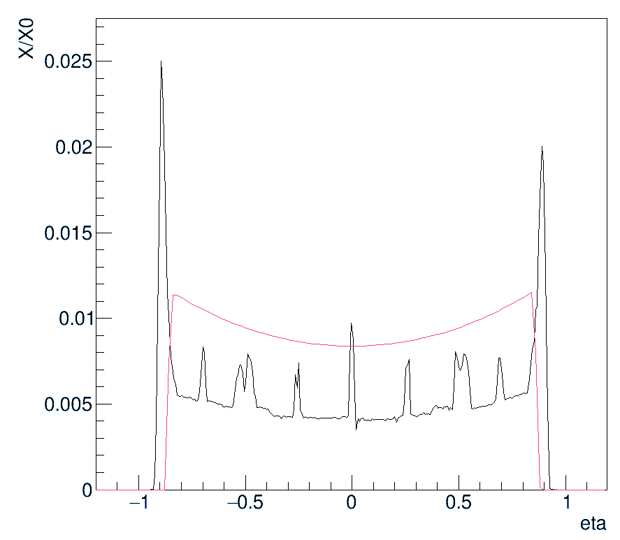
ePIC SVT – Material Thickness
Using epic/bin/g4MaterialScan_to_csv script by Chao Peng
Lower baseline thickness than standard geometry

Slide 12
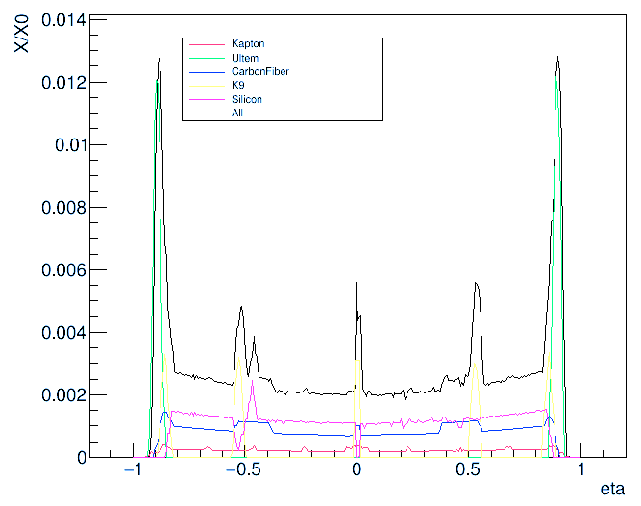
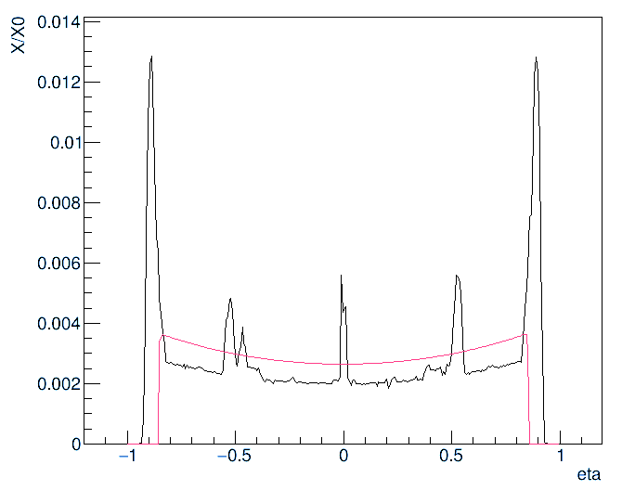
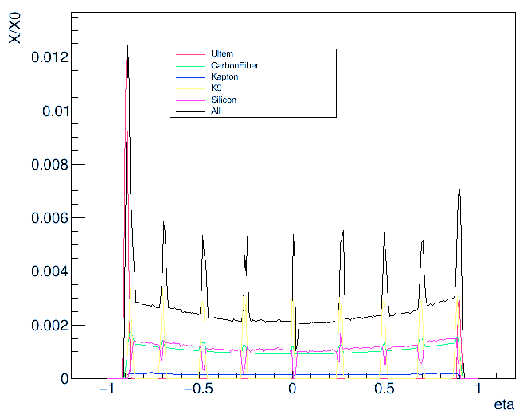
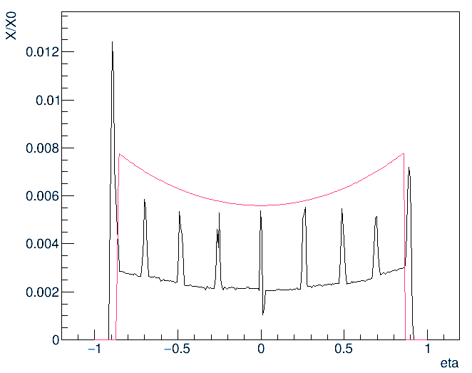
L3
Average ratio: 0.85
L4
Average ratio: 0.42

Slide 13
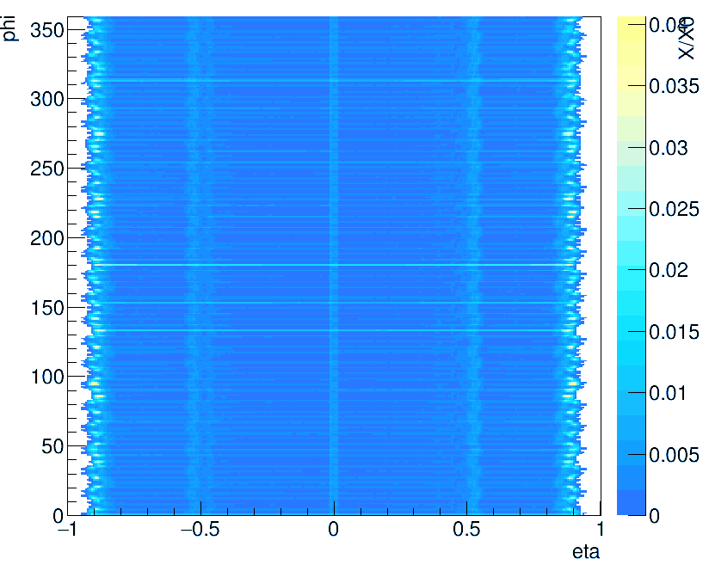
L3

Slide 14
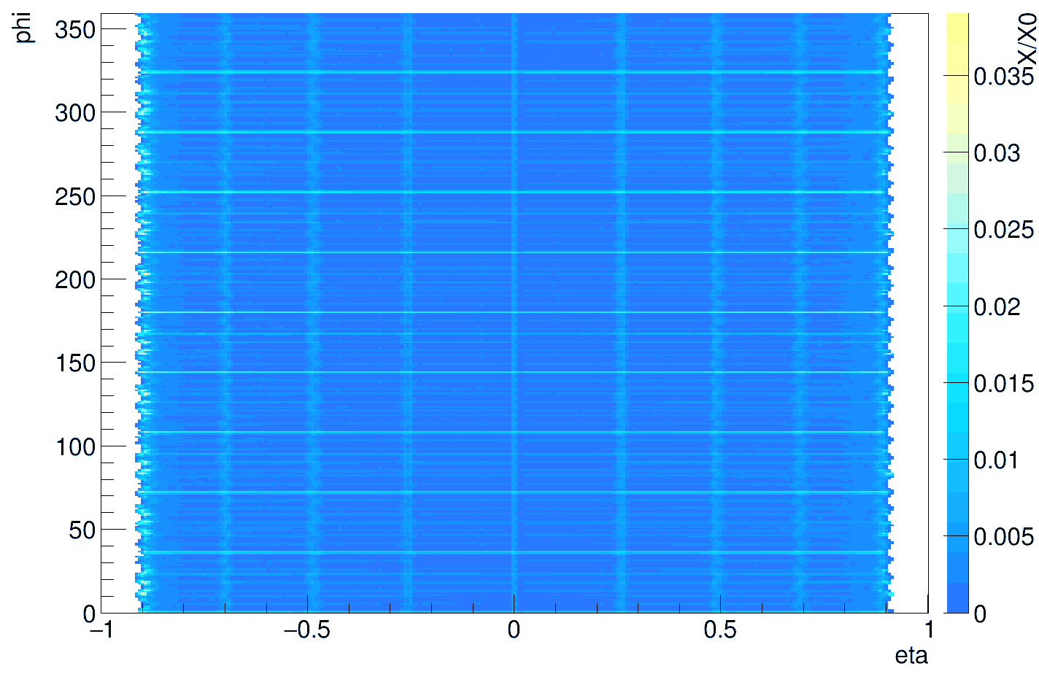
L4

Slide 15
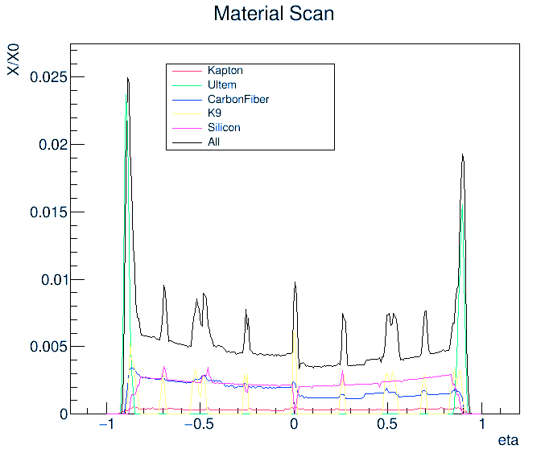
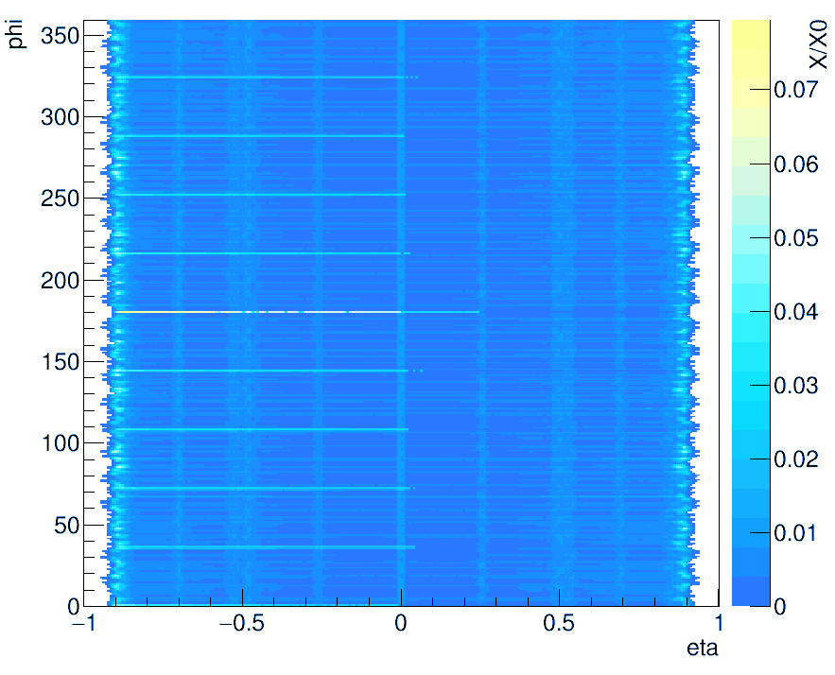
Update after bug fixed – no large change, but strange asymmetry?

Slide 16
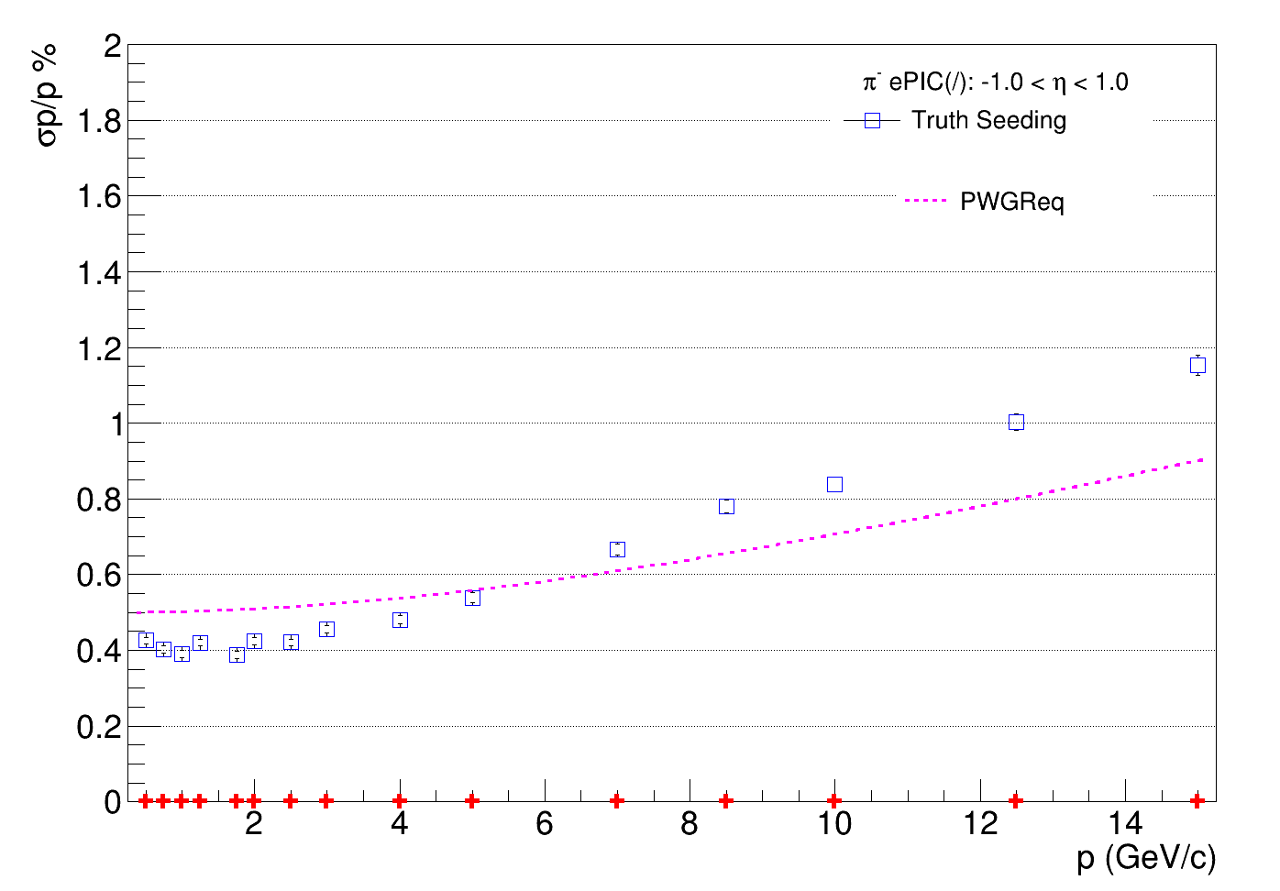
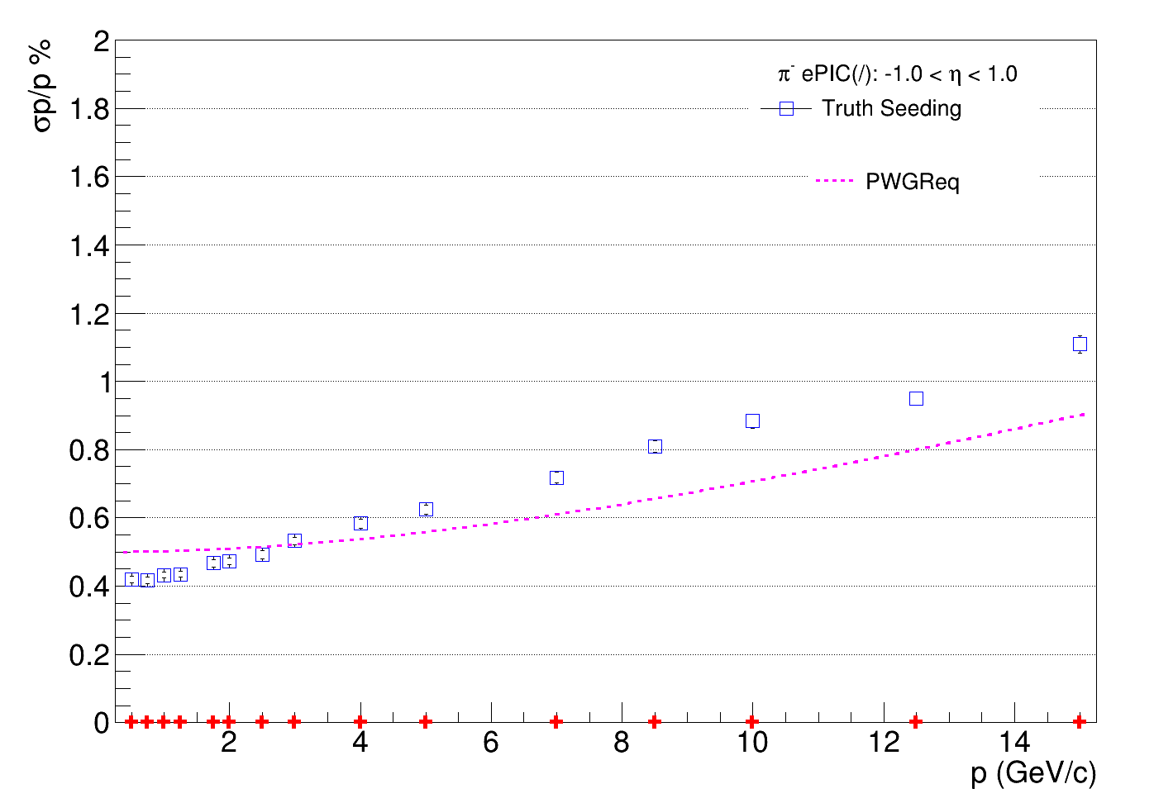
ePIC SVT simulation test results
Using tracking performance benchmark script by Shyam Kumar, epic_craterlake_tracking_only.xml https://github.com/eic/detector_benchmarks/tree/master/benchmarks/tracking_performances
New geometry from CAD files
epic-24.10.0 geometry
Run time: 92±25 minutes
Run time: 10±3 minutes
Running ddsim and eicrecon on 10,000 events

Slide 17
Next steps changes to epic geometry
Simulations show material thickness in CAD design is significantly less than in design specs and standard epic geometry. Simulations show similar thickness for L3,L4
Looks reliable. Obvious bugs have been fixed and it seems about right. Doesn’t include glue, bonding wires, additional support material …
Options:
Keep the existing model?
Reduce thickness of aluminium layer in epic geometry to match average X/X0 of detailed simulation?
Reduce thickness of L4 aluminium layer to give X/X0=0.25% (to match L3)?
Construct new simple geometry?

Slide 18
ePIC SVT simulation test results
Using tracking performance benchmark script by Shyam Kumar, epic_craterlake_tracking_only.xml https://github.com/eic/detector_benchmarks/tree/master/benchmarks/tracking_performances
New geometry from CAD files
epic-24.10.0 geometry
Run time: 92±25 minutes
Run time: 10±3 minutes
Running ddsim and eicrecon on 10,000 events

Slide 19
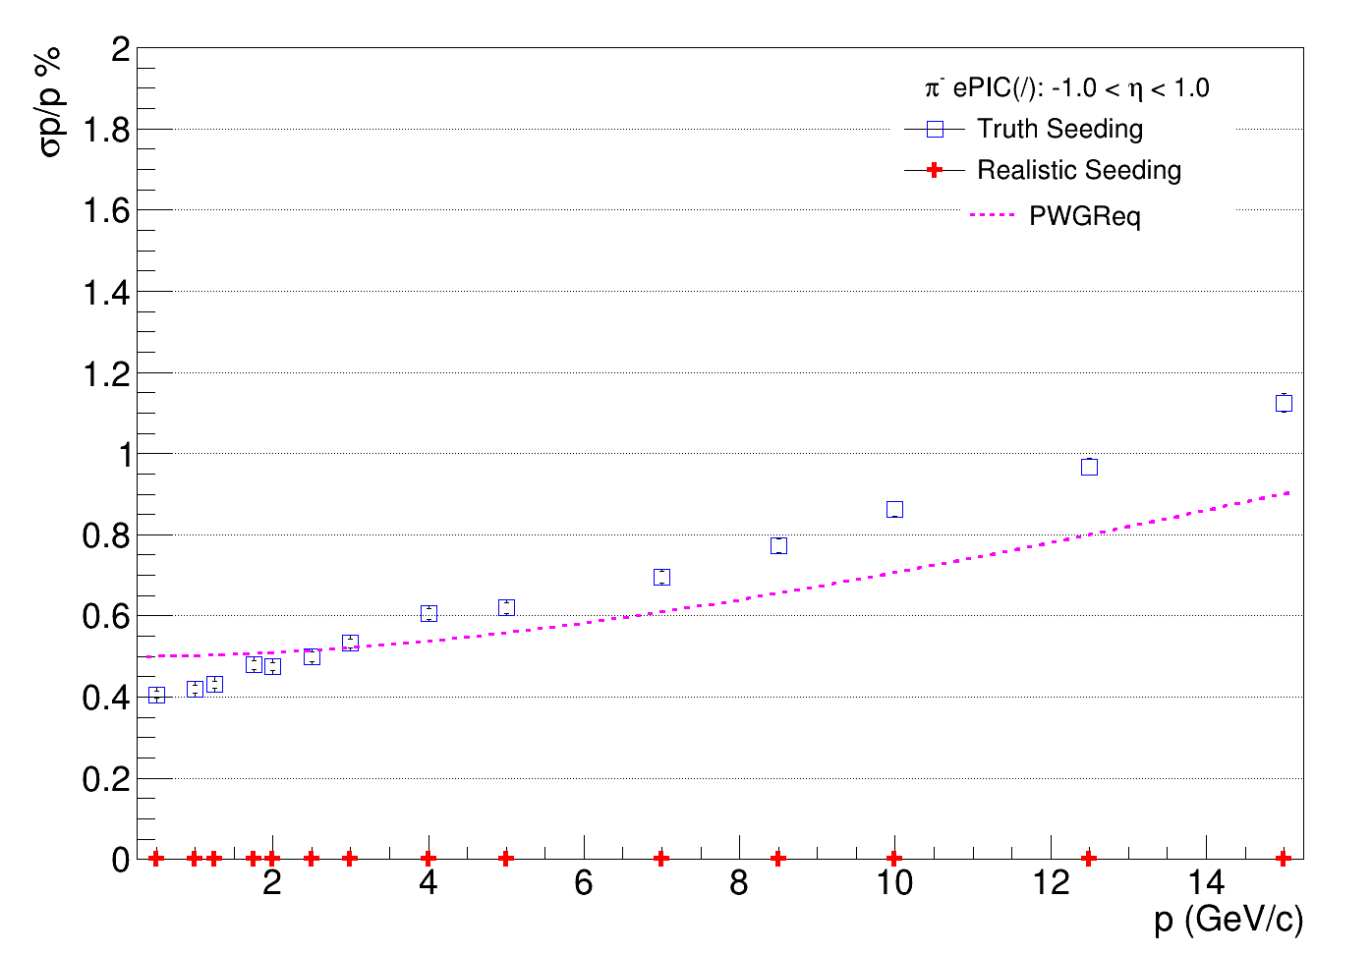
ePIC SVT simulation test results
Using tracking performance benchmark script by Shyam Kumar, epic_craterlake_tracking_only.xml https://github.com/eic/detector_benchmarks/tree/master/benchmarks/tracking_performances
New geometry from CAD files
epic-24.10.0 geometry
L4 aluminium layer
reduced from 0.37 to 0.15
Run time: 92±25 minutes
Run time: 10±3 minutes
Running ddsim and eicrecon on 10,000 events

Slide 20
ePIC SVT OB Simulations: Next Steps
Make CAD-DD4HEP code accessible to wider collaboration
Further testing to be sure there are no bugs
Further investigation of tracking performance on detector design. More benchmarks?
Create more accurate simplified geometry for routine simulations, and use detailed geometry simulations to test this
Further develop techniques to convert CAD files to DD4HEP

