Slide 1
Air Flow Vibration Studies - Update

Slide 2
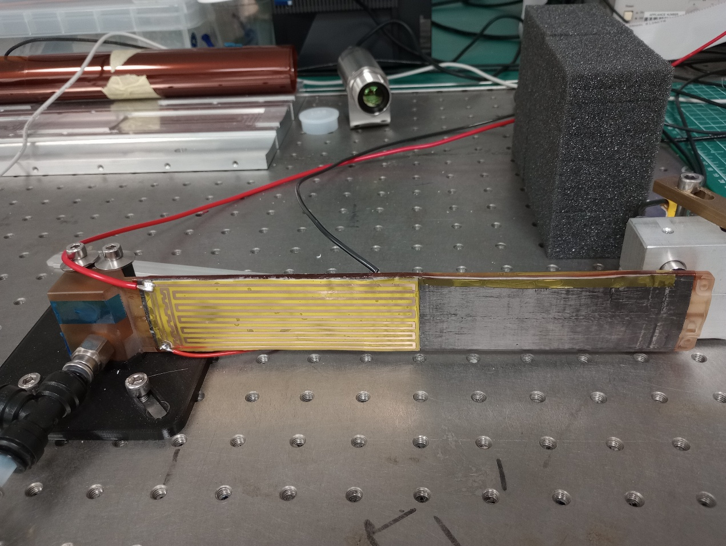
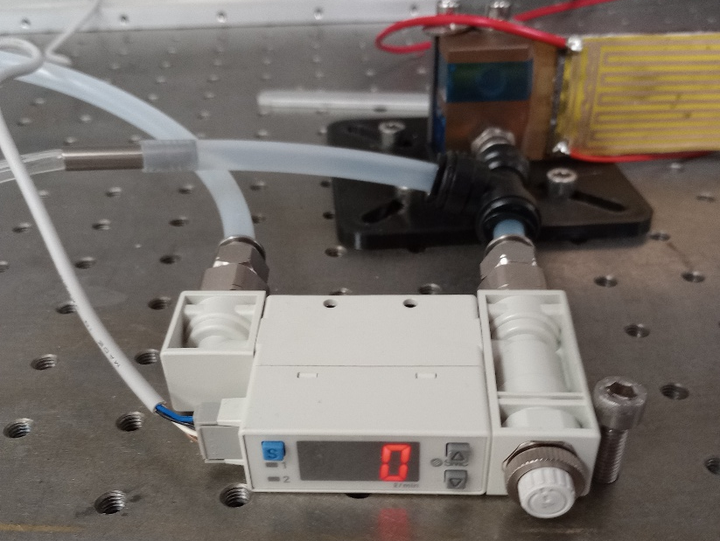
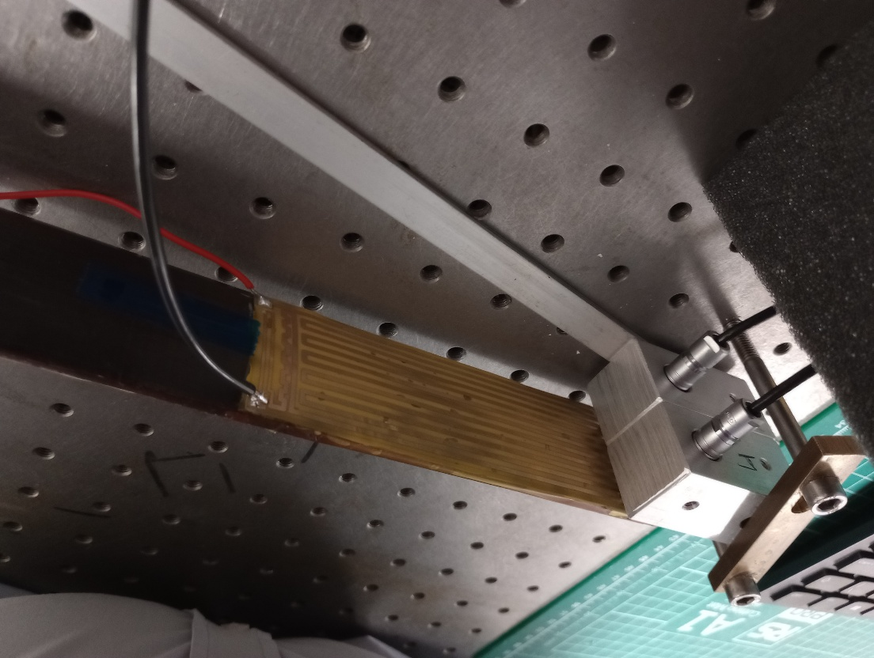
Changes to setup
Added resistive heaters to QSP3
  Cu/Kapton glued onto steel shim dummy modules with BN-loaded Araldite rapid
Procured a thermal imaging camera
  Optris Xi400 (382 x 288 pixels)
As last time:
  Flow control and measurement
    Still flow in only one half
  Input pressure measurement
  Capacitive displacement sensors
TI camera
Front view
Air out
Flow regulator and meter
Air in
Rear view
Capacitive displacement sensors

Slide 3
Observations
Staves are quite delicate and QSP3 has seen some damage
  On the downstream module the facesheet split close to one of the C-channels
    When gluing the heater circuit we used wider Kapton, which we folded and glued around the C-channel – seemed to prevent air flowing out
  The facesheet opposite to the upstream module developed a split next to the central I-beam
    This was fixed by putting some tape over the split
  Some damage could have occurred when we heat-shrinked the
  As discussed below I have not yet operated QSP3 in this configuration at high flows to not stress it too much

Slide 4
Reminder: What do we need?
Target flow rates still defined by coolant ΔT = 10˚C and sensor /chip power numbers from Iain @ Frascati
For max power scenario & L4 (2×8 5-RSU LAS + AncAsic + FPC ohmic loss): P_{stave} = 48.2 W or 223 l/min (about 15.5 m/s)
  For the QSP this power is 12 W
Nominal: P_{stave} = 31.4 W or 145 l/min (about 10.1 m/s)
  For the QSP this power is 7.8 W
Per channel (one half of the stave): Max flow about 112 l/min, nominal flow about 73 l/min

Slide 5
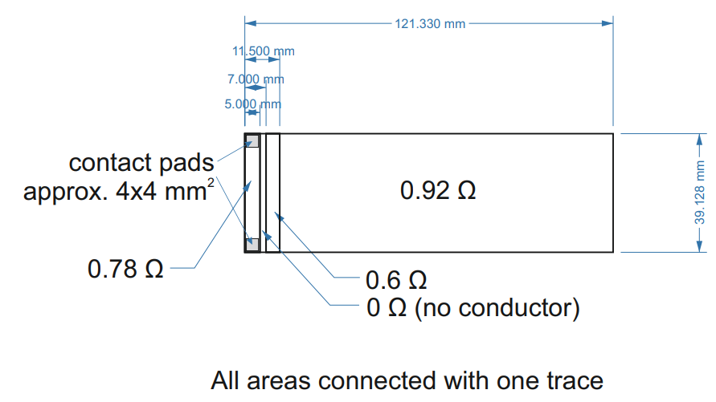
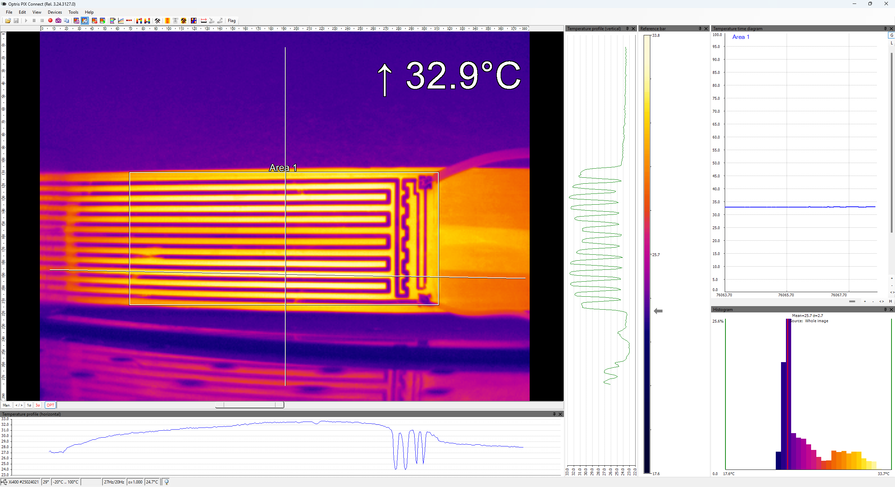
Heater layout
One heater for 2-LAS module + AncASICs
Observed (using power supply parameters): R_{total} = 1.15 Ω for one heater
  Need to understand the discrepancy, and whether ratio of resistances in different regions is correct

Slide 6
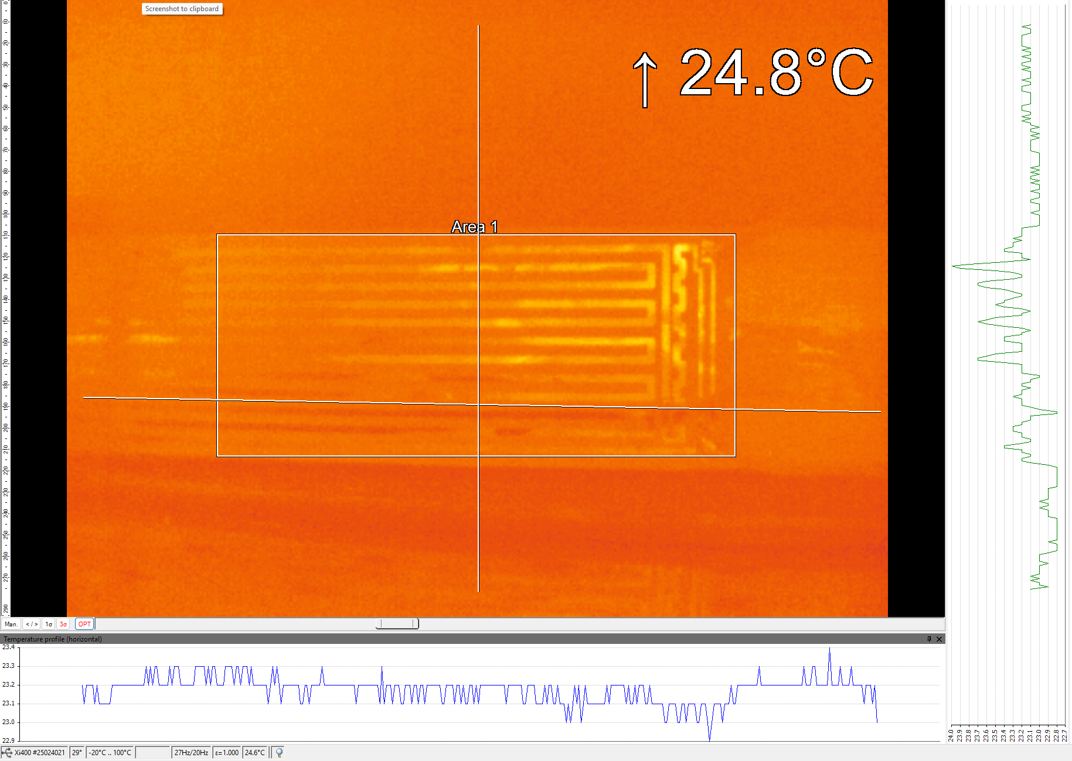
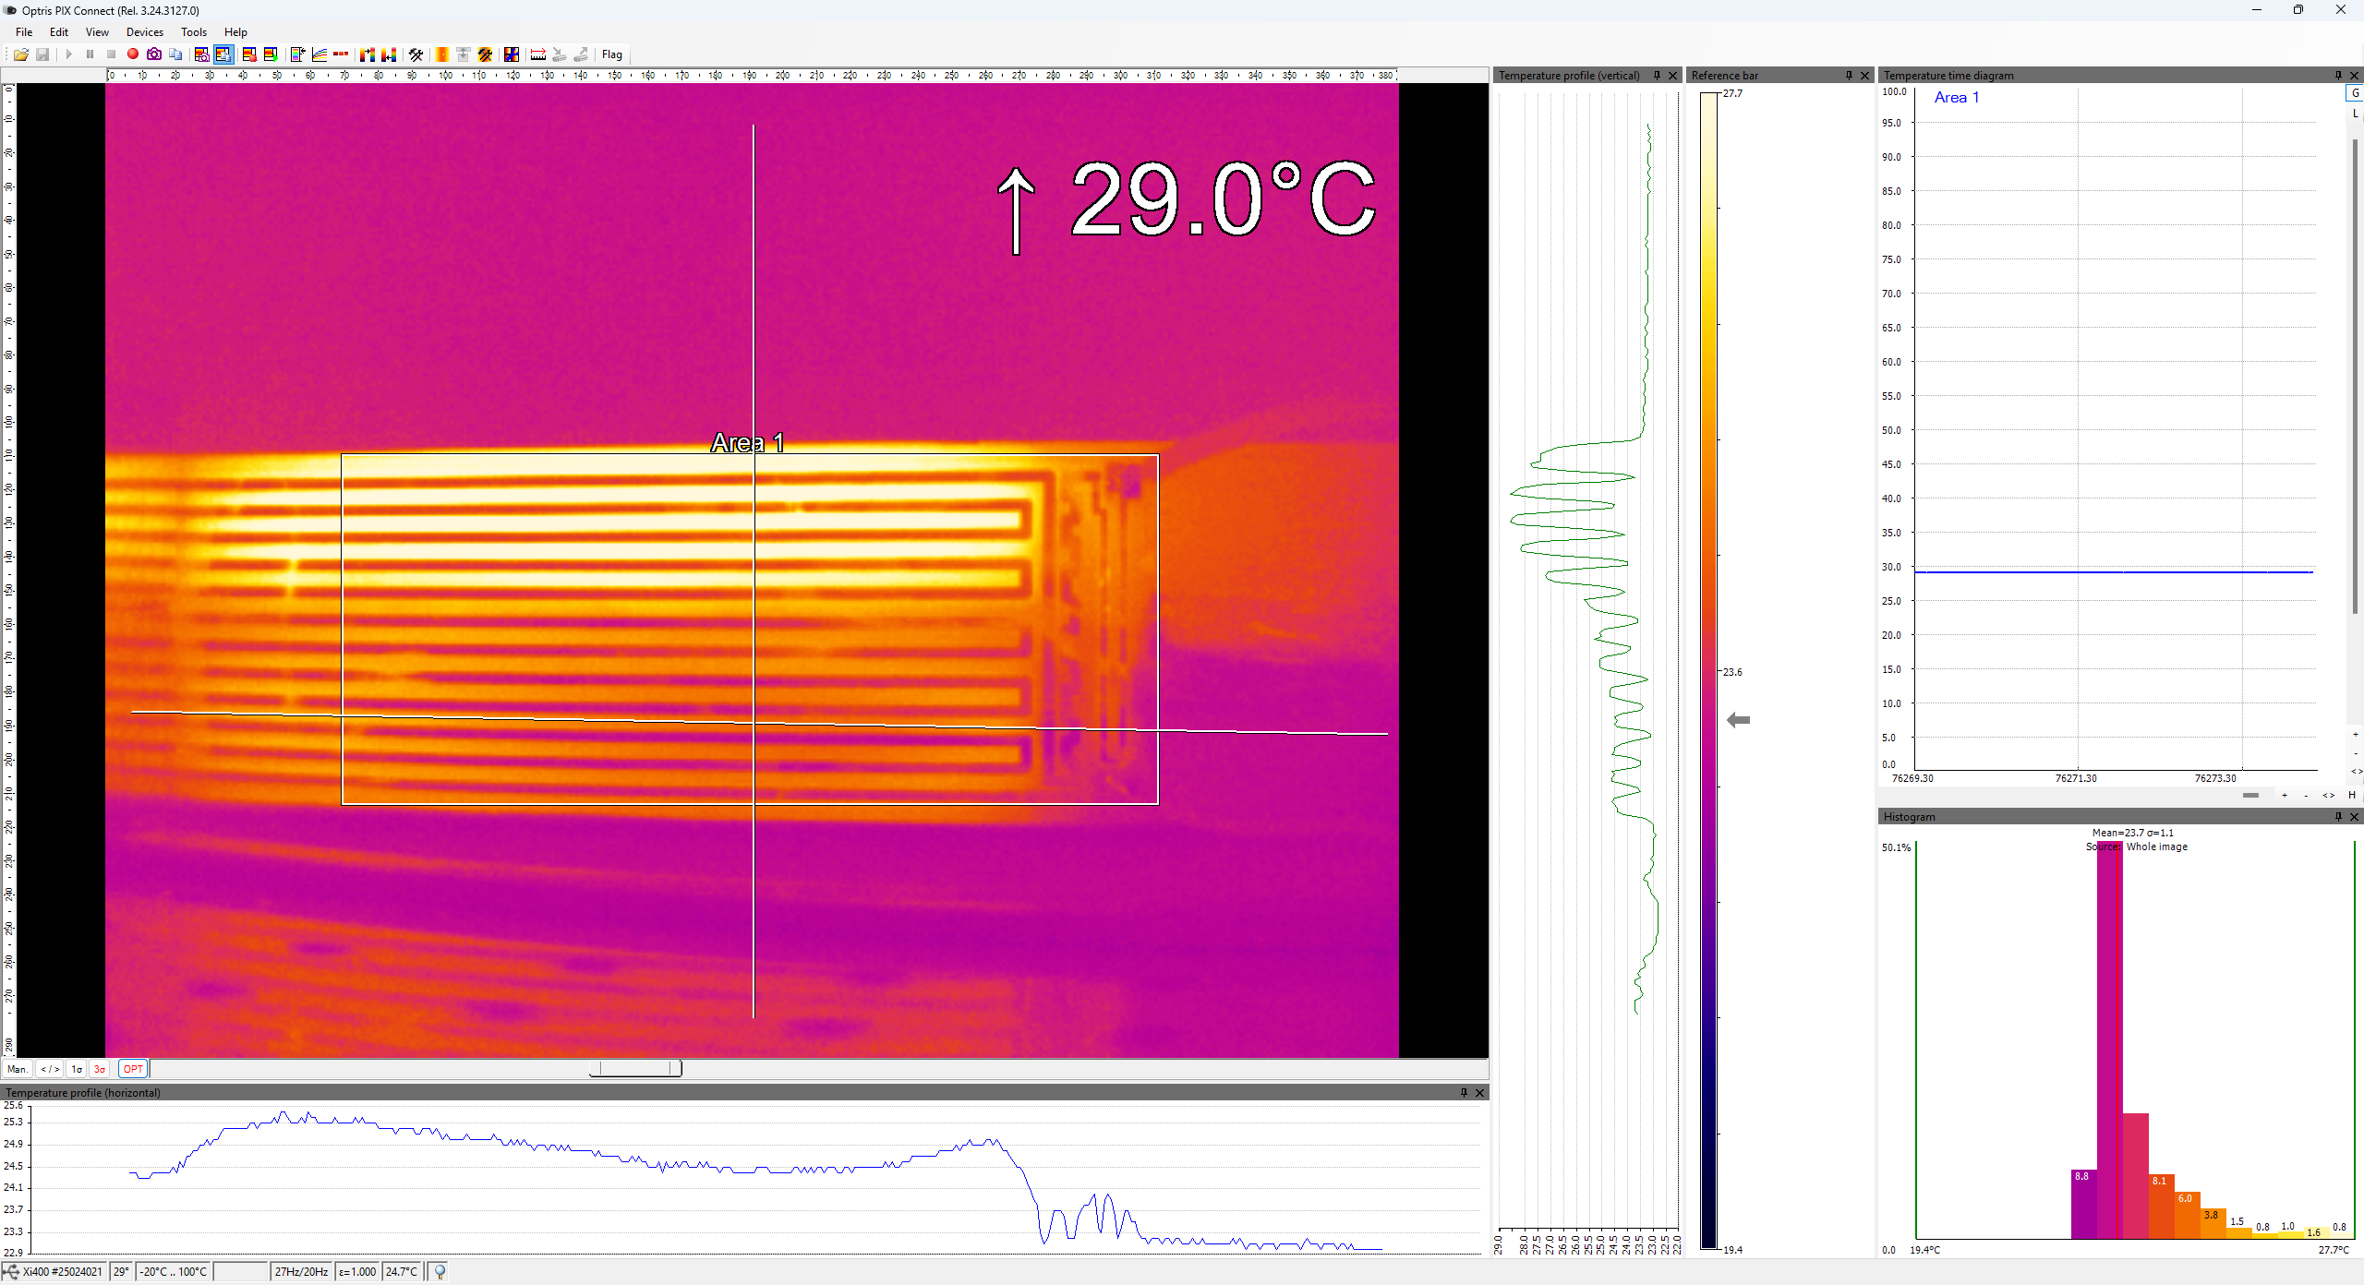
Thermal studies
0 W, no cooling
1.8 W/QSP, no cooling
1.8 W/QSP, 30 l/min in lower channel
Downstream module
(air flow in lower half from the right)
Horizontal
LEC & AncASIC
Foam block
Vertical
cooled
5˚C
uncooled

Slide 7
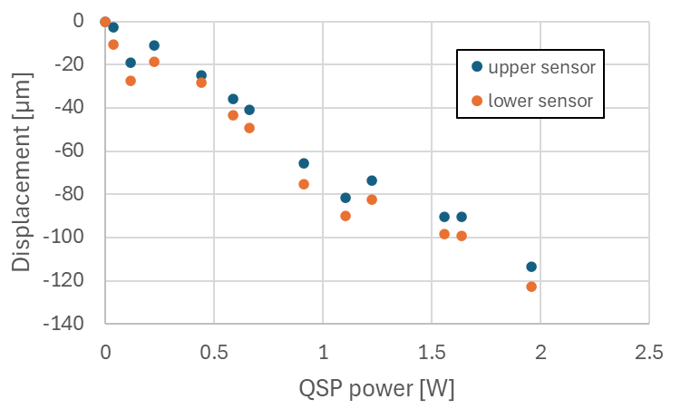
Thermal deformations
No air flow
CTE for steel (10 ‒ 17) µm/(m°C), for Si ~3 µm/(m°C)
Also, deformations will be smaller for fixed-fixed support

Slide 8
Conclusions
Similar to last week, none of the results should be taken seriously at this point
  The QSPs and the support conditions used are not fully representative of the final staves
However, we are learning valuable lessons in terms of tooling and handling
The main message is that we are making good progress in getting together the tools that will allow us to study the stave design with more realistic full-length prototypes
  We are just at the start of understanding what measurements will be useful

Slide 9
Further material (slides from last week)

Slide 10
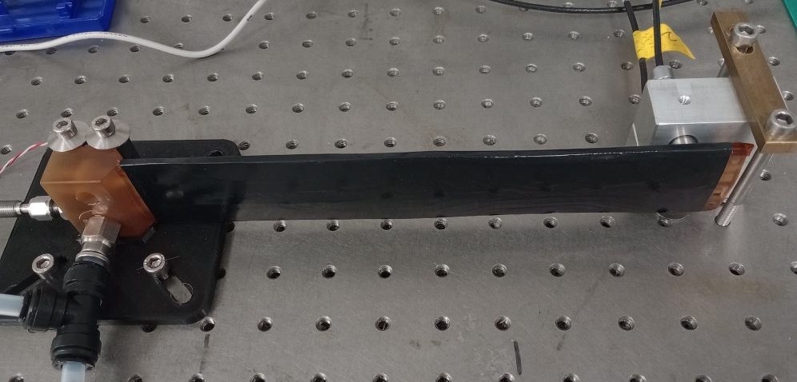
Setup
Use quarter stave prototypes
  For now use one flow channel (one half) of the quarter stave
  Quarter stave prototype 2 (QSP2)
    Prototype which erroneously has only one layer of CF prepreg in each skin (no transverse layer)
    To stabilize this was put into heat shrink, which makes a close air channel
  Quarter stave prototype 3 (QSP3)
    Using thin steel shim stock to replace modules, first again with shrink wrap, then glued
    Found that facesheet was damaged next to C-channel
  For now mostly proof of principle
Sensors & readout
  Flow meter (up to 100 l/min) + needle valve to adjust flow, flow measurement in DAQ
  2 capacitive displacement sensors, in DAQ
  Pressure sensor (up to 0.350 bar_{d}) – standalone, no connection to DAQ
Fixed edge
Displacement sensors

Slide 11
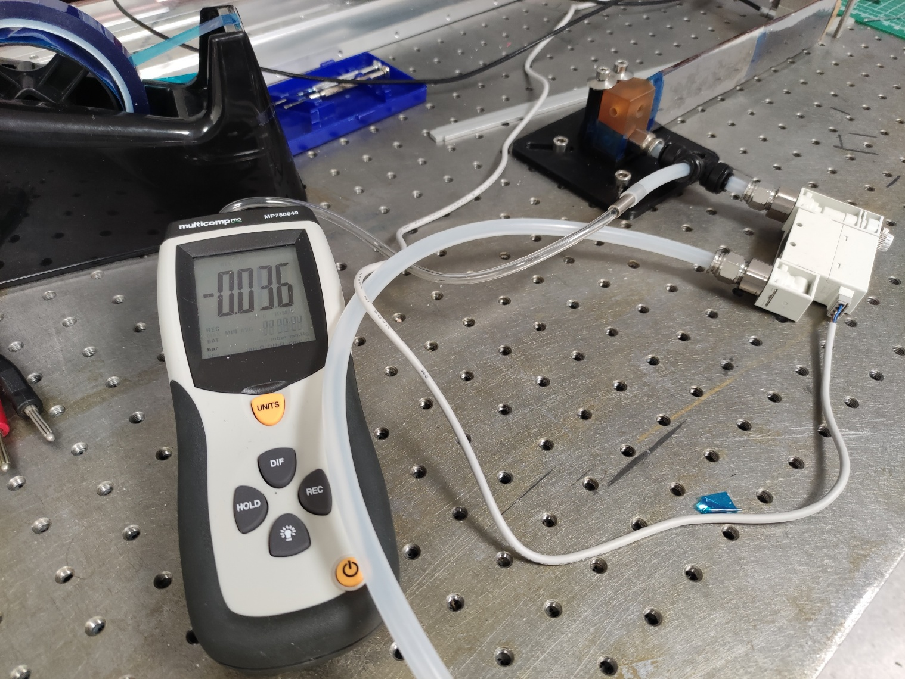
Setup

Slide 12
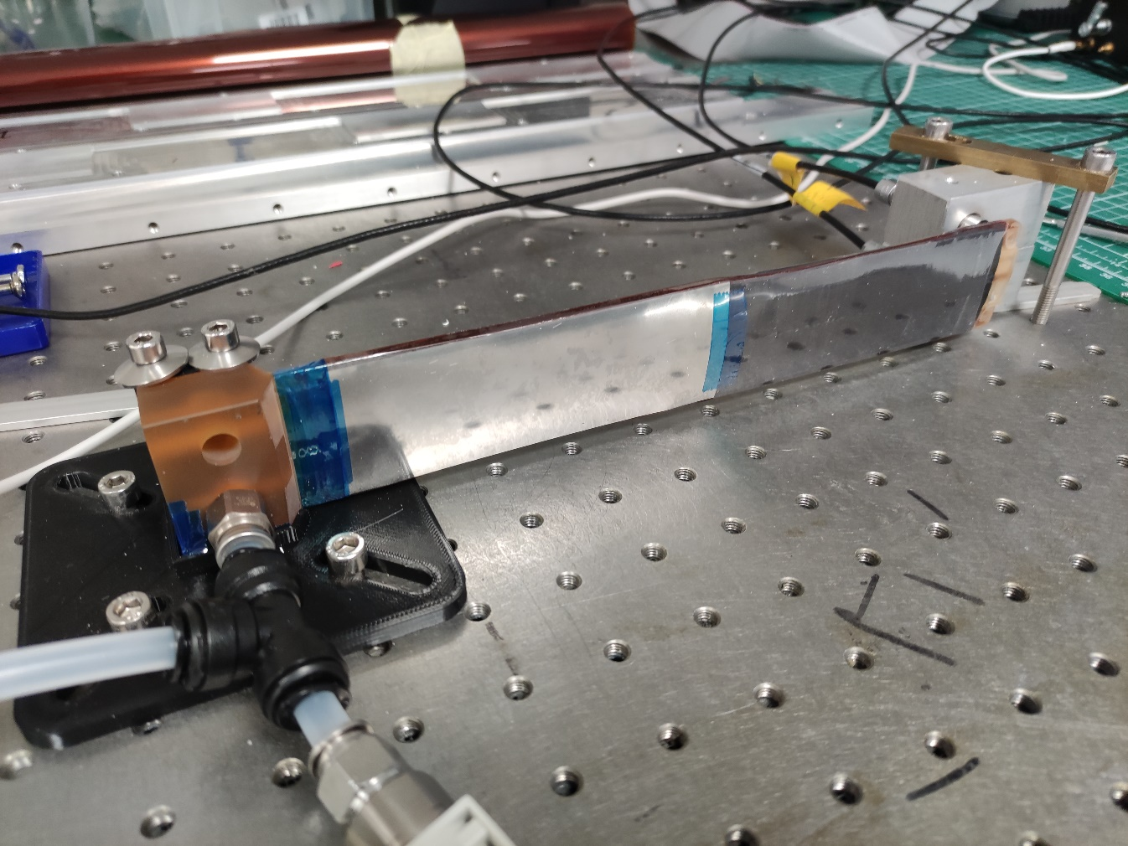
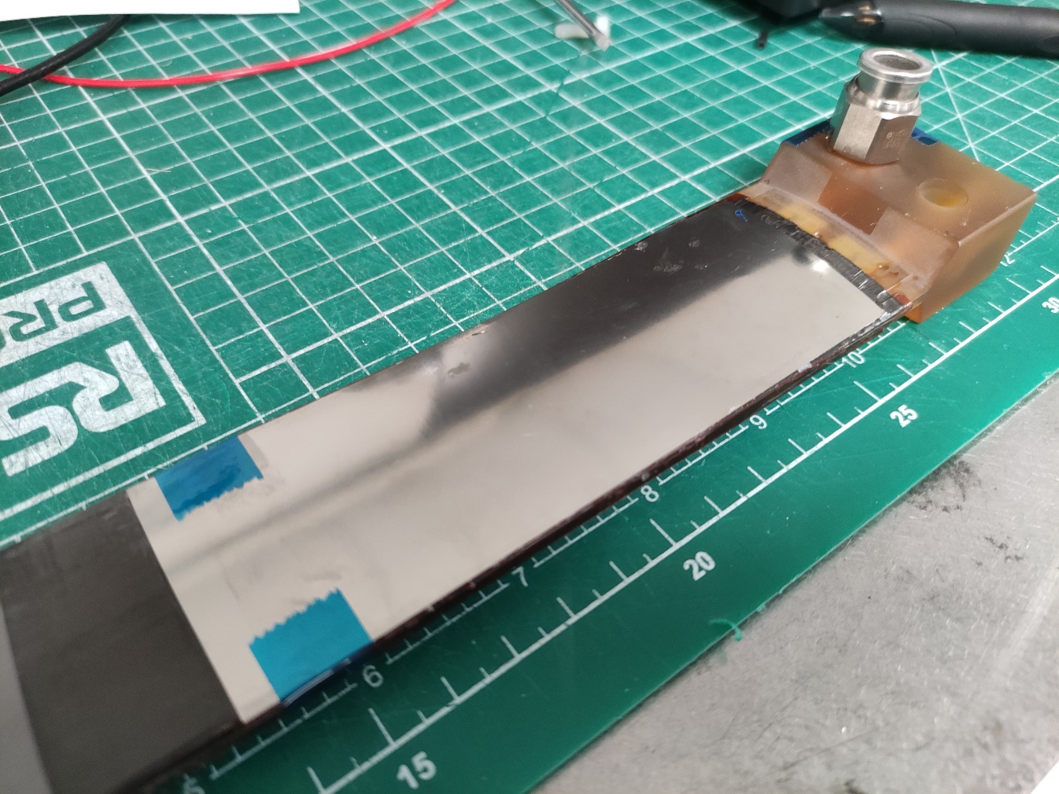
QSP3
Steel shim taped on, and heat shrink wrapped
Steel shim glues to stave structure with Araldite Rapid

Slide 13
What do we need?
Target flow rates
  Still defined by coolant ΔT = 10˚C and sensor /chip power numbers from Iain @ Frascati
  for max power scenario & L4 (2×8 5-RSU LAS + AncAsic + FPC ohmic loss): P_{stave} = 48.2 W or 223 l/min (about 15.5 m/s)
  Nominal: P_{stave} = 31.4 W or 145 l/min (about 10.1 m/s)
  Per channel (one half of the stave): Max flow about 112 l/min, nominal flow about 73 l/min
RMS displacement not really known
  Needs to come from alignment and tracking studies
  Different for different directions
    Probably more demanding in-plane vs out-of-plane
    Here only measure out-of-plane displacements at worst point

Slide 14
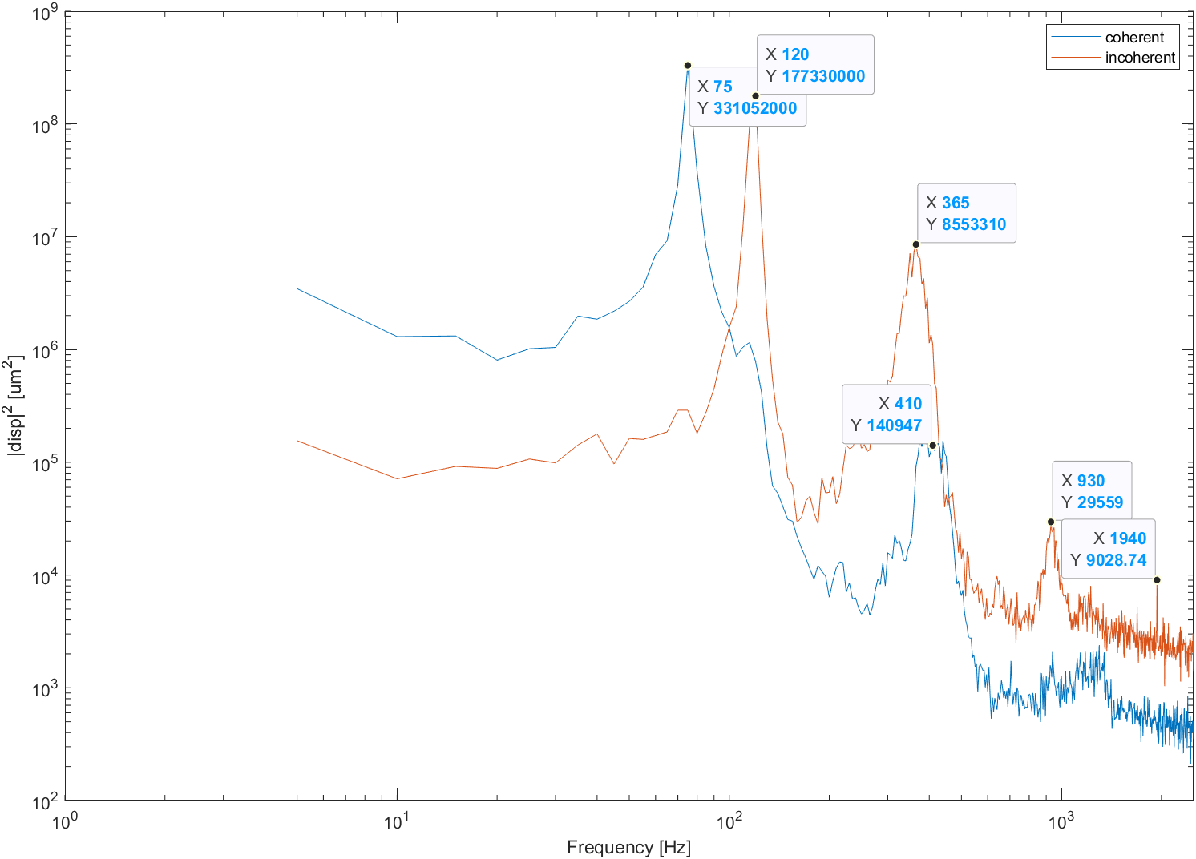
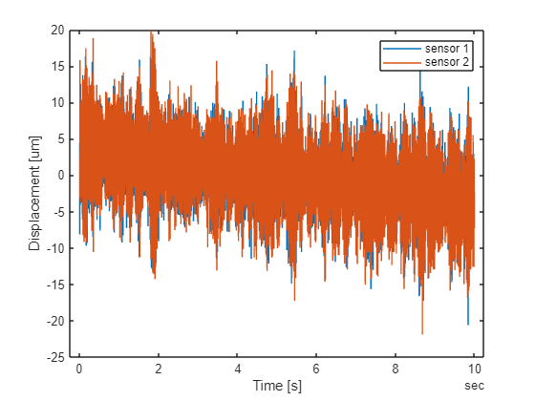
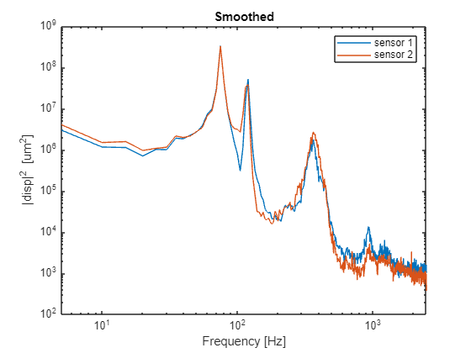

Single shot QSP2
f_{s} = 5 kHz, fl = 92.9 l/min, T = 10 s
d_{RMS}¹ = 7.9 µm, d_{RMS}¹ = 8.2 µm
$d_{coh}=\frac{d_{1}+d_{2}}{2}$, for longitudinal (beam) modes
$d_{incoh}=d_{1}−d_{2}$, for transverse (torsional) modes
First longitudinal mode is consistent with frequency scan on shaker table for QSP3

Slide 15
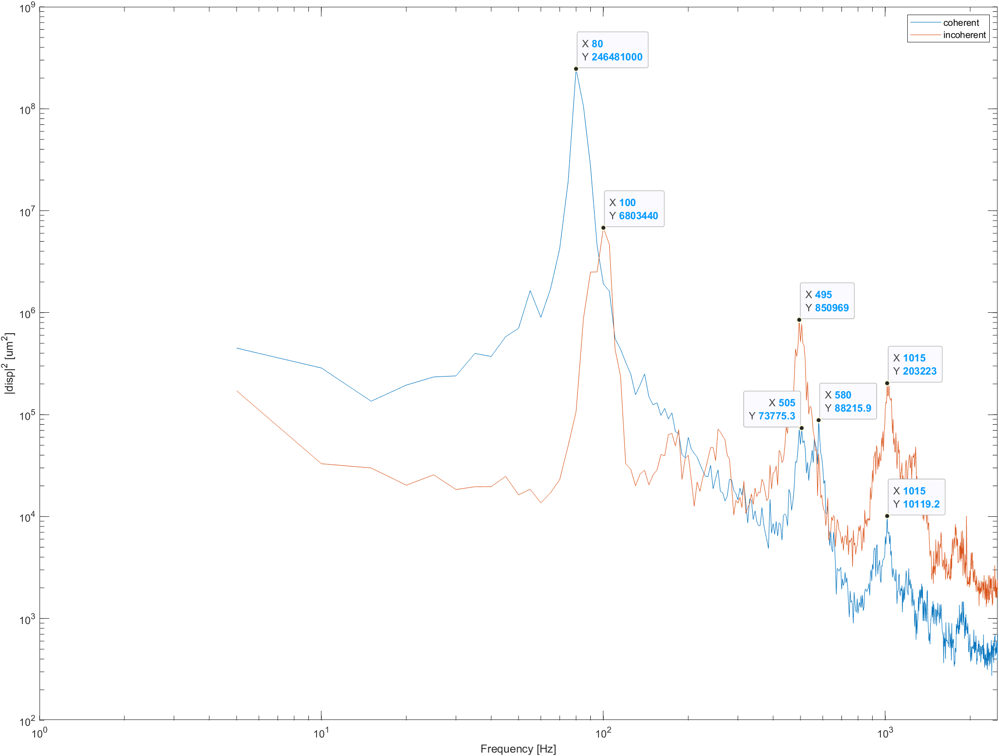
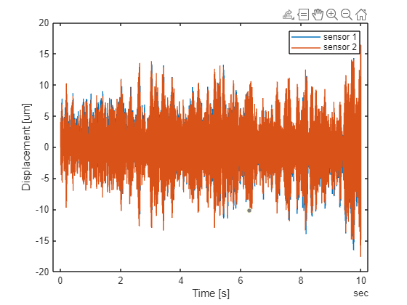
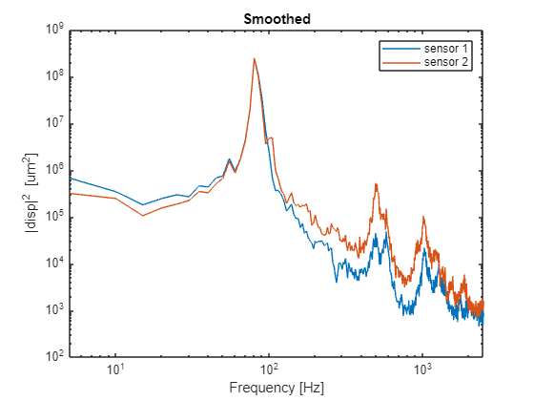

Single shot QSP3
f_{s} = 5 kHz, fl = 68.1 l/min, T = 10 s
d_{RMS}¹ = 4.2 µm, d_{RMS}¹ = 4.2 µm
$d_{coh}=\frac{d_{1}+d_{2}}{2}$, for longitudinal (beam) modes
$d_{incoh}=d_{1}−d_{2}$, for transverse (torsional) modes
First longitudinal mode is consistent with frequency scan on shaker table for QSP3

Slide 16
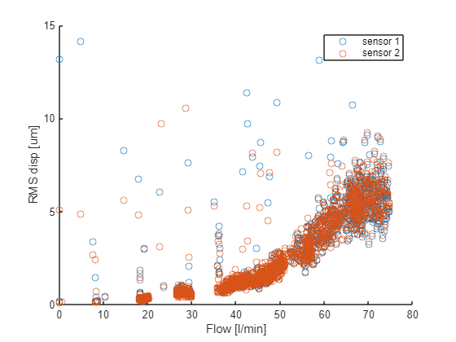
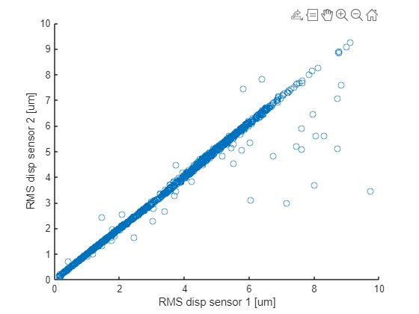
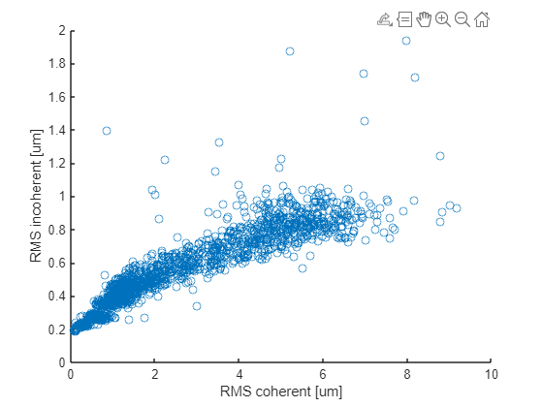
Varying flow rate QSP2
f_{s} = 5 kHz, T = 10 s, 2000 points

Slide 17
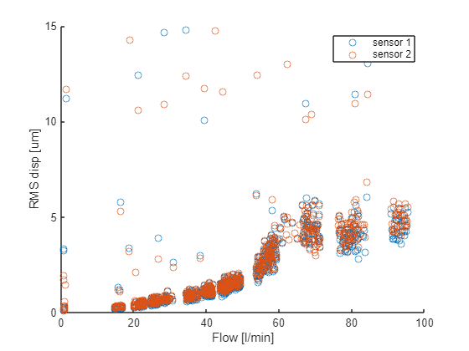
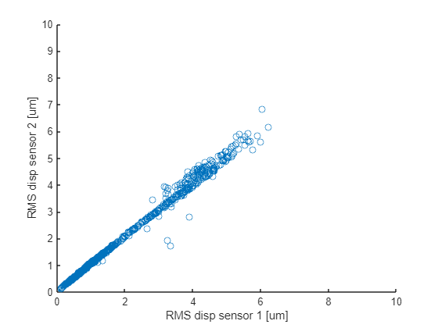
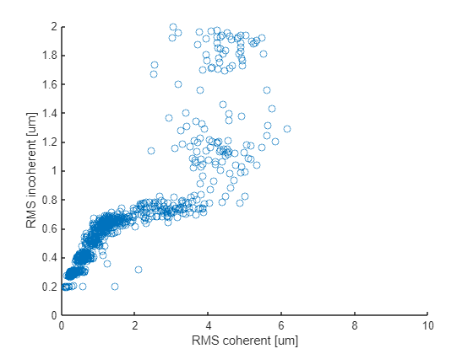
Varying flow rate QSP3
f_{s} = 5 kHz, T = 10 s, 2000 points

Slide 18
Pressure drop vs flow
Nominal
Max
Scale by 4 for full stave: nominal 0.668 bar, max 1.568 bar

Slide 19
Conclusions and next steps
Qualitative conclusions
  The pressure drops are much more than we expected
  Containing this pressure will be challenging
  Staves are vibrating, but not shaking violently
  We can do the mechanical measurements that we planned to do
Quantitative conclusions
  None of the results shown here do have a final relevance, as the prototypes used show signs of structural damage
Next steps
  Will need to make more prototypes
  We have made a first set of simple Cu-on-Kapton heaters (incl. heat for AncASIC), use thermal camera to survey temperatures
  Also have in-flow temperature sensors
    Still need to be included into DAQ
  Mould parts for full length stave prototype are in preparation

